Slide 1


Certification of ‘Government Commission of Banks’ by CMAs
CMA (Dr.) P. Siva Rama Prasad
M.Com., MBA (Finance)., FCMA., FCS., FIII (Life & General)., MAIMA

Slide 2

Presented by:
Banking, Financial Services and Insurance Board
The Institute of Cost Accountants of India
Kolkata

Slide 3
“Opportunities are NOT Visible”

Slide 4
Certification of Government Commission of Banks by CMAs
Coverage-1
Introduction.
Timelines for Submission of ‘Agency Commission Claim’ on Government Transactions.
‘Settlement Data’ for Agency Commission.
Commission ‘Calculation Process’.
Deduction of ‘TDS’ on Agency Commission.

Slide 5
Certification of Government Commission of Banks by CMAs
Coverage-2
Verification and ‘Certifications’.
‘Central Government’ Transactions.
Submission of ‘Claim to RBI’.
‘Branch Accounting’ for Commission.
‘Compliance & Review’.

Slide 6
Certification of Government Commission of Banks by CMAs
Introduction

Slide 7
Certification of Government Commission of Banks by CMAs
RBI - Banker's to Government: RBI acts as a Bank for both the ‘Central as well as State Governments’ (Section 20 of the RBI Act 1934)
It provides them the ‘Short-term Loans’ whenever necessary.
The ‘Government Deposit Accounts’ are also maintained by the RBI.
On behalf of the Government, it Collects the ‘Receipts of the funds and makes the Payments’.

Slide 8
Certification of Government Commission of Banks by CMAs
Agency Commission is referred to since Banks (Through their Network of Branches) Work as an Agent of RBI under MOU/Agreement for conducting Government Business.
‘Agency Commission’ is the remuneration received from the Reserve Bank of India (RBI), based on the ‘Count/Amount’ of eligible transactions, by the ‘Agency Banks (Public and Private Sector Banks)’, for transacting Central Government/State Government ‘Receipts/Payments’.

Slide 9
Certification of Government Commission of Banks by CMAs
The Claim of the Central Government /State Government Commission is submitted to RBI after ‘Validation of the Transactions’ within the ‘Stipulated Timelines’.

Slide 10
Certification of Government Commission of Banks by CMAs
‘Agency Commission’ of ‘Central Government Business’ Comprises of Claims on:
  Receipt Transactions.
  Payment Transactions other than Pension Payments.
  Pension Transactions.
  PPF (Public Provident Fund).
  SCSS (Senior Citizens’ Savings Scheme).
  SDS (Special Deposit Scheme, 1975) and Sukanya-Samridhi Transactions etc.

Slide 11
Certification of Government Commission of Banks by CMAs
Whereas ‘State Governments’ Agency Commission Claim comprises of Claims on ‘Receipts & Payments’ including ‘Pensions’ made on behalf of State Governments.

Slide 12
Certification of Government Commission of Banks by CMAs
Similarly for State Govt. Agency Commission Claim, that FSLOs/Settlement Units get their Data from Core Banking System, Internet Banking, Cash Management Product, etc.

Slide 13
Certification of Government Commission of Banks by CMAs
List of Agency Banks (Public Sector Banks) Agency Agreement with RBI:
Bank of Baroda Bank of India Bank of Maharashtra
Canara Bank Central Bank of India Indian Bank
Indian Overseas Bank Punjab and Sind Bank Punjab National Bank
State Bank of India UCO Bank Union Bank of India.

Slide 14
Certification of Government Commission of Banks by CMAs
List of Agency Banks (Private Sector Banks) Agency Agreement with RBI:
Axis Bank Ltd. DCB Bank Ltd. Federal Bank Ltd.
HDFC Bank Ltd. ICICI Bank Ltd. IDBI Bank Ltd.
IDFC FIRST Bank Ltd. IndusInd Bank Ltd. Jammu & Kashmir Bank Ltd.* Karnataka Bank Ltd. Karur Vysya Bank Ltd. Kotak Mahindra Bank Ltd.
RBL Bank Ltd. South Indian Bank Ltd. Yes Bank Ltd.
Dhanlaxmi Bank Ltd. Bandhan Bank Ltd. CSB Bank Ltd.
* Approved for limited Agency Business.

Slide 15
Certification of Government Commission of Banks by CMAs
Agency Commission / Charges paid by RBI to Public / Private Sector Banks
(₹ in Crores)
2017-2018 | 2018-2019 | 2019-2020 | 2020-2021 | 2021-2022
3,903.06 | 3,910.21 | 3,876.08 | 3,280.06 | 4,400.62

Slide 16
Certification of Government Commission of Banks by CMAs
Timelines for Submission of Agency Commission Claims

Slide 17
Certification of Government Commission of Banks by CMAs
Reserve Bank of India, vide Circular No. RBI/2018-19/16 DGBA.GBD. No.87/31.02.007/2018-19 dated 12.07.2018, revised the timelines for submission of Agency Commission on Central/State Government Transactions, w.e.f.,30.06.2018.
Accordingly, the Time Period allowed to furnish a Claim on Agency Commission to Reserve Bank is 60 Calendar Days from the End of the Quarter in which the Transactions have been Conducted.

Slide 18
Certification of Government Commission of Banks by CMAs
Settlement Data for ‘Agency Commission’

Slide 19
Certification of Government Commission of Banks by CMAs
The ‘Commission Claim’ is based on the Actual Settlement of Central/State Government Transactions as Reported through e-Kuber to RBI.

Slide 20
Certification of Government Commission of Banks by CMAs
Commission Calculation Process

Slide 21
Certification of Government Commission of Banks by CMAs
‘Agency Commission’ is Calculated on ‘Central Government Transactions’ settled by Government Accounts Department (GAD) of Banks with Reserve Bank of India, Central Accounts Section (CAS), Nagpur.

Slide 22
Certification of Government Commission of Banks by CMAs
The Central Government Agency Commission in respect of settled transactions of all Dealing Branches as well as Focal Point Link Branches, is calculated for Every Quarter as per the prescribed methodology:
  Customer Home-Branch-wise Commission in respect of all Internet Banking Transactions.
  Pensioner Home-Branch-wise Commission in respect of all Central Government Pension Payments, Commutation & Gratuity Transactions;
  Reports showing the Calculation of the Commission are generated separately for the Main Claim, PPF (Public Provident Fund), SCSS (Senior Citizens’ Savings Scheme, SSA (Sukanya Samridhi Account) & SDS (Special Deposit Scheme 1975).

Slide 23
Certification of Government Commission of Banks by CMAs
Similarly, FSLOs/Settlement Units Calculate the Commission Claim on the basis of settlement done with the Regional Offices of RBI through e-Kuber.
Reserve Bank of India, vide RBI Notification No. RBI/2018-19/219 DGBA.GBD. No.3144/31.02.007/2018-19dated 24.06.2019 and RBI Master Circular on Agency Commission vide RBI/2019-20/28 DGBA.GBO. No.250/31.12.010/2019-20 dated 01.08.2019, revised agency commission rates on Eligible Government Transactions to be Carried out with effect from July 01, 2019.

Slide 24
Certification of Government Commission of Banks by CMAs
Type of Transaction | Rate of Commission
e-Receipts | ₹ 9 per transaction
Physical Receipts | ₹ 40 per transaction
Non-Pension Payments | 6.5 Paise per ₹ 100.00
Pension Payments | ₹ 75 per transaction
Commutation & Gratuity | 6.5 Paise per ₹ 100.00

Slide 25
Certification of Government Commission of Banks by CMAs
Ineligible items for Agency Commission:
The following activities do not come under the purview of Agency Bank Business and are therefore not eligible for payment of Agency Commission.
Furnishing of Bank Guarantees/Security Deposits, etc. through Agency Banks by Government Contractors/Suppliers, which constitute Banking Transactions undertaken by Banks for their Customers.
The Banking Business of Autonomous/Statutory Bodies/Municipalities/ Companies/ Corporations/Local Bodies.

Slide 26
Certification of Government Commission of Banks by CMAs
Payments that have been Classified as Capital in nature by the Government to cover Losses incurred by Autonomous/Statutory Bodies/ Municipalities/ Corporations/Local Bodies, etc.
Prefunded Schemes may be implemented by a Central Government Ministry/Department (In consultation with CGA-Controller General Accounts) and a State Government Department through any Bank.

Slide 27
Certification of Government Commission of Banks by CMAs
Transactions related to Gold Monetization Scheme 2015
Any other item of Work Specifically advised by Reserve Bank or Central or State Government as Ineligible for Agency Commission.
Transactions arising out of Letters of Credit / Bank Guarantee opened by Banks on behalf of Ministries/Departments etc. Do not qualify for Agency Commission as RBI only reimburses the paid amount to the Banks based on the mandate received from the Governments.

Slide 28
Certification of Government Commission of Banks by CMAs
Further, as per RBI directives, the following Transactions are also in-eligible for Central Govt. Commission.
Type of Business | Source of Data
TDS | OLTAS Database
Bank’s own Taxes | Head Office of the Banks
Taxes deposited by other Banks | RBI, CAS, Nagpur
Reversal/Returned Transactions | OLTAS-Online Tax Accounting System/GBSS-Government Business Software Solutions Database/CMP
Pension Recoveries | CPPC-Central Pension Processing Centre

Slide 29
Certification of Government Commission of Banks by CMAs
Deduction of ‘TDS’ on ‘Agency Commission’

Slide 30
Certification of Government Commission of Banks by CMAs
Central Board of Direct Taxes (CBDT) has Clarified that “TDS would not be required to be deducted by RBI on the Turnover Commission Paid or Credited by it to the Agency Banks for transacting General Banking Business of the Central Government and State Governments”.
However, Agency Commission would be Taxable in the Accounts of the Bank, as it is part of the Bank’s Income.

Slide 31
Certification of Government Commission of Banks by CMAs
Verification and Certifications

Slide 32
Certification of Government Commission of Banks by CMAs
The Agency Commission on Central/State Govt. Transactions calculated by GAD-Government Accounts Department/FSLOs-Funds Settlement Link Offices, are required to be checked and Certified by the Internal Auditor, i.e., a Concurrent Auditor, and An External Auditor, i.e.,
A Chartered Accountant OR
A Cost Accountant
Before submission to RBI.

Slide 33
Certification of Government Commission of Banks by CMAs
Central Govt. Transactions

Slide 34
Certification of Government Commission of Banks by CMAs
The Certified Final Claim, duly signed by the Head of Government Accounts Department of Banks, along with all the required certificates and declarations as stipulated by RBI, is submitted to RBI, CAS, Nagpur as per RBI Notification RBI/2019-20/21 DGBA.GBD. No.5/31.02.007/2019-20.
As per RBI’s requirement, for Every Quarter, a Certificate regarding Pension, duly Signed by the Head of Government Business Unit of the Banks, is also submitted.
The Claim of Agency Commission is submitted by GAD of Banks to RBI after Sign-off from the Compliance Department of Banks.

Slide 35
Certification of Government Commission of Banks by CMAs
For State Govt. Claims, Similar Certificates are required, by External/Internal Auditor & Zonal Office Heads of the Banks.
The Commission Claims on State Governments Business is to be submitted through Head Office, Compliance Department.

Slide 36
Certification of Government Commission of Banks by CMAs
Submission of Claim to RBI

Slide 37
Certification of Government Commission of Banks by CMAs
As per RBI Master Circular on Agency Commission vide RBI/2020-21/03 DGBA.GBD. No.2/31.12.010/2020-21 dated 01.07.2020, Agency Banks are required to submit their claims for Agency Commission in the prescribed format to RBI in respect of Central/State Government Transactions along with documents.

Slide 38
Certification of Government Commission of Banks by CMAs
Annexure-2 - Details of the Claim for Agency Commission;
  Annexure-2A - Certificate from a Senior Officer of the Banks;
  Annexure-2B - Certificate by a Chartered Accountant or Cost Accountant.
  Certificate from Chief General Manager / Head of Government Department of the Bank.

Slide 39
Certification of Government Commission of Banks by CMAs
Physical Documents of the “Agency Commission Claim” on Central Government Business should be forwarded to The Chief General Manager, Reserve Bank of India, Central Accounts Section, Nagpur.
Whereas the Agency Commission Claims of State Government Business should be forwarded to Regional Offices of RBI by respective FSLOs/Settlement Units of the Banks.

Slide 40
Certification of Government Commission of Banks by CMAs
‘Branch Accounting’ for Commission

Slide 41
Certification of Government Commission of Banks by CMAs
The Accounting Procedure of the Agency Commission at the Branches is as under:
  The Accounting Entries, between the Commission Receivable “BGL Accounts and Commission BGL Accounts at Branches”, are posted at Month end EOD.
  The Actual Commission is Calculated based on the Fund Settled with RBI for the Quarter.

Slide 42
Certification of Government Commission of Banks by CMAs
The Accounting Procedure of the Agency Commission at the Branches is as under:
  On receipt of the Actual Commission, the Commission received from RBI, is Credited to the Commission Receivable BGL of Branches thereby Zeroizing the balance in the Commission Receivable BGL.
  In the case of “Difference Between” the Commission Accrued and Received, necessary entries will be passed between the Commission Receivable BGL and the Commission BGL to Zeroize the balance in the Commission Receivable BGL.

Slide 43
Certification of Government Commission of Banks by CMAs
Compliance & Review

Slide 44
Certification of Government Commission of Banks by CMAs
Designated Official, Govt. Accounts Department of Banks would arrange for keeping SOP-Standard Operating Procedure up-to-date in the light of amendments to Laws, Rules, and Regulations, as Applicable / Renewal of SOP every Three Years / RBI Directions in this regard.

Slide 45
Certification of Government Commission of Banks by CMAs
Certification Proforma

Slide 46
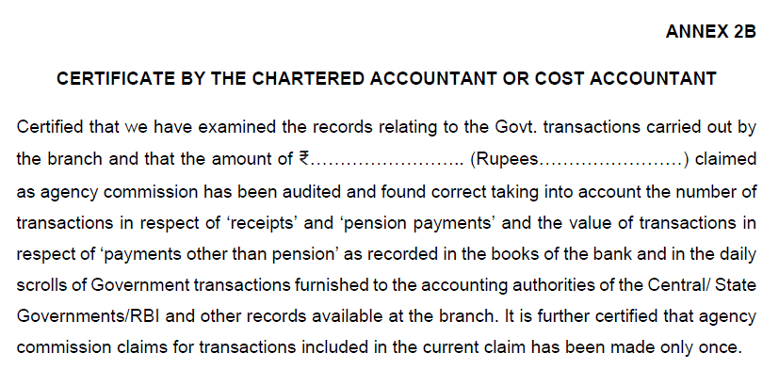
Certification of Government Commission of Banks by CMAs
Annexure-2B – Certification of Government Commission of Banks by CMAs

Slide 47
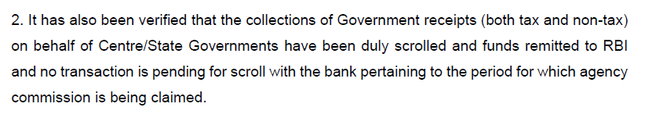
Certification of Government Commission of Banks by CMAs
Annexure-2B – Certification of Government Commission of Banks by CMAs-Contd.. ..

Slide 48
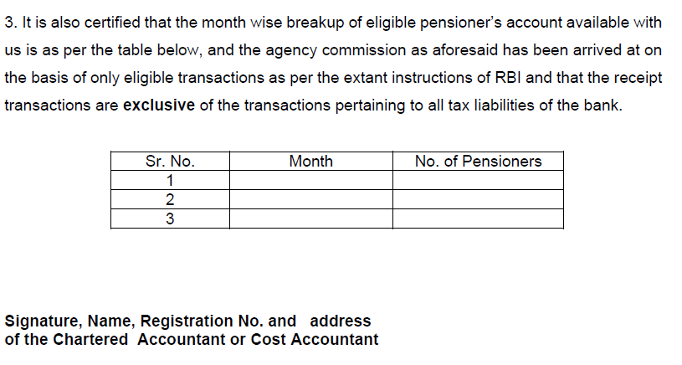
Certification of Government Commission of Banks by CMAs
Annexure-2B – Certification of Government Commission of Banks by CMAs-Contd.. ..

Slide 49
Certification of Government Commission of Banks by CMAs
To Whom CMAs Contact for this Assignment

Slide 50
Certification of Government Commission of Banks by CMAs
To Whom CMAs Contact in Public Sector and Private Sector Banks to get the Assignment
District Headquarters Branches of Private / Public Sector Banks.
Treasury Branches of Private / Public Sector Banks-In Almost all Districts in SBI.
Pension Disbursement Branches.
PPF / SSY / Direct Taxes / GST – Designated Branches.
CPPC – Centralized Pension Processing Centres-Almost all States in SBI
All most 40% of the Public Sector / Private Sector Branches were designated for Central and State Government Transactions – To get a reasonable Share in ~ ₹ 5,000 Crores of Commission to be paid by Reserve Bank of India every Year.

Slide 51
Certification of Government Commission of Banks by CMAs
To Conclude

Slide 52
“This is a ‘NEW Opportunity’ for CMAs”
All The Best
Banking, Financial Services and Insurance Board
The Institute of Cost Accountants of India
Kolkata

Slide 53
Certification of Government Commission of Banks by CMAs
Please refer RBI Master Circular
RBI/2022-23/08 CO.DGBA.GBD.No.S-1/31.12.010/2022-23 April 1, 2022

Slide 54
Thank You
CMA (Dr.) P. Siva Rama Prasad
Asst. General Manager (Retd.)
State Bank of India
M.Com., MBA (Finance)., FCMA., FCS., FIII (Life & General)., MAIMA.,

