Slide 1
Life Insurance Finance
Centre for Insurance and Risk Management
Koushal Vikas Foundation ®
A Fundamentals
Prof. CMA P N Murthy
M Com, FCMA, FIII, FLMI(USA), ARA(USA),ACII(UK),MIMA,AIV,AMT
Cost Accountant and Management Consultant
Chartered Insurer (London)
Insurance and Reinsurance Specialist
Accredited Management Teacher
cma.pnmurthy@gmail.com
ceo@koushalvikasfoundation.org
Notes:
NOTE:
To change the image on this slide, select the picture and delete it. Then click the Pictures icon in the placeholder to insert your own image.

Slide 2
Agenda
Why this discussion today?
Insurance Finance- Fundamentals
Fundamentals of Accounts/Principles
Revenue/Income Accounting:
Premium
Other Income
Expenses Accounting:
Policy Disbursements
Other Management Expenses
Investment Accounting
Final Accounts : Revenue Account & Balance Sheet
IRDA Regulations
Budgetary Control
Accounting Standards
Audit

Slide 3
Why this discussion today?
India a land of opportunities
Growing economy
CMAs- Management Consultants
“Insure India by 2047”
Opportunities galore
CFO/Director Finance & Investments -Sr.Manager/Manager/Asst Manager Fin -Fin Executives -Internal Auditor -Financial Underwriters -Claims Investigators -Risk Control Executive -Training & Upskilling

Slide 4
Companies Act 2013

Slide 5
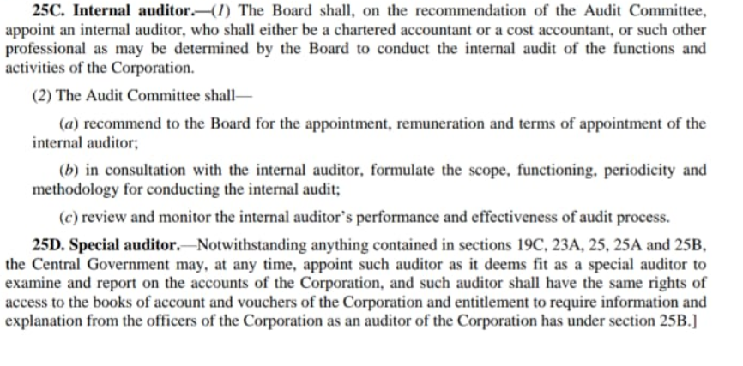
THE LIFE INSURANCE CORPORATION ACT, 1956 amended 2021

Slide 6
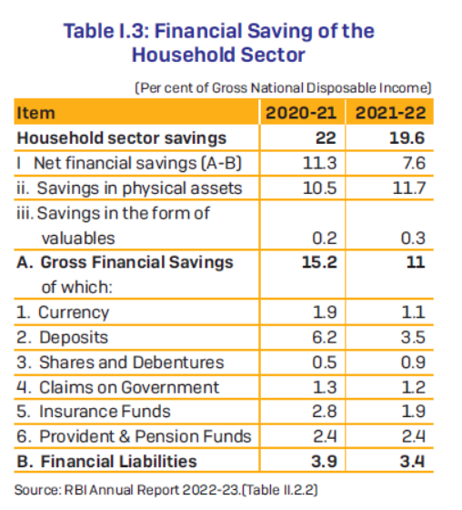
%of IF to GFS
=1.9/11*100
=17.3%
% of IF to FL
=1.9/3.4*100
=55.9%

Slide 7
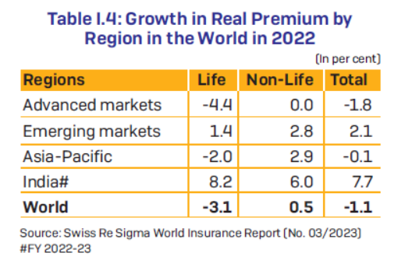

Slide 8
Measures : Insurance
Insurance penetration is measured as the percentage of insurance premiums to GDP
Insurance density is calculated as the ratio of premium to population (per capita premium).

Slide 9
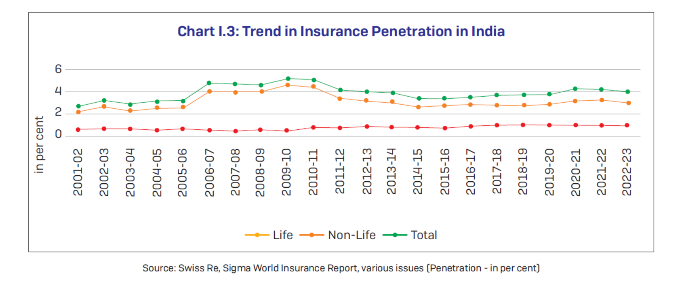

Slide 10
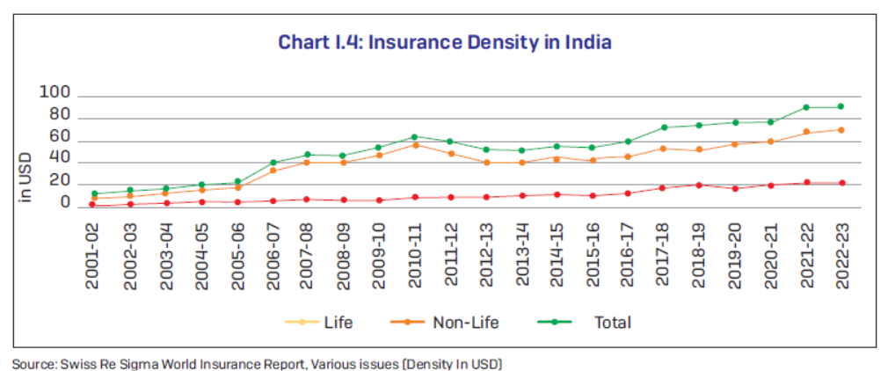

Slide 11
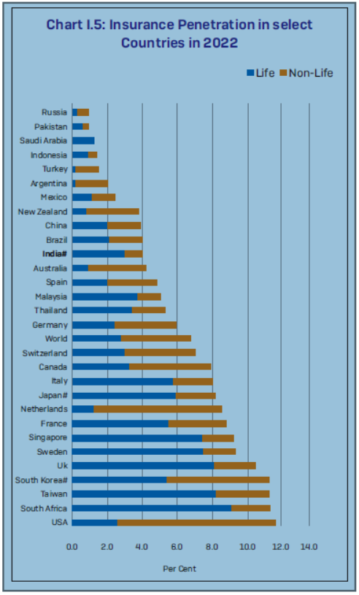
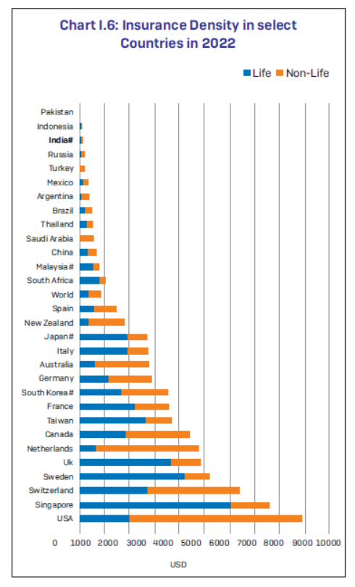

Slide 12
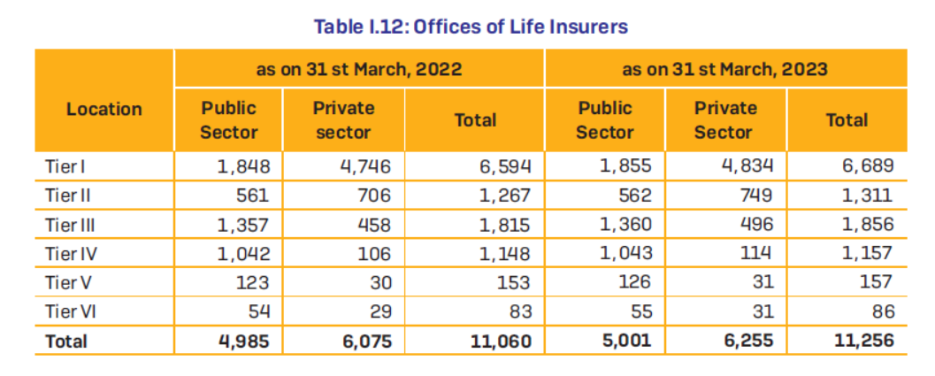

Slide 14
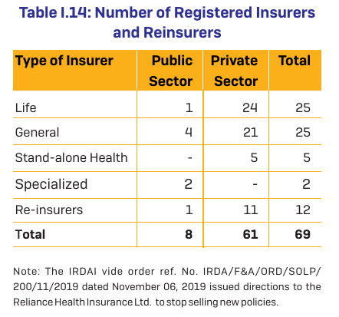

Slide 15
“There is no business like Life Insurance business because there is nothing like Life Insurance”
Fred A Lumb CLU

Slide 16
Insurance Finance
Part of BFSI Industry
Has vast history/ancestry
Transaction Oriented
Cash Rich
Asset Base
Barometer of Economic Growth- GDP Contribution

Slide 17
Accounting Principles
Account Type | Principle
1. Personal Account | Debit- Receiver Credit- Giver
2. Real Account | Debit- What comes in Credit- What goes out
3. Nominal Account | Debit- Expenses & Losses Credit- Income & Gain
Books of Accounts
Journal – Transaction
2. Ledger Accounts – Principal Ledger
3. Cash Book, Bank Ledger, BRS
4. Trial Balance,
5. Journal- Rectifications

Slide 18
Other important aspects
Capital & Revenue : Receipts & Expenditure
Deferred Revenue Expenditure: Expense of revenue nature but benefit available for more than one year so written off in more than one year. Eg: Publicity expenses- R&D exp- Preliminary Expenses etc

Slide 19
Life Insurance Business Defined:
Life Insurance Business Sec 2(11) Insurance Act, 1938:
“2(11) “life insurance business” means the business of effecting contracts of insurance upon human life, including any contract whereby the payment of money is assured on death (except death by accident only) or the happening of any contingency dependent on human life, and any contract which is subject to payment of premiums for a term dependent on human life and shall be deemed to
include—
(a) the granting of disability and double or triple indemnity accident benefits, if so provided in the contract of insurance,
(b) the granting of annuities upon human life ; and
(c) the granting of superannuation allowances and [benefit payable out of any fund] applicable solely to the relief and maintenance of persons engaged or who have been engaged in any particular profession, trade or employment or of the dependents of such persons ;]

Slide 20
Important Terms:
Sum Assured: is the face value of the Policy
Premiums: are the monies paid consideration for securing the insurance contract
Forms of premiums:
First Premium
First Year Premium
Renewal Premium
Single Premium
Extra Premium
Lapse: Policy is said to lapse when contract terminates due to non-payment of premiums before the contract period (policy term)
Reduced Paid Up: if stipulated premiums are paid then on lapsation, benefits get reduced to paid up (PUV)

Slide 21
Important Terms:
Surrender Value : is the specified % of PUV
GSV: Sec 113 of Insurance Act : (LIC) [{TP-(FYP+TEP}*30%)
Life Fund: Excess of Level Premiums over (Mortality Exp +Mgt Exp)
Actuarial Valuation: Valuation of surplus/Deficit
Valuation of Liablity: [PV of future claims Payable- PV of future premiums receivable]
Surplus= (LF-liability) being positive
Deficit = (LF-liability) being negative
With Profits/Participating Policies: Attracting Bonus
Without Profits/Non-Participating: No Bonus element

Slide 22
Premium
Mortality Curve-Level Premium- Surplus/Deficit
Mortality Curve
Later Deficit
Level Premium
Age of assured
Initial Surplus
0
Duration of the Policy

Slide 23
Premium Accounting: Entries
FP: If deposit is created:
Cash/Bank A/c……………Dr
To PPl Deposit
PPL Deposit…………….Dr
To First Premium or
To Single Premium
FYP
Cash/Bank A/c…….Dr
To FYP A/c
RP
Cash/Bank A/c…….Dr
To RP A/c

Slide 24
Reinsurance & Misc:
Limit of Issue: Max amount of insurance a co can carry on a single life
Retention: max amount of risk retained on books
Reinsurance Ceded: Excess risk over retention ceded to reinsurer
Entry:
Reinsurance Premium FY/RP A/c….Dr
To Bank
Outstanding Premium: Premiums fallen due and not paid & grace period not expired & no earlier arrears are pending
Entry:
O/s Premiums FY/Ren ……………….Dr
To FYP/RP

Slide 25
Policy Payments : Entries
Policy Loan: is raised against the SV and carries interest element
If interest is not paid, will deplete PUV and policy foreclosed
Loans against inforce policies only – not lapsed policies
Entries:
Policy Loan a/c………..Dr
To O/s Renewal Premium
To Bank
(When loan granted)
Cash/Bank………………..Dr
To Interest on Policy Loan
(Loan Interest is received)

Slide 26
Policy Payments : Entries
Foreclosure:
Surrender a/c……….Dr
To Policy Loan
To Loan interest
To Bank
At the close of Fin year, O/s and Accrued Interest are brought into books
Interest on Policy Loan- outstanding …………Dr
Interest on Policy Loan – accrued ………………Dr
To Interest on Policy Loan
(only an Adj entry- reversed immediately in the next year)

Slide 27
Policy Payments : Entries
Claims: liability Created
Claims by Death/Maturity/SB………………Dr
To Premiums (o/s or due in year)
To Policy Loans
To Interest on Policy loan
To O/s Death/Maturity/SB
Claims paid
O/s DC/MC/SB………………….Dr
To bank
Surrenders/Annuities paid
Surrenders a/c……………….Dr
Annuities………………………..Dr
To Bank

Slide 28
Policy Payments : Entries
Writing Back old o/s and unclaimed claims
o/s DC,MC,SB Claims……………..Dr
To O/sDC,MC,SB unclaimed Written back a/c
When paid
O/sDC,MC,SB unclaimed Written back a/c….Dr
To Bank a/c
When Death Claim is repudiated
Repudicated claims by death…..Dr
To claims by death
Sec 14(6) of Insurance Act requires maintenance of a detailed claims register.

Slide 29
Payments: Other
Commission: A compensation for business solicited
Forms:
First Commission
First Year Commission
Renewal Commission
Bonus commission

Slide 30
Payments of Management expenses :Sec 40-B of Insurance At 1938
Commission
Salaries
Travelling expenses
Auditor’s remuneration
Medical fees
Law charges
Advertisements
Printing & Stationry
Postage & Tel, MO, Receipt stamps
Policy Stamps
Bank Charges
Telephone charges
Electricity
Carriage & Frieght
Repairs & Maintenance
Rents
Depreciation
Misc expenses

Slide 31
Mgt Expenses Entries
FC/FYR/RC/BC….Dr
To TDS
To Bank
When TDS remitted:
TDS………………Dr
To Bank
At year end a provision is created for o/s commission
FYC/RC/BC………..Dr
To FYC/RC/BC outstanding

Slide 32
Other Management Expenses
Policy stamps;
Policy stamps……Dr
To Bank
Year end provision for unissued policies
Policy stamps a/c ………….Dr
To Other O/S expenses

Slide 33
Management of Expenses Regulations 2023
Separate Expenses of Management (EoM) Regulations for Life and General Insurers (applicable to Health Insurers)- These new regulations enable and provide flexibility to the insurers to manage their expenses within the overall limits based on their gross written premium to optimally utilize their resources for enhancing benefits to policyholders.
Some of the salient features of these regulations are:
In case of life insurance, expenses of management (EoM) caps are linked to product categories (participating and non-participating).
In case of general and health insurers, Single limit of EoM are set out as against existing segmental /sub-segmental limits.
These regulations permitted insurers to incur additional allowable expenses and required a well-documented EOM and business plan.
Extra allowances for policy is now EOM permitted to promote Insur-Tech, insurance awareness, rural sector, and government sponsored schemes.

Slide 34
Investments: Sec 27A Insurance Act 1938, Now a Regulation

Slide 35
Amendments to Investment Norms: Allowed increased investment in the BFSI sector from 25% to 30% to align with benchmark indices, flexibility in dividend eligibility criteria for insurers’ investments in preference and equity shares and allowed more investments by life insurers in Mutual Funds and Real Estate Investment Trusts ( REIT Investment Trusts ( s)/Infrastructure s). These INVIT changes aimed to encourage more investments in housing and infrastructure sectors.

Slide 36
Final Accounts:
THE INSURANCE REGULATORY AND DEVELOPMENT AUTHORITY (PREPARATION OF FINANCIAL STATEMENTS AND AUDITOR’S REPORT OF INSURANCE COMPANIES) REGULATIONS, 2000.
SCHEDULE A (See Regulation 3) PART I Accounting principles for preparation of financial statements
PART II Disclosures forming part of Financial Statements .The following shall be disclosed by way of notes to the Balance Sheet:
FORM A-RA – Revenue Account – Policy Holders (Technical) Account
FORM A-PL – P&L Account- Share holders account
FORM A-BS – Balance sheet
Link:Document Detail - IRDAI

Slide 37
Budgetary Control
Revenue Budget- important
Conservatism essential
Maker/Checker
Asset Control Register
Quarterly review

Slide 38
IFRS in Indian Insurance Industry
IFRS 17 came into effect for annual reporting periods beginning on or after January 1, 2023. However, the Insurance Regulatory and Development Authority of India (IRDAI) extended the deadline to FY27 to give companies more time to comply.

Slide 39
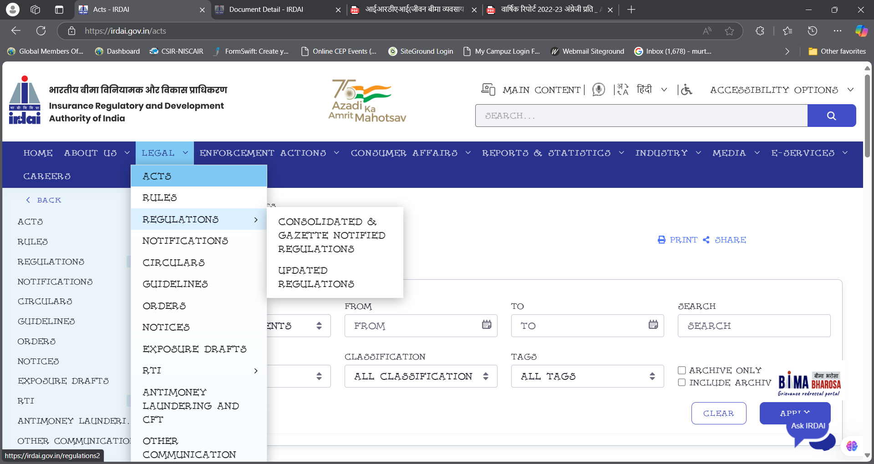
IRDAI Regulations

Slide 40
Annual Reports

Slide 41
Ind AS 104 – Insurance Contract
https://resource.cdn.icai.org/23727IndAS-104.pdf
“Indian Accounting standard 104 details financial reporting by an insurer. This standard requires limited improvements to accounting by an insurer and disclosure that explains the amounts arising from contracts and helps users understand the nuances of the contracts.”
“This standard applies to all the insurance contract that an insurer issues including reinsurance contract that it holds and financial instrument it issues with a discretionary participation feature. ”

Slide 42
Audit
Internal Audit
Inspection of Processes
Compliance Review
Statutory audit
Compliance Audit/Inspection by Regulator

Slide 43
Fin &Accounts
Control and clearance of extraneous items in Reconciliations
Reconciliation of functional schedules
Payments by cheque
Restrictive endorsement
Duplicate keys
Stock of Printed receipts
Stock of Stamps
Control on IBT
Control on Inter Office Transaction
Control on imprest
Principle Ledger

Slide 44
Audit & Compliance
Financial discrepancies, responsibility fixing, rectifications
Audit Queries
Audit Observations
Compliance filing
Rectification/indemnification
Fixing the system
Repeated offences
Punishments, Censures, dismissal
Inspection of Processes
Identifying process violations, responsibility fixing
Corrective steps in processes

Slide 45
General Computations
1.Age
2.Date of maturity
3.Due date of last premium
4.Date of vesting
5.Office Year of Birth (OYB)
6.Office Year of Maturity (OYM)
7.Office Year of Last Payment plus One (OYLP +1)
8.Simple Interest
9.Compound Interest
10.Premium
11.Agent’s Commission
12.Revival or Reinstatements
13.Paid Up Amount
14.Surrender Value
15.Loan
16.Settlement Options
17.Computation of BMI
18.Estimated Weight , Numerical Rating, EMRs
19.Miscellaneous Topics

Slide 46
General Computations
1.Age
2.Date of maturity
3.Due date of last premium
4.Date of vesting
5.Office Year of Birth (OYB)
6.Office Year of Maturity (OYM)
7.Office Year of Last Payment plus One (OYLP +1)
8.Simple Interest
9.Compound Interest
10.Premium
11.Agent’s Commission
12.Revival or Reinstatements
13.Paid Up Amount
14.Surrender Value
15.Loan
16.Settlement Options
17.Computation of BMI
18.Estimated Weight , Numerical Rating, EMRs
19.Miscellaneous Topics

Slide 47
Age, Dates etc (Academic specimens only)

Slide 48
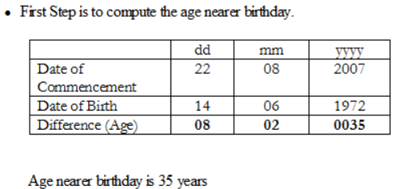
Premium Computation

Slide 49
Paid Up Computation
Solution: In the given case due date of first unpaid premium needs to be computed, which is nothing but, date of last premium paid + Mode. In other words the FUP is 11-11-1991 + (half year) = 11-05-1992. Paid up value computation is required when the policy is in inforce condition.

Slide 50
.

