Slide 1
Fraud &Investigations- Case Studies
Presentation at ICMAI, KOLKATA

Slide 2
Regulatory Actions
Administrative warning
Adjudication
For levy of penalty
Prosecution
References
Debarring proceedings

Slide 3
Types of Early warnings
Change in Key Managerial Personnel/ resignation of independent director
Inconsistent select financial ratios (eg High receivables)
Transactions with Shell Companies
Early Warning Signals
Consistently increasing debt, low tax payments
Auditor qualifications / Resignation of auditors
Unusual related party transactions
Complex Corporate Structure
Frequent fund raising/ equity dilution

Slide 4
Motives of listed companies for committing financial frauds
To increase investment in company stocks
To receive higher purchase price for acquisitions
To maintain a stable stock price in order to safe guard promoters and investors wealth
To meet companies goals and objectives and receive performance based bonus
To obtain financing or obtain more favourable terms on existing financing by pledging promoters shares
To avoid negative market perceptions
To demonstrate increased earnings per share, thus allowing increased dividend/ distribution payouts

Slide 5
Sanwaria Consumers Limited (Overstatement of Sales and Debtors)
Registered office at Bhopal, MP, 462016 was incorporated in April 1991.
It is integrated food processors, engaged in the business of manufacturing and selling of rice, edible oil and staple food products like Pulses, Sugar, Soya Chunks, Wheat Flour, Rice Flour, Salt, Suji, Maida, Besan, Daliya, Soya Meal etc.
Bank had conducted forensic audit and forensic auditor had not concluded with regard to sales and debtors.

Slide 6
Analysis of sales and debtors/advances
Particulars | 2017-18 | 2018-19 | 30.06.2019 (Unaudited) | 30.09.2019 (Unaudited)
Net Sales (A) | 5,054.73 | 5,303.79 | 1274.23 | 2,239.43
Trade Receivables as on Balance Sheet Date (B) | 916.03 | 1,176.81 | 1231.61 | 1348.00
Less: Other Advances | 350.00 | 350.00 | 350.00 | 350.00
Net Debtors | 566.03 | 826.81 | 881.61 | 998.92
Net debtors/sales | 11% | 15% | 69% | 44%

Slide 7
Debtors verification
The company provided the Debtors statement amounting to Rs.883.12 crores as on 30.06.2019 to the bank which took up the top 25 parties of the list (which constitute 461 crores) and sent confirmations letters/emails to these parties.
Out of these 25 parties, confirmations letter were returned from six parties, not received by 11 parties, refused any dealing with the company by four parties, two parties showing credit balance and remaining two entities confirmation received but not relied by the bank.
One of the reason explained by the company they sold goods to these debtors/ customers through brokers who issued the challans and invoice to the customers/ debtors. Further, the brokers, on behalf of the company also made supplies to the debtors/customers and therefore, the company was unknown to these debtors/customers.

Slide 8
The company sold goods to the customers through brokers and invoice also issued by the brokers to customers. In that case, company should have accounted the sales to the brokers instead of sales to the said debtors/ parties.
Company had not provided list of brokers
In this regard, the provisions of IND AS 115 inter alia state that while contract/sale is made to customer, the following must be satisfied:
the parties to the contract have approved the contract (in writing, orally or in accordance with other customary business practices) and are committed to perform their respective obligations;
the entity can identify each party’s rights regarding the goods or services to be transferred;
the entity can identify the payment terms for the goods or services to be transferred;
the contract has commercial substance (i.e. the risk, timing or amount of the entity’s future cash flows is expected to change as a result of the contract)
In the instant matter, contract to sale is not approved by the seller (company) and customer (debtors), and therefore, neither the seller (company) nor customers (debtors) can identify each other. Further, the invoice is issued by the brokers, therefore, payment terms are between the broker and customers. Recording the sale transactions to customers (debtors) were not in compliance of IND AS 115

Slide 9
Action taken by the company on debtors (customers)
it was observed that legal notice and recovery letter were served to the debtors of the company. This is contradicting to the statement given by the company that debtors don’t know the company. It should have issued the letters to the brokers instead of the debtors.
It was also observed that legal notice was issued during FYs 2015 to 2020. Further, company issued the recovery letter in FY 2018-19.
Reference of earlier letter were not mentioned
Details of broker also not mentioned
Failed to provide details of communication
These legal notice and recovery letter were not issued to top 25 debtors
No court cases against the debtors

Slide 10
Final outcome
Debtors were written off the company to the tune of Rs. 946 crores.
i) absence of underlying documents relating to sales; ii) unusual credit period and high outstanding receivable; iii) failure to provide complete details of debtors and brokers; iv) absence of documents with regard to recovery efforts made by the company; v) Negative/no confirmation by the debtors/customers to bank; vi) Noncompliance of IND AS115; vii) failure to provide third party confirmation; vii) debtors to the tune of Rs. 946.65 crores were written off by the company in FY 2019-20; the sales transactions with the aforesaid debtors are therefore, fictitious & fraudulent in nature. The same had resulted in overstatement of revenue and also debtors of to the tune of Rs. 946 crores.
Calculation of unlawful gains on shares sold by the promoters

Slide 11
SMS Case
The SMS was circulated in the style as DM-70000 with message “BEST BUY TIMBOR HOME AT BSE (533444) & NSE (24316) AT CMP 14 SHORT TERM TGT @17 THIS WEEK N 25 WITHIN NEXT WEEK WITH SAFESIDE SL 11.5 LONG TERM TGT 60” from July 2014 onwards.

Slide 12
SMS CASE
DM-70000 D- Aircel
M- Maharashtra

Slide 13
Main Issue of SMS case
1. Who had sent the SMS
2. Who had taken the actual benefit
3. Connection between SMS sender and those who had taken the benefit.
4 Calculations of Unlawful Gains

Slide 14
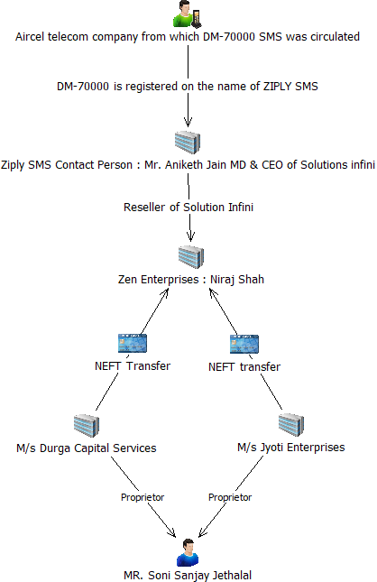
Circulation of Bulk SMS

Slide 15
Important Evidence to collect
Bank statement
Invoice
Ledger
Purchase order
Other details

Slide 16
Modus Operandi
Prior to sending bulk SMS, connected entities bought small quantity of shares in each transaction which contributed to increase in scrip price.
Around the same time, promoters of the company transferred shares to other connected entities through off market route. (as given in chart above)
Subsequently, one of the connected entity viz. Soni Sanjay Jethalal circulated bulk SMS during July 25, 2014 to July 28, 2014 containing unsolicited advice recommending purchase of shares of the company.
Pursuant to sending bulk SMS, i.e, 17 connected entities and 2 promoters, offloaded 26,15,280 no. of shares at BSE and 32, 00,000 shares at NSE, thereby cheated gullible investors.
It was observed that the average daily trading volumes during patch I (April 1, 2014 to July 24, 2014) i.e before the bulk SMS circulation period were low vis-à-vis average daily trading volumes during patch II (July 25, 2014 to May 30, 2015) i.e. after circulation of bulk SMS.

Slide 17
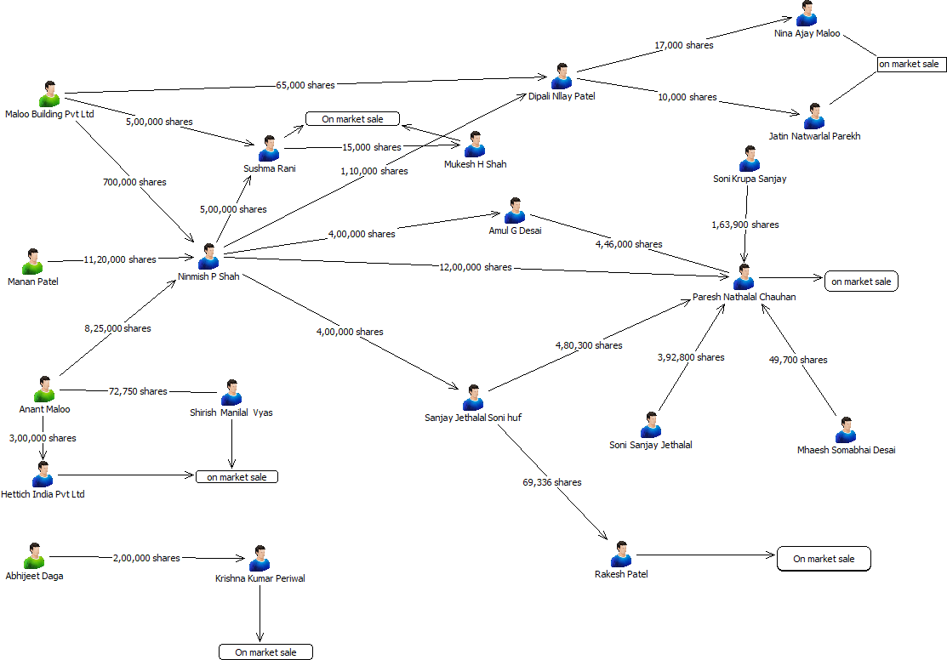

Slide 18
Unlawful / ill Gotten Gains:
Unlawful / ill Gotten Gains:
Quantity to be considered for ill-gotten gains
It was observed that the 4 promoters had transferred a total of 3700000 shares before and after circulation of bulk SMS, which were routed directly or indirectly to other connected entities, who sold shares on-market after circulation of bulk SMS. Since the objective of circulation of bulk SMS was to create demand in order to dump the shares held by these promoters through connected entities, these shares have been included for the purpose of calculation of ill-gotten gains.
Cost of Acquisition for promoters shares
Option I – Last day of price of the investigation period
Option II – trading suspended (previous day price)
Option III – Nil Price (Since company has gone in to liquidation)
Sale Consideration – connected entities had sold a cumulative total of 37,00,000 shares up to September 02, 2014. Therefore, actual sale price is available for 37,00,000 shares. Accordingly, the sale value of these 37,82,750 shares have been taken for the purpose of calculation of ill-gotten gains

Slide 19
Final Outcome
Disgorgement of unlawful gains –Rs. 3.11 crores
entities are restrained from accessing the securities market and further prohibited rom buying, selling or otherwise dealing insecurities, for a period of two years
Monetary Penalty of Approx Rs. 1.25 crores

Slide 20
LTCG Case
It was observed that a group of connected clients were trading amongst themselves regularly and their trading constituted significant proportion of total trading.

Slide 21
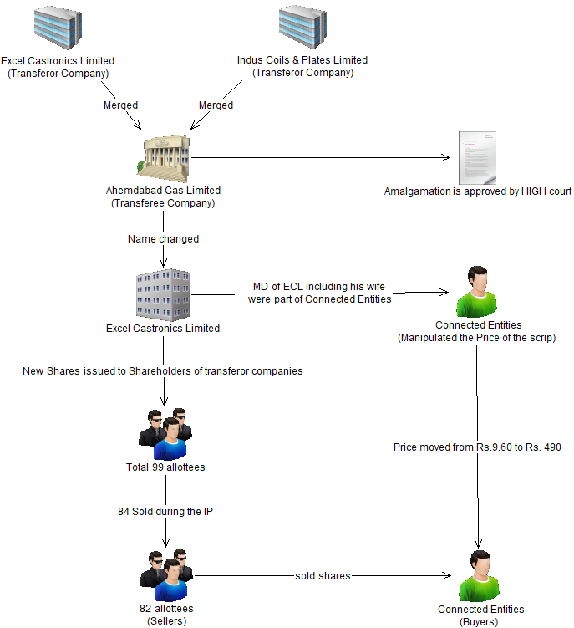

Slide 22
Modus operandi
As per the scheme of amalgamation, the shares of the transferee company were allotted to shareholders of the 2 transferor companies. (total 99 allottees)
Thereafter, during the IP, the connected entities manipulated the scrip price by traded among themselves. Out of 99 amalgamation allottees, 84 allotees sold shares in market.
Out of 84 allottees, 82 amalgamation allottees sold shares to connected entities on manipulated price.
It was observed that the 22 connected entities (Excel group) who had manipulated scrip price also acted as buyers and counterparties to the trades of amalgamation allottees. Hence, these connected entities of ECL group assisted and facilitated the sale of shares by the amalgamation allottees at a higher price and enabled the amalgamation allotted to make wrongful gains.

Slide 23
Connection between amalgamation allottees and suspected entities
An attempt was made to find out connection between 21 connected entities (The company ECL was one of the suspected entity but it had not traded in its own shares during the IP) and 82 amalgamation allottees based on the bank statements, UCC details, off market and MCA database.
Out of 82 amalgamation allottees, 10 amalgamation allottees (one of them was also a connected entity) were found to be connected to the ECL Group based on information collected from UCC details, MCA data, off market data and bank statements

Slide 24
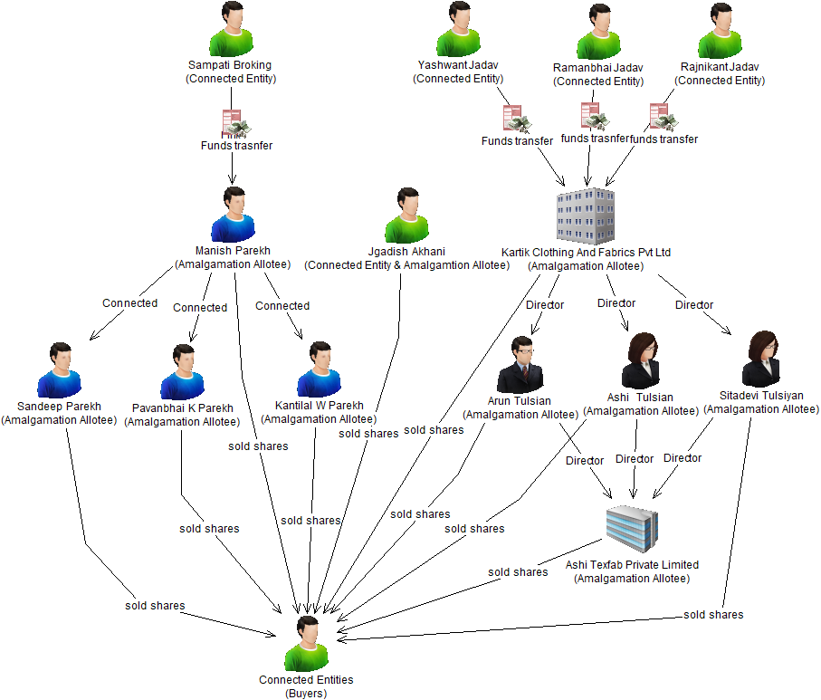

Slide 25
Unlawful / ill Gotten Gains:
Quantity to be considered for wrongful gains
it was observed that pursuant to amalgamation, shareholders of the transferor company were allotted shares in the ECL (transferee company). During the investigation period, these Amalgamation allottees sold majority of shares of a higher price. Out of that, substantial quantity of shares were sold to connected entities who manipulated the price of the scrip. Hence, shares sold by Amalgamation allottees to connected entities is considered for the purpose of calculation wrongful gains.
Cost of Acquisition for Amalgamation Allottees
Option I
The share price was Rs. 13.48 (on BSE) on the last trading day before amalgamation. Hence, for the purpose of calculation of ill-gotten gains, the cost of acquisition per share has been assumed to be Rs. 13.48 (on BSE).
Option II
Shares of new company (transferee company) were issued to transferor company in the ratio of 1:1. Face value of transferor companies shares was Rs. 10, which is actual price paid by the Amalgamation Allotees in the transferor companies. It was also observed from BSE report that these amalgamation allotees got shares in the unlisted transferor companies through preferential allotment. The preferential allotment in transferor companies was done just before the amalgamation. Hence, the cost of acquisition per share has been assumed to be Rs. 10 (Face Value).
Sale Consideration
It is seen from the details of shares sold by 10 amalgamation allottees that they had sold a cumulative total of 3,97,777 shares to connected entities. Accordingly, the sale value of these 3,97,777 shares have been taken for the purpose of calculation of wrongful gains.

Slide 26
Final Outcome
Disgorgement of unlawful gains –Rs. Approx 4.30 crores
entities are restrained from accessing the securities market and further prohibited rom buying, selling or otherwise dealing insecurities, for a period of two years
Monetary Penalty of Approx Rs. 1.92 crores

Slide 27
Zee Entertainment Enterprises Ltd (ZEEL)
Resignation of two independent directors (viz. Mr. Sunil Kumar and Ms. Neharika Vohra) of ZEEL” in November 2019 after raising concerns over appropriation of certain Fixed Deposit (“FD”) of ZEEL by Yes Bank Ltd. (“Yes Bank”) for squaring off loans of related entities of Essel Group.
Mr. Subhash Chandra, the then Chairman of ZEEL/ Essel Group, had provided a ‘Letter of Comfort’ (“LoC”) dated September 04, 2018 towards credit facilities availed by certain group companies from Yes Bank, wherein it was stated that “This is with regards to the Rs 200 Crore loan outstanding in Essel Green Mobility Ltd from Yes Bank Ltd. We will ensure that a fixed deposit of at least Rs. 200 Crore is available with Yes Bank Ltd, from any one of Essel Group of companies (including Zee Entertainment Enterprises Ltd), at all times whilst the said facility remains due and outstanding and that in the event of default under the said facility, you may appropriate the fixed deposit towards repayment of the said Facility.”

Slide 28
Appropriation of 200 crore FD by the Yes Bank
it was observed that the abovementioned LoC was known only to a few persons in management and even the Board of ZEEL was not aware of the same.
Yes Bank had adjusted Fixed Deposit of Rs. 200 Crore of ZEEL for meeting the obligations of the following seven entities (“Associate Entities”) towards Yes Bank. Sl. No. Name of the Associate Entities
1. Pan India Infraprojects Pvt Ltd
2. Essel Green Mobility Ltd
3. Essel Corporate Resources Pvt Ltd
4.Essel Utilities Distribution Company Ltd
5.Essel Business Excellence Services Pvt Ltd
6. Pan India Network Infravest Ltd
7. Living Entertainment Enterprises Pvt Ltd
These Associate Entities are owned/controlled by family members of Mr. Subhash Chandra & Mr. Punit Goenka (“Promoter Family”). The Promoter Family is also the beneficial owner of promoters of ZEEL. These 7 entities are described as RPTs in the books of ZEEL.

Slide 29
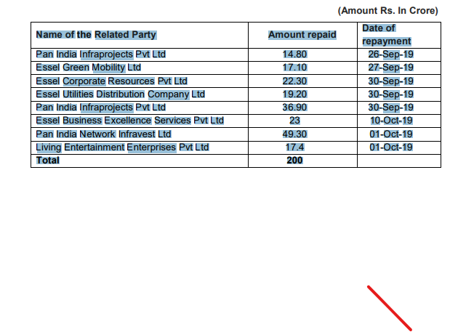
Repayment of Rs. 200 crores to ZEEL
ZEEL submitted that Rs.200 Crore, equivalent to the value of FD which was encashed by Yes Bank for the dues from Associate Entities owned by Promoter Family, had subsequently been received back from those Associate Entities in September/October 2019.

Slide 30

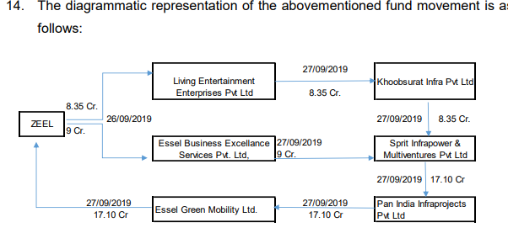
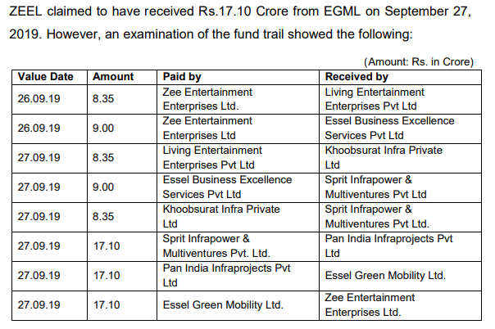
Modus operandi adopted by the ZEEL

Slide 31
What is front running
Front running :Buying or selling securities ahead of a large order so as to benefit from the subsequent price move.
This denotes persons dealing in the market, knowing that a large transaction will take place in the near future and that parties are likely to move in their favor.
The illegal private trading by a broker or market -maker who has prior knowledge of a forthcoming large movement in prices (Investment)

Slide 32
Example of front running case
On June 13, 2019, buy orders were placed from the trading account of Alka for 1,10,000 shares between12:54:00 pm. (i.e. at price of Rs. 1070). The buy order for 60,00,000 shares was placed by the Fidelity funds. At 1:30:00 pm (i.e. at price of Rs.1080.00).
As soon as Fidelity Asian Values Plc. started buying, Sell orders were put for 1,10,000 shares at 1:31:00 pm from the trading account of Alka. (i.e. at an average of Rs.1080.00).The entire trade had a positive square off difference of Rs. 7,70,000

Slide 33
Front Running BBS SSB, Vaibhav (Avi), Alka (mother), Arushi sister
Vaibhav Dhadda (Avi), being an employee of Fidelity, in his capacity as Fund Manager, had knowledge about investments and impending orders of Fidelity group entities. He had the authority to give instructions, for sale of shares, to the trading members of Fidelity Group.
Vaibhav Dhadda, based on advance knowledge about orders of Fidelity group entities, was front running their trades. He was placing orders through the trading account of his mother (Ms. Alka Dhadda) and his sister (Ms. Arushi Dhadda), in the same scrips, in which trading was being carried out by Fidelity Group entities.

Slide 34
Connection between alka and Avi
Alka’s email id is avidhadda92@gmail.com, which is matching with the name of the trader of Fidelity Group i.e. Mr. AviDhadda.
Further, her husband’s name is Mr. Virender Dhadda and her address is of Jaipur. It is also observed from the details of the PAN of Mr. Avi Dhadda(DFAPD6039C) the said PAN is registered in the name of Mr. Vaibhav Dhadda and the jurisdiction details of the said PAN is of Jaipur.
The passport details of Mr. Vaibhav Dhadda reveals that his parents are Mr. VirenderDhadda and Ms. Alka Dhadda. Additionally, the matrimonial website(www.jainshubhbandhan.com) profile mentions Mr. Vaibhav Dhadda as son of Mr. Virender Dhadda and Ms. Alka Dhadda.

Slide 35
Pyramid structure
Avi (Vaibhav Dhadda)
Alka Dhadda (HK)
Mother, PAN, Passport, Matrimony
Arushi Dhadda (HK) (Sister)
Aditya Barla (HK)
Beena Jain (Indore)
Pramod Jain (Indore)
Sumit Kanungo (Indore)
Prashant (Son)
Siddartha (Son)
Riya (Wife)

Slide 36
SEBI had passed order against Vaibhav , Arushi, Alka
Fidelity removed Vaibhav Dhadda from Job and conducted forensic scan of Vaibhav Dhadda, mobile, desktop and other electronic devices.
Accordingly, information were collected from 4 suspected entities including name of family members and their PAN, mobile number, email, address, bank details and passport details.
These details were sent to fidelity to check whether they have appeared in their forensic scan.
Bank statement analysis has been done for all family members. Also, they were asked whether they know each other.

Slide 37
Bank Statement Analysis
1. Alka Dhadda Received funds Rs. 2,00,000 from Aditya Barla in her Indian bank account.
Explanation given by the entity :
Beautiful story : I met Aditya Barla in a mall at Hong Kong and sold him a key ring on April 15 and received Rs. 200000 in my Indian bank account on April 17.
2. Alka Dhadda transferred money to Riya Kanugo (wife of Sumit Kanungo)
Another beautiful story : Alka given loan to Riya, they went for astrology purpose . Points to be ponder

Slide 38
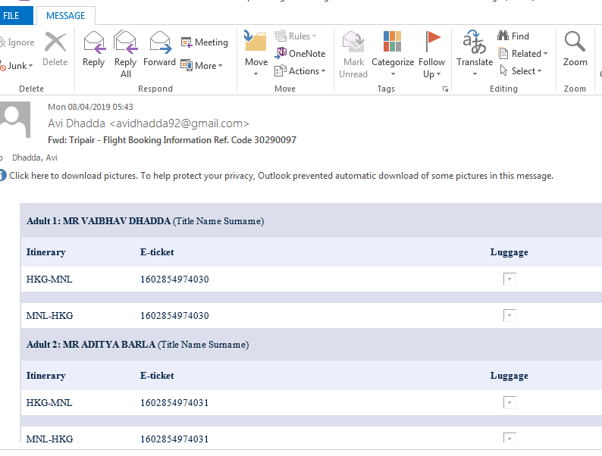
Connections with Aditya Barla

Slide 39
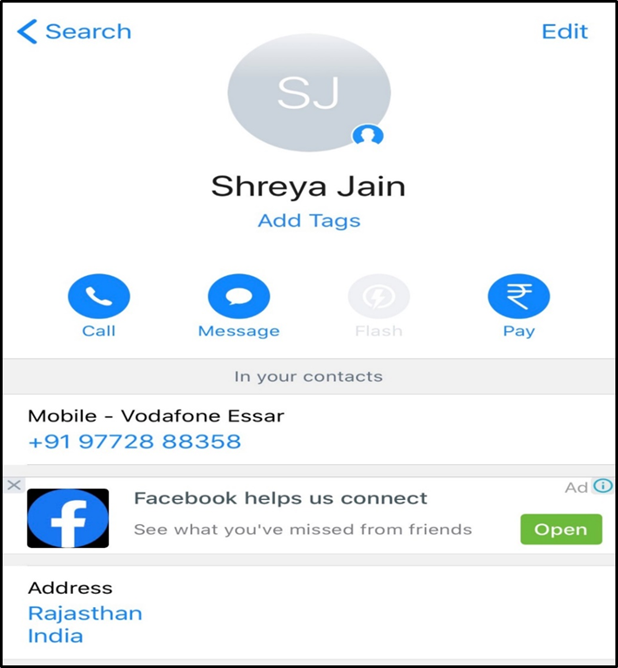
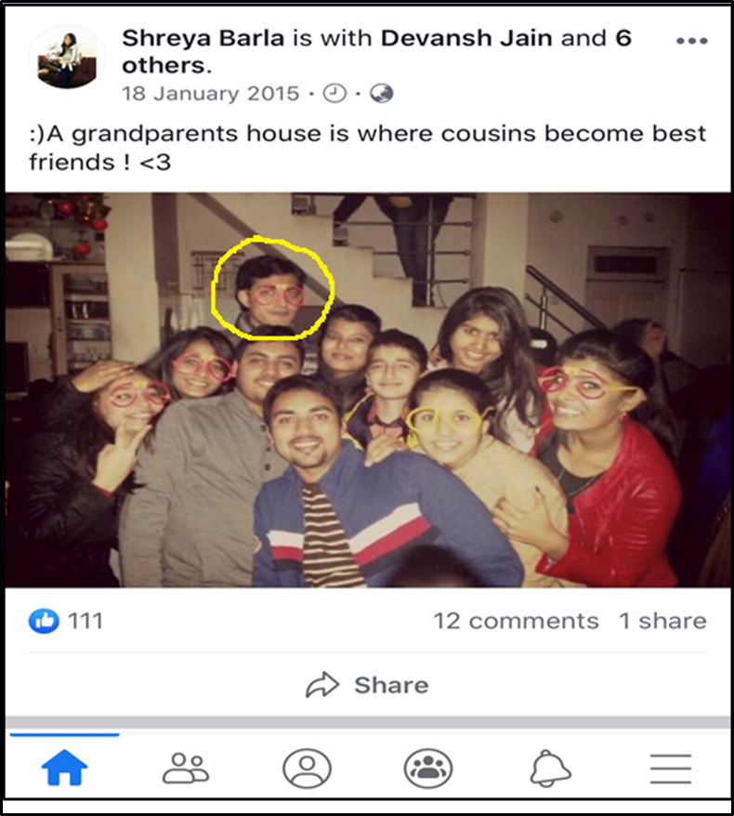
It was observed that mobile number ‘9772888358’ found in UCC database of Aditya Barla, was registered with the name of Shreya Jain in truecaller. we found that Aditya Jain is the brother of Shreya Barla. From one of the cousin photo posted by Shreya Barla, we found that photo of Aditya Barla matches with the photo in KYC.

Slide 40
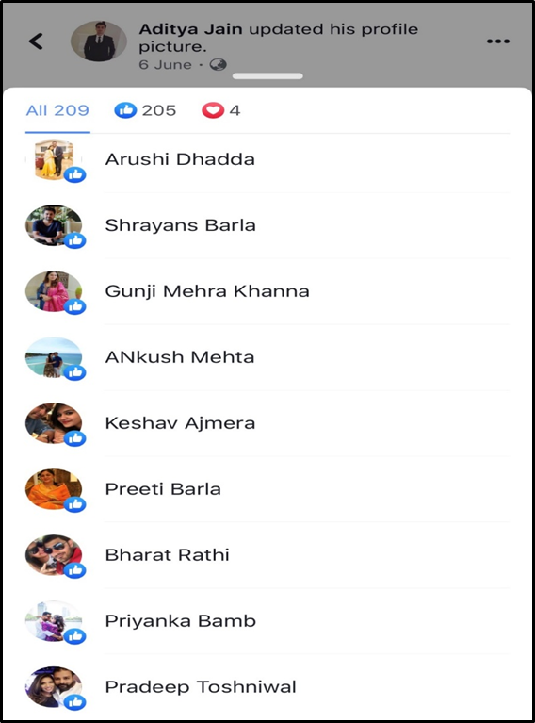
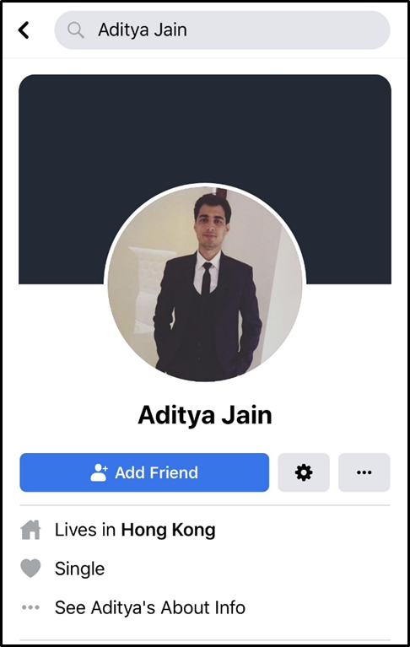
Aditya Jain has received like to one of the photo from Arushi Dhadda (Daughter of Ms. Alka Dhadda and sister of Mr. Vaibhav Dhadda i.e. Avi Dhadda who is trader of Fidelity).

Slide 41
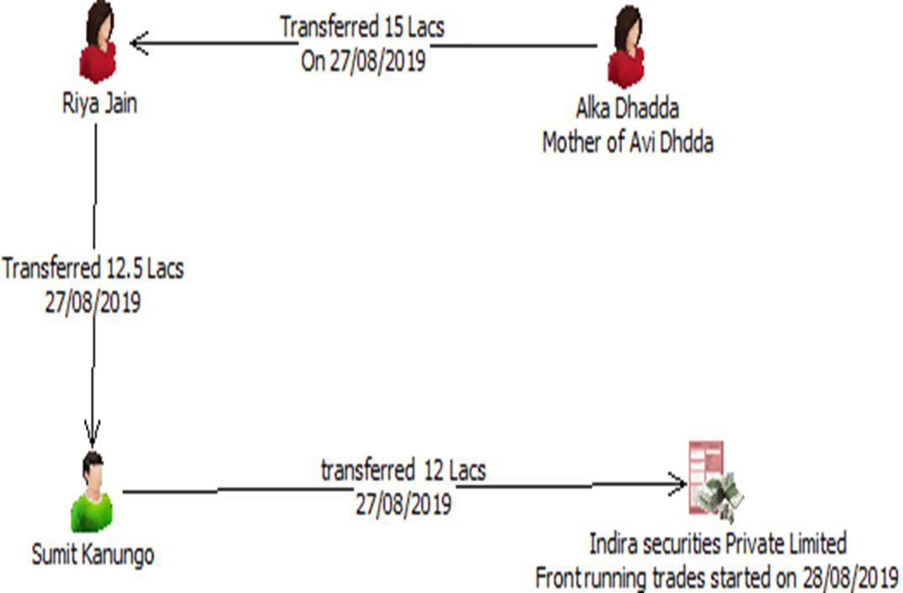
Bank statement transfer between Alka, Riya Jain and Sumit

Slide 42
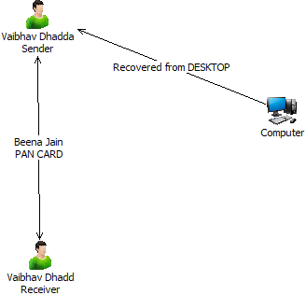
Connection between Beena Jain and Vaibhav Dhadda

Slide 43
Connection Analysis
(IP Address analysis): Passport History
Opening of Trading Account
Trading History
Opening of Bank Account and Fund Transfers(Riya Jain bank transfers and Alka Dhadda Ring), Riya Jain PAN card
Facebook connection
Data received from Fidelity
Travel tickets
Pan card of beena jain (Email)
Desktop File

Slide 44
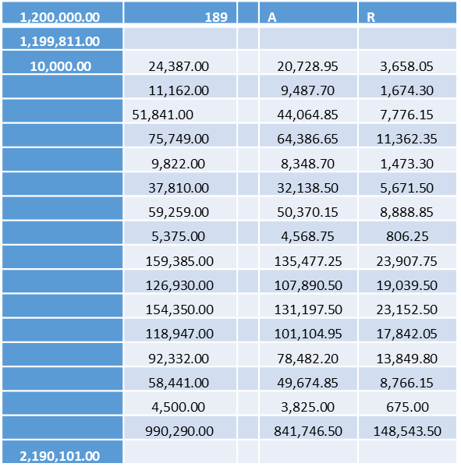

Slide 45
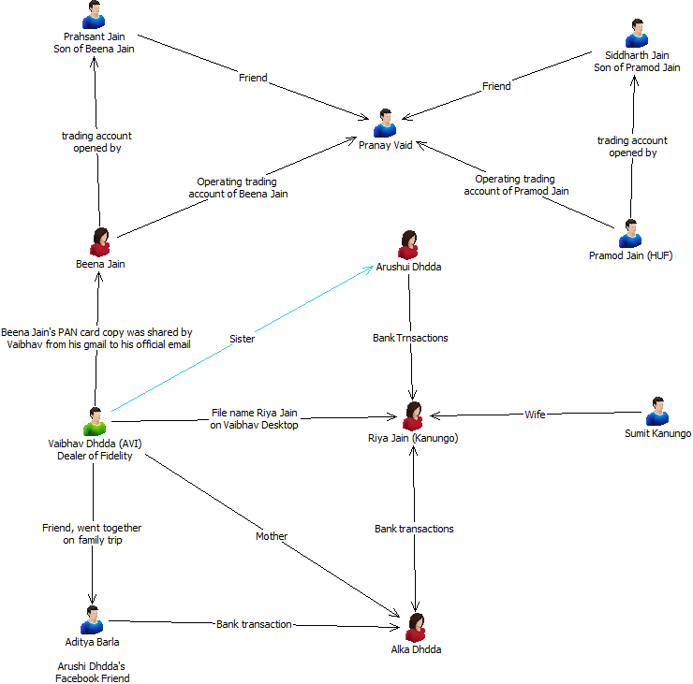

Slide 46
Final Outcome
Disgorgement of unlawful gains –Rs. 3.55 crores
entities are restrained from accessing the securities market and further prohibited rom buying, selling or otherwise dealing insecurities, for a period of two years
Monetary Penalty of Approx Rs. 4.25 crores

Slide 47
Omaxe Limited- Background
Omaxe Ltd. was incorporated in 1987 and its registered office of the company is situated at Shop No. 19-B, First Floor, Omaxe Celebration Mall, Sohna Road, Gurugram, Haryana, 122001.
The company is diversified into real estate sector and got listed on BSE and NSE stock exchanges in 2007. The closing price of the scrip is Rs. 103.80 with market cap. of Rs. 1898 crore as on November 19, 2024

Slide 48
Challenges in forensic audit-Omaxe Limited
Forensic Auditor was appointed conduct forensic audit of the books of accounts of the company to assist the investigation in the matter.
Forensic auditor submitted forensic audit report with almost NIL observation.
On analysis it was observed that omaxe has made 50% of its sales to JBPL (JEET).

Slide 49
Basic information of JBPL (jeet)
Group companies of Omaxe and Jeet had same address.
Directors of JBPL namely Radhey Krishna Goel and Uttam Kumar are employees of Omaxe as per the company’s Payroll.
e-mail ids of Radhey Krishna Goel and Uttam Kumar are shown as radhegoel@omaxe.com and uttam@omaxe.com respectively which carry Omaxe’s domain name.
Further, a bank account of JBPL was opened on October 14, 2008 and Rs. 10 lacs were transferred by Omaxe to JBPL’s bank account on the same day.
Statement recording of the directors of JBPL.
It was also observed that full time employees/KMPs of Omaxe were the authorized signatories for the bank account of JBPL
Mismatch in Omaxe and Jeet’s books

Slide 50
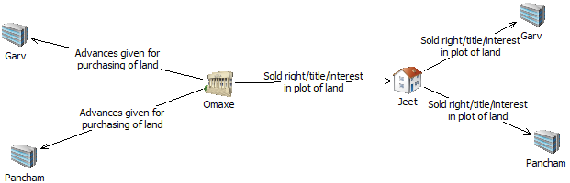

Slide 51
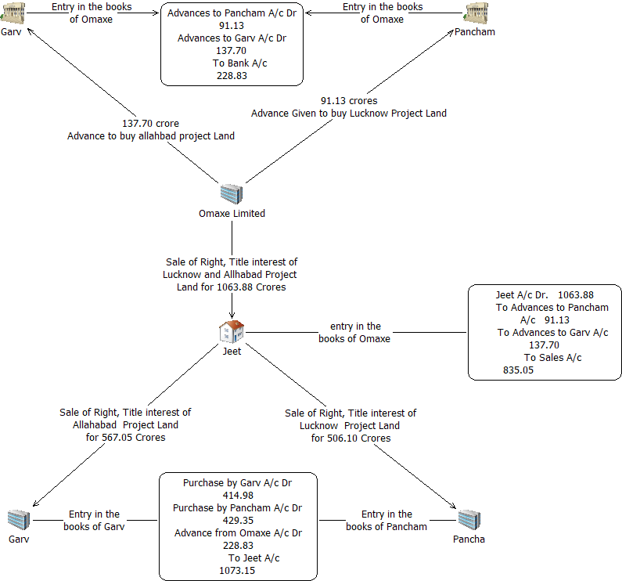

Slide 52
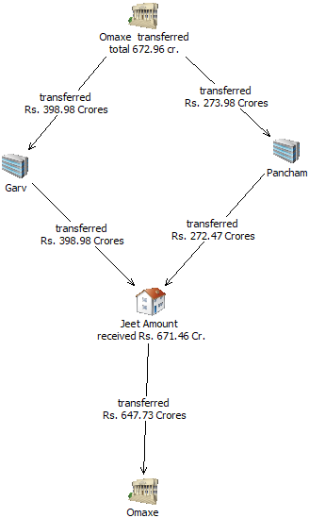

Slide 53
Fraudulent Scheme:
The company, along with its executives, engaged in a fraudulent scheme to portray these manipulations as standard transactions. This was done to maintain the company's stock price and the value of collateral pledged by promoters against loans.
Company has booked fictitious sales in the end of each quarter to book fictitious profit

Slide 54
Booking fake sale on last few days of the quarter, 74% promoters shareholding and 66% of that was pledged
FY | Transaction between Omaxe-JBPL for Allahabad Hitech City Project |  |  | Total | Transaction between Omaxe-JBPL for Lucknow Hitech City Project |  |  | Total
 | Quarter | Date | Amount |  | Quarter | Date | Amount
2016-17 | 2 | 27/06/2016 | 57.75 | 165 | 3 | 01/12/2016 | 48.425 | 223.5
 |  | 27/06/2016 | 57.75 |  |  | 07/12/2016 | 63.325
 |  | 30/06/2016 | 49.50 |  |  | 08/12/2016 | 70.775
 | 4 | 30/03/2017 | 110.00 | 170.50 |  | 09/12/2016 | 40.975
 |  | 30/03/2017 | 60.50
 | Total |  | 335.5 |  | Total |  | 223.5 | 559.00
2017-18 | 2 | 30/09/2017 | 46.75 | 68.75 | 2 | 30/09/2017 | 55.875 | 104.30
 |  | 30/09/2017 | 22.00 |  |  | 30/09/2017 | 48.425
 | 3 | 24/11/2017 | 41.25 | 110 | 3 | 03/11/2017 | 52.15 | 100.57
 |  | 24/11/2017 | 38.50 |  |  | 03/11/2017 | 48.425
 |  | 24/11/2017 | 30.25 |  | 4 | 31/03/2018 | 74.50 | 74.50
 | 4 | 31/03/2018 | 46.75 | 46.75
 | Total |  | 225.5 |  | Total |  | 279.375 | 504.88
Total |  |  | 561 |  | Total |  | 502.88 | 1063.88

Slide 55
Modus Operandi transfer of Land (MOUs)
relevant extracts of the ICAI Guidance note on Revenue recognition of real estate transactions inter alia provide that:
“The completion of the revenue recognition process is usually identified when the following conditions are satisfied:
(a) the entity has transferred to the buyer the significant risks and rewards of ownership of the real estate;
(b) the entity retains neither continuing managerial involvement to the degree usually associated with ownership nor effective control over the real estate sold;
(c) the amount of revenue can be measured reliably;
(d) it is probable that the economic benefits associated with the transaction will flow to the entity; and
(e) the costs incurred or to be incurred in respect of the transaction can be measured reliably.
Where transfer of legal title is a condition precedent to the buyer taking on significant risks and rewards of ownership and accepting significant completion of the seller’s obligation, revenue should not be recognized till such time legal title is validly transferred to the buyer.
Date | Listed to Sbdry G | Listed to Sbdry P | Sbdry G to paper company | Sbdry p to paper company | Paper Company to Listed company
30/03/2017 | 23.25 | - | 23.25 | - | 23.25
19/05/2017 | 200.00 | 150.00 | 200.00 | 148.50 | 331.40
22/05/2018 | 101.25 | 98.50 | 101.25 | 98.50 | 200.87
13/06/2018 | 74.50 | 25.47 | 74.50 | 25.47 | 92.21
Total | 398.99 | 273.97 | 398.99 | 272.47 | 647.73

Slide 56
Action taken by SEBI
Market Ban: Omaxe Limited, its Chairman Rohtas Goel, Managing Director Mohit Goel, and three other executives—Sudhangshu S. Biswal, Arun Kumar Pandey, and Vimal Gupta—were barred from accessing the securities market for a period of two years.
Prohibition on Managerial Positions:
These individuals were also prohibited from holding any position as Director or Key Managerial Personnel in any other listed company for two years.
Due to SEBI order there was lower circuit on the scrip on continuous five days

Slide 57
DHFL Scam
A prominent Non-Banking Financial Company (NBFC) that provided housing loans in India. The primary function of the NBFC is to issue home loans to lower and middle-income Indian groups. DHFL is considered one of the earliest housing lenders in India.
Kapil and Dheeraj Wadhawan, the former founders and promoters of DHFL. The Wadhawan brothers commanded important roles on DHFL’s board, with Kapil being the Chairman and Managing Director, while Dheeraj was the non-executive Director of the company.
The equity shares of the Company are listed on BSE and NSE. It is observed that the Company had also issued Non-Convertible Debentures (NCDs). As on May 31, 2019, DHFL had more than Rs. 24000 crores worth of outstanding NCDs issued through public issue

Slide 58
Cobra Post Article
On January 29, 2019, Cobrapost, a media portal, published an article “Anatomy of India’s Biggest Financial Scam Pulled off by Dewan Housing”1. It was alleged in the articlethat the promoters of the Company-Mr Kapil Wadhawan and Mr Dheeraj Wadhawan, hadsiphoned off more than Rs.31,000 crores of public money primarily through grants and advances to shell companies.
DHFL was taken to the National Company Law Tribunal (NCLT) under the Insolvency and Bankruptcy Code (IBC) by RBI and NCLT admitted the application and appointed RP.

Slide 59
Initiation of forensic audit
Grant Thornton India LLP(“Transaction Auditor”)was appointed to assist the RP in conducting a transaction audit of the Company. The Transaction Auditor was also required to identify and review irregular borrower accounts
Rs. 14,046 Crores, being the amount outstanding in the books of the Company as on June 30, 2019;
(b)Rs,3,348 Crores being amount considered as due and outstanding towards notional loss to the Company on account of fraudulently charging lower rate of interest to certain entities referred to in the Application as the Bandra Book Entities.

Slide 60
Finding of the forensic audit
the investigation uncovered a fictitious "Bandra Branch" within DHFL's software system. This branch, existing only in the digital realm, was allegedly used to channel funds towards the shell companies.
Out of the Rs. 23,815 crores shown as disbursed to Bandra Book entities in the accounts of the Company, only Rs. 11,755.79 crores was actually disbursed. This amount (Rs. 11,755.79 crores), the report notes,was disbursed to 91 entities, but was shown in the books of the company as comprising of 2,60,315 home loan accounts. The closing balance outstanding in the books of the company towards such accounts as of June 30, 2019 was Rs. 14,046 crores.

Slide 61
Conclusion- money siphoned off to the promoters
The transaction auditor verified the financial statements of 50 of the said 91 entities,which accounted for 70% of the disbursals, and noted that 34 entities had invested a portion of the loan amount received from the lender in companies which were linked to the promoters of DHFL. The report also identified that such entities had weak financial strength and their repayment capacity was doubtful. These loans were unsecured and givenwithout taking any collateral. Thereport concludes that the Company suffered a notional loss of Rs. 3,348 crores
Losses in all financial years

Slide 62
Impact of the case
Money laundering: The diverted funds are suspected to have been used for various purposes, potentially including investments in real estate and other assets.
Impact: This elaborate scam resulted in massive losses for the bank consortium and eroded trust in the Indian financial system. The Wadhawan brothers have been arrested and are facing trial. Investigations and efforts to recover the lost funds are ongoing.
Loss to Banks: The scam resulted in a loss of over Rs 34,000 crore (approximately $4.3 billion) to the consortium of banks that had loaned money to DHFL.
Impact on borrowers: Borrowers who had taken legitimate loans from DHFL faced uncertainty due to the company's financial woes.

Slide 63
Current status
The Central Bureau of Investigation (CBI) arrested Dheeraj Wadhawan in May 2024 in connection with the Rs 34,000 crore bank fraud case. He was already charge sheeted by the CBI in 2022 for his alleged involvement in the scam. It's important to note that Dheeraj Wadhawan was previously arrested in connection with the Yes Bank corruption probe. This development signifies continued action from the authorities in the DHFL case. However, it's important to remember that the overall investigation and legal proceedings are still ongoing.

Slide 64
Brightcom- Background of the company
Brightcom Group, established in 2000 and headquartered in Hyderabad, India, is a prominent player in the digital marketing and ad-tech industry. The company offers a comprehensive suite of services, including video advertising, display ads, search marketing, email marketing, lead generation, affiliate marketing, social media marketing, and mobile marketing.
In terms of financial performance, Brightcom Group reported consolidated revenues of ₹7,396.77 crores and a profit after tax of ₹1,370.99 crores for the fiscal year 2022-23. The company has also been recognized in the Fortune India 500 list, ranking 400th in 2020.
Market cap of Brightcom was 1558 crore.

Slide 65
Irregularities in preferential allotments:
During FY 2020-21& 2021-22, the company raised INR 867.8 Crores from a total of 82 allottees through preferential allotment which was investigated by SEBI. SEBI’s investigation revealed several irregularities.
Company round-tripped funds through a series of entities which helped route funds to the promoter group, some applicants were given a full refund of money paid through layering transactions.
Company falsely claimed to have received full payment for preferential shares/warrants by providing ‘forged and fabricated bank statements’ to SEBI.

Slide 66
Bank Statements
SEBI independently sought Company’s bank account statements for the same bank accounts from the concerned banks. On comparison of the bank account statements received from the Company with those received directly from the banks,
it was observed that the credit entries appearing in the bank account statements submitted by the company, which were purported to be the receipts of share application money from the allotees, did not appear in the bank account statements obtained directly from the banks

Slide 67
Irregularities in preferential allotments:
Preferential allottees, have either not paid for the shares, made a part payment or have got their money refunded.
Certain entities that were allotted shares were categorized as promoter entities after the preferential allotment with the CMD making himself a partner in each of them. This allowed the group to circumvent the prescribed lock-in period for promoters.
The statutory auditors, apart from failing to report outright fraud, colluded in the fabrication of information and falsification of accounts.
The registrar and share transfer agent (RTA) of the company, was an associate of the auditors of the company.

Slide 68
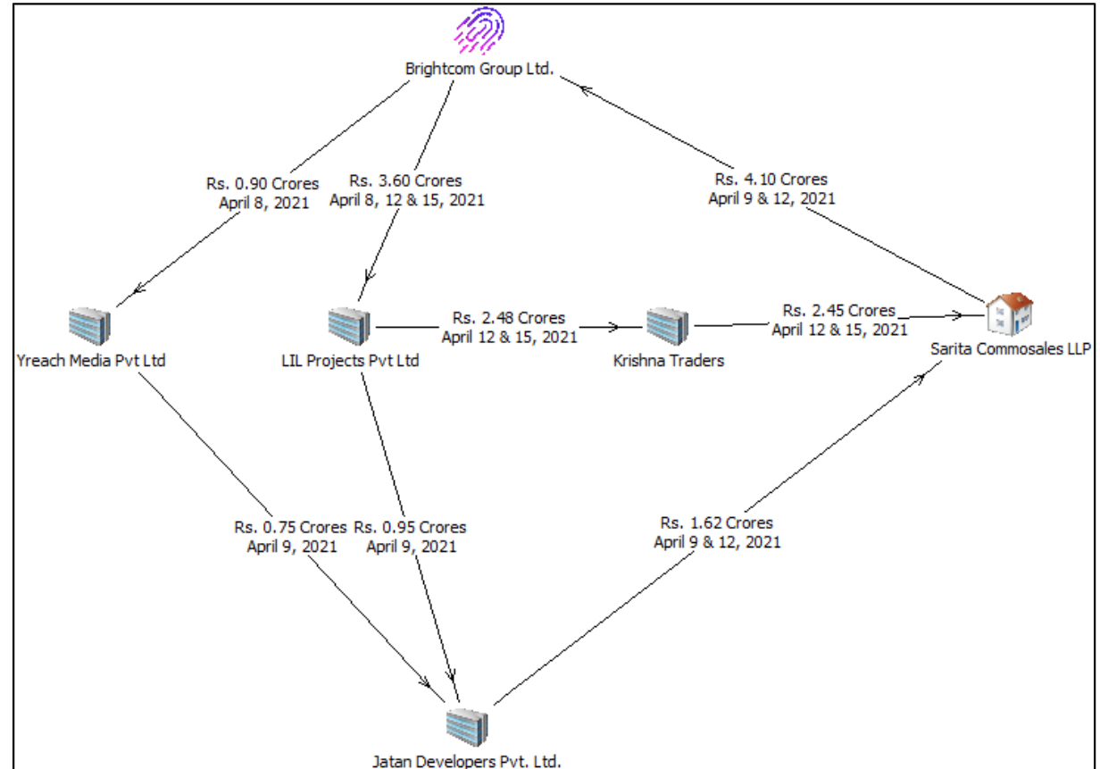

Slide 69
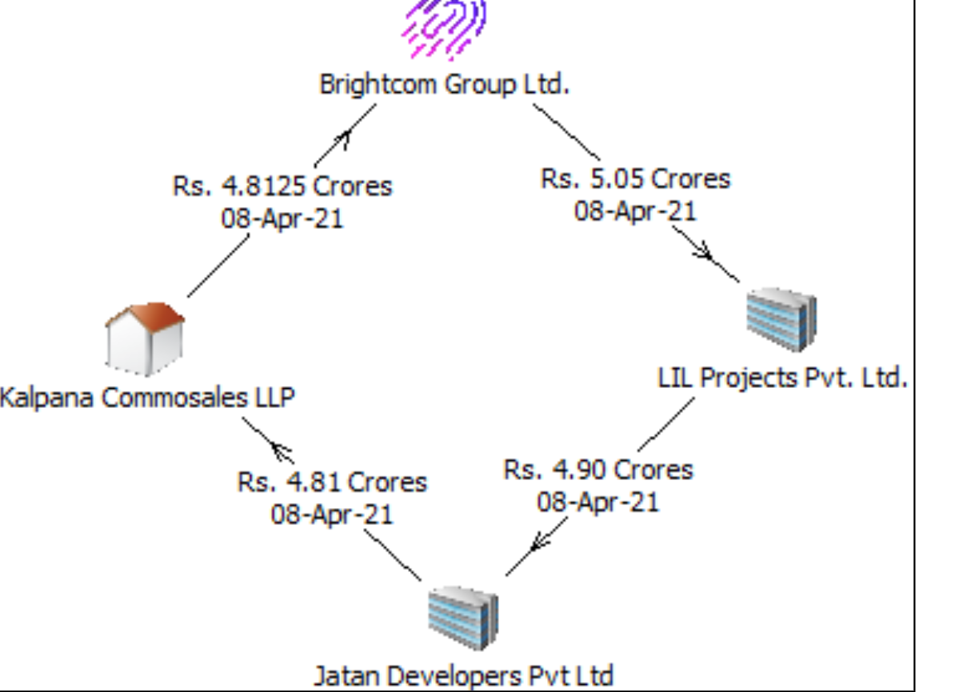

Slide 70
SEBI issued the following directions:
Directors and KMPs were directed not to sell/ dispose of/ dilute their shareholding in the Company,
CMD and CFO were directed not to hold the position of director or KMP in any listed company or its subsidiaries.
The company was directed to submit the statement of the impact of all the non-compliances for each of the financial years
The company was directed to publish correct shareholding patterns.

Slide 71
ASERL and WOAL Background
Background
Entities Involved:
Add-Shop E-Retail Limited (ASERL) is engaged in manufacturing, marketing, and distributing products like Ayurvedic products and food supplements.
White Organics Agro Limited (WOAL) deals in organic food products.
Investigation Period:
SEBI investigated transactions from April 1, 2020, to March 31, 2023, after complaints about irregularities in related-party transactions and false announcements.

Slide 72
Modus operandi
Circular Transactions:
ASERL, WOAL, and Dada Organics (DO/DOL) engaged in circular trading. They sold and purchased goods among themselves without actual stock movement, inflating their financial statements.
The goods allegedly traded, including animal food supplements and multigrain, were never physically moved.
Promoter and Public Shareholding Changes:
ASERL’s promoter holding reduced from 62.99% to 36.03% during the period, partly due to non-participation in rights issues and sales at inflated prices.
The number of public shareholders of ASERL rose drastically, indicating widespread investor interest influenced by false financials.
Rights Issue Proceeds:
ASERL raised ₹48.33 crore in FY23 through a rights issue based on its misleading financials.

Slide 73
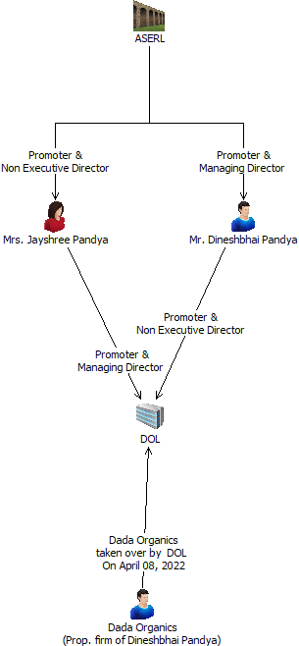

Slide 74
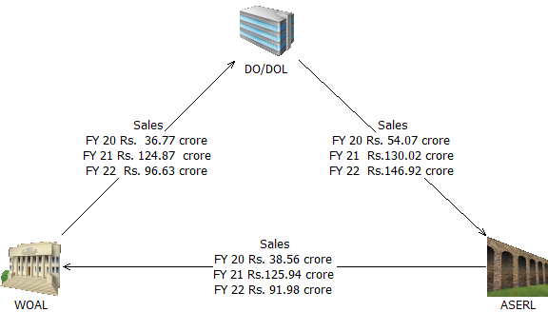
Add-Shop E-Retail Limited (ASERL) and White Organics Agro Limited(WOAL)

Slide 75
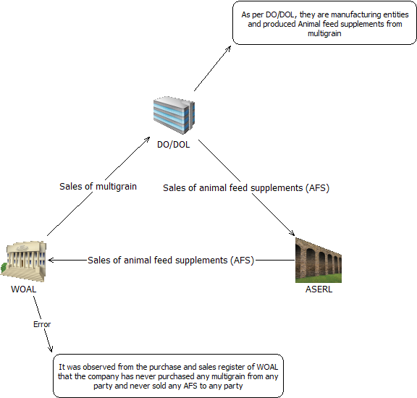
Sale of Animal food supplement

Slide 76
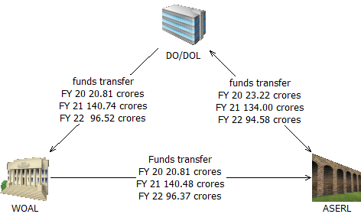
Bank statement analysis

Slide 77
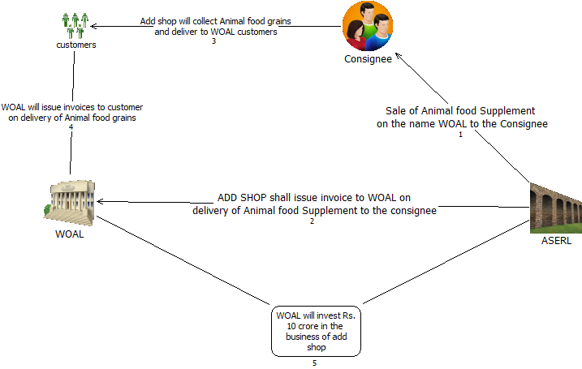
Agreement submitted by the company : barter system

Slide 78
Conclusion
As submitted by Mr. Darshak Rupani, there is no godown with WOAL and there was no stock movement between ASERL & WOAL and between WOAL & DO/DOL.
Managing Director of ASERL also admitted that ASERL has provided book entries to WOAL.
Emails were sent to ASERL and WOAL to provide the email communication wherein the agreement was shared by them with anyone i.e. lawyer, CA, employees of ASERL/WOAL, etc.
Excess stock, working capital need, failed to provide the details barter system
Based on manipulated financial statement, company promoter sold the shares of the company.
Stat auditor of the company did not have the copy of the agreement

Slide 79
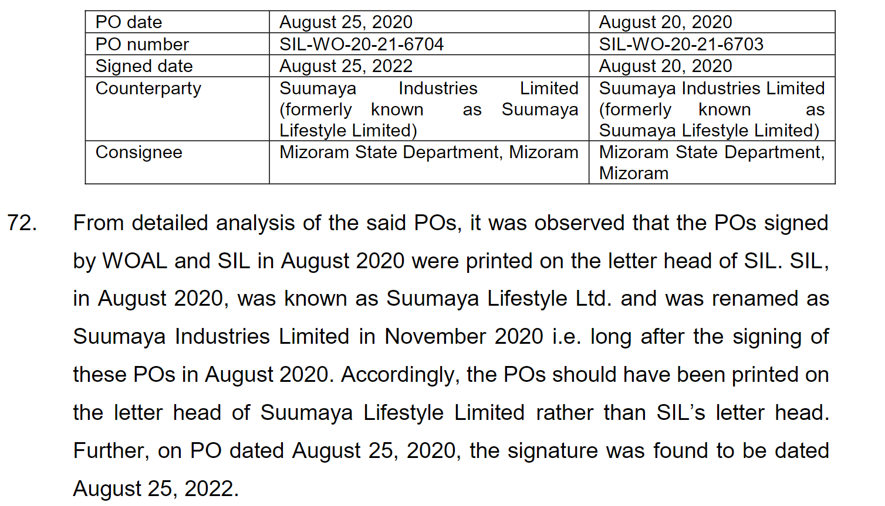
Misleading corporate announcement

Slide 80
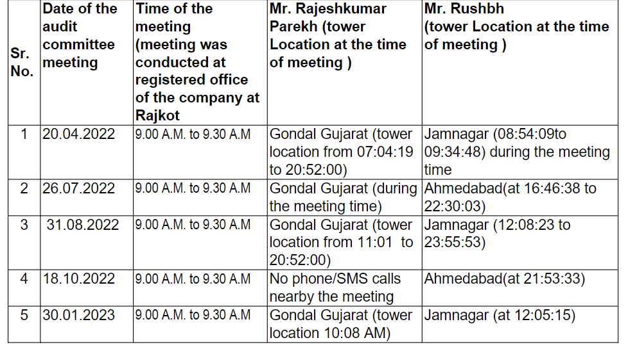
Audit committee meetings

Slide 81
Home and Work Location
Tower location of another Audit Committee member, Mr. Vivek Dadhania, showed that during the audit committee meeting days and time his location was mostly Building of Neptune Tower, and TERRACE OF Anand Plaza". These two locations are away from the registered office of the company.
Mr. Vivek Dadhania’s location for maximum time during night time was Neptune tower (343 days and 2965 calls) and during day time was Anand Plaza (519 days and 7277 calls), which indicated that the said addresses were his home and workplace respectively.
Further, his tower location on May 29, 2023 at 11:08: 58(meeting time was 11.00 A.M. to 11.30 A.M.) was Saurastra University which was 5km away from the company.103.. Further, ASERL has also failed to submit any email/ other means of communication through which the agendas and minutes were shared with the audit committee members.104.From the above observations, it is apparent that AC meetings werenever held in ASERL and there was no review of the financial statements, before placing them for approval of its Board of Directors.

Slide 82
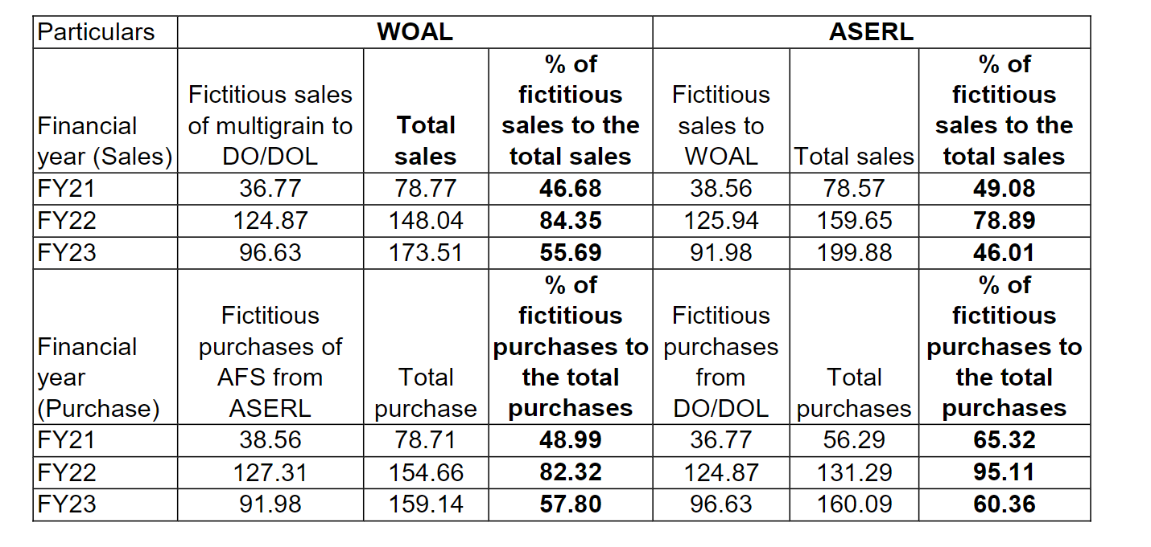
Fictitious purchase and sales

Slide 83
THANK YOU

