Slide 1
Responsible Financing
CMA (Dr.) P. Siva Rama Prasad
Hyderabad​

Slide 2
Responsible Financing
Dubai - City of Gold
Rain Havoc
Cause for Heavy Rainfall
Cloud Seeding or Climate Change – Experts Say

Slide 3
Responsible Financing
Record Rainfall in Dubai. Blame Climate Change, Not Cloud Seeding

Slide 4
Responsible Financing
Heavy Rain Leads to Floods in Dubai

Slide 5
Electronic City of India (Dry Days Ahead for Bengaluru?)
Responsible Financing

Slide 6
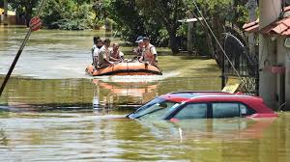
A Dry Story of India’s Silicon Valley The Water Crisis in Bengaluru Pictures Saying that Bengaluru is a City Best for Work-from-Home As the Roads Flood when it Rains and There is No Water in Summer
Responsible Financing

Slide 7
Responsible Financing

Slide 8
Responsible Financing
Employees in Bengaluru Skip Offices ..

Slide 9
Responsible Financing

Slide 10
Mr. Kofi Annan, the former Secretary-General of the United Nations, expressed during the Paris Climate Agreement that the Global Community is Approaching a Critical Juncture where Climate Change may become Irreversible, Potentially Depriving Current and Future Generations of a Healthy and Sustainable Planet, a Scenario with Terrible Consequences for Humanity as a Whole. These Sentiments vibrate more Strongly Today than Ever.
‘Paris Climate Agreement’

Slide 11
Achieving the Goal of Limiting Global Warming to Around 1.5°C or 2°C above Pre-industrial Levels is deemed practically Unattainable without Urgent, Substantial, and Widespread Reductions in Greenhouse Gas Emissions.
‘Paris Climate Agreement’

Slide 12
Such a Scenario could have Profound Adverse Repercussions on: -Ecosystems. -Health. -Infrastructure, and -The Economy.
‘Paris Climate Agreement’

Slide 13
A Recent Study by “CarbonBrief” suggests that a Temperature Rise of 1.5°C - 2°C could Reduce Global GDP by Approximately 8% to 13% by the Year 2100.
‘Paris Climate Agreement’

Slide 14
Extreme Weather Events (Tropical Cyclones / Typhoons)
Responsible Financing

Slide 15
Responsible Financing

Slide 16
Extreme Weather Events (Winter Storms)
Responsible Financing

Slide 17
Responsible Financing

Slide 18
Extreme Weather Events (Floods)
Responsible Financing

Slide 19
Responsible Financing

Slide 20
Extreme Weather Events (Heat Waves)
Responsible Financing

Slide 21
Responsible Financing

Slide 22
Extreme Weather Events (Droughts)
Responsible Financing

Slide 23
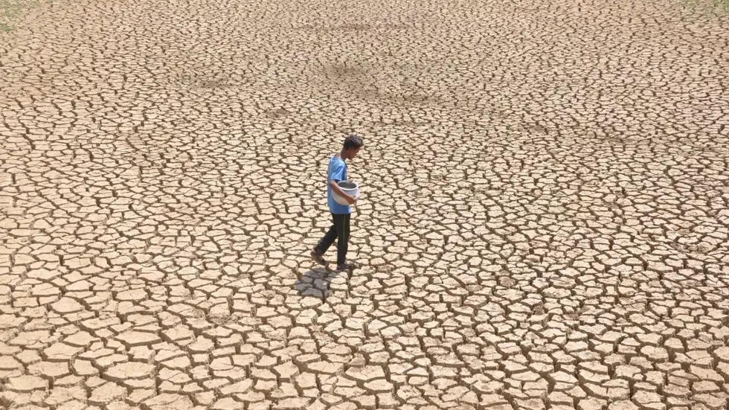
Responsible Financing

Slide 24
Extreme Weather Events (Hailstorms)
Responsible Financing

Slide 25
Responsible Financing

Slide 26
Extreme Weather Events (Wildfires)
Responsible Financing

Slide 27
Responsible Financing

Slide 28
Ecosystem Pollution (Soil Pollution and Degradation)
Responsible Financing

Slide 29
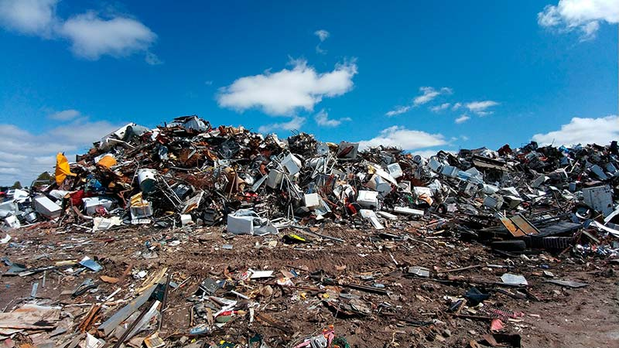
Responsible Financing

Slide 30
Ecosystem Pollution (Air Pollution)
Responsible Financing

Slide 31
Responsible Financing

Slide 32
Ecosystem Pollution (Water Pollution)
Responsible Financing

Slide 33
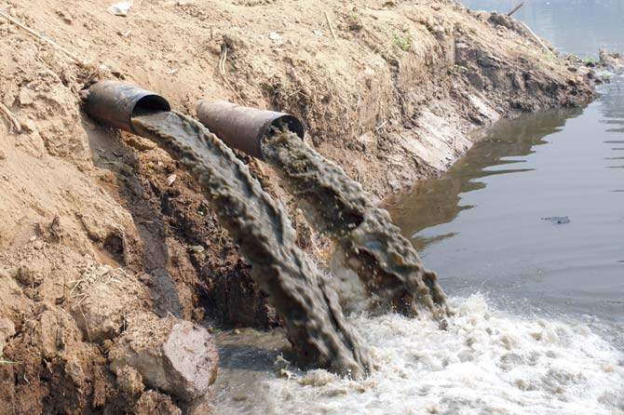
Responsible Financing

Slide 34
Ecosystem Pollution (Marine Pollution)
Responsible Financing

Slide 35
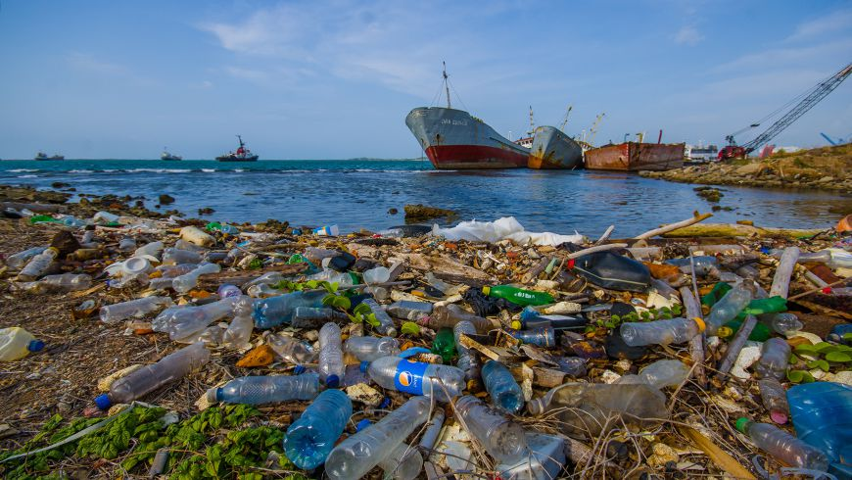
Responsible Financing

Slide 36
Ecosystem Pollution (Environmental Accidents)
Responsible Financing

Slide 37
Responsible Financing

Slide 38
Sea-level Rise (Chronic Sea-level Rise or Sea Surges)
Responsible Financing

Slide 39
Responsible Financing

Slide 40
Water Scarcity (Drought or Insufficient Supply for Increasing Demand)
Responsible Financing

Slide 41
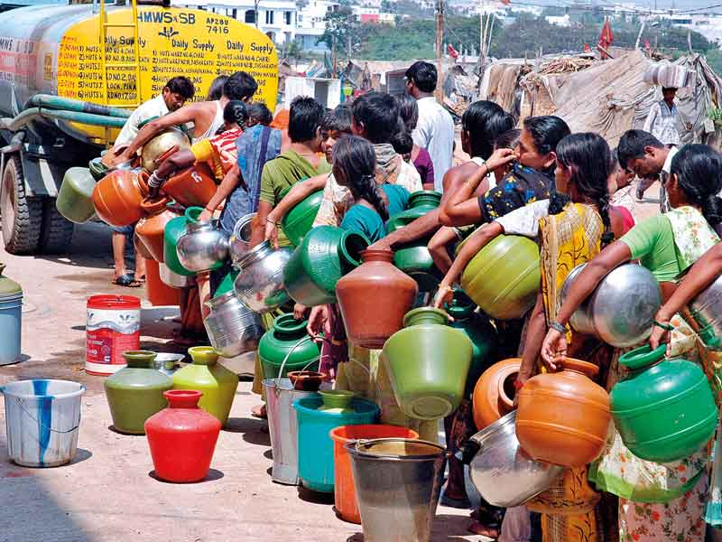
Responsible Financing

Slide 42
Deforestation
Responsible Financing

Slide 43
Responsible Financing

Slide 44
Desertification
Responsible Financing

Slide 45
Responsible Financing

Slide 46
Public Policy Change (Pollution Control Regulations)
Responsible Financing

Slide 47
Responsible Financing

Slide 48
Responsible Financing

Slide 49
Responsible Financing
While Green Loans can be ESG-Linked, they are Issued Solely to Finance Environmentally Sustainable Projects. These Guidelines, the RBI’s First Step in Implementing ESG Norms, will help India meet its Target of reducing its carbon emissions to Net Zero by 2070.

Slide 50
Responsible Financing
Banks are supporting THREE important Sectors in the Economy. Hence, Banks are Called ‘Backbone’ of the Economy.
Agriculture Sector (Primary Sector).
Industrial Sector (Secondary Sector).
Service Sector (Tertiary Sector) .
Green Loans (ESG-Linked) by Banks is need of Hour under “Responsible Lending”.

Slide 51
Responsible Financing
Sustainable Development is at the forefront of the National Agenda, influencing Banks and NBFCs to raise ESG-Based “Responsible Lending”.

Slide 52
Responsible Financing
This Directs Banks towards funding Sustainable Projects based on Environment, Social, and Governance aspects and also Invites a Change in the Ecosystem to benefit those following ESG Practices.

Slide 53
Responsible Financing
Banks in India are now turning their focus towards Environmental, Social, and Governance Based Lending while Lending / Investing in Projects Ranging Around:
Wind Energy.
Hydropower and
Solar Energy
And Contributing Towards Social Development Projects.

Slide 54
Responsible Financing
Responsible Lending Concept gives a New Horizon to the Banks, NBFCs, or Financial Institutions and makes them take more Interest in Funding Organizations Working Towards Green Projects (ESG Linked).

Slide 55
Responsible Financing
This enables Banks or NBFCs to not only Invest in ESG-Based Projects but also to Offer Loans to Organizations through ESG Metrics which could be Beneficial in Terms of Sustainability Development.

Slide 56
Responsible Financing
Understanding “ESG Linked Loans”

Slide 57
Responsible Financing
The ESG-linked loans focus on the Environment, Social, and Governance aspects or Performance of the Borrower.

Slide 58
Responsible Financing
This becoming a “New Norm” in the ‘Banking Industry’ as it not only Bring up Organizations to be Responsible Towards Environmental, Social, or Government-related efforts but also to avail Greater Benefits like Lower Interest Rates on various Types of Loans.

Slide 59
Responsible Financing
On the other hand, this Overall Promotes Sustainability Development and Social Responsibility of Banks in the Long run.

Slide 60
Responsible Financing
ESG Linked Loans, The Financial Terms of the Loans are Linked with the ESG Performance, like Workplace Diversity Score and Contribution to Green Energy Projects or Social Initiatives.

Slide 61
Responsible Financing
These can be Tracked through Diverse Metrics like Sustainability Performance Targets and Key Performance Indicators laid down by the Banks.

Slide 62
Responsible Financing
Role of Banks and Financial Institutions to Promote Sustainability.

Slide 63
Responsible Financing
As per the Reserve Bank of India, it is Important to Link Development with the Financial System, Largely Supporting Sustainable Practices and Initiatives in the Country.

Slide 64
Responsible Financing
Not only makes Financial Institutions more Responsible and Society Centric but also Enables other Organizations Seeking Funds to work in Areas related to ESG as it might offer them some Lucrative Benefits while Availing Loans.
Both Ways, this Concept Enables Sustainable Development.

Slide 65
Responsible Financing
‘ESG Strategies’ Link to Higher ROI

Slide 66
Responsible Financing
The Companies Following ESG Practices are seen to be more Return-oriented, thus Offering Better Returns to Investors or Lenders.

Slide 67
Responsible Financing
Since ESG Accesses the Business Processes in Terms of Dealing with their Stakeholders, these Companies are giving Better Equity Returns in Different Aspects.

Slide 68
Responsible Financing
Reasons why ESG based “Responsible Lending” is a Positive Aspect for Banks or NBFCs:
The ESG Based Responsible Lending “Reduces the Risk” for Financial Institutions to ‘Lend Money’ to the Organizations Following Sustainability Practices.

Slide 69
Responsible Financing
Reasons why ESG based “Responsible Lending” is a Positive Aspect for Banks or NBFCs:
ESG Linked Investments for NBFCs or Banks also “Improve their Reputation” in the Market or Industry.
This, in turn, “Improve the Funding Ecosystem”.

Slide 70
Responsible Financing
Reasons why ESG based “Responsible Lending” is a Positive Aspect for Banks or NBFCs:
It Opens up “Opportunities to Diversify Investments” in New Markets Linked with ‘Sustainable Development’ and ‘Social Projects’.
Increase the Demand for Funding for “Social Enterprises”.

Slide 71
Responsible Financing
Principles of ‘Responsible Lending’

Slide 72
Responsible Financing
Principle-1: Ethical Conduct and E&S Governance.
Financial Institutions should Develop Sound Governance Systems to Oversee Environmental and Social Performance of their Business Activities and Disclose Accordingly.

Slide 73
Responsible Financing
Principle-2:Integration of E&S Risk Management in Business Activities.
Financial Institutions should Integrate the Analysis of Environmental, Social and Governance Factors in their Investment, Lending and Risk-management Processes across Business Lines to Minimize Adverse Impact on their Own Operations and on Society.

Slide 74
Responsible Financing
Principle-3:Minimizing Environmental Footprint in Internal operations.
Financial Institutions should Minimize the Negative Impacts of their Business Operations on the Environment in which they Operate and, where Possible, Promote Positive Impacts.

Slide 75
Responsible Financing
Principle-4: Environmentally Friendly Products, Services and Investment.
Financial Institutions should Invest in Environmentally Friendly Products and Businesses that Enhance Positive Environmental Impact.

Slide 76
Responsible Financing
Principle-5: Enabling Inclusive Human and Social Development.
Financial Institutions should Support Inclusive and Equitable Human and Social Development.

Slide 77
Responsible Financing
Principle-6: Stakeholder Engagement.
Financial Institutions should Develop an Understanding of their Stakeholders’ Needs, Interests and Expectations to Inform and Guide their Strategy and Decision-making.

Slide 78
Responsible Financing
Principle-7: Commitment to Human Rights.
Financial Institutions should Respect and Promote Human Rights.

Slide 79
Responsible Financing
Principle-8: Disclosure.
Financial Institutions should Regularly Review and Report on their Progress in meeting the Principles Contained in these Guidelines.

Slide 80
Public Policy Change (Resource Conservation Regulations)
Responsible Financing

Slide 81
Responsible Financing

Slide 82
Public Policy Change (Energy Transition Policies)
Responsible Financing

Slide 83
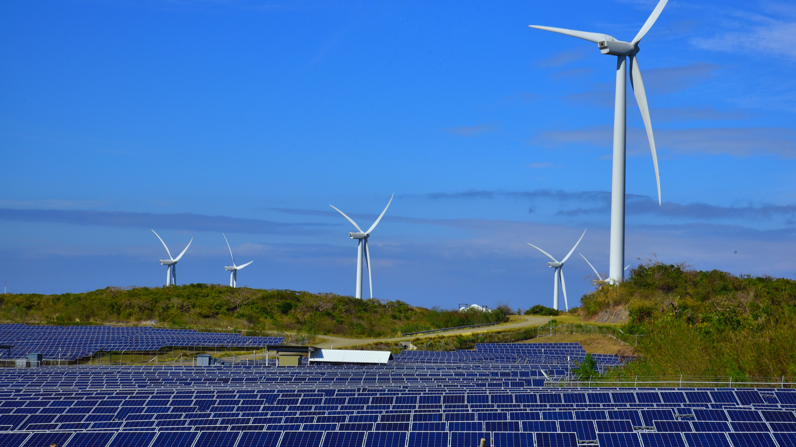
Responsible Financing

Slide 84
Technological Changes (Clean Energy Technologies)
Responsible Financing

Slide 85
Responsible Financing

Slide 86
Technological Changes (Energy Saving Technologies)
Responsible Financing

Slide 87
Responsible Financing

Slide 88
Technological Changes (Clean Transportation)
Responsible Financing

Slide 89
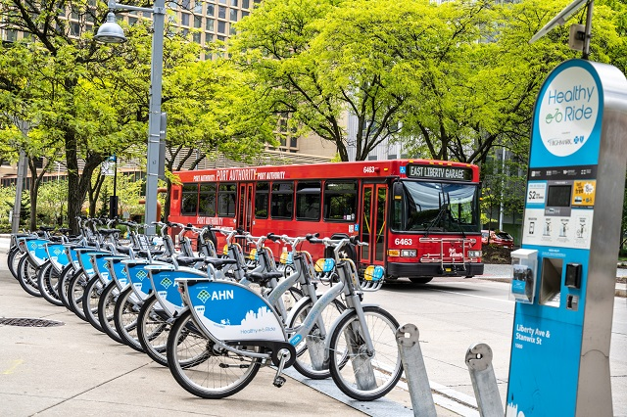
Responsible Financing

Slide 90
Technological Changes (Other Green Technologies)
Responsible Financing

Slide 91
Responsible Financing

Slide 92
Shifting Sentiment (“Brown” Industries TO “Green” Companies)
Responsible Financing

Slide 93
Responsible Financing

Slide 94
Disruptive Business Model
Responsible Financing

Slide 95
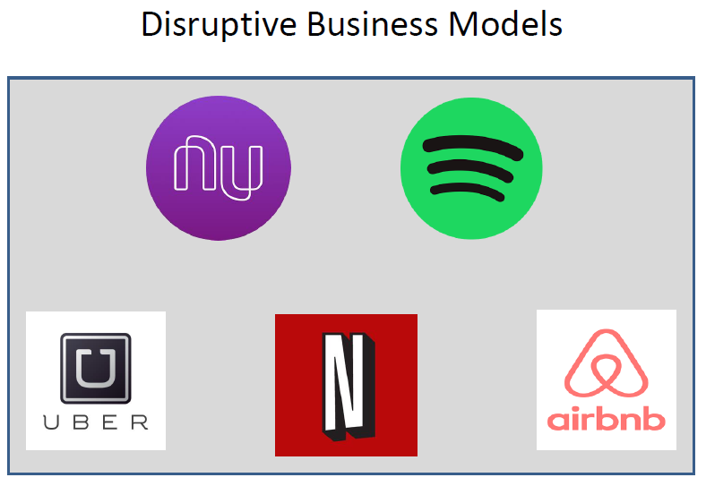
Responsible Financing

Slide 96
Responsible Financing
Way forward for ESG Based Lending in India

Slide 97
Responsible Financing
The Reserve Bank of India has already intimated the interest in laying down “Rules and Regulations” Governing ESG-Based Lending, which will give a Roadmap and Direction to Banks and NBFCs to Follow Norms and Offer benefits while funding Sustainability Projects Linked with ESG Metrics.

Slide 98
Top THREE Banks in the World-Responsible Lending
Responsible Financing

Slide 99
Responsible Banking Pertains to Financial Institutions that prioritize Environmental, Social, and Governance (ESG) Factors in their Operations and Investments.
Responsible Financing

Slide 100
KFW Development Bank-No:1 in the World
Responsible Financing

Slide 101
1.KfW is a German Development Bank Recognized for its Emphasis on Sustainable Finance. 2.The Institution Extends Financial Backing and Assistance to a Diverse Array of Initiatives that further Sustainable Development within Germany and Globally. 3.Concerning Sustainable Finance, KfW Presents an Variety of Products and Services Tailored to Bolster Environmental and Social Sustainability.
Responsible Financing

Slide 102
3.This encompasses funding for Renewable Energy Projects, Energy-efficient Measures, and Sustainable Transport, Alongside initiatives supporting sustainable Urban Growth, Biodiversity Preservation, and Climate Resilience. 4.KfW also Upholds a firm Dedication to Transparency and Responsibility in its Sustainability Practices. 5.The Bank Periodically issues Sustainability Reports that furnish Comprehensive Insights into its Performance Across Dimensions like Carbon Emissions, Resource Utilization, and Engagement with Stakeholders.
Responsible Financing

Slide 103
ING Bank (Netherlands)-No:2 in the World
Responsible Financing

Slide 104
1.ING Bank is a Prominent Financial Institution that Prioritizes sustainability in its Core Strategic Framework. 2.The Institution's Responsible Banking Approach revolves Around three Fundamental Principles: - Diminishing its own Environmental Impact. - Funding Sustainable Economic Endeavors, and - Cultivating a Sustainability-Oriented Ethos. 3.In the Realm of Lessening its Environmental Footprint, ING Bank has Established Ambitious Objectives to Decrease its Carbon Emissions, Advocate for Energy Efficiency, and Transition to a more Sustainable Working Environment.
Responsible Financing

Slide 105
4.To Sponsor Sustainable Economic Ventures, ING Bank provides an Array of Sustainable Financial Solutions, Encompassing Green Bonds and Loans, alongside Guidance and Assistance to Clients aiming to Shift towards a Low-carbon Economy. 5.Beyond its Tangible Initiatives, ING Bank also Fosters a Sustainability-Focused Culture by involving Employees, Clients, and Stakeholders in Discussions on Sustainability Matters and Stimulating Innovation with a Sustainability Focus. 6.Moreover, the Bank Routinely releases Sustainability Reports to ensure Transparency regarding its Performance and Advancement towards Sustainability Targets.
Responsible Financing

Slide 106
ING Bank (Netherlands)-No:2 in the World
Responsible Financing

Slide 107
1.Standard Chartered Bank UK Upholds a Steadfast Dedication to Responsible Banking Practices, Aimed at Harmonizing Financial Performance with Positive Social and Environmental Outcomes. 2.The Bank has outlined Sustainability Objectives such as Curbing Carbon Emissions, funding Renewable Energy Ventures, and Championing Diversity and Inclusivity.
Responsible Financing

Slide 108
3.Moreover, Standard Chartered provides Sustainable Financial instruments like Green Bonds and Impact Investment Products to Facilitate Clients in Transitioning Towards a Low-carbon Economy. 4.Furthermore, the Bank Conducts Sustainability Risk Evaluations for its Lending Operations and Collaborates with Clients to embed Sustainability Considerations into their Business Frameworks.
Responsible Financing

Slide 109
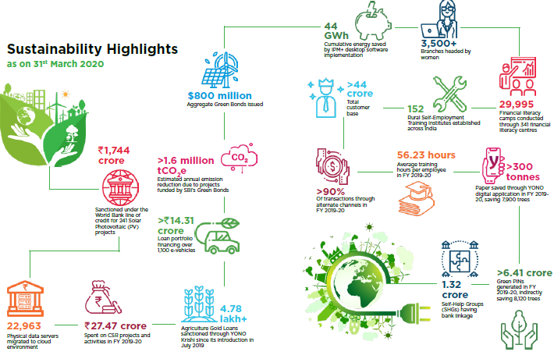
Conclusion
Responsible Financing
GREEN State Bank of India
A

Slide 110
Conclusion
Being a Custodians of People’s Wealth, Banks have a Profound Responsibility to Create Long-term Value for all its Stakeholders BY Incorporating Sustainability and Responsible Business Practices in its Operations.

Slide 111
Conclusion
Environmental Risk Evaluation and Environmental Audit of Credit Proposals.
Like Stock and Book Debts, some of the Banks in the World taking the Services of Professional for “Environmental Risk Evaluation and Environmental Audit” of Credit Proposals of above Certain Threshold Limit of Loan Proposal – Pre and Post Sanction State.
SUGGESTION: If BFSI Board Take up the Matter with RBI / IBA, this may add one more Opportunity to CMAs.

Slide 112
Thank You
CMA (Dr.) P. Siva Rama Prasad
Hyderabad
cma.psrprasad@gmail.com

