Slide 1
CMA (Dr.) P. Siva Rama Prasad M.Com., MBA (Finance)., FCMA., FCS., FIIBF., FIII (Life & General Insurance)., MAIMA., Asst. General Manager (Retd.) State Bank of India Hyderabad
Credit Information Companies
(Redressal Mechanism)

Slide 2
Credit Information Companies (Complaint Redressal)
Credit Rating Report gives an Idea to the Bank about the Credit Worthiness of the Applicant.
Credit Rating Report Reveals the Information to the Bank about Credit Discipline of the Loan Applicant.
Credit Ratings System is Controlling the NPAs of the FIs/Banks.
If Errors are not rectified Genuine Loan Applicants are Unable to Avail Loan Facilities from the Banks / FIs.

Slide 3
Credit Information Companies (Complaint Redressal)
The Credit Information Companies (CICs) Collects Financial Information about all the Individuals and Forms a Credit Report based on their Financial History.
This Credit Report plays a Very Important Role as it helps Banks and other Financial Institutions determine the Creditworthiness of an Individual / Commercial Organizations Applying for a Loan or Credit Card etc. with them.

Slide 4
Credit Information Companies (Complaint Redressal)
Credit Information Companies (CIC) In India:
Credit Information Bureau Limited or CIBIL.
Equifax.
Experian.
High Mark Credit Information Services.

Slide 5
Credit Information Companies (Complaint Redressal)
Credit Information Bureau Limited or CIBIL

Slide 6
Credit Information Companies (Complaint Redressal)
CIBIL: The Credit Information Bureau Limited or CIBIL was founded in the year 2000.
It is also the First Credit Information Company (CIC) of India.
CIBIL Boasts of over 900 Strong Member Base including Public and Private Sector Banks, Non-banking Financial Institutions and Housing Finance Companies.

Slide 7
Credit Information Companies (Complaint Redressal)
CIBIL Collects Commercial and Consumer Finance related Data and Forms a “Credit Report” and CIBIL Commercial Report etc.
The Company also issues a Score Derived from this data known as CIBIL Score.
Any Individual can Purchase a Copy of their CIBIL Report.

Slide 8
Credit Information Companies (Complaint Redressal)
Equifax

Slide 9
Credit Information Companies (Complaint Redressal)
Equifax: Equifax is a CIC that was Founded in the year 1899 in Atlanta.
It is one of the Oldest CIC as of now.
Equifax Got its 'Certificate of Registration' in India’ in the Year 2010 by the Reserve Bank of India.

Slide 10
Credit Information Companies (Complaint Redressal)
The Company has a Separate Bureau dedicated to Address the Growing Lending and Regulatory Needs of the Microfinance Institutions.
The Company Charges a Fee for a Basic Credit Report and a Fee for Credit Score.

Slide 11
Credit Information Companies (Complaint Redressal)
Experian

Slide 12
Credit Information Companies (Complaint Redressal)
Experian: Experian Credit Information Company was established as a Joint Venture with Several Banks and Financial Institutions in India in the Year in 2006.
It was Named as one of the 'World’s Most Innovative Companies' by Forbes Magazine in the Year 2014.

Slide 13
Credit Information Companies (Complaint Redressal)
Experian Prepares Credit Reports of Individuals based on the Information provided by Banks and other Financial Institutions about the Financial History of the Individual.
The Company Charges for a Credit Report and Credit Score while a Credit Report will Charge extra.

Slide 14
Credit Information Companies (Complaint Redressal)
CRIF-High Mark Credit Information Services

Slide 15
Credit Information Companies (Complaint Redressal)
CRIF High Mark Company not only provides Credit Reports to Customers, but also Caters to Borrower Segments such as SME, Commercial Borrowers and Retail borrowers.
It was established in 2005 in Mumbai.
The Company Charges a Nominal Fee for a Credit Report.

Slide 16
Credit Information Companies (Complaint Redressal)
Ratings of CICs

Slide 17
Credit Information Companies (Complaint Redressal)
CIBIL: TransUnion Credit Information Bureau (India) Limited: A CIBIL Score is considered Good if it lies in the Range of 700 and 900.

Slide 18
Credit Information Companies (Complaint Redressal)
Experian: Provide a score from between 0-999 and consider a ‘Good' score to be anywhere between 881 and 960, with ‘Fair' or Average between 721 and 880.

Slide 19
Credit Information Companies (Complaint Redressal)
CRIF High Mark: The Range of Scores provided by CRIF High Mark is 300 to 850, with a Score of 720 or Higher being the Best and a Score of 640 or Less being Subpar.

Slide 20
Credit Information Companies (Complaint Redressal)
Equifax: Equifax Scores Range from 0-700. 380-419 is considered a Fair Score. A Score of 420-465 is considered Good. A Score of 466-700 is considered Excellent.

Slide 21
Credit Information Companies (Complaint Redressal)
Components of a CIBIL Report
(A CIBIL Report Contains Six Main Sections)

Slide 22
Credit Information Companies (Complaint Redressal)
CIBIL Score:
A CIBIL score is a 3-Digit Number that falls in the Range of 300-900.
It is Calculated by the CIBIL Credit Bureau after taking into Consideration Factors such as Credit History and Repayment Behavior.
A CIBIL Score in the Range of 750-900 is considered as a Good CIBIL Score.
A Higher CIBIL Score suggests High Creditworthiness.

Slide 23
Credit Information Companies (Complaint Redressal)
Personal Information:
This Section Contains Personal Information such as Name, Date of Birth, and Unique Identification Numbers like PAN and Aadhaar.
Make Sure that the Personal Details are Accurate in the Report.
These Details are Reported to the Bureau by the Bank.

Slide 24
Credit Information Companies (Complaint Redressal)
Contact Information:
This Section will have Mobile Number, Telephone Number, Residential Address, and Email Address.

Slide 25
Credit Information Companies (Complaint Redressal)
Employment Information:
This Section of the CIBIL Report contains Employment Information.
It will specify the Type of Occupation such as Salaried, Professional, or Business.
It will also mention Monthly or Annual Income as Reported by Banks.

Slide 26
Credit Information Companies (Complaint Redressal)
Account Information:
This is the Most Important Section of CIBIL Report as it Contains Records of Credit Accounts.
It will mention the Loans and Credit Cards Taken.
The Report will also mention the Lenders’ Names and Loan Amounts.
The Report will Record Defaults, Late Payments, Amount Overdue, Current Balance, Date Opened, and Date of Last Payment.

Slide 27
Credit Information Companies (Complaint Redressal)
Account Information:
It contains a Month-on-Month Record of Payments toward Loan EMIs as well as Credit Card Bills for up to the last 3 years.
Ensure that the Loan Details reflected in the Account are Accurate.
Discrepancies in Credit Report can reduce Chances of getting Loan Approval.

Slide 28
Credit Information Companies (Complaint Redressal)
Enquiry Information:
This Section Records all the Enquiries made by Lenders in the Past.
An Enquiry takes place when a Lender Pulls out CIBIL Report from the Bureau to Check Creditworthiness.
The Date and Purpose of the Enquiry is also mentioned in the report.

Slide 29
Credit Information Companies (Complaint Redressal)
Enquiry Information:
The Enquiry Amount is also recorded in the report.
It is Advised to Avoid Making Multiple Credit Enquiries in a Short Span of Time as it may Trigger Hard Enquiries from Lenders, making appear Credit Hungry.

Slide 30
Credit Information Companies (Complaint Redressal)
Key Terms and Keywords - CIBIL Report

Slide 31
Credit Information Companies (Complaint Redressal)
A CIBIL report is a Summary of Detailed Credit Behaviour.
It Consists of Various Sections that offer Detailed Information ranging from Personal Information, Home or Auto Loan availed, Overdraft Facilities, Personal Loan, and much more.

Slide 32
Credit Information Companies (Complaint Redressal)
In Addition, the CIBIL Report Consists of CIBIL Score and History.
There are Several Key Terms and Keywords that are present in CIBIL Report that will help to understand the Report in a Better Way.

Slide 33
Credit Information Companies (Complaint Redressal)
Cash Limit: Cash Limit refers to the Amount of Cash on Credit Card that are Allowed to Use.
Amount Overdue: It indicates the Total Amount that has not been paid to the Lender in a Specific Time.

Slide 34
Credit Information Companies (Complaint Redressal)
NA/NH: NA means No Activity while NH means No History.
This means No Credit History or not even a Credit History to Get Scored. The NA/NH term also means No Credit Activity for a Couple of Years. Finally, it also Suggests that not have any Add-on Credit Cards and have No Credit Exposure.

Slide 35
Credit Information Companies (Complaint Redressal)
DPD: Days Past Due refers to the Number of Days that have passed since the Due Date of the Payment. It must be noted that anything over zero or even ‘Standard’ is Bad.

Slide 36
Credit Information Companies (Complaint Redressal)
Written-Off Amount: When a Loan is Written-off there is an Interest and Principal Component. This Field Reflects the Total Interest and Principal amount Written-off.

Slide 37
Credit Information Companies (Complaint Redressal)
Written-Off and Settled Status: If the Status of an Account is mentioned as written-off, it implies that the Borrower was Unable to Pay the outstanding dues for More than 180 Days and as a result, the Lender has Written off the Unpaid Dues. If the Status of an Account is mentioned as Settled, it implies that, the Borrower in Consent with the Lender, has Partly Paid the Dues against the Total Outstanding Amount.

Slide 38
Credit Information Companies (Complaint Redressal)
SMA: Special Mention Account refers to a Special Account created for reporting a Standard Account that is Moving towards a Sub-standard.

Slide 39
Credit Information Companies (Complaint Redressal)
CN: Control Number Acts as a Reference Number in case there is Some Incorrect Information in the credit report. It is presented at the top of the document.

Slide 40
Credit Information Companies (Complaint Redressal)
Repayment Tenure: It refers to the Term of Loan. In order to Understand it Accurately, Repayment Tenure should be read with ‘Payment Frequency’.

Slide 41
Credit Information Companies (Complaint Redressal)
SUB: Sub-standard refers to Accounts (Loan/Credit Card) Payments that are made After 90 Days.

Slide 42
Credit Information Companies (Complaint Redressal)
LSS: It Refers to the Account where the Loss has been Identified and remains uncollectible.

Slide 43
Credit Information Companies (Complaint Redressal)
DBT: It means an Account that has Continued to Remain in the Sub-standard Account status for 12 months.

Slide 44
Credit Information Companies (Complaint Redressal)
Actual Payment Amount: It is the Amount Paid the Lender if it is Different from the EMI Amount. The Actual Payment Amount can be Higher or Lower than the EMI Amount.

Slide 45
Credit Information Companies (Complaint Redressal)
Current Balance: It Refers to the Amount that Still Owe on a Certain Credit Facility.

Slide 46
Credit Information Companies (Complaint Redressal)
STD: This entry is Termed as (Standard) and is found against Loan/Credit Card Accounts, if the Credit Payments are made in a Timely Manner, or within 90 Days from the Due Date.

Slide 47
Credit Information Companies (Complaint Redressal)
Factors Considered for Credit Score by CICs

Slide 48
Credit Information Companies (Complaint Redressal)
A CIBIL Score is made up of four main factors. Each factor has a different weightage. The factors and how they can affect CIBIL Score.
Payment History | 30%
Credit Exposure | 25%
Credit Type and Duration | 25%
Other Factors | 20%

Slide 49
Credit Information Companies (Complaint Redressal)
Payment History – 30%

Slide 50
Credit Information Companies (Complaint Redressal)
Payment History:
In order to maintain a High Score, to be prompt with monthly credit card bill payments as well as loan EMIs of various Loans.
If delaying payments or are defaulting on EMIs, it will hamper score.
Irregular payment behaviour also effects the Score.

Slide 51
Credit Information Companies (Complaint Redressal)
Payment History:
A Recent CIBIL Analysis (Reported by the Financial Express) revealed that 30-days (SMA-0, SMA-1 and SMA-2) Delinquency can Reduce Score by 100 Points.

Slide 52
Credit Information Companies (Complaint Redressal)
Credit Exposure – 25%

Slide 53
Credit Information Companies (Complaint Redressal)
Credit Utilization Ratio / Credit Exposure:
Having a Loan or Multiple Credit Cards Does Not Negatively Impact CIBIL Score.
However, if Credit Utilization Ratio is High, it will bring Score Down.
Ideally, should only Spend Up to 30% of Credit Limit (OD/CC/CREDIT CARE).

Slide 54
Credit Information Companies (Complaint Redressal)
Credit Utilization Ratio / Credit Exposure:
A Higher Credit Utilization Ratio increasing Debt and are likely to turn into a Defaulter.
Therefore, it is Advised to keep a Tab on Credit Expenses and make Sure Not Maxing out Limit.

Slide 55
Credit Information Companies (Complaint Redressal)
Credit Type and Duration – 25%

Slide 56
Credit Information Companies (Complaint Redressal)
Credit Type and Duration:
The Age of Credit History is the Number of Years that have passed since opened First Credit Account.
CIBIL Considers the Average Number of Years for which holding a Credit Account.
Having a Good Balance of Secured (Car or Home) Loans as well as Unsecured (Credit Card) loans helps to Boost Score.

Slide 57
Credit Information Companies (Complaint Redressal)
Credit Type and Duration:
When a Healthy Credit Mix, it suggests that have Good Experience in handling Different Types of Accounts.
A Long Credit History with Good Repayment Behaviour makes a Low-risk Borrower.
It is better to start building Credit History at an Early Stage as it will be helpful later at the time when Planning to Buy a House or a Car.

Slide 58
Credit Information Companies (Complaint Redressal)
Other Factors – 20%

Slide 59
Credit Information Companies (Complaint Redressal)
Other Factors:
A Credit Inquiry is Another Factor that is Considered while Calculating Score. Every Time Apply for a Loan or a Credit Card, the Lender will Check Credit Report.
This is called a Hard Inquiry. If make Multiple Credit Requests within a Short Period, it will bring Score Down.
Therefore, it is advised to Spread Credit Applications throughout the Year instead of making them all at once.

Slide 60
Credit Information Companies (Complaint Redressal)
Calculation of CIBIL Score

Slide 61
Credit Information Companies (Complaint Redressal)
A CIBIL Score is a Numeric Summary of Credit History that is calculated based on the following:
Track Record of Past Payments.
Previous Settlements, Defaults, Write-offs.
Loans as Proportion of Income.
Secured Loans vs. Unsecured Loans and Credit Cards.
Loan Equities.

Slide 62
Credit Information Companies (Complaint Redressal)
Track Record of Past Payments | Record of all Past Re-payments. Consistently Making Payments On Time leads to a Higher Score. Delayed Payments Lead to a Lower Score. Recent Delayed Payments make a more Negative Impact.

Slide 63
Credit Information Companies (Complaint Redressal)
Previous Settlements, Defaults, Write-offs | Recent Write-offs impact more Negatively than Older Ones. Multiple Write-offs lead to Lower Score. Write-offs Documented by Lenders on Previous Debts Lower Score. Delays or Defaults on Secured Loan Repayments Impact more Negatively than Unsecured Loans.

Slide 64
Credit Information Companies (Complaint Redressal)
Loans as Proportion of Income | Low Loan Balance Indicative of Healthy Credit Usage and thus Higher Score. High Loan Balance Reduces Score.

Slide 65
Credit Information Companies (Complaint Redressal)
Secured Loans vs. Unsecured Loans and Credit Cards | High Credit Card Balances Lower Score. Reliance on Unsecured Loans (Credit Cards) over Secured Loans Viewed Negatively. Lesser Number of such Accounts Coupled with Frequent Payment History Pushes Up-Score.

Slide 66
Credit Information Companies (Complaint Redressal)
Loan Equities | Many Loan Enquiries to Avail Loans Indicative of “Credit Hungry” Behaviour, Negatively Impacts Score.

Slide 67
Credit Information Companies (Complaint Redressal)
“Rectification of Errors” in CIBIL Report
(Process)

Slide 68
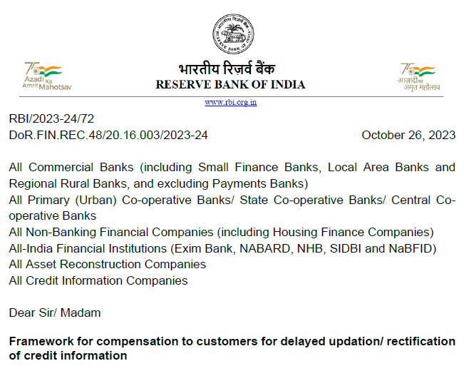
Credit Information Companies (Complaint Redressal)

Slide 69
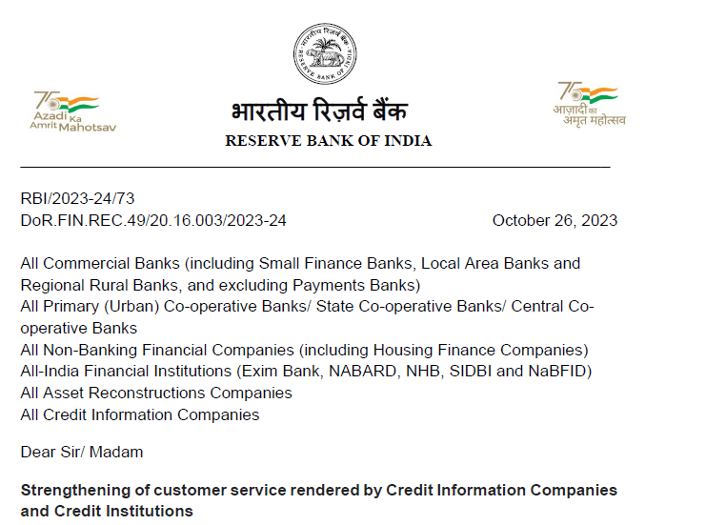
Credit Information Companies (Complaint Redressal)

Slide 70
Credit Information Companies (Complaint Redressal)
In Exercise of the Powers Conferred by Sub-section (1) of Section 11 of the Credit Information Companies (Regulation) Act, 2005 (CICRA, 2005), the Reserve Bank of India Directs Credit Information Companies (CICs) and Credit Institutions (CIs) to implement the Compensation Framework for Delayed Updation/Rectification of credit information by CIs and CICs.

Slide 71
Credit Information Companies (Complaint Redressal)
Complainants shall be Entitled to a Compensation of ₹100 per Calendar Day in Case their Complaint is Not Resolved within a period of thirty (30) Calendar Days from the Date of the Initial Filing of the Complaint by the Complainant with a CI/ CIC.

Slide 72
Credit Information Companies (Complaint Redressal)
Section 21 (3) of Credit Information Companies (Regulation) Act, 2005 (CICRA, 2005) provides that a Complainant may request a CIC or CI to update the Credit Information by making an Appropriate Correction, Addition or Otherwise, and on such request the CI or CIC shall Take Steps to Update the Credit Information Within Thirty (30) Days after being Requested to do So.

Slide 73
Credit Information Companies (Complaint Redressal)
Rule 20 (3) (c) of CIC Rules, 2006 provides that the CI shall forward the Corrected Particulars of the Credit Information to the CIC or Complainant within a Period of Twenty-one (21) Days from the Date when the CI was informed of the Inaccuracy in the Credit Information.

Slide 74
Credit Information Companies (Complaint Redressal)
The Combined Reading of Section 21(3) of CICRA, 2005 and Rule 20 (3) (c) of Credit Information Companies Rules, 2006 provide the CI and the CIC, Collectively, an Overall Limit of Thirty (30) Days to Resolve/ Dispose of the Complaint.
In effect, this would mean that a CI would get Twenty-one (21) Days and CICs would Effectively get the Remainder of Nine (9) days for Complete Resolution of the Complaint.

Slide 75
Credit Information Companies (Complaint Redressal)
A CI shall Pay Compensation to the Complainant if the CI has failed to Send Updated Credit Information to the CICs by making an Appropriate Correction or Addition or Otherwise Within Twenty-one (21) Calendar Days of being informed by the Complainant or a CIC.

Slide 76
Credit Information Companies (Complaint Redressal)
A CIC shall Pay Compensation to the Complainant if the CIC has Failed to Resolve the Complaint Within Thirty (30) Calendar Days of being informed by the Complainant or a CI, Despite the CI having Furnished the Updated Credit Information to the CIC within Twenty-one (21) Calendar Days of being informed by the Complainant or the CIC.

Slide 77
Credit Information Companies (Complaint Redressal)
The Complainant shall be Advised by the CI/ CIC of the Action taken on the Complaint in All Cases, including the Cases where the Complaint has been Rejected.
In cases of Rejection, the Reasons for Rejection shall also be provided By CI and CIC to the Complainant.

Slide 78
Credit Information Companies (Complaint Redressal)
Where the Grievance / Complaint involves Inaccurate Credit Information Provided by More than One CI, the Complaint shall be Registered by the Complainant with the Concerned CIC.
The CIC shall Co-ordinate with all the CIs Concerned and furnish the Complainant with a Comprehensive Resolution of the Grievance.

Slide 79
Credit Information Companies (Complaint Redressal)
Where the Complaint has been Received and Registered by a CIC and there has been a Delay in the Resolution of the Complaint, the CIC shall inform the Concerned CI(s) and the Complainant after the Final Resolution, regarding Total Delay (in Calendar Days) and the Amount of Compensation To Be paid by the CI(s) and/ or CIC.

Slide 80
Credit Information Companies (Complaint Redressal)
Where the Complaint has been Received and Registered By a CI and there has been a Delay in the Resolution of the Complaint, the CI Shall Inform the Concerned CIC(s) and the Complainant after the Final Resolution, regarding Total Delay (in Calendar Days) and the Amount of Compensation to be Paid by the CI and/ or CIC(s).

Slide 81
Credit Information Companies (Complaint Redressal)
The Date of the Resolution of the Grievance shall be the Date when the Rectified Credit Information Report (CIR) has been sent by the CIC or CI to the Postal Address or Email ID provided by the Complainant.

Slide 82
Credit Information Companies (Complaint Redressal)
The CICs/ CIs shall make Appropriate Provision in their Complaint Submission Format (Both Online and Offline) for enabling the Complainant to Submit the Contact Details, Email ID, and Bank Account Details / Unified Payment Interface (UPI) ID For Crediting the Compensation Amount.
The Onus of Providing Accurate Details will lie with the Complainant and the CIs/ CICs will not be held responsible for any incorrect information provided by the complainant.

Slide 83
Credit Information Companies (Complaint Redressal)
The Compensation Amount shall be Credited to the Bank Account of the Complainant within Five (5) Working Days of the Resolution of the Complaint.

Slide 84
Credit Information Companies (Complaint Redressal)
The Complainant can Approach RBI Ombudsman, under the Reserve Bank - Integrated Ombudsman Scheme, 2021, in case of Wrongful Denial of Compensation by CIs or CICs.
Compensation Frame work to be implemented within 6 Months(April, 2024).

Slide 85
Credit Information Companies (Complaint Redressal)
How to Initiate a Dispute
Step 1:
If Individual have An Account with CIBIL, Login to CIBIL Dashboard.
Or, If Individual have received a Copy of CIBIL Report from One of Partners of CIBIL or any Other Bank / Financial Institutions, Individual can Signup for a Free Annual Credit Report.

Slide 86
Credit Information Companies (Complaint Redressal)
Step 2:
Before Initiating a Dispute, Login to Refresh CIBIL Score & Report.
This Ensures Individual referring to Latest updated Report to Reduce Incorrect Disputes.

Slide 87
Credit Information Companies (Complaint Redressal)
Step 3:
Complete the Dispute Request Form.
Individual can Raise Multiple Dispute Requests at a Time.

Slide 88
Credit Information Companies (Complaint Redressal)
Step 4:
Await the Banks / Financial Institutions Response.
Rest assured CIBIL Diligently follow-up with the Reporting Lenders, however Typical Processing Time may take upto 30 days.

Slide 89
Credit Information Companies (Complaint Redressal)
Complainant to be mentioned the Following Information:
Name of the Borrower:
PAN Card:
Aadhar Card:
Account Number of the Loan:
Name of the Bank:
Address of the Bank Branch:
Branch Code Number:
No Dues Certificate-Given at the Time of Closure:
Account Statement-At the Time of Account Closure.

Slide 90
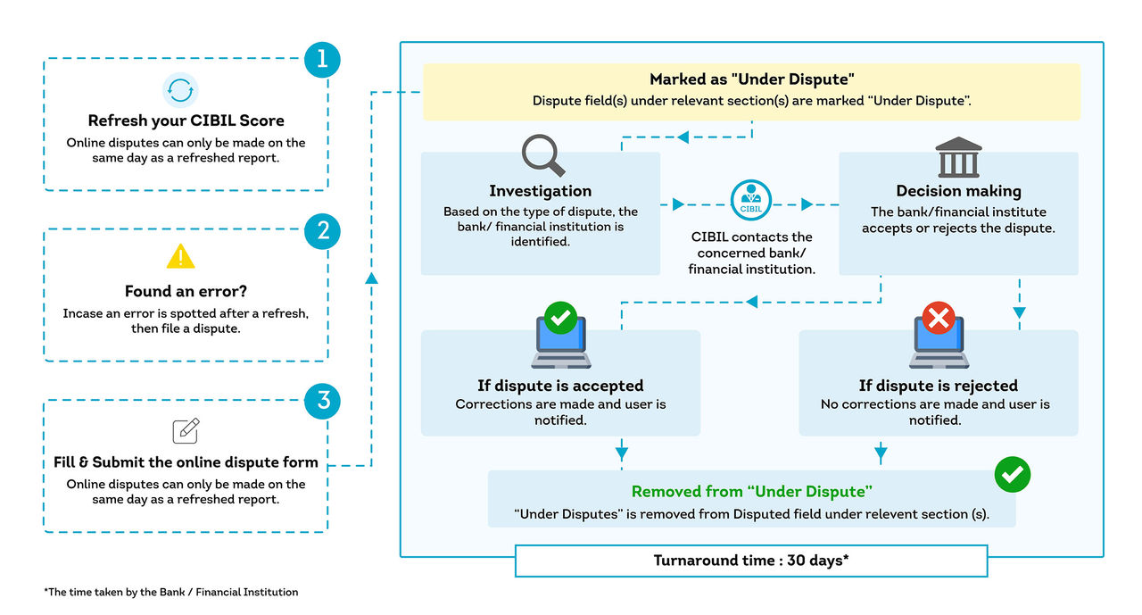
Credit Information Companies (Complaint Redressal)

Slide 91
Credit Information Companies (Complaint Redressal)
Alternatively, Raise a Dispute by Writing to this Address:
TransUnion CIBIL Limited,
One World Center,
Tower 2,
19th Floor,
Senapati Bapat Marg, Elphinstone Road,
Mumbai - 400 013

Slide 92
Credit Information Companies (Complaint Redressal)
Consumer Helpline Number: 022-61404300.
Timings [Monday- Friday]: 10:00 am to 06:00 pm.
Principal Nodal Officer: Mr. N Pohare.
Address: TransUnion CIBIL Limited, One World Centre, Tower 2A, 19th Floor, Senapati Bapat Marg, Elphinstone Road, Mumbai - 400013.
Email Id: nodalofficer@transunion.com

Slide 93
Credit Information Companies (Complaint Redressal)
RBI Notification Paves the Way for “Specified Users”

Slide 94
CMA / CS (Dr.) P. Siva Rama Prasad M.Com., MBA (Finance)., FCMA., FCS., FIIBF., FIII (Life & General Insurance)., MAIMA., Former Asst. General Manager State Bank of India Hyderabad
THANK YOU

