Slide 1



SAP Asset Accounting Part 1
By: CMA Jayesh P Desai
14 Mar 2020

Slide 2

About
Worked on SAP since 1997 as end-user, core team member, consultant and delivery manager
End-user experience in SAP FI (AP, AR, GL, AA), SAP CO (CCA, PC, PA,PCA)
Implemented 4 projects in SAP FICO with integration
Specialised in Product Costing, Profitability Analysis
Delivered on several large and global SAP & Data Analytics projects
Head SAP Team (all modules), Head Data Analytics
Worked with General Motors, Shaw Wallace, Bayer, Colgate, IBM, General Mills
CMA Jayesh P Desai
FCMA, CFA, CISA
CIA, PMP, UCLA (PGPX)
Registered Valuer (IBBI)
Jayesh P Desai & Co.
www.jayeshdesai.com
Jayeshdesai@rediffmail.com

Slide 3

Content
Asset Accounting
  AW01N – Asset Explorer
  Asset Master
  Asset Class
  Account Determination
  Chart of Depreciation
  Depreciation Area
“SAP” is a trademark of SAP AG, Neurottstrasse 16, 69190 Walldorf, Germany. SAP AG is not the publisher of this material and is not responsible for any inaccuracy.

Slide 4


Slide 5
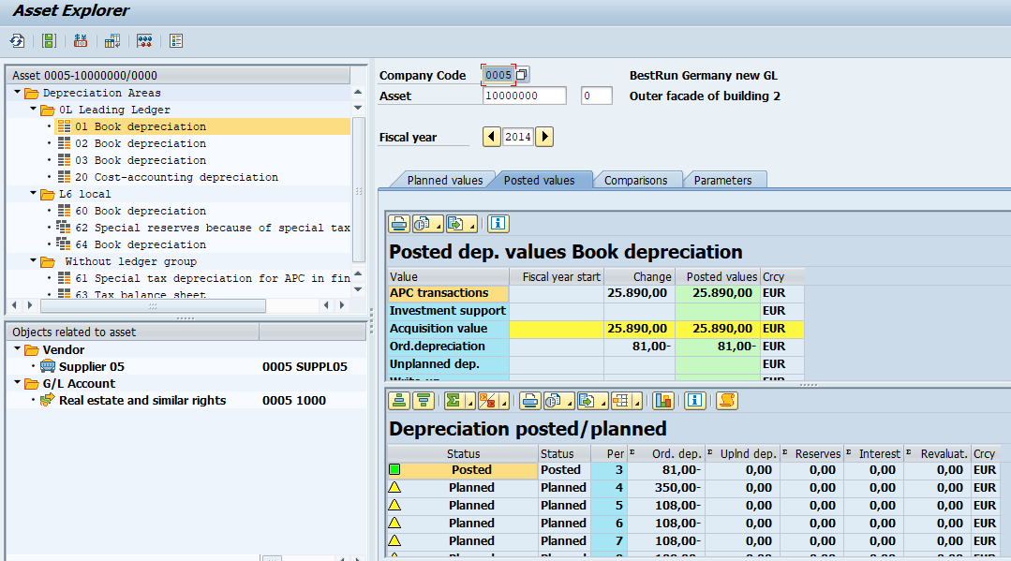
Asset Explorer – AW10N

Slide 6
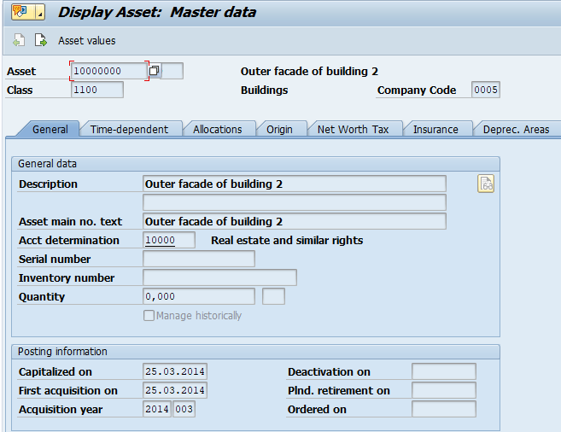
Asset Master AS03

Slide 7
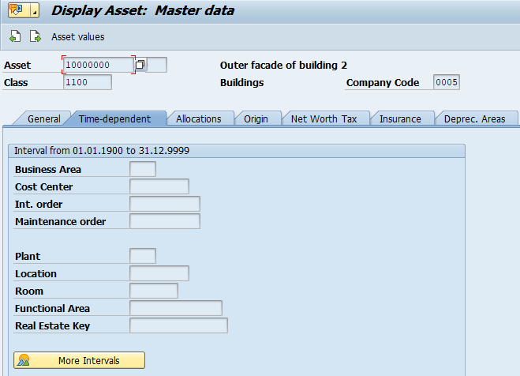
Asset Master

Slide 8
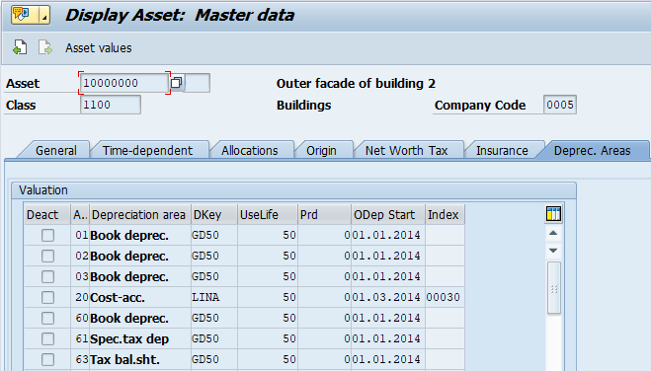
Asset Master

Slide 9
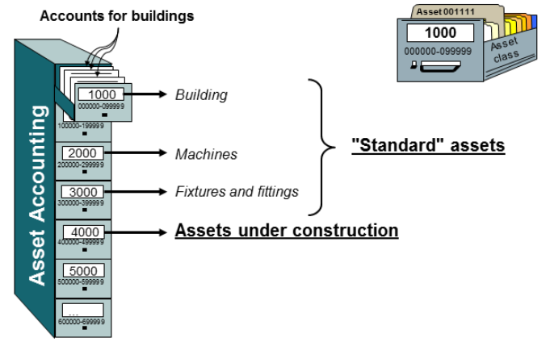
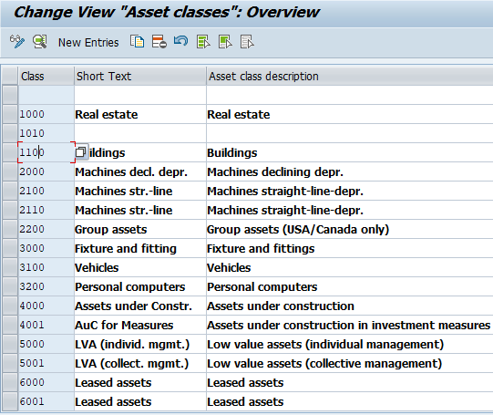
Asset Class

Slide 10
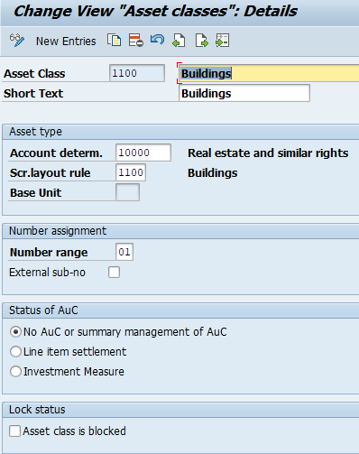
Asset CLass

Slide 11
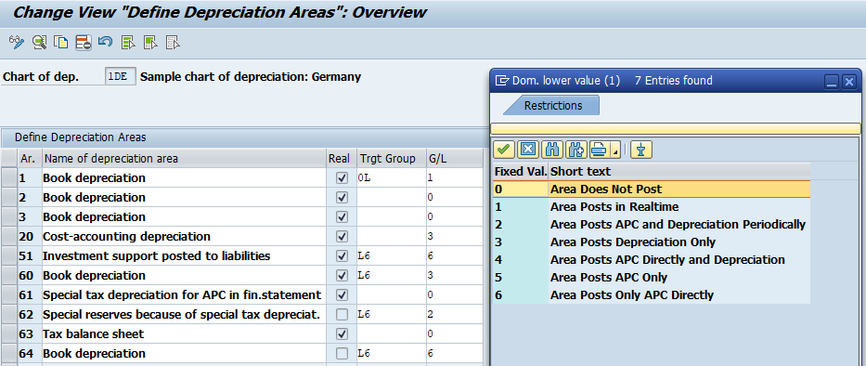
Depreciation Area

Slide 12
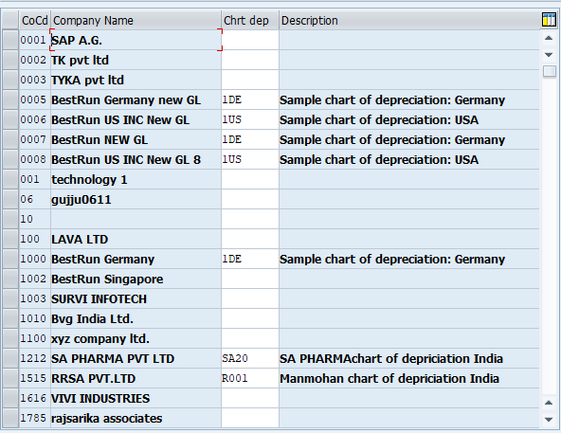
Chart of Depreciation

Slide 13

Thanks!
Jayesh P Desai & Co.
www.jayeshdesai.com
Jayeshdesai@rediffmail.com

