Slide 1
Module Objectives
Upon completing this module, you will be able to:
Understand the concepts of Goods Issue
Understand the differences between planned & unplanned goods issue movements
Demo on Goods Issue scenarios
1
Notes:
Key Message(s):
To learn to create and use reservation , list of reservations in various goods movement processes.

Slide 2
Agenda
Overview and Conceptual understanding of Goods Issue Process
Demo on Goods Issue scenarios
Notes:
Topic Duration:

Slide 3
Agenda
Overview and Conceptual understanding of Goods Issue Process
Demo on Goods Issue scenarios
Notes:
Topic Duration:

Slide 4
Overview of Goods Issue
Definitions:
Goods Movement: A physical or logical movement of materials leading to a change in stock levels or resulting in the consumption of the material.
Goods Issue: A reduction in warehouse stock due to a withdrawal of stock or the delivery of goods to a customer.
Movement Type: The movement type in SAP R/3 system is a three digit key used to differentiate between goods movements.
Examples of such goods movements are goods receipts, goods issues, or transfer posting.
Notes:
Key Message(s):
The above slide gives an pictorial representation of hierarchy in MM organization structure.

Slide 5
Overview of Goods Issue
Goods Issue (GI) is a type of goods movement with which the materials are issued from the warehouse.
Goods Issue leads to a decrease in warehouse stock.
Stock is updated real time at the time of posting of goods Issue.
Accounting document is created if the goods movement is relevant for accounting.
Notes:
Key Message(s):
The above slide gives an pictorial representation of hierarchy in MM organization structure.

Slide 6
Overview of Goods Issue
Features:
The Inventory Management system supports the following types of goods issues:
Withdrawal of material for production orders
Scrapping and withdrawal of material for sampling
Return deliveries to vendors
Other types of internal staging of material
Deliveries to vendors without the involvement of the SD Shipping component

Slide 7
Overview of Goods Issue
Planned Goods Issue (for Reservation/Order)
With this type of withdrawal, the system automatically creates a reservation for the components planned in the order. When you enter the goods issue, you can reference the order or the reservation and the system determines all components to be withdrawn.
Unplanned Goods Issue
With this type of withdrawal, it is determined during the production process that an additional material or an additional quantity of a component already withdrawn is required for an order. This withdrawal is unplanned because there is no reservation to be referenced. You enter this withdrawal as a goods issue without reference.

Slide 8
Overview of Goods Issue
Goods Issue with Reference
System will create reservations automatically from the work order/ network orders based upon the business scenarios. User can refer this reservation while posting the goods issue so that all the data is copied from the reservation to the system.
Alternatively, user can create a reservation for goods issue with all the relevant data which can be later used for posting goods issue from the warehouse.

Slide 9
Overview of Goods Issue
Goods Issue Without Reference
While posting the goods issue without reference, we need to manually input the details such as Document date, Posting date, material number, Quantity, movement types, Account assignment details, Plant, storage location etc.
When the goods issue document is posted, system creates a material document and accounting document only if the goods movement is relevant for accounting.

Slide 10
Overview of Goods Issue
Some of the commonly used movement types for Goods Issue are as below:
Note: Material documents with movement types 543, 601, 641, 643 etc. will be automatically created by the system based upon the scenario.
Movement Type | Description
201 | Goods issue for a cost center
221 | Goods issue for a project
261 | Goods issue for an order
281 | Goods issue for a network
551 | Scrapping from unrestricted-use stock
601 | Goods Issue for Delivery (Shipping)
641 | Goods issue for a stock transport order (Shipping)
643 | Goods issue for a cross-company stock transport order (Shipping)

Slide 11
Overview of Goods Issue
Results of a Goods Issue Posting
A goods issue has the following results in the system:
Material document is created
Accounting document is created (if the goods movement is relevant for accounting)
Goods receipt/issue slip is created
Stock update
Update of G/L accounts
Consumption update
Reservation update
Order update
Transfer requirement is created when the Warehouse Management System is connected
Inspection lot is created when QM is connected

Slide 12
Overview of Goods Issue
Creation of a Material Document
When you post a goods issue, the system automatically creates a material document which serves as proof of the goods movement.
Creation of an Accounting Document
Parallel to the material document, the system creates an accounting document. The accounting document contains the posting lines (for the corresponding accounts) that are necessary for the movement.
Note: From the screen displaying the material document, you can display the accounting document.

Slide 13
Overview of Goods Issue
Creation of a Goods Receipt/Issue Slip
When you enter the goods issue, you can print the goods issue slip at the same time.
Stock Update
The following stocks are reduced by the issued quantity:
Total valuated stock
Unrestricted-use stock
Reserved stock if the goods issue is entered with reference to a reservation or an order.
The stocks are updated both at plant level and at storage location level.

Slide 14
Overview of Goods Issue
Update of G/L Accounts
When the goods issue is posted, the system automatically creates posting lines on the accounts of the accounting system.
Consumption Update
In addition to causing an inventory update in the material master record, a goods issue posting causes an update of the consumption statistics if the material is planned with MRP.
You can see the consumption statistics when you display plant stock availability or the material master record.

Slide 15
Overview of Goods Issue
Reservation Update
With a goods issue that references a reservation or a sales order, the quantity withdrawn is updated in the reservation item. The reservation item is completed when the total reservation quantity has been withdrawn or when the final issue indicator is set manually at goods issue.
Order Update
In the case of a goods issue with reference to an order, the quantities withdrawn for the components are updated in the order.
Update in Other Applications
Updates can also occur in other related applications.
For example, In the case of a goods issue for internal consumption the point of
consumption (such as cost center, order, asset) is debited.

Slide 16
Overview of Goods Issue
Creation of a Transfer Requirement when the Warehouse Management System is Connected
If the storage location is managed with the Warehouse Management system, the goods issue posting creates a quant at the goods issue interim storage area, as well as a transfer requirement, which starts an action in the Warehouse Management system.
Creation of an Inspection Lot When QM is Connected
If inspection processing is active in the Quality Management system (QM), an inspection lot is created at the time of goods issue. The Quality Management system uses this inspection lot to carry out the inspection.

Slide 17
Purpose
Entering Material for Scrapping
Purpose
You might scrap a material if you cannot use it any more, for example because:
the quality has been reduced due to long storage time
it is out of date
the material has been destroyed (for example, a container of crystal glasses falls off the forklift during transport). You have to enter this as a scrapping.
In the SAP System, you post a scrapping like a goods issue without reference.
Scope of Functions
You can scrap materials from the stock types below:
Unrestricted-use stock
Quality inspection stock
Blocked stock

Slide 18
Overview of Goods Issue
A scrapping has the following results in the system:
the relevant stock is reduced
the value of the scrapped material is posted from the stock account to a scrap account
the costs of the scrapped material are assigned to the cost center specified. The value is picked from the material master record at the time of the posting.
Activities
From the Inventory Management menu, choose Goods movement→ Goods issue and post the scrapping using the required movement type

Slide 19
Overview of Goods Issue
Goods Issue documents can be posted by using the below transactions and will be controlled in the configuration of movement types:
MB1A
MB11
MIGO

Slide 20
Accounting entries for Goods Issue
The financial entries will be posted once the goods issue is done and accounting document will be posted
Brief overview of accounting postings for some scenarios:
Scenario | Debit | Credit
Goods Issue for sales order | Cost of goods sold GBB-VAX | Inventory Account-BSX
Physical Inventory - movement type 701 | Inventory Account-BSX | income from inventory differences GBB-INV
Physical Inventory - movement type 702 | for Expenditure from inventory differences - GBB-INV | Inventory Account-BSX
Internal Goods issue to Cost center | GBB-VBR | Inventory Account-BSX
Scrapping | GBB-VNG | Inventory Account-BSX

Slide 21
Agenda
Overview and Conceptual understanding of Goods Issue Process
Demo on Goods Issue scenarios
Notes:
Topic Duration:

Slide 22
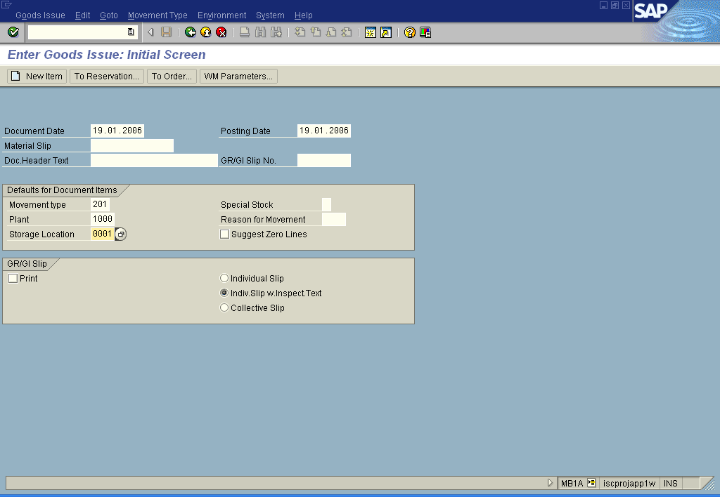
Demo1_Goods Issue_ Without Reference
Objective | To post a Goods issue against a cost center , T.code: MB1A/ MB11
Notes:
Key Message(s):
.

Slide 23
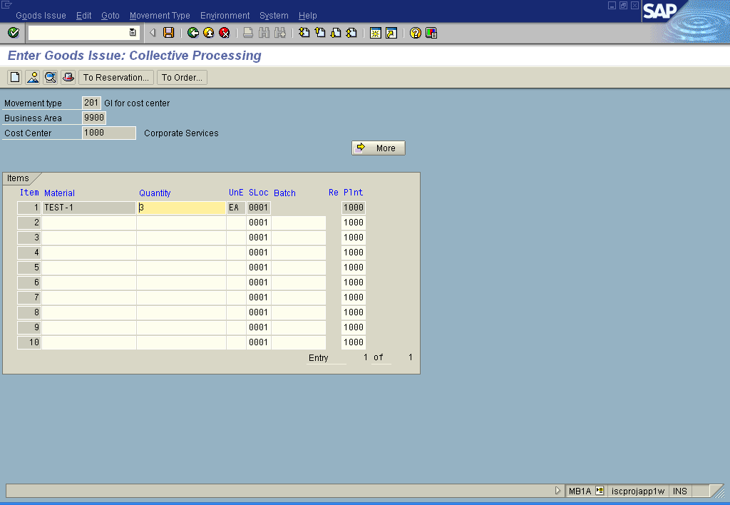
Demo1_Goods Issue_ Without Reference
Objective | To post a Goods issue
Notes:
Key Message(s):
.

Slide 24
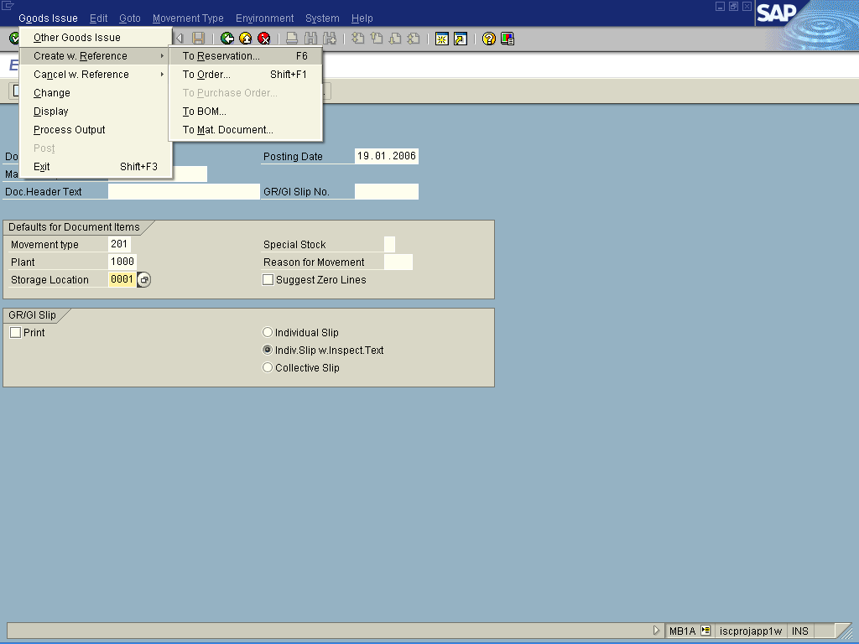
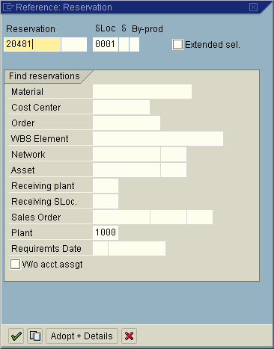
Demo2_Goods Issue _ With Reference to Reservation
Objective | To post a Goods Issue With reference To Reservation
Notes:
Key Message(s):
.

Slide 25
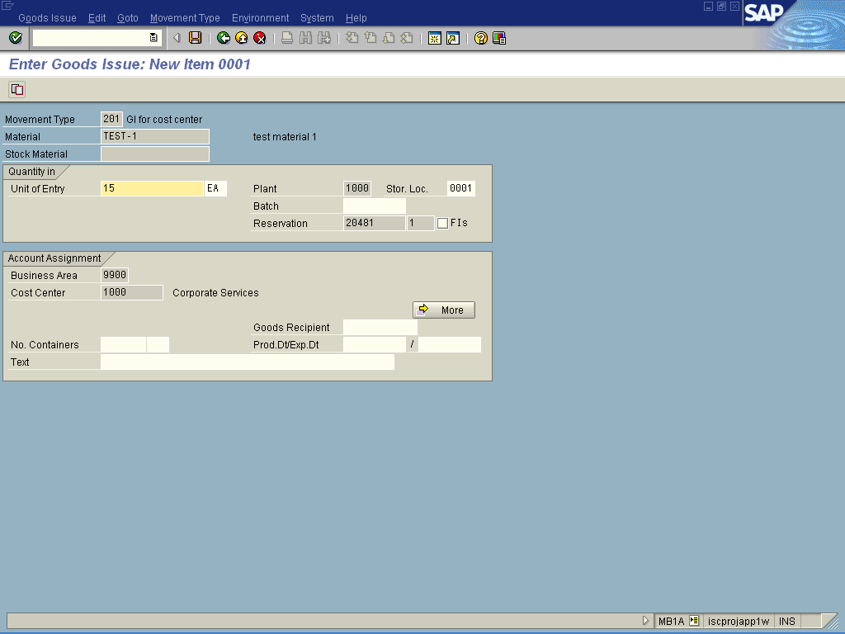
Demo2_Goods Issue _ With Reference to Reservation
Objective | Goods Issue With reference To Reservation
Notes:
Key Message(s):
.

Slide 26
Quiz/Check point
Questions/Discussions :
What are effects of goods issue?
Notes:
Key Messages:
Discuss with the participants and list the answers on a flip chart.
Spend 15 minutes on this discussion,

Slide 27
Questions and Comments
What questions or comments do you have?
Notes:
Key Message:
Ask participants for any questions or comments they may have.

