Slide 1
Module Objectives
Upon completing this module, you will be able to:
Understand the concept of Goods receipt
Overview of various types of Goods Receipt scenarios
Other goods receipts.
Demo on Goods Receipt scenarios.
1
Notes:
Key Message(s):
To learn to create and use reservation , list of reservations in various goods movement processes.

Slide 2
Agenda
Concept of Goods receipt process
Overview of various types of Goods Receipt scenarios
Other goods receipts.
Demo on Goods Receipt scenarios.
Notes:
Topic Duration:

Slide 3
Agenda
Concept of Goods receipt process
Overview of various types of Goods Receipt scenarios
Other goods receipts.
Demo on Goods Receipt scenarios.
Notes:
Topic Duration:

Slide 4
Goods Receipt
A Goods Receipt (GR) is a goods movement with which the receipt of goods
from a vendor or from production is posted.
A goods receipt leads to an increase in warehouse stock.
All transactions that bring about a change in stock are entered real time in SAP
R/3.
Stock is updated real time at the time of posting of a goods receipt.
Goods receipts are processed against the open purchase order quantity.
The open purchase order quantity is the quantity still to be delivered for an
ordered item. It is calculated as the difference between the quantity ordered
and the quantity delivered to date.
The movement type in SAP R/3 system is a three digit key used to differentiate
between goods movements. Examples of such goods movements are goods
receipts, goods issues, or transfer posting.
Notes:
Key Message(s):
The above slide gives an pictorial representation of hierarchy in MM organization structure.

Slide 5
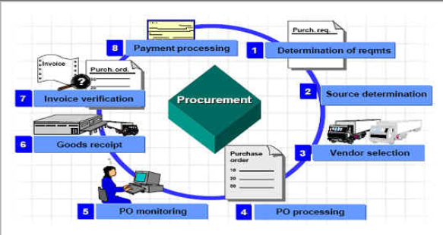
Goods Receipt
Purpose:
You use this component to post the receipt of goods from an external vendor or from production or from another plant. A goods receipt leads to an increase in warehouse stock.
Notes:
Key Message(s):
The above slide gives an pictorial representation of hierarchy in MM organization structure.

Slide 6
Goods Receipt
Goods receipts can be categorized into 2 types:
Planned goods receipts and
Unplanned goods receipts.
Planning a goods receipt in advance means storing certain information that is
important for the goods receipt before the actual goods receipt is posted.
Advantages of Planned GR:
Simplify and accelerate the goods receipt process and to better organize the work at the goods receiving point.
Materials Planning can monitor the stocks of ordered or manufactured materials and achieve an optimal inventory balance.
Planned receipts are also important for determining whether you have received materials promised by vendors or in-house production. Without them, the system cannot establish a link between orders and received material.
Notes:
Key Message(s):
The above slide gives an pictorial representation of hierarchy in MM organization structure.

Slide 7
Goods Receipt
Features of planned Goods receipt processes:
Depending on the source of information (that is, the document in which the data relevant to planning is stored), the system distinguishes between three types of planned goods receipts:
Planned goods receipts using purchase orders: Purchase orders contain all of the information needed for planning the goods receipt.
Planned goods receipts using production orders: Production orders contain all information necessary to plan a goods receipt.
Planned goods receipts using reservations: If your company does not have the MM Purchasing component or the PP Production Orders component, you enter reservations to plan goods receipts from the vendor or from production.
Notes:
Key Message(s):
The above slide gives an pictorial representation of hierarchy in MM organization structure.

Slide 8
Agenda
Concept of Goods receipt process
Overview of various types of Goods Receipt scenarios
Other goods receipts.
Demo on Goods Receipt scenarios.
Notes:
Topic Duration:

Slide 9
Goods Receipt
Goods receipt with reference to Purchase Order:
The delivery is marked in the purchase order history. This allows the Purchasing department to monitor the purchase order history and initiate reminder procedures in the event of a late delivery.
The vendor invoice is checked against the ordered quantity and the delivered quantity.
The goods receipt is valuated on the basis of the purchase order price or the invoice price.
Notes:
Key Message(s):
The above slide gives an pictorial representation of hierarchy in MM organization structure.

Slide 10
Effects of Goods Receipt
Below are the subsequent actions/process/document posted along with the goods receipt
Material document is created
Accounting document is created if the goods movement is relevant for Accounting.
Stock & Consumption A/c updated
Stock and value updated in material master
PO /PO history update
Inspection lot is created for QM relevant materials.
Notes:
Key Message(s):
.

Slide 11
Goods Receipt
Result of Goods receipt posting:
Notes:
Key Message(s):
The above slide gives an pictorial representation of hierarchy in MM organization structure.

Slide 12
Goods Receipt
Goods receipts for the warehouse can be posted to three different stock types:
To unrestricted-use stock
To stock in quality inspection
To blocked stock
You can define in the purchase order whether or not the material is to be posted to stock in quality inspection. However, at the time of goods receipt you decide to which stock type the material is posted.
Notes:
Key Message(s):
The above slide gives an pictorial representation of hierarchy in MM organization structure.

Slide 13
Goods Receipt
Consumption:
If the material is intended for consumption (order items with account assignments), the Purchasing department can specify a recipient or an unloading point. Both specifications are then automatically proposed by the system during entry of the goods receipt.
Goods receipt blocked stock
You can conditionally accept a delivery. You record such deliveries in goods receipt blocked stock. Unlike goods receipts to the warehouse, the receipts posted to the goods receipt blocked stock are not yet part of the valuated stock.
Notes:
Key Message(s):
The above slide gives an pictorial representation of hierarchy in MM organization structure.

Slide 14
Goods Receipt
Below are the movement types used for posting goods receipt having reference to purchase order:
Movement Type | Description of movement type
101 | Goods receipt for purchase order or order
103 | Goods receipt for purchase order into GR blocked stock
105 | Release from GR blocked stock for purchase order
107 | Goods Receipt to Valuated Goods Receipt Blocked Stock
109 | Goods Receipt from Valuated Goods Receipt Blocked Stock
Notes:
Key Message(s):
The above slide gives an pictorial representation of hierarchy in MM organization structure.

Slide 15
Goods Receipt
Goods receipt can be done either in 1-step (or) 2-step process.
In the case of 1-step process, materials are directly taken into stock or posted
to consumption based upon the nature of purchase order. Goods receipt is
posted with Movement type 101.
In the case of 2-step process, materials are taken to GR blocked stock and are
subsequently taken to stock. Goods receipt is done using movement types 103
+105 if the materials are to be posted to non-valuated GR blocked stock and
subsequently posted to warehouse stock.
Notes:
Key Message(s):
The above slide gives an pictorial representation of hierarchy in MM organization structure.

Slide 16
Reference documents for Goods Receipt
Goods Receipt is posted using transaction code MIGO or MB01. Goods receipt can be created with reference to:
Purchase Order
Order
Reservation
Inbound delivery
Outbound delivery
Other
Note: transaction MB01 is now obsolete and not in use currently.
Notes:
Key Message(s):
.

Slide 17
Accounting entries for Goods Receipt
The financial entries will be posted once the goods receipt is done and accounting document will be posted
Acc. entry for Stock material
Stock account - Material (BSX ) : Debit
GR/IR clearing - Material (WRX): Credit
Acc. entry for account assigned PO
Consumption account/Asset account -: Dr
GR/IR clearing - Material (WRX): Cr

Slide 18
Agenda
Concept of Goods receipt process
Overview of various types of Goods Receipt scenarios
Other goods receipts.
Demo on Goods Receipt scenarios.
Notes:
Topic Duration:

Slide 19
Goods receipt without reference Document
Goods Receipt can be created without reference by using option others
The others is usually used for scenario like initial stock upload, free sample or free goods or goods received without Purchase order and etc
There will be no preceding document for reference or tracking

Slide 20
Goods receipt without reference Document
Other Goods Receipts: In addition to the goods receipts described previously, you can enter goods receipts in the SAP system without referencing another document. You enter such goods receipts by selecting Goods movement→ Goods receipt→ Other.

Slide 21
Goods receipt without reference Document
Scope of Functions
You can enter the following types of goods receipts this way:
Initial Entry of Inventory Data: Using this goods movement, you can transfer book inventory balances from an existing system to the SAP System when you first implement the Inventory Management component.
External Goods Receipts Without a Purchase Order: If you are working without the Purchasing component, you enter external receipts as ‘other’ goods receipts. You can plan such a movement with a reservation.
Internal Goods Receipts Without a Production Order: If you are not using the PP Production Orders component, you enter receipts from production as ‘Other’ goods receipts. You can plan such a movement with a reservation.

Slide 22
Goods receipt without reference Document
Goods Receipt of By-Products: Goods receipts of by-products can also be entered as miscellaneous goods receipts.
Delivery Free of Charge: If you receive a delivery from a vendor free of charge, for which no purchase order was placed, you can only enter the receipt of the goods as an ‘Other’ goods receipt.
Returns From Customer: Even without a returns delivery from the Sales component, you can post returns from a customer into blocked stock returns.

Slide 23
Goods receipt without reference Document
Below are the commonly used movement types for Goods receipt without reference:
Movement Type | Description of movement type
501 | Goods receipt without purchase order - unrestricted-use stock
503 | Goods receipt without purchase order - stock in quality inspection
505 | Goods receipt without purchase order - blocked stock
511 | Free-of-charge delivery from vendor
521 | Goods receipt without order - unrestricted-use stock
523 | Goods receipt without order - stock in quality inspection
561 | Initial entry of stock - unrestricted-use stock
563 | Initial entry of stock - quality inspection
565 | Initial entry of stock - blocked stock

Slide 24
Accounting entries for Goods Receipt without reference
When stock is posted at the time of initial stock posting, the below postings happen:
MT 561- Initial Stock entry
Stock account - Material (BSX ) : Debit
Offsetting entry for stock posting- GBB – BSA: Credit
MT 501- GR without purchase order
Stock account - Material (BSX ) : Debit
Offsetting entry for stock posting- GBB – ZOB: Credit

Slide 25
Agenda
Concept of Goods receipt process
Overview of various types of Goods Receipt scenarios
Other goods receipts.
Demo on Goods Receipt scenarios.
Notes:
Topic Duration:

Slide 26
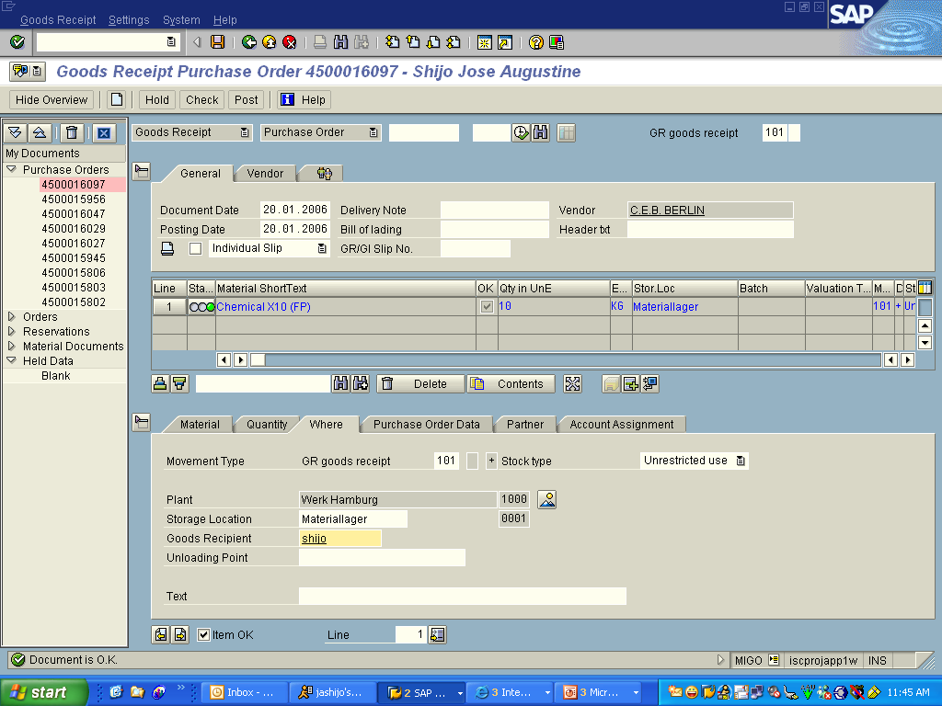
Demo1_ Goods Receipt for PO
Objective | Goods Receipt for PO (MIGO)
Notes:
Key Message(s):
.

Slide 27
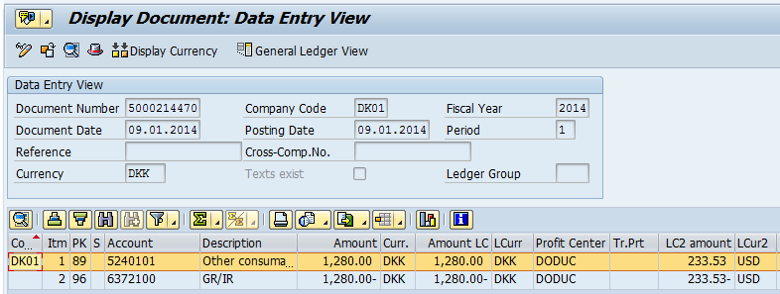
Demo1_ Goods Receipt for PO
Objective | Display accounting document for the GR document
System will post entries as below:
Debit – Inventory account
Credit – GR/ IR clearing account
Notes:
Key Message(s):
.

Slide 28
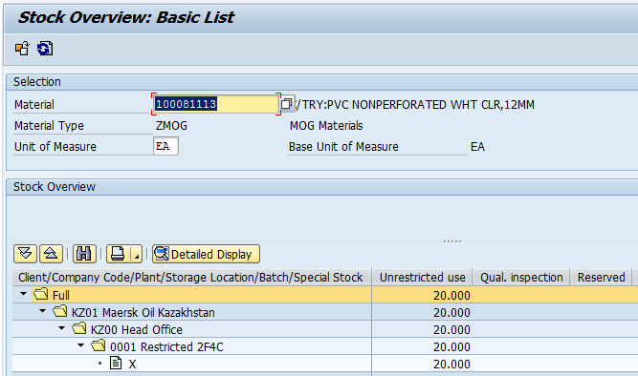
Demo1_ Goods Receipt for PO
Objective | Display Stock Overview report. T.Code: MMBE
Notes:
Key Message(s):
.

Slide 29
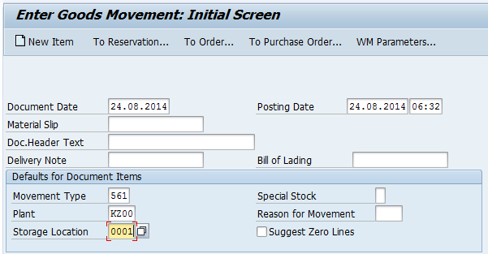
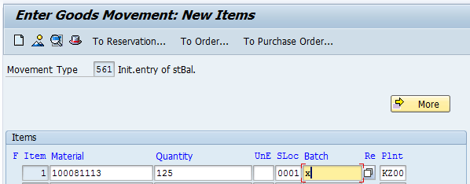
Demo-2: Initial Stock Entry
Objective | Initial Stock Entry (MB1C/ MB11)
Notes:
Key Message(s):
.

Slide 30
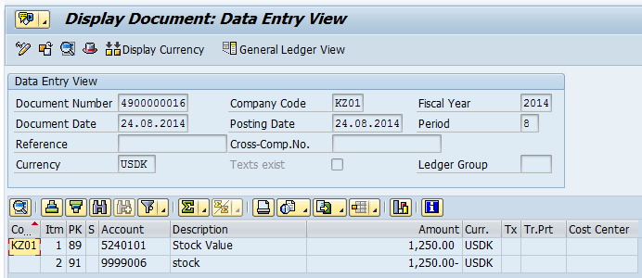
Demo1_ Goods Receipt for PO
Objective | Display accounting document for the GR document
System will post entries as below:
Debit – Inventory account (BSX)
Credit – Offsetting entry for stock account (GBB- BSA)
Notes:
Key Message(s):
.

Slide 31
Quiz/Check point
Questions/Discussions :
What are effects of goods receipt?
Notes:
Key Messages:
Discuss with the participants and list the answers on a flip chart.
Spend 15 minutes on this discussion,

Slide 32
Questions and Comments
What questions or comments do you have?
Notes:
Key Message:
Ask participants for any questions or comments they may have.

