Slide 1
Module Objectives
Upon completing this module, you will be able to:
Understand about Importance of PR.
Create PR in Various Method.
Understand the important fields used in PR
Understand Customization Settings & it’s control for PR.
1

Slide 2
Agenda
Introduction and overview of Purchase Requisitions.
Various methods for Creation of Purchase Requisitions (for stock and account assigned).
Customization settings for Purchase Requisitions.

Slide 3
Introduction and overview of Purchase Requisitions.
A purchase requisition is a request to Purchasing to procure a certain quantity of a material or a service so that it is available at a certain point in time.
In procurement, the internal requisition for materials or services triggers a procurement process.
Notes:
No need to include individual slide times unless the design calls for this treatment.
Key Message(s):
Additional Information:

Slide 4
Introduction and overview of Purchase Requisitions.
A purchase requisition will contain details regarding:
What is to be purchased?
Material or Service
How much is to be purchased?
How much does it cost?
Who’s paying for it?
When is it needed?
Where does it go when it arrives?
What additional information is needed, relative to this purchase?
This can contain the details such as desired Vendor, requisitioner, purchasing group, tracking number, etc.

Slide 5
Agenda
Introduction and overview of Purchase Requisitions.
Various methods for Creation of Purchase Requisitions (for stock and account assigned).
Customization settings for Purchase Requisitions.

Slide 6
Various methods for Creation of Purchase Requisitions.
A purchase requisition can be created directly or indirectly.
Direct means that a purchase requisition is created manually in the department
that made the request. Whoever creates the purchase requisition determines which material or service is ordered, and the quantity and date.
In Direct means that that purchase requisition from another SAP component is
created automatically. Purchase requisitions can be created automatically, as
follows:
In MRP
With maintenance orders
With production orders
With networks
Notes:
No need to include individual slide times unless the design calls for this treatment.
Key Message(s):
Additional Information:

Slide 7
Various methods for Creation of Purchase Requisitions.
A purchase requisition can be created for stock or for direct consumption.
This will be decided from the Account Assignment Category used in the Purchase Requisition.
If the PR is created for stock, account assignment category will be left blank.
If the PR is to created for direct consumption, account assignment category will determine where the stock will be consumed.
It can be:
Work Order
Network Order
WBS
Cost Center
Project Stock etc.

Slide 8
Various methods for Creation of Purchase Requisitions (Cont.)
PR contains number of Items, for each of which a procurement type is defined.
Following procurement type are exist.
Standard
Subcontracting
Consignment
Stock Transfer
External Service

Slide 9
Various methods for Creation of Purchase Requisitions (Cont.)
Standard:
This is used when the material is to be procured for unrestricted stock.
Subcontracting
This is used when the materials are to be assembled. We will send the goods to the subcontracting Vendor and received an assembled product.
Consignment
This will be used when we are ordering consignment stock(wherein the vendor will kept large quantity of stock at our location, but we will only be liable to pay for the quantity used).

Slide 10
Various methods for Creation of Purchase Requisitions (Cont.)
Stock Transfer
This is used when the material is to be procured from another plant.
The plant may belong to the same company code or different company code.
External Service
This is used to request services from external Vendor.

Slide 11
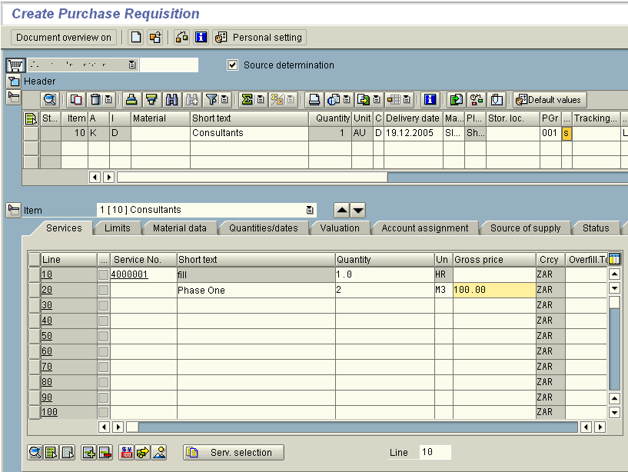
Various methods for Creation of Purchase Requisitions (Cont.)
Purchase Requisition Structure(ME51N):
Notes:
No need to include individual slide times unless the design calls for this treatment.
Key Message(s):
Additional Information:

Slide 12
Various methods for Creation of Purchase Requisitions (Cont.)
Header
Item Overview
Item Detail
Notes:
Every purchasing document in SAP has three segments:
Header – includes information relevant to the entire document. Texts, Vendor information (on all but requisition). On the requisition, the user has only the header text box available. In this text box, the requisitioner can enter following information:
Vendor name and phone number for price or quote
Contact info for the buyer, if there are any questions
Advice about attachment(s) that will follow
Rush or after-the-fact order notification for the buyer
Information about special discounts/payment terms
New vendor information if the requested supplier is not in SAP
Item Overview – includes an overview of each item on the purchasing document – material, account assignment, quantity, delivery date, etc.
Item Detail – contains more specific information about the line item – delivery information, status of the line item, specific account assignment information. This segment is not populated until there is information in the item overview.

Slide 13
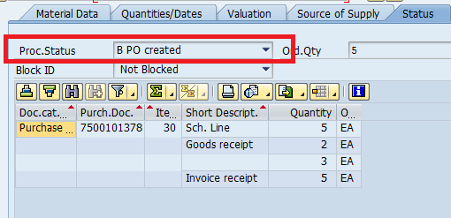
Various methods for Creation of Purchase Requisitions (Cont.)
Features of the Purchase Requisition: Following are the important features of PR.
Valuation price:
Processing Status:
Notes:
Key Message(s): Valuation Price: When you create a purchase requisition item for valuated material, the valuation price is pulled from the material master record. For non-valuated material or material without a master record, the creator must manually enter the valuation price. This valuation price can be used for a value-related release procedure. The release can refer to the value of the individual item or to the total value of the requisition. If a previously defined release strategy becomes effective, you can create a request or a purchase order with reference to a purchase requisition only after the purchase requisition has been released.
Processing Status: If you want to trace whether your purchase requisition item has been processed, evaluate the processing status of the purchase requisition item. You can see the processing status on the Status tab page in the item detail area. The processing status provides information about whether the item has been ordered, not ordered
or requested, or whether the item has been converted into an outline agreement. The Status tab lists the purchase order history of referenced purchasing documents
(created with reference to this purchase requisition item). You can obtain information about previously posted goods receipts and invoices.
Additional Information:

Slide 14
Various methods for Creation of Purchase Requisitions (Cont.)
Creation Indicator:
Notes:
Key Message(s): For you as a buyer, it might be interesting to see how the purchase requisition was created in the system, manually or automatically (for example, through materials
planning). In the item detail on the Contact person tab, the creation indicator can provide information.
Additional Information:

Slide 15
Agenda
Introduction and overview of Purchase Requisitions.
Various methods for Creation of Purchase Requisitions (for stock and account assigned).
Customization settings for Purchase Requisitions.

Slide 16
Customization settings for Purchase Requisitions.
Following Customization Settings influence a PR during Creation, Change or Display Mode:
Document Types
Define Number Ranges
Define Screen Layout at Document Level
Notes:
No need to include individual slide times unless the design calls for this treatment.
Key Message(s):
Additional Information:

Slide 17
Customization settings for Purchase Requisitions (Cont.)
Document Types : Document Type is the key which controls the entire attributes of a PR such as :
Number Ranges
Item Interval
Release Procedure Method
Field Selection Control.
Notes:
No need to include individual slide times unless the design calls for this treatment.
Key Message(s):
Additional Information:

Slide 18
Customization settings for Purchase Requisitions (Cont.)
Document Types :
Notes:
No need to include individual slide times unless the design calls for this treatment.
Key Message(s):
Additional Information:

Slide 19
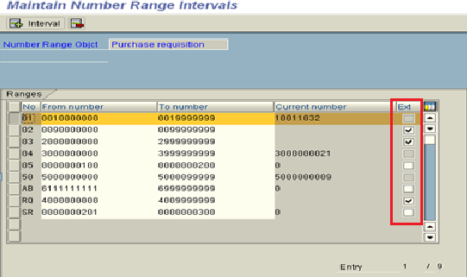
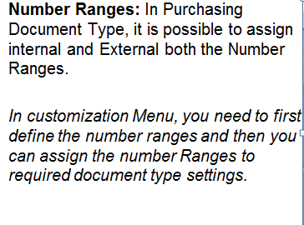
Customization settings for Purchase Requisitions (Cont.)
Notes:
No need to include individual slide times unless the design calls for this treatment.
Key Message(s):
Additional Information:

Slide 20
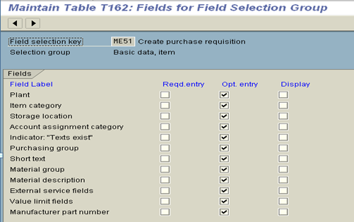
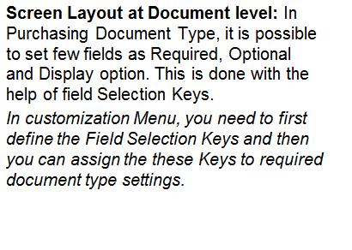
Customization settings for Purchase Requisitions (Cont.)
Notes:
No need to include individual slide times unless the design calls for this treatment.
Key Message(s):
Additional Information:

Slide 21
Discussion
Explain about different ways to create a PR.
How we can check the PR status.
Explain structure of a PR
How different field in a PR is controlled.
Notes:
Key Messages:
Note: Use this discussion slide as appropriate to encourage interaction throughout/in between topics, as time or topic allows. Include key discussion points, or encourage participants to add examples from their real-life experiences.
Additional Information:
Discuss with the participants and list the answers on a flip chart.
Spend XX minutes on this discussion,

Slide 22
Checkpoint
22
PR is an external document or Internal Document?
What are the various ways to generate PR?
What is the significance of PR document type?
Is it possible to Create PR document for both Internal Number Range and
External No Range for same document type?
Notes:
Answers:
Internal Document.
Manual, Production Order, Network et
3. PR document Controls the number Range, Field Selection.
4. Yes, It is possible.

Slide 23
Module Summary
23
You should now be able to:
Explain the Various method to Create a PR.
Explain the PR document type, number range, Field Selection Keys and their significance.
Explain the PR structure and it’s important fields.
Notes:
Key Message(s):
Briefly review the module’s key topics with participants.
Additional Information:

Slide 24
Questions and Comments
What questions or comments do you have?
Notes:
Key Message:
Ask participants for any questions or comments they may have.
Additional Information:

Slide 25
Exercise
Exercise 7: Purchase Requisition Process (60 min.)

