Slide 1
IT Governance &
IS Governance
Mrs. Geetha Murugesan
CISA,CRISC , CGEIT (Passed), COBIT 5.0

Slide 2
Knowledge Areas
Corporate Governance
Governance and Management
IT Governance
Information Security Governance
Challenges - Governance

Slide 3
What is Corporate Governance?
Corporate governance has been defined as “ the system by which business corporations are directed and controlled .“
Sir Adrian Cadbury
International Corporate Governance Meeting
Corporate governance involves a set of relationships between a company’s management , its board, its shareholders and other stakeholders. Corporate Governance also provides their structure through which the objectives of the company are set, and the means of attaining those objectives and monitoring performance are determined . Good Corporate Governance should provide proper incentives for the board and management to pursue objectives that are interests of the company and its shareholders and should facilitate effective monitoring.”
The Organization for Economic Co-operation and Development (OCED)
Corporate Governance is a mechanism through which boards and directors are able to direct, monitor and supervise the conduct and operation of the corporation and its management in a manner that ensures appropriate levels of authority, accountability, stewardship, leadership, direction and control.

Slide 4
It’s about Leadership………!
Leadership for efficiency……
  to compete in the global economy, create jobs
Leadership for probity (integrity , honesty , morality …)
  because investors require confidence
  to provide assurance of management's integrity
Leadership with responsibility….
  to take account of broader stakeholder interests
Leadership that is accountable and transparent
  to build trust in companies and in the economy!!
Notes:
4
4

Slide 5
Corporate Governance
Ethical corporate behavior by directors or others charged with governance in the creation and presentation of value for all stakeholders
The distribution of rights and responsibilities among different participants in the corporation, such as board, managers, shareholders and other stakeholders
Establishment of rules to manage and report on business risks

Slide 6
Enterprise Governance
Enterprise Governance - By ISACA
A set of responsibilities and practices exercised by the board and executive management with the goal of providing strategic direction, ensuring that objectives are achieved, ascertaining that risk is managed appropriately and verifying that the enterprise’s resources are used responsibly.

Slide 7
Board Governance Framework – An Example
Shareholders
Board of Directors
Achievement of strategic objectives and value creation
Fulfil responsibilities and duties in law and prescribed functions
Chairman
Board
Meetings
Strategy
Information and Communication
Board Operations
Corporate Policies & Procedures
Corporate
Secretary
Key Areas of Responsibility
Board Governance Instruments
Reporting &
Disclosure
Monitoring and Evaluation
Governance
System and
Controls
Board Committees
CEO & Management
Audit
Committee
Remuneration
Committee
Other
Committees
Executive
Committee
Internal Controls
& Assurance
Combined Assurance Model
Internal Audit
External Audit
Other Assurance
Providers
Management
Source: KPMG
Notes:
7
7

Slide 8
Distinction Between Governance and Management
Governance
Governance ensures that stakeholder needs, conditions and options are evaluated to determine balanced, agreed-on enterprise objectives to be achieved; setting direction through prioritization and decision making; and monitoring performance and compliance against agreed-on direction and objectives.
In most enterprises, governance is the responsibility of the board of directors under the leadership of the chairperson.

Slide 9
Distinction Between Governance and Management
Management
Management plans, builds, runs and monitors activities in alignment with the direction set by the governance body to achieve the enterprise objectives.
In most enterprises, management is the responsibility of the executive management under the leadership of the CEO.

Slide 10
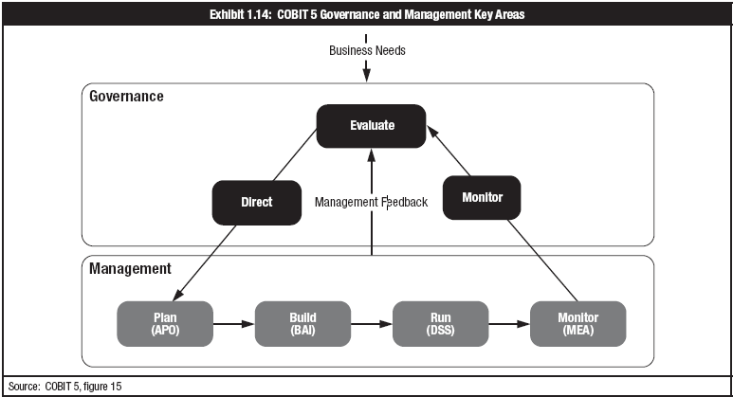
Governance and Management Roles, Activities and Relationships

Slide 11
Accountability
Definition
The ability to map a given activity or event back to the responsible party
Helps clarify who is the responsible party for any of the information quality goals:
  Intrinsic quality
  Contextual and representational quality
  Security/accessibility quality

Slide 12
Information Quality
Intrinsic quality—The extent to which data values are in conformance with the actual or true values.
  Accuracy—The extent to which information is correct and reliable
  Objectivity—The extent to which information is unbiased, unprejudiced and impartial
  Believability—The extent to which information is regarded as true and credible
  Reputation—The extent to which information is highly regarded in terms of its source or content

Slide 13
Information Quality
Contextual and representational quality—The extent to which information is applicable to the task.
  Relevancy—The extent to which information is applicable and helpful for the task at hand
  Completeness—The extent to which information is not missing and is of sufficient depth and breadth for the task at hand
  Currency—The extent to which information is sufficiently up to date for the task at hand
  Appropriate amount of information—The extent to which the volume of information is appropriate for the task at hand
  Concise representation—The extent to which information is compactly represented
  Consistent representation—The extent to which information is presented in the same format
  Interpretability—The extent to which information is in appropriate languages, symbols and units, with clear definitions
  Understandability—The extent to which information is easily comprehended
  Ease of manipulation—The extent to which information is easy to manipulate and apply to different tasks

Slide 14
Information Quality (contd)
Security/accessibility quality—The extent to which information is available or obtainable.
  Availability/timeliness—The extent to which information is available when required, or easily and quickly retrievable
  Restricted access—The extent to which access to information is restricted appropriately to authorized parties

Slide 15
Conformance and Performance
Conformance and Performance:
Are sub-dimensions of enterprise governance
Must be balanced

Slide 16
… and CIO’s must balance among many competing priorities.
Maximize return:
Improve business results;
grow revenue and earnings,
cash flow, reduced
cost-of-operation
Increase agility:
Enable the business organization and operations to adapt to changing business needs
Mitigate risk:
Ensure security and continuity
of internal business operations, while minimizing exposure to external risk factor
Improve performance:
Improve business operations performance end-to-end
across the enterprise
Increase customer and
employee satisfaction

Slide 17
Information Technology - IT
Components
Hardware – Server , SAN, Desktops, Laptops etc..
Software - OS, System , Application – Customized / Products etc..
Communication Networks – LAN , WAN etc..
Databases – ORACLE , SQL etc..
Network Devices – Router , Switch etc…
Operating Process – Configurations, Parameters etc…
People – IT Manager , Networks Manager, Application Software Manager, Database Administrator etc…

Slide 18
Information Technology Governance

Slide 19
What is IT Governance?
Decision rights framework & mechanisms
Vision,
goals/priorities, measures; value prop & service portfolio;
resource approaches & commitments;
change management
plans
IT governance is the formal process of defining the strategy of the IT organization and overseeing its execution to achieve the goals of the enterprise.
Translation into
aligned, tactical, operational
plans; closed-loop monitoring & control;
accountability;
regulatory compliance
Aligned/synchronized with the enterprise strategy, including other key asset strategies

Slide 20
IT Governance
• Definition - IT Strategy , IT Orgainsation Structure , IT Policies, IT Procedures, IT Metrics
- What is not defined cannot be controlled
• Measurement – BSC , COBIT 5
- What is not controlled cannot be measured
• Continuous Improvement – Maturity Model , CMMI, Six Sigma
- What is not measured cannot be improved

Slide 21

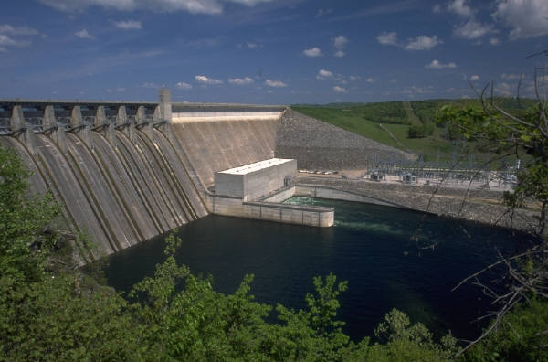
IT Governance
  Defined as: The management of risk & compliance.
  “The overall methodology by which IT is directed, administered and controlled”
Governance
Compliance

Slide 22
Business Drivers Related to IT Governance
Key Concepts
Pain points
Trigger events
Contractual requirements
Regulatory requirements

Slide 23
Typical Pain Points
Business Frustration
Failed initiatives
Rising IT costs
Significant incidents
Reputational loss
Project failure
Outsourcing delivery problems
Service Delivery issues
Arduous service provider manage
Low perceived IT value
Compliance Failures
Legal
Regulatory
IT limiting business capabilities
Reputational loss
Project failure
Regular audit findings
Poor performance
Quality of service problems
Contractual

Slide 24
Typical Pain Points … Contd
Multiple/Complex Assurance Efforts
Lack of IT and business collaboration
Unsupportive Leadership
Lack of business understanding
Lack of visibility/organizational structure
Complex IT operating models
Lack of trust
Lack of communication
Decentralized/federated IT structure
Complex practices and policies portfolio

Slide 25
Trigger Events in the Internal and External Environments
Mergers, acquisitions or divestitures
Shifts in the market, economy or competitive position
Changes in business operating model or sourcing arrangements
New regulatory or compliance requirements
An enterprise-wide governance focus
Change in leadership
External audit or consultant assessments
A new business strategy or priority
Desire to significantly improve the value to be gained from IT

Slide 26
Best Practices for Governance of Enterprise IT
Governance of Enterprise IT (GEIT) has become significant due to:
Demands for better return from IT investments
Increases in IT expenditures
Regulatory requirements for IT controls
Selection of service providers and outsourcing
Complexity of network security
Adoptions of control frameworks

Slide 27
IT Governance – Focus Area
Structure to help align IT strategy with business strategy
Five Focus Areas - IT Governance Institute (ITGI):
  Strategic alignment
  Value delivery
  Resource management
  Risk management
  Performance measurement

Slide 28
IT Governance Enablers
Key Concepts
Principles, policies and frameworks
Processes
Organizational structures
Culture, ethics and behavior
Information
Services, infrastructure and applications
People, skills and competencies

Slide 29
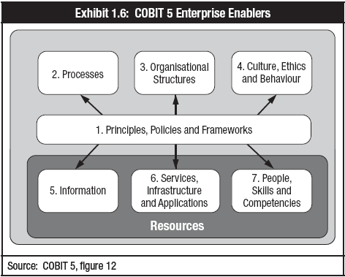
COBIT 5 - Enablers

Slide 30
COBIT 5 – 7 Enablers
There are seven enablers:
  Principles, policies and frameworks are the vehicles to translate the desired strategy into practical guidance for day-to-day management.
  Processes describe a set of practices and activities to achieve certain objectives and produce a set of outputs in support of achieving overall IT-related goals.
  Organizational structures are the key decision-making entities in an enterprise.
  Culture, ethics and behavior of individuals and of the enterprise are very often underestimated as a success factor in governance and management activities.

Slide 31
COBIT 5 – 7 Enablers
  Information is pervasive throughout any organization and includes all information produced and used by the enterprise. Information is required for keeping the organization running and well governed, but at the operational level, information is very often the key product of the enterprise itself.
  Services, infrastructure and applications include the infrastructure, technology and applications that provide the enterprise with IT processing and services.
  People, skills and competencies are linked to people and are required for successful completion of all activities and for making correct decisions and taking corrective actions.

Slide 32
Information Security Governance

Slide 33
What is Information Security?
ISO27001:2005 defines Information Security as
Preservation of
Confidentiality: the property that information is not made available or disclosed to unauthorized individuals, entities, or processes
Integrity: the property of safeguarding the accuracy and completeness of assets
Availability: the property of being accessible and usable upon demand by an authorized party

Slide 34
Information Security Defined
ISACA defines information security as something that:
  Ensures that within the enterprise, information is protected against disclosure to unauthorized users (confidentiality), improper modification (integrity) and non-access when required (availability).
Confidentiality, Integrity, Availability

Slide 35
IS Governance overview
Information vs. Knowledge
Information can be defined as “data endowed with meaning and purpose.
Knowledge in turn, captured, transported and stored as organized information.

Slide 36
Information – Any form !!!
Printed or written on paper
Stored electronically
Transmitted by post or using electronic means
Shown on corporate videos
Verbal-spoken in conversations
“Whatever form the information takes, or means by which it is shared or stored, it should always be appropriated protected”

Slide 37
Information!
Information is a key resource for all enterprises.
Information is created, used, retained, disclosed and destroyed.
Technology plays a key role in these actions.
Technology is becoming pervasive in all aspects of business and personal life.

Slide 38
Information - Classification
It is essential to classify information according to its actual value and level of sensitivity in order to deploy the appropriate level of security.
A system of classification should ideally be:
  simple to understand and to administer
  effective in order to determine the level of protection the information is given.
  applied uniformly throughout the whole organization (note: when in any doubt, the higher, more secure classification should be employed).

Slide 39
Information - Classification
With the exception of information that is already in the public domain, information should not be divulged to anyone who is not authorized to access it or is not specifically authorized by the information owner.
Violations of the Information Classification Policy should result in disciplinary proceedings against the individual.
Number of information classification levels in an organization should be a manageable number as having too many, makes maintenance and compliance difficult.

Slide 40
Information – Classification eg..
Top Secret: Highly sensitive internal documents and data. For example, impending mergers or acquisitions, investment strategies, plans or designs that could seriously damage the organization if lost or made public. Information classified as Top Secret has very restricted distribution indeed, and must be protected at all times. Security at this level is the highest possible.
Highly Confidential: Information which is considered critical to the organization’s ongoing operations and could seriously impede or disrupt them if made shared internally or made public. Such information includes accounting information, business plans, sensitive information of customers of banks (etc), patients' medical records, and similar highly sensitive data. Such information should not be copied or removed from the organization’s operational control without specific authority. Security should be very high.

Slide 41
Information – Classification eg..
Proprietary: Procedures, project plans, operational work routines, designs and specifications that define the way in which the organization operates. Such information is usually for proprietary use by authorized personnel only. Security at this level is high.
Internal Use Only: Information not approved for general circulation outside the organization, where its disclosure would inconvenience the organization or management, but is unlikely to result in financial loss or serious damage to credibility/reputation. Examples include: internal memos, internal project reports, minutes of meetings. Security at this level is controlled but normal.
Public Documents: Information in the public domain: press statements, annual reports, etc. which have been approved for public use or distribution. Security at this level is minimal.

Slide 42
Information Classification
Not all information has the same value
Need to evaluate value based on CIA
Value determines protection level
Protection levels determine procedures
Labeling informs users on handling

Slide 43
Information Classification
Government classifications:
  Top Secret
  Secret
  Confidential
  Sensitive but Unclassified
  Unclassified

Slide 44
Information Classification
Private Sector classifications:
  Confidential
  Private
  Sensitive
  Public

Slide 45
Information Classification
Criteria:
  Value
  Age
  Useful Life

Slide 46
IS Governance Transcends Technology
Based on principles that go beyond a particular technology or platform:
  “Information is a valuable asset that requires protection from unauthorized access or disclosure.”
Anchored in sound business goals and ideals.
Helps organization deal with rapidly changing technological environment:
  Passwords … pass phrases … two keys … biometrics

Slide 47
IT Governance -Standards and Frameworks
Key Concepts
Capability Maturity Model Integration (CMMI)
ISACA’s COBIT 5, Risk IT and Val IT frameworks
International Organization for Standardization (ISO)
IT Infrastructure Library (ITIL)
PRojects IN Controlled Environments (PRINCE2®)
Project Management Body of Knowledge® (PMBOK®)
The Open Group Architecture Framework (TOGAF®)

Slide 48
Frameworks, Standards and Best Practices
Framework
Standard
Practice
A generally accepted, business-process oriented structure that establishes a common language and enables repeatable business processes
A mandatory requirement, code of practice or specification approved by a recognized external standards organization, such ISO
A frequent or usual action performed as an application of knowledge

Slide 49
IT Governing Committees
The creation of an IT strategy committee is an industry best practice
Committee should broaden its scope to include not only advice on strategy when assisting the board in its IT governance responsibilities, but also to focus on IT value, risks and performance

Slide 50
IT Governing Committees
Analysis of Steering Committee Responsibilities
Level | IT Strategy Committee | IT Steering Committee
Responsibility | • Provides insight and advice to the board on topics such as: – The relevance of developments in IT from a business perspective – The alignment of IT with the business direction – The achievement of strategic IT objectives – The availability of suitable IT resources, skills and infrastructure to meet the strategic objectives – Optimization of IT costs, including the role and value delivery of external IT sourcing – Risk, return and competitive aspects of IT investments – Progress on major IT projects – The contribution of IT to the business (i.e., delivering the promised business value) – Exposure to IT risks, including compliance risks – Containment of IT risks – Direction to management relative to IT strategy – Drivers and catalysts for the board’s IT | • Decides the overall level of IT spending and how costs will be allocated • Aligns and approves the enterprise’s IT architecture • Approves project plans and budgets, setting priorities and milestones • Acquires and assigns appropriate resources • Ensures projects continuously meet business requirements, including reevaluation of the business case • Monitors project plans for delivery of expected value and desired outcomes, on time and within budget • Monitors resource and priority conflict between enterprise divisions and the IT function as well as between projects • Makes recommendations and requests for changes to strategic plans (priorities, funding, technology approaches, resources, etc.) • Communicates strategic goals to project teams • Is a major contributor to management’s IT governance responsibilities and governance practices
Authority | • Advises the board and management on IT strategy • Is delegated by the board to provide input to the strategy and prepare its approval • Focuses on current and future strategic IT issues | • Assists the executive in the delivery of the IT strategy • Oversees day-to-day management of IT service delivery and IT projects • Focuses on implementation
Membership | • Board members and specialist nonboard members | • Sponsoring executive • Business executive (key users) • CIO • Key advisors as required (IT, audit, legal, finance)

Slide 51
Information Security Governance
Focused activity with specific value drivers
  Integrity of information
  Continuity of services
  Protection of information assets
Integral part of governance of enterprise IT
Importance of information security governance

Slide 52
Information Security Governance (cont.)
Importance of information security governance
Information security (Infosec) covers all information processes, physical and electronic, regardless of whether they involve people and technology or relationships with trading partners, customers and third parties.
Infosec is concerned with all aspects of information and its protection at all points of its life cycle within the organization.

Slide 53
Information Security Governance (cont.)
Effective information security can add significant value to an organization by:
  Providing greater reliance on interactions with trading partners
  Improving trust in customer relationships
  Protecting the organization’s reputation
  Enabling new and better ways to process electronic transactions

Slide 54
Information Security Governance (cont.)
Effective information security governance
To achieve effective information security governance, management must establish and maintain a framework to guide the development and management of a comprehensive information security program that supports business objectives
This framework provides the basis for the development of a cost-effective information security program that supports the organization’s business goals.

Slide 55
Information Security Governance (cont.)
Information security governance requires strategic direction and impetus from:
  Boards of directors / senior management
  Senior management
  Steering committee
  Chief information security officers

Slide 56
IS Governance - Outcomes
Outcomes of effective security governance:
Strategic alignment—align with business strategy
Risk management—manage and execute appropriate measures to mitigate risks
Value delivery—optimize security investments
Enablers of security governance:
Performance measurement – measure, monitor and report on information security processes
Resource management—utilize information security knowledge and infrastructure efficiently and effectively
Process integration – integration of management assurance processes for security

Slide 57
Why is Governance important?
Compliance with regulations
Competitive advantage
Support of enterprise goals
Growth and innovation
Increase in intangible assets
Reduction of risk

Slide 58
Who is involved?
Team leaders
Managers
Executives
Board of Directors
Stakeholders

Slide 59
Information Security Management System (ISMS)
Part of the overall management system, based on a business risk approach, to establish, implement, operate, monitor, review, maintain and improve information security
Information security should be seen as an ongoing activity of continual improvement
ISMS adoption should be a strategic decision by the top management

Slide 60
ISMS (cont.)
ISMS requires that everyone is clear about what is required of them, that:
  they are trained in what they are meant to do,
  they have the facilities and resources they need, etc.
ISMS to initiate the production of standard set of (broad) requirements which all have to be complied with.

Slide 61
Challenges - Governance

Slide 62
Aligning IT and Business Strategy
Corporate Mission – Business Goals – IT Strategy
Requires involvement from many levels and activities within the enterprise.
Lack of alignment leads to adverse business issues.
Strong IT Governance contributes toward proper alignment.

Slide 63

Answers Key Business Questions – Information Paradox
Is my information technology
organisation doing the right things?
Are we doing them the right way?
Are we getting them done well?
Are we getting the benefits? *
* Based on the “Four Ares” as described by John Thorp in his book The Information Paradox, written jointly with Fujitsu, first published in 1998 and revised in 2003

Slide 64
Ensuring Value and Effectiveness
IT issues are the least understood, despite increasing reliance placed on IT.
Initiate IT governance structures with the right level of executive involvement.
Board of Director’s require essential IT related skills

Slide 65
IS Governance
Consists of leadership, organizational structures and processes that safeguard information.
Security over information assets.
Benefits of IS Governance.
IS is a top-down process.

Slide 66

Measuring IT Governance Performance
Measuring IT performance is a key concern as it demonstrates the effectiveness and added business value of IT.
Commonly seen as the IT “Black Hole” – costs continually rise without clear evidence of value derived from the IT function.
Traditional performance measurement methods require monetary values which are hard to apply to IT systems.

Slide 67
Importance of IT Performance Management
Measuring and managing IT performance should provide answers to questions such as:
If I spend extra funds on IT, what do I get back?
How does my IT benchmark against competitors?
Do I get back from IT what was promised?
How do I learn from past performance to optimize my organization?
Is my IT implementing its strategy in line with the business strategy?

Slide 68
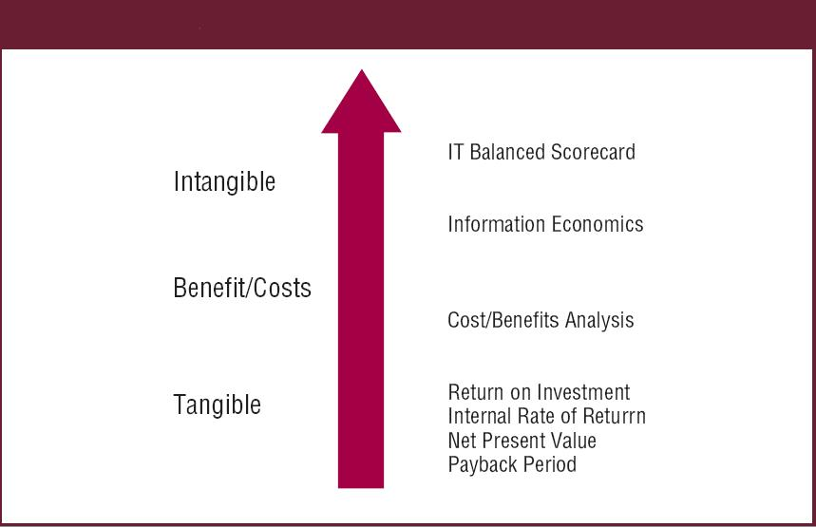
IT Governance Performance Management Approaches

Slide 69
IT Balanced Scorecard
One of the most effective means to aid an organization in achieving IT and business alignment.
Provides a systematic translation of the IT strategy into tangible success factors and metrics.
Gives a balanced view of the value added by IT to the business.
Calculating the value of IT investments is a business issue for which business managers are ultimately responsible for.

Slide 70
Best Practices for IT Performance Management
Business Contribution
Future Orientation
Operational Excellence
User Orientation

Slide 71
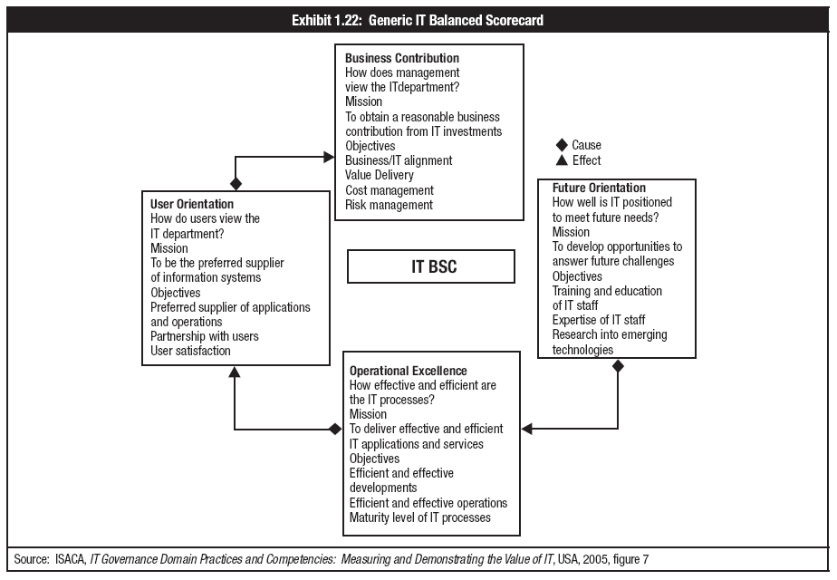
Best Practices for IT Performance Management

Slide 72
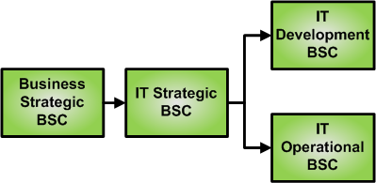
Best Practices for IT Performance Management

Slide 73
Consideration on overall performance of the organization may impact…
CIA of information
Customer loyalty
Repeat business and referral
Operational results e.g. revenue and market share
Reviewing threats and vulnerabilities on a regular basis
Efficient and effective use of resources
Alignment of processes which will best achieve desired results
Competitive advantages through improved organizational capabilities
Understanding and motivation of people towards the organizational goals and objectives, as well as participation in continual improvement

Slide 74
Consideration on overall performance of the organization may impact…
Confidence of interested parties in the effectiveness and efficiency of the organization
Ability to create value for both the organization and its suppliers by optimization of cost and resources as well as flexibility and speed of joint responses to changing markets

Slide 75
ISMS – A Need !!
Information security protects information from a wide range of threats in order to ensure business continuity, minimize business damage and maximize return on investment and business opportunities
Every organization will have a differing set of requirements in terms of control requirements and the level of confidentiality, integrity, and availability

Slide 76
Questions?

