Slide 1
IT Risk Management
Sunil Bakshi

Slide 2
Agenda
IT Risk Management
IT Risk and ERM
Risk Strategy and Policy
Risk Management standards and framework
Risk Management approach
Summary

Slide 3
Learning Objectives
To understand and provide assurance that the necessary IT risk management process is implemented and used in business decisions to enable risk informed decisions

Slide 4
Corporate Governance
Ethical corporate behavior by directors or others charged with governance in the creation and presentation of value for all stakeholders
The distribution of rights and responsibilities among different participants in the corporation, such as board, managers, shareholders and other stakeholders
Establishment of rules to manage and report on business risks

Slide 5
Governance of Enterprise IT
Comprises the body of issues addressed in considering how IT is applied within the enterprise.
Effective governance of enterprise IT focuses on:
  Individual and group expertise
  Experience in specific areas
Key element: alignment of business and IT
GEIT is concerned with two issues:
  IT delivers value to the business
  IT risks are managed

Slide 6
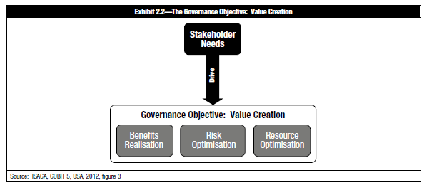
Governance of Enterprise IT

Slide 7
Audit and Governance of Enterprise IT
In accordance with the defined role of the IS auditor, the following aspects related to IT governance need to be assessed:
How enterprise governance and GEIT are aligned
Alignment of the IS function with the organization’s mission, vision, values, objectives and strategies
Achievement of performance objectives established by the business (e.g., effectiveness and efficiency) by the IS function
Legal, environmental, information quality, fiduciary, security, and privacy requirements
The control environment of the organization
The inherent risks within the IS environment
IT investment/expenditure

Slide 8


Highest Risk?
Annually 150 persons die due to coconuts falling on head
Annually 5 persons die due to Shark attacks

Slide 9
“Common sense”
Common sense is the ability to make rapid and accurate risk assessments, and act upon that knowledge.
We make judgments about risk every day:
deciding to walk under a ladder,
the distance of a jump,
where to merge in traffic.
The better we are able to assess risk and take preventive measures, the longer we live.
Common sense guides our choices … or sometimes not…

Slide 10
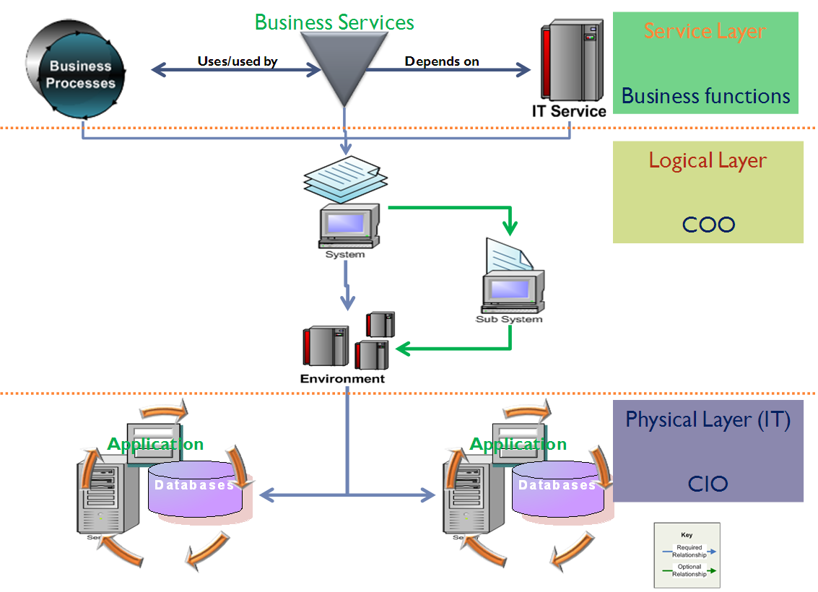
Business and IT

Slide 11
Enterprise Risk Management (ERM)
An End to End, Enterprise Level Process to:
  Manage Risks to be within Risk Appetite
  Provide reasonable assurance regarding the achievement of the Organization’s objectives by mitigating risks
  Be able to visualize and control potential events that may affect the Organization
A proactive approach by Management to Identity, Govern and Manage Enterprise Risks
Enterprise Risk Management is not a discrete technology that can be bought
Success depends on risk-aware culture
Notes:
The ultimate objective of ERM is to relate risk to value creation, and the association of risk to performance, which involves:
Erasing the LOB boundaries and fragmented approaches to risk management
Evaluating performance on a risk-adjusted basis for compensating managers
Making informed decisions for allocating capital

Slide 12
Risk Management
Enterprise Risk Management
Business Risk
Strategic Risk
IT Risk
Market Risk
Competition
IT Risk
Operational Risk
IT Risk

Slide 13
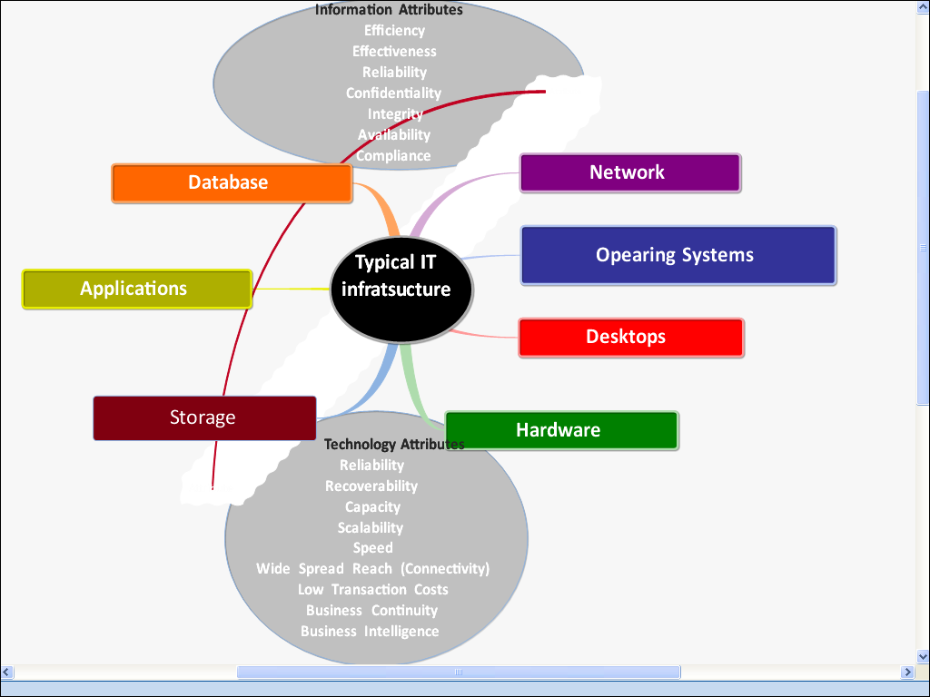
Threat Profile
External Threats
Malware (Virus, Trojans, etc.
Data Theft
Denial of Service (DoS)
Unauthorized access
Physical threats
Environmental threats
Terrorist
Power failure
Disasters
Facilities failure
Internal Threats
Unauthorized changes
Service disruption
Data Leak/Loss
Unauthorized access

Slide 14
What is IT Risk Management?
Proactive approach by management to identify, govern and manage risks.
Risk management must consist at the minimum:
  Risk strategy and framework
  Risk Identification
  Risk Assessment
  Risk Prioritization
  Risk response
  Risk Monitoring and review

Slide 15
Goals of IT Risk Management
Organization must be able to:
  direct and manage information risks
  make the risk informed decisions by aligning IT risk with business risks
  focus on protecting key business
  effectively communicate about status of risks to business and IT stakeholders

Slide 16
IT Risk Strategy
A structured and coherent approach to managing risk
Strategy defines
  Way to identify Risks to business
  Method to assess
  Determine response option and policy
  Define framework
  Establish link with ERM
Components of Risk Strategy
  Goals and Objectives
  Policy
  Framework

Slide 17
Risk Policy
A uniform method to address risk related issues across organization
Determining way to respond to risks - who, when, how?
  Accept
  Avoid
  Transfer
  Mitigate
Identify Risk Owners
Define roles and responsibilities for risk owners and facilitators

Slide 18
Standards and Frameworks

Slide 19
Standards
One good thing about standards is that there are so many to choose from
Standards and Frameworks are like Maps
  “If you do not know where you want go any road is good” - Alice in Wonderland
  “If you don’t know where you are any map is useless” – Chinese proverb

Slide 20
Risk management – Standards/Frameworks
OCTAVE
  Operationally Critical Threat, Asset, and Vulnerability Evaluation
  By Carnegie Mellon – SEI and CERT US
IRAM
  The International Security Forum (ISF)
COSO ERM
  Enterprise Risk Management-Integrated Framework" published in 2004
AS/NZS 4360
  Australia – New Zealand standard #4360 for IT risk management
RIMS ERM
  Risk and Insurance Management Society
NIST SP800-30
  Computer Security Division,
  Information Technology Laboratory,
  National Institute of Standards and Technology
ISO31000
  New ISO standard
M_O_R
  Management of Risk by Office of Government of commerce, UK
RISK IT
  Risk Management framework by ITGI and ISACA

Slide 21
Risk management – Other methods
What-IF Analysis
FMEA - Failure mode and impact analysis
Fault tree - root-cause
HAZOP - Hazards and operability analysis
Gap Analysis
Operator/competence
Reliability - MTBF
Probability and consequences

Slide 22
ISO 27001 and IT Risk Management
2005 – Asset based risk management
2013 – ISO 31000 based IS risk management

Slide 23
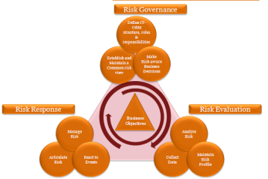
ERM Process
Retail
Corp.
Inv.
L&A
Oth.
Treasury
Del. Ch.
Service
Outcome:
Risk Profile for each IT App/ Process/Project
Likelihood & Impact of each Risk
Risk Ownership
Monitoring
IT- Projects
IT-ORM Framework
Net Banking
KYC
Input:
Prepare Masters
Risk Scenario Catalogue
Control Catalogue
Risk & Controls of Mapping
Department wise Risk Assessment
Compliance
New Products, Projects, BE
Other Departments
IT- Projects & Applications
Applications
Database
Hardware
IT- Processes
Network

Slide 24
Approach to Risk Assessment
Revenue inputs from Finance & Accounts
Confirm with process owners
Identify risks for each process in department
Assess Financial Impact
Assess Non-Financial Impact
Yes
No
No
Validate
Process wise maximum acceptable downtime & data-loss defined by process champions
Process wise maximum acceptable downtime & data loss workshop
Determine Criticality of Processes
Yes
Determine response plan
Control catalogue

Slide 25
Common terminology
People perceive different meaning for different terms.
It is necessary to adopt to common terminology.
Risk
Threat
Vulnerability
Exposure
Control
Probability/likelihood
Impact/Consequences
Risk Scenario
Risk Factors
Inherent risk
Residual risk
Current risk
Risk appetite
Risk tolerance

Slide 26
Broad Outline of Steps Involved
Step 1
Step 2
Step 3
Step 4
Step 5
Develop of Risk Management Framework
Evaluate risk for business processes and prioritize with stakeholders
Determine and implement response plan
Develop Maturity model for risk management
Implement ongoing risk monitoring process

Slide 27
Risk Impact & Probability Scale
Expected Event Likelihood Scale
Rating | Frequency | Annual Probability
1 | Every 10 years | 10%
2 | Every 5 years | 20%
3 | Every 2 years | 50%
4 | Every year | 100%
5 | Every 6 Months | ≥ 100%
6 | Every quarter
7 | Every month
8 | Every week
9 | Every Day
10 | More Frequent
Expected Event Impact Scale
Rating | Severity | Quantitative
 |  | (Rs. Range)
1 | Low | <10 k
2 |  | 10k to 1 Lac
3 |  | 1 Lac to 10 Lacs
4 | Medium | 10 Lacs to 50 Lacs
5 |  | 50 Lacs to 1 Crore
6 |  | 1 Crore to 5 Crores
7 | High | 5 Crores to 10 Crores
8 |  | 10 Crores to 50 Crores
9 | Extreme | 50 Crores to 100 Crores
10 |  | > 100 Crores

Slide 28
Sample Risk Response policy
A risk response policy enables management to delegate the risk response decisions.
Risk score (Likelihood x Impact) | Risk Rating
Score 1 to 30 | Low
30 to 50 | Medium
50 to 70 | High
70 > | Extreme
Risk Rating | Delegation
Low | AVP/VP
Medium | SVP
High | Top Management
Extreme | Risk Committee

Slide 29
Risk Response options
Risk Response
Accept
Transfer
Controls
Residual Risk
Mitigate
Avoid
Control Catalogue
BCM
The response options depicted here are indicative and not the Policy

Slide 30
Residual Risk – Sample
Likelihood | Consequence
 | Insignificant 1 | Minor 2 | Moderate 3 | Major 4 | Catastrophe 5
5 Almost Certain | Power + UPS Failure (Generator)
4 Likely | Virus (AV, Awareness) | Hard Disk Crash (Backup)
3 Possible |  | Fire(Sprinkler)
2 Unlikely | Intrusion (IPS) | Frauds (Access) | Flood (Transfer)
1 Rare |  |  | Tornado (Accept/Insurance) | Earth-quake (Accept)

Slide 31
Residual Risk - Sample
10
 | 10 | 20 | 30 | 40 | 50 | 60 | 70 | 80 | 90 | 100
9
 | 9 | 18 | 27 | 36 | 45 | 54 | 63 | 72 | 81 | 90
8
 | 8 | 16 | 24 | 32 | 40 | 48 | 56 | 64 | 72 | 80
7
 | 7 | 14 | 21 | 28 | 35 | 42 | 49 | 56 | 63 | 70
6
 | 6 | 12 | 18 | 24 | 30 | 36 | 42 | 48 | 54 | 60
5
 | 5 | 10 | 15 | 20 | 25 | 30 | 35 | 40 | 45 | 50
4 | OM1,R2.2
 | 4 | 8 | 12 | 16 | 20 | 24 | 28 | 32 | 36 | 40
3 |  |  |  | SA3.R10 |  |  |  |  | PT1.R1.1, PT1.R4.1
 | 3 | 6 | 9 | 12 | 15 | 18 | 21 | 24 | 27 | 30
2 |  |  |  |  |  |  | SA3.R11
 | 2 | 4 | 6 | 8 | 10 | 12 | 14 | 16 | 18 | 20
1 | SA2.R1..1, |  |  |  |  | OP2.R1.1 | PT1.R4.3 |  | PT1.R1.2
 | 1 | 2 | 3 | 4 | 5 | 6 | 7 | 8 | 9 | 10
 | 1 | 2 | 3 | 4 | 5 | 6 | 7 | 8 | 9 | 10
Likelihood
Impact

Slide 32
Risk Monitoring
Triggers : periodic assessment, Change/ Incident Management, IT Procurement, Projects
Risk Assessment
Conduct Risk Assessment for
Update Documents
Update Masters
Update Risk Profile
Update Risk Profile:
Identify new Risks
Existing Risks
Control Catalogue,
New Risks
Risk Impact
Likelihood
Risk & Controls Catalogue
Risk Scenarios Catalogue
Control Catalogue

Slide 33
Summing Up
Common Steps:
  Align with Business objectives and ERM
  Risk Strategy
    Risk response
    Risk Appetite
    Risk tolerance
  Define processes for reporting
    KRI and Metrics
    Monitoring processes
  Operations management and risk maintenance
    Updating risk profile based on:
      Review
      Changes in environment

Slide 34
Summary
Implementing Risk framework is not just a science - One needs to build a Risk culture within organization
There are multiple frameworks / standards available that could be confusing - One needs to focus on final goal based on business objectives
Matured Risk Management improves security and helps Management in taking risk informed decisions

Slide 35
References
www.isaca.org/www.itgi.org – RISK IT and COBIT
www.iso.org - ISO31000 and ISO27005
www.RIMS.org – Risk and Insurance Management Institute
www.securityforum.org – Information Security Forum
www.nist.gov – National institute of standards and technology, US government
www.standards.com.au – Australia-New Zealand Standard 436-:2004
http://www.ogc.gov.uk/ - Management of Risk (M_O_R)
http://www.cert.org/octave/ - Computer Emergency Response Team, US

Slide 36
Practice Question
What is considered the MOST critical element for the successful implementation of an information security (IS) program?
    An effective enterprise risk management (ERM) framework.
    Senior management commitment
    An adequate budgeting process.
    Meticulous program planning.
Notes:
The correct answer is B
Commitment from senior management provides the basis to achieve success in implementing an information security program. An effective ERM framework is not a key success factor for an IS program. Although an effective IS budgeting process will contribute to success, senior management commitment is the key ingredient. Program planning is important, but will not be sufficient without senior management commitment.
Pg. 79 (answer and explanation on pg. 80)

Slide 37
Thank you bakshies@gmail.com

