Slide 1
IS Management practices
Mrs. Geetha Murugesan
CISA,CRISC , CGEIT (Passed), COBIT 5.0

Slide 2
Knowledge objectives
IS Policy
IS Procedure
Risk Management
Human Resources Management
Sourcing practices
Change management

Slide 3
Security Management, Administration and Governance
Develop the information security strategy in support of business strategy and direction.
Obtain senior management commitment and support
Ensure that definitions of roles and responsibilities throughout the enterprise include information security governance activities.
Establish reporting and communication channels that support information security governance activities.
Identify current and potential legal and regulatory issues affecting information security and assess their impact on the enterprise.
Establish and maintain information security policies that support business goals and objectives.
Ensure the development of procedures and guidelines that support information security policies.
Develop business case for information security program investments.

Slide 4
Introduction
Creation of information security program begins with creation and/or review of an organization’s information security policies, standards, and practices
Then, selection or creation of information security architecture and the development and use of a detailed information security blueprint creates a plan for future success
Without policy, blueprints, and planning, an organization is unable to meet information security needs of various communities of interest

Slide 5
Information Security Policy, Standards, and Practices
Communities of interest must consider policies as the basis for all information security efforts
Policies direct how issues should be addressed and technologies used
Policies should never contradict law
Policies should be disseminated within the organization

Slide 6
Policies
Policies are statements of management intentions and goals and reflects management guidance and direction in developing controls over:
  Information systems
  Related resources
  IS department processes
Senior Management support and approval is vital to success
General, high-level objectives
Acceptable use, internet access, logging, information security, etc

Slide 7
Policies (cont.)
Information Security Policy
  Defines information security, overall objectives and scope
  Is a statement of management intent
  Is a framework for setting control objectives including risk management
  Defines responsibilities for information security management
Defines a set of guidelines and/or rules to control how its information system resources will be used

Slide 8
Policies(cont.)
High level documents
Must be clear and concise
Set tone for organization as a whole (top down)
Lower-level policies – defined by individual divisions and departments

Slide 9
Definitions
A policy is
  A plan or course of action business intends to influence and determine decisions, and actions
Policies are organizational laws
Standards, on the other hand, are more detailed statements of what must be done to comply with policy
Practices, procedures and guidelines effectively explain how to comply with policy
For a policy to be effective it must be properly disseminated, read, understood and agreed to by all members of the organization

Slide 10
Types of Policy
In General Management defines three types of security policy:
  General or security program policy
  Issue-specific security policies – Cyber crime, Payment card industry policy , etc.
  Systems-specific security policies – Firewall , IDS , IPS etc.

Slide 11
Policy Management
Policies must be managed as they constantly change
To remain viable, security policies must have:
  Individual responsible for the policy (policy administrator)
  A schedule of reviews
  Method for making recommendations for reviews
  Specific policy issuance and revision date
  Automated policy management

Slide 12
Enterprise Information Security Policy (EISP)
Sets strategic direction, scope, and tone for all security efforts within the organization
Executive-level document, usually drafted by or with CIO of the organization
Typically addresses compliance in two areas
  Ensure meeting requirements to establish program and responsibilities assigned therein to various organizational components
  Use of specified penalties and disciplinary action
Management’s goals and objectives in writing
Documents compliance
Creates security culture

Slide 13
Procedures
Procedures are detailed documents that:
  Document and define steps for achieving policy objectives
  Must be derived from the parent policy
  Must implement the spirit (intent) of the policy statement
  Must be written in a clear and concise manner
  Decommissioning resources, adding user accounts, deleting user accounts, change management, etc

Slide 14
Standards
Standards specify the use of specific technologies in a uniform manner
Requires uniformity throughout the organization
Operating systems, applications, server tools, router configurations, etc

Slide 15
Guidelines
Guidelines are recommended methods for performing a task
Recommended, but not required
Malware cleanup, spyware removal, data conversion, sanitization, etc

Slide 16
Baselines
Baselines are similar to standards but account for differences in technologies and versions from different vendors
Operating system security baselines
  FreeBSD 6.2, Mac OS X Panther, Solaris 10, Red Hat Enterprise Linux 5, Windows 2000, Windows XP, Windows Vista, etc

Slide 17
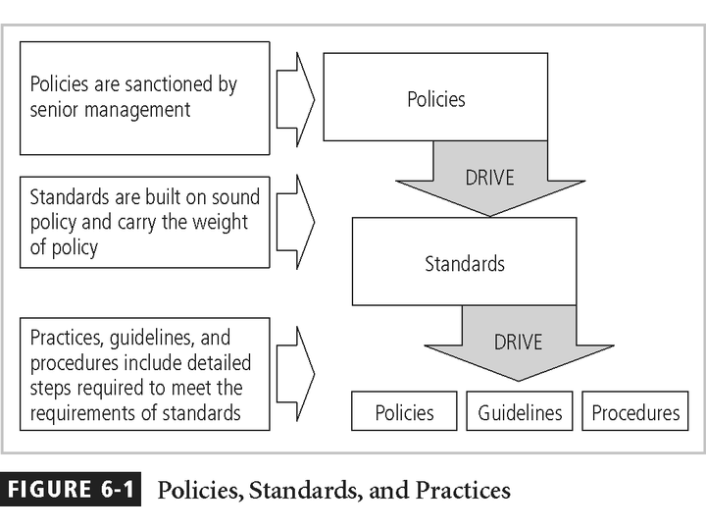
Policies Standards & Practices

Slide 18
ISMS
ISMS requires that everyone is clear about what is required of them, that:
  they are trained in what they are meant to do,
  they have the facilities and resources they need, etc.
ISMS to initiate the production of standard set of (broad) requirements which all have to be complied with.

Slide 19
Steps of ISMS
Establish the ISMS
Implement and operate the ISMS
Monitor and review the ISMS
Maintain and improve the ISMS

Slide 20
Security Governance
Security Governance is the organizational processes and relationships for managing risk
  Policies, Procedures, Standards, Guidelines, Baselines
  Organizational Structures
  Roles and Responsibilities

Slide 21
The Information Security Blueprint
Basis for design, selection, and implementation of all security policies, education and training programs, and technological controls
More detailed version of security framework (outline of overall information security strategy for organization)
Should specify tasks to be accomplished and the order in which they are to be realized
Should also serve as scalable, upgradeable, and comprehensive plan for information security needs for coming years

Slide 22
InfoSec - Function
InfoSec department must be carefully structured and staffed with appropriately credentialed personnel
Proper procedures must be integrated into all human resources activities, including hiring, training, promotion, and termination practices

Slide 23
Chief information Security Officer (CISO)
CISO is typically considered the top information security officer in the organization, although the CISO is usually not an executive-level position and frequently reports to the CIO
Although these individuals are business managers first and technologists second, they must be conversant in all areas of information security, including technology, planning, and policy

Slide 24
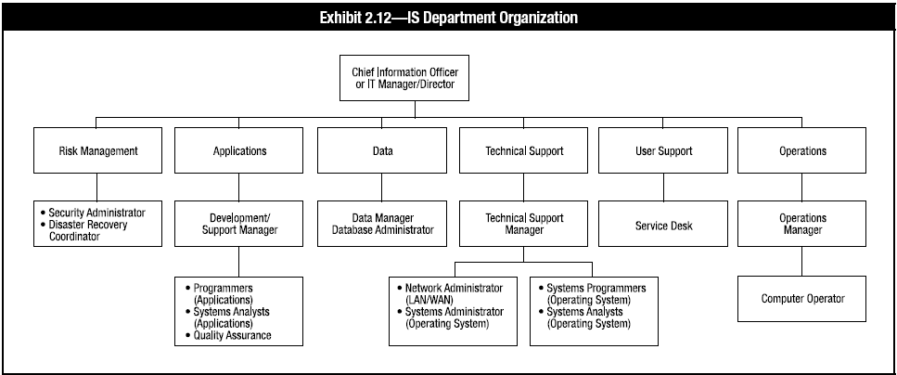
A Typical IS Organizational Structure and Responsibilities

Slide 25
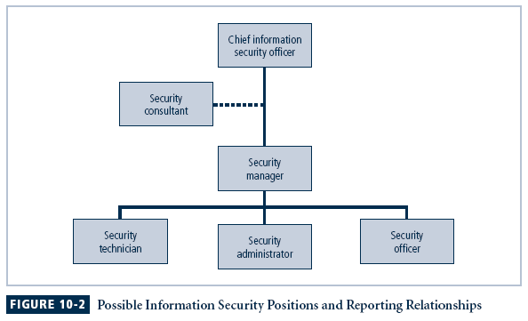
Information Security Positions and Relationships

Slide 26
IS Roles
Systems development manager
Project management
Service Desk (help desk)
End user
End user support manager
Data management
Quality assurance manager
Information security manager
Vendor and outsourcer management
Infrastructure operations and maintenance

Slide 27
IS Roles (cont.)
Media management
Data entry
Systems administration
Database administration
Systems analyst
Security architect
Applications development and maintenance
Infrastructure development and maintenance
Network management

Slide 28
Roles and Responsibilities
Best Practices:
  Least Privilege
  Mandatory Vacations
  Job Rotation
  Separation of Duties

Slide 29
Roles and Responsibilities
Owners
  Determine security requirements
Custodians
  Manage security based on requirements
Users
  Access as allowed by security requirements

Slide 30
Segregation of Duties Within IS
Duties that should be segregated include:
  Custody of the assets
  Authorization
  Recording transactions
If adequate segregation of duties does not exist, the following could occur:
  Misappropriation of assets
  Misstated financial statements
  Inaccurate financial documentation (i.e., errors or irregularities)
  Improper use of funds or modification of data could go undetected
  Unauthorized or erroneous changes or modification of data and programs may not be detected

Slide 31
Internal Roles
Executive Management
Information Systems Security Professionals
Owners
Custodians
Operations Staff
Security Staff
Data and System Owners
Users
Operations Staff
Security Staff
Data and System Owners
Users

Slide 32
External Roles
Vendors/Suppliers
Contractors
Temporary Employees
Customers
Business Partners
Outsourced Relationships
Outsourced Security

Slide 33
Human Resource Management
Hiring
Employee handbook
Promotion policies
Training
Scheduling and time reporting
Employee performance evaluations
Required vacations
Termination policies

Slide 34
Hiring
From information security perspective, hiring of employees is laden with potential security pitfalls
CISO, in cooperation with CIO and relevant information security managers, should establish a dialogue with human resources personnel so that information security considerations become part of the hiring process

Slide 35
Hiring Issues
Job Descriptions - Organizations that provide complete job descriptions when advertising open positions should omit elements of the job description that describe access privileges
Interviews - Information security should advise HR to limit information provided to candidates on access rights of the position
  When an interview includes a site visit, tour should avoid secure and restricted sites → visitor could observe enough information about the operations or information security functions to represent a potential threat to the organization

Slide 36
Hiring Issues (Continued)
New Hire Orientation - New employees should receive, as part of their orientation, an extensive information security briefing
On-the-Job Security Training - Organizations should conduct periodic security awareness and training activities to keep security at the forefront of employees’ minds and minimize employee mistakes
Security Checks - Background check should be conducted before organization extends an offer to any candidate, regardless of job level

Slide 37
Common Background Checks
Identity checks: Personal identity validation
Education and credential checks: Institutions attended, degrees and certifications earned, and certification status
Previous employment verification: Where candidates worked, why they left, what they did, and for how long
Reference checks: Validity of references and integrity of reference sources
Worker’s compensation history: Claims from worker’s compensation

Slide 38
Common Background Checks (Continued)
Motor vehicle records: driving records, suspensions, and other items noted in the applicant’s public record
Drug history: drug screening and drug usage, past and present
Medical history: current and previous medical conditions, usually associated with physical capability to perform the work in the specified position
Credit history: credit problems, financial problems, and bankruptcy
Civil court history: involvement as the plaintiff or defendant in civil suits
Criminal court history: criminal background, arrests, convictions, and time served

Slide 39
Contracts and Employment
Once a candidate has accepted a job offer, the employment contract becomes an important security instrument
It is important to have these contracts and agreements in place at the time of the hire

Slide 40
Employee Handbook / Manual
A permanent reference guide for employers and employees that contains information about a company, its goals and its current employment policies and procedures.

Slide 41
Security Education, Training, and Awareness Program (SETA)
As soon as general security policy exists, policies to implement security education, training, and awareness program should follow
SETA is a control measure designed to reduce accidental security breaches
Security education and training builds on the general knowledge the employees must possess to do their jobs, familiarizing them with the way to do their jobs securely
The SETA program consists of: security education; security training; and security awareness
Notes:
.

Slide 42
Security Education
Everyone in an organization needs to be trained and aware of information security; not every member needs formal degree or certificate in information security
When formal education for individuals in security is needed, an employee can identify curriculum available from local institutions of higher learning or continuing education
A number of universities have formal coursework in information security

Slide 43
Security Training
Involves providing members of organization with detailed information and hands-on instruction designed to prepare them to perform their duties securely
Management of information security can develop customized in-house training or outsource the training program
Alternatives to formal training include conferences and programs offered through professional organizations

Slide 44
Security Awareness
One of least frequently implemented but most beneficial programs is the security awareness program
Designed to keep information security at the forefront of users’ minds
Need not be complicated or expensive
If the program is not actively implemented, employees begin to “tune out” and risk of security incidents increases

Slide 45
Security as Part of Performance Evaluation
To heighten information security awareness and change workplace behavior, organizations should incorporate information security components into employee performance evaluations
Employees pay close attention to job performance evaluations
  Including information security tasks in them will motivate employees to take more care when performing their tasks

Slide 46
Termination Issues
When an employee leaves an organization, the following tasks must be performed:
  Access to organization’s systems must be disabled
  Former employee must return all removable media
  Former employee’s hard drives must be secured
  File cabinet locks must be changed
  Office door locks must be changed
  Former employee’s keycard access must be revoked

Slide 47
Termination Issues (Continued)
  Former employee’s personal effects must be removed from the premises
  Former employee should be escorted from the premises, once keys, keycards, and other business property have been turned over
  Exit interview to remind employee of any contractual obligations, such as nondisclosure agreements, and to obtain feedback on the employee’s tenure in the organization
  Two methods for handling employee outprocessing, depending on the employee’s reasons for leaving, are hostile and friendly departures

Slide 48
Hostile Departure
Security cuts off all logical and keycard access before employee is terminated
Employee reports for work and is escorted into supervisor’s office to receive bad news
Individual is then escorted from the workplace and informed that his or her personal property will be forwarded, or is escorted to his or her office, cubicle, or personal area to collect personal effects under supervision
Once personal property has been gathered, the employee is asked to surrender all keys, keycards, and other organizational identification and access devices, PDAs, pagers, cell phones, and all remaining company property, and is then escorted from the building

Slide 49
Friendly Departure
Employee may have tendered notice well in advance of actual departure date which can make it much more difficult for security to maintain positive control over employee’s access and information usage
Employee accounts are usually allowed to continue with a new expiration date
Employee can come and go at will, usually collects any belongings and leaves without escort
Employee is asked to drop off all organizational property before departing

Slide 50
Termination Issues Concluded
In either circumstance, offices and information used by departing employees must be inventoried, their files stored or destroyed, and all property returned to organizational stores
Possible that departing employees have collected and taken home information or assets that could be valuable in their future jobs
Only by scrutinizing system logs during transition period and after employee has departed, and sorting out authorized actions from system misuse or information theft, can the organization determine whether a breach of policy or a loss of information has occurred

Slide 51
Personnel Security Practices
There are various ways of monitoring and controlling employees to minimize their opportunities to misuse information
  Separation of duties is used to make it difficult for an individual to violate information security and breach the confidentiality, integrity, or availability of information
  Two-man control requires that two individuals review and approve each other’s work before the task is considered complete

Slide 52
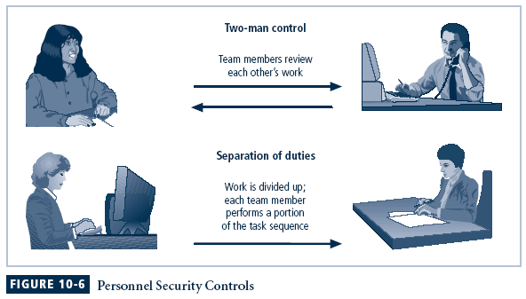
Personnel Security Controls

Slide 53
Personnel Security Practices (Continued)
Job rotation
  Another control used to prevent personnel from misusing information assets
  Requires that every employee be able to perform the work of at least one other employee
Task rotation
  All critical tasks can be performed by multiple individuals
Both job rotation and task rotation ensure that no one employee is performing actions that cannot be knowledgeably reviewed by another employee
For similar reasons, each employee should be required to take a mandatory vacation, of at least one week per year

Slide 54
Personnel Security Practices (Continued)
Policy gives organization a chance to perform a detailed review of everyone’s work
Finally, another important way to minimize opportunities for employee misuse information is to limit access to information
Employees should be able to access only the information they need and only for the period required to perform their tasks
This policy gives the organization a chance to perform a detailed review of everyone’s work
  Principle of least privilege

Slide 55
Personnel Security Practices (Continued)
Similar to the need-to-know concept, least privilege ensures that no unnecessary access to data occurs
If all employees can access all the organization’s data all the time, it is almost certain that abuses—possibly leading to losses in confidentiality, integrity, and availability.

Slide 56
Security of Personnel and Personal Data
Organizations are required by law to protect sensitive or personal employee information, including personally identifying facts such as employee addresses, phone numbers, Social Security numbers, medical conditions, and even names and addresses of family members
This responsibility also extends to customers, patients, and anyone with whom the organization has business relationships
While personnel data is, in principle, no different than other data that information security is expected to protect, certainly more regulations cover its protection
As a result, information security procedures should ensure that this data receives at least the same level of protection as other important data in the organization

Slide 57
Security Considerations for Non-employees
Many individuals who are not employees often have access to sensitive organizational information
Relationships with individuals in this category should be carefully managed to prevent threats to information assets from materializing

Slide 58
Temporary Workers
Because temporary workers are not employed by the organization for which they are working, they may not be subject to contractual obligations or general policies that govern other employees
Unless specified in contract, temp agency may not be liable for losses caused by its workers
From a security standpoint, access to information for these individuals should be limited to what is necessary to perform their duties

Slide 59
Contract Employees
While professional contractors may require access to virtually all areas of the organization to do their jobs, service contractors usually need access only to specific facilities → should not be allowed to wander freely in and out of buildings
In a secure facility, all service contractors are escorted from room to room and into and out of the facility
Any service agreements or contracts should contain the following regulations:
  Facility requires 24 to 48 hours’ notice of a maintenance visit
  Facility requires all on-site personnel to undergo background checks
  Facility requires advance notice for cancellation or rescheduling of a maintenance visit

Slide 60
Consultants
Consultants have their own security requirements and contractual obligations
Should be handled like contract employees, with special requirements, such as information or facility access requirements, being integrated into the contract before they are given free access to the facility
In particular, security and technology consultants must be prescreened, escorted, and subjected to nondisclosure agreements to protect the organization from intentional or accidental breaches of confidentiality
Just because you pay security consultants, it doesn’t mean that protecting your information is their number one priority
Always remember to apply the principle of least privilege when working with consultants

Slide 61
Business Partners
Businesses sometimes engage in strategic alliances with other organizations, so as to exchange information, integrate systems, or enjoy some other mutual advantage
A prior business agreement must specify the levels of exposure that both organizations are willing to tolerate
If strategic partnership evolves into an integration of the systems of both companies, competing groups may be provided with information that neither parent organization expected
Level of security of both systems must be examined before any physical integration takes place, as system connection means that vulnerability on one system becomes vulnerability for all linked systems

Slide 62
Organizational Structure
Audit should be separate from implementation and operations
  Independence is not compromised
Responsibilities for security should be defined in job descriptions
Senior management has ultimate responsibility for security
Security officers/managers have functional responsibility

Slide 63
Sourcing Practices
Sourcing practices relate to the way an organization obtains the IS function required to support the business
Organizations can perform all IS functions in-house or outsource all functions across the globe
Sourcing strategy should consider each IS function and determine which approach allows the IS function to meet the organization’s goals

Slide 64
Sourcing Practices (cont.)
Delivery of IS functions can include:
  Insourced—Fully performed by the organization’s staff
  Outsourced—Fully performed by the vendor’s staff
  Hybrid—Performed by a mix of the organization’s and vendor’s staff; can include joint ventures/supplemental staff
IS functions can be performed across the globe, taking advantage of time zones and arbitraging labor rates, and can include:
  Onsite—Staff work onsite in the IS department
  Offsite—Also known as nearshore, staff work at a remote location in the same geographical area
  Offshore—Staff work at a remote location in a different geographic region

Slide 65
Sourcing Practices (cont.)
Reasons for outsourcing include:
  A desire to focus on core activities
  Pressure on profit margins
  Increasing competition that demands cost savings
  Flexibility with respect to both organization and structure
The services provided by a third party can include:
  Data entry
  Design and development of new systems in the event that the in-house staff does not have the requisite skills or is otherwise occupied in higher-priority tasks, or in the event of a one-time task in which case there is no need to recruit additional in-house skilled staff
  Maintenance of existing applications to free in-house staff to develop new applications
  Conversion of legacy applications to new platforms. For example, a specialist company may web-enable the front end of an old application.
  Operating the help desk or the call center
  Operations processing

Slide 66
Sourcing Practices (cont.)
Outsourcing practices and strategies
Contractual agreements under which an organization hands over control of part or all of the functions of the IS department to an external party
Becoming increasingly important in many organizations
The IS auditor must be aware of the various forms outsourcing can take as well as the associated risks

Slide 67
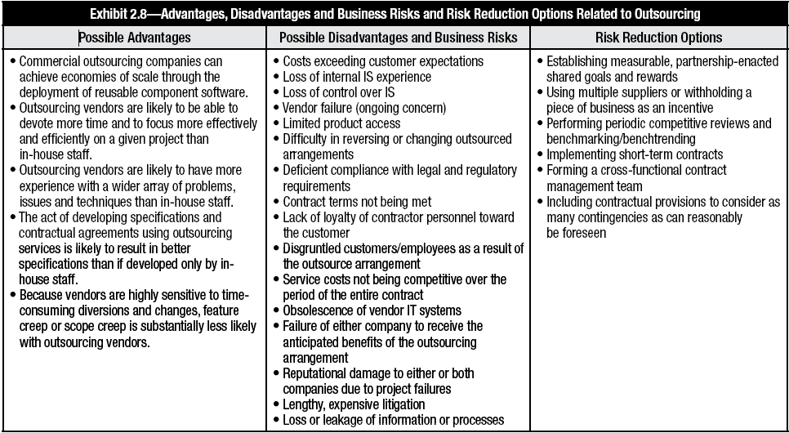
Sourcing Practices (cont.)

Slide 68
Sourcing Practices (cont.)
Globalization practices and strategies
Requires management to actively oversee the remote or offshore locations
The IS auditor can assist an organization in moving IS functions offsite or offshore by ensuring that IS management considers the following:
  Legal, regulatory and tax issues
  Continuity of operations
  Personnel
  Telecommunication issues
  Cross-border and cross-cultural issues

Slide 69
Sourcing Practices (cont.)
Governance in outsourcing
Mechanism that allows organizations to transfer the delivery of services to third parties
Accountability remains with the management of the client organization
Transparency and ownership of the decision-making process must reside within the purview of the client

Slide 70
Sourcing Practices (cont.)
Third-party service delivery management
Every organization using the services of third parties should have a service delivery management system in place to implement and maintain the appropriate level of information security and service delivery in line with third-party service delivery agreements
The organization should check the implementation of agreements, monitor compliance with the agreements and manage changes to ensure that the services delivered meet all requirements agreed to with the third party.

Slide 71
Change Management
What is change management?
Managing IT changes for the organization
  Identify and apply technology improvements at the infrastructure and application level
Change Management ensures that changes are recorded, evaluated, authorized, prioritized, planned, tested, implemented, documented and reviewed in a controlled manner.
The purpose of the Change Management process is to ensure that standardized methods are used for the efficient and prompt handling of all changes, that all changes are recorded and that overall business risk is optimized.

Slide 72
Change Types
Normal
  Non-urgent, requires approval
Standard
  Non-urgent, follows established path, no approval needed
Emergency
  Requires approval but too urgent for normal procedure

Slide 73
Change Advisory Board
Change Manager (VITAL)
One or more of
  Customer/User
  User Manager
  Developer/Maintainer
  Expert/Consultant
  Contractor
CAB considers the 7 Rs
  Who RAISED?, REASON, RETURN, RISKS, RESOURCES, RESPONSIBLE, RELATIONSHIPS to other changes

Slide 74
Change Management – Challenges
Respond to customers changing business requirements
Respond to business and IT requests for change that will align the services with the business needs
Roles
  Change Manager
  Change Authority
    Change Advisory Board (CAB)
    Emergency CAB (ECAB)
80% of service interruption is caused by operator error or poor change control (Gartner)

Slide 75
Risk Management
Risk Management is identifying, evaluating, and mitigating risk to an organization
  It’s a cyclical, continuous process
  Need to know what you have
  Need to know what threats are likely
  Need to know how and how well it is protected
  Need to know where the gaps are

Slide 76
Risk Management
The process of identifying vulnerabilities and threats to the information resources used by an organization in achieving business objectives.
Avoid
Mitigate
Transfer
Accept

Slide 77
Risk Management (cont.)
IT risk management needs to operate at multiple levels including:
The operational level
The project level
The strategic level

Slide 78
Auditing IT Governance Structure and Implementation
Indicators of potential problems include:
  Unfavorable end-user attitudes
  Excessive costs
  Budget overruns
  Late projects
  High staff turnover
  Inexperienced staff
  Frequent hardware/software errors

Slide 79
Reviewing Documentation – IS Auditor
The following documents should be reviewed:
  IT strategies, plans and budgets
  Security policy documentation
  Organization/functional charts
  Job descriptions
  Steering committee reports
  System development and program change procedures
  Operations procedures
  Human resource manuals
  Quality assurance procedures

Slide 80
Summary
Security Management practices involve balancing security processes and proper management and oversight
Risk Management is a big part of managing holistic security of an organization

Slide 81
References
ISO 27001 : 2013
NIST publications
  SP 800-12, The Computer Security Handbook
  SP 800-14, Generally Accepted Principles and Practices for Securing IT Systems
  SP 800-18, The Guide for Developing Security Plans for IT Systems
  SP 800-26, Security Self-Assessment Guide for Information Technology Systems
  SP 800-30, Risk Management Guide for Information Technology Systems

Slide 82
Questions ?

