Slide 1

COBIT 5 Webinar -1
Nanda Mohan Shenoy D
CAIIB,DBM-Part I,CISA,NCFM in(Commodities, FNO, Currency Derivatives, AMFI , Depository) PG Diploma in IRPM, PG Diploma in EDP and Computer Management, DIM,LA ISO 9001,LA ISO 27001
President ISACA Mumbai Chapter(2010-2012)

Slide 2
Disclaimer
This presentation is being made on a Best Effort basis.
No representation or warranties are made by the ISACA Mumbai Chapter with regard to the speaker’s presentation.
Views expressed by the Speaker is his Own Views and do not represent the views of ISACA
Members are expected to perform their own due diligence.
COBIT 5 is the copyright of ISACA International

Slide 3
Agenda
Two Modules
Part-1 & Part -2 (11th May 2014)
Part-1 Agenda
  Introduction to COBIT
  Understanding Principle-1
  Understanding Principle-2
  Understanding Principle-3

Slide 4
Prelude
Top of the mind recall two episodes which has affected the masses and showed IT in poor light in the last couple of years
Maharashtra Government online admissions to colleges for 11th Standard. Two years in a row
CAT Admission Fiasco
What went wrong?
  IT or the Process of Implementing the IT?

Slide 5
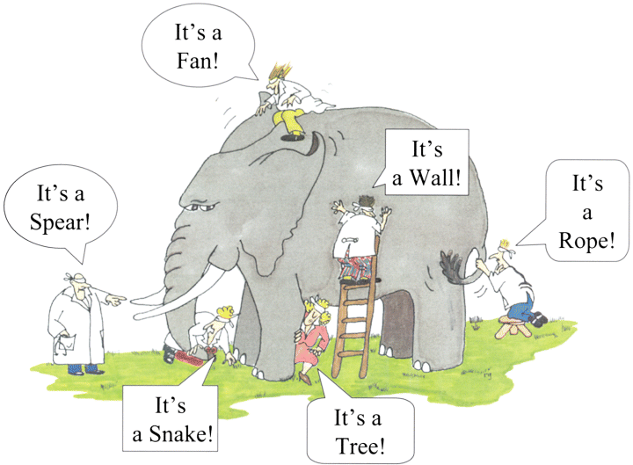
Blind Man & the elephant

Slide 6
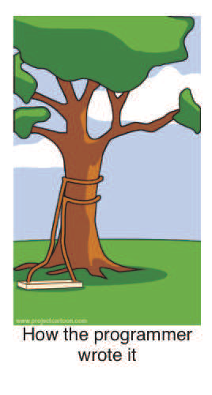
Business Vs IT Gap

Slide 7
4 W and 1 H Principle
What
Why
Where
When
How

Slide 8
What is COBIT
It is an acronym for
Control Objectives for Information
and Related Technology
It is a Framework by ISACA
Latest Version 5.0 released on 10th April 2012

Slide 9
Framework Vs Standard
Standards can be certified
Standards for certification has to be implemented in totality
Frameworks cannot be certified
Framework can be implemented in parts relevant to the organisation.

Slide 10
Version
Latest 5.0 released on 10th April 2012
Earlier Versions
  4.1 released in 2007
  4.0 released in 2005
Major overhaul of the framework between 4.1 & 5.0

Slide 11
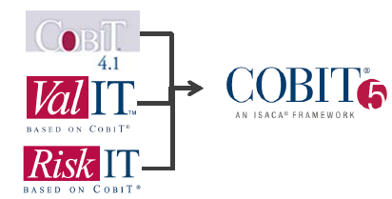
Integrated Framework

Slide 12
Definitions
Control
  The means of managing risk ,including policies, procedures, guidelines, practices or organisational structures which can be of administrative , technical, management or legal nature. Also used as a synonym for safeguard or counter measure
Objective
  Statement of the desired outcome.
Appendix H- Glossary

Slide 13
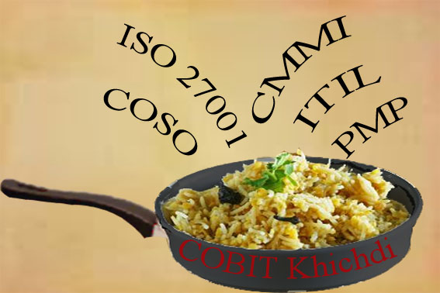
Inputs?

Slide 14
Inputs
ISO/IEC 38500 –Corporate Governance of Information Technology (adopted from AS 8015)
ITIL
ISO/IEC 27000-Information Security Management Systems
ISO/IEC 31000 – Risk Management
TOGAF(The Open Group Architecture Framework)
CMMI
PRINCE2

Slide 15
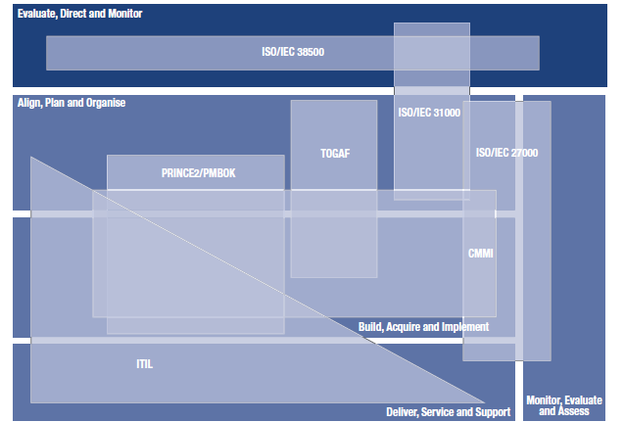
Overlaps

Slide 16
Other Q
Where?
  Any type of organisation irrespective of size ,sector and profit motive
When?
How?

Slide 17
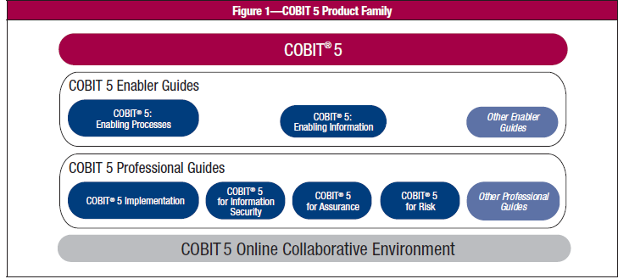
Product Family

Slide 18
Audience for COBIT
Executive Management and Boards
Business and IT Management
Governance Assurance ,control and Security Professionals

Slide 19
Framework Contents
Organised into 8 chapters
Ch-1-Overview of COBIT 5
Ch-2Principle 1- Meeting Stakeholder needs
Ch-3Principle 2- Covering Enterprise end to end
Ch-4Principle 3- Applying a Single Integrated Framework
Ch-5Principle 4-Enabling a holistic approach

Slide 20
Framework Contents
Ch 6.Principle 5-Seperating Governance from Management
Ch 7.Implementation Guidance
Ch 8.The COBIT 5 Process Capability Model
There are 8 Appendix to the main framework

Slide 21
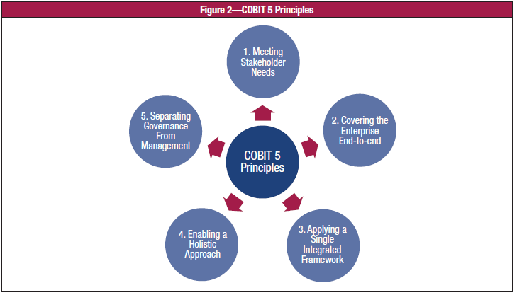
5 Principles

Slide 22
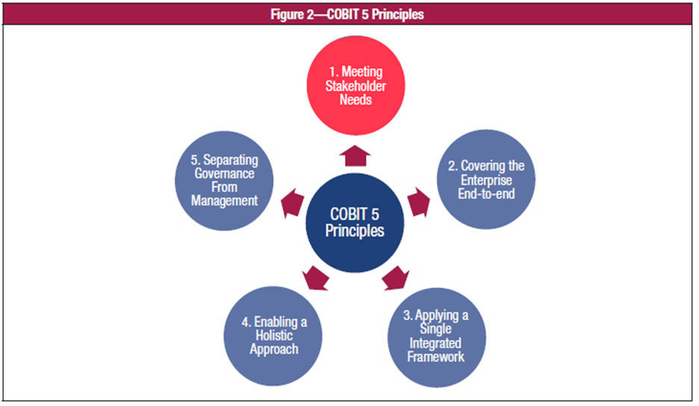
Prin-1

Slide 23
Principle 1:
Meeting Stakeholder Needs
Enterprises have many stakeholders
  Internal
  External
Governance is about
  Negotiating
  Deciding amongst different stakeholders’ value interests
  Considering all stakeholders when making benefit, resource and risk assessment decisions
For each decision, ask:
  For whom are the benefits?
  Who bears the risk?
  What resources are required?
Notes:
Ref 3.1

Slide 24
Stakeholder
Anyone who has a responsibility for ,an exception from or some other interest to the enterprise - e.g., shareholders, users, government, suppliers, customers and the public

Slide 25
Governance defined
Governance ensures that stakeholder needs, conditions and options are evaluated to determine balanced ,agreed on enterprise objectives to be achieved ;setting direction through prioritisation and decision making and monitoring performance and compliance against agreed on condition and objective-

Slide 26
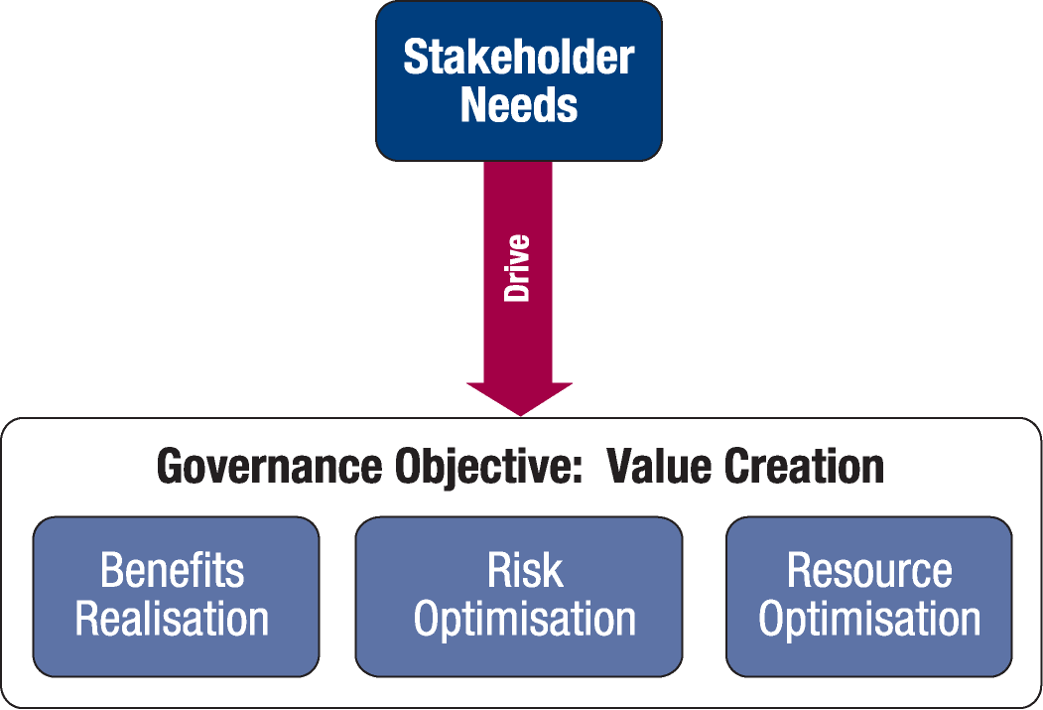
Principle 1:
Meeting Stakeholder Needs
Enterprises exist to create value for their stakeholders
Value creation: realizing benefits at an optimal resource cost while optimizing risk.
Notes:
Ref 3.1

Slide 27
Benefit Realisation
One of the objectives of governance. The bringing about of new benefits for the enterprise, the maintenance and extension of existing forms of benefits, and the elimination of those initiatives and assets that are not creating sufficient value.

Slide 28
Principle-1 contd
Because every enterprise has different objectives, an enterprise can customise COBIT 5 to suit its own context through the goals cascade, translating high-level enterprise goals into manageable, specific, IT-related goals and mapping these to specific processes and practices.

Slide 29
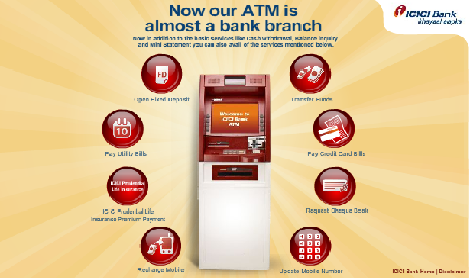
ATM Trends

Slide 30

ATM Trends

Slide 31
Risk Optimisation
One of the governance objectives. Entails recognising risk; assessing the impact and likelihood of that risk; and developing strategies, such as avoiding the risk, reducing the negative effect of the risk and transferring the risk , to manage it within the context of the enterprises’ risk appetite

Slide 32
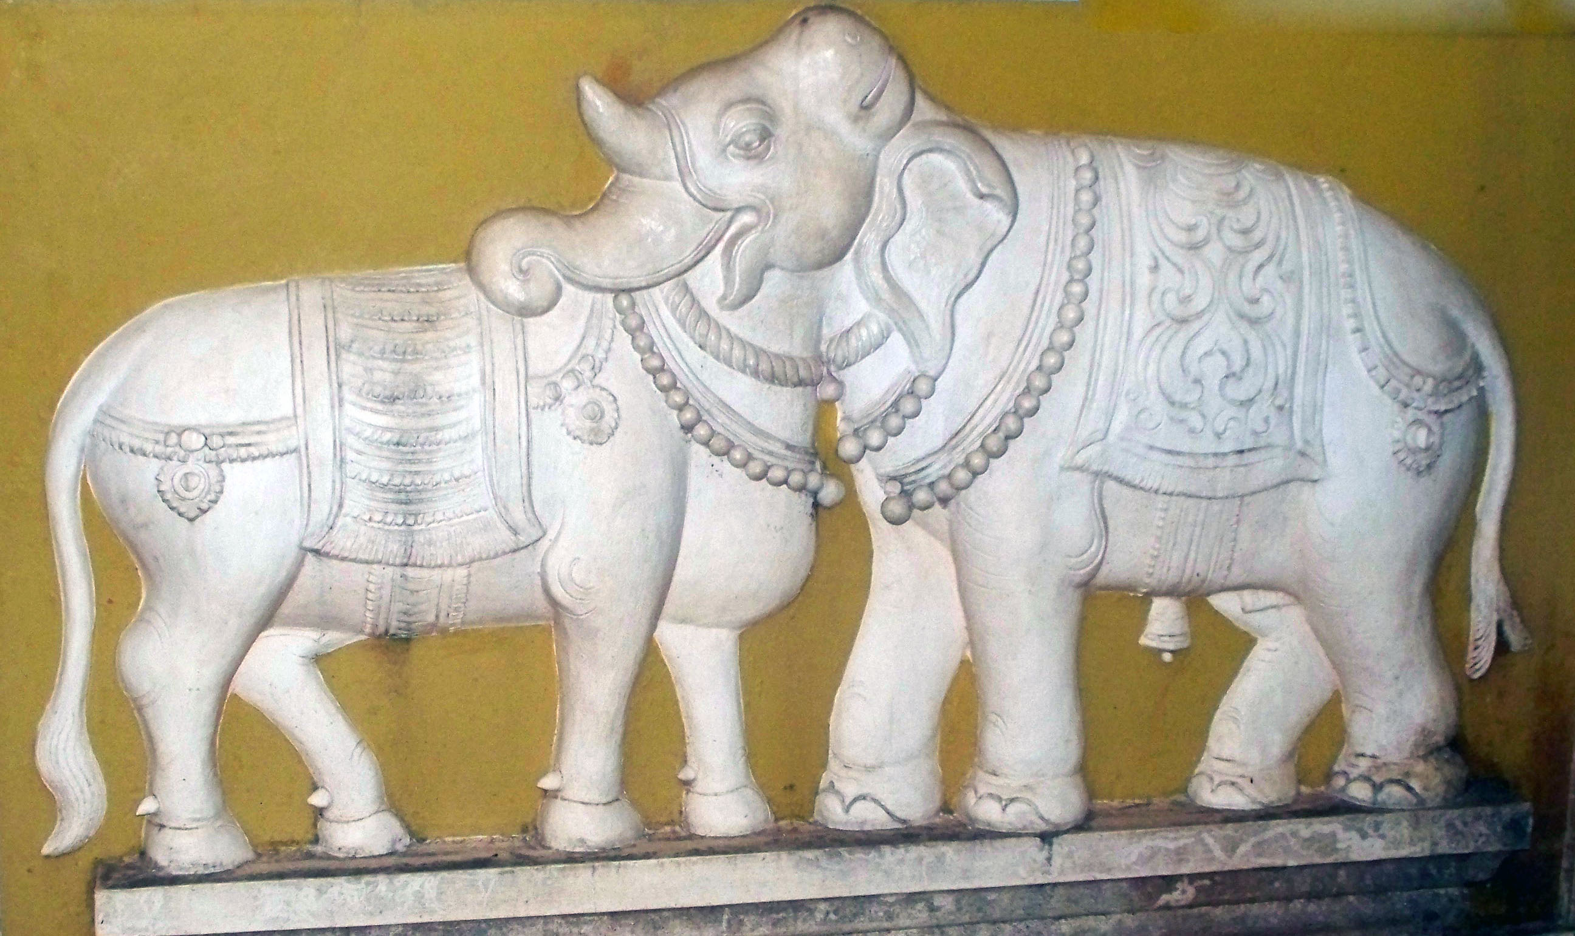
Risk

Slide 33

Risk ?

Slide 34
Risk
And the cynic... wonders who drank the other half
The school teacher says it's not about whether the glass is half empty or half full, it's whether there is something in the glass at all.
The professional trainer does not care if the glass is half full or half empty, he just knows that starting the discussion will give him ten minutes to figure out why his power point Presentation is not working
The optimist says the glass is half full.
The pessimist says the glass is half empty
The project manager engineer says the glass is twice as big as it needs to be
The realist says the glass contains half the required amount of liquid for it to overflow.
Notes:
Risk perception of CFO/CISO/CEO etc will keep varying

Slide 35
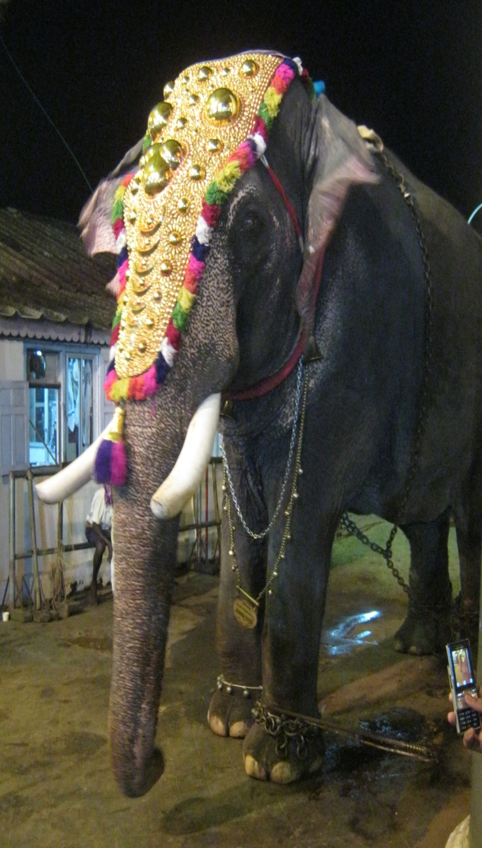

Case Study from nature
Kerala has a number of elephants and these elephants are taken from temple to temple for processions. These elephants travel by road and that too on the national highway especially during the night. There have been a number of accidents in which the elephants were injured. Identify a practical solution to manage this risk.

Slide 36
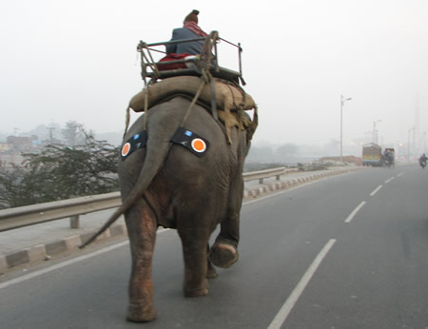
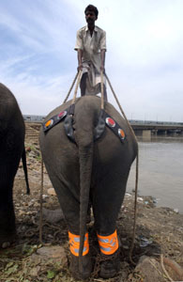
Solution

Slide 37
Case Study-2
One of the most memorable case studies on Japanese management was the case of the empty soapbox, which happened in one of Japan 's biggest cosmetics companies. The company received a complaint that a consumer had bought a soapbox that was empty.

Slide 38
Case Study-2 Contd..
Immediately the authorities isolated the problem to the assembly Line, which transported all the packaged boxes of soap to the delivery department. For some reason, one soapbox went through the assembly line empty.

Slide 39
Solution ?
Post-haste, the engineers worked hard to devise an X-ray machine with high-resolution monitors manned by two people to watch all the soapboxes that passed through the line to make sure they were not empty. No doubt, they worked hard and they worked fast but they spent a whoopee amount to do so.

Slide 40
Common Man Solution
A rank-and-file employee in a small company was posed with the same problem,
He bought a strong industrial electric fan and pointed it at the assembly line.
He switched the fan on, and as each soapbox passed the fan, it simply blew the empty boxes out of the line.

Slide 41

Risk Management

Slide 42
Resource Optimization
One of the governance objectives. Involves effective, efficient and responsible use of all resources-human financial ,equipment facilities etc

Slide 43
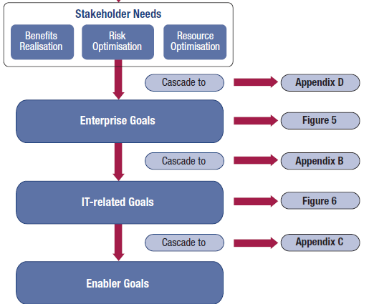
Principle-1

Slide 44
Principle 1 – Cascade Steps
Notes:
3.2 in facilitator’s guide

Slide 45
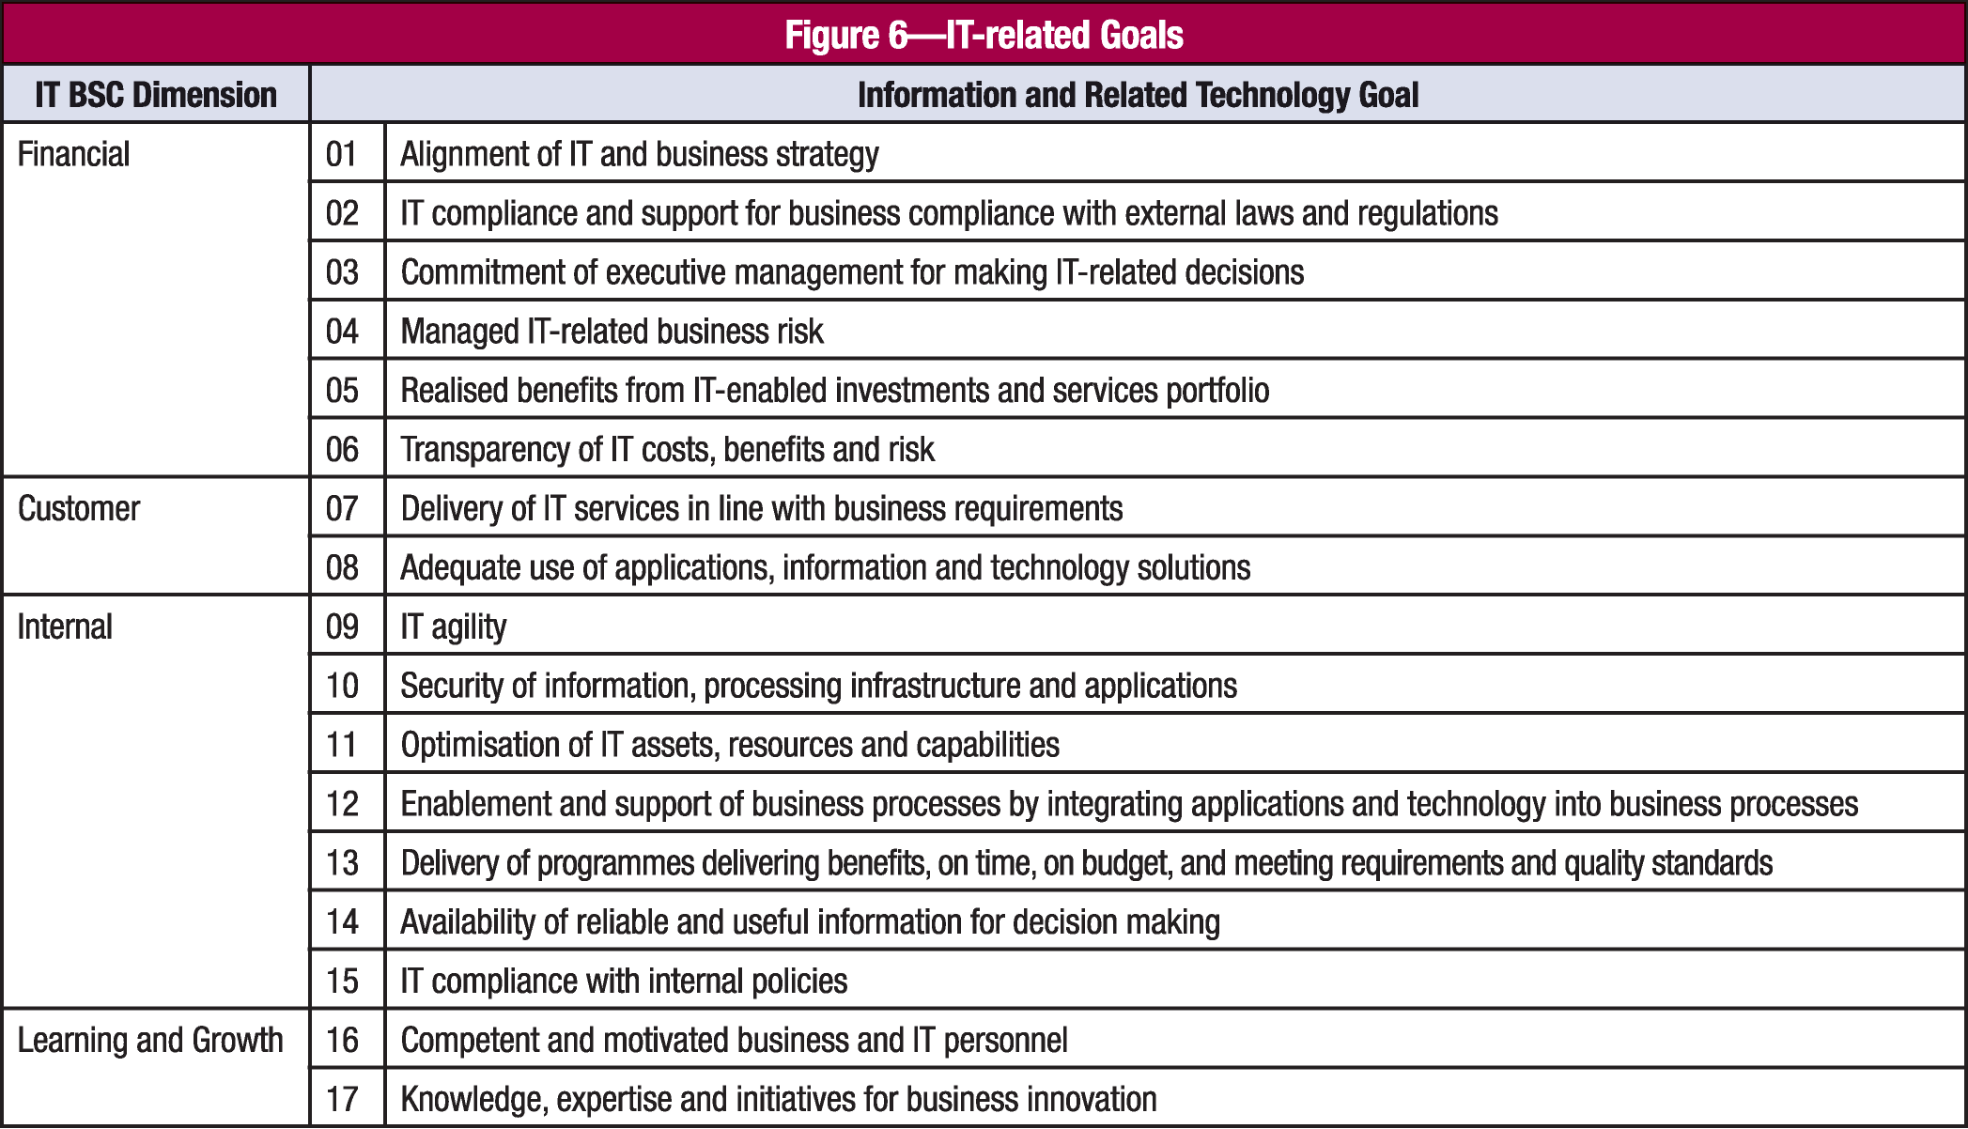
Principle 1 – Cascade Steps
Step 3 - Enterprise Goals cascade to IT related Goals
There are also 17 generic IT related goals as shown in Figure 6 (shown below) that are also categorised into the Balanced Score Card (BSC) categories. The relationship of enterprise goals to IT related Goals are shown in Appendix B Figure 22 page 50

Slide 46
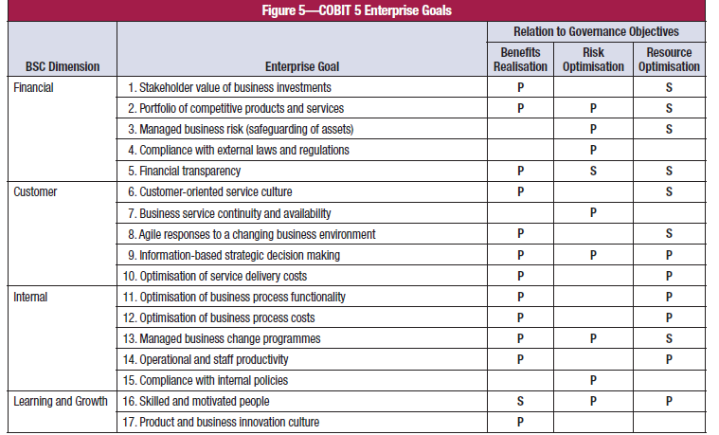
Fig-5

Slide 47
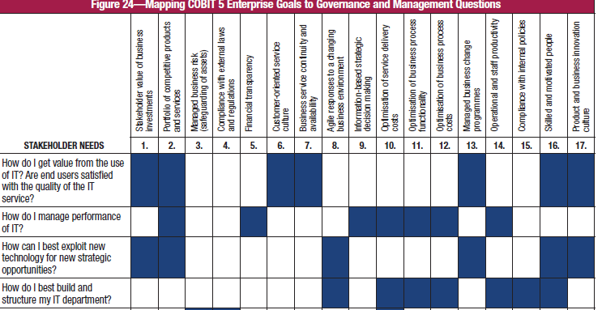
Appendix-D

Slide 48
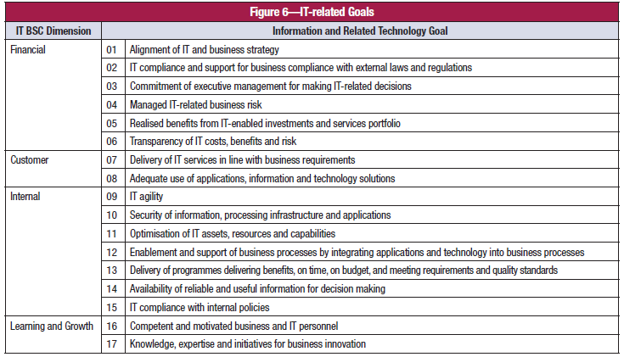
Fig-6

Slide 49
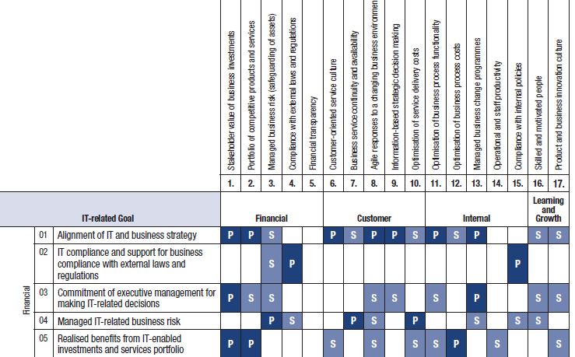
Appendix-B

Slide 50
Principle 1 – Cascade Steps
Step 4 IT related Goals Cascade to Enabler Goals
Processes are one of the key enablers which is expanded on in the Enabler Learning Area module, but it is important to know that Enabler Goals are represented in the Process Reference module in all 37 processes. A mapping is shown in Appendix C

Slide 51
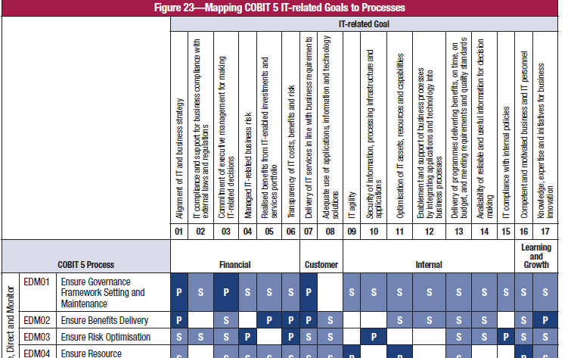
Appendix C

Slide 52
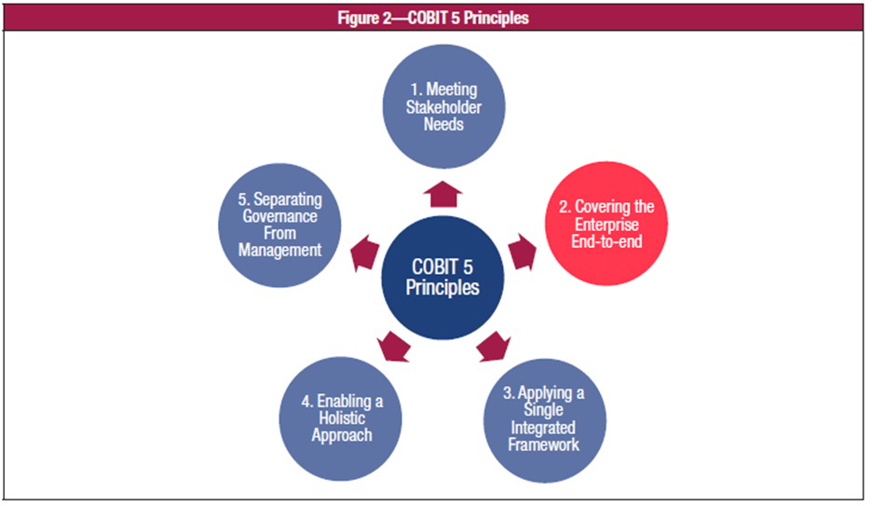
Prin-2

Slide 53
Principle-2
Covering the Enterprise end to end
COBIT 5 integrates governance of enterprise IT into enterprise governance:
– It covers all functions and processes within the enterprise; COBIT 5 does not focus only on the ‘IT function’, but treats information and related technologies as assets that need to be dealt with just like any other asset by everyone in the enterprise.

Slide 54
Principle-2
– It considers all IT-related governance and management enablers to be enterprise wide and end-to-end, i.e., inclusive of everything and everyone—internal and external—that is relevant to governance and management of enterprise information and related IT.

Slide 55
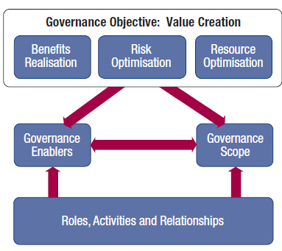
Principle-2

Slide 56
Governance Enablers
Governance enablers are the organisational resources for governance, such as frameworks, principles, structures, processes and practices, through or towards which action is directed and objectives can be attained. Enablers also include the enterprise’s resources—e.g., service capabilities (IT infrastructure, applications, etc.), people and information. A lack of resources or enablers may affect the ability of the enterprise to create value

Slide 57
Governance Scope
Governance can be applied to the entire enterprise, an entity, a tangible or intangible asset, etc. That is, it is possible to define different views of the enterprise to which governance is applied, and it is essential to define this scope of the governance system well. The scope of COBIT 5 is the enterprise—but in essence COBIT 5 can deal with any of the different views

Slide 58
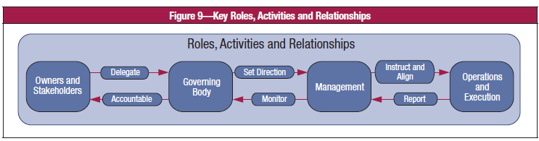
Role etc

Slide 59
India Government End to end
What is your perception of the Indian Government with respect to e-Governance covering all the departments?

Slide 60
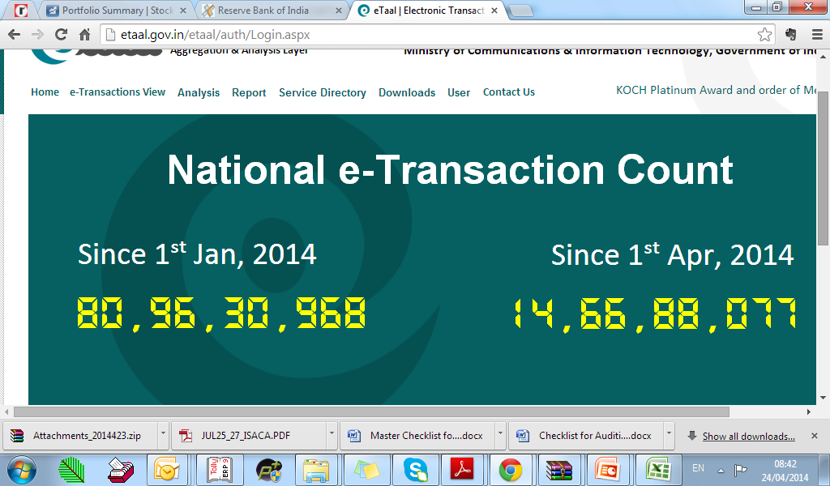
etaal
Which aspect of the BSC is this trying to address

Slide 61
Principle 2:
Covering the Enterprise End–to–End
Governance roles, activities and relationships
  Define Who is involved in governance
  How they are involved
  What they do and
  How they interact
COBIT 5 defines the difference between governance and management activities in principle 5
Notes:
Reference 3.3.2 see also www.takinggovernanceforward.org

Slide 62
To BE CONTINUED

