Slide 1
Business Continuity
Management
Mrs. Geetha Murugesan
CISA,CRISC , CGEIT (Passed), COBIT 5.0

Slide 2

Business Continuity in the 21st Century
Heightened Threats
Since 9/11, everyone knows that now even the unimaginable is possible
SARS outbreaks in China, Hong Kong and Canada have raised the spectre of widespread employee illness or quarantine
Major power blackouts in the US and Canada, Italy, and elsewhere have demonstrated the fragility of critical infrastructures
The catastrophic tsunami of 2004 and the 2010 earthquake in Haiti demonstrated the power and unpredictability of Mother Nature
H1N1 caused international concern, and the threat of a Flu Pandemic still looms in the future

Slide 3

Business Continuity in the 21st Century
Heightened Expectations
The catastrophic collapses of Enron, Arthur Andersen, Worldcom, etc. have resulted in higher standards for risk management and executive accountability
Sarbanes-Oxley (SOX), HIPAA, Basel II, and a score of other regulations have made good governance and effective risk management a boardroom priority
As an essential component of risk management and good governance, BCP can no longer be considered optional

Slide 4
Disasters – natural, man-made
Fire, flood, hurricane, tornado, earthquake, volcanoes
Plane crashes, vandalism, terrorism, riots, sabotage, loss of personnel, etc.
Anything that diminishes or destroys normal data processing capabilities

Slide 5
Disasters are defined in terms of the business
If it harms critical business processes, it may be a disaster
Time-based definition – how long can the business stand the pain?
Probability of occurrence

Slide 6
Failing to Plan
is
Planning to Fail

Slide 7
Broad BCP objectives - CIA
Availability – the main focus
Confidentiality – still important
Integrity – still important

Slide 8
Drivers for Business Continuity Management
Key Stakeholders
Customers
Regulator
Staff
Board of Directors
Insurance Company (Highly Protected Risk status!)
Supply Chain
Protection of the Organisation’s Reputation

Slide 9
BCP objective
Create, document, test, and update a plan that will:
  Allow timely recovery of critical business operations
  Minimize loss
  Meet legal and regulatory requirements

Slide 10
Scope of BCP
Used to be just the data center
Now includes:
  Distributed operations
  Personnel, networks, power
  All aspects of the IT environment

Slide 11
What is Business Continuity Planning (BCP)?
A proactive process that identifies and prioritizes the critical functions and the likely threats to those functions. From this information, plans and procedures are developed through a regular program of personnel training, plan testing, and maintenance. These management disciplines, processes, and techniques provide business continuity for critical business functions under the circumstances and limits set by senior management.
These circumstances and limits include:
  Defining worst-case scenarios used for business continuity planning.
  Approving the funding and staffing of the company's BCP Program.

Slide 12
BCP …. Contd
At a high level, a Business Continuity Plan is a combination of:
  defined strategies and detailed procedures for system recovery
  defined strategies and detailed procedures for business resumption
  a formal team structure for executing the applicable procedures and managing the crisis
  all advance arrangements required to support the above
At a detailed level, a Business Continuity Plan is:
  a documented series of activities (Business Resumption Plan) that may need to be performed by designated teams to recover systems and/or resume critical business functions following a disruptive incident

Slide 13
BCP Definition
“BCP,” or Business Continuity Planning, is an effort within a company to ensure that Critical Business Functions continue to be performed during a wide range of emergencies, including localized acts of nature, accidents, and technological or attack-related emergencies (the terms Business Continuity Planning and Business Continuity Management are generally used interchangeably)
Notes:
13

Slide 14
Business Continuity Management (BCM) – What ?
BCM is about ensuring that your Business prepares a plan to handle a serious incident. During this process you can identify ways to reduce the risk of an incident happening and minimise the impact if it does happen.
If an incident occurs key staff should be trained to handle the situation through testing and exercising which will enable your business to continue to function to the agreed level with the least disruption possible.

Slide 15
Disaster Recovery
Business Continuity Planning
  A business continuity plan specifies how a company plans to restore core business operations when disasters occur
Disaster Recovery
  Disaster recovery looks specifically at the technical aspects of how a company can get back into operation using backup facilities

Slide 16
Creating a BCP
Is an on-going process, not a project with a beginning and an end
  Creating, testing, maintaining, and updating
  “Critical” business functions may evolve
The BCP team must include both business and IT personnel
Requires the support of senior management

Slide 17
The Purpose of a Business Continuity Plan
When a company is faced with a continuity event, the BCP will:
Provide for continuation of critical business functions
Enable a rapid response to any emergency situation
BCP is different from ordinary emergency plans.
It goes a step further to ensure delivery of the most critical services even when personnel, equipment and resources are missing or not working.
Notes:
17

Slide 18
BCP Overview: Planning Considerations
BCP plans must:
Be capable of implementation anytime, with and without warning.
Provide full operational capability for critical business functions not later than 12 hours after activation, often sooner.
Be capable of sustaining operations for up to 30 days or longer.
Include regularly scheduled Testing and Training.
Notes:
18

Slide 19
What should the detailed plans contain?
Each Team’s plan should contain:
Activity Details
  Strategy overview for each incident type (or ‘disaster scenario’)
Activity Lists
Off-site Materials
  List of minimum recovery requirements
Team Members
Recovery Requirements
  Team membership and contact info.
Strategy Overviews
  Off-site materials list and other supporting documentation
Your Organization
Business Continuity Plan
  Activity lists (organized by phase and scenario)
  Activity details

Slide 20
What is an Activity?
An activity is the ‘Operating Unit’ of the plan
Each activity describes:
  What has to be done
  How it can be done
  Who can do it
  What is needed to do it

Slide 21
What is a Phase?
A phase is a grouping of activities used to provide a logical structure for each team’s plan
Each phase represents a critical stage in the Operations Resumption plan
There are typically five phases

Slide 22
The five BCP phases
Project management & initiation
Business Impact Analysis (BIA)
Recovery strategies
Plan design & development
Testing, maintenance, awareness, training

Slide 23
I - Project management & initiation
Establish need (risk analysis)
Get management support
Establish team (functional, technical, BCC – Business Continuity Coordinator)
Create work plan (scope, goals, methods, timeline)
Initial report to management
Obtain management approval to proceed

Slide 24
II - Business Impact Analysis (BIA)
Goal: obtain formal agreement with senior management on the MTD for each time-critical business resource
MTD – maximum tolerable downtime, also known as MAO (Maximum Allowable Outage)

Slide 25
II - Business Impact Analysis (BIA)
Quantifies loss due to business outage (financial, extra cost of recovery, embarassment)
Does not estimate the probability of kinds of incidents, only quantifies the consequences

Slide 26
Important Terminologies - BIA
Recovery Time Objective (RTO)
    Maximum Elapsed time required to complete the recovery
Recovery Point Objective (RPO)
    Which data must be recovered to resume business operations
Critical Support
    Business units to be present to sustain continuity of business
Maximum Tolerable Downtime (MTD)
    Maximum delay a business can tolerate to be viable

Slide 27
Maximum Tolerable Downtime
Normal – 7 days
Important – 72 hours
Urgent – 24 hours
Critical – Minutes to hours

Slide 28
II - BIA phases
Choose information gathering methods (surveys, interviews, software tools)
Select interviewees
Customize questionnaire
Analyze information
Identify time-critical business functions

Slide 29
II - BIA phases (continued)
Assign MTDs
Rank critical business functions by MTDs
Report recovery options
Obtain management approval

Slide 30
III – Recovery strategies
Recovery strategies are based on MTDs
Predefined
Management-approved

Slide 31
III – Recovery strategies
Different technical strategies
Different costs and benefits
How to choose?
Careful cost-benefit analysis
Driven by business requirements

Slide 32
III – Recovery strategies
Strategies should address recovery of:
  Business operations
  Facilities & supplies
  Users (workers and end-users)
  Network, data center (technical)
  Data (off-site backups of data and applications)

Slide 33
III – Recovery strategies
Technical recovery strategies - scope
  Data center
  Networks
  Telecommunications

Slide 34
III – Recovery strategies
Technical recovery strategies – methods
  Subscription services
  Mutual aid agreements
  Redundant data centers
  Service bureaus

Slide 35
III – Recovery strategies
Technical recovery strategies – subscription service sites
  Hot – fully equipped
  Warm – missing key components
  Cold – empty data center
  Mirror – full redundancy

Slide 36
III – Recovery strategies
Technical recovery strategies – mutual aid agreements
  I’ll help you if you’ll help me!
  Inexpensive
  Usually not practical

Slide 37
III – Recovery strategies
Technical recovery strategies – redundant processing centers
  Expensive
  Maybe not enough spare capacity for critical operations

Slide 38
III – Recovery strategies
Technical recovery strategies –service bureaus
  Many clients share facilities
  Almost as expensive as a hot site
  Must negotiate agreements with other clients

Slide 39
III – Recovery strategies
Technical recovery strategies –data
  Backups of data and applications
  Off-site vs. on-site storage of media
  How fast can data be recovered?
  How much data can you lose?
  Security of off-site backup media
  Types of backups (full, incremental, differential, etc.)

Slide 40
Recovery Strategies
Types of Backup Facilities
  Hot sites
    Ready to run (power, HVAC, computers): Just add data
    Considerations: Rapid readiness versus high cost
  Cold sites
    Building facilities, power, HVAC, communication to outside world only
    No computer equipment
    Might require too long to get operating

Slide 41
Recovery Strategies
  Site sharing
    Site sharing with a firm’s sites (problem of equipment compatibility and data synchronization)
    Site sharing across firms (potential problem of prioritization, sensitive actions)
  Hosting
    Hosting company runs production server at its site
    Will continue production server operation if user firm’s site fails
    If hosting site goes down, there have to be contingencies

Slide 42
Recovery Strategies
Restoration of Data and Programs
  Restoration from backup tapes: Need backup tapes at the remote recovery site
  Real-time journaling (copying each transaction in real time)
  Database replication

Slide 43
IV – BCP development / implementation
Detailed plan for recovery
  Business & service recovery plans
  Maintenance
  Awareness & training
  Testing

Slide 44
IV – BCP development / implementation
Sample plan phases
  Initial disaster response
  Resume critical business ops
  Resume non-critical business ops
  Restoration (return to primary site)
  Interacting with external groups (customers, media, emergency responders)

Slide 45
V – BCP final phase
Testing
Maintenance
Awareness
Training

Slide 46
V – BCP final phase - testing
Until it’s tested, you don’t have a plan
Kinds of testing
  Structured walk-through
  Checklist
  Simulation
  Parallel
  Full interruption

Slide 47

Test the Plan
How ready are you?
Test the equipment
Exercise abilities to see if we can do what we said we could do
Carry out drills to make sure that every individual, in all areas, is sure of personal capabilities and personal responsibilities in the event of an emergency
Notes:
47

Slide 48
Type of Testing
Checklist Test
    DR plans to be verified by all functional heads
Walkthrough Test
    Representatives from each department go over the plan to ensure its accuracy
Simulation Test
    Practicing of the plan based on specific scenario

Slide 49
Type of Testing
Parallel Test
    Running of critical systems at another site when main site is functioning and comparing the results
Full Interruption Test
    Shutting down of Main facility and moving operations to the DR site and checking the functionality

Slide 50
V – BCP final phase - maintenance
Fix problems found in testing
Implement change management
Audit and address audit findings
Annual review of plan
Build plan into organization

Slide 51

Keep the Plan Up-To-Date
Conduct drills
Evaluate drills
Drills and evaluations will aid us in developing improvement plans and help us change our plan to make it better
All of this keeps your plan up-to-date and flexible to change, realizing that you are only as good as your next opportunity to show it
Notes:
51

Slide 52
V – BCP final phase - training
BCP team is probably the DR team
BCP training must be on-going
BCP training needs to be part of the standard on-boarding and part of the corporate culture

Slide 53

Train Personnel
Check the knowledge, skills and abilities of all personnel
Provide training so everyone is sure they are ready for emergencies
Train on procedures for emergencies that occur with warning, and without warning
Training is a key to being ready
Notes:
53

Slide 54
Elements of the DR Team
Recovery Team
    To get the pre-defined critical business functions operating at the alternate site
Salvage Team
    To bring the primary site in the normal processing environmental state
Resumption of Normal Operations
    Emergency is not over until operations are in full production mode

Slide 55
Elements of the DR Team
Other Recovery issues
    Employee Relations
    External Agency Interfacing
    Fraud and Crime
    Financial Disbursement
    Media Relations

Slide 56
The Keys to Success
Plan development is not rocket science, but …
  every function must follow a consistent methodology to ensure the plans will work, and work together, when required
  plans must be documented in sufficient detail that they may be executed even in the absence of the primary expert
  standard formats and terminology must be used to avoid misinterpretation and facilitate maintenance
The use of templates or software tools alone will not ensure these goals are met

Slide 57
The Keys to Success (cont)
The keys to successful plan development are:
Commitment from all functions
Selection of the right people to develop each team’s plan
Practical training of those people in the plan development process

Slide 58
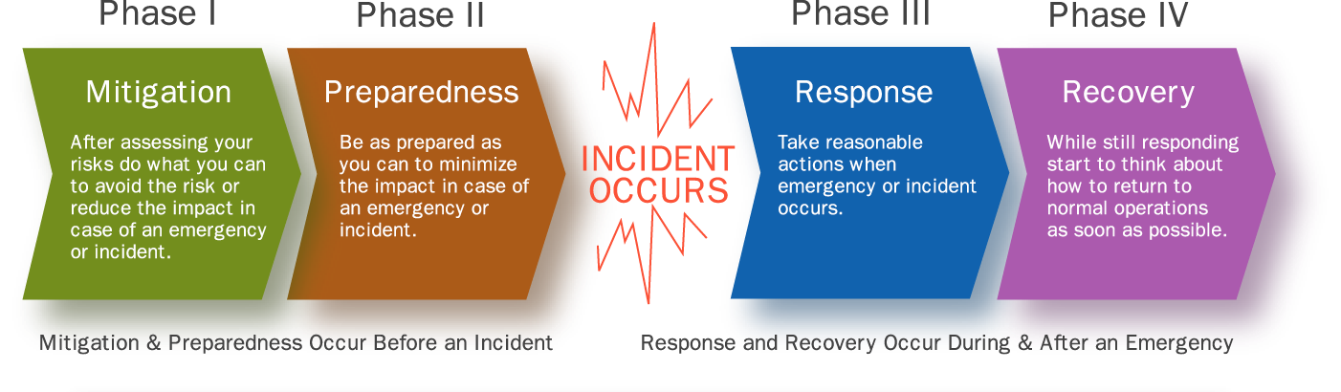
Phases of Continuity Planning
58
June 20, 2014
Notes:
58

Slide 59
Summary
BCP Planning is not just a one-time event
It is only one aspect of an on-going program to manage risk and maintain a company’s ability to withstand potentially disastrous incidents
As such, it requires:
  permanent management commitment,
  the assignment of accountability,
  establishment of an annual budget
  the provision of adequate resources, and
  executive management support.

Slide 60
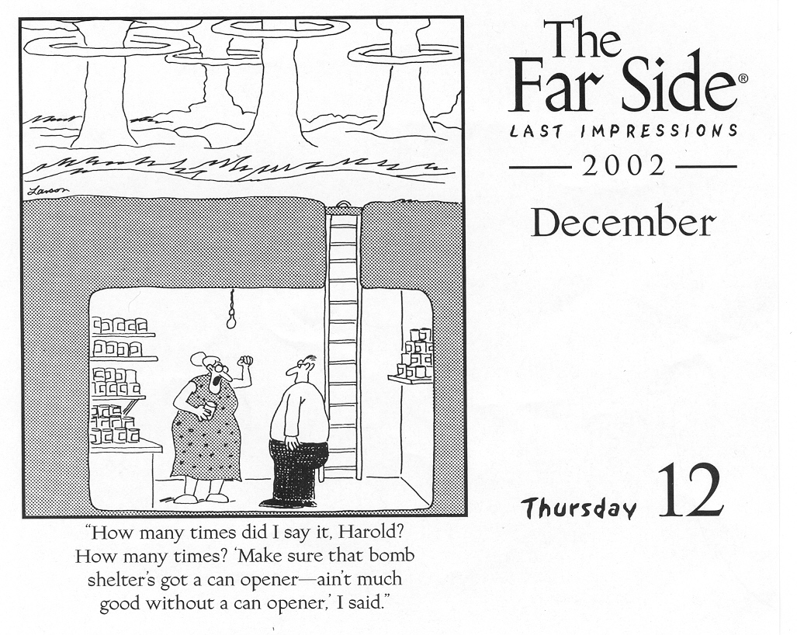
Why do BCP?
Disaster can strike without warning.
Planning what to do in advance is an important part of being prepared.
BCP planning means you might need to do fewer things.
It means you might do things at a new location.
It means you might do things with different personnel.
What you get in the end is a real plan for keeping your people safe, your company still working and your recovery safe and effective as you resume normal operations.
Notes:
60

Slide 61
Business Continuity Standards
Some standards that exist are:
•NFPA 1600 – US National Fire Protection Association, developed from dealing with fire and looks at business continuity from a denial of access perspective
•ISO 17799 – a standard for information security management systems that manages and minimizes threats to information
•ISO 22399 – guidelines for incident awareness and operational continuity management
•AS/NZS 4360:2004 – shared by Australia/New Zealand, provides risk management guidelines
•SPRING TR 19 – Singapore technical reference to BCM, which mainly deals with the technical aspects of systems
•The King II report of Corporate Governance – these South African guidelines for risk management look at BCM from a governance perspective

Slide 62
Business Continuity Standards
BS 25999 and ISO 22301
A standard approach to Business Continuity Management (BCM) has been suggested for decades. Prototype draft standards have been published, but never really quite gained the momentum to succeed.
This void has therefore been obvious and glaring for a long time. However, this landscape finally changed dramatically late in 2006, with the publication of the first part of BS 25999, a code of practice for business continuity management.
The concept of the standard itself has also been on the table for quite a long time. BSI published a draft standard known as PAS56 back in 2003. This was largely for public comment: the normal process adopted by BSI as part of the development of its major standards. In 2006 a draft version of BS25999-1 was published, again for public comment. Eventually, in November of that year, the standard was finally born, with a fanfare of announcements, conferences and podcasts.

Slide 63
Business Continuity Standards
A similar process followed in November 2007 when the second and final part of the standard was published.
ISO 22301
As with so many BSI standards, an ISO standard eventually began to emerge: ISO 22301. Although the influence of other standards is clear, the foundation is based upon BS25999-2.

Slide 64
Reference materials - websites
Disaster Recovery Institute International
  www.drii.org
Disaster Recovery Journal
  www.drj.com
Business Continuity Institute (UK)
www.thebci.org
Contingency Planning and Management (US)
www.contingencyplanning.com
Disaster Recovery Information Exchange (Canada)
  www.drie.org
Global Continuity (UK)
  www.globalcontinuity.com
Survive (New Zealand, Australia, Ireland, UK)
  www.survive.com

Slide 65
Questions?

