Slide 1
Accounts Payables

Slide 2
Accounts Payable
SAP Purchasing Cycle
Creating Documents in Accounts Payable
Payment Terms and Cash Discounts
Automatic Payment Run
Post Payment Run Processes Key Simplifications in S/4 HANA
SAP Purchasing Cycle

Slide 3
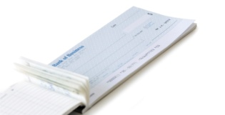




Accounts Payable Process Flow
Purchase
Request
SAP Purchase Cycle
8
Payment Processing
1
Determination of Requirements
Invoice
Item:
1
2
3
Purchase
Order
Item:
1
2
Procurement
Data
2
Source Determination
7
Invoice Verification
Data
6
Goods Receipt
3
Vendor Selection
Purchase
Order
Item:
1
2
3
5
PO Monitoring
4
PO Processing
Integration with SAP Finance
PTP uses integrated Vendor Master Record but does not post document to Finance
Inventory Receipt requires posting to Finance GL (no postings to sub ledger)
Invoice Receipt requires posting to Vendor Subledger recording the amount owed

Slide 4
Purchase Cycle Organizational Structure
SAP Purchase Cycle
Purchase To Pay
Finance To Manage
Company Code
PTP
Purchasing Group
FTM
A B ‘A is assigned to B’
Purchasing Organization
Cost Center
Valuation Area
Storage
Location
Plant
In order for the purchase process to work, the following organizational structure must be defined and assignment must be made where the arrows exist
Shipping Point
Loading Point

Slide 5
Accounts Payable Process Flow
SAP Purchase Cycle
  Within SAP FI, there are a group of transaction codes where users create AP documents and monitor AP activity
  On the right, the SAP transaction codes are shown where these documents can be created and viewed
SAP FI Module
SAP FI Module
Company Owes Money
Company Pays Money to Vendor
Vendor Invoice
Customer Payment
Invoice Created – FB60
Report to View Invoices – FBL1N
Manual Payment – F-53
Automatic Payment – F110

Slide 6
Accounts Payable
SAP Purchasing Cycle
Creating Documents in Accounts Payable
Payment Terms and Cash Discounts
Automatic Payment Run
Post Payment Run Processes
Creating Documents in Accounts Payable

Slide 7
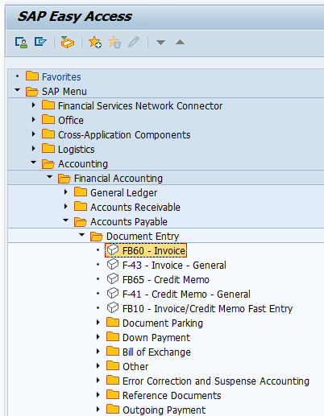
Document Entry in SAP FI-AP
Creating Documents in Accounts Payable
  On the main homepage of SAP, a user can click through the folder structure on the right to find the transactions where they can create Accounts Payable related documents
  In each of these screens, a user will enter a different type of document such as creating invoices to capture a sale of goods, recording customer payments, clearing documents, etc
  They are all programmed to make a specific accounting journal entry to record the event in the company’s financial books

Slide 8
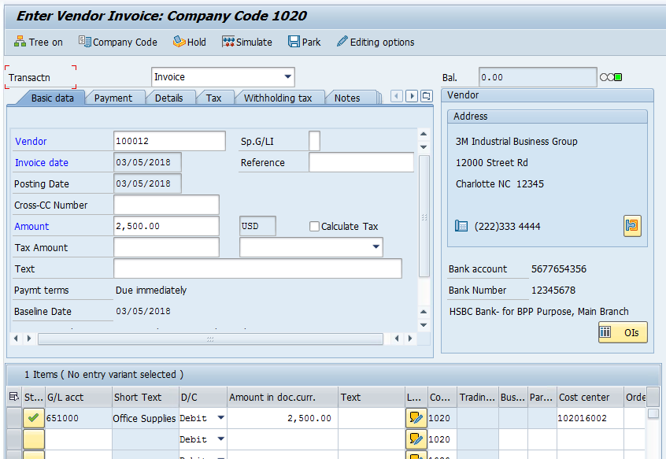
Vendor Invoice: T-Code FB60
Creating Documents in Accounts Payable
  Transaction code FB60 shown on the right is where Vendor invoices are created
  If the PTP module is integrated with finance, PTP purchase orders can automatically create the FI vendor invoices
  Once created, SAP establishes that it owes a certain amount of money to a particular business partner
  It can be immediately viewed in the ‘Open Items’ Report’ in the transaction code FBL1N

Slide 9
Create a Vendor Invoice: T-Code FB60
Creating Documents in Accounts Payable
  Because FB60 is only used for Vendor invoices, the program defaults many values behind the scenes, which users do not need to enter
  Some of these defaulted values include:
  Document Type
  Posting Keys
  Currency

Slide 10
Create a Vendor Invoice: T-Code FB60
Creating Documents in Accounts Payable
  Despite defaulted values, at a minimum certain required fields must be entered by the user
  In the Document Header these include:
  Company Code
  Posting Date
  Amount
  In the Line Item these include:
  G/L Account (ie. ‘Expense’)
  Amount
  Cost Center/Profit Center

Slide 11
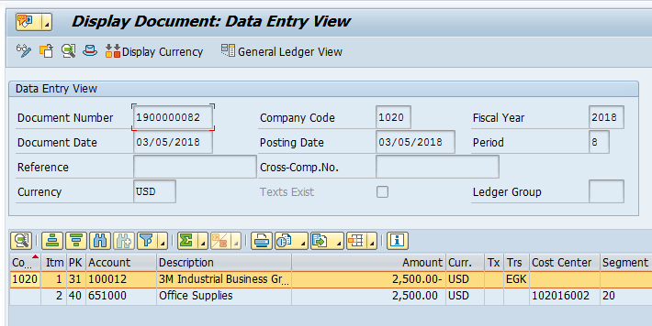
Displaying any FI Document: T-Code FB03
Creating Documents in Accounts Payable
  The transaction code FB03 can be used to display any FI document
  In this case a user can review the details of the vendor invoice that was just entered and posted
  Two offsetting line items are created by the document to capture the accounting activity of the purchase
    The first line places $2,500 in the vendor Subledger account. This indicates that the company now owes 3M $2,500
    The second line places $2,500 in the company’s ‘Office Supplies’ expense account. This indicates that the company has $2,500 in additional expenses which will need to be included on the 2018 income statement and deducted from sales to derive Net Income

Slide 12
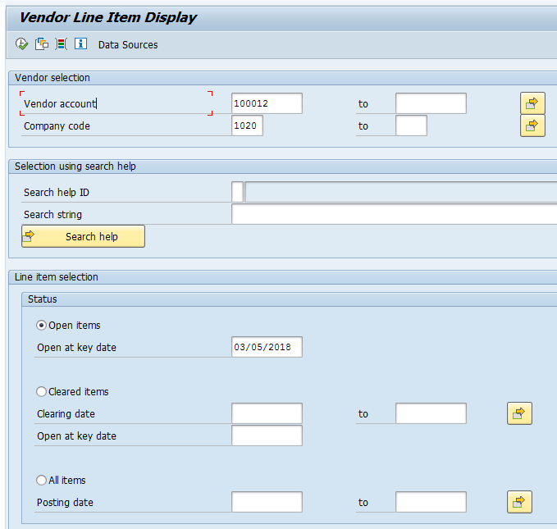
Using the Vendor Subledger Report – FBL1N
Creating Documents in Accounts Payable
  The transaction code FBL1N is a report which shows all activity saved in the subledger for a certain vendor
  By entering 3M’s vendor account number and selecting ‘Open Items’ a user can check how many invoices are outstanding that Google owes the company

Slide 13
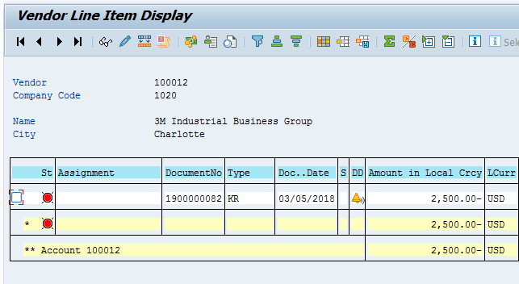
Using the Vendor Subledger Report – FBL1N
Creating Documents in Accounts Payable
  For now, the report only displays one open invoice which was created in the previous slide
  At any given point in time, a vendor could have hundreds of open invoices with the company which can all be tracked and displayed in this report
  The red circle on the far left indicates that the invoice is still considered open in the system and which means that the company has not paid 3M yet
  The icons at the top of the screen allow the user to customize the output of the report

Slide 14
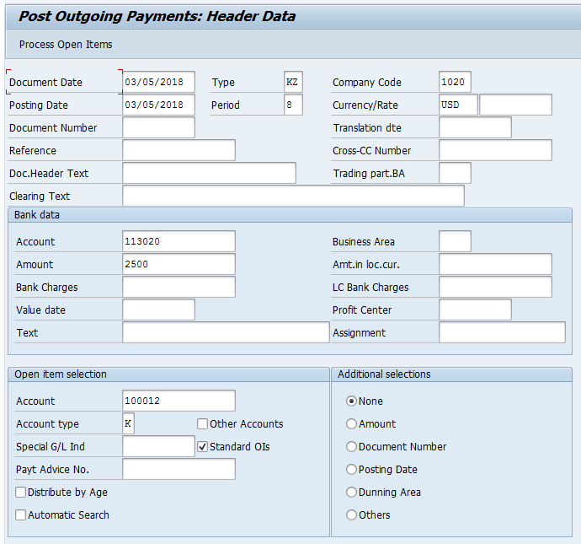
Posting Outgoing Payment: T-Code F-53
Creating Documents in Accounts Payable
  Once a the company is ready to send payment to the vendor (for example the negotiated payment term is almost over), the payment can be entered into SAP in F-53
  Below are some required fields to give SAP enough information to create the payment document:
  Header Section
  Company Code
  Document Date
  Bank Data
  Account (this is the bank account that cash should be pulled from)
  Payment Amount
  Open Item Selection
  Account (this is the vendor account to send the payment to)

Slide 15
Posting Outgoing Payment: T-Code F-53
Creating Documents in Accounts Payable
  In the example shown, the company is sending 3M a payment for the full amount of the previous invoice shown
  To capture the payment, the user has entered the following information:
    3/08/2018 is the date the payment is made
    113020 represents the general ledger account of the bank where the cash will pulled from. This code captures the cash’s location on the company’s books
    2,500 is the amount of money of the payment
    100012 is 3M’s vendor account

Slide 16
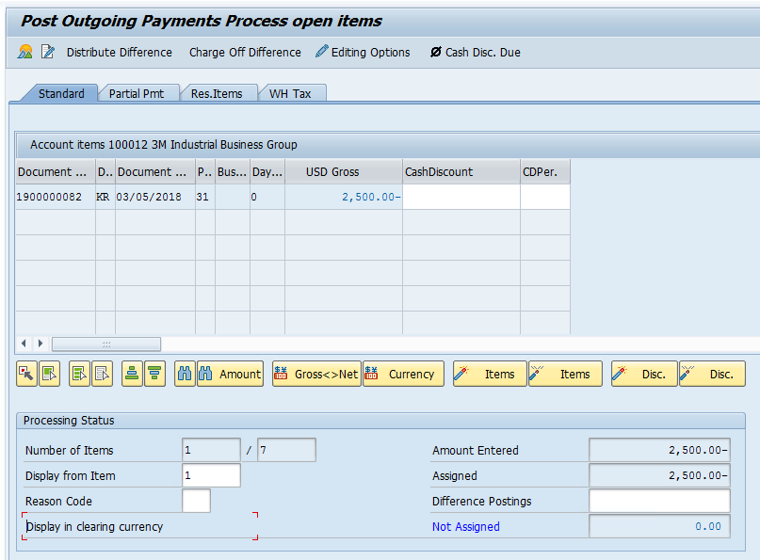
Posting Outgoing Payment: T-Code F-53
Creating Documents in Accounts Payable
  Here a user will select the invoice (or invoices) that the payment is intended to clear
  The net amount in the bottom right must be zero in order for the payment to save
    Differences can be handled through residual payments or partial payments
  Upon saving, both the payment and the selected invoices will be cleared
  If the invoice to be cleared is unknown, the payment can post ‘On Account’
    In this case, the payment is made to the vendor account and remains open until it can clear a proper invoice

Slide 17
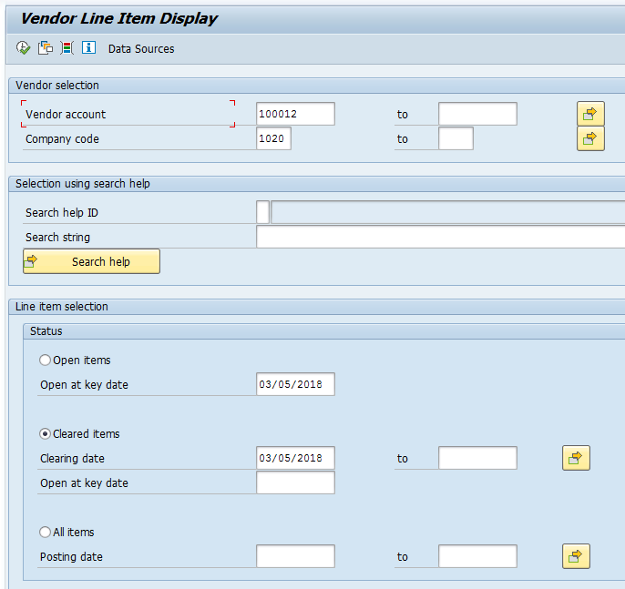
Using the Vendor’s Subledger Report – FBL1N
Creating Documents in Accounts Receivable
  The FBL1N report can also be used to show that the original invoice was successfully cleared
  By entering 3M’s vendor account number and selecting ‘Cleared Items’ a user can check how many invoices have been successfully created and paid by the customer

Slide 18
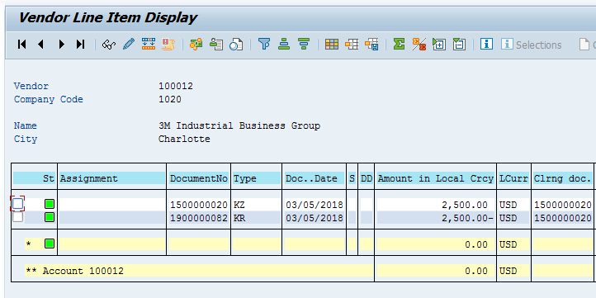
Using the Vendor’s Subledger Report – FBL1N
Creating Documents in Accounts Receivable
  In this case, the original invoice document and payment document are both displayed netting to zero on the vendor’s account
  This indicates that a $2,500 payment has been made to 3M this period and the payment has been sent. All past purchases can be tracked by vendor using this report. Many other reports can provide more sophisticated analysis as well
  The green square on the far left indicates that the invoice is now cleared and has been paid to 3M

Slide 19
Accounts Payable
SAP Purchasing Cycle
Creating Documents in Accounts Payable
Payment Terms and Cash Discounts
Automatic Payment Run
Post Payment Run Processes
Payment Terms and Cash Discounts

Slide 20
Terms of Payment
Payment Terms and Cash Discounts
  A critical element of any vendor invoice posting is indicating to SAP when the payment is due. Every purchase contract can be negotiated with different credit terms and discounts for paying early. These are set up in SAP in a series of defined rules called ‘Terms of Payment’
  For example: ABC Company negotiates a contract to buy $1,000 of steel from Vendor 1. Vendor 1 doesn’t expect ABC Company to pay immediately because they have a good business relationship. The agree on the following payment terms
    Payment must be made in the next 45 days. If ABC pays in the first 15 days, they can get a 2% discount on the purchase price for paying early. If the ABC pays in the first 30 days, they can get a 1% discount
  Using the variant principle, all of these rules will be saved under a 4 character code called the payment terms. A user can assign this code to any document where these terms are negotiated. A user can also assign this code to the business partner master data so that it becomes the default value for all documents with that vendor.
  All possible terms of payment that a business uses with all customers and vendors must be determined during ‘requirements gathering’ and configured during the project implementation

Slide 21
Terms of Payment
Payment Terms and Cash Discounts
  To create a terms of payment in SAP, the following characteristics are needed:
  Baseline date – This represents the date where the due date calculation begins. This does not need to exactly match the posting date of the invoice.
  Cash discount periods – In the previous example there were three cash discount periods. There was a 15 day period for a certain rate, a 30 day period for a certain rate, and a 45 day period for a certain rate
  Cash discount percentage rates – In this example the rates in each period were 2%, 1%, 0%
  The code for ‘terms of payment’ can be assigned at the vendor master data or document level. The code can be:
  Assigned to customer/vendor master record
  Defaulted by the system or entered by the user
  Used in transaction line items to determine payment conditions
  For priority, if the document and master data terms of payment don’t match, the system will always choose the term entered in the invoice document over the master data

Slide 22
Terms of Payment in Invoices
Payment Terms and Cash Discounts
  You can enter terms of payment in:
  Terms of payment in an invoice is copied from
Customer master
Company code segment
Sales area segment
Vendor master
Company code segment
Purchasing organization segment
Company code segment | Invoice created in Financials
Sales area segment | Invoice created in SD
Purchasing organization segment | Invoice created in MM

Slide 23
Terms of Payment in Credit Memos
Payment Terms and Cash Discounts
  Invoice related credit memos
  A standard vendor invoice created using FB60 is designed to always show that the company owes more money to the vendor. If for any reason the company owes less money to the vendor, then they would show this by creating a ‘Credit Memo ‘ in FB65
    For example if the company purchases $1,000 in steel from Vendor 1, it would create a vendor invoice in FB60.
    If 10% of the shipment was damaged in transit and the vendor agreed to refund 10% of the cost, ABC would create a credit memo and link it to the original invoice
  Credit memos can be linked to the original invoice by entering the invoice number in the "Invoice Reference" field during document entry.
  In this case, the terms of payment are copied from the invoice so that the invoice and the credit memo are due on the same date.

Slide 24
Terms of Payment in Credit Memos
Payment Terms and Cash Discounts
  Other credit memos
  Not all credit memos are related to a prior, existing invoice
  Terms of payment in other credit memos are invalid.
  These credit memos are due on the baseline date.
  To activate the payment terms on these non-invoice related credit memos, enter a “V” in the "Invoice Reference" field when entering the document.

Slide 25

Terms of Payment - Basics
Payment Terms and Cash Discounts
  Description:
  With a 15 day limit: 2% cash discount until the 15th of the next month. Until the end
  of the following month without a discount.
  With a 31 day limit: 2% cash discount until the end of the next month. Until 15th of
  the second month without a discount.
  Two types of descriptions:
  Automatically generated
  SD text for printing on invoices
  Account type: Customer Vendor
Day limit Payment terms 0009 Payment terms 0009
Day limit 15 Day limit 31
Each payment term must be checked if it is valid for customers or vendors

Slide 26
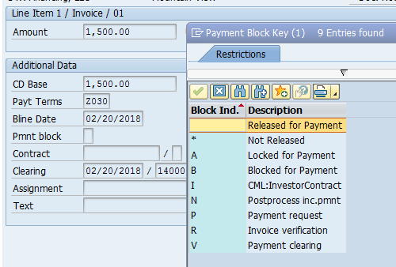
Terms of Payments: Payment Controls
Payment Terms and Cash Discounts
  There are many reasons why a company may want to block a vendor invoice from being paid
  For example, it might be that all invoices are blocked until it is verified that the goods have arrived at the company’s warehouse
  To block an invoice, a user will input a Payment Block Key, which can be entered in the line item of a document (blocking that one line from being paid) or in the vendor’s master data (which would block all documents against that vendor)
  These block keys can also be entered in payment terms.
  If the payment block field on a document is blank, then the invoice is ready for payment

Slide 27
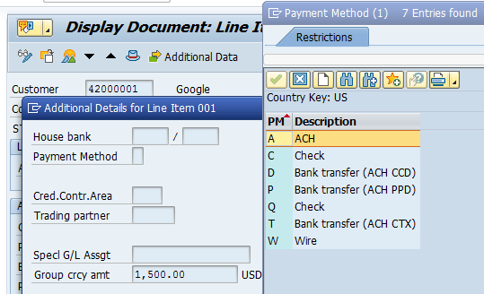
Terms of Payments: Payment Controls
Payment Terms and Cash Discounts
  A payment method can also be entered at the document level or vendor master data level (for each country, the system has payment methods defined that you can use in that country)
  The payment method determines how the company will go about transferring funds from the company’s account to the vendor’s account. This will be discussed in more detail in later slides
  Every payment method has a 1 character code which is added to a document or master data to indicate the appropriate payment method
  A few examples are shown on the right
  Like payment blocks, payment methods can be entered in the terms of payment.

Slide 28
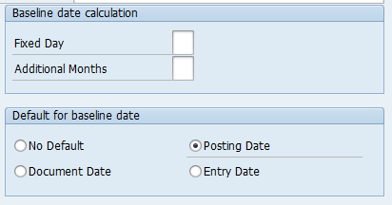
Baseline Date
Payment Terms and Cash Discounts
  The baseline date is the starting date the system uses to calculate the invoice due date
  Fixed day used to overwrite the calendar day of the baseline date
  The number of month(s) to be added to the calendar month of the baseline month

Slide 29
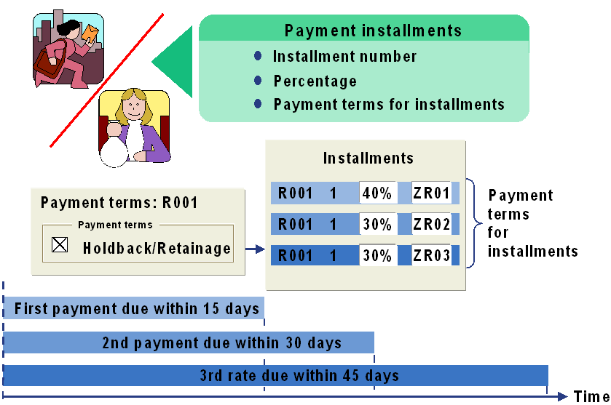
Installments
Payment Terms and Cash Discounts
  In all of the previous examples, the full amount of the invoice is due at the same time
  Many contracts can negotiate to be paid in separate installments paid over time
    System creates line items for each installment.
  The same terms of payment for the line items are the terms of payment defined for the individual installments.

Slide 30
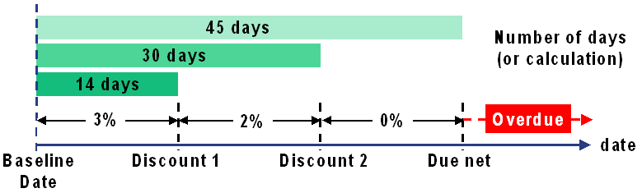
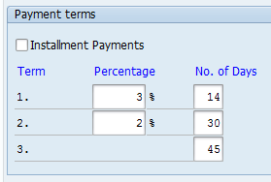
Cash Discount Calculation
Payment Terms and Cash Discounts
  You can enter up to three cash discount periods
  The days and months specified in the terms of payment are used in conjunction with the baseline date to calculate the correct cash discount amount for the payment date.

Slide 31
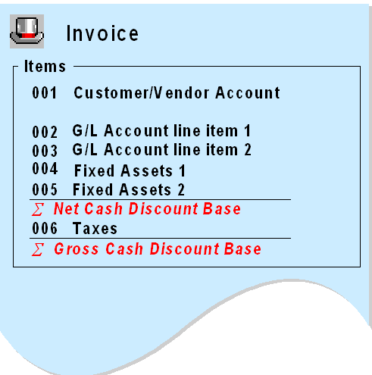
Cash Discount Base Amount
Payment Terms and Cash Discounts
  Cash discount base amount can be either net value (excluding taxes) or gross value (including taxes).
  It is defined in global parameters of company code (OBY6).

Slide 32
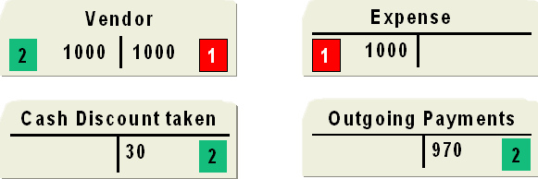


Posting Cash Discount – Gross Procedure
Payment Terms and Cash Discounts
Accounts payable:
Invoice
clearing
Assuming no tax
Invoice posted with document type KR
In the Gross Procedure, cash discounts post to the company’s books at the time of clearing

Slide 33
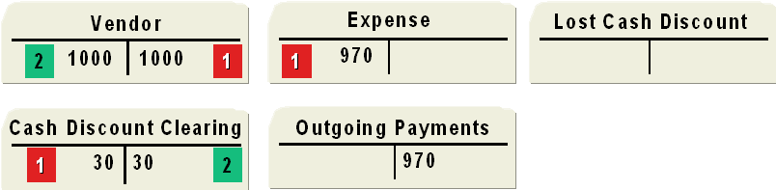
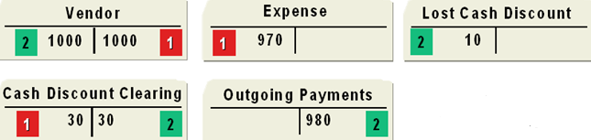
Posting Cash Discount – Net Procedure
Payment Terms and Cash Discounts
Paying within the cash discount period
Paying after cash discount deadline
Invoice
clearing
Assuming no tax
Invoice posted with document type KN
In the Net Procedure, cash discounts post to the company’s books at the time of the original Invoice

Slide 34
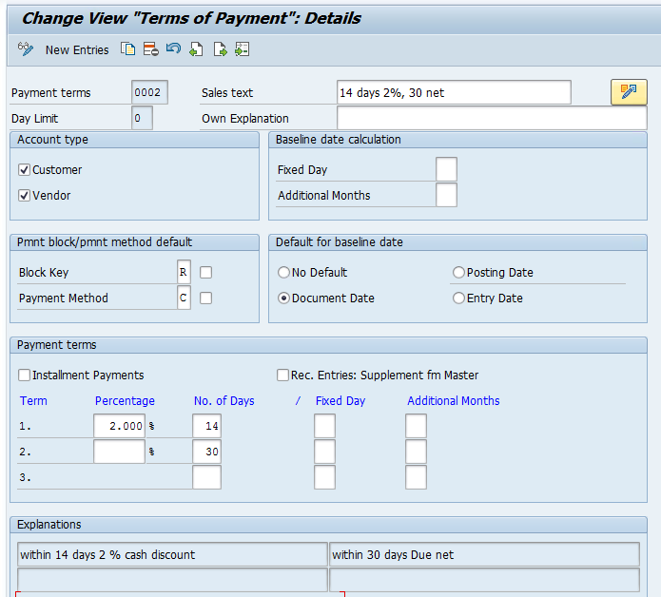
Automatic Posting of Cash Discount: Screen
Payment Terms and Cash Discounts
  The example on the right shows the Terms of Payment configuration screen in SAP. Note that the following values have been maintained
    Any document with this payment term will receive a block key of ‘R’
    These documents will default to the payment method of ‘C’
    If paid in the first 14 days, a 2% discount will be applied
    After 30 days, the invoice is considered ‘overdue’
    It can be applied to customers or vendors
    The baseline date can be changed manually but it will be defaulted to ‘Document Date’
    To use this payment term, enter the code ‘0002’ on a vendor or customer invoice

Slide 35
Accounts Payable
SAP Purchasing Cycle
Creating Documents in Accounts Payable
Payment Terms and Cash Discounts
Automatic Payment Run
Post Payment Run Processes
Automatic Payment Run

Slide 36
Purpose of the Automatic Payment Process
Automatic Payment Run
  In the normal course of business for a large global entity, thousands of vendor invoices might be created every day
  It would be a huge and tedious manual effort for AP clerks to manually scan all open invoices to see what is due to be paid and manually pay each one individually
  Once invoices are entered into the system with the correct payment terms, SAP can automatically pay it by using the Automatic Payment Program (F110)
  When running the payment program, a user will enter the parameters for the group of invoices that should be paid. The system will identify all invoices that satisfy these search criteria and pay them all immediately

Slide 37
Automatic Payment Process
Automatic Payment Run
Steps in Payment process
The SAP payment program lets you automatically
Select open invoices to be paid or collected
Pay thousands of documents instantly
Post payment documents in the system
Send communication to vendors that payment has been initiated
Send communication to banks to physically move money to the vendors’ bank accounts
Invoices are entered
Open invoices are analyzed for due date
Invoices due for payment are prepaid for review
Payments are approved and/or modified
Invoices are paid

Slide 38
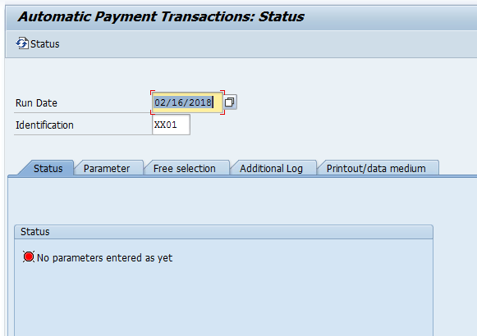
Steps for Running the Payment Program
Automatic Payment Run
  Step 1 – Identification
  To begin the payment program, simply enter the date of payment and a 5 character ID code to identify the program run.
    The Run ID can be any code to help you uniquely identify the run
    A typical Run ID could be the user’s initials and the payment method used

Slide 39
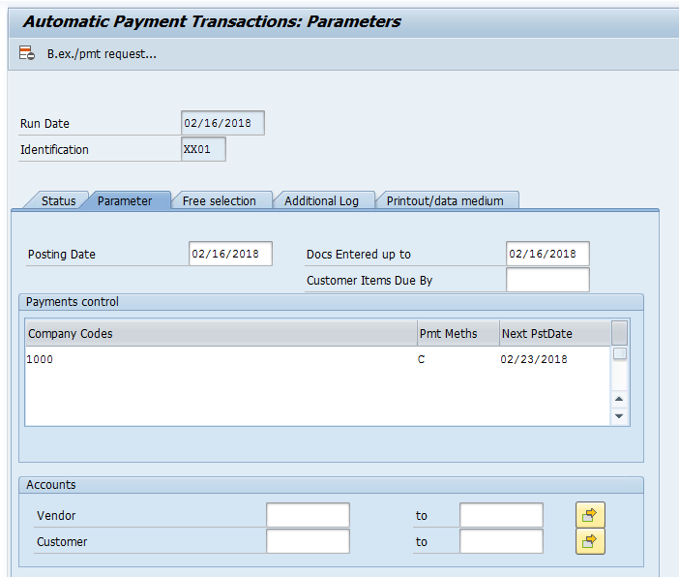
Steps for Running the Payment Program
Automatic Payment Run
  Step 2 – Parameters
  The ‘Parameter’ tab is where a user specifies which invoices should be analyzed by the program. Below are some helpful fields for specifying the scope of a particular program run:
    Company Code
    Posting Date
    Payment Method
    Range of Vendor Accounts
  Next Payment Date estimates the next time the program will be run. The system will only pay open items that are due between now and the next payment date
  If multiple company codes are listed, they have to be separated by commas. If you want to specify a range of company codes, you have to enter the first and last company code in the range in parentheses.

Slide 40
Steps for Running the Payment Program
Automatic Payment Run
  Step 3 – Additional Details
  Free Selection tab allows a user to include more focused search criteria. For example is a user wanted to pay two or three specific invoices, those document numbers could be specified there
  Additional log allows the user to include additional details in the finished program log
  Printout/data medium is where the user will enter any required printouts. For example, if the team has developed a custom check form or a custom email that notifies vendors when payments have been initiated, those program technical names would be entered here

Slide 41
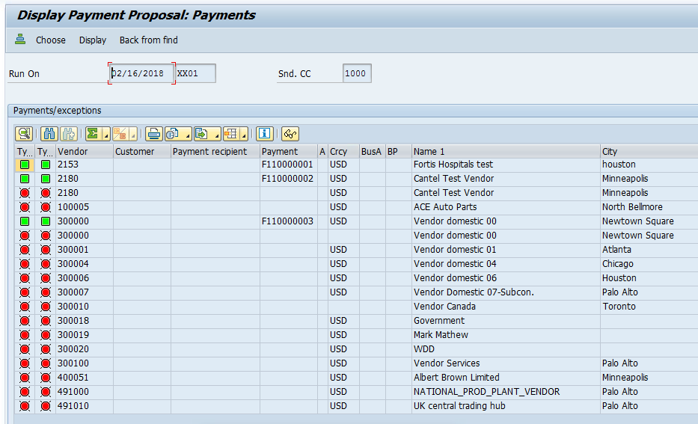
Steps for Running the Payment Program
Automatic Payment Run
  Step 4 – Creating/Reviewing the Proposal
  This screen displays the proposal. Green invoices will be paid by the program and red invoices will not be paid due to an error
  Double clicking any of the line items or reading the proposal log can provide more information on why certain invoices have errors
  At this point it is very simple to delete the proposal and rerun it after errors have been remediated

Slide 42
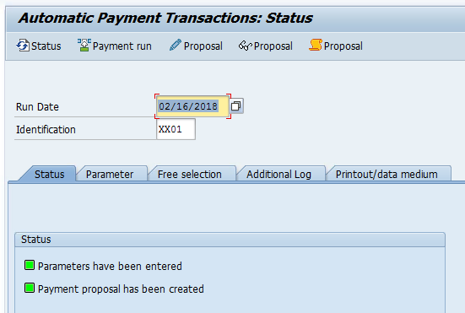
Steps for Running the Payment Program
Automatic Payment Run
  Step 5 – Running the Program
  After reviewing the proposal, the ‘Payment Run’ is clicked and the program automatically generates all due payments
  Note that no physical checks will be printed, wires sent to the bank, etc. unless a printout program is entered in the last tab. This is not required to run the program but it is required for printing
  Once the payment run is complete all of the postings are made to the system. There is no way to undo it without mass reversal of the posted documents
  The final postings will use the company code, payment method, and posting dates entered originally in the parameter tab

Slide 43
Resolving Errors in the Payment Run
Automatic Payment Run
  Every time the proposal is created in the automatic payment program, some invoices will turn up with errors
  Possible reasons for errors include but are not limited to:
    A user has blocked the invoice for payment (many possible reasons for this, each with their own code)
    The payment method used in the program is not allowed for this particular vendor (allowable payment methods must be saved in the vendor master data)
    The amount is beneath the minimum amount for the payment program
    The invoice has a debit balance (the vendor owes you more money than you owe them)
    The payment needs to be made via the bank (ACH/Wire transfer) and no bank has been entered in the vendor master data
    The vendor is locked by another unfinished proposal in a separate F110 program run
    And many more
  Errors should be investigated by the AP clerk. Unless they are valid errors, they will be remediated in the system and then the proposal can be deleted and rerun with the new information

Slide 44
Editing the Payment Proposal
Automatic Payment Run
  After the payment run is created, it can be edited by accounting clerks.
    Users can assign an accounting clerk to a customer/vendor by entering the clerk’s key in the customer/vendor master data.
    When editing the payment proposal, you can enter the key of a specific clerk to show only the customer/vendor payments that are assigned to the clerk.
  The screen in the editing transaction shows an overview of all the payments the program proposes.
    By double-clicking a payment, you can display a list of all the open items that are due to be paid with the payment.
    You can change the payment block and cash discount for these line items.
    You can also assign the item to a different existing payment, or create a new payment by choosing a payment method and house bank.

Slide 45
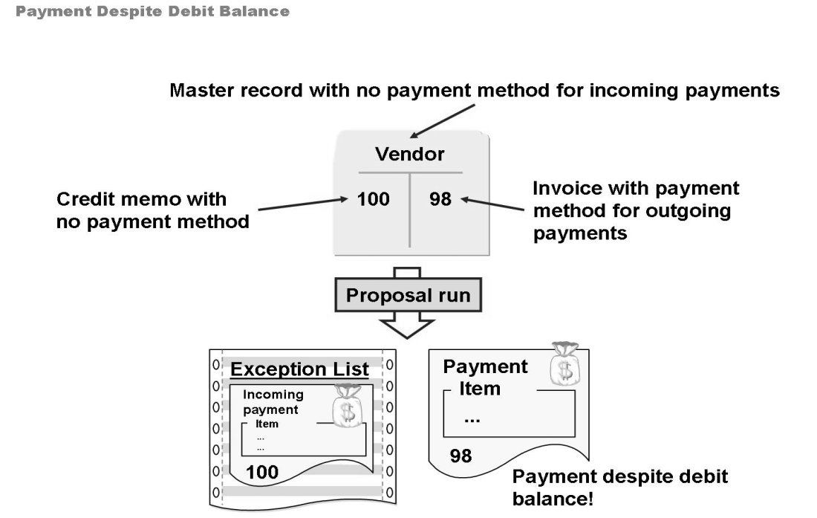
Debit Balance Check
Automatic Payment Run
  In some cases, the payment run can result in payments being made even though the account has a debit balance.
  This figure shows one such example. A vendor account contains an invoice for 98 and a credit memo for 100. The invoice item contains a payment method for outgoing payments. A payment method for incoming payments, however, has not been defined in the master record nor in the credit memo.
  The payment proposal enters the credit memo for 100 in the exception list, since this cannot be paid without a suitable payment method. The invoice for 98 is paid, however, since the item contains the payment method directly.

Slide 46
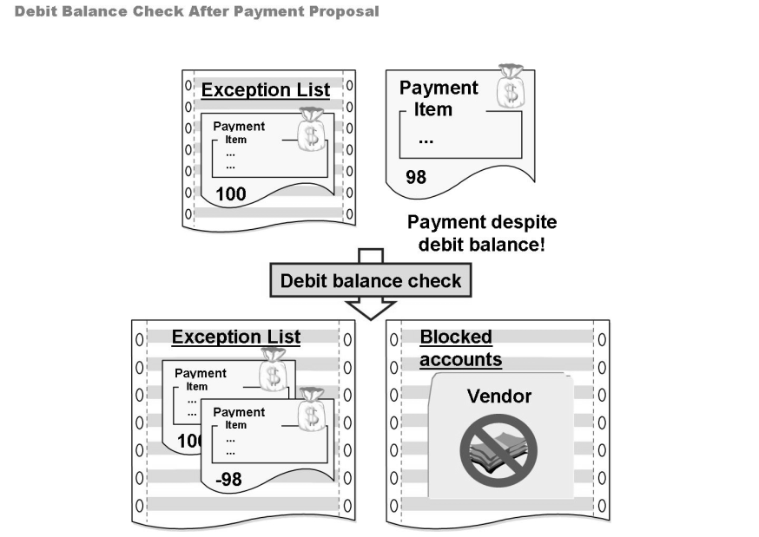
Debit Balance Check
Automatic Payment Run
  The debit balance check can be carried out after a payment proposal has been created.
    The check offsets all the due debit items without an incoming payment method against the proposed payments. If the resulting debit balance or credit balance is less than the minimum payment amount, the payments are added to the exception list and the account is placed on a list of blocked accounts.
  The relevant accounts remain blocked even if the payment proposal is then deleted.
  Blocked accounts can be manually released.
  The debit balance check is carried out with the program (technical name RFF110SSP)

Slide 47
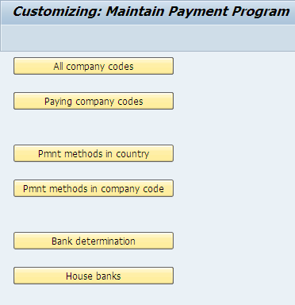
Structure of Payment Program Configuration
Automatic Payment Run
  ‘FBZP’ is the shortcut code to arrive at the Configuration Screen Opening Page
  To use the automatic payment program, the following elements need to be set up in this screen:
    Company Code set up for automatic payment
    Payment Method configured in any country it will be used in and any company code it will be used with
    SAP needs to know which banks to use for payment and what the ranking order is between all of the banks a company uses

Slide 48
Configuration Step 1: All Company Codes
Automatic Payment Run
  The main purpose of this step is to determine if a company code will be paying its own vendors or if another company code will pay on its behalf. For example, the global headquarters might pay vendors on behalf of many subsidiaries around the world.
  If company code A is making payments on behalf of another company code B, then A is referred to as the ‘Paying Company Code’ and B is called the ‘Sending Company Code’
    If a paying company code is not specified, the system automatically regards the sending company code as the paying company code.
  The paying company code is the company code that is responsible for processing the outgoing payments.
    This company code records the bank postings (A)
    The sending company code records the sub ledger postings (B)
    Both companies balance by automatically generating cross company postings

Slide 49
Configuration Step 2: Paying Company Codes
Automatic Payment Run
  Users define the minimum amounts for payment and the forms that will be used for each paying company code.
  Users define how many bills of exchange are created for each account during the payment run for the bill of exchange payment method.
  Users control which open items for the bill of exchange payment method are to be considered during the payment run using the due date specifications.

Slide 50
Configuration Step 3: Payment Method/Country
Automatic Payment Run
  Payment methods have two components: country-specific settings and company code-specific settings.
  This section details the basic requirements and specifications for payment methods for each country.
  If a particular payment method has certain master record requirements, that is, the address is required, invoices will not be paid with this payment method unless the requirements are met.
  Specify the document types that will be used for posting and clearing documents.
  You can restrict payment methods to specific currencies.
  If don’t specify the any currencies, the payment method is valid for all currencies.

Slide 51
Configuration Step 3: Payment Method/Country
Automatic Payment Run
  Below is a list of payment methods which are often configured in the United States
  Configuration needs to be separately set up for every country where these payment methods are used
  Automated Clearing House (ACH) – A form of bank transfer used mostly in the United States
    ACH PPD – ‘Prearranged payment and deposit’ supports collection from consumers
    ACH CCD – ‘Cash Collection and Disbursement’ supports payments to consumers
    ACH CTX – ‘Company Trade Exchange’ supports payments between companies
  Check – A physically printed banking device
  Wire Transfer – Transfer between multiple bank accounts

Slide 52
Configuration Step 4: Payment Method for Company Code
Automatic Payment Run
  Foreign business partner - when selected, this indicator allows foreign customers and vendors to be processed using this payment method.
  The minimum and maximum check amounts to be processed. Any amounts lower/higher than this amount will be excluded from the payment run.
  Payments via customer/vendor’s bank abroad - When selected, this indicators allows payments from customer and vendor banks abroad.
  Foreign currency - When selected, this indicator allows you to use foreign currency with this payment method.
  Bank optimization - When selected, the payment program will try to pay from a bank within the same clearing house system (ACH).
  Postal code optimization - By using the change icon on the right-hand side, you can assign banks to particular postal areas. When selected, the payment program looks to make payment from the bank based on the customer/vendor’s city of residence.

Slide 53
Configuration Step 5: Bank Ranking Order
Automatic Payment Run
  If the bank/payment method combination does not exist, create a new one by defining:
  Payment method
  Currency – This field must be empty if the payment method for this bank is to apply to all currencies. Otherwise the payment method only applies to the currency entered here.
  Ranking order – The payment program will take this into consideration when determining which bank to pay from.
  House bank identifier to be used with this payment method

Slide 54
Configuration Step 6: House Banks
Automatic Payment Run
  The Available Amounts screen lists the house banks and the amount of funds available at each bank.
  To add a new house bank, define the following:
  The bank and the bank account
  Days until the value date when using bills of exchange. This enables payments to be posted before their due date. In all other cases, enter 999. The value dates are then not taken into account.
  Currencies: This field must be empty if the payment method for this bank is to apply to all currencies. Otherwise the payment method only applies to the currency entered here.
  Amount available for outgoing payment: Enter the amount of funds available at the house bank. Note that the amount field is not updated automatically after each payment run.

Slide 55
Configuration Step 6: House Banks (Value Date)
Automatic Payment Run
  The value date is used in conjunction with cash management (cash management position) to track the outflow of funds
  For example, payments which are made by transfer are deducted from the bank the next day regardless of the amount
    This means that the money must be available the next day for payments with this method
    For this payment method, enter 1 in the Days until value date field
  The value date is used in conjunction with cash management (cash management position) to track the outflow of funds
  Value date = payment run posting date + days until value date

Slide 56
Configuration Step 6: House Banks (Charges)
Automatic Payment Run
  The functions for incoming and outgoing payments feature a bank charges field for users to enter any bank charges that are part of the payments made or received.
    For incoming payments, the system subtracts the bank charges from the clearing amount.
    For outgoing payments, it adds the charges to the clearing amount.
  The Relevant to cash flow indicator must be set in the master record of accounts that record bank charges.

Slide 57
Accounts Payable
SAP Purchasing Cycle
Creating Documents in Accounts Payable
Payment Terms and Cash Discounts
Automatic Payment Run
Post Payment Run Processes
Post Payment Run Processes

Slide 58
After the Payment Program
Post Payment Run Processes
  Once the payment program is complete, a number of events are triggered:
  Document are posted in SAP to reflect the payment journal entries in the system
  Payment media are generated to communicate the payments to external parties. The new main types of communication are:
    Payment Advice Notes – These send a communication directly to the vendor to inform them that a payment has been initiated
    Data Media Exchange (DME) – This creates a data file which can be sent to the bank with the information they will need to actually move cash from the company’s bank account to the vendor’s bank account
  The actual output of the payment media can take many different forms including:
  Paper forms such as a physically printed checks, or payment summary which can be mailed to vendors
  Emails can be generated to vendor email addresses alerting them to expect the payment
  An Electronic Data Interchange (EDI) can be set up to send the record of a payment directly to a vendor’s database without needing to send an email to an employee of the vendor

Slide 59
After the Payment Run: Payment Documents Posted
Post Payment Run Processes
  Once the payment run is executed, payment documents are created, open items are cleared, and the general and sub ledgers are posted to
  The payment program automatically posts payments and related postings, such as those for tax, tax adjustments, exchange rate differences, or cash discounts
  Some countries require that the payment documents are not posted before the actual settlement, that is, not before the payment appears on the bank statement
  In the payment method definitions of these countries, you can set the Generate payment order only indicator
    In this case, the payment program does not post a payment document
    Instead, a payment order is generated that contains information on the paid documents
    When the payment appears on the bank statement, the payment document is generated by entering the payment order
    Until then, the paid items are blocked for other clearing transactions.

Slide 60
After the Payment Run: Payment Documents Posted
Post Payment Run Processes
  Typically when the program pays a vendor, the system will not be set up to post a reduction to the ‘cash account’
  Instead, the program will post a reduction to a bank clearing account or bank subaccount
    The bank subaccounts have to be assigned to the payment methods when the bank selection settings are configured
  There are many advantages to using subaccounts.
    You can reconcile the bank account balance at any time with the corresponding G/L account
    The subaccounts contain all incoming and outgoing payments until the money is actually debited from/credited to the bank account (value date).
  When the bank sends out the cash from the company’s bank account, it will inform the company with a manual or electronic bank account statement.
    This bank statement file will clear the open item in the bank subaccount and offset that with a posting to reduce the company’s cash balance
    Because of this clearing process, subaccounts are generally managed on an open item basis

Slide 61
After the Payment Run: Payment Documents Posted
Post Payment Run Processes
  The document type for payment documents is defined in the country-specific specifications for the payment method
  For cross-company-code payments, you can enter a further document type that is used for the clearing postings
  Both document types must be defined using internal number assignment
  Documents from the payment run contain the date and identification number (for example, 19940301-ID) of the run in the document header text

Slide 62
After the Payment Run: Printing Payment Media
Post Payment Run Processes
  In addition to posting the correct documents in the system, it is paramount that SAP is able to send the right communication to external parties. As was previously mentioned, these external communications fall into two main groups:
  Payment Advice Notes – These send a communication directly to the vendor to inform them that a payment has been initiated
  Data Media Exchange (DME) – This creates a data file which can be sent to the bank with the information they will need to actually move cash from the company’s bank account to the vendor’s bank account
  Payment Advice Notes can be sent through multiple different channels
  Payment summaries, checks, and others can be physically printed and mailed to vendors
  Email can be sent to vendor employees’ email addresses maintained in the vendor master data
  Electronic Data Interchange (EDI) messages can be sent directly from SAP’s system to the vendor’s system if the vendor is set up to handle such messages
    When using EDI, SAP will create an Intermediate Document for each payment which is colloquially referred to as (IDOCs). These IDOCs are used as ways to easily package and transfer data in and out of SAP for a number of different purposes

Slide 63
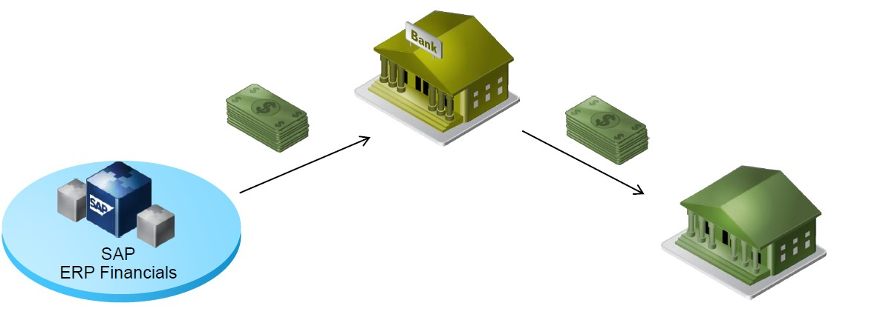
After the Payment Run: Printing Payment Media
Post Payment Run Processes
  Data Media Exchange can take the payments generated by the automatic payment program and repackage it into an XML or flat file format to help transfer the information to the bank
  DME can usually be used with all payment methods in which the payment medium is handed to the bank for further processing, e.g. bank transfer, direct debit, etc.
    It cannot be used with payment methods where the payment medium is sent to the customer/vendor, e.g. check

Slide 64
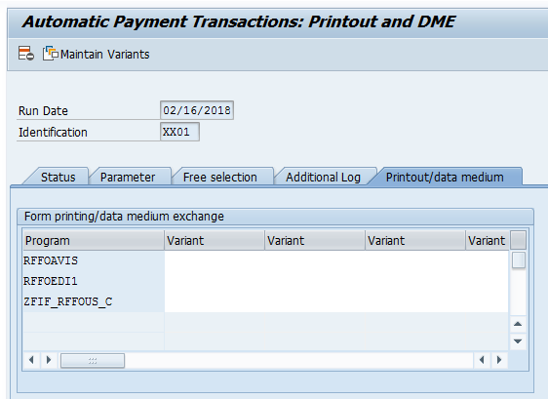
After the Payment Run: Printing Checks
Post Payment Run Processes
  While setting up the payment run, the ‘Printout/data medium’ tab is where a user chooses what print programs should be called to send information to external parties
  In FBZP configuration, a consultant will choose what programs should appear in this tab, which can be different for each payment method (check, wire, ACH, etc.)
  In this example, three programs are available for payment method C check. The names of the programs are in the red box to the right
    RFFOAVIS
    RFFOEDI1
    RFFOUS_C (ignore ZFIF for a moment)

Slide 65
After the Payment Run: Printing Checks
Post Payment Run Processes
  Each program will create a different set of communications
    RFFOAVIS – This standard SAP program will send a notification to vendors when their receivables and payables balance to zero
    RFFOEDI1 – This standard SAP program creates Intermediate Documents (IDOCs) which can be sent via EDI to the bank
    RFFOUS_C – This standard SAP program creates pre-numbered checks from the company’s check lots, which can be printed and mailed to vendors
  Each program follows a similar naming convention. For example RFFOUS_C
    RFFO indicates a standard SAP payment program
    US_ indicates the country this program is intended to be used in (all countries have unique requirements when it comes to check printing)
    C indicates this is only relevant to payment method C ‘Check’ (all payment methods have unique requirements for printing)

Slide 66
After the Payment Run: Printing Checks
Post Payment Run Processes
  Any time a standard delivered SAP program does not meet the client’s requirements, the consulting team needs to make an important design decision
  The team can work with the client to adapt the business process to conform to SAP’s system constraints
  The team can create a custom object (PRICEFW) and add their own code to enhance SAP’s capabilities to fit the client’s unique business process
  In this case, RFFOUS_C needed to be enhanced. The consultants copied the program and renamed the copy ‘ZFIF_RFFOUS_C’ to add their enhanced, custom code
  It is general practice never to write custom code into a standard program without copying it first and adding a ‘Z’ to the front to indicate the enhancement

Slide 67
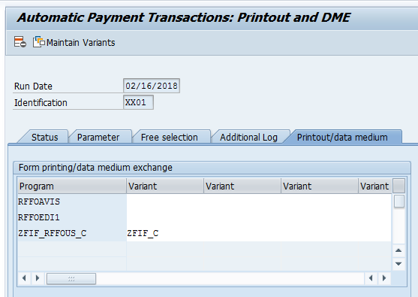
After the Payment Run: Printing Checks
Post Payment Run Processes
  Once a user encounters this screen, the possible print programs are displayed. To actually run a program, a variant must be entered in the variant column.
  To define the variant, simply enter any code to define a name and click ‘Maintain Variants’ to define the parameters of the print program. In this case, only program ZFIF_RFFOUS_C will be run upon completion of the automatic payment program and it will use the parameters of variant ‘ZFIF_C’
  A user can enter as many variants as they want. The print program will be rerun by SAP for every variant entered

Slide 68
After the Payment Run: Printing Checks
Post Payment Run Processes
  In the ‘Maintain Variant’ screen for RFFOUS_C, a user will determine things such as:
    Of all the check groups (called check lots) that a company uses, which check group will be used for this program run?
    Which specific printer should these checks be printed on?
    Which banks can have checks printed for them in this program run?
    Which payment methods will use this program to print an output?
  In this example, all of these have been determined in the ‘Maintain Variant’ screen and saved as the variant code ‘ZFIF_C’

Slide 69






After the Payment Run: Printing Checks
Post Payment Run Processes
Print
EDI
Email
  In this example of checks, the printed check serves the dual purpose of notifying the vendor that a payment has been made and providing the bank all of the necessary information to transfer the funds
  One benefit of using checks is that no other communications are usually necessary
  A downside is that a huge manual effort and cost is often needed to print them onto actual paper, stuff them into envelopes, and mail them. Also it takes significantly more time to move funds from your account to your vendor’s account, and it has more room for manual error such as checks being lost or physically destroyed

Slide 70
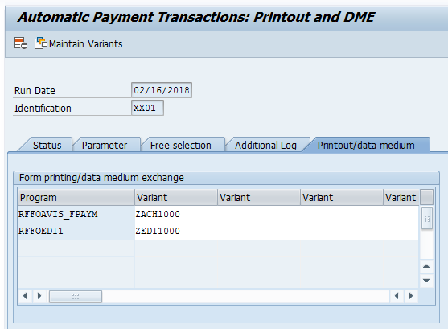
After the Payment Run: EDI
Post Payment Run Processes
  In the example shown, a different program run has been entered for ACH transfers. In this case, checks do not need to be printed, instead the clients requirements are that:
    A file needs to be sent to the bank with all of the relevant details to initiate the actual transfer of funds
    An email needs to be sent to the vendor to inform them that the company has requested a wire transfer and the funds should be in their account in 3-5 business days
  In this case, the following programs are being used
    RFFOEDI1 is being leveraged to create the IDOCs that will be sent to the bank
    RFFOAVIS_FPAYM is being leveraged to send payment advice notes to vendors via email
  Two program variants had to be named to call the program and define its parameters

Slide 71
After the Payment Run: EDI
Post Payment Run Processes
Print
EDI
Email
  In this example of Electronic Data Interchange, EDI is being used to communicate with the bank and email is being used to communicate with vendors. EDI can be used for both methods as long as vendors have the capability of receiving EDI messages
  To use EDI, the value ‘Generate SAP IDoc’ must be checked
  A separate variant must be used for each house bank

Slide 72
Standard SAP Capability vs. Required Custom Objects
Post Payment Run Processes
  It is important to understand the distinction between what comes standard with the purchase of SAP for this process and what will need to be enhanced with custom code by the project team
  Check Example
  The checks need to be printed on a check form that meets the following requirements:
    The payment advice must professionally capture the company’s brand and display the unique information their vendors care about
    The check portion must meet precise bank specifications so that the bank can read the account data
  Because each company’s forms are unique, SAP does not come with usable forms that can be configured. Whenever forms are required in the project scope, they must be customized by the project team as part of a custom solution

Slide 73
Standard SAP Capability vs. Required Custom Objects
Post Payment Run Processes
  It is important to understand the distinction between what comes standard with the purchase of SAP for this process and what will need to be enhanced with custom code by the project team
  EDI Example
  SAP can repackage the data in a format using IDOCs that almost all banks are prepared to understand
    Standard SAP does not have the capability to actually send data from its database to the bank
  Because the connection between the company and each bank is unique, the project team will need to identify how many connections will be required between the bank and the company.
  Each of these will require an interface to be developed with custom code to facilitate the transfer.
  In addition, every project will identify and use a middleware solution which will be used to move data between the company’s internal SAP system and the outside world. This middleware solution is owned by technical consultants

Slide 74
Automating the Automatic Payment Run
Post Payment Run Processes
  In the previous examples, a user manually enters new parameters every time the automatic payment program is run. In a real business scenario, users may choose to manually trigger this at regular intervals
  Oftentimes, the parameters for F110 are consistently the same and run at consistent intervals (ie. Daily, weekly, etc.)
  SAP has a built in program which captures all of the F110 parameters and schedules it to be run in the background on a regular basis
    The program technical name is RFF110S
  The selection screen for this RFF110S essentially features the same parameters as transaction F110. This means that you can save these parameters in a variant and schedule the program RFF110S to run periodically with this variant

Slide 75
Automating the Automatic Payment Run
Post Payment Run Processes
  You have to use selection variables to automatically adapt the time data to the periodic run date.
  The program RFF110S, in turn, can automatically run three additional programs consecutively
    To prevent outgoing payments despite a due debit balance, the program RFF110S should first be scheduled as a proposal run
    Following this, the program RFF110SSP should be called automatically to perform the debit balance check
    Once the debit program is complete, the third step is that the program RFF110S is called again automatically. This time, however, as an update run with possible generation of the payment media
  The programs can be scheduled to run periodically using job management or the Schedule Manager

Slide 76
Payment Medium Workbench (PMW) Overview
Post Payment Run Processes
  In the release of SAP R/3 Edition 4.6 in 1999, SAP introduced an improved tool for creating output files to send to banks called the ‘Payment Medium Workbench’
  The PMW is useful for large enterprises who transact with multiple banks in multiple countries
  Without PMW, the standard RFF0* programs are less flexible and require more custom code to alter them. For dozens of bank and country combinations this can become burdensome
  PMW introduced ‘Payment Medium Formats’ which can be created separately for every bank in every country and provides more flexibility to adapt to each bank’s requirements
    Formats can be more easily changed without making modifications directly to SAP’s code
    New formats can be created (no programming or development is necessary)
  For companies who do not use too many banks or who do most of their banking in one or two countries, the older RFFO* programs still oftentimes suffice

Slide 77
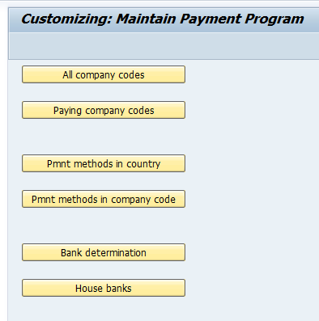
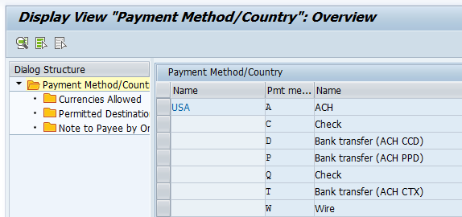
Conversion of a Payment Method to PMW
Post Payment Run Processes
  To use PMW, each payment method needs to be slightly reconfigured in each country
  This is completed in the node ‘Payment Methods in Country’ in FBZP shown earlier
  PMW is backwards compatible and allows companies to use the standard payment media programs RFFO* and the new PMW payment media formats in the same system, and even in the same payment run

Slide 78
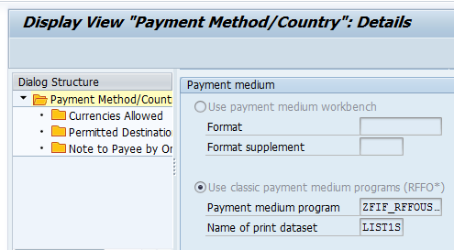
Conversion of a Payment Method to PMW
Post Payment Run Processes
  Conversion Steps for a Payment Method
  Switch to PMW (radio button) in the payment method definition/country
  Enter an existing PMW format in the payment method definition/country
  Assign notes to payee (general and/or origin specific) to the payment method definition/country (for example, SAMPLE 02 for origin FI-AP and FI-AR)
  Assign a PMW form for accompanying sheets
  Remove the form for document-based payment medium (if you have not already done so)
  Create and assign selection variants for each payment group

Slide 79
Steps in the PMW Process
Post Payment Run Processes
  The new program names used by PMW are:
    SAPFPAYM
    FRROAVIS_FPAYM
  The program RFFOAVIS_FPAYM generates all the required advice notes and the zero balance notices.
  The program SAPFPAYM generates the payment media which will be transmitted to the bank.
  Using this tool allows a company to more flexibly adapt and create new formats as they open accounts with new banks. The result is still ultimately a series of IDocs or some other output such as a txt flat file which will need to be transmitted to a bank in order to communicate transfer orders or other activity required by the bank.

Slide 80
Key S/4 HANA Simplifications in Accounts Payables
P2P | What’s changed | Benefits
Invoice processing | SAP S/4HANA integration with Ariba Procurement tool ensures efficient three-way match process. | Reduces three-way match document fallout for invoices.
 | Workflow management in Ariba is very rule based. With introduction of BRF some of the rules can be maintained by the business. | BRF enables business to maintain rules, similar to Ariba, Concur provides a flexible process.
 | Machine learning recommends ways to resolve invoice exceptions. | Enhanced invoice automation for exceptions monitoring and handling.
 | OCR is now embedded with Concur and S/4 integrated natively. | Concur has OCR technology for expenses and invoices. Touchless invoice processing.
 | Workflow tool for approval management – Fiori application. | Web-based interaction to approve invoices, even through a smart phone.
Problem resolution | Optimize goods and invoice receipt reconciliation through machine learning functionality offered by SAP S/4HANA. | Increase in auto match GR-IR line items.
Invoice payment | SAP Fiori applications view the payment data by different dimensions, including company code, supplier, currency, and user. | Helps in vendor account maintenance activity.
 | Pay schedules can be initiated from central finance for all Co codes at a time. | Periodic schedule payments gets automated.
T&E | OCR is now embedded with Concur and SAP S/4HANA integrated natively. | Concur has OCR technology for expenses and invoices. Touchless invoice processing.
 | Single source of information vs. multiple tables. | Improved reporting, data extraction, tool integration, and ability to access data real time in a simplified way.
Intercompany | SAP S/4HANA provides a dashboard of accounts receivable and account payable open items. | Open items need not be identified manually or with support of external system.
 | SAP S/4HANA introduces Business Partner, which is now capable of centrally managing master data for business partners, customers, and vendors. | Customers and vendors have been replaced by business partners.

