Slide 1
Procurement Cycle and Documents
Procurement is a component of the Materials Management module that supports the purchase of materials and / or services by an organization from sources outside the organization.
In keeping with the system’s Document Principle, the steps in the Procurement Cycle are represented by various documents, which are produced in both the Materials Management and Financial Accounting Modules.

Slide 2
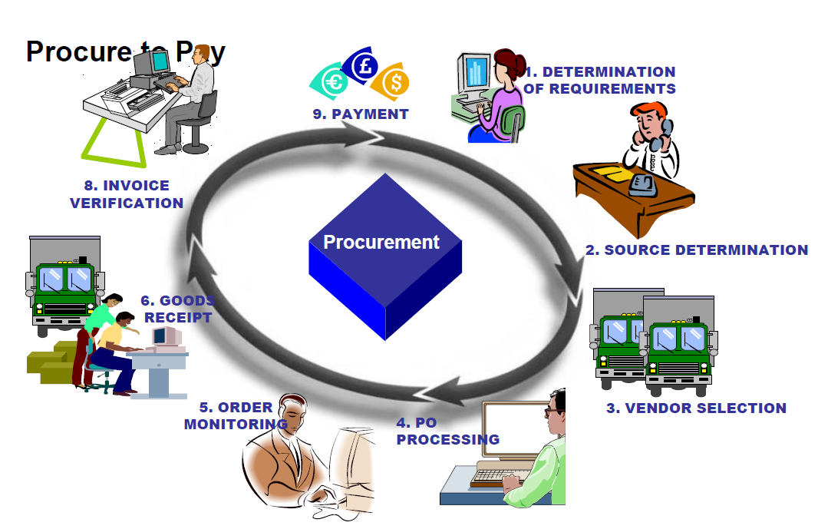
Procure to pay – process view

Slide 3
Procurement Cycle – SAP View
Purchase
Requisition
    (MM)
A/P
X
Cash
X
Vendor
Payment
  (FI)
Purchase
  Order
  (MM)
  Invoice
Verification
  (MM)
Goods
Receipt
  (MM)
A/P
GR/IR
Inventory
X
GR/IR
X
X
X
Notes:
SAP Documents that are created in the Procurement Cycle are:
Purchase Requisition (SAP MM document)
Purchase Order (SAP MM document)
Goods Receipt (SAP MM and FI documents)
Invoice Verification (SAP FI document)
Vendor Payment (SAP FI document)
A Purchase Requisition can be created either manually or automatically by the MRP (Material Requirement Planing)
A Vendor Payment can be done manually or automatically by the Payment Program

Slide 4
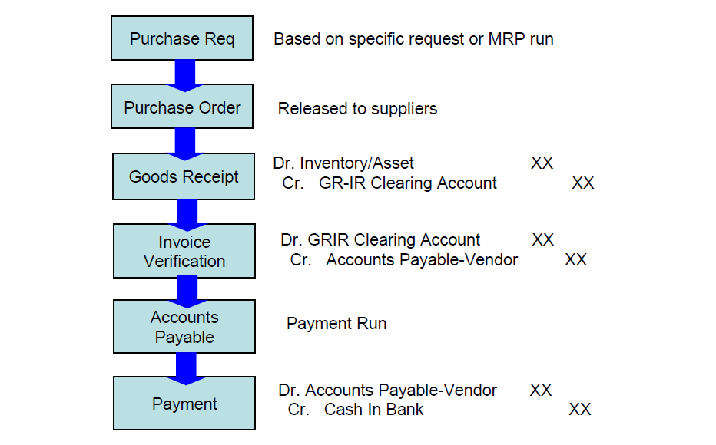
Procurement Cycle – Accounting flow
Notes:
SAP Documents that are created in the Procurement Cycle are:
Purchase Requisition (SAP MM document)
Purchase Order (SAP MM document)
Goods Receipt (SAP MM and FI documents)
Invoice Verification (SAP FI document)
Vendor Payment (SAP FI document)
A Purchase Requisition can be created either manually or automatically by the MRP (Material Requirement Planing)
A Vendor Payment can be done manually or automatically by the Payment Program

Slide 5
Procurement & Accounts Payable
Material Management
PO
GR
Invoice
Display Vendor
Account Balances
Process
Outgoing
Payment
Process
Down Payment
and
Credit Memo
Create, Display
and change
Vendor Master
Records
Display / Change
Vendor Line Items
Create Vendor
Invoices Manually
FI Accounts Payable
Notes:
Accounts Payable (A/P) is a sub-module of the Financial Accounting (FI) module, just as Purchasing is a sub-module of the Materials Management (MM) module.
The Accounts Payable sub-module processes Vendor accounting transactions. It is an integral part of the Procurement Cycle because purchasing transactions automatically update various accounts in the Financial Accounting module as described earlier in this chapter. Invoices from vendors also update financial planning and cash management data used to plan cash requirements.
Some of the many functions performed in the Accounts Payable sub-module include:
Creating Vendor master records.
Displaying balances for a Vendor Account.
Displaying / changing Line Items (both open and cleared) for a
Vendor Account.
Creating Vendor Invoices manually.
Processing payment of Vendor Invoices (automatically via the Payment Program or manually).

Slide 6
Main Procurement Cycle Documents
Purchase Requisition
Request for Quotation
Quotation
Outline Agreements
    Contract
    Scheduling Agreement
Purchase Order
Goods Receipt
Invoice Verification
Vendor Payment
Notes:
Procurement Cycle - A cycle that encompasses all activities relating to the purchase of materials and/or services.
Purchase Requisition - An order document that identifies the need to purchase a material or service.
Purchase Order - A legal contract between a buyer and a vendor. It lists the materials or services to be purchased on specified terms and conditions (quantity, price / pricing conditions, delivery date).
Goods Movement - Any event that causes a change in stock. The change could be a quantity or value change or a physical stock movement to a
new location.
Goods Receipt - An event where goods are received.
Invoice Verification - A process in the Materials Management Module that processes Vendor Invoices by matching them to Procurement Documents (Purchase Order and Goods Receipt) and sends them to the Financial Accounting Module to create a payable in the General Ledger.
Payment Program - An automatic process within the system that performs Vendor payments.

Slide 7


Documents in
Materials Management
Purchasing
Goods
Receipt
Invoice
Verification
Save Order Document
Post Goods Receipt
Post Invoice
Order Document
Vendor
Delivery Date
Conditions
Materials
Quantities
Prices
GR Document
Delivery Date
Materials
Quantity
Values
Account Postings
IR Document
Vendor
Quantity
Values
Account Postings
Materials
Management
Accounting
Notes:
The three types of Materials Management Documents are:
Order Documents
Goods Receipt (GR) Documents
Invoice Receipt (IR) Documents
Information in Order Documents can only be viewed in Materials Management.
Information in Goods Receipt (GR) and Invoice Receipt (IR) Documents can be displayed from two views:
Materials Management
Financial Accounting
The information in the three types of documents is used during Invoice Verification to perform comparisons and tolerance checking.

Slide 8
Purchase Requisition
Internal Document
Identifies demand for a product
Purchase Requisition
Authorizes Purchasing Department to procure
Can be created automatically or manually
A purchase requisition is a document that identifies an organizations demand for a product or service from an outside vendor. It is an internal document (i.e.. It is not visible to the vendor or any other outside organization).
Notes:
A Purchase Requisition is a document that identifies the organization’s
need to purchase a material or service from an outside vendor. It has the following characteristics:
It authorizes the Purchasing Department to procure materials and/or services in specified quantities within a specified time.
It is an internal document; it is not used outside the organization.

Slide 9
Purchase Requisitions
MRP
Purchase
Requisition
Manual
Creation
Identify
Vendor
Process
Requisition
Request for
Quotation
Purchase
Order
Notes:
A Purchase Requisition can be created automatically as a result of Material Requirements Planning or manually by the individual department or user within an organization that requires the material or service. It is an internal request to the Purchasing Department to procure a certain quantity of the desired material or service on a certain date.
After the appropriate vendor is identified, the Purchase Requisition is processed and becomes either a Purchase Order or a Request For Quotation.

Slide 10
Purchase Order
Legal contract between Buyer and Vendor
A purchase order is a legal contract between a buyer and a vendor. It lists the materials or services to be purchased on specified terms and conditions (quantity, price/pricing conditions, delivery date).
Notes:
A Purchase Order is a legal contract between a buyer and a vendor. It lists the materials or services to be purchased on specified terms and conditions (quantity, price / pricing conditions, delivery date).

Slide 11
Purchase Order (PO)
Reference
RFQ
Create
Contract
PO
Vendor: 1000
Purchase
Requisition
Another
PO
Notes:
A Purchase Order (PO) can be created directly or with reference to a Request for Quotation (RFQ), a Contract, a Purchase Requisition, or another Purchase Order.
All items on a Purchase Order must belong to the same Company Code.
The Purchase Order History (PO History) shows all transactions that have been entered for an item listed on the PO. For example, the PO History contains the Goods Receipt document number and the Invoice Receipt document number for each item listed on the Purchase Order.
Users can access additional information for both the GR and IR documents by double clicking on each document number.

Slide 12
Request For Quotations (RFQ)
Purchase
Requisition
Create
Vendor: 1000
RFQ
Reference
RFQ
Vendor: 2000
Vendor: 3000
Outline
Agreement
Notes:
Request for Quotation (RFQ) is an invitation to a vendor to submit a quotation listing the terms required for purchase of materials or services.
A Request for Quotation (RFQ) can be created directly or with reference to a Purchase Requisition, another RFQ or an Outline Agreement.
The RFQ can be sent to one or more vendors and linked together.
An RFQ can be monitored and reminders can be sent to vendors, who do not submit their quote on a timely basis.

Slide 13
Quotations
Vendor 1000
Comparison
þ
Info. Record
Quotation for RFQ: 1
Item: 10
Gross Price: $400/t
Discount: $50
Vendor A $350/t þ
Vendor B $480/t ý
Vendor C $520/t ý
Average $450/t
Vendor 1000
Purchase Order
Mat Qty Price
Steel 2t $350/t
Vendor 2000
ý
Quotation for RFQ: 2
Item: 10
Gross Price: $400/t
Surcharge: 20%
Vendor B, C
Rejection Letter
Vendor 3000
Quotation for RFQ: 3
Item: 10
Gross Price: $500/t
Fixed Costs: $20
Notes:
A Quotation is a Vendor’s declaration of willingness to supply materials or provide services. It contains price information and conditions of purchase and is submitted in response to an RFQ.
When Quotations are received from the vendors, the pricing and delivery data is entered in the RFQ.
Quotation data can be compared using a Price Comparison List. The list displays the most reasonable vendor for an individual item and for all of the items.
The system can be configured to automatically print a rejection letter for the vendors that are not selected.

Slide 14
Outline Agreements
Contract $
Total:
Contract Qty
Total:
Scheduling
Agreement
Release
Order
Delivery
Schedule
An Outline Agreement is a binding declaration of a buying party’s intention to purchase materials or services within an agreed-upon period with agreed-upon terms and conditions.
The two types of Outline Agreements are:
  Contracts
  Scheduling Agreements
The Outline Agreement details the materials or services and price but not the dates or quantities for the individual deliveries.
Notes:
An Outline Agreement is a binding declaration of a buying party’s intention to purchase materials or services within an agreed-upon period with agreed-upon terms and conditions.
The two types of Outline Agreements are:
Contracts
Scheduling Agreements
The Outline Agreement details the materials or services and price but not the dates or quantities for the individual deliveries.

Slide 15
Contracts
Create
Requisition
Contract
Request for
Quotation
Reference
Contract
Release
Order
March 1997
1
2
3
4
5
6
7
8
9
10
11
12
13
Quantity
14
15
16
17
18
19
20
21
22
23
24
25
26
27
28
29
30
31
A Contract is a long-term agreement with a vendor (one of the two forms of Outline Agreements in the system) to supply materials or provide services for a certain period of time.
A Contract is sometimes referred to as a blanket order.
Notes:
A Contract is a long-term agreement with a vendor (one of the two forms of Outline Agreements in the system) to supply materials or provide services for a certain period of time.
A Contract is sometimes referred to as a blanket order. The two types of
contracts are:
Quantity
Value
A Contract can be created directly or with reference to an Outline Agreement Request (Requisition), an RFQ, or another Contract.
A Contract contains a validity period with specific beginning and ending dates.
Purchase Orders created against a Contract are called Release Orders (in non-system terms, they are also known as blanket releases, contract releases or call-offs). Quantities and delivery dates are specified in the Release Order.

Slide 16
Scheduling Agreements
Requisition
Reference
RFQ
Reference
Scheduling
Agreement
History
Vendor
Vendor
Scheduling
Agreement
One-Time Vendor
Delivery
Schedule
1/30
3/30
5/30
A Scheduling Agreement is a long-term agreement with a vendor to supply materials or provide services on defined dates on which deliveries are to be made.
Some advantages of using the vendor Scheduling Agreement are that it:
  Streamlines paperwork.
  Promotes low inventories and allows for just-in-time deliveries., Shortens vendor lead times because the vendor can plan for the delivery.
Notes:
A Scheduling Agreement is a long-term agreement with a vendor (one of the two forms of Outline Agreements in the system) to supply materials or provide services on defined dates on which deliveries are to be made.
A vendor Scheduling Agreement is similar to a quantity contract in that it specifies a target quantity to be ordered over a period of time, as well as the designated price.
A Scheduling Agreement can be created directly or with reference to a Scheduling Agreement Request (Requisition), a RFQ, or another
Scheduling Agreement.
A delivery schedule exists for each Scheduling Agreement item.
Some advantages of using the vendor Scheduling Agreement are that it:
Streamlines paperwork.
Promotes low inventories and allows for just-in-time deliveries.
Shortens vendor lead times because the vendor can plan for the delivery.

Slide 17
Goods Receipt (GR) Document
Vendor
Buyer
Goods
Receipt
A goods receipt document is created when goods are received at a plant/ware house. At this time an accounting document is created to make a general ledger entry and a material document is created to record changes in physical inventory.
Notes:
When a Goods Receipt is posted, the quantity and value of Plant / Warehouse stock is increased.
At the same time, documents are created to record the event. These include
an Accounting Document to record the financial impact of Goods Receipt and
a Material Document to record changes in physical inventory.
By referencing an Order Document during Goods Receipt, the following advantages are gained:
Data from the Order Document is copied into the Goods Receipt document.
Purchase Order History is updated.
Invoice Verification is possible.

Slide 18
Posting a Goods Receipt
Stock
GR/IR Clearing
Inward movement on
goods receipt
Notes:
The posting of a Goods Receipt results in the following:
A Material Document is created (stock quantity is increased).
An Accounting Document is created (G/L Accounts are updated).
Purchase Order history is updated.
Goods Receipt Slip (GR Slip) can be printed.
When a Goods Receipt is posted, a debit to the stock account and a credit to the GR / IR (Goods Receipt / Invoice Receipt) Clearing account is posted. The GR / IR Clearing Account is a holding account to which the payment obligation is posted before the actual vendor invoice is received or posted.

Slide 19
Invoice Verification
Materials Management
Financial Accounting
PO
Open Items
Goods
Receipt
Invoice
Verification
Invoice
when invoices are received from a vendor, an invoice receipt is created in the system. This document can be linked to a purchase order, a goods receipt, a delivery note, or a vendor. In addition to the material document an accounting document is created, which updates the relevant vendor account (sub-ledger) and general ledger accounts.
Notes:
Invoice Verification is a process in the Materials Management Module that performs the following tasks:
Processes Vendor Invoices by matching them to Procurement Documents (Purchase Order and Goods Receipt).
Sends information from matched Vendor Invoices to the Financial Accounting Module, which automatically creats a payable in the General Ledger.
A Vendor Invoice can be created with reference to a Purchase Order, a Goods Receipt, a Delivery Note, or a Vendor.
The results of posting a Vendor Invoice in Invoice Verification are:
The Vendor Invoice is included in the Purchase Order history to update the status of the Purchase Order Line Item.
A debit is posted to the GR / IR Clearing Account to reverse the original entry
An open item (credit) is created in the Vendor Account (sub-ledger) with a corresponding credit to the appropriate Reconciliation (G/L) Account defined in the Vendor master record. The open item represents the payable to the vendor and remains open until a vendor payment is processed.
Invoice Verification will be discussed in more detail in Chapter 23.

Slide 20
Posting the Invoice
Stock
GR/IR Clearing
Vendor
Goods Receipt
Invoice Receipt
(Invoice Verification)
Notes:
The example above is a graphical depiction of the accounts that are updated in the process described on the preceding pages.

Slide 21
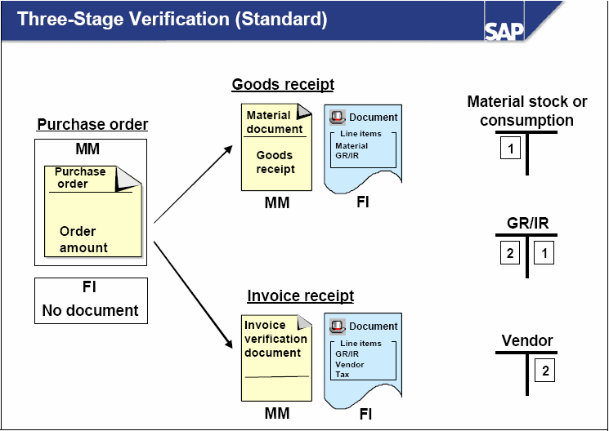

Slide 22
FI MM Integration
The three-step verification is the standard procedure for posting procurement transaction in FI.
The procedure contains the following three steps:
1) Purchase order
This transaction is completed in MM. No postings are made in FI.
2) Goods receipt
To update the inventory, a material document is created in MM. At the same time, a document is created in FI, with which the value of the goods is posted to the materials account (debit) and the goods receipt/invoice receipt account (credit) in the general ledger.

Slide 23
FI MM Integration
3) Invoice receipt :
The vendor invoice is posted in MM, which automatically creates a document in FI. The FI document contains the invoice amount that is posted to the goods receipt/invoice receipt account (debit) and the vendor account (credit).
The last two steps can be completed in reverse order, depending on the order the goods and the invoice are received.
The goods receipt/invoice receipt account ensures that goods were received for each invoice and vice versa.
Logistic Invoice Verification:
Invoice verification is the process of matching Vendor Invoices to the Purchase Order and Goods Receipt documents. For matched vendor invoices, a payable is automatically created in the FI General Ledger.

Slide 24
Postings in case of Goods Receipt
Postings in case of Invoice Receipt
GR/IR account
GR/IR account
10000
10000
Inventory Raw Material account
Vendor account
10000
10000

Slide 25
Automatic postings
What are automatic postings?
Postings are made to G/L accounts automatically in the case of Invoice Verification and Inventory Management transactions relevant to Financial and Cost Accounting.
Example:
Posting lines are created in the following accounts in the case of a goods issue for a cost center:
Stock account
Consumption account
How does the system find the relevant accounts?
When entering the goods movement, the user does not have to enter a G/L account, since the R/3 System automatically finds the accounts to which postings are to be made using the following data:
Chart of accounts of the company code
If the user enters a company code or a plant when entering a transaction, the R/3 System determines the chart of accounts which is valid for the company code.
You must define the automatic account determination individually for each chart of accounts.

Slide 26
Payment in the Procurement Cycle
MM
Purchase Order
MM
Goods Receipt
MM
Invoice Posting
FI
Payment
Notes:
While the Purchase Order, Goods Receipt, and Invoice Verification processing are performed in the Materials Management (MM) module, the Vendor Payment is performed in the Financial Accounting (FI) module.

Slide 27
Payment Processing
Vendor A
Vendor A
Vendor B
Vendor C
Invoice
In
Invoice
In
Invoice
In
Invoice
Manual
Payment
Payment
Program
OR
Check
Bank Transfer
After receiving invoices, payables are automatically created in the financial accounting general ledger. The payment program is set to maximize cash discounts when paying open vendor items. It creates a list of proposed vendor items to be paid and suggests payment methods for each proposed payment.
Notes:
Vendor Payments can be processed automatically using the Payment Program
or manually.
The Payment Program is designed to maximize cash discounts when paying Vendor Open Items.

Slide 28
Payment Processing Results
PAYMENT
(Manual or via Payment Program)
Create a
Payment
Form
Create a Vendor
Payment
Document
Clear the
Vendor
Open Item
Post to Vendor Account
Post to G/L Accounts
Notes:
The results of posting a Vendor Payment include:
Creation of a Payment Document that:
Creates a debit in the Vendor (subledger) Account and the appropriate Reconciliation (G/L Accounts Payable) Account.
Creates a credit to the G/L Cash Account linked to the House Bank from which the payment was made.
Matching the Vendor Payment against the open Vendor Invoice in the Vendor Account and clearing them against each other.
The Outgoing Payment Program will be discussed in more detail in Chapter 24.

Slide 29
Procurement Cycle - recap
Purchase
Requisition
    (MM)
A/P
X
Cash
X
Vendor
Payment
  (FI)
Purchase
  Order
  (MM)
  Invoice
Verification
  (MM)
(FI)
Goods
Receipt
(MM)
(FI)
A/P
GR/IR
Inventory
X
GR/IR
X
X
X

