Slide 1
Risk Based Internal Audit ( RBIA)
Audit teams of most of the entities predominantly follow audit procedures to complete AAP(Annual Audit Plan) by bifurcating into time horizon (e.g quarterly coverage) with prioritization, to cover at least the high risk areas (as high risk areas are first priority) during the plan period based on adequate manpower scheduling. This methodology suffers from the following inadequacies:
- RBIA (Risk Based Internal Audit) Plan prepared at the commencement of the year/period may not be entirely harmonized with complete risk profile of the entity, signaling presence of unattended risks.
- Inadequacy in capturing dynamic risk profiles due to the absence of continuous risk review and mitigation programs

Slide 2
Risk Based Internal Audit ( RBIA) – contd.
- Inadequacy in the flexibility of functioning of the Audit Team to report concerns emanated while conducting audit of an already committed area.
Obligation of team members to deliver on a time bound manner, may severally impact the review quality and risk identification as well as their mitigation process.
Absence of dynamism in coverage of high risk areas (which ceaselessly changes during audit period) under the RBIA Annual Plan, may effectively keep major concerns out of audit purview for a considerable period (may be for a year or more).
Absence of critical appraisal of Risk management process to assess their robustness and adaptability under changed dynamics.
Customary periodical reporting not been able to address real time risk issues to Management/Audit Committee as well the steps taken by Management for mitigation.
Better oversee and governance function of the Audit Committees may be affected due to non-appraisal of prevalent risk by audit team

Slide 3
Risk Based Internal Audit ( RBIA) – Case Study for a big conglomerate
Business and Strategic Risk – An Example
Business and Strategic Risk Basket | Audit Area
Dependency on group Companies with fixed rate contracts | Revenue Cycle
Cyclical nature of industry attributing volatility to service rates | Revenue Cycle
Environmental pollution and property damages/losses | Revenue Cycle Fixed Assets
Currency fluctuations | Treasury Cycle Revenue Cycle
Dependency on contractual workforce for commercial operations | Operating Cycle Treasury Cycle
Increase in operating costs due to fuel price hike | Operating Cycle
Regulatory risk and Compliance | Regulatory Cycle

Slide 4
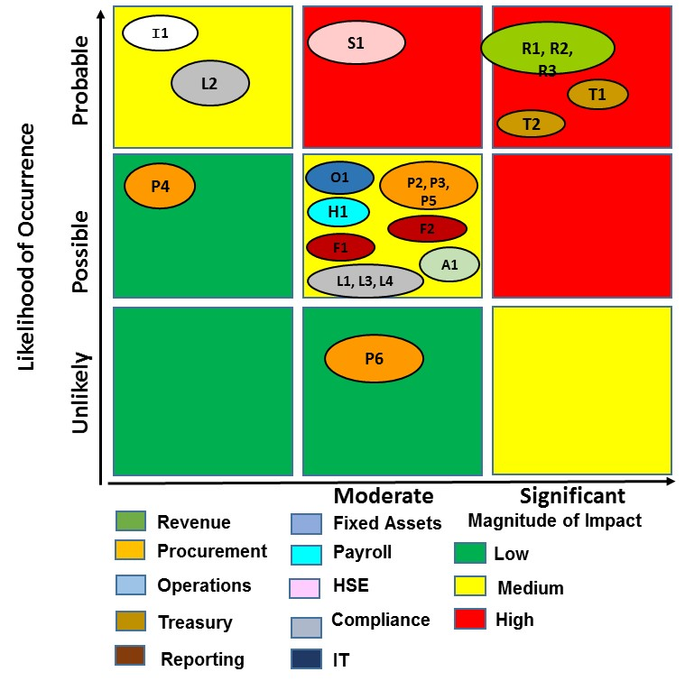
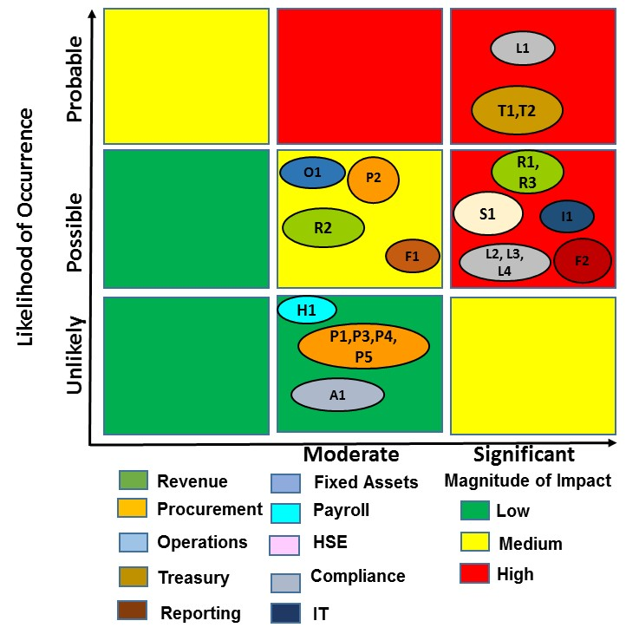
Case Study for a big conglomerate – Contd.
Pre and Post Review Risk Matrix -Shift

Slide 5
Case Study for a big conglomerate – Contd.

Slide 6
Case Study for a big conglomerate – Contd.: Changes in Risk after each review
Sr. No. | Business Processes of the Entity | Assessment/Review during the Year
 |  | 1st | 2nd | 3rd
R1 | Business Development | Medium | High | High
R2 | Order Management and Invoicing | High | High | Medium
R3 | Receivable & Collections | Medium | High | High
P1 | Vendor Selection, Planning, Pricing | High | Medium | Low
P2 | P.O and Receipts Logistics | High | Medium | Medium
P3 | Inventory Management | Medium | Low | Low
P4 | Accounts Payable & Payments | Medium | Medium | Low
P5 | Other Service and Expenses | Medium | Low | Low
O1 | Operating Expenses | High | Medium | Medium
T1 | Loans (Secured & Unsecured) | High | High | High
T2 | Investments | High | High | High
F1 | Financial Reporting | Medium | Medium | Medium
F2 | Related Party/Inter gr. transaction | Medium | Medium | High
A1 | Fixed Assets/CWIP | High | Medium | Low
H1 | HR and Payroll Process | Low | Medium | Low
S1 | Health, Safety and Environment | High | High | High
L1 | Companies Act and SEBI Act | High | Medium | High
L2 | FEMA and allied Laws | High | Medium | Medium
L3 | Industrial and Labour relation | High | Medium | Medium
L4 | Other incidental /ancillary laws | Medium | Medium | Medium
I1 | Application Control ( Systems) | High | Medium | High

Slide 7
Case Study for a big conglomerate – Contd.: Reason for reclassification
No. | Business Process of Entity | Reason for Change in Risk Classification
R1 | Business Development | No growth in new business initiatives High spent on initiatives taken
R2 | Order Management and Invoicing | Timely execution & avoidance of Liquidated Damages
R3 | Receivable & Collections | High Receivables, poor collection initiative Cost of fund blockage increased
P1 | Vendor Selection, Planning, Pricing | Prices benchmarked against market rates
P2 | P.O and Receipts Logistics | Timely inventorization after quality check Just in time inventory maintained
P3 | Inventory Management | Adequate inventory in terms of Production Plan
P4 | Accounts Payable & Payments | Accurate and timely release of payment
P5 | Other Service and Expenses | Low involvement of fund
O1 | Operating Expenses | Initiatives for expense curtailment
T1 | Loans (Secured & Unsecured) | High borrowings with varied interest rate
T2 | Investments | New business initiatives and huge fund deployment
F1 | Financial Reporting | Adherence to Accounting Policies Adequate provisions for accounting events
F2 | RP/Inter group transaction | Pending reconciliation between Group entities
A1 | Fixed Assets/CWIP | Timely capitalization and booking depreciation
H1 | HR and Payroll Process | Adequacy of checks and balances
S1 | Health, Safety and Environment | Nature of industry –pollutant
L1 | Companies Act and SEBI Act | New regulations and compliance requirement
L2 | FEMA and allied Laws | Min. fund movement and ensured compliance
L3 | Industrial and Labour relation | IR Regulations mostly complied with
L4 | Other incidental /ancillary laws | Transactional compliance
I1 | Application Control ( Systems) | Inadequate access control Improper mapping of Delegation of Authority in ERP

Slide 8
THANK YOU!!

