Slide 1
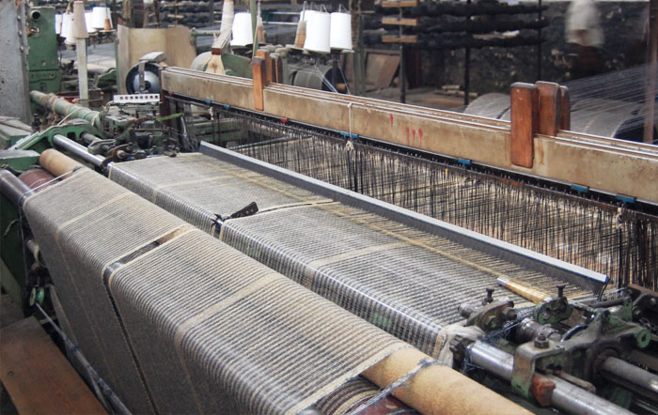
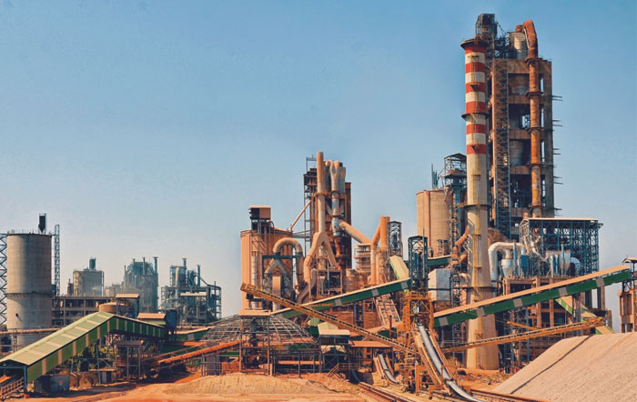
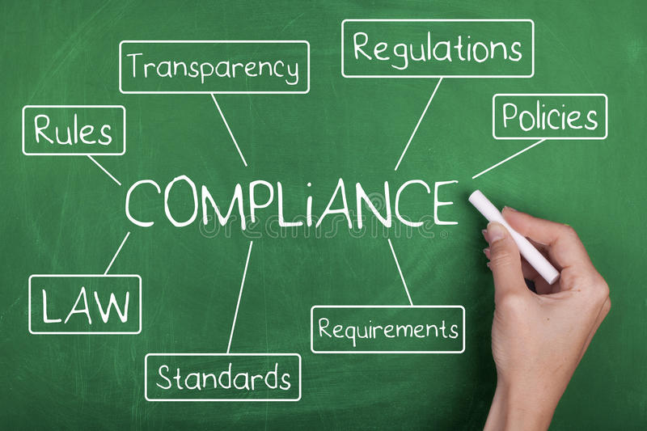



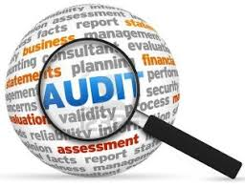

Advanced Certificate Course on IA
  Journey towards Learning

Slide 2
Agenda
Case Study , IA Charter
Role of Internal Auditor as Management Member
Role of Cost. Accountant as an Internal Auditor
Interpersonal and Communication skills
Process of Mapping, Flow Charting
CSA ( Control Self Assessment)

Slide 3
Internal Audit Charter --Contents
Mission and Purpose
Responsibilities of Management
Scope of Internal Audit function
Internal audit’s purpose within the organization
Internal audit’s authority
Internal audit’s responsibility
Internal audit’s position within the organization
Reporting
Relationship with external auditor

Slide 4
Table of Contents
1. Need for Internal Audit Charter
2. Objectives
3. Vision and Mission Statement
4. Organisation Structure
5. Role
6. Responsibilities
7. Scope and Coverage
8. Operations
8.1 Risk Assessment
8.2 Audit Process
8.3 Fraud and Forensic Management
9. Audit Committee Meetings
9.1 Management Audit Committee meeting
9.2 Board Audit Committee (AC) meeting
10. Review Committee
11. Approvals, Acceptance and Amendment
Audit Charter - Sample

Slide 5
Audit Charter – Sample(Contd.)
Need for Internal Audit Charter
Charter is the cornerstone for building a robust assurance function within an organization. It’s the pivotal document that sets the philosophy / tone of the function and makes it operational in discharging its responsibilities. This Charter aims to institutionalize the duties, reporting lines and protocol of Assurance Team.
The Charter provides the framework in which Assurance Team operates, its objectives, interface with businesses audited, overview of the procedures followed in Assurance function, and remedies to issues and challenges.
An equally important component of this Charter is Assurance Team’s engagement with the Review Committee and Audit Committee to various companies audited by the Team.
2. Objectives of Assurance Team
The primary objective is to serve as an oversight function that objectively evaluates and recommends improvements to the Company’s internal control structure through a risk based audit approach.
Essentially, the broad objectives of are:
a. Build an IA structure which encompasses all levels of Controls, Governance, Business Process and risks as well as transactional controls.

Slide 6
Audit Charter – Sample(Contd.)
Vision and Mission Statement
To establish an audit function that is truly reflective of entity’s Vision of being “respected global entrepreneur, through the power of Positive Action”.
We believe in aligning the Assurance Team’s vision through robust audit practices powered by:
Systematic planning and approach;
Engagement and involvement with the auditees and various stakeholders; and
Knowledgeable, proactive and world class resources.
Assurance Team provides “Control Assurance” to Management embedded with “Business Consulting” to enhance the performance of the organization and stakeholders’ value.

Slide 7
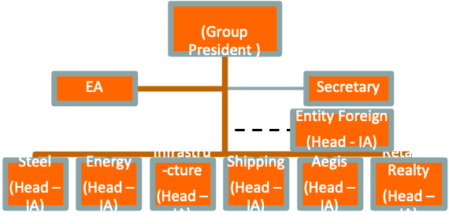
Audit Charter – Sample(Contd.)
(Group President )
Energy
(Head – IA)
Infrastru-cture
(Head – IA)
Shipping
(Head – IA)
Aegis
(Head – IA)
Retail & Realty
(Head – IA)
Steel
(Head – IA)
Information Technology Audit/ Assurance
Functional Specialist
Project Assurance
Functional Specialist
Forensics & Investigations
Functional Specialist
Compliance & Financial Assurance
Functional Specialist
Process Assurance
Head - PA
Pre-Audit
Head – Pre Audit
Knowledge Management & Learning
Knowledge Manager
Functional Specialist
Functional Specialist
Functional Specialist
Process Assurance
Process Assurance
Process Assurance
Head - PA
Head - PA
Head - PA
Knowledge Management & Learning
Knowledge Management & Learning
Knowledge Management & Learning
Knowledge Manager
Knowledge Manager
Knowledge Manager
Information Technology Audit/ Assurance
Information Technology Audit/ Assurance
Information Technology Audit/ Assurance
Project Assurance
Project Assurance
Project Assurance
Forensics & Investigations
Forensics & Investigations
Forensics & Investigations
Compliance & Financial Assurance
Compliance & Financial Assurance
Compliance & Financial Assurance
Organisation Structure
Organisation Structure
Organisation Structure
Pre-Audit
Pre-Audit
Pre-Audit
Head – Pre Audit
Head – Pre Audit
Head – Pre Audit
Functional Specialist
Functional Specialist
Functional Specialist
Functional Specialist
Functional Specialist
Functional Specialist
Functional Specialist
Functional Specialist
Functional Specialist

Slide 8
Audit Charter – Sample(Contd.)
Role of Assurance
Assurance is an independent body that performs internal audit of various group companies as per the internal audit plan and calendar agreed with the respective Management and/or Audit Committees of these companies.
Assurance Team reports directly to the Audit Committees of various companies audited by it and the Review Committee.
This Charter represents the general authorization from Promoter Directors, Company Management and Audit Committees to conduct internal audits of Group entities.
The specific authorization to perform the scope of work is according to the Internal Audit Plan approved by the Audit Committee annually.
The scope of work contained in this plan will be based on joint assessment by Assurance Team and Management of the inherent risks and the significance of these risks in terms of its likelihood and impact to the business. Internal audit coverage focuses on risks that are significant to the organization.
A typical internal audit carried out by the Team is to ascertain the risks in achieving process objectives and assessing the appropriateness of management’s response to address these risks.
They may also carry out special reviews or investigation on request from Management or Audit Committee or Review Committee.

Slide 9
Audit Charter – Sample(Contd.) Responsibility
Assurance team will be primarily responsible for ensuring that all the audits are carried out as per the approved audit plan and special requests of the Management.
Assurance team’s functional review will be carried out by the oversight committee, namely, Review Committee.
Team will execute the audit under the direction and supervision of the Group President.
An audit report summarizing the exceptions noticed during the course of audit review will be circulated as per the distribution list by the Business Audit Lead.
Assurance will be responsive to the company’s changing needs and will strive for continuous improvement and maintain integrity in carrying out their activities.
A representative from Assurance will be present for Audit Committee meetings (including Management Audit Committee {MAC}) to discuss key findings and matters requiring attention of the Audit Committee.
Assurance will not be responsible for implementation of the action plan agreed by the Management.
Assurance will, suo moto, interact with the statutory auditors for matters requiring inputs from them or on request from the auditors or the Management. (All internal audit reports released by Assurance will be submitted to the statutory auditors by the Management only, unless formally requested by Management to release it from Assurance).
Group President shall have the discretion to roll-out policies and procedures best suited to the function.

Slide 10
Audit Charter – Sample(Contd.)
Team members will ensure “Confidentiality” of data / record / information at all times and there is no sharing of information to internal or external parties without formal approval of Group President and/or the Management.
Assurance will appraise Management of non-availability of data / records / response and seek necessary guidance on way forward.

Slide 11
Audit Charter – Sample(Contd.)
Management’s responsibilities
Management will be responsible for risk management, and laying down business processes and internal control structure. Assurance Team shall only review these and can raise concerns or suggest improvements to the Management. They will not play Management role in designing, implementing, monitoring and evaluating the right procedures, controls or systems for the organization.
Management shall make available all resources, people, systems, records, etc. to ensure smooth conduct of audit. Management shall not limit or restrict access to work papers, records and systems.
Management shall be obligated to respond to inquiries and recommendations, formal and informal, in a timely and diligent manner.
Management will provide periodic update on the implementation of action plan , which will be presented to the Audit Committee (including MAC) and Review Committee.
Management shall be responsible for inviting the concerned Business Audit Lead and Group President for the Audit Committee meetings.

Slide 12
Audit Charter – Sample(Contd.)Scope and Coverage
Team shall have uninhibited and complete access to all records, data, information, documents, systems and personnel for discharging its audit duties / objectives.
Assurance shall have audit documentation tool to preserve the documents, records, information, etc. that were collected to support the reported conclusions and observations.
Team shall be independent of the Management of entities audited and will have reporting line to the Audit Committee of each of these companies.
Team will work closely with Management to identify and assess risk and control, which will assist them in the effective discharge of their responsibilities, while maintaining their independence.
Team may time-to-time advise Management on existing and evolving corporate governance, risk management and compliance practices prevalent and may suit to the organization. Team shall not serve as a substitute for management control, since an adequate internal control structure should not necessitate the performance of any audit.
Team will not review areas where they were responsible for the design or implantation of a process or system.

Slide 13
Audit Charter – Sample(Contd.)Scope and Coverage
Team shall not assume organizational responsibilities or authority outside the department, and not perform management functions, procedures, reviews or render organizational decisions. Similarly, the Internal Audit Department shall not in any way utilize its resources to relieve or subsidize other persons or functions in the Company.
Team will keep abreast of relevant best practices and new developments affecting their work, and in matters affecting the organizations audited.

Slide 14
Audit Charter – Sample(Contd.)
Operations by Assurance Team
Prepare Risk-based Audit Plan
Obtain buy-in from Manage-ment and AC
Preparation of Audit Programme/ Checklist
Fieldwork / Execution
Reporting to Manage-ment
Manage-ment Response
Debrief

Slide 15
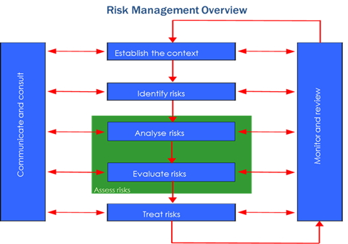
Audit Charter – Sample(Contd.)
The Team will perform a detailed Risk Assessment as a part of the Audit Planning process.
.
Assurance Team’s role in terms of Risk Management are:
Giving reasonable assurance on the correctness of risk evaluation; Review the process of tracking and communicating risks;
Reviewing the process of treating key risks by the Management; Participating in discussions and advising on risk management
matters, but not discharging any duties or functions of risk management

Slide 16
  Fraud and Forensic Management
Identification and reporting of fraud during the course of audit reviews will be done and the team will deploy the resources (internal or external) with requisite skillsets to conduct review of suspicious or fraudulent transactions either suo moto or on formal request from Management or an empowered Committee.
Assurance team will review and evaluate the fraud management framework established by Management of each group companies.
A graphical representation of Team’s involvement in fraud control is given below:
Audit Charter – Sample(Contd.)
A
Fraud Control
Prevention
Detection
Investigation
Fraud risk assessment
Suspicious transactions analysis
Field investigations
Computer forensics

Slide 17
Audit Charter – Sample(Contd.)
Audit Committee Meetings
Audit Committee can be either:
  Management Audit Committee; and
  Board Audit Committee.
Management Audit Committee meeting
A MAC meeting is held prior to the AC for discussion with company’s Management on key issues to be presented to the Board Audit Committee. A MAC meeting, therefore, has to be held quarterly.
Note: In certain businesses, MAC meetings are not held and the reports are directly discussed in the Board Audit Committee meetings.
MAC also serves as a forum for the company’s Management to provide their explanation or clarification on the audit observations that are being presented.
A MAC can provide guidance to the audit team on any additional work to be performed or to overcome any issues or hassle while conducting the audit.
MAC meetings will be attended by the Business Audit Lead and Group President. In addition, any team member may attend the meeting with approval from Group President.

Slide 18
Audit Charter – Sample(Contd.)
Board Audit Committee (AC) meeting
Review of internal audit and internal controls is one of the agenda items during the AC meeting.
Board Audit Committee meeting will be convened by the concerned business at least once in a quarter for which the Assurance team will be invited.
Assurance will be represented at least by the Business Audit Lead and Group President.
A summary of key observations and other audit related matters will be presented to the Audit Committee.

Slide 19
Audit Charter – Sample(Contd.)
Review Committee
Functional review of the performance for each month is carried out by the Review Committee.
Review Committee provides guidance for handling any matters that has reached an impasse or can ask for special reviews to be conducted or can seek additional information on matters reported.
Review Committee can co-opt or through Group President invite any additional member, if it deems necessary.
Monthly operations report is submitted to the Review Committee members, which is discussed during the monthly meeting.
Minutes of Review Committee meeting is circulated along with the actionable, the status of which is to be reported in the ensuring meeting.

Slide 20
Audit Charter – Sample(Contd.)
Approvals, Acceptance and Amendments
The signatures below signify approval of the GACC Review Committee and acceptance by Group President-GACC.
Signature ____________________________________ Date ________________
Member- Review Committee
Signature ____________________________________ Date ________________
Member- Review Committee
Signature ____________________________________ Date ________________
Group President
Amendments
Amendments shall be signed by persons consistent with those authorizing this original Charter to be effective.

Slide 21
Role of Internal Auditor as Management Member
Internal Auditor can be an employee of the entity/Organization designated for performing Internal Audit.
Firms and Consultants can also be appointed to perform the function of Internal Auditor.
Persons can also be hired on Contractual basis to conduct Internal Audit ( IA).
Reporting relationship for the employee internal auditor can be as per Organizational hierarchy.
The employee internal auditor is accountable to Audit Committee (AC).
Independency is a challenge while serving the entity and reporting to AC
A clear job profile for the internal audit role need to be in place for the IA Team.
Multiple tasks of the appointing entity having conflict of interest as internal auditor should not be taken up.
Should not take part in management decisions, however, can guide the decision making process.
Eyes and Ears of Management, developing foresight of Audit Committee.

Slide 22
Role of Cost Accountant as Internal Auditor
Companies Act 2013 u/s 138(1), specifically provides an opportunity to Cost Accountants/Firm of Cost Accountants , who can function as an Internal Auditor , if otherwise not been found disqualified.
The Cost Auditor is supposed to comment on adequacy of Internal Audit under Cost Accounting Record Rules 1968, hence he can not be appointed as Internal Auditor for the said period.

Slide 23
Mock Discussion :Win the Heart
“We are going to discuss with you the report on inventory management, the areas which we have covered are-------“
Basic Guidelines
Organize and develop your discussion logically. Follow the sequence. E.g. if you are discussing an audit observation;
  Present what is happening and what is wrong
  Reason behind the same
  Suggest corrective measure to rectify the same
  Appeal for action (evoke desired results)
Support your points with logical and relevant (facts, statistics, examples, analysis etc.). Do enough home work.
Don’t get drawn into an argument with auditee in course of discussion.
Be courteous all throughout the discussion.
Don’t allow auditee to divert the subject, keep a tab on the subject matter.
Try to sale your point/observation and win his confidence.
Try to be within time schedule.
Accept auditee’s view ,if it’s logical
Thank the auditee for giving his Valuable time.

Slide 24
Mock Discussion :Win the Heart ( Contd.)
Auditee – “We appreciate your recommendations but you should also appreciate our limitations. We do not have sufficient storage facility to stock materials properly.”
You – “That’s right, but you see how much production loss the company is incurring due to non-availability of material in time? This need to be controlled”
Auditee – “I have no clue as to how do I achieve this with limited resources and Capex sanction?”
You – (Staring at him blankly!)
Auditee – “I am not sure whether I will be able to enforce your recommendation for additional space/storage”
You – “You must work on some solution.”
Auditee – We appreciate your recommendations but you should also appreciate our limitations. We can’t pay demurrage when a vessel accepted under compulsion.
You – Yeah, Sir, in fact we did consider this before putting this recommendation! We were wondering what stopped you from making a proper chartering schedule with stock-out planning for so long!
Auditee – Exactly, (gets excited). Even my supervisor/store keepers could not help me in this?

Slide 25
Mock Discussion :Win the Heart ( Contd.)
You – We understand sir! We were also concerned about volume of production which ‘We’ are losing.
Auditee – I am not sure whether I can achieve this, may be I will try to convey this to the Inventory Management Team in small group meetings!
You – Sure, this will definitely help you to convey ‘YOUR’ ideas to them in positive manner.
Auditee – Let’s see, I will plan something next week. Also ask for a enhanced capex budget sanction.
You – Sure, sir, do let us know if you need our help!
Auditee – Sure , thank you very much.
More such areas/ Report in entirety can be discussed at workshop with playing different roles by the Team.

Slide 26
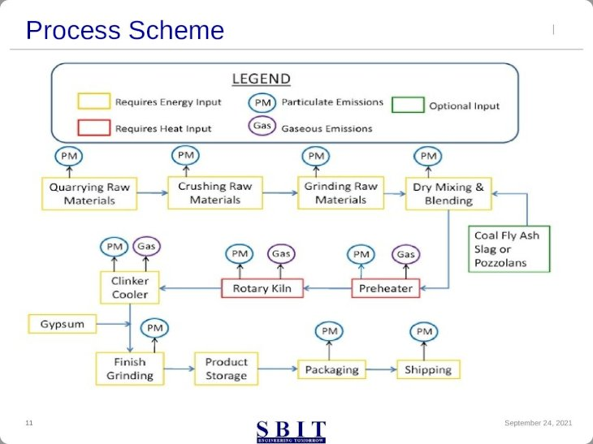
Process Flow – Cement Manufacturing

Slide 27
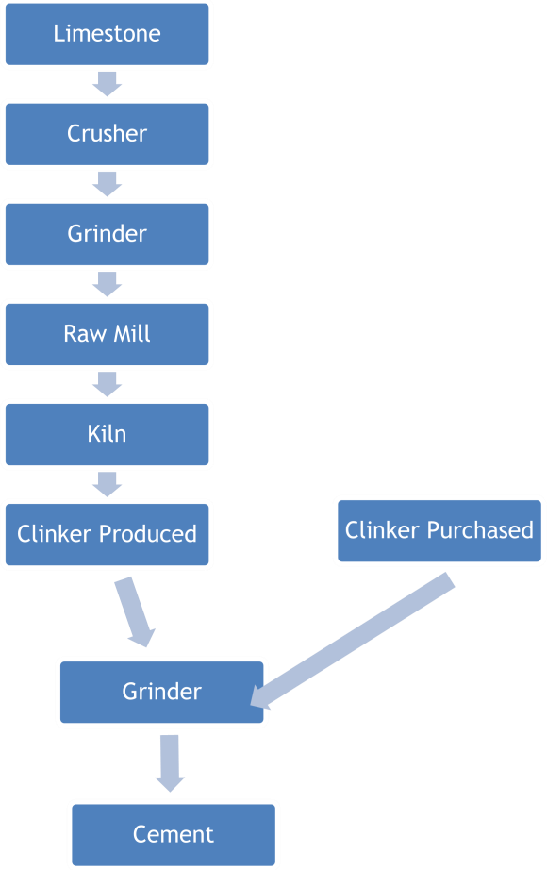
Process Flow – Cement Manufacturing

Slide 28
Process Flow – Cement Manufacturing
The most common raw materials used for cement production are limestone, chalk and clay. The major component of the raw materials, the limestone or chalk, is usually extracted from a quarry adjacent to or very close to the Plant. Limestone provides the required calcium oxide and some of the other oxides, while clay, shale and other materials provide most of the silicon, aluminium and iron oxides required for the manufacture of Portland cement.
The quarried material is reduced in size by processing through a series of crushers. Normally primary size reduction is accomplished by a jaw or gyratory crusher, and followed by secondary size reduction with a roller or hammer mill. The crushed material is screened and stones are returned. More than 1.5 Mt. of raw materials are required to produce 1 (one) Mt. of Portland cement.
Clinker is produced through a controlled high-temperature burn in a kiln of a measured blend of calcareous rocks (usually limestone) and lesser quantities of siliceous, aluminous, and ferrous materials. The Kiln feed blend (also called raw meal or raw mix) is adjusted depending on the chemical composition of the raw materials and the type of cement desired.

Slide 29
Process Flow – Cement Manufacturing
Clinker is produced by pyro processing in large kilns. These kiln systems evaporate the inherent water in the raw meal, after cooling the cinker can be stored in the clinker silos, bins, or outside. The material handling equipment used to transport clinker from the clinker coolers to storage and then to the finish mill is similar to that used to transport raw materials (e.g. belt conveyors, deep bucket conveyors, and bucket elevators). Where the lime stone sourcing is not possible, the manufacturers transports Clinker through Trucks/Rail Wagons to grinding units for cement production. To produce powdered cement, the nodules of cement clinker are ground to the consistency of face powder. Grinding of cement clinker, together with additions (3-5% gypsum to control the setting properties of the cement) can be done in Ball Mills, Ball Mills in combination with roller presses, roller mills, or roller presses. Coarse material is separated in a classifier that is re-circulated and returned to the mill for additional grinding to ensure a uniform surface area of the final product.

Slide 30
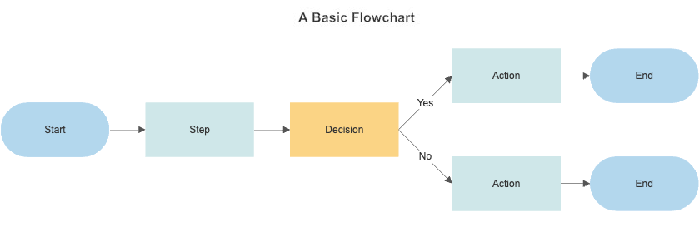
Flow Chart

Slide 31
Control Self Assessment
Internal auditors normally consider operations as a whole with respect to the five key internal control objectives. The IIA's (Institute of Internal Auditor) Standards of Professional Practice outlines five key objectives for an entity's system of internal control:
Compliance with policies, plans, procedures, laws and regulations;
Accomplishment of established objectives and goals for operations or programs ,not just the financial aspects;
Reliability and integrity of information;
Economical and efficient use of resources;
Safeguarding of assets;
These are collectively coined as “CARES”.

Slide 32
Control Self Assessment (Contd.)
The most pertinent way to accomplish ‘control effectiveness assessment’ is to implement ‘self-assessment of Control’ program as part of the Company’s ongoing evaluations within its monitoring activities. Self- Assessment of Controls is a sustainable process whereby management periodically authenticates the operational effectiveness of the company’s key controls vs. relying on internal or external auditors to make such an assessment. Self – Assessment steers management responsibility and augments confidence in management’s appraisal of the effectiveness of their internal control system. Applied technology solutions are available for comparing transaction details against predetermined thresholds, monitoring for trends and patterns, and assessing automated performance indicators and matrices. ‘Self’-assessment refers to the involvement of management and operating staff in the assessment process. Propagating a framework named ‘OPTION’, where
O- Objective Setting
P – Process and related Risk defining
T- Test for results
I- Initiate required activity
O- Operate and replicate
N- No or low risk outcome

Slide 33
Control Self Assessment (Contd.)

Slide 34
Control Self Assessment (Contd.)
Measuring Effectiveness (Case Study)
For updating and measuring the effectiveness of Control in any of the Business Process/Sub-process/Activity a questionnaire with pre-agreed scoring ( 3 = Existence of adequate control ; 2 = Major controls in place ; 1= Partial control ; 0 = Absence of control) methodology need to be in place. Weightage in scale of 3 (3 = High;2= Medium; 1=/low) need to be used as multiplication factor to arrive at the actual score. One such example in the Sub-process viz. “Fixed Asset” given hereunder
Self-Assessment Questionnaire
Sr. No | Self-Assessment of Control | Wt. | Maker | Checker | Approver | Score Scale | Max Score =Wt* Score Scale | Actual Score = Wt. x Test Result | Risk Grade
Capex Approval and Monitoring
1 | Whether there is exists detailed Capital Expenditure policy highlighting the procedures to be followed for estimation of CAPEX & pre-defined authority for sanction of the capital expenditure budget with value limits? | 3 | 896 | 567 | 9101 | 3 | 9 | 6
2 | All CAPEX proposals are approved as per DOA? | 3 | 896 | 567 | 9101 | 2 | 6 | 6
3 | Whether separate CAPEX proposals for assets to be replaced are put specifying the need to replace the asset? | 2 | 896 | 567 | 9101 | 2 | 4 | 4
4 | Whether a Bill of Material is prepared for all assets to be constructed in SAP PS module? | 2 | 896 | 567 | 9101 | 3 | 6 | 4
5 | Whether the sanctioned budget for each material item as per BOM is uploaded in SAP under the specific WBS no.? | 3 | 896 | 567 | 9101 | 3 | 9 | 6
6 | Whether the sanctioned budget for each project is uploaded in SAP under the specific WBS no. and specific cost element? | 3 | 896 | 567 | 9101 | 3 | 9 | 9
7 | Whether separate PRs/POs/SOs are generated for the Capital Items with attached WBS No.? | 2 | 896 | 567 | 9101 | 2 | 4 | 2
8 | Whether all PRs generated for Capital Material contain the technical specification Sheet required for the asset/item? | 2 | 896 | 567 | 9101 | 3 | 6 | 6

Slide 35
Control Self Assessment (Contd.)
Requisitioning, Ordering ,Receipt of Assets
9 | Whether SAP allows to raise Purchase Requisitions or Purchase Orders or Service Orders only up to the amount of budget available? | 2 | 896 | 567 | 9101 | 3 | 6 | 8
10 | Whether expenses charged to WBS are settled periodically to charge them to relevant Asset Under Construction (AUC) A/c? | 3 | 896 | 567 | 9101 | 3 | 9 | 4
11 | Whether the AUC accounts are Capitalised as Fixed Assets on receipt of Project completion Certificate? | 3 | 896 | 567 | 9101 | 3 | 9 | 9
12 | Whether Fixed Assets are properly classified (while capitalising) as per the provisions of the Companies Act? | 3 | 896 | 567 | 9101 | 3 | 9 | 6
13 | Whether it is ensured that CENVAT and VAT on the cost of assets are not included within the capitalization cost? | 3 | 896 | 567 | 9101 | 3 | 9 | 9
14 | Whether ageing analysis of all AUC are done periodically and reasons for long pending non-completions are found out? | 2 | 896 | 567 | 9101 | 2 | 4 | 0

Slide 36
Control Self Assessment (Contd.)
Asset identification and Verification
15 | Whether physical verification is done on project completion to identify surplus materials? | 3 | 896 | 567 | 9101 | 3 | 9 | 2
16 | Whether a unique identification no. is given to assets and sub-units during at Capitalisation? | 3 | 896 | 567 | 9101 | 3 | 9 | 9
17 | Whether Fixed Asset Register being updated for all fixed assets constructed/purchased? | 3 | 896 | 567 | 9101 | 3 | 9 | 6
18 | Whether the unique asset no. of the asset has been attached and displayed on the asset? | 3 | 896 | 567 | 9101 | 3 | 9 | 6
19 | Whether Physical Verification of Fixed Assets is being carried out at regular intervals? | 3 | 896 | 567 | 9101 | 3 | 9 | 6
20 | Whether all discrepancies noticed during physical verification are adjusted only after taking approval of higher authorities? | 3 | 896 | 567 | 9101 | 3 | 9 | 3
21 | Whether the surplus items are added as Fixed Asset at nominal value in the books of Account? | 3 | 896 | 567 | 9101 | 3 | 9 | 6
22 | Whether movement/transfer (within the plant or to other locations) are done ‘gh a std. form signed both by the transferor & transferee dept. / under an intimation to Accounts Dept.? | 3 | 896 | 567 | 9101 | 3 | 9 | 0

Slide 37
Control Self Assessment (Contd.)
23 | Whether FAR is updated after receiving approved Asset Transfer Note? | 3 | 896 | 567 | 9101 | 2 | 6 | 0
24 | Whether transfer from one plant location to another is approved by defined approving authority? | 3 | 896 | 567 | 9101 | 2 | 6 | 0
25 | Whether proper steps have been taken to ensure physical security of assets? | 2 | 896 | 567 | 9101 | 3 | 6 | 6
26 | Whether adequate steps are being taken in case of theft/encroachment of Assets? | 2 | 896 | 567 | 9101 | 3 | 6 | 6
27 | Whether assets are allowed to be taken out only on the basis of valid gate passes issued by appropriate authorities? | 3 | 896 | 567 | 9101 | 3 | 9 | 9
28 | Whether there is a regular process of identification of idle or non-performing Assets by Departments? | 3 | 896 | 567 | 9101 | 3 | 9 | 6
29 | Whether identified NPAs are sent to Technology Officer to check the genuineness of NPA claim? | 3 | 896 | 567 | 9101 | 3 | 9 | 0
30 | Whether NPA list got approved as per DOA before the identified NPAs are transferred to stores for disposal? | 3 | 896 | 567 | 9101 | 3 | 9 | 6

Slide 38
Control Self Assessment (Contd.)
31 | Whether all assets finally approved as NPAs are transferred to Stores for disposal/discarding? | 3 | 896 | 567 | 9101 | 3 | 9 | 6
32 | Whether all receipt of goods and Invoices are first adjusted against the advance given and are not shown as payables? | 3 | 896 | 567 | 9101 | 3 | 9 | 9
33 | Whether approvals of HOD, COO, MD etc. have been taken before the asset is actually dropped and written off in the Books? | 3 | 896 | 567 | 9101 | 3 | 9 | 9
34 | Whether projects dropped in between are expensed in a separate GL and are not capitalised? | 3 | 896 | 567 | 9101 | 2 | 6 | 6
35 | Whether physical verification of asset to be dropped is carried out? | 3 | 896 | 567 | 9101 | 2 | 6 | 6

Slide 39
Control Self Assessment (Contd.)
Accounting controls
36 | Whether all the provisions of the Accounting Standards and disclosure requirements are complied with? | 3 | 896 | 567 | 9101 | 3 | 9 | 9
37 | Whether rates of Depreciation as per 'Life class' used for computation? | 3 | 896 | 567 | 9101 | 2 | 6 | 6
38 | Whether depreciation computed by the system is test-checked for correctness before Accounts are Finalised? | 3 | 896 | 567 | 9101 | 3 | 9 | 9
For the ‘Fixed Assets’ module, 38 controls with weightage scale band of 1 to 3(High =3, Medium =2 and Low=1) used to measure the existence, effectiveness and adequacy of controls. Similarly, actual score derivation based on assessment, also on a similar scale of 0 to 3 (3= Effective,2= Partially Effective,1= Existing and 0=Non-existing)used. Out of Maximum Score of 294, the function assessed at 210; which in turn measured at 71% effectiveness indicating further scope of improvement in the said area of activity. The typical nature of assessment and corrective measures provides more robustness in the process and risk management. Continuous updation of risk-scape, leads to operate only with acceptable risk and helps internal financial control (IFC) as well as internal control over financial reporting (ICFR).
Accounting controls
36 | Whether all the provisions of the Accounting Standards and disclosure requirements are complied with? | 3 | 896 | 567 | 9101 | 3 | 9 | 9
37 | Whether rates of Depreciation as per 'Life class' used for computation? | 3 | 896 | 567 | 9101 | 2 | 6 | 6
38 | Whether depreciation computed by the system is test-checked for correctness before Accounts are Finalised? | 3 | 896 | 567 | 9101 | 3 | 9 | 9

Slide 40
THANK YOU!!

