Slide 1

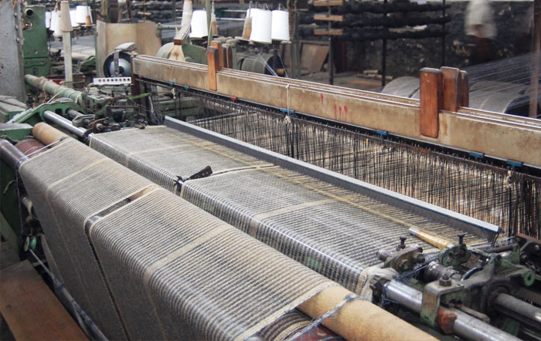
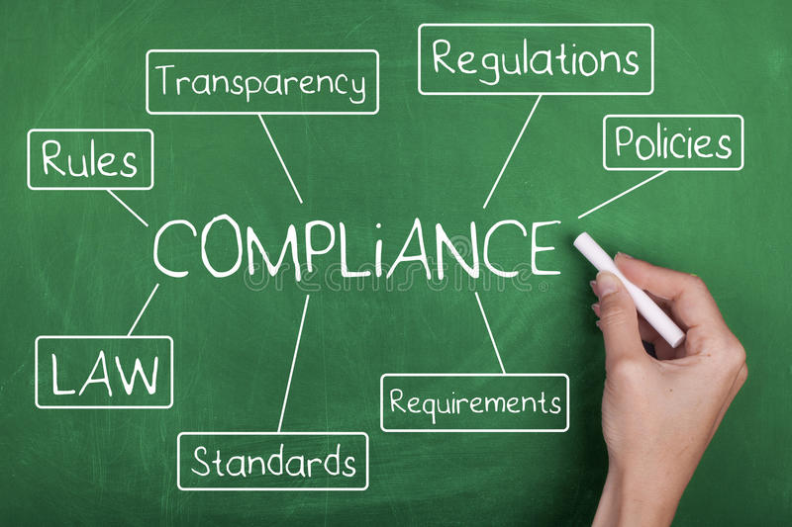



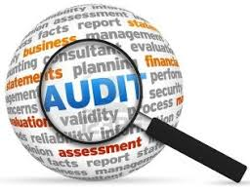

Advanced Certificate Course on IA
  Journey towards Learning

Slide 2

Know Your Resource :
M.Com., FCA, AICWA
More than 30 Years experience in ERM,IA & Process Improvement with reputed Companies
Declaration :
The pictures used in Slides are taken from freely available pictures in networld
Co-authored articles published in the ‘’Management Accountant Journal’’ are used in the course material
Research Publication of ICMAI ON Cement Industry ( authored by me) used in case studies

Slide 3
Coverage on 11.06.22 ,12.06.22 ,18.06.22,19.06.22,26.06.22,02.07.22,03.07.22,09.07.22, 10.07.22
Evolution and history of Internal Auditing
Assurance and Consulting Services in Internal Audit
Internal Controls – Internal Check – Internal Audit
Knowledge of Business and Industry
Operations and Process Understanding
Operations and Process Understanding – Case Study – Value Add
Internal Audit Programme – Case Study of Model Programs
Internal Audit questionnaire and check-list
Internal Audit Evidence (execution Data, Documents etc.)
Audit Conclusion and corrective measures
Format of IA Report – contents and presentation
Communicating to Audit Committee/Board : Case study
Enterprise Risk Management
Risk Based Internal Audit
Risk Based Internal Audit – Plan : Case Study
Risk Based Internal Audit- Case Study

Slide 4
Evolution and history of Internal Auditing
Evolution and history of Internal Auditing
The word “ Audit “ has come from the Latin “ Audire“ , means ” to hear”.
In ancient time, the King of state used to listen Income/Expenditure and transaction Report from the designated persons - “King’s Men”.
Chanakya in ‘Arthasastra’ mentioned that “it is very difficult to ascertain how much water the fishes are consuming from a pond full of water, similarly it is difficult to stop unauthorized use of funds by King’s men unless proper controls are in place.’
To assess the above, requirement of a ‘class of people’ called Auditors are adopted in the social eco-system.
For reasonable assurance, these people has to undertake ABCDEFGHI to ensure: A- Accuracy (w.r.t) ; B – Books ( Accounts) ; (by) C – Checking , D- Directing ( and ) E- Expected (to) F- Fix , G –Governance(standard) and H- Hygiene( by) I –Implementation(of audit issues).

Slide 5
Evolution and history of Internal Auditing – Chanakya way
Basic Highlights-
Accounting thoughts : East ahead of West
Chanakya on Accounting and Controls
Concept of ‘’Periodical Accounting and Accounting period’’
Auditing of Expenditure and Income
The 40 Ways of embezzlement ( except banking)
Fraud – may go unnoticed

Slide 6
Application Base :Today’s Challenge – Good Governance
Corporate
Governance
Legislation
Competition
Socioculture
Management Audit
Board
Economic
Political
Audit Comm.
Management
Global
Technological
Statutory Audit

Slide 7
Definition of Internal Audit -
Corporates exist to create value or benefit to their owners, other stakeholders ( not only stockholders), customers, and clients.
IIA definition of Auditing, Assurance and our focus :
“It is an independent, objective assurance and consulting activity designed to add value and improve an organisation’s operations. It helps an organisation accomplish its objectives by bringing a systematic, disciplined approach to evaluate and improve effectiveness of risk management, control and governance process.”

Slide 8
Standard Audit Flow -
Internal Auditor must learn how to turn hindsight into foresight that helps Audit Committee to develop insight
Determine
and Monitor
Auditee
expectation
Understand
and analyze
the business
Identify
Target
Processes/
Risks
Identify
Target
Processes/
Risks
Analyze
Target
Processes/
Risks
Communicate
and Monitor
Results
Engagement
Management
Entity Level
Business Risk Analysis
Process Assurance
Process Analysis
Process Improvement
Understand
Business
Strategy,
Objective
&
Environment
Understand
Relevant
Business
Performance
Measures
Understand
Relevant
Business
Processes
Understand
Relevant
Business
Performance
Measures
Understand
The
Process
Assess
Business
Risk in
Process
Assess
Process
Performance
& Control
Gaps
Identify Root
Causes and
Solution to
Process
Performance
And Control
Gaps

Slide 9
Assurance and Consulting services in Internal Audit
Requirements of Section 138 –
(i) the internal auditor may or may not be an employee of the company;
(ii) the term “Chartered Accountant” shall mean a Chartered Accountant whether engaged in practice or not.
(iii) specific mention about ‘Cost Accountant’ eligible to undertake the role.
Assurance Services and Consulting Services
Assurance Services -
An objective examination of evidence for the purpose of providing an independent assessment on risk management, control, or governance processes for the organization. Examples may include financial, performance, compliance, system security,and due diligence engagements.
Consulting Services – top up ( Case Studies are given separately)
The range of services, beyond internal audit’s assurance services, provided to assist management in meeting its objectives. The nature and scope of work are agreed upon with the client/organization. Examples include facilitation, process design, training, and advisory services.

Slide 10
Assurance and Consulting services in Internal Audit : Value Add
Case Study: 1
A ‘bulk packing’ centre operates with two Packing Machines on three shift basis. Daily deployment schedule is of 18 Operators (3/Shift/Packer) in three Shifts ( Shift I : 6 a.m to 2 p.m and so on ) for the two Packing Machines. Job descriptions and work content of Operators are given hereunder.
Bag feeding in nozzles - one operator each at each discharge end of double discharge facility. Rotation-wise off is taken by the workmen to ensure continuity of discharge operation.
The aforesaid modus of on and off/rest is mutually settled by the gang.
Our proposition indicates uninterrupted production with 5 workmen denoted as 1,2,3,4,5(instead of 6 per shift) by maintaining the prevalent off/rest time mutually agreed upon amongst workmen.
It is pertinent to mention here that recesses not being planned/ projected at the start and last lap of the eight hour shift as per prevalent system.
Considering continuity of effective working time span, that is, half an hour, one hour and so on; many such propositions can be build. Based on wage rate, savings can be achieved through modified matrix.

