Slide 1
Fraud Risk Management, Applicable Standard
&
Best Practices, Financial Forensic Audit Techniques
Presented by
CA. Sanjay Kumar Gupta

Slide 2
CA. Sanjay Kumar Gupta
FCA, DISA, CISA, CRISC, Cert. FAFD(ICAI), Cert. ACL,
ISO 31000 (I), Insolvency Professional
Conducted more than 100 Information System Audits in India & Abroad, in Manufacturing, Telecom, Banking and Financial Services sectors.
Specialised in Forensic , Concurrent & Transactions Audits.
Faculty with ICAI for DISA & Concurrent Audit courses and for ISCA classes & with ICAI ( Cost Accountant) for DISSA & DFA course . Also visiting faculty at C & AG.
Experience in GRC implementation for SAP module.
Contact : gsk@icai.org , 8851803867.

Slide 3
The cause for defeat in our life, does not relate to extent of problems we face, but lay in weak determination.
( Dr. Daisaku Ikeda, President Soka Gakkai International)

Slide 4
Forensic Audit
A forensic audit examines and evaluates a firm's or individual's financial records to derive evidence used in a court of law or legal proceeding. Forensic auditing is a specialization within accounting , and most large accounting firms have a forensic auditing department. Forensic audits require accounting and auditing procedures and expert knowledge about the legal framework of such an audit.

Slide 5
Fraud
Fraud is an intentionally deceptive action designed to provide the perpetrator with an unlawful gain or to deny a right to a victim. Types of fraud include tax fraud, credit card fraud, wire fraud, securities fraud, and bankruptcy fraud. Fraudulent activity can be carried out by one individual, multiple individuals or a business firm as a whole.
Fraud involves the false representation of facts, whether by intentionally withholding important information or providing false statements to another party for the specific purpose of gaining something that may not have been provided without the deception.

Slide 6
Fraud Risk Indicators
Key fraud indicators (KFI) are parameters that will help you to detect and investigate any wrongdoing in some part of your business. The indicator by its presence can also help in prevention. A KFI is not only a financial indicator, and it might have no connection with finance. These help organization in its ability to withstand against risk arising from fraud.

Slide 7
Fraud Risk Indicators
Frauds are a very important issue for organizations and are usually triggered by one of four situations:
  Opportunistic crime: employees commit fraud for their own benefit. This may be entirely opportunistic or carefully planned. There are likely to be a number of possible motives.
  Lack of a corporate ethic: in some organizations low-level fraud, such as the inflation of expenses claims may appear to be condoned by both employer and employee.
  The recruited criminal: some individuals seek employment (often in the financial sector) with the deliberate intention of defrauding their employer or gathering intellectual property.
  Employee intimidation: organized crime groups are increasingly involved in the intimidation of staff to directly participate in frauds or to provide information on customer accounts or internal procedures in order to assist other attempts.

Slide 8
‘Red flag’ indicators
There are a number of warning signs that can indicate that there may be a problem within your business. These should not be taken alone as evidence that fraud is occurring within the organization; there may be other legitimate explanations for the occurrence of these indicators. Fraud indicators are inherently interrelated.

Slide 9
Categorization of Fraud Risk Indicator
The fraud triangle refers that fraud requires three components: perceived pressure, perceived opportunity and rationalization. Pressure refers to the pressures on a person to perpetrate a fraud, opportunity is the means by which the fraud is committed and rationalization is the cognitive state that allows the perpetrator to justify the fraud
While considering the corruption indicators, it is important to consider the evidence left behind by fraudulent act. The Footprints of fraud may refer to the transaction, the perpetrator or the method of hiding the fraud

Slide 10
Fraud Risk Indicators - Pressure
Pressures on a person to perpetrate fraud may include financial pressures, including due to the economy, addictions, health problems, family circumstances and a desire to live well beyond one’s means; threats to safety from criminals or others who have something to gain or potentially lose; social pressures from colleagues; career pressures from managers and supervisors; social pressures from those to whom one has a loyalty.

Slide 11
Fraud Risk Indicators - Rationalization
People may be able to justify perpetrating fraud when the organization has not adequately clarified the difference between acceptable and unacceptable conduct, or is lax in following or enforcing it. Individuals may justify perpetrating fraud when they have a sufficiently negative perception of management, their colleagues, the organization or the environment. Psychological issues may also lead to fraud rationalization.

Slide 12
Fraud Risk Indicators - Rationalization
Indicators include:
  Inadequate policies or procedures to make it clear where the organization’s ethical line is drawn.
  Training in ethical issues is inadequate, or only gives the organizations stance and does not contain a component to motivate employees to do the right thing.
  A poor ethical culture or subculture, or a perception that managers or supervisors are ethically challenged.
  A significantly adversarial relationship exists between managers and employees.
  The person perceives that management have failed to provide support when it was needed.

Slide 13
Fraud Risk Indicators - Opportunity
Opportunity arises due to inadequate internal controls or breakdowns in the system of internal control. It may therefore be useful to consider opportunity in terms of an internal control framework. Here the five components from the COSO framework have been used in a broad manner. The components are control environment, risk assessment, control activities, information and communication, and monitoring.

Slide 14
Fraud Risk Indicators - Control Environment
It is useful to consider the indicators of fraud arising from issues relating to ethical culture, people and structures. . Indicators include:
  Limited or poor supervision and management so that people may not carry out control checks properly.
  Employees performing internal controls do not consider certain kinds of fraud to be wrong.
  Some employees are over-trusted.
  Managers do not want to hear bad news. The culture is not to question people or certain people. The area is perceived as being geographically or structurally removed, or is remote from management.

Slide 15
Fraud Risk Indicators - Risk Assessment
  Indicators include fraud control objectives not being properly formulated, communicated or appreciated; certain sources and categories of fraud being ignored for political or other reasons; individual fraud risks not being identified or being underestimated; inappropriate responsibility for fraud identification, and measurement and significant change in the organization’s environment, structure or systems.

Slide 16
Fraud Risk Indicators - Control Activities
  Indicators include instances where the internal controls to mitigate fraud risks are poorly designed or do not operate properly. Indicators include:
    There is a poor understanding of internal controls, the reasons for performing the controls, and the link between controls, objectives and fraud risks.
    There are internal control problems such as inadequate segregation of duties, poor access controls, ICT control weaknesses, insufficient verification controls, poor supervision
    Documentation of processes, decision-factors and other key elements is poor.

Slide 17
Fraud Risk Indicators - Information & Communication
  Indicators are where there is poor communication and use of information to support internal controls to deter fraud, and there is poor communication with external parties. These indicators include where managers and staff with key roles in preventing and detecting fraud do not receive training or adequate information to allow them to meet the expectations placed on them.

Slide 18
Fraud Risk Indicators - Monitoring
  Fraud indicators related to monitoring include:
    Limited or no transaction reviews.
    Inadequate management reporting, including key aspects not included in reports, and reports not suitable for finding fraud.
    Transactions created after initial reports have been produced which significantly improve the position or may disguise profits or sales for future use.
    There is an ability to suppress reports or transactions.

Slide 19
Indicators of Fraud Checklist
  Do:
    Understand the ‘red flags’. Consider how they may apply to your organization. Be vigilant.
    Use ‘red flags’ in conjunction with broader risk management.
    Establish a credible mechanism for staff to report suspicions of fraud. Encourage an open culture where the reporting of genuine suspicions is acceptable.
    Be alert to possible collusion between staff and third parties. Ensure regular monitoring of compliance with fraud prevention and detection policies, processes and controls.

Slide 20
Indicators of Fraud Checklist
  Do Not:
    Ignore ‘red flags’. Certain industries and/or activities are exposed to specific fraud risks. Ensure that any risks specific to the business are adequately addressed.
    Act too swiftly. They are only indicators of potential fraudulent activity – not proof.
    Overlook petty or frivolous reporting by employees

Slide 21
Fraud Risk Management
Presented by
CA. Sanjay Kumar Gupta

Slide 22
Fraud Risk Management
Fraud risk management, simply put, is the process of assessing fraud risk within your organization. It involves identifying potential and inherent risks and developing a program that works to detect and prevent suspected fraud, both internal and external to the business. An effective fraud risk management program includes processes and procedures for investigating and remediating any identified instances of fraud, and for providing swift and appropriate punishment to identified perpetrators.

Slide 23
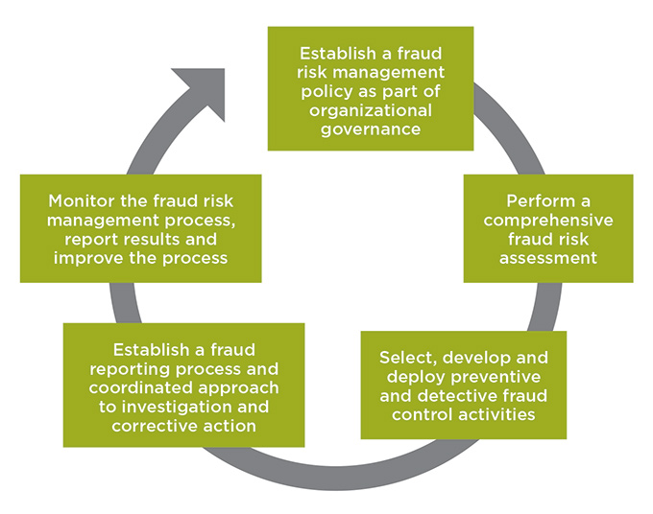
Comprehensive Fraud Risk Management Process

Slide 24
Benefits of Fraud Risk Management
  An organization can derive different forms of benefits by having a framework related to fraud risk management:
    Early Detection: Having such a framework would help the organization determine and detect the risk prone to the organization.
    Prioritize other Goals: An organization can delegate the risk functions to other departments and can focus and prioritize on other tasks.
    Compliance: Compliance with the protocols related to fraud risk management would effectively help in increasing the productivity of the organization. It also increase organization reputation in terms of public.
    Protect of Reputation

Slide 25
  Types of Fraud under Fraud Risk Management
    Fraud Related to Payroll: This would be when a department or a particular individuals, deceives the organization by putting more time of work and sales.
    Asset Frauds: Missing inventory or increasing the amount of stock can lead to this form of fraud.
    Information Technology Fraud: This type of fraud occurs in an organization, if there is no form of cyber security protocol in an organization.
    Intellectual Property Data Theft: A data protection framework would be present for an organization to ensure such form of fraud is mitigated.

Slide 26
  Roadmap to Fraud Risk Management
    Diagnose Vulnerability to Fraud
    Evaluate the current situation and organization’s control over anti-fraud control environment which involves assessing the culture, attitude, and awareness among the employees about their knowledge and response related to the issues of fraud or misconduct.
    Detect gaps in anti-fraud controls
    Suggest solutions to mitigate Antifraud controls.
    Recommend enhancement of existing controls to mitigate the risk to be implemented on the basis of anti-fraud controls.
    Periodic Monitoring
    Develop a Fraud Response Plan

Slide 27
  Essentials for Development of Fraud Risk Management
The following are essential for the development of fraud risk management:
  Governance- A framework related to governance of fraud risk management must be made and carried out in an organization. Such framework must be written down and policies must be provided throughout the organization.
  Risk Assessment- Risk assessment is crucial in an organization. It would help develop policies related to risk assessment. If the risks are prone in an organization then having such procedures related to assessing risk would be carried out.
  Prevention of Fraud: Preventing fraud is better than detecting.
  Detection- Detection is a crucial step in the fraud risk framework.
  Continuous Monitoring- Monitoring is required to tackle the fraud. Without monitoring, frauds can occur constantly in an organization.

Slide 28
  Key Services under Fraud Risk Management
Fraud awareness workshops & training : These training activities can help to be conscious of potential fraud indicators. Training helps the participants to learn to directly apply working concepts, take away measures and tools to mitigate the fraud risk and promote the ethical environment.
    Fraud Risk Assessment implementation: Fraud Risk Assessment Implementation helps in management and development of fraud prevention strategies by identifying the risk and their weaknesses in their process and evaluate potential gaps in the framework.
Forensic Health Check: It will help in quick and easy due diligence procedure for organizations who do not follow a comprehensive Fraud Risk assessment approach.
    Organization’s Perception Survey popular way to measure the employee’s point of view

Slide 29
  Key Services under Fraud Risk Management
    Ethics Helpline: Helpline team provides assistance to the employees
Risk Assessment and Fraud Vulnerability Tool : This tool helps to evaluate organization’s attentiveness towards fraud as quickly as possible. This diagnostic tool is quite popular and allows a quick response to assess the fraud in an organization.
    Anti-Counterfeiting Risk assessment: Developing and implementing an effective anti-counterfeiting framework.
    Competition Risk Management: Understand key compliance aspect and potential risk of violation of the Competition Act, 2002 to the clients.

Slide 30
  Steps of Risk Management Process:
Here are a few things that you need to take care of while dealing with the risk management process.
  Everybody who is in the planning process relating to the project should mandatorily identify and understand the risks.
  Once the risks are distributed to every team member, they again need to be combined in a single sheet to avoid any duplication.
  Evaluate the impact of the risk with the help of a matrix.
  Every team should come up with a plan that can clear off all the risks identified.
  Finally, plan the risk management process where you need to identify the triggers and then find a solution for it.

Slide 31
Early Warning Indicators of fraud , Money- laundering , Misconduct
Presented by
CA. Sanjay Kumar Gupta

Slide 32
Early warning signs/Indicators of Frauds
  ERRATIC REPORTING
  APPARENT PROCESS LAZINESS
  ORGANIZATIONAL CHANGE AND THE DESIRE TO DUMP DATA
  DATA INCONSISTENCIES OR ABSENCE IN THE ARCHIVES:
  AUDIT-TIME DELAYS
  BEHAVIOURAL ANOMALIES
  GOSSIP MONGERS IN OVERDRIVE
  TWITCHY NON-EXECS
  UNOFFICIAL IT WORK
  SCAPEGOATING

Slide 33
Money Laundering
Money laundering is the illegal process of making large amounts of money generated by a criminal activity, such as drug trafficking or terrorist funding, appear to have come from a legitimate source.

Slide 34
  How It Works: Money Laundering Three-Step Process
Money laundering is a three-part process.
  Placement: First things first: “placing” ill-gotten gains into the financial system.
  Layering: Once deposited, “the money is layered, or shifted through a series of transactions designed to create confusion and complicate the paper trail for investigators.” It includes:
    Wire transfers between bank accounts, often held in multiple names, at multiple banks, and in multiple countries.
    Property or service transactions with shell companies
    High-dollar purchases of tangible goods or commodities & Purchases of real estate investment properties
  Integration: During the final step, integration, laundered funds become legitimate.

Slide 35
Early warning signs/Indicators of Money Laundering
  Reluctance to Provide Information
  Incomplete or Inconsistent Information
  Irregular Money Transfers and Transactions
  Complex Group Structures
  Negative Reviews

Slide 36
Examples of Money Laundering (Vectors & Strategies)
  Casinos and Gambling Venues
  Cash Smuggling
  Life Insurance Policies
  Securities:
  Real Estate
  Currency Exchange Bureaus
  Drug Trafficking
  International and Domestic Terrorism
  Embezzlement
  Arms Trafficking

Slide 37
Misconduct
  Misconduct is wrongful, improper, or unlawful conduct motivated by premeditated or intentional purpose or by obstinate indifference to the consequences of one's acts. It is an act which is forbidden or a failure to do that which is required. Misconduct may involve harm to another person's health or well-being.

Slide 38
Banking: Fraud Risk Assessment in Credit decisions
Presented by
CA. Sanjay Kumar Gupta

Slide 39
Fraud Risk Assessment
A Fraud risk management model is a framework outlining all processes related to how fraud can be identified, assessed, mitigated, monitored, and reported to senior management. An efficient Fraud Risk Management approach can have a significantly positive impact on the overall costs of fraud in a bank.
The most fatal of all the risk facing banks, because in this area a bank becomes vulnerable to losing most of its assets. Fraudsters are continually formulating fresh strategies, updating archaic procedures and trying out new methods of circumventing these electronic systems intended to warrant high degree of safety of banking activities.

Slide 40
Bank Credit Analysis
In bank credit analysis, banks consider and evaluate every loan application based on merits. They check the creditworthiness of every individual or entity to determine the level of risk that they subject them self by lending to an entity or individual.
Bank credit analysis involves verifying and determining the creditworthiness of a potential client by looking at their financial state, credit reports, and business cash flows.
The goal of credit analysis is to determine the level of default risk that a client presents to the company and the losses that the bank will suffer if the client defaults.

Slide 41
Steps before making credit decisions by the Bank
    Information Gathering
    The Creditworthiness of a Borrower
    Credit Security
    Credit Bank Analysis Decision-Making

Slide 42
Importance of Credit Risk Management
Commercial banks and private lenders are constantly taking efforts to reduce the risk of fraud and cyber security threats to protect the financial information of their clients, but also need to protect their own treasury from unreliable borrowers. When a borrower misses a monthly payment, or worse, defaults on a loan altogether, the lending party at a loss. Even if collateral is taken, the time and money spent to turn it into funds can still leave the lender with a negative return. That’s why it’s incredibly important for financial institutions to thoroughly evaluate each borrower’s credit risk.

Slide 43
Ways to manage Credit Risk
Know Your Customer
Analyze Non-financial Risks:
Understand the Numbers
  Structure the deal:
Price the Deal
Present the Deal
Close the Deal
Monitor the Relationship
  Micro and macro risk

Slide 44
Challenges to Successful Credit Risk Management
Inefficient data management.
  No group wide risk modeling framework. Without it, banks can’t generate complex, meaningful risk measures and get a big picture of groupwide risk.
  Constant rework. Analysts can’t change model parameters easily, which results in too much duplication of effort and negatively affects a bank’s efficiency ratio.
  Insufficient risk tools. Without a robust risk solution, banks can’t identify portfolio concentrations or re-grade portfolios often enough to effectively manage risk.
  Cumbersome reporting.

Slide 45
Best Practices in Credit Risk Management
The first step in effective credit risk management is to gain a complete understanding of a bank’s overall credit risk by viewing risk at the individual, customer and portfolio levels.
The key to reducing loan losses – and ensuring that capital reserves appropriately reflect the risk profile – is to implement an integrated, quantitative credit risk solution. The solution should include:
  Better model management that spans the entire modeling life cycle.
  Real-time scoring and limits monitoring.
  Robust stress-testing capabilities.
  Data visualization capabilities and business intelligence tools that get important information into the hands of those who need it, when they need it.

Slide 46
Credit information analysis, indicators of wilful default
Presented by
CA. Sanjay Kumar Gupta

Slide 47
Wilful Defaulters
Wilful defaulters are entities (legal/natural) which have not repaid the loan amount despite its financial ability to repay it.
The Reserve Bank of India (“RBI”) has defined the ‘wilful default’ as a ‘unit’ (individual/company) which has defaulted in meeting its payment obligations or not utilized the finance from the lender for the specific purposes for which finance was availed or has siphoned off the funds.

Slide 48
History and Concept of ‘WILFUL DEFAULT’
The beginning of measures against wilful defaulter began in the year of 1999 when the Central Vigilance Commission and the RBI gave instructions to the bank/financial institution(s), for collection of information on wilful defaulters of Rupees 25 Lac and above.
Several modifications were made by the RBI in the identification of the wilful defaulters and the procedures that should be initiated against them. The regulation against ‘wilful defaulters’ have gained attention again due to the striking rise in the number of non-performing assets with the banks and/or financial institution(s) (especially Public Sector Banks) in the recent past.

Slide 49
Events indicating Wilful default
The unit has defaulted in meeting its payment / repayment obligations to the lender even when it has the capacity to honour the said obligations.
  The unit has defaulted in meeting its payment / repayment obligations to the lender and has not utilised the finance from the lender for the specific purposes for which finance was availed of but has diverted the funds for other purposes.
  The unit has defaulted in meeting its payment / repayment obligations to the lender and has siphoned off the funds so that the funds have not been utilised for the specific purpose for which finance was availed of, nor are the funds available with the unit in the form of other assets.
  The unit has defaulted in meeting its payment / repayment obligations to the lender and has also disposed off or removed the movable fixed assets or immovable property given for the purpose of securing a term loan without the knowledge of the bank / lender.
  The RBI has further specified that the identification of the wilful defaulter should be made keeping in view the track record of the borrower and should not be decided on the basis of isolated transactions / incidents.

Slide 50
‘Diversion of Funds’ & ‘Siphoning of Funds’
deploying borrowed funds for purposes / activities or creation of assets other than those for which the loan was sanctioned;
transferring borrowed funds to the subsidiaries / group companies or other corporate by whatever modalities;
routing of funds through any bank/financial institution, other than the lender or members of consortium without prior permission of the lender;
investment in other companies by way of acquiring equities / debt instruments without prior approval of the lender(s);
shortfall in deployment of funds vis-à-vis the amounts disbursed / drawn and the difference not being accounted for.

Slide 51
Mechanism for identification of Wilful Defaulters
  The evidence of wilful default on the part of the borrowing company and its promoter / whole-time director at the relevant time would have to be examined by a Committee headed by an Executive Director, or equivalent and consisting of two other senior officers of the rank of GM / DGM.
  If the Committee concludes that an event of wilful default has occurred, it shall issue a Show Cause Notice to the concerned borrower and the promoter / whole-time director and call for their submissions and after considering their submissions issue an order recording the fact of wilful default and the reasons for the same.
  The order of the Committee should then be reviewed by another Committee headed by the Chairman / Chairman & Managing Director,

Slide 52
Major Consequences Of Being Declared As A Wilful Defaulter
No additional facilities should be granted by any bank / FI to the wilful defaulters.
An objective of restricting access to the wilful defaulters in the capital markets and to enable them to raise funds.
Certain Public sector banks also have formulated guidelines, qua publication of photographs of wilful defaulters.
The lenders may initiate criminal proceedings against wilful defaulters
  Under section 29A of the Insolvency and Bankruptcy Code, 2016, a wilful defaulter cannot be a resolution applicant

Slide 53
Additional Facts on Wilful Default
In addition to the above, banks are advised that with a view to ensuring proper end-use offends and preventing diversion / siphoning of funds by the borrowers, lenders could consider engaging their own auditors for such specific certification purpose without relying on certification given by borrower’s auditors.
Besides, “Role of Internal Audit / Inspection: The aspect of diversion of funds by the borrowers should be adequately looked into while conducting internal audit / inspection of their offices / branches and periodical reviews on cases of wilful defaults should be submitted to the Audit Committee of the bank”

Slide 54
Fraud Investigation Analysis & Scenario Analysis
Presented by
CA. Sanjay Kumar Gupta

Slide 55
Fraud Investigation
Fraud investigations are used to expose a fraudulent offence and to punish the perpetrator for this deceitful and illegal act. Fraud investigations are necessary to ensure the correct individual is punished, and to ensure that the victim of fraud is offered justice.

Slide 56
Key Functions of Fraud Investigator
The effective fraud investigator adheres to relevant security standards, internal and external procedures and legislative requirements. Their role often involves developing and maintaining close working relationships with relevant law enforcement agencies, ensuring that cases are developed and prosecuted to a criminal standard. working with an organization in a preventative fashion, a fraud investigator will perform fraud risk assessments across the business relating to both external and internal threats; implementing mitigation measures as required. They also build appropriate fraud prevention and detection processes and implements them.

Slide 57
Key Functions of Fraud Investigator
Some other functions performed by Fraud Investigator are as follows
  Evaluate potential fraud indicators and the impact of current fraud trends and make recommendations as to appropriate mitigation.
  Reviewing and researching evidence/documents to analyse the overall fact pattern of a claim and synthesise data into a professional report with recommendations
  Preparing and coordinating field assignments to obtain relevant evidence and information
  Conduct objective, fair, thorough, unbiased and timely investigations into allegations of fraud, waste or abuse committed by clients against our company
  Review and research evidence/documents to analyse the overall fact pattern of a claim and synthesise data into a professional report with recommendations
  Manage and prioritise a large and varied caseload effectively and efficiently to achieve positive results

Slide 58
Fraud Investigator Responsibilities
Conducting extensive and confidential investigations of suspected fraud allegations.
Interviewing individuals who may have information on particular fraud allegations.
Analyzing documentation, such as victim testimonies and financial records to determine if fraud occurred.
Writing in-depth reports on your findings and presenting them to management.
Testifying on fraud cases in civil or criminal proceedings.

Slide 59
Fraud Investigation key Steps
  Decide to investigate
  Assess the situation
  Choose the Investigator
  Conduct a preliminary assessment
  Preserve and collect evidence
  Analyze financial, business, and electronic records
  Interview the Reporter / Conduct the Interviews
  Take Interim Action
  Brush up on protocol
  Plan the Investigation
  Determine the Scope
  Outline your Strategy
  Create a Timeline
  Report the findings

Slide 60
Fraud Investigation and Engagement Process
Presented by
CA. Sanjay Kumar Gupta

Slide 61
Fraud Investigation
Fraud investigations begin with a meeting between the investigator and client. A good fraud investigator will use this initial information to find more evidence and information. To do this, they may use surveillance, asset searches, background checks, employee investigations, business investigations, and other methods.

Slide 62
How to detect Fraud
Detecting Fraud Most fraud or forensic investigations begin with a suspicion of wrongdoing. The suspicion may be the result of a tip provided through a fraud reporting portal, an unexpected financial occurrence, a person internal to the Company (such as an owner, director or manager), or the result of an external audit. The purpose of the investigation is to determine whether there are fact patterns that indicate there may have been wrongdoing in the area(s) suspected, determine the possible method(s) employed, and attempt to quantify the questionable amounts involved.

Slide 63
Major types of Fraud
Asset Misappropriation (Embezzlement ,skimming, larceny, vendor fraud, investor fraud, ghost employees, kickback arrangements, employee expense reimbursements or Ponzi schemes)
Financial Statement Misrepresentation
  Income statement (misstated revenue, expenses, net income).
  Balance sheet (asset valuation, misstated liabilities, fictitious assets).
Corruption and Other Illegal Acts (include all other violations of laws or governmental regulations not covered in asset misappropriation or financial statement misrepresentation)

Slide 64
Common types of Fraud
Insurance Fraud – false claim
Corporate Fraud – theft of information
Financial Fraud- tax evasion
Identity Theft- faulty loan using alternate name
Internet Fraud- phishing
Corporate Slip and Fall – false claim
Transit Fraud – False claim while using public transport
Expense Claim Fraud
Theft of Inventory

Slide 65
Fraud engagement process
Begins with the investigators first contact with the case and ends with complete agreement regarding the services. The services below must be performed by Fraud investigator while performing Fraud engagement process.
  Create incident report
  Conduct the initial notifications and evaluation
  Consider legal issues
  Evaluate the loss mitigation and recovery considerations
  Define scope, objectives, costs of investigation
  Produce engagement latter or memorandum

Slide 66
Objectives of Fraud Investigation
Identifying improper conduct
Identifying the persons responsible for improper conduct
Determining the extent of potential liabilities or losses that might Helping to facilitate the recovery of losses
Mitigating other potential consequences
Strengthening internal control weaknesses
  Regulatory / legal requirements

Slide 67
Principles of fraud investigation
Assume litigation will follow – gather evidence in proper manner
Act on predication
Approach with two perspectives – a) fraud has occurred or b) fraud has not occurred

Slide 68
Forensic audit plan, program , field work, evidence , court proceedings
Coordination with law enforcement agencies & engagement conclusion
Presented by
CA. Sanjay Kumar Gupta

Slide 69
Forensic Audit _An overview
Forensic Audit examines and evaluates a firm's or individual's financial records to derive evidence used in a court of law or legal proceeding. A forensic audit is often conducted to prosecute a party for fraud, embezzlement, or other financial crimes. In the process of a forensic audit, the auditor may be called to serve as an expert witness during trial proceedings.

Slide 70
Process of Forensic Audit Work
  Accepting The Investigation And Know Your Client
  Planning the Investigation
  Collecting Evidence ( Substantive techniques / Analytical procedures/ CAAT)
  Reporting
  Court Proceedings

Slide 71
Reasons for Forensic Audit
Corruption or Fraud: In a forensic audit, an auditor would be on the lookout for
  Conflicts of Interest
  Bribery
  Extortion
Asset Misappropriation
Financial Statement Fraud

Slide 72
Benefits of a Forensic Audit
Uncovering of Corruption
Uncovering of Asset Misappropriation
Uncovering of Financial Statement
Making Sound Investment Decisions
Assisting in the formulation of Economic Policies
Clear Objectivity and Credibility
Definite valuable Accounting Expertise and Industry Knowledge
Enhanced Efficiency

Slide 73
Legal provisions
It is required to know about the various statutes that talk about forensic audits' implementation to understand the legal provisions, and consequences that a person attracts on being caught in a forensic audit in India.
  Sections - 235 & 237 Of The Companies Act, 2013
  Provisions Of Sick Industrial Companies Act 1985
  Prevention Of Money-Laundering Act, 2002
  SEBI Act, 1992- (Regulation 11 C)

Slide 74
Fraud Prevention & Detection – Case Studies
Presented by
CA. Sanjay Kumar Gupta

Slide 75
Fraud Detection
Fraud detection is a set of activities undertaken to prevent money or property from being obtained through false pretenses. Fraud detection is applied to many industries such as banking or insurance.
Detecting fraud with data analytics, fraud detection software and tools, and a fraud detection and prevention program enables organizations to predict conventional fraud tactics, cross-reference data through automation, manually and continually monitor transactions and crimes in real time, and decipher new and sophisticated schemes.

Slide 76
Fraud Prevention
Fraud prevention is the implementation of a strategy to detect fraudulent transactions or banking actions and prevent these actions from causing financial and reputational damage to the customer and financial institution (FI).

Slide 77
Fraud Detection and Prevention Techniques
Fraud data analytics methodologies can be categorized as either statistical data analysis techniques or artificial intelligence (AI).
  Statistical data analysis techniques include:
    Statistical parameter calculation, such as averages, quantiles ( range of probability) and performance metrics
    Regression analysis (estimates relationships between independent variables and a dependent variable)
    Probability distributions and models
    Data matching (used to compare two sets of collected data, remove duplicate records, and identify links between sets )
    Time-series analysis (specific way of analyzing a sequence of data points collected over an interval of time)

Slide 78
Fraud Detection and Prevention Techniques
  Time-series analysis
    Data mining (classifies and segments data groups in which millions of transactions can be performed to find patterns )
    Neural networks (suspicious patterns are learned and used to detect further repeats or a series of algorithms that endeavours to recognize underlying relationships in a set of data through a process that mimics the way the human brain operates - recognizing handwriting or facial recognition)
    Machine Learning (Machine Learning uses advanced algorithms that parse data, learns from it, and use those learnings to discover meaningful patterns of interest – rejection rate in production)
    Pattern recognition (detects patterns or clusters of suspicious behavior – a person sitting late in winters)

Slide 79
Fraud Detection and Prevention Techniques
The four most crucial steps in the fraud prevention and detection process include:
  Capture and unify all manner of data types from every channel and incorporate them into the analytical process.
  Continually monitor all transactions and employ behavioral analytics to facilitate real-time decisions.
  Incorporate analytics culture into every facet of the enterprise through data visualization.
  Employ layered security techniques.

Slide 80
Procedures and Controls for minimizing Fraud Occurrence
One can minimize fraud occurrences by implementing different procedures and controls.
  Know Your Employees
  Make Employees Aware/Set Up Reporting System
  Implement Internal Controls
  Monitor Vacation Balances
  Hire Trustworthy Experts
  Corporate Culture

Slide 81
Importance of Fraud Prevention
Investing in security and fraud prevention although costly, can save you money in the long run. It will also prevent a lot of potential future paperwork and the time wasted to resolve fraudulent activity.
An equally as important reason is to make sure your company is trusted. By being able to avoid fraud, it is guaranteed that your business will be deemed credible by sellers, buyers and customers
With a proper fraud prevention strategy, you can help your employees want to be more honest, and any new staff will be able to know right from the start that any dishonest behaviour will not be tolerated by you or their colleagues.

Slide 82
Frauds in IT/ERP environment, Computer & Cyber forensics
Presented by
CA. Sanjay Kumar Gupta

Slide 83
ERP Systems
ERP system helps to integrate various functions of the organization and helps in easy flow and sharing of data between various departments. The system also helps to increase the efficiency of the back end processes by making real time information available which enhances strategic decision making process while improving the efficiency of customer service.
The ERP system leads to easy flow of information from one department to another, thus keeping all the systems updated and reducing the service time and errors.
It is used in manufacturing division to keep a check on the inventory. It is also used in the marketing department and supply chain activities to keep a check on the delivered goods.

Slide 84
ERP Frauds
There are a number of ways in which frauds can take place in ERP.
  One of the ways fraud is perpetuated is that organizations can make changes in the payment information of vendors by making illegal modifications in the order processing and payment file. This has been done by some companies in the past to save the costs of operations.
  Another fraud that has been witnessed is companies developing fictitious receipts and modifying the name of clients and their payment amounts on the cheques.
  The ERP systems are more prone to fraud because of the technical complexity and the usage constraints. Another factor that makes fraud detection or prevention difficult is large volume or size of data that ERP systems deal with. Lack of governance and user identification and authorization is another major issue that leads to perpetration of fraud in the ERP systems. Unrestricted access and lack of segregation of duties amongst users is another factor that has led to fraud in the ERP systems.

Slide 85
Computer Fraud
Computer fraud is act of using a computer to take or alter electronic data, or to gain unlawful use of a computer or system.

Slide 86
Types of Computer and Internet Fraud
Computer fraud is act of using a computer to take or alter electronic data, or to gain unlawful use of a computer or system. It involves different types of criminal acts including:
  Crimes involving the use false pretenses to obtain confidential information, personal information, or unauthorized access.
  Crimes involving altering electronic data.
  Crimes intended to transmit or provide false or misleading information.
  Crimes intended to obtain unlawful use of a computer or of a computer system. Botnet crimes are an example of this type of computer fraud.

Slide 87
  Examples of Computer Fraud and Abuse
There are countless different examples of computer fraud and abuse, including international auction fraud; romance scams using online dating sites, and rental listing scams in which online real estate websites are used to connect with scammers or illegally obtaining customer data.
Internet websites and emails are used to run scams, and to perpetrate advance fee fraud where people are convinced to send money.
Botnet-related fraud - DOS
Trojan horse scams – stealing password and other information

Slide 88
  Cybercrime
Cybercrime also called computer crime, the use of a computer as an instrument to further illegal ends, such as committing fraud, trafficking in child pornography and intellectual property, stealing identities, or violating privacy. Cybercrime is “unlawful acts wherein the equipment transforming the information be it a computer or a mobile is either a tool or a target or both”.

Slide 89
Types of Frauds in Cybercrime
  Financial crimes
  Cyber pornography
  Sale of Illegal articles
  Online gambling
  Intellectual Property crimes
  Email spoofing
  Forgery
  Cyber Defamation
  Cyber stalking
  Unauthorized access to computer systems or networks
  Theft of information contained in electronic form
  Email bombing – crashing mail servers

Slide 90
Cyber forensics
Cyber forensics also known as computer forensics is an electronic discovery technique used to determine and reveal technical criminal evidence. It often involves electronic data storage extraction for legal purposes.

Slide 91
Tools of Cyber forensics
Network Forensic tools- Accentrix, Metasploit,
Database analysis tools.
File analysis tools.
Registry analysis tools.
Email analysis tools.
OS analysis tools – Nmap, MBSA,
Disk and data capture -FTK

Slide 92
Expert Witness , Dispute Resolution
Presented by
CA. Sanjay Kumar Gupta

Slide 93
Certified Fraud Examiner Expert Witnesses
Certified fraud examiner expert witnesses investigate all types of suspicious activity to determine fraud or fraud exposure to an organization, such as a financial institution, insurance company, corporation, or non-profit.
Forensic Group experts are experienced in forensic accounting and fraud examination with extensive experience in evidence documentation, detection of fraudulent financial statements, embezzlements, misappropriation of assets, and other suspicious financial activities. Their expertise includes developing, implementing, and monitoring controls designed to reduce the risk of fraud and ensure accurate, internal controls and compliance, timely reporting.
These experts offer consulting services in divorce litigation, business valuations, hidden assets, fraud detection and prevention, forensic accounting, and securities litigation.

Slide 94
The use of experts in fraud cases
Cases involving fraud and requiring expert evidence will be broadly similar to “ordinary “commercial litigation. The lawyers will seek permission to rely on expert evidence and the expert will produce his or her report and, if necessary, give evidence at trial in the normal way.
Cases involving fraud will involve some form of deception. The authenticity of documents and the truth of the contents are often disputed. A party will therefore often require evidence about the provenance of particular documents, either to prove that the document in question is false or that a particular individual produced a document containing false information. It is only after these issues have been determined that a court can go on to consider their effect.

Slide 95
Role and Qualifications of the Expert Witness
For the cases that are not settled, accountants can play another important role in the trial, the role of expert witness. Accountants can testify in court regarding the client’s financial matters and give an expert opinion based on their findings.
Professionals can be called as witness to testify various financial aspects of financial statements.
Below are two examples of high profile fraud cases in which expert witnesses testified in court?
  The Enron Case:
  The HealthSouth Case

Slide 96
Dispute Resolution
Dispute resolution is how disputes are brought to an end. This can occur through: ... an arbitrated or adjudicated outcome, where an independent arbitrator or court decides how the dispute should be resolved and makes a binding decision or order to that effect.

Slide 97
Alternative Dispute Resolution
Alternative Dispute Resolution ("ADR") refers to any means of settling disputes outside of the courtroom. ADR typically includes early neutral evaluation, negotiation, conciliation, mediation, and arbitration.

Slide 98
Major forms of Alternate Dispute Resolution (ADR)
Mediation
Arbitration
The rent-a-judge program (choose a retired judge to hear their case)
Summary jury trial
Minitrial ( formats vary somewhat but typically involve one high-level executive from each side of the dispute plus one neutral adviser)

Slide 99
Money Laundering , financial crime in cross-border transactions
Presented by
CA. Sanjay Kumar Gupta

Slide 100
Financial Crime
Financial crime is a significant ongoing challenge for banks, institutions, and individuals. As regulators and financial authorities introduce new strategies to detect and prevent financial crime, criminals develop more sophisticated methodologies to evade legal scrutiny and commit offences – including fraud, money laundering, and the financing of terrorism. Financial institutions are also expected to participate in the fight against financial crime, by ensuring compliance with the regulations that authorities put in place – at the risk of potentially severe penalties

Slide 101
Types of Financial Crimes
Money laundering: When criminals derive funds from illegal activities, that money must be disguised before it can be introduced into the legitimate financial system.
Terrorism financing: The financing of terrorism involves the provision of funds to individuals and groups for the purposes of committing terrorist acts. Terrorism financing resembles money laundering in the sense that it often requires criminals to conceal the transfer of funds within the legitimate financial system.

Slide 102
Money Laundering- An overview
Money laundering: . Money laundering is the processing of the criminal proceeds to disguise their illegal origin. This process is of critical importance, as it enables the criminal to enjoy these profits without jeopardizing their source.
Illegal arms sales, smuggling, and the activities of organized crime, including for example drug trafficking and prostitution rings, can generate huge amounts of proceeds. Embezzlement, insider trading, bribery and computer fraud schemes can also produce large profits and create the incentive to “legitimize” the ill-gotten gains through money laundering.

Slide 103
Consequences of Money Laundering
Money laundering is seen as critical to the effective operation of transnational and organized crime. However, money laundering affects a country’s economy, government, and social well-being. The economic & social effects of Money Laundering includes:
  Economic Effects
    undermining the legitimate private sector
    undermining the integrity of financial markets
    loss of control of economic policy
    loss of revenue
    reputation risk
  The social costs of money laundering include allowing drug traffickers, smugglers, and other criminal to expand operations and the transfer of economic power from the market, government, and citizens to criminals.

Slide 104
Stages of Money Laundering
  Placement
  Layering
  Integration

Slide 105
Defenses to Money Laundering
  Money laundering is a complicated crime. A number of defenses may arise to such charges. Some potential defenses that may apply in money laundering cases include:
    Lack of Evidence
    No Intent
    Duress ( Action based on threat by criminal)

Slide 106
Trade-Based Money Laundering Processes (TBML)/ Cross border transactions
It mainly involves the export and import of goods and the exploitation of a variety of cross-border financial instruments of trade. The most frequent Trade-Based Money laundering methods, are:
  Over-invoicing
  Under-invoicing
  Multiple-invoicing
  Over/under-shipment
  Quality misrepresentation

Slide 107
International Guidance on Trade-Based Money Laundering
Financial Action Task Force (FATF), an international body, issue advice and guidance to aid financial institutions in detecting and addressing TBML. It is focused on raising private-sector awareness of the need for trade finance AML policies and educating banking supervisors on TBML weaknesses in their AML/CFT (Combating financing terrorism) programs.
The FATF provides to financial institutions with a list of trade finance AML red flags to consider when managing cross-border transactions.
  Significant discrepancies between invoices and the description of goods on official documents
  Shipments with unusual traffic of goods handled by a particular importer or exporter.

Slide 108
International Guidance on Trade-Based Money Laundering
  Shipments are routed through a number of nations or multiple unconnected subsidiaries without a concrete reason.
  Payment methods are inconsistent with the level of risk presented by the transaction.
  Shipment of goods is typically at a high risk of money laundering.
  Transport of goods entering or leaving countries that are considered to be at high risk of money laundering.
  Shipments paid by cash.
  Shipments paid by third parties without an obvious connection to the transaction.

Slide 109
Considering fraud in financial statement audit (ISA – 240)
Presented by
CA. Sanjay Kumar Gupta

Slide 110
ISA 240
International Standard on Auditing 240, indicates an auditor conducting an audit in accordance with ISAs is responsible for obtaining reasonable assurance that the financial statements are free from material misstatement. It is issued by International Federation of Accountants ( IFAC)

Slide 111
Scope of ISA 240
ISA 240 deals with auditor’s responsibilities relating to fraud in an audit of financial statements.
Identifying and assessing the risks of material misstatement due to fraud.

Slide 112
Objective of ISA 240
To identify and assess the risks of material misstatement of the financial statements due to fraud.
To obtain sufficient appropriate audit evidence regarding the assessed risks of material misstatement due to fraud, through designing and implementing appropriate responses.
To respond appropriately to fraud or suspected fraud identified during the audit.

Slide 113
Requirements of ISA 240
The auditor shall maintain professional skepticism throughout the audit.
Where responses to inquiries of management or those charged with governance are inconsistent, the auditor shall investigate the inconsistencies.
Discuss among team members;
Make inquiries of management about;
  Management’s process for identifying and responding to the risks of fraud in the entity
  Management’s communication, if any, to those charged with governance regarding its processes for identifying and responding to the risks of fraud in the entity.
  Management’s communication, if any, to employees regarding its views on business practices and ethical behavior.

Slide 114
Requirements of ISA 240
Auditor shall evaluate whether unusual or unexpected relationships that have been identified in performing analytical procedures.
The auditor shall evaluate whether the information obtained from the other risk assessment procedures and related activities performed indicates that one or more fraud risk factors are present.
Auditor shall design and perform procedure that is responsive to assessed risk.
Auditor shall perform following procedure due to risk of Management override of control;
  Test the appropriateness of journal entries
  Review accounting estimates for biases by evaluation and retrospective review.
  For significant transaction outside the normal course of business, evaluate the business rationale.

Slide 115
Evaluation of Audit Evidence
The auditor shall evaluate whether analytical procedures that are performed near the end of the audit
If the auditor identifies a misstatement, the auditor shall evaluate whether such a misstatement is indicative of fraud.
The auditor shall consider whether circumstances or conditions indicate possible collusion involving employees, management or third parties when reconsidering the reliability of evidence previously obtained.
  If the auditor confirms that, or is unable to conclude whether, the financial statements are materially misstated as a result of fraud the auditor shall evaluate the implications for the audit.

Slide 116
Documentation
The auditor shall include the following in the audit documentation of the auditor’s understanding of the entity and its environment and the assessment of the risks of material misstatement.
    The significant decisions reached during the discussion among the engagement team regarding the susceptibility of the entity’s financial statements to material misstatement due to fraud; and
    The identified and assessed risks of material misstatement due to fraud at the financial statement level and at the assertion level.

Slide 117
IIA Standards / Guidance on Fraud prevention / detection
Presented by
CA. Sanjay Kumar Gupta

Slide 118
Institute of Internal Auditors (IIA)
The Institute of Internal Auditors (IIA) is a leader in certification, education, and research for professionals engaged in evaluating an organization's operations and controls. Established in 1941, the Institute of Internal Auditors awards the certified internal auditor (CIA) designation, a globally accepted certification for internal auditors.

Slide 119
Introduction to the IIA-Standards
Internal auditing is conducted in diverse legal and cultural environments; for organizations that vary in purpose, size, complexity, and structure; and by persons within or outside the organization. While differences may affect the practice of internal auditing in each environment, conformance with the IIA’s International Standards for the Professional Practice of Internal Auditing (Standards) is essential in meeting the responsibilities of internal auditors and the internal audit activity.

Slide 120
The purpose of the IIA-Standards
Guide adherence with the mandatory elements of the International Professional Practices Framework.
Provide a framework for performing and promoting a broad range of value-added internal auditing services.
Establish the basis for the evaluation of internal audit performance.
Foster improved organizational processes and operations.

Slide 121
Fraud
Any illegal act characterized by deceit, concealment, or violation of trust. These acts are not dependent upon the threat of violence or physical force. Frauds are perpetrated by parties and organizations to obtain money, property, or services; to avoid payment or loss of services; or to secure personal or business advantage.

Slide 122
Provisions on Fraud
Proficiency: Internal auditors must possess the knowledge, skills, and other competencies needed to perform their individual responsibilities.
  1210. A1: The chief audit executive must obtain competent advice and assistance if the internal auditors lack the knowledge, skills, or other competencies needed to perform all or part of the engagement.
  1210.A2 – Internal auditors must have sufficient knowledge to evaluate the risk of fraud and the manner in which it is managed by the organization
  1210. A3 – Internal auditors must have sufficient knowledge of key information technology risks and controls and available technology-based audit techniques to perform their assigned work.

Slide 123
Provisions on Fraud
Due Professional Care : Internal auditors must apply the care and skill expected of a reasonably prudent and competent internal auditor.
  1220. A1 – Internal auditors must exercise due professional care by considering Extent of work needed, Relative complexity, materiality, Adequacy and effectiveness of governance, risk management, and control processes and Probability of significant errors, fraud,
  1220. A2 – Auditors must consider the use of technology-based audit and other data analysis techniques.
  1220. A3 – Internal auditors must be alert to the significant risks that might affect objectives
  1220. C1 – Internal auditors must exercise due professional care during a consulting engagement, by considering needs of client

Slide 124
Provisions on Fraud
Reporting to Senior Management and the Board : The chief audit executive must report periodically to senior management and the board on the internal audit activity’s purpose, authority, responsibility, and performance relative to its plan and on its conformance with the Code of Ethics and the Standards.

Slide 125
  Provisions on Fraud
  Risk Management: The internal audit activity must evaluate risk exposures relating to the organization’s governance, operations, and information systems regarding:
  2120.A2 - must evaluate the potential for the occurrence of fraud and how the organization manages fraud risk.
  2120. C1 internal auditors must address risk consistent with the engagement’s objectives
  2120. C2 – Internal auditors must incorporate knowledge of risks gained from consulting engagements
  2120. C3 internal auditors must refrain from assuming any management responsibility by actually managing risks.

Slide 126
  Provisions on Fraud
  Engagement Objectives: Objectives must be established for each engagement
  2210. A1 – Internal auditors must conduct a preliminary assessment of the risks relevant to the activity under review.
  2210. A2 – Internal auditors must consider the probability of significant errors, fraud, noncompliance, and other exposures when developing the engagement objectives.
  2210. A3 Internal auditors must ascertain the extent to which management and/or the board has established adequate criteria to determine whether objectives and goals have been accomplished.

Slide 127
  Provisions on Fraud
  Engagement: A specific internal audit assignment, task, or review activity, such as an internal audit, control self-assessment review, fraud examination, or consultancy. An engagement may include multiple tasks or activities designed to accomplish a specific set of related objectives.

Slide 128
International Best Practices & Advisories in Forensic Audit
Presented by
CA. Sanjay Kumar Gupta

Slide 129
Forensic Auditing
Forensic auditing is focused on the identification, interpretation, and communication of the evidence of underlying strategic economic and reporting events. Forensic audits are easily adapted to a principles-based accounting environment with broad guidelines applied to a variety of accounting investigations without using rule-based audit approaches or more narrowly-focused fraud practices.

Slide 130
International Practices
Principles-based generally accepted accounting principles (GAAP) are being developed by the International Accounting Standards Board (IASB). Continued globalization of the business economy has resulted in the adoption of these accounting standards by 100 countries including five G8 countries along with plans for adoption by a number of other countries within the next five years. The IASB's accounting standards, known as the International Financial Reporting Standards (IFRS), are being considered for adoption as GAAP in the United States. The SEC has been holding hearings to assess opinions about the timing and form of adoption in the United States. The IASB's standards do not use the detailed rule-based approach found in U.S. GAAP.

Slide 131
Fraud And Forensics in Practice
It is difficult for fraud examination and forensic accounting to effectively operate within the traditional auditor-client relationship. Fraud and forensic approaches do not assume the client will honestly follow any of the detailed rules of GAAP or that an audit check-off list for revenue recognition, for example, will lead to the discovery of financial misconduct.
An investigations fall under the annual periodic procedures of the financial audit, the mindset of forensic or fraud practitioner must change to correspond with financial auditor-client relationship. As a result, forensic and fraud investigations must closely fit within the non-adversarial, step-by-step procedural practice of a financial audit. Such a change makes it difficult to apply the principle-based and flexible forensic and fraud techniques needed to identify the unpredictable criminal patterns used in committing and concealing financial crimes.

Slide 132
Fraud And Forensics in Practice
The Frauds and Forensics in Practices example are below:
  Shortly after the Enron, World Com, and Xerox debacles, fraud examination was given recognition under audit practices.
  In 2002, Sarbanes-Oxley (SOX) legislation was enacted by the U.S. Congress in response to corporate fraud.
The PCAOB’s (Public Company Accounting Oversight Board) most recent audit guidance is found in Auditing Standard No.5, (AS5) An Audit of Internal Control over Financial Reporting, that is integrated with an Audit of Financial Statements.
The main focus of professional standard setters has been to incorporate a measure of fraud examination into the audit environment.

Slide 133
PCAOB – Auditing Standard no. 5
This standard establishes requirements and provides direction that applies when an auditor is engaged to perform an audit of management's assessment of the effectiveness of internal control over financial reporting ("the audit of internal control over financial reporting") that is integrated with an audit of the financial statements.
Effective internal control over financial reporting provides reasonable assurance regarding the reliability of financial reporting and the preparation of financial statements for external purposes.
When planning and performing the audit of internal control over financial reporting, the auditor should take into account the results of his or her fraud risk assessment.

Slide 134
Key Quotes
When your determination changes, everything will begin to move in the direction you desire. The moment you resolve to be victorious, every nerve and fibre in your being will immediately orient itself toward your success.
(Dr. Daisaku Ikeda, President Soka Gakkai International)

Slide 135
Introduction to Data Extraction, Digital Forensics & Cyber crime
Presented by
CA. Sanjay Kumar Gupta

Slide 136
Data Extraction
Data extraction is the process of collecting or retrieving disparate types of data from a variety of sources, many of which may be poorly organized or completely unstructured. Data extraction makes it possible to consolidate, process, and refine data so that it can be stored in a centralized location in order to be transformed.
Data extraction is the first step in both ETL (extract, transform, load) and ELT (extract, load, transform) processes.

Slide 137
Data Extraction and ETL
ETL allows companies and organizations to 1) consolidate data from different sources into a centralized location and 2) assimilate different types of data into a common format.
Steps in the ETL process:
  Extraction: Data is taken from one or more sources or systems. Extraction allows many different kinds of data to be combined and ultimately mined for business intelligence.
  Transformation: Once the data has been successfully extracted, it is ready to be refined. During the transformation phase, data is sorted, organized, and cleansed.
  Loading: The transformed, high quality data is then delivered to a single, unified target location for storage and analysis.

Slide 138
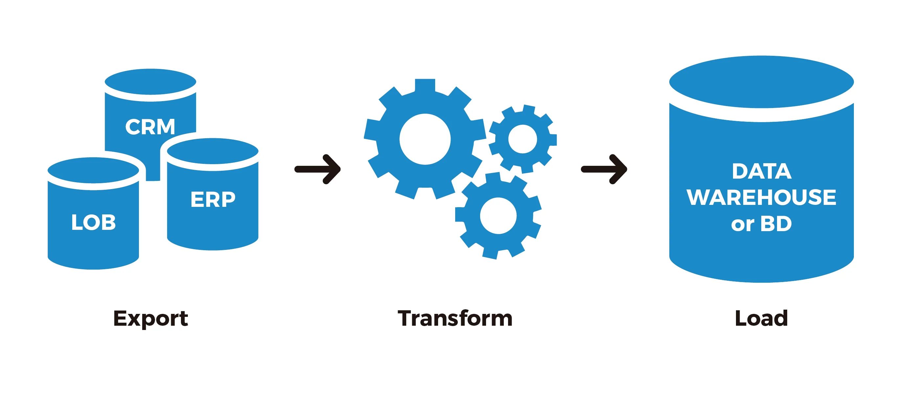
Data Extraction and ETL

Slide 139
Data Extraction without ETL
  Can data extraction take place outside of ETL? The short answer is yes. Raw data which is extracted but not transformed or loaded properly will likely be difficult to organize or analyze, and may be incompatible with newer programs and applications. As a result, the data may be useful for archival purposes, but little else. If you’re planning to move data from a legacy databases into a newer or cloud-native system, you’ll be better off extracting your data with a complete data integration tool.
Another consequence of extracting data as a standalone process will be sacrificing efficiency, especially if you’re planning to execute the extraction manually. Hand-coding can be effective process for an extraction data.

Slide 140
Types of data extraction
  Update notification: The easiest way to extract data from a source system is to have that system issue a notification when a record has been changed.
  Incremental extraction: Some data sources are unable to provide notification that an update has occurred, but they are able to identify which records have been modified and provide an extract of those records.
  Full extraction: Some data sources have no way to identify data that has been changed, so reloading a whole table may be the only way to get data from that source, because full extraction involves high data transfer volumes, which can put a load on the network, it’s not the best option if you can avoid it.

Slide 141
Benefits of Using an Extraction Tool
More control.
Increased agility
Simplified sharing
Accuracy and precision

Slide 142
Digital Forensics
Digital forensic science is a branch of forensic science that focuses on the recovery and investigation of material found in digital devices related to cybercrime.
Digital forensics is the process of identifying, preserving, analyzing, and documenting digital evidence. This is done in order to present evidence in a court of law when required.

Slide 143
Steps of Digital Forensics
Identification: First, find the evidence, noting where it is stored.
Preservation: Next, isolate, secure, and preserve the data. This includes preventing people from possibly tampering with the evidence.
Analysis: Next, reconstruct fragments of data and draw conclusions based on the evidence found.
Documentation: Following that create a record of all the data to recreate the crime scene.
Presentation: Lastly, summarize and draw a conclusion.

Slide 144
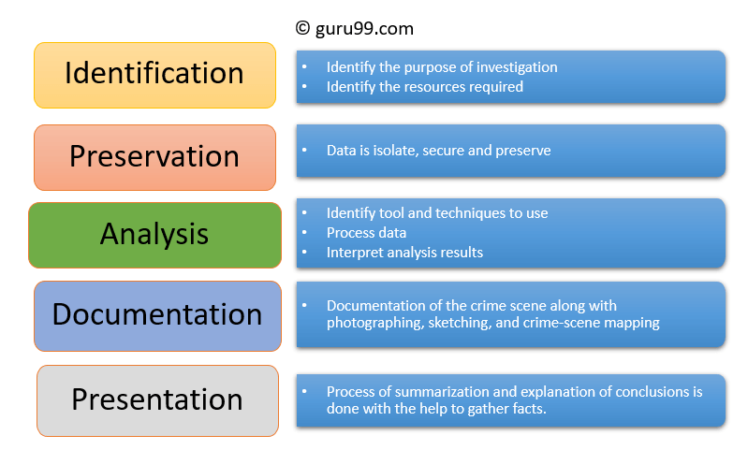

Slide 145
Types of Digital Forensics
  Disk Forensics -It deals with extracting data from storage media by searching active, modified, or deleted files.
  Network Forensics - It is related to monitoring and analysis of computer network traffic to collect important information and legal evidence.
Wireless Forensics - to offers the tools need to collect and analyze the data from wireless network traffic
Database Forensics - study and examination of databases and their related metadata
Malware Forensics - identification of malicious code, to study their payload, viruses, worms, etc.

Slide 146
Challenges faced by Digital Forensics
The increase of PC's and extensive use of internet access
Easy availability of hacking tools
Lack of physical evidence makes prosecution difficult.
The large amount of storage space into Terabytes that makes this investigation job difficult.
Any technological changes require an upgrade or changes to solutions.

Slide 147
Advantages of Digital forensics
To ensure the integrity of the computer system.
To produce evidence in the court
It helps the companies to capture important information if their computer systems or networks are compromised.
Efficiently tracks down cybercriminals from anywhere in the world.
Helps to protect the organization's money and valuable time.
Allows to extract, process, and interpret the factual evidence

Slide 148
Disadvantages of Digital forensics
Digital evidence accepted into court. However, it is must be proved that there is no tampering
Producing electronic records and storing them is an extremely costly affair
Legal practitioners must have extensive computer knowledge
Need to produce authentic and convincing evidence
Lack of technical knowledge by the investigating officer might not offer the desired result

Slide 149
Cybercrime
Cybercrime is any criminal activity that involves a computer, networked device or a network. While most cybercrimes are carried out in order to generate profit for the cybercriminals, some cybercrimes are carried out against computers or devices directly to damage or disable them, while others use computers or networks to spread malware, illegal information, images or other materials.

Slide 150
Examples of cybercrime
  Malware attacks
  Phishing
  Distributed DoS attacks (DDoS)
  Denial of Service(DoS) attacks
  Security Hacker
  Cyberstalking
  Cyberterrorism
  Ransomware
  Email spoofing
  Online piracy

Slide 151
How to protect against cybercrime
Keep software and operating system updated
Use anti-virus software and keep it updated
Use strong passwords
Never open attachments in spam emails
Do not click on links in spam emails or untrusted websites
Do not give out personal information unless secure
Be mindful of which website URLs you visit

Slide 152
Relative Size Factor ( RSF), Use of Benford Law, Luhn’s Algorithm and Hollinger Clark Theory
Presented by
CA. Sanjay Kumar Gupta

Slide 153
Relative Size Factor (RSF)
  Relative size factor is a test for reasonableness, identifies anomalies where the largest amount for groups of data sets based on the Vendors Name/ Paid To /Received From) is outside the norm for those groups or subsets. . It compares the top two amounts for each group and calculates the RSF for each. It is a powerful test for detecting errors and potential fraudulent activities.

Slide 154
Theory of Relative Size Factor (RSF) :
  It highlights all unusual fluctuations, which may be routed from fraud or genuine errors. RSF is measured as the ratio of the largest number to the second largest number of the given set.

Slide 155
Large differences might be attributed to errors such as the record belongs to another subset or that the amount was posted incorrectly (e.g., a shifted decimal point). Large differences may also be an indication of fraudulent activity, such as occupational accounts payable fraud, falsified invoices for HST or VAT input tax credits, offset money-laundering revenue, or product sales to related companies (offshore transfer pricing)

Slide 156
  Case Study on Relative Size Factor (RSF)
  This test compares the top two amounts for each subset and calculates the RSF for each.
  Here is a 3 column dataset. The first column is Vendor Number; the second is Invoice number and last is invoice amount. There can be multiple invoices per vendor. The objective is to determine the highest invoice value for a vendor and divide that by the second highest invoice value for that same vendor to get a ratio. The same needs to be done for all vendors. An interesting case in the dataset below is Vendor No V4439 - there are 2 instances of highest value for this vendor i.e. 25,378.30 and another 2 instances of second highest value i.e. 24,068.25. The RSF for this case will be 25,378.30/24,068.25. If there is no instance of second highest value for a vendor, then the result should be 0.

Slide 157
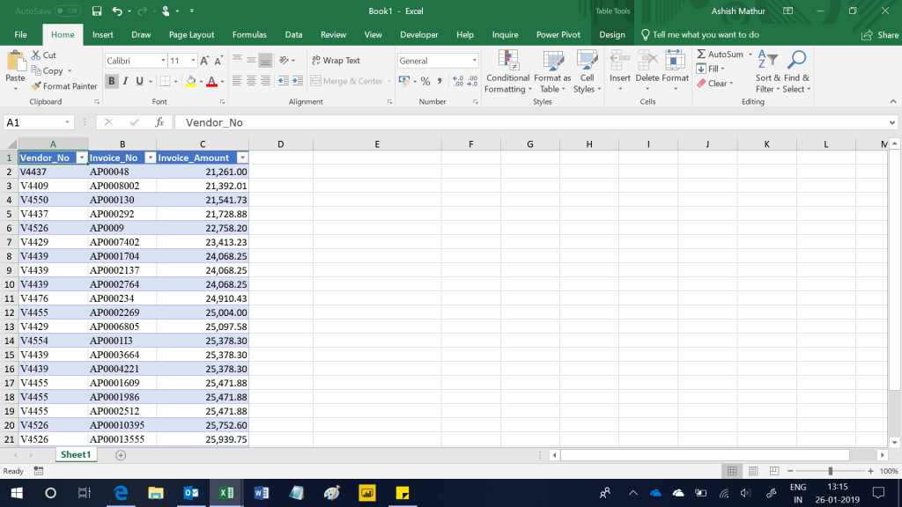
  Case Study on Relative Size Factor (RSF)

Slide 158
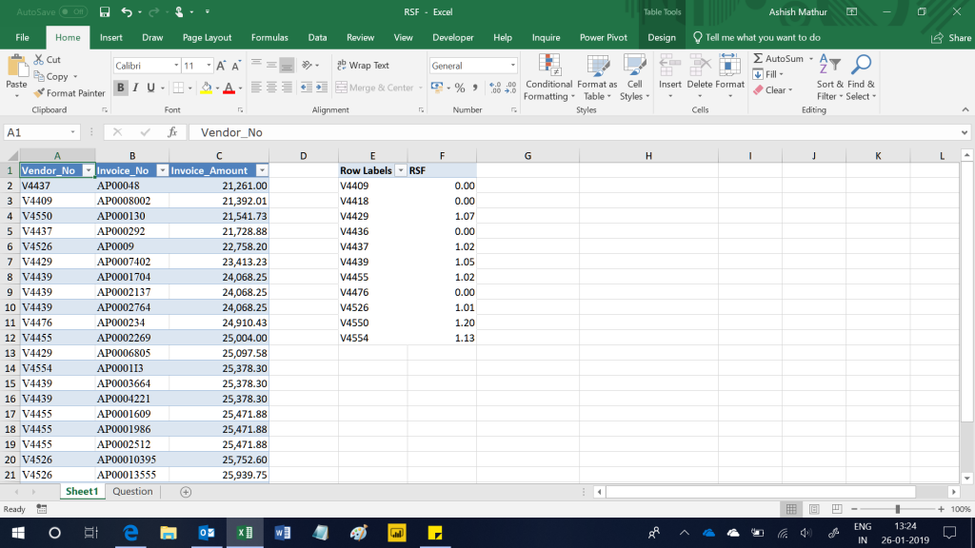
  Case Study on Relative Size Factor (RSF)
The expected result is:

Slide 159
Computer Assisted Audit Tool (CAATs)
Computer-assisted audit tool (CAATs) or computer-assisted audit tools and techniques (CAATs) is a growing field within the IT audit profession. CAATs is the practice of using computers to automate the IT audit processes& to detect frauds.

Slide 160
  Uses of CAATs
Creation of electronic work papers
Fraud detection
Analytical tests – aging / stratification / gap detection
Data analysis reports
Continuous monitoring
Curb stoning in surveys - Curb stoning is the term for instances where a surveyor completes a survey form by making up data

Slide 161
Benford’s Law
It is a mathematical tool, and is one of the various ways to determine whether variable under study is a case of unintentional errors (mistakes) or fraud. On detecting any such phenomenon, the variable under study is subjected to a detailed scrutiny.

Slide 162
History of Benford’s Law
The story of Benford's Law begins in 1881, when astronomer Simon Newcomb noticed that the page numbers in a book of logarithm tables were worn (or smeared) more toward the front of the book and progressively less worn toward the end of the book. Where others would simply dismiss the worn page numbers, Newcomb recognized a distinct pattern related to the occurrence of lower versus higher numbers. He published an article explaining his observations and postulated that the probability of a single number n being the first digit of a number was equal to log (n+1) − log (n). Fifty-seven years later, in 1938, physicist Frank Benford tested Newcomb's hypothesis against 20 sets of data and published a scholarly paper verifying the law. This was referred as Benford's Law.

Slide 163
Use of Benford's Law to Spot Fraud
Benford's Law maintains that the numeral 1 will be the leading digit in a genuine data set of numbers 30.1% of the time; the numeral 2 will be the leading digit 17.6% of the time; and each subsequent numeral, 3 through 9, will be the leading digit with decreasing frequency. This expected occurrence of leading digits can be illustrated as shown in the chart "Benford's Law."
The resulting curve pictured (shown below) in this green bar chart closely resembles a steep water slide and is sometimes referred to as the Benford curve.

Slide 164
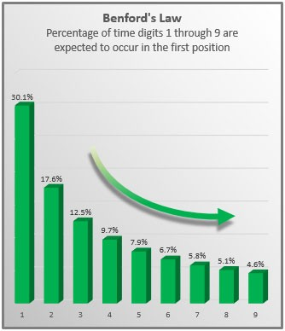
Use of Benford's Law to Spot Fraud_Contd……

Slide 165
Use of Benford's Law to Spot Fraud_Contd……
A few caveats regarding the application of Benford's Law are as follows:
  The larger the better: Benford's Law works better with larger sets of data.
  Equal opportunity. To conform to the law, the data set you use must contain data in which each number 1 through 9 has an equal chance of being the leading digit. Otherwise, Benford's Law doesn't apply.
  No definitive proof. Benford's Law calculations can never definitively prove or disprove the presence or absence of genuine numbers.

Slide 166
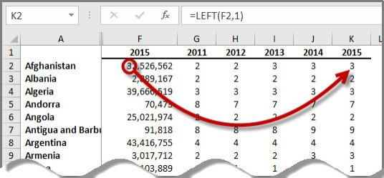
Case Study - Understand Benford's Law using Excel
The three basic Excel tools needed to apply Benford's Law are the LEFT and COUNTIF functions, along with the Column Chart tool.
For this example, we will examine the populations of the world's 258 countries from 2011 through 2015 as reported by the World Bank Group's World Databank
Extracting the first digit

Slide 167
Case Study - Understand Benford's Law using Excel_Contd….
The next step is to count the occurrence of each number 1 through 9 within the extracted digits using the =COUNTIF function (see the screenshot "Applying the COUNTIF Function"). This is achieved by numbering a range of cells 1 through 9 (as shown in cells M2 through M10), entering into cell N2 the formula =COUNTIF ($G$2:$K$259, M2), and then copying that formula down to cell N10.

Slide 168
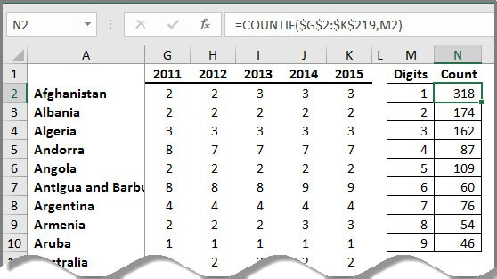
Case Study - Understand Benford's Law using Excel_Contd….
Applying the COUNTIF function
In this example, we see that the numeral 1 occurs 318 times; the numeral 2 occurs 174 times; the numeral 3 occurs 162 times; and so on. Charting these occurrences produces the results in the chart "World Populations by Country."

Slide 169
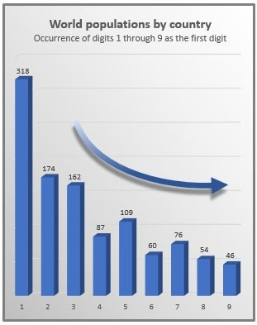
Case Study - Understand Benford's Law using Excel_Contd….
As you can see in the chart above, even with this relatively small data set, the results do roughly (but not exactly) follow Benford's curve. (While you should never expect the results to exactly match Benford's curve, you should expect the curve produced by larger sets of data to match Benford's curve more closely than in this ­relatively small data set example.) As a result, we can conclude that this Benford analysis tends to verify the populations as genuine numbers that have not been fabricated.

Slide 170
Luhn’s Algorithm
The Luhn algorithm, also known as the modulus 10 or mod 10 algorithm, is a simple checksum formula used to validate a variety of identification numbers, such as credit card numbers, IMEI numbers, Social Insurance Numbers etc. Most credit cards and many government identification numbers use the algorithm as a simple method of distinguishing valid numbers from mistyped or otherwise incorrect numbers. It was designed to protect against accidental errors, not malicious attacks.
The Luhn algorithm helps to validate identification numbers, which explains why it’s widely used in electronic payment systems

Slide 171
How does the Luhn’s Algorithm work?
Example: Visa number: 4003600000000014
  Multiply the digits from the back, starting from the second-to-last or vice-versa. Skip one number, double the next until you’re now on the first number.
    4003600000000014
    1 x 2 + 0 x 2 + 0 x 2 + 0 x 2 + 0 x 2 + 6 x 2 + 0 x 2 + 4 x 2
    Now, we have product digits for all doubled digits, e.g. the product digit of 1 × 2 is 2. However, the product digit of 6 × 2 will be 1 + 2 (derived from its product '12') because 12 is higher than 10. Add all the derived product digits together. = 2 + 0 + 0 + 0 + 0 + 1 + 2 + 0 + 8 = 13
    The sum derived should be added to the sum of the digits that weren’t doubled.
    If the last digit in the total is 0, then the set of numbers is valid.
    The last digit in 20 is 0. So, the Visa number is correct.

Slide 172


Case Study with an example of Luhn’s Algorithm
Consider the example of an account number “79927398713“.
  Starting from the rightmost digit, double the value of every second digit,
  If doubling of a number results in a two digit number i.e greater than 9(e.g., 6 × 2 = 12), then add the digits of the product (e.g., 12: 1 + 2 = 3, 15: 1 + 5 = 6), to get a single digit number.

Slide 173

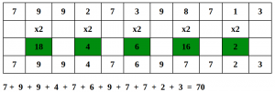
Case Study with an example of Luhn’s Algorithm_Contd….
Now take the sum of all the digits. Starting from the rightmost digit, double the value of every second digit,
If the total modulo 10 is equal to 0 (if the total ends in zero) then the number is valid according to the Luhn formula; else it is not valid.
Since the sum is 70 which is a multiple of 10, the account number is possibly valid.

Slide 174
Theory of Work Place Deviance (R. Hollinger & J .Clark)
Hollinger and Clark (1983) were of the opinion that employees steal primarily due to workplace conditions and concluded that the true costs of employee theft are vastly understated
  Hypotheses of Employee Theft – (R. Hollinger & J .Clark)
    The first was external economic pressures.
    The second hypothesis was that contemporary employees, specifically young ones
    The third theory was that every employee could be tempted to steal from his employer.
    The fourth theory was that job dissatisfaction is the primary cause of employee theft.
    The fifth was that theft occurs because of the broadly shared formal and informal structure of organizations

Slide 175
  Richard C. Hollinger and John P. Clark – Additional Research
Employee Deviance - a) Acts by employees against property (misuse and theft of company property), and b)Acts of employee deviance that affect productivity
Income and Theft
Age and Theft
Position and Theft
Job Satisfaction and Deviance
Organizational Controls and Deviance
Employee Perception of Control
Other Hollinger and Clark Conclusions
  Management must pay attention to four aspects of policy development:(1) A Clear Understanding Regarding Theft Behavior, (2) Continuous Dissemination Of Positive Information Reflective Of The Company’s Policies, (3) Enforcement Of Sanctions, And (4) Publicizing The Sanctions

Slide 176
Using excel in fraud risk analysis
Presented by
CA. Sanjay Kumar Gupta

Slide 177
  Fraud Risk Analysis
Fraud Risk analysis are large and complex subjects. Only the risk specifically of fraud is addressed here. The principal foundations for fraud risk analysis involve an understanding of the fraud threats, assets, external environment, and the organization itself.

Slide 178
  Excel in Fraud Risk Analysis
To analyze data from a multi-dimensional perspective, one might need to slice & dice data like out of a sales report of sales made in different periods, in different departments, of different products, by different salesmen, of different amounts; you need an overview of sales period wise, salesmen wise, product wise, with different subgroups; for that matter, you might have a hundred data points to track. All this is possible using a star feature of Excel called PivotTables.

Slide 179
  Pivot Table
The Pivot Tables tool is one of the most powerful yet intimidating features in Excel. Pivot tables allow to turn data inside out, upside down, sideways, and backward, quickly summarize and analyze large amounts of data in lists and tables--independent of the original data layout in spreadsheet--by dragging and dropping columns to different rows, columns, or summary positions.

Slide 180
  Features of Pivot tables
Convenience
Flexibility
Documentation
Many formatting options

Slide 181
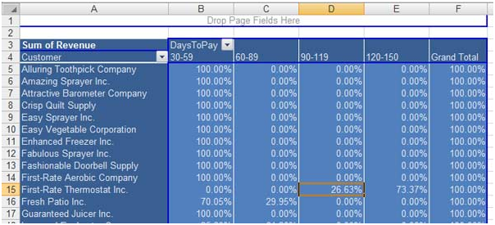
  Features of Pivot tables_contd……
Figure1

Slide 182
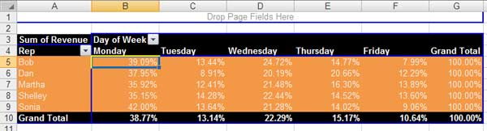
  Features of Pivot tables_contd……
Figure2

Slide 183
  IF Function
The IF Function is one of the most important Logical Excel Function. It helps to check a condition and give the output either TRUE or FALSE according to the condition. The general syntax is as follows:
= IF ( logical test, [value_if_true], [value_if_false] )
Here, the “logical_test” is the condition which will be tested and output will return according to the logic. If logic is TRUE, it will give one value and if logic is FALSE, it will return another value.
In the example, we have 2 columns i.e. Name and Amount column. We want to check whether the amount is greater than 9000. We want 4 different output based on one single condition as follows:

Slide 184
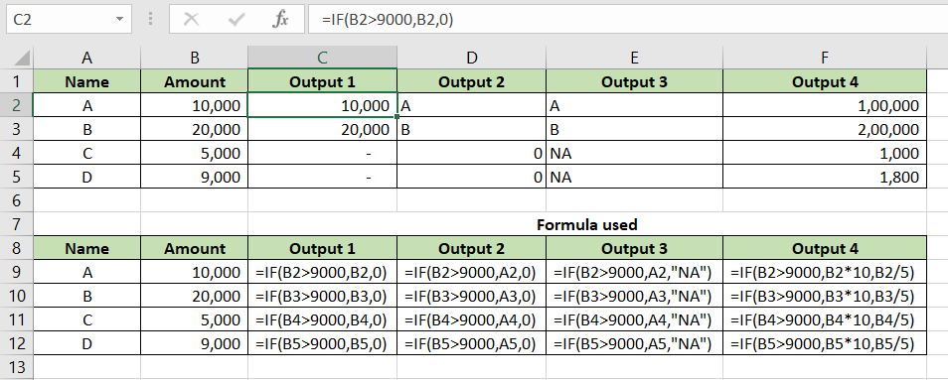
  IF Function_contd…..
Figure3

Slide 185
  IF Function_contd…..
Condition in Output 1: If Amount > 9000, return the same amount if TRUE and return 0 if FALSE.
Condition in Output 2: If Amount > 9000, return the Name of the person if TRUE and return 0 if FALSE.
Condition in Output 3: If Amount > 9000, return the Name of the person if TRUE and return “NA” if FALSE.
Condition in Output 4: If Amount > 9000, if TRUE, multiply Amount by 10 and if FALSE, divide amount by 5.

Slide 186
VLOOKUP Function
The VLOOKUP function extracts the data from a particular cell in a table. VLOOKUP Function looks for a value in left most column of a table and then returns a value in the same row from a column specified by us.
=VLOOKUP ( lookup_value, , table_array, col_index_num, [range_lookup]
Here, “lookup_value” is the value which we are looking in the “table_array”. After matching the value in left most column (i.e. first column in the table_array), it will return the value in the target cell by considering col_index_num specified by us. The “range_lookup can be TRUE (Approximate match) or FALSE (Exact match). Selection of TRUE or FALSE will depend on the nature of lookup value and value in table array. Generally, in case of Text or exact number search, we use FALSE. In case table array is in the form of range or slab, in that situation, we prefer TRUE.

Slide 187
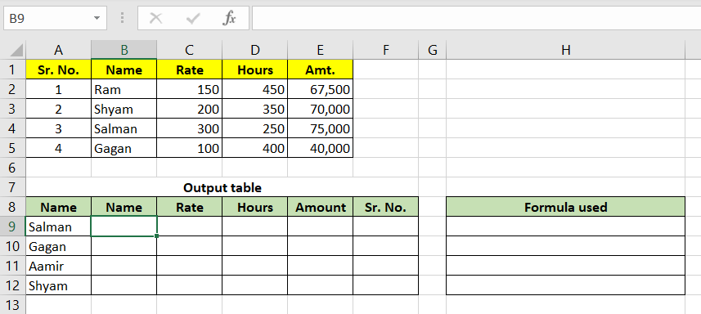
  VLOOKUP Function_contd…..
Figure4_Table Structures

Slide 188
  VLOOKUP Function_contd…..
Figure5_Name Column

Slide 189
INDEX Function
The INDEX Function returns a value or reference of the cell at the intersection of a particular row and column in a given range.
=INDEX (array, row_num, [column_num] )
Here, the array is the range, where we have to search for value based on intersection of row number and column number. The row number and column can be written manually (can be difficult in large table) or can be derived using MATCH Function.
Figure-6_INDEX and MATCH Function for extracting all column data

Slide 190
More Excel-Functions to analyse Fraud Risks
HLookup Function
Choose Function
Sum IF Function
Count IF Function
Auto Filters Function
Stratify Data Test
Duplicates Test
Averages Test

Slide 191
Usage of Excel in different areas of Fraud detection
Excel tools for spotting duplicate payments: payroll, vendor invoices, and more
Stratifications, frequencies and maximum analysis
Receivables and inventory analysis
Payables, payroll and disbursements
Finding fictitious vendors, payroll comparisons, duplicate payments, and more
Fictitious sales - bonuses to salesmen - using pivot tables to age receivables

Slide 192
Data Mining
Presented by
CA. Sanjay Kumar Gupta

Slide 193
Data Mining
Data mining is the process of looking at large banks of information to generate new information. It helps in extracting information from a given data set to identify trends, patterns, and useful data. The objective of using data mining is to make data-supported decisions from enormous data sets. It makes use of complex mathematical algorithms to study data and then evaluate the possibility of events happening in the future based on the findings. It is also referred to as knowledge discovery of data or KDD. The main purpose of data mining is to extract valuable information from available data.
The first three processes, that are data selection, data preprocessing and data transformation, are considered as data preparation processes. The last three processes including data mining, pattern evaluation and knowledge representation are integrated into one process called data mining. (Refer: fig-1)

Slide 194
Data Mining_contd….
Fig 1. The process of data mining transitioning from raw data to valuable knowledge

Slide 195
Data Mining Techniques
Tracking patterns.
Classification.
Association.
Outlier detection - an observation that lies an abnormal distance from other values in a random sample from a population
Clustering.
Regression- regression analysis is a set of statistical processes for estimating the relationships between a dependent variable
Prediction

Slide 196
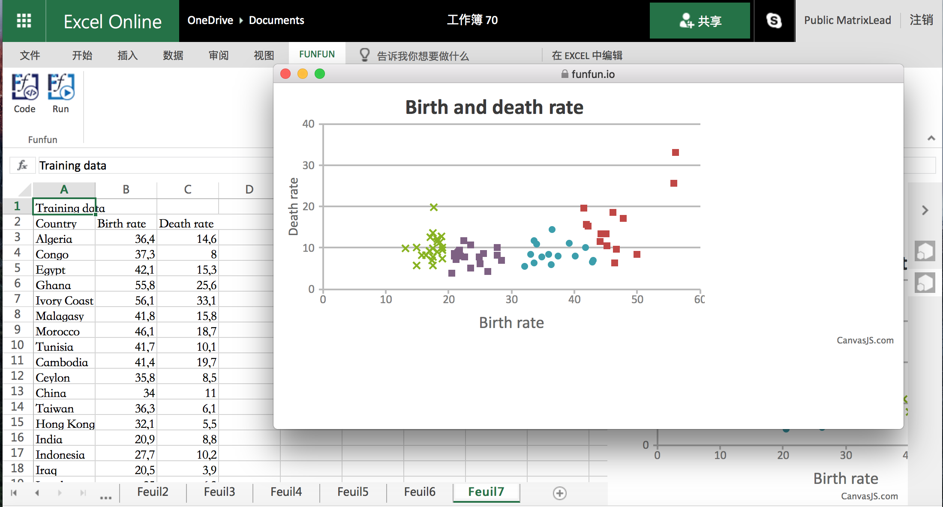

Slide 197
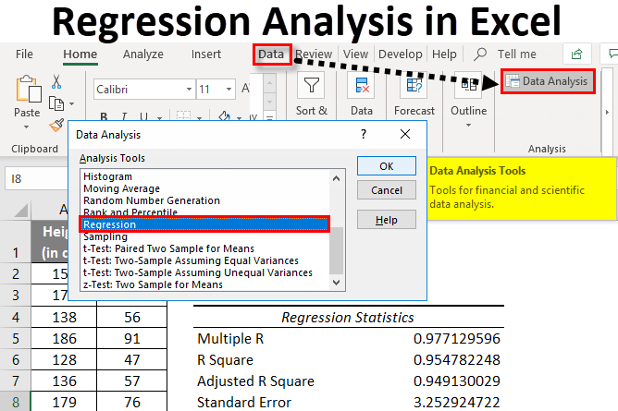

Slide 198
Uses of Data Mining in Large Scale Financial Transaction
Financial Institutions are involved with generating and handling million records of transactions across their platforms. These transactions contain significant patterns and trends which are hidden but needed for knowledge discovery and actionable insight into either fraudulent or non-fraudulent events. Data Mining is used to uncover significant patterns and trends in large scale financial transactions and construct a model to predict and forecast fraud on the basis of uncovered patterns and trends.

Slide 199
Summary of the most significant Fraud Detection Techniques/Models in Data Mining.
DM Technique Employed | Description | Fraud Type
Neural Network | It can be taught to implement sophisticated machine learning algorithms and pattern recognition to make predictions from historical data. | Financial statement fraud
Fuzzy Neural Network | Use traditional association rules | Financial Reporting
Rule-Learning | The extraction of useful if-then rules from data based on statistical significance | Credit Card Fraud
Decision Tree Analysis | Predictive Model based on sequence of decision | Credit Card Fraud

Slide 200
Summary of the most significant Fraud Detection Techniques/Models in Data Mining._contd…..
DM Technique Employed | Description | Fraud Type
Fuzzy C-Means Clustering | Relates known fraudsters to other individuals | Financial and automobile insurance fraud detection
Peer Group Analysis | Detects individual objects that begin to behave in a different way | Credit Card Fraud
K-Means Clustering | Forms clusters or patterns of transactions to describe the data | Refund fraud, financial statement fraud and Credit card fraud
Logistic Regression | Uses predictive analysis | Financial fraud statements.

Slide 201
Forensic Lexicology – How to analyze Words like Numbers
Presented by
CA. Sanjay Kumar Gupta

Slide 202
Lexicology
Lexicology is derived from lexico 'word' plus logos 'learning or science' i.e. the science of words. Lexicology is the science of the study of word. Lexicology relies on information derived from morphology, the study of the forms of words and their components, and semantics, the study of their meanings. Lexicology provides the theoretical basis of lexicography. In lexicology the study of words is objective, governed by the theories of semantics and word formation.

Slide 203
How to analyse text
The text may come from opencat-diary-ended responses on surveys, social networking sites, email, online reviews, public comments, notations (e.g., medical, customer relations), documents and text files, or even recorded and transcribed interactions. Statisticians have to assign three tasks as follows for analysing text:
  Get the text into a spreadsheet or other software so that it can used to manipulate.
  Break the text into analyzable fragments – letters, words, phrases, sentences, paragraphs, or whatever.
  Assign properties to the text fragments.

Slide 204
Text Analysis vs. Text Mining
Text analysis delivers qualitative results and text analytics delivers quantitative results. Whereas
Text mining also referred to as text data mining, similar to text analytics, is the process of deriving high-quality information from text. It involves "the discovery by computer of new, previously unknown information, by automatically extracting information from different written resources."

Slide 205
Techniques of Text Analysis
  Text Classification
    Sentiment Analysis
    Topic Analysis
    Intent Detection
  Text Extraction
  Word Frequency
  Collocation
  Concordance
  Word Sense Disambiguation
  Clustering

Slide 206
Forensic Indices
Presented by
CA. Sanjay Kumar Gupta

Slide 207
Indexing
Indexing actually provides the investigator have a complete look at a file and gather potential evidence from it. The evidence could be contained within a file, a disk image, a memory snapshot, or a network trace. Indexing helps in reducing time for time-consuming tasks such as keyword searching. Indexing also helps in listing the keywords in a sorted list.
The following example shows how you can use indexing
aList = [123, 'sample', 'zara', 'indexing'];
print "Index for sample : ", aList.index('sample')
print "Index for indexing : ", aList.index('indexing')

Slide 208
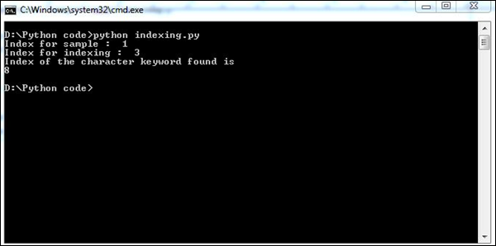
Indexing_contd…..
str1 = "This is sample message for forensic investigation indexing";
str2 = "sample";
print "Index of the character keyword found is "
print str1.index(str2)
The above script will produce the following output.
Hence, “Indexing” means referring to an element of an iterable by its position within the iterable.

Slide 209
The CODIS Concept
For detecting criminals or fraudsters Combined DNA Index System (CODIS) database created and maintained by the Federal Bureau of Investigation is being used in United States National (US).
CODIS is the acronym for the Combined DNA Index System and is the generic term used to describe the FBI’s program of support for criminal justice DNA databases as well as the software used to run these databases. DNA profiles developed from crime scene evidence. CODIS utilize computer software to automatically search these indices for matching DNA profiles.
Profiles stored in CODIS contain a specimen identifier, the sponsoring laboratory’s identifier, the initials (or name) of DNA personnel associated with the analysis, and the actual DNA characteristics.

Slide 210
The CODIS Concept_contd.....
CODIS is designed so that forensic laboratories have control over their own data. The system has three tiers (or levels): local, state, and national.
The CODIS software contains multiple different databases depending on the type of information being searched against. Examples of these databases include, missing persons, convicted offenders, and forensic samples collected from crime scenes.
However, for privacy reasons, the CODIS database does not contain any personal identifying information, such as the name associated with the DNA profile.

Slide 211
How do these DNA databases using CODIS work?
In the case of a sexual assault where an evidence kit is collected from the victim, a DNA profile of the suspected perpetrator is developed from the swabs in the kit. The forensic unknown profile attributed to the suspected perpetrator is searched against their state database of convicted offender and arrestee profiles (contained within the Convicted Offender and Arrestee Indices, if that state is authorized to collect and database DNA samples from arrestees). If there is a candidate match in the Convicted Offender or Arrestee Index, the laboratory will go through procedures to confirm the match and, if confirmed, will obtain the identity of the suspected perpetrator. The DNA profile from the evidence is also searched against the state’s database of crime scene DNA profiles called the Forensic Index.

Slide 212
What happens after there is a hit in the DNA database?
CODIS was designed to compare a target DNA record against the DNA records contained in the database. Once a match is identified by the CODIS software, the laboratories involved in the match exchange information to verify the match and establish coordination between their two agencies. . The law enforcement agency can use this documentation to obtain a court order authorizing the collection of a known biological reference sample from the offender. The casework laboratory can then perform a DNA analysis on the known biological sample so that this analysis can be presented as evidence in court.

Slide 213
What DNA information is stored in these databases?
The DNA profile, also known as a DNA type, is stored in the database. For Forensic STR DNA analysis, the DNA profile consists of one or two alleles at the 20 CODISCore Loci.

Slide 214
Is any personal information relating to the convicted offenders, arrestees, or detainees stored in these DNA databases?
No names or other personal identifiers of the offenders, arrestees, or detainees are stored using the CODIS software (for missing persons records stored at NDIS, available metadata, such as the date of birth, may be included.) Only the following information is stored and can be searched at the national level:
  The DNA profile—the set of identification characteristics or numerical representation at each of the various loci analyzed;
  The Agency Identifier of the agency submitting the DNA profile;
  The Specimen Identification Number—generally a number assigned sequentially at the time of sample collection.
  The DNA laboratory personnel associated with a DNA profile analysis.

Slide 215
What precautions are taken for safeguarding the information in these DNA databases?
The computer terminals/servers containing the CODIS software are located in physically secure space. Access to these computers is limited to only those individuals authorized to use CODIS and approved by the FBI. Communications between participating federal, state, and local laboratories occur over a wide area network accessible to only criminal justice agencies approved by the FBI.
Access to DNA data to be restricted to criminal justice agencies for law enforcement identification purposes.
The unauthorized disclosure of DNA data in the National DNA database is subject to a criminal penalty not to exceed $250,000.

Slide 216
Forensic Financial Analysis – manipulation and window dressing –
Potential techniques and detecting patterns
Presented by
CA. Sanjay Kumar Gupta

Slide 217
Forensic Financial Analysis
Forensic financial analysis is more commonly thought of as fraud detection. Financial forensics is a field that combines criminal investigation skills with financial auditing skills to identify criminal financial activity coming from within or outside of an organization.
Financial forensics may be used in prevention, detection, and recovery activities to investigate terrorism and other criminal activity, provide oversight to private-sector and government organizations, and assess organizations' vulnerability to fraudulent activities.
Financial forensics is similar to forensic accounting, which utilizes accounting, auditing, and investigative skills to analyze a company's financial statements for possible fraud in conjunction with anticipated or ongoing legal action.

Slide 218
Financial Statements Manipulation
Financial statement manipulation refers to the practice of using creative accounting tricks to make a company’s financial statements reflect what the company wants its performance to look like rather than its actual performance. The manipulation of financial statements to commit fraud against investors or skirt regulation is a real and ongoing problem.

Slide 219
  Why do Companies manipulate their Financial Statements?
    Feeling intense pressure to show a positive picture
    Tapering investors’ expectations
    Triggering executive bonuses

Slide 220
Detecting Accounting Manipulation
The main three pillars of the annual report are income statement, balance sheet, and cash flow. Any creative accounting or manipulation in any of these accounts is reflected in the other account for definite.
  Income Statement: Manipulation can be done through:
    Recording the revenue before taking the delivery of the goods.
    Recording fictitious revenues
    Recording increase in revenues through categorizing investment gains as revenue.
    Shifting current expenses to earlier or later accounting periods.
    Shifting future expenses to the current accounting period.
  Provision for doubtful accounts
  Inventory

Slide 221
Detecting Accounting Manipulation_contd….
  Cash flows: Management sometimes tries to manipulate the cash flow to make it appear higher than it should really look. Operating cash flow can be manipulated through:
  Misusing of non-operating cash
  Working Capital Manipulation

Slide 222
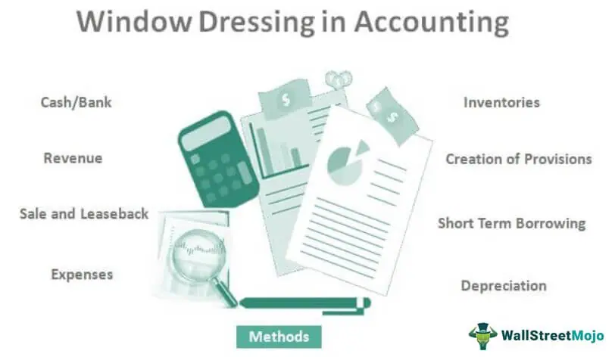
  Window Dressing in Accounting
Window Dressing in Accounting refers to the manipulation done by the management of the company intentionally in the financial statements in order to present a more favorable picture of the company in front of the users of the financial statement before the same is released in the public.

Slide 223
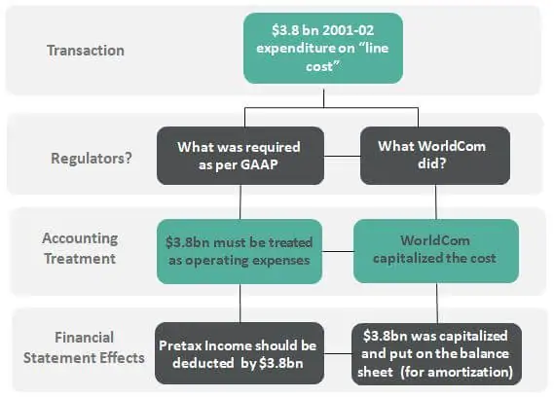
Example of Window Dressing
WorldCom case is one of the most infamous examples of window dressing, which was done by inflating earnings through improper capitalization of expenses. WorldCom declared bankruptcy in July 2002. Chief Accounting and finance executives charged with securities fraud.

Slide 224
Purpose of Window Dressing
It is useful to seek funds from investors or to obtain any loan.
The stock price of the company will shoot up if the financial performance is good.
Tax avoidance can be done by showing poor financial results.
To cover up the poor management decisions taken.
It improves the liquidity position of the business.
To show a stable profit and results for the company.
It is done to achieve targeted financial results.
It is done to showcase a good return on investment.
To increase the performance bonus to the management team based on the overstated profits.

Slide 225
Identifying Window Dressing in Accounting
Window dressing in accounting can be spotted by proper analysis and comparison of the financial statements. The following can be looked into the financials of the company to identify window dressing.
  Improvement in cash balance because of short term borrowings or cash flow from non-operating activities.
  Unusual increase or decrease in any of the account balances in financial statements.
  Change in accounting policy.
  Change in the inventory valuation, change in depreciation method, etc during the year.
  Improvement in sales due to enormous discounts and an increase in trade payables;

Slide 226
Valuation & Forensic – Why & How
Presented by
CA. Sanjay Kumar Gupta

Slide 227
FORENSIC & VALUATION
Valuation is the analytical process of determining the current (or projected) worth of an asset or a company. A business valuation is a general process of determining the economic value of a whole business or company unit. Business valuation can be used to determine the fair value of a business for a variety of reasons, including sale value, establishing partner ownership, taxation, and even divorce proceedings.
Business valuation and forensic accounting must be integrated in order to achieve the most accurate results. It should be based on comprehensive analysis of a business that includes all factors. Those factors include close consideration of many variables affecting value including:
  The historical financial statements of the business
  Financial analysis of the business

Slide 228
FORENSIC & VALUATION_contd…..
  Industry specific research and analysis
  National and local economic research and analysis
  Analysis of competition
  Company specific factors
  Risk factors for the business and development of an appropriate discount rate

Slide 229
Necessity of valuations for Business
Valuations provide a baseline
Valuations help chart the course for the future
Valuations measure progress
Valuations can identify gaps
Valuations help you manage your business
Valuations create accountability
Valuations provide a benchmark
Valuations provide a perspective on price
Valuations can provide the gateway to capital

Slide 230
Approaches of Business valuation
There are generally three acceptable valuation approaches: Asset, Income and Market.
  Under the asset approach: a company’s value is equal to the fair market value of its assets less the fair market value of its liabilities, essentially looking at what it would cost to recreate the business.
  The income approach is based on the premise that the value of a business is equal to the present value of the company’s future stream of cash flows.
  The market approach, estimates value based on recent sales of similar businesses or ownership interests which are then adjusted for difference in size, quantity or quality.

Slide 231
A Forensic Accounting Methodology to support Counter-terrorism
Presented by
CA. Sanjay Kumar Gupta

Slide 232
Forensic Accounting
Forensic accounting is a type of accounting which cross-checks the various financial records of a business to find any indication of fraud being committed. It also provides an in-depth analysis of all of the financial books of the business which could be presented in the court of law as evidence.
Forensic accounting not only helps the business to minimize its losses but will also help to improve the efficiency of the business which will ultimately lead to greater profitability. It can furthermore help the management to keep track of the various business activities and prevent any fraud from happening in the future.

Slide 233
Forensic Accounting Techniques
Reviewing Public Documents and Conducting Background Checks
Conducting Detailed Interviews
Gathering Information from Trustworthy Sources
Analyzing Evidence Gathered
Conducting Surveillance
Going Undercover
Analyzing the Financial Statements

Slide 234
Counterterrorism
Counter Terrorism is a collaborative strategy between several agents of the government, which include the military, law enforcement, businesses, and intelligence agencies. Counter-terrorism strategy is a government's plan to use the instruments of national power to neutralize terrorists, their organizations, and their networks in order to render them incapable of using violence to instill fear and to coerce the government or its citizens to react in accordance with the terrorists' goals.

Slide 235
A forensic accounting methodology to support counterterrorism
Forensic accounting analysis in support of counterterrorism efforts must be conducted in a methodical manner consistent with the high standards of federal law enforcement. However it requires consistent use of best technology to use forensic accounting to support counter-terrorism.

Slide 236
The Impact on Forensic Accounting and Counterterrorism
A major challenge facing the counterterrorism environment is the inability of the investigating agencies other government agencies to keep up with technological advancements like virtual currency transactions.
Criminals “who hide their crimes and identities behind layers of anonym zing technologies… [and] use virtual currencies to obscure their transactions” seriously limit the scope of investigations. This information gap necessitates 1) recruiting and retaining top global talent and 2) sharing information with other government agencies and private-sector businesses.
Further research may be necessary to examine the integration of government databases into single inter-agency data hub to exchange financial crime information. With rapid technological innovation, the countries will need forensic accountants more than ever.

Slide 237
The Impact on Forensic Accounting and Counterterrorism_contd.
It is not feasible to examine every transaction, so forensic accountants will be needed to perform analytical functions to identify patterns and red flags in data sets.
Materiality is a matter of professional judgment and requires specific training and experience. While many processes like manufacturing, dining, and even grocery shopping have the ability to be automated, professional judgment driven by years of skill and experience cannot be programmed into an algorithm.

