Slide 1


Cloud Computing –Forensic Audit
CMA (Dr.) Siva Rama Prasad Puvvala
M.Com., MBA., FCMA., FCS., FIIBF., FIII (Life & General)., MAIMA.,

Slide 2
Cloud Computing – Forensic Audit
Investigation related information not available in Physical Form.
It is Available in RAM (Random Access Memory) i.e., on Hard Disk.
Most of the Hard Disks are not available in the Organization. It is in Cloud.
It is a BIG Challenge for ‘Forensic Auditor’ to Extract the Information.
Forensic Auditors should have the Knowledge of Cloud Computing.

Slide 3
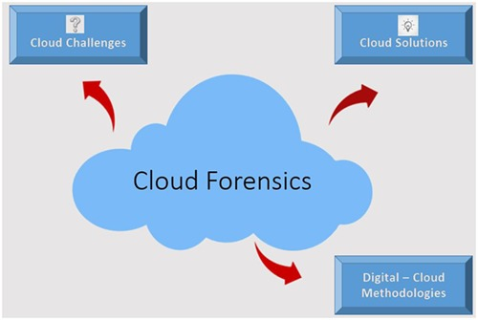
Cloud Computing – Forensic Audit

Slide 4
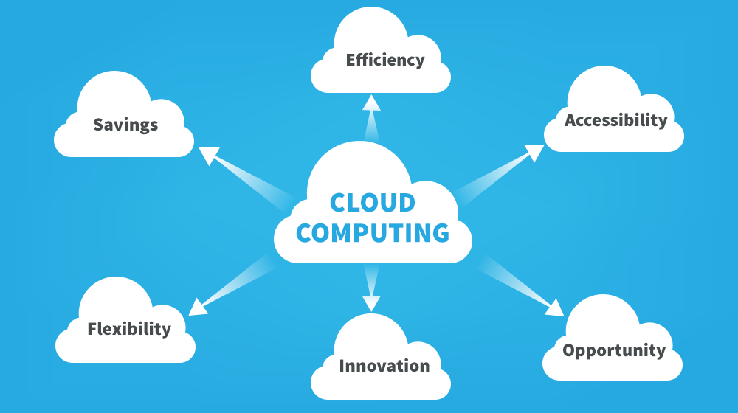
Cloud Computing – Forensic Audit

Slide 5
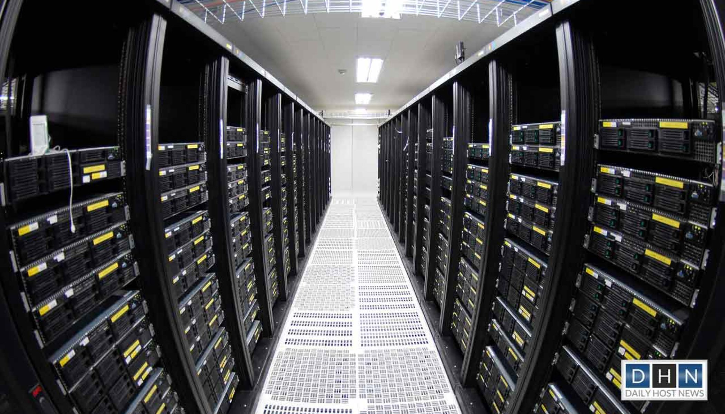
Cloud Computing – Forensic Audit

Slide 6
Cloud Computing – Forensic Audit
Cloud Computing is another IT Revolution or Evolution.
Key issues which it still raises are questions about its implications for Security and its Readiness for Forensic Investigations.
There is no doubt that Cloud Computing will offer some Benefits such as increased Flexibility, Reduced Costs and Business Agility etc.

Slide 7
Cloud Computing – Forensic Audit
However, Crime has a new frontier and Cloud Computing creates Breeding grounds for Digital Evidence.
Recent Study has shown that Security, Privacy, Jurisdiction, and lack of control as being common of stumbling blocks for companies adopting Cloud Computing.
Cloud Security, Data Privacy, and Data Protection. But to date, aspects of Forensic Investigation in Cloud environments have been Neglected.

Slide 8
Cloud Computing – Forensic Audit
IT Function (In House)
Capital Expenditure - (Servers, Fixtures & Fittings, UPS / DRM / BCP / DC etc.) - IRR.
Recurring Expenditure – Firmware, Software, Humanware (Attrition Rate), Annual Maintenance Costs (AMC), Memory Management Costs.

Slide 9
Cloud Computing – Forensic Audit
IT Function (In House) – Contd.. ..
Technology Obsolescence (Hardware and Software).
Depreciation – Software-100% and Hardware – 33.33%.

Slide 10
Cloud Computing – Forensic Audit
In-house IT Function Vs. Hiring of IT Function
Supervision & Control Costs (Department / Function) / Risk Management Function.
Compliances – Cyber Laws – IT Act, 2000.
Virus Attacks / Cyber Frauds.

Slide 11
Cloud Computing – Forensic Audit
In-house IT Function Vs. Hiring of IT Function - Contd.. ..
Business Expansion.
Shutdown Costs / No salvage Value.

Slide 12
Cloud Computing – Forensic Audit
Cloud Computing is an:
  “On-demand Delivery” of Compute, Storage, Applications, and other IT Infrastructure.
  With Metered Payment based on Usage.

Slide 13
Cloud Computing – Forensic Audit
Cloud Computing (CC) helps to Business Organizations:
  Reinvent and “Optimise” relationship with Technology.
  For “Quickening” Go-to-Market.
  Automating and Strengthening Security.

Slide 14
Cloud Computing – Forensic Audit
Cloud Computing (CC) helps to Business Organizations: - Contd.. ..
  Increasing ‘Stakeholder Value’ and ‘Customer Experiences’.
  Reducing Overhead Costs / Capital Expenditure.

Slide 15
Cloud Computing – Forensic Audit
The Main Benefits of adoption of Cloud Computing are: - Contd.. ..
Capital Expenditure / Variable Expenses.
Benefit from Massive Economies of Scale.

Slide 16
Cloud Computing – Forensic Audit
The Main Benefits of adoption of Cloud Computing are: - Contd.. ..
Access to Greater Service Breadth and Depth.
Increase Speed and Agility (Move Quickly & Easily).

Slide 17
Cloud Computing – Forensic Audit
The Main benefits of adoption of Cloud Computing are: - Contd.. ..
Global Footprint.
Security and Compliances.

Slide 18
Cloud Computing – Forensic Audit
The Main benefits of adoption of Cloud Computing are: - Contd.. ..
Carbon Footprint.
Business Continuity.

Slide 19
Cloud Computing – Forensic Audit
The Main Benefits of adoption of Cloud Computing are: - Contd.. ..
Improved Performance.
Reduced Software Costs.
Instant Software Updates.

Slide 20
Cloud Computing – Forensic Audit
The Main Benefits of adoption of Cloud Computing are: - Contd.. ..
Unlimited Storage Capacity.
Latest Versions Availability.

Slide 21
Cloud Computing – Forensic Audit
The phrase “Cloud Computing” Originated in a collaboration project between “IBM and Google”.
The NIST (National Institute of Standards and Technology, USA) defined:
Five Essential Characteristics.
Three Delivery Models.
Four Deployment Models.

Slide 22
Cloud Computing – Forensic Audit
End Users
MSME Sector.
Start-up Companies.
Educational Institutions.
Health Sector.

Slide 23
Cloud Computing – Forensic Audit
End Users - Contd.. ..
Coaching Institutions.
Professional Institutes.
Existing Companies – Hybrid Cloud.

Slide 24
Cloud Computing – Forensic Audit
Five Essential Characteristics:
On Demand Self-service.
Broad Network Access.
Resource Pooling.

Slide 25
Cloud Computing – Forensic Audit
Five Essential Characteristics: - Contd.. ..
Rapid Elastic and
Measured Service.

Slide 26
Cloud Computing – Forensic Audit
On-demand Self-service: Organizations can request and consume a cloud service without interaction with the selected service provider based on their need.

Slide 27
Cloud Computing – Forensic Audit
Broad Network Access: Cloud Resources are available over Network and Access to Network is available through Multiple Devices such as Laptop, Smartphone and Tablet, etc.

Slide 28
Cloud Computing – Forensic Audit
Resource Pooling: Provider Pools the Resources (Applications, Storage, Bandwidth, Virtual Machines) to Service many Organizations using a Multi-tenant Model.

Slide 29
Cloud Computing – Forensic Audit
Rapid Elasticity: Elasticity is the ability to Scale-Up or Down Computing Resources (Cores - CPUs, Storage and RAM) in Real-Time as per Need.

Slide 30
Cloud Computing – Forensic Audit
Measured Service: Provider Transparently Meters and Measures Services, Monitors Controls and Documents Service Usage for Billing just like any other Utility Metering.

Slide 31
Cloud Computing – Forensic Audit
Three Delivery Models are:
Software as a Service (SaaS).
Platform as a Service (PaaS).
Infrastructure as a Service (IaaS).

Slide 32
Cloud Computing – Forensic Audit
Software as a Service (SaaS)

Slide 33
Cloud Computing – Forensic Audit
Software as a Service (SaaS) provides a Complete Solutions (Infrastructure, Platform and Application) that is managed by the Service Provider.
SaaS is software that is deployed over the Internet rather than installed on a computer. It is often used for enterprise applications that are distributed to multiple users. SaaS applications typically run within a Web browser, which means users only need a compatible browser in order to access the software.

Slide 34
Cloud Computing – Forensic Audit
Software as a Service (SaaS) provides a Complete Solutions (Infrastructure, Platform and Application) that is managed by the Service Provider – Contd.. ..
SaaS solution are like CRM, e-mail and Collaboration Tools, BI and Analytics, Secure Backup etc.
Organisations do not have to worry about how the Service is maintained or how the underlying infrastructure is managed.

Slide 35
Cloud Computing – Forensic Audit
Platform as a Service (PaaS)

Slide 36
Cloud Computing – Forensic Audit
Platform as a Service (PaaS): Organizations that use either in-house or Partner Staff to perform Software Product Development can use PaaS to develop, Deploy and Manage Applications.
Platform-as-a-Service (PaaS) is a type of Cloud Computing offering in which a service provider delivers a platform to clients, enabling them to develop, run, and manage business applications without the need to build and maintain the infrastructure such software development processes typically require.

Slide 37
Cloud Computing – Forensic Audit
Platform as a Service (PaaS): – Contd.. ..
PaaS helps Organizations to be more efficient as Organization do not need to worry about Software Procurement, Capacity Planning, Software Maintenance, Patching, or any of the other IT Operations involved in running Organizations Applications.

Slide 38
Cloud Computing – Forensic Audit
Infrastructure as a Service (IaaS)

Slide 39
Cloud Computing – Forensic Audit
Infrastructure as a Service (IaaS) contains all basic building blocks for cloud IT and typically provides Compute, Network and Storage in a Virtual environment. IaaS provides Organizations with Highest Level of flexibility and Management Control over their IT resources and is most similar to existing IT resources that many IT Departments and Application Developers are familiar with Today.
IaaS Service Provider manages the entire Infrastructure while Organizations are responsible for all other aspects of the Deployment.

Slide 40
Cloud Computing – Forensic Audit
Four Deployment Models:
Public Cloud.
Private Cloud.
Community Cloud and
Hybrid Cloud.

Slide 41
Cloud Computing – Forensic Audit
Public Cloud

Slide 42
Cloud Computing – Forensic Audit
Public Cloud:
The cloud infrastructure is provisioned for open use by public on internet.
It owned, maintained and operated by a CSP.
The CSP is responsible for the creation and maintenance of the public cloud and its IT resources.

Slide 43
Cloud Computing – Forensic Audit
Public Cloud: – Contd.. ..
Applications on public cloud are either created in the cloud environment or migrated from an existing infrastructure to take advantage of the benefits of cloud computing.
Cloud-based applications can be built on low-level infrastructure pieces or can use higher level services that provide abstraction from the management, architecting and scaling requirements of core infrastructure.

Slide 44
Cloud Computing – Forensic Audit
Public Cloud: – Contd.. ..
Public cloud exists on CSP premises.
Some popular CSP’s are AWS, Microsoft Azure, Google App Engine etc.
With the increased digital push and IT adoption across Sectors, Public Cloud service providers such as AWS, Microsoft Azure, IBM SoftLayer and others have set-up India availability zones.

Slide 45
Cloud Computing – Forensic Audit
Public Cloud: – Contd.. ..
Companies that are in the business of providing Datacentre Space and last mile Connectivity are also offering cloud services in India.
Some of the popular India-based options are Reliance, Ctrl-S, Netmagic, Tata Communications, Airtel etc.

Slide 46
Cloud Computing – Forensic Audit
Private Cloud

Slide 47
Cloud Computing – Forensic Audit
Private Cloud:
Deploying resources on-premises, using virtualization and resource management tools, is called “Private Cloud”.
Cloud infrastructure is provisioned for Exclusive Use by a single Organization for its various business units.

Slide 48
Cloud Computing – Forensic Audit
Private Cloud: – Contd.. ..
It may be owned, managed and operated by an Organisation or Third Party.
Private cloud may exist On or Off the Premises of a Organization.
Some of the popular software that is used for establishing Private Cloud are Microsoft System Center, VMWare, vCloud, Openstack etc. is an Opensource Software with distributions and support from IBM, Redhat, HP etc.

Slide 49
Cloud Computing – Forensic Audit
Community Cloud

Slide 50
Cloud Computing – Forensic Audit
Community Cloud:
Community Cloud is a Shared Cloud which supports a Specific Community that has shared concerns (e.g. Mission, Security, Policy, and Compliance Considerations).
Community Cloud may be Managed by Organizations or Third Party.

Slide 51
Cloud Computing – Forensic Audit
Community Cloud: – Contd.. ..
An example of this is Indian Bank Community Cloud (IBCC) offering CBS, e-mail, Mobile Banking, eKYC and e-Learning, etc.
IBCC is set up by IDRBT, the first community cloud for banking industry in the world and is Currently being Managed by its Subsidiary IFTAS (Indian Financial Technology & Allied Services), Hyderabad.

Slide 52
Cloud Computing – Forensic Audit
Hybrid Cloud

Slide 53
Cloud Computing – Forensic Audit
Hybrid Cloud:
The cloud infrastructure is a composition of two or more distinct cloud infrastructures (Private, Community, or Public) that remain unique entities, but are bound together by standardised or proprietary technology that enables data and application portability.
In this model,, computing capabilities and resources are owned and maintained by Organization and CSP.

Slide 54
Cloud Computing – Forensic Audit
Hybrid Cloud: – Contd.. ..
A CSP’s role in hybrid cloud is to work with Organizations to develop integrations with existing infrastructure and the CSP infrastructure, so that the Organizations can easily use the CSP as a seamless extension to their existing infrastructure investments.
An example is Archival Storage on Public Cloud for long-term retention of data while accessing it from on-premises applications.

Slide 55
Cloud Computing – Forensic Audit
Business Goals while Adopting Cloud Computing

Slide 56
Cloud Computing – Forensic Audit
Few Business Goals while Adopting Cloud Computing are:
Improve Customer Engagement and Experience, Resiliency including Geo-redundancy.
Improve Performance Metrics like Risk Metrics by Leveraging Advanced Analytics, Risk Management and Monitoring Tools.

Slide 57
Cloud Computing – Forensic Audit
Few Business Goals while adopting Cloud Computing are: – Contd.. ..
Improve Business Process and Employee Productivity by Automatic Routine Tasks – e.g. Testing, Batch Processing, Reporting, Monitoring, etc.
Reduce Medium and / or Long-term Total Cost of Ownership (TCO) with better ROI for Money invested in IT Systems and Application Software.

Slide 58
Cloud Computing – Forensic Audit
Business Goals that Banks may consider while adopting Cloud Computing

Slide 59
Cloud Computing – Forensic Audit
Few Business goals that Banks may consider while adopting Cloud Computing are:
Improve Cash Flow with change from Capital Expenditure (CapEx) to Operational Expenditure (OpEx).
Improve Quality of Service (QoS) and / or Service-Level Agreements (SLAs).

Slide 60
Cloud Computing – Forensic Audit
Few business goals that banks may consider while adopting Cloud Computing are: – Contd.. ..
Adapt to a Business Model that has shifted from High-Value, High-Touch, High-Margin, Low-Volume to Low-Value, Automated, Non-margin and Very High Scale.
Scale Labour and / or Fixed Asset Capacity Up / Down.

Slide 61
Cloud Computing – Forensic Audit
Concerns and possible Mitigations in CC Selection

Slide 62
Cloud Computing – Forensic Audit
Concerns and possible Mitigations in CC Selection:
Security and Privacy.
Regulatory Compliance.
Technical Limitations.
Availability, Reliability, Fault Tolerance and Disaster Recovery.
Interoperability and Portability.

Slide 63
Cloud Computing – Forensic Audit
Security and Privacy:
Generally, cloud solutions vary in the benefits and the degree of security they offer, requiring organizations to identify the right procurement strategy based on the delivery and deployment models available and the associated benefits.

Slide 64
Cloud Computing – Forensic Audit
Security and Privacy: – Contd.. ..
Organizations should do due diligence while selecting Cloud Service Providers (CSPs) to ensure that Organizations can designate in which physical region their data, virtual servers, etc., will be located, and should be able to retain control and ownership of their data.
Organization should also ensure that CSP has well defined security model which clearly define who owns what (in terms of security controls) between Organizations and CSP.

Slide 65
Cloud Computing – Forensic Audit
Regulatory Compliance:
Some Organizations governed by national and, in some cases outside the nation, need to satisfy availability, confidentiality, and integrity of data.
Many Organization regulators require that financial data for Organization customers to stay within geographical boundaries of the country.

Slide 66
Cloud Computing – Forensic Audit
Regulatory Compliance: – Contd.. ..
Essentially, Organizations must ensure that the CSP complies with all the government specified regulations and also with any relevant Regulator or domain specific standards.
CSP should be properly audited for such compliance or be able to provide prior audit certifications for any required compliance.

Slide 67
Cloud Computing – Forensic Audit
Technical Limitations:
Cloud Solutions may lack the technical capability to host specific applications requiring niche software packages and capability-driven architectures.
Organizations need to identify and factor in such exceptions while building the overall business case.

Slide 68
Cloud Computing – Forensic Audit
Availability, Reliability, Fault Tolerance and Disaster Recovery:
Leading Cloud Providers, having worked with the most Demanding Customers and Mission critical workloads have built the expertise to offer levels of Resilience, Reliability and Availability for addressing a Organization’s Mission Critical Workloads.
Service Level availability details for the Critical Services (Compute, Storage, Databases, etc.) are provided for in the Public Websites of the Cloud Service Providers.

Slide 69
Cloud Computing – Forensic Audit
Interoperability and Portability:
The interoperability and portability of information between private clouds and public clouds are critical enablers for broad adoption of CC by the Organizations.
Most CSP’s provide services allow Organizations to operate Hybrid environments.

Slide 70
Cloud Computing – Forensic Audit
Interoperability and Portability: – Contd.. ..
Organization decide to move the data out of the CSP, usually CSPs allow and assist the movement of data to another CSP or on-premises data centre.
Organizations should be free to switch the cloud service providers if they are not satisfied.
Interoperability may be need at infrastructure level, platform level and software / application level.

Slide 71
Cloud Computing – Forensic Audit
How does a Company select a Cloud Service Provider?

Slide 72
Cloud Computing – Forensic Audit
How does a Company select a Cloud Service Provider?
This being one of the most important decisions in a Company’s cloud Journey, it should be given due attention and selection of the CSP must be done using an objective, scientific data based methodology.
Both business and technical requirements must be carefully written down, prioritized and matched against the data from multiple CSPs to find the best fit CSP or a combination of CSPs for those requirements.

Slide 73
Cloud Computing – Forensic Audit
Major requirements to consider while evaluating CSP are:
Risk Assessment: Assess Interaction Risk relevant to a Company - CSP Interaction by combining Trustworthiness and Competence.
Reputation Estimate: Companies should evaluate reputation of a CSP based on Referral / Feedback from various sources.

Slide 74
Cloud Computing – Forensic Audit
Major requirements to consider while evaluating CSP are: – Contd.. ..
Trustworthiness: Evaluate a Company’s Trust on a given CSP. This is similar to assessment of a Vendor Based on Past Credentials, Experiences and Interactions.
SLAs: The different Recommendations / Standards and Controls to be satisfied by the SLAs including availability of High Availability (HA) and Disaster Recovery (DR) Services from CSPs or Third Party Providers that work with the CSP.

Slide 75
Cloud Computing – Forensic Audit
Major requirements to consider while evaluating CSP are: – Contd.. ..
Competence: Competence of a CSP based on the Information Available from its SLA.
Interaction Ratings: Data Repository for Company to provide Feedback / Ratings for CSP.

Slide 76
Cloud Computing – Forensic Audit
Major requirements to consider while evaluating CSP are: – Contd.. ..
Ease of Use and Deployment: Review the CSP’s Tools, Dashboards and Other Techniques for Cloud Management, Application Deployment, etc.
Integration with Existing Services: If Hybrid Cloud is determined to be the best model for a Class of the Company’s Applications – Review CSP’s Integration Capabilities at each level (Tools, IaaS, PaaS, etc.)

Slide 77
Cloud Computing – Forensic Audit
Major requirements to consider while evaluating CSP are: – Contd.. ..
Governance and Regulatory Compliance: Review the Industry Standards and Government Regulations or Standards that the CSP has been Audited or Certified.
Also, check if the CSP has been Empanelled by any Government Agency since that process would have covered a lot of the requirements for Government Class of Applications including Security related Certifications.

Slide 78
Cloud Computing – Forensic Audit
Operating Cost: A Very detailed Review of the Operating Costs at each CSP.
Considering all the Infrastructure Elements
- Compute
- Storage
- Networking, etc.
Software Elements (Licensing Costs, Maintenance / Upgrade Costs, etc.) and Support Costs must be done thoroughly.

Slide 79
Cloud Computing – Forensic Audit
The Escalation Matrix: CSPs usually provide their Highest Levels of support at a Price.
Some of the deliverables would be technical support with 24 x 7 access to Senior Cloud Support Engineers viz., e-mail, Chat, and Phone.

Slide 80
Cloud Computing – Forensic Audit
The Case Severity and response times usually are as below:
General Guidance : < 24 Hours
System Impaired : < 12 Hours
Production System (CP) Impaired : < 4 Hours
Production System down : < 1 Hour
Business-Critical System down : < 15 Minutes

Slide 81


Cloud Computing – Forensic Audit
IDC: Cloud Computing Could Prevent 1b Tones of CO2 Emissions

Slide 82
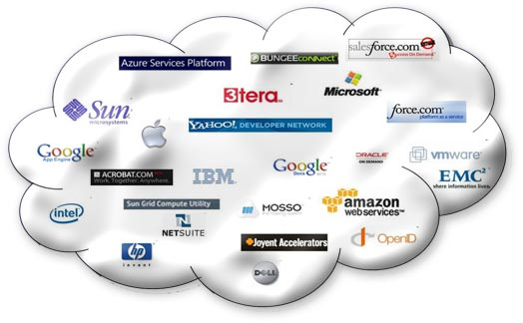
Cloud Computing – Forensic Audit
CLOUD STORAGE PROVIDING COMPANIES

Slide 83
Cloud Computing – Forensic Audit
Number of Start-Up FinTech Companies

Slide 84
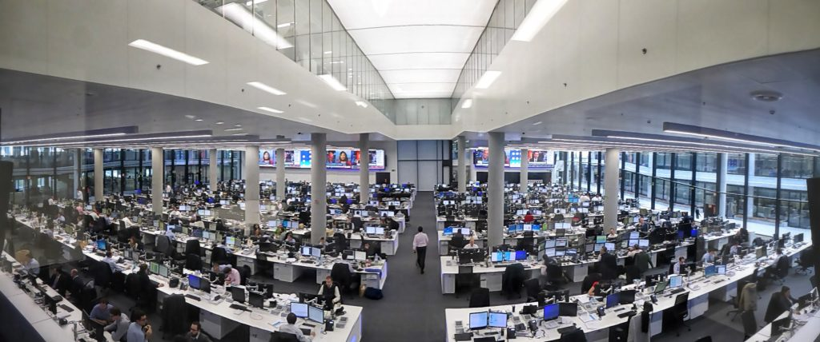
Cloud Computing – Forensic Audit
(Core Banking System)

Slide 85
Cloud Computing – Forensic Audit
Functionalities of a Cloud Auditor:
Security Audit: Systematic evaluation of a Cloud System by measuring how well it conforms to a set of established Security Criteria.
Privacy-Impact: Assessment-Systematic Assessment of a Cloud System by measuring how well it conforms to a set of established privacy-impact criteria.
These audits provide information that could be used for Internal / External compliance requirements.

Slide 86
Cloud Computing – Forensic Audit
Functionalities of a Cloud Auditor:
Performance Audit: Systematic evaluation of a cloud system by measuring how well it conforms to a set established performance criteria.
These audits provide information that could be used for Internal / External compliance requirements.

Slide 87
THANK YOU
CMA (Dr.) Puvvala Siva Rama Prasad
M.Com., MBA (Finance)., FCMA., FCS., FIIBF., FIII (Life & General)., MAIMA

