Slide 1



Module-IV : Corporate Code of Ethics Policy
CMA (Dr.) P. Siva Rama Prasad
M.Com., MBA (Finance).,FCMA., FCS., FIIBF., FIII (Life & General)

Slide 2
Corporate Code of Ethics Policy
Prevention is Better Than Cure
(It’s Easier to Stop Something Happening in the First Place than to Repair the Damage after it has Happened)
I.E.,
Corporate Code of Ethics Policy

Slide 3
Corporate Code of Ethics Policy
To Protect itself (Organization) and its Stakeholders Effectively and Efficiently from Fraud, An Organization should Understand Fraud Risk and the Specific Risks that Directly or Indirectly Apply to the Organization.

Slide 4
Corporate Code of Ethics Policy
A Structured Fraud Risk Assessment, Tailored to the Organization’s Size, Complexity, Industry, and Goals, should be Performed and Updated Periodically.

Slide 5
Corporate Code of Ethics Policy
The Assessment may be Integrated with an Overall Organizational Risk Assessment or Performed as a Stand-alone Exercise, but should, at a Minimum, include Risk Identification, Risk Likelihood and Significance Assessment, and Risk Response.

Slide 6
Corporate Code of Ethics Policy
In Risk Mitigation Process of the Organizations
‘Corporate Code of Ethics Policy’
Is
One Tool

Slide 7



CODE OF CONDUCT
AND ETHICS

Slide 8
Corporate Code of Ethics Policy
IMPORTANCE OF BUSINESS ETHICS
Today Every Business is Working in Societal Marketing Era.
So Business needs to be a Truly Acting in a way which Go beyond Profit Based Motivation.

Slide 9
Corporate Code of Ethics Policy
IMPORTANCE OF BUSINESS ETHICS
Business is for
People.
Planet and
Profit.
Companies showing Clear Commitment to Ethical Conduct Consistently outperform in Competitive Environment.

Slide 10
Corporate Code of Ethics Policy
A Code of Ethics is a Guide of Principles Designed to help Professionals Conduct Business Honestly and with Integrity.
A Code of Ethics, also referred to as an “Ethical Code" may Encompass Areas such as
Business Ethics.
A Code of Professional Practice and
An Employee Code of Conduct.

Slide 11
Corporate Code of Ethics Policy
Benefits of Ethical Business Practices:
•Ethics is Cornerstone of Corporate Governance.
• It Ensures the Sustainability (Support) of a Business.
• It Creates Goodwill and Reputation.

Slide 12
Corporate Code of Ethics Policy
Benefits of Ethical Business Practices – Contd. ..
• It Plays a Major Role in Prevention of Fraud.
• It Reduces Risks and Costs.

Slide 13
Corporate Code of Ethics Policy
Benefits of Ethical Business Practices – Contd. ..
It Creates Strong Competitive Advantage.
It Attracts More Capital and Foreign Investment.
It Increases Profits with Strong Customer Base.
It Gives International Respect for Enterprises in Emerging Market.

Slide 14
Corporate Code of Ethics Policy
Benefits of Ethical Business Practices – Contd. ..
It Attracts More Employees and enable the Company to Get the most Talented Employees.
It Enhances Leadership Skills.
It Reduces Stress for Corporate Managers and Other Employees.

Slide 15
Corporate Code of Ethics Policy
Ethisphere Announced the Designation of 128 Honourees Representing 21 Countries and 50 industries as the 2019 World’s Most Ethical Companies.
The list includes 16 first-time Honourees and Eight Organizations that have been named to the List Every Year since 2007.
Ethisphere Institute is a Organization that Defines and Measures Corporate Ethical Standards, Recognizes Companies that Excel, and Promotes Best Practices in Corporate Ethics.
USA Based Institute.

Slide 16
Corporate Code of Ethics Policy
Industries and Companies included in List:
Aerospace & Defense:
Noblis.
Automotive:
Aptiv.
Cummins.
Oshkosh.
Volvo.

Slide 17
Corporate Code of Ethics Policy
Banking:
BMO.
Fifth Third Bank.
Old National Bank.
Teachers Mutual Bank.
US Bank.

Slide 18
Corporate Code of Ethics Policy
Electronic Components:
Avnet
TE Connectivity
Western Digital

Slide 19
Corporate Code of Ethics Policy
Information Technology Services:
Hewlett Packard Enterprise.
IBM.
Leidos.
Wipro.

Slide 20
Corporate Code of Ethics Policy
Technology:
Dell.
LinkedIn.
Microsoft.

Slide 21
Corporate Code of Ethics Policy
Non-Profit Business Services:
AARP.
Payment Services:
VISA.
Master Card.

Slide 22
Corporate Code of Ethics Policy
Software Services:
CA Technologies.
Salesforce.
Teradata.

Slide 23
Corporate Code of Ethics Policy
Telecomm:
Nokia.
T-Mobile.
Vivo.

Slide 24
Corporate Code of Ethics Policy
INDIAN COMPANIES IN WORLD’S LIST:
Many reasons behind the non-existence of Indian Companies in the list of world’s most ethical companies, below are some of them:
Not Practicing the Ethical Code of Conduct.
Lack of Good Corporate Governance.
Lack in follow-up of the Unethical Practices.
Inconsistency in following the Ethical Practices.

Slide 25
Corporate Code of Ethics Policy
INDIAN COMPANIES IN WORLD’S LIST-Contd. .. :
Violation of Rules and Regulations.
Failure of maintaining Transparency in the Dealings.
Lack of Proper Communication.
Absence of Strong Legislation.
Lack of Strong Willingness of being Good Corporate Citizen.

Slide 26

CODE OF CONDUCT
Code of Conduct sets forth our Core Values, Shared Responsibilities, Global Commitments, and Promises.
It provides General Guidance about the Company’s Expectations, Highlights Situations that may require Particular Attention.
It is also the First Step for you to Get Clarity on any Questions relating to Ethical Conduct.
i

Slide 27
CODE OF CONDUCT
Each of Staff is Responsible for our own Actions and the Ethical Choice is always the Best Choice.
Review Entire Code whenever a Question on Ethical Conduct.
Confirm in Writing that EVERY STAFF MEMBER reviewed the Code, and Understand and Agree to Adhere to our Core Values, Shared Responsibilities, Global Commitments, and Promises.
i

Slide 28

Corporate Code of Ethics Policy

Slide 29

Corporates as Moral Agents
Corporate Code of Ethics Policy
Corporates are increasingly viewed as Moral Agents that are Accountable for their conduct to Stakeholders.
  Society Holds Companies Accountable for Employee Conduct, their Decisions and the Consequences.

Slide 30
Corporates as Moral Agents
Corporate Code of Ethics Policy
Laws and Regulations are necessary to provide Formal Structural Restraints (Limits) and Guidance on Ethical Issues.

Slide 31
Causes of Misconduct
Corporate Code of Ethics Policy

Slide 32
The Need for Corporate Ethics Programs
Corporate Code of Ethics Policy
Scandals in Corporates in America have Reduced Trust in Businesses.
Understanding the Factors that influence Ethical Decision-making can help Companies to Encourage Ethical Behavior.
Employees are Not Legal Experts and Need Guidance.

Slide 33
The Need for Corporate Ethics Programs
Corporate Code of Ethics Policy
Organizations should Develop an Organizational Ethics Program by
Establishing.
Communicating, and
Monitoring.
Uniform Ethical Values and Legal Requirements.

Slide 34
The Need for Corporate Ethics Programs
Corporate Code of Ethics Policy
A Strong Ethics Program includes:
  Written Code of Conduct.
  Ethics Officer to Oversee the Program.
  Care in the Delegation of Authority.
  Formal Ethics Training.
  Auditing, Monitoring, Enforcement, and Revision of Program Standards.

Slide 35

An Effective Ethics Program
Corporate Code of Ethics Policy
Helps to Ensure that all Employees Understand the Organization’s Values and Comply with the Policies and Codes of Conduct that Create its Ethical Climate.
  Cannot Assume that Employees will Know How to Behave When Entering an Organization.

Slide 36
An Ethics Program Can Help Avoid Legal Problems
Corporate Code of Ethics Policy
FSGO Encourage Companies to Assess Key Risks and Create a Program to Address them.
  An Ethics Program can Help a Firm Avoid Civil Liability.
  Company Bears the Burden of Proving that it has an Effective Program.
Federal Sentencing Guidelines for Organizations (FSGO) Apply to a Wide Range of Companies and Organizations, including Corporations, Partnerships, Workforce Unions, Pension Funds, Trusts, Non-profit Entities and Governmental Units.)

Slide 37
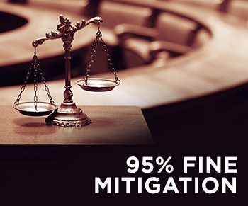
An Ethics Program Can Help Avoid Legal Problems
Corporate Code of Ethics Policy
Potential Fines can be mitigated by anything up to 95% if an organization can demonstrate that it had put in place an effective Compliance and Ethics Program.

Slide 38
An Ethics Program Can Help Avoid Legal Problems
Corporate Code of Ethics Policy
A Program Developed in the Absence of Misconduct will be more effective than one imposed as a reaction to scandal.
The Sarbanes-Oxley Act of 2002 Established New Requirements for “Corporate Governance” to Prevent Fraudulent Behavior in Business.

Slide 39
An Ethics Program Can Help Avoid Legal Problems
Corporate Code of Ethics Policy
The Sarbanes-Oxley Act of 2002 is a Federal Law that established Sweeping Auditing and Financial Regulations for Public Companies.
Lawmakers created the legislation to help Protect Shareholders, Employees and the Public from Accounting Errors and Fraudulent Financial Practices.

Slide 40
An Ethics Program Can Help Avoid Legal Problems
Corporate Code of Ethics Policy
The Term ‘Clause 49’ refers to clause number 49 of the Listing Agreement between a Company and the Stock exchanges on which it is listed (The Listing Agreement is Identical for all Indian Stock Exchanges, including the NSE and BSE).
This Clause is addition to the Listing Agreement and was inserted as late as 2000 consequent to the recommendations of the Kumar Mangalam Birla Committee on Corporate Governance Constituted by the Securities Exchange Board of India (SEBI) in 1999.

Slide 41
An Ethics Program Can Help Avoid Legal Problems
Corporate Code of Ethics Policy
As per Clause 49, for A Company with an Executive Chairman, at least 50 per cent of the Board should Comprise Independent Directors. In the case of a Company with a Non-executive Chairman, at Least one-third of the Board should be Independent Directors.
It would be necessary for Chief Executives and Chief Financial Officers to establish and maintain Internal Controls and Implement remediation and Risk Mitigation Towards Deficiencies in Internal Controls, among others.

Slide 42
An Ethics Program Can Help Avoid Legal Problems
Corporate Code of Ethics Policy
Clause VI (ii) of Clause 49 requires all Companies to submit a Quarterly Compliance Report to STOCK EXCHANGE in the prescribed form. The Clause also requires that there be a Separate Section on Corporate Governance in the Annual Report with a detailed Compliance Report.
A Company is also required to obtain a Certificate either from Auditors or Practicing Company Secretaries regarding Compliance of Conditions as Stipulated, and Annex the same to the Director's Report.

Slide 43
An Ethics Program Can Help Avoid Legal Problems
Corporate Code of Ethics Policy
The Clause mandates Composition of an AUDIT Committee; one of the Directors is required to be "Financially Literate".
It is Mandatory for all Listed Companies to Comply with the Clause.

Slide 44
Minimum Requirements for Ethics and Compliance Programs
Corporate Code of Ethics Policy

Slide 45
Values Versus Compliance Orientation
Corporate Code of Ethics Policy
Compliance Orientation:
  Requires that employees identify with and commit to specified conduct.
  Uses legal terms, statutes and contracts that teach employees the rules and penalties for non-compliance.

Slide 46
Values Versus Compliance Orientation
Corporate Code of Ethics Policy
Values Orientation:
  Focuses more on an Abstract Core of Ideals such as Respect and Responsibility.
  Research shows is most effective at Creating Ethical Reasoning.

Slide 47
Codes of Conduct
Corporate Code of Ethics Policy
Codes of Conduct:
  Formal Statements that describe what an organization expects of its employees.
Codes of Ethics:
  Most Comprehensive Document.
  Consists of General Statements that serve as Principles and the basis for the Rules of Conduct.
Statement of Values:
  Serves the General Public and Addresses Stakeholder Interests.

Slide 48
Percentage of Employees Who Identify Comprehensive Codes of Ethics and Compliance in their Companies
Corporate Code of Ethics Policy
Notes:
The prevalence of corporate codes of ethics is on the rise

Slide 49

Corporate Codes of Ethics
Corporate Code of Ethics Policy
Often Contain Six Core Values
  Trustworthiness.
  Respect.
  Responsibility.
  Fairness.
  Caring.
  Citizenship.

Slide 50

QUESTION
RESPONSE
This company can compete for the work, but the
My department is in the process of choosing a
vendor. One of my employees recommended a company owned by his sister. I have heard good things about this company from other sources. Can I consider this company even though one of my employees is related to the owner?
employee who is related to the owner cannot be
involved in decisions about choosing the vendor. Nor can the employee be involved in managing the vendor, if chosen. Your employee should also understand that he cannot provide any confidential information or other advantage to his sister that would help her company be selected. Also, you should consult your manager about any actual or apparent conflicts of interest under the circumstances, particularly where family members are involved.

Slide 51
Ethics Officers
Corporate Code of Ethics Policy
Ethics Officers or Committees are Responsible for Oversight of the Ethics / Compliance Program.
  Assess the Needs and Risks that an Ethics Program must Address.
  Develop, Revise, and Disseminate the Code.
  Conduct Training Programs for Employees.
  Develop Effective Communication.
  Establish Audits and Control Systems.
  Review and Modify the Program to Improve Effectiveness.

Slide 52
Ethics Training and Communication
Corporate Code of Ethics Policy
Must Start with a Foundation, A Code of Ethics, a Procedure for Airing Ethical Concerns, and Executive Priorities on Ethics.
  Educate Employees about Firm’s Policies and Expectations, Laws and Regulations, and General Social Standards.
  Make Employees Aware of Resources, Support Systems, and Personnel who can Assist them with Ethical Advice.
  Empower Employees.

Slide 53

Systems to Monitor and Enforce Ethical Standards
Corporate Code of Ethics Policy
An Effective Ethics Program Employs many resources to Monitor Ethical Conduct and Measure the Program’s Effectiveness:
  Observing Employees.
  Internal Audits.
  Surveys.
  Reporting Systems.
  Investigations.
  Independent Audits.

Slide 54
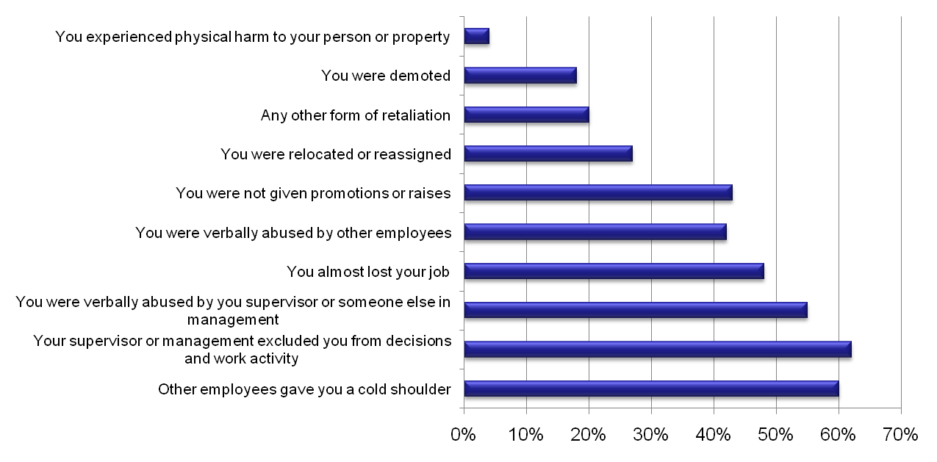
Forms of Reported Retaliation Experienced as a Result of Reported Misconduct
Corporate Code of Ethics Policy

Slide 55


Slide 56

Continuous Improvement
Corporate Code of Ethics Policy
Implementation requires Designing Activities to Achieve Organizational Objectives using available Resources and Existing Constraints.
Depends in part on How an Organization Structures Resources and activities to Achieve its Ethical Objectives.

Slide 57
Common Mistakes in
Designing / Implementing an Ethics Program
Corporate Code of Ethics Policy
Not having a Clear Understanding of the Goals of the program from the beginning.
Not setting Realistic and Measurable program objectives.
Senior Management’s Failure to take Ownership of the Ethics Program.

Slide 58
Common Mistakes in
Designing / Implementing an Ethics Program
Corporate Code of Ethics Policy
Developing Program Materials that do not Address the needs of the Average Employee.
Transferring a Domestic Program Internationally.
Designing a Program as a Series of Lectures.

Slide 59


Slide 60
What to do Next
Read the Code of Conduct.
Discussing a Workplace Problem in Next Team Meeting.
Discuss the Values to make a Major Decision.
Examine Behaviour and Challenge Misconduct in Workplace.
Discuss with HR in Developing a Values Based Organisation.
Notes:
Today was an introduction to the code of conduct, the Victorian public sector values and the behaviours that support them. There are lots of ways you can put the code into practice. Here are some. Can you suggest other ways?

Slide 61

THANK YOU
Good Night - Forensic Auditors

