Slide 1


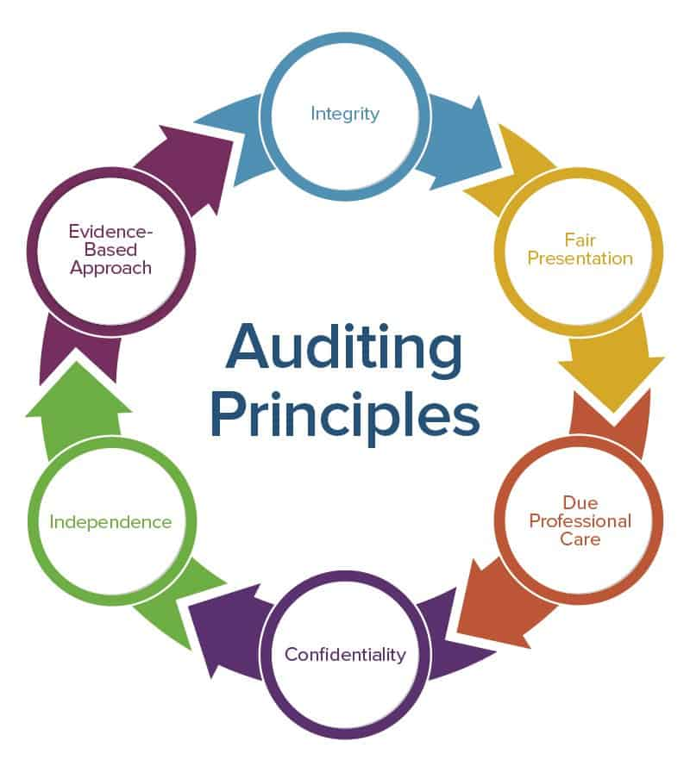

Diploma in Forensic Audit
(An Initiative of Board of Advanced Studies & Research – 2021)
Objectivity, Independence and Integrity

Slide 2
Objectivity, Independence and Integrity
Forensic Auditor - Qualifications?

Slide 3
Objectivity, Independence and Integrity
Eligibility Criteria for Forensic Auditor
CRITERIA AND TERMS & CONDITIONS FOR EMPANELMENT OF FORENSIC AUDITOR Eligibility Criteria:
Individuals/Corporates/Firms, who display exceptional professional competence in Forensic Auditing.
Member of the Institute of Chartered Accountants of India/ the Institute of Cost Accountants of India with experience, preferably having exposure in the banking sector.

Slide 4
Objectivity, Independence and Integrity
Eligibility Criteria for Forensic Auditor
CRITERIA AND TERMS & CONDITIONS FOR EMPANELMENT OF FORENSIC AUDITOR Eligibility Criteria:
Having in-depth knowledge and extensive experience in accounting and should be aware of the various practices existing in a cross-section of industries.
Having a proven track record of conducting a number of Forensic and Investigative audits and exposed/established frauds and malpractices.

Slide 5
Objectivity, Independence and Integrity
Eligibility Criteria for Forensic Auditor
CRITERIA AND TERMS & CONDITIONS FOR EMPANELMENT OF FORENSIC AUDITOR Eligibility Criteria:
Having integrity and character beyond reproach. Unblemished track record, with no unsatisfactory conduct in the past, and should have not been blacklisted by any financial institution/other organizations/any government department. The self-attested affidavit on a stamp paper in this regard should be furnished
Having branches/offices in -------- States.
The name of the Firm/Company or its promoter/partner etc. should not be in the defaulters/barred/caution list published/displayed at websites of public bodies such as by RBI/IBA/ECGC/SEBI/CICs etc

Slide 6
Objectivity, Independence and Integrity
Forensic Audit - Code?

Slide 7
Objectivity, Independence and Integrity
India will Soon Come-up with Forensic Accounting and Investigation Standards (FAIS).
As it Aims to Set Basic Quality Parameters for Conducting Investigations.

Slide 8
Objectivity, Independence and Integrity
The Institute of Chartered Accountants of India (ICAI) has constituted a Committee to deliberate on FAIS.

Slide 9
Objectivity, Independence and Integrity
“The Proposed Objectives of the FAIS are to Codify Best Practices in the Twin Domains of
Forensics and Investigations.
Set Basic Quality Benchmarks.
For Conducting Assignments in these Areas”.

Slide 10
Objectivity, Independence and Integrity
The FAIS will Comprise 30 Standards Covering All Aspects of these Domains.

Slide 11
Objectivity, Independence and Integrity
Besides Improving the Quality of such Reports and their Admissibility as Evidence in Court Proceedings, the move is expected to Benefit:
Corporate Entities.
Banks.
Regulators.
Enforcement Agencies.
Serious Fraud Investigation Office.
Economic Offence Wing and
Reserve Bank of India (RBI).

Slide 12
Objectivity, Independence and Integrity
The RBI has mandated a ‘Forensic Audit’ for Transactions over ₹.200 Crores.
While Lenders or Companies Individually call for such Audits or Investigations upon Suspected Fraud.

Slide 13
Objectivity, Independence and Integrity
“There should be Forensic Due Diligence For All Companies where Public Interest is Involved, Above A Threshold Level”.

Slide 14
Objectivity, Independence and Integrity
The ICAI plans to Consult Stakeholders, including:
The Corporate Affairs Ministry.
Reserve Bank of India.
The Securities and Exchange Board of India and
The Comptroller and Auditor General of India.
During the Course of its Deliberations.

Slide 15
Objectivity, Independence and Integrity
Few Draft Standards were released for Public Comments by ICAI.

Slide 16
Objectivity, Independence and Integrity
The Digital Accounting Assurance Board of The Institute of Chartered Accountants of India (ICAI) invites comments on the following exposure drafts of Forensic Accounting and Investigation Standards(FAIS):
Exposure Draft on Standard on Forensic Accounting and Investigation (FAIS)-110-Understanding the Nature of Engagement.
Exposure Draft on Standard on Forensic Accounting and Investigation (FAIS)-120-Understanding Fraud Risk.

Slide 17
Objectivity, Independence and Integrity
The Digital Accounting Assurance Board of The Institute of Chartered Accountants of India (ICAI) invites comments on the following exposure drafts of Forensic Accounting and Investigation Standards(FAIS):
Exposure Draft on Standard on Forensic Accounting and Investigation (FAIS)-130-Laws and Regulations.
Exposure Draft on Standard on Forensic Accounting and Investigation (FAIS)-140-Applying Hypotheses.

Slide 18
Objectivity, Independence and Integrity
Exposure Draft on Standard on Forensic Accounting and Investigation (FAIS)-220-Engagement Acceptance & Appointment.
Exposure Draft on Standard on Forensic Accounting and Investigation (FAIS)-230-Using the Work of an Expert.

Slide 19
Objectivity, Independence and Integrity
These Standards will be mandatory with Prospective effect for ICAI Members working on Forensic and Investigative Engagements, and Failure to comply will result in Disciplinary Action.

Slide 20
Objectivity, Independence and Integrity

Slide 21
Objectivity, Independence and Integrity
General Traits / Self-Code of Forensic Auditor
The Forensic Auditor should be straightforward, honest, and sincere in his approach to his professional work.
He should maintain an impartial attitude.
He should not only be independent in fact but also appear to be independent.

Slide 22
Objectivity, Independence and Integrity
Traits / Self-Code of Forensic Auditor
The Forensic auditor should maintain the confidentiality of the information acquired in the course of his work and should not disclose any such information to a third party, including the employees of the entity, without the specific authority of the management/ client or unless there is a legal or professional responsibility to do so.

Slide 23
Objectivity, Independence and Integrity
Traits / Self-Code of Forensic Auditor
The Forensic auditor should exercise due professional care, competence, and diligence expected of him while carrying out the Forensic audit.
The Forensic auditor should either have or obtain such skills and competence, acquired through general education, technical knowledge obtained through study, and formal courses, as are necessary for the purpose of discharging his responsibilities.

Slide 24
Objectivity, Independence and Integrity
Traits / Self-Code of Forensic Auditor
The Forensic auditor should carefully direct, supervise and review the work delegated to assistants.
He should be satisfied that he has no reasons to believe that he should not have relied on the work of the expert.
The Forensic auditor should document matters, which are important in providing evidence that the audit was carried out in accordance with the Standards on Forensic Audit and support his findings or the report submitted by him.

Slide 25
Objectivity, Independence and Integrity
Traits / Self-Code of Forensic Auditor
The Forensic auditor should plan his work to enable him to conduct an effective Forensic audit in a timely and efficient manner, ensuring that appropriate attention is devoted to significant areas of Forensic audit, identification of potential problems, and appropriate utilization of skills and time of the staff.
The Forensic audit plan should be based on the knowledge of the business of the entity.

Slide 26
Objectivity, Independence and Integrity
Traits / Self-Code of Forensic Auditor
A plan once prepared should be continuously reviewed by the Forensic auditor to identify any modifications to the plan required to bring the same in line with the changes, if any, to the audit universe.
The Forensic auditor should based on his professional judgment, obtain sufficient appropriate evidence to enable him to draw reasonable conclusions therefrom on which to base his opinion or findings.

Slide 27
Objectivity, Independence and Integrity
Traits / Self-Code of Forensic Auditor
Obtain an understanding of the risk management and internal control framework established and implemented by the management.
Perform steps for assessing the adequacy of the framework developed in relation to the organizational setup and structure.
Review the adequacy of the framework.

Slide 28
Objectivity, Independence and Integrity
Traits / Self-Code of Forensic Auditor
The Forensic auditor should carefully review and assess the conclusions drawn from the audit evidence obtained, as the basis for his findings contained in his report and suggest remedial action.

Slide 29
Objectivity, Independence and Integrity
Code of “Professional Conduct” is binding on all Practicing
“Forensic Auditors”

Slide 30
Objectivity, Independence and Integrity
Forensic Auditors Code of “Professional Conduct” is structured on Three Principles:
Meeting the Client’s Requirements.
Integrity, Independence, Objectivity.
Responsibility to the Profession as Forensic Auditor.

Slide 31
Objectivity, Independence and Integrity
When Applying these Fundamental Principles, Forensic Auditors must be aware that in order to retain Public Confidence they should conduct their activities in such a way that they can Demonstrate that these Principles are being Applied.

Slide 32
Objectivity, Independence and Integrity
Integrity

Slide 33
Objectivity, Independence and Integrity
It is Essential for ‘Forensic Auditors’ to retain a ‘Reputation for Integrity’.
This implies not merely Honesty but
  Trustworthiness.
  Fair Dealing and
  Truthfulness.

Slide 34
Objectivity, Independence and Integrity
Such Attributes most obviously relate to matters of Personal Advantage arising from Professional Activities.
But they are of Equal Importance in the way that Services to Clients are carried out.

Slide 35
Objectivity, Independence and Integrity
For Example, Situations occur where Opportunities Arise to Present Information in Varying Ways, which can Create Entirely Different Financial Pictures.

Slide 36
Objectivity, Independence and Integrity
Forensic Auditors must resist any pressure, for whatever reason, to Misrepresent the Facts.

Slide 37
Objectivity, Independence and Integrity
Where Professional Judgment is exercised in Circumstances that might lead to------
  Challenges, such Judgments and
  The Reasoning behind them should be Documented.

Slide 38
Objectivity, Independence and Integrity
Forensic Auditors are Expected: In Appropriate Circumstances.
To provide Advice and Comment on a Financial Matter of which they may become aware even if not invited to do so.

Slide 39
Objectivity, Independence and Integrity
Objectivity

Slide 40
Objectivity, Independence and Integrity
Objectivity is Exercised when Forensic Auditors make Judgments:
  Based upon all the available Evidence.
  Not depending on, or Influenced by, Personal Opinions or Prejudices, or
  By Inappropriate Pressure or Influence.

Slide 41
Objectivity, Independence and Integrity
Forensic Auditors may be exposed to situations that involve inappropriate pressure being exerted on them which can threaten their objectivity.

Slide 42
Objectivity, Independence and Integrity
Similarly, some relationships may allow the partiality, bias, or influence of others to threaten that objectivity.

Slide 43
Objectivity, Independence and Integrity
It is impossible to define and prescribe all such situations and relationships where these possible pressures exist.

Slide 44
Objectivity, Independence and Integrity
Reasonableness should prevail in identifying circumstances and relationships that are likely to or appear to, harm a Forensic Auditor’s objectivity.

Slide 45
Objectivity, Independence and Integrity
An inability to uphold one or more of the other fundamental principles in standards on account of circumstances or relationships would indicate a lack of objectivity.

Slide 46
Objectivity, Independence and Integrity
Forensic Auditors should not concurrently engage in any business occupation or other activity which impairs or might be perceived to harm their ability to carry out their public service role with integrity and objectivity.

Slide 47
Objectivity, Independence and Integrity
They should advise their employers of all outside interests of a financial nature and any non-financial interests which are relevant to the employment responsibilities of the Forensic Auditor.

Slide 48
Objectivity, Independence and Integrity
Many organizations operate a register for this purpose.
Forensic Auditors should be aware that a declaration of interest may not always be sufficient to remove the perception of a lack of objectivity and integrity.

Slide 49
Objectivity, Independence and Integrity
Competence and Due Care

Slide 50
Objectivity, Independence and Integrity
Forensic Auditors should stop from agreeing to perform professional services which they are not competent to carry out, whether in terms of skill or resources unless competent advice and assistance are obtained so as to enable them satisfactorily to perform such services.

Slide 51
Objectivity, Independence and Integrity
Professional Competence may be divided into two separate but related parts:
  Attainment of Professional Competence:
  The attainment of professional competence requires a high standard of general education followed by specific education, training, and examination in professionally relevant subjects, and a period of work experience.
  This is the normal pattern of development for Forensic Auditors.

Slide 52
Objectivity, Independence and Integrity
(b) Maintenance of Professional Competence:
The maintenance of professional competence requires a continuing awareness of developments in the accountancy profession including relevant national and international pronouncements on accounting, auditing, and other relevant regulations and statutory requirements.
Forensic Auditors are encouraged to demonstrate this by participating in CEP Programmes of Professional Institutes.

Slide 53
Objectivity, Independence and Integrity
Forensic Auditors should also be aware of the risks to their own and the reputation from incompetent work.

Slide 54
Objectivity, Independence and Integrity
Forensic Auditors should ensure that they meet statutory requirements, accounting, and auditing standards.

Slide 55
Objectivity, Independence and Integrity
Where the Professional Institute has issued codes of practice or there is other formal guidance, such advice should be followed.

Slide 56
Objectivity, Independence and Integrity
Confidentiality

Slide 57
Objectivity, Independence and Integrity
Forensic Auditors have an obligation to respect the confidentiality of information about an employer's or client's affairs in the course of professional services.
The duty of confidentiality continues even after the end of the relationship with the employer or client.

Slide 58
Objectivity, Independence and Integrity
Forensic Auditors should always observe confidentiality unless the specific authority has been given to disclose information or there is a legal or professional duty to disclose.

Slide 59
Objectivity, Independence and Integrity
Forensic Auditors have an obligation to ensure that staff under their control and persons from whom advice and assistance are obtained respect the principle of confidentiality.

Slide 60
Objectivity, Independence and Integrity
Confidentiality is not only a matter of disclosure of information.
It also requires that a Forensic Auditor acquiring information in the course of performing professional services shall neither use nor appear to use that information for personal advantage or for the advantage of a third party.

Slide 61
Objectivity, Independence and Integrity
In particular, a Forensic Auditor who discloses confidential information, or uses such information for her or his own purposes may in some circumstances be guilty of the offence of insider dealing.

Slide 62
Objectivity, Independence and Integrity
However there may be occasions when confidential information should be disclosed:
When disclosure is authorized - even when disclosure is authorized by employer or client, the interests of all parties, including third parties who may be affected, should be considered:
  When Disclosure is required by law – e.g., Money Laundering.

Slide 63
Objectivity, Independence and Integrity
When the Forensic Auditor has determined that confidential information should be disclosed, the following points should be considered:
Whether all the relevant facts are known and substantiated, to the extent it is practical to do so; when the situation involves unproven fact or opinion, professional judgment should be used in determining the type of disclosure to be made, if any.

Slide 64
Objectivity, Independence and Integrity
The extent of communication; in particular the Forensic Auditor should be satisfied that the parties to whom the communication is addressed are appropriate recipients and have the responsibility to act on it.

Slide 65
Objectivity, Independence and Integrity
In all such circumstances, the Forensic Auditor should consider the need to take professional legal advice and/or consult with an appropriate organization before disclosing.

Slide 66
Objectivity, Independence and Integrity
Confidentiality should not be used unnecessarily by Forensic Auditors in their own work', as this can give rise to the perception that breaches of the fundamental ethical principles are being hidden.

Slide 67
Objectivity, Independence and Integrity
Forensic Auditors are expected, in appropriate circumstances, to provide advice and comment on a financial matter of which they may become aware even if not invited to do so.

Slide 68
Objectivity, Independence and Integrity
Proper Conduct

Slide 69
Objectivity, Independence and Integrity
Forensic Auditors must not engage in conduct, whether in chase of their profession or otherwise, which would discredit, be prejudicial to, or likely to diminish public confidence in them in their professional capacity, or the Audit profession.
They should also promote fundamental ethical principles through leadership and example.

Slide 70
Objectivity, Independence and Integrity
A Forensic Auditor who has evidence of professional misconduct by another Forensic Auditor should take necessary steps to protect the public, the profession, the employer, and the other Forensic Auditor.
Before taking any action a Forensic Auditor should establish the facts and any report of misconduct must be honest and sustainable.

Slide 71
Objectivity, Independence and Integrity
If Forensic Auditor break the law, this diminishes public confidence.
The severity and nature of the offence would have to be taken into account in determining its impact on the profession.

Slide 72
Objectivity, Independence and Integrity
Proper conduct also covers behavior.
Forensic Auditors should conduct themselves with courtesy and consideration towards all with whom they come into contact during the course of performing their work.
A Forensic Auditor shall carry out professional work in accordance with the technical and professional standards relevant to the work.

Slide 73
Objectivity, Independence and Integrity
Questions?

Slide 74


THANK YOU
Good Night - Forensic Auditors

