Slide 1




Diploma in Forensic Audit
(An Initiative of Board of Advanced Studies & Research – 2021)
Anti-bribery Management System - ABMS

Slide 2

Anti-bribery Management System - ABMS
Small Amounts of Bribery Cases become/turn into BIG Frauds if Organization is not controlled/arrested at the Root Level.

Slide 3
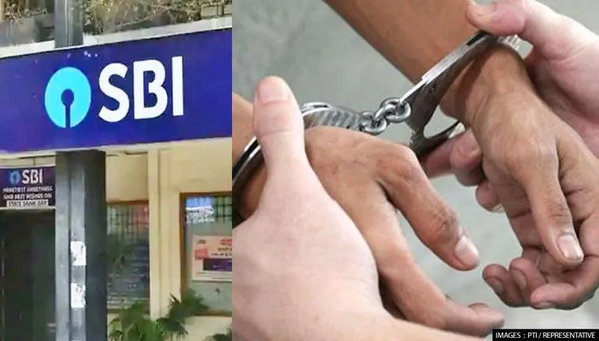
Anti-bribery Management System - ABMS
CBI Arrests Amaravati-based SBI Home Loan Sales Executive, His Accomplice In Bribery Case: The Central Bureau of Investigation (CBI) on Saturday (Yesterday) arrested a Home Loan Sales Executive working for the State Bank of India in Amravati and his accomplice for allegedly demanding a Bribe of ₹.20,000 for Processing and Sanctioning of Top-up Loan on the Transfer of Home Loan Account from Equitas Small Finance Bank to SBI, even though the Complainant had urged to Transfer the Loan to ICICI Bank.

Slide 4
Anti-bribery Management System - ABMS
Delhi: CBI arrests Sub-inspector in bribery case, recovers over ₹ 1 Crore Cash.
The CBI arrested a Sub-inspector in a bribery case in New Delhi. The cop was caught red-handed while accepting a bribe of ₹ 50,000.

Slide 5
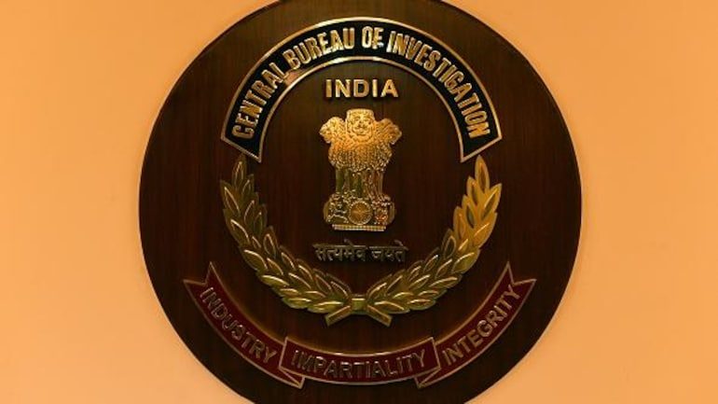
Anti-bribery Management System - ABMS
CBI Arrests Two Indian Army Personnel, IAF’s Civilian Officer in separate Bribery Cases.
The CBI arrested Two Indian Army Personnel and an IAF’s Civilian Officer in Separate Cases for Demanding and Accepting Bribes.

Slide 6
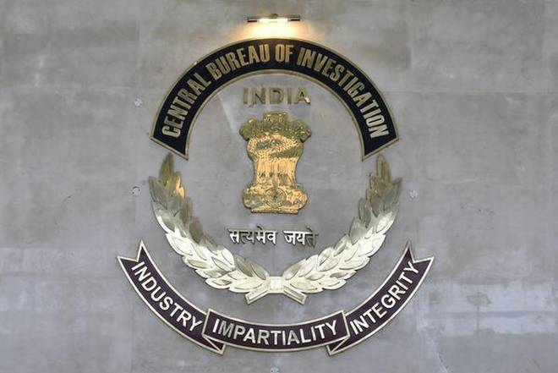
Anti-bribery Management System - ABMS
CBI Arrests 4 Bhopal FCI Staffers in Bribery Case.
The Central Bureau of Investigation (CBI) has arrested four officials, including a Divisional Manager and Two Managers, of the Food Corporation of India’s Bhopal Division in a Bribery Case.

Slide 7

Anti-bribery Management System - ABMS
Cognizant Looks To Settle Indian Bribery Case For $95M.
Cognizant Technology Solutions and the plaintiffs in the case, stopping from an alleged $2 million bribe two of the Company’s Top Executives Authorized a Contractor to Pay to Senior Indian Government Officials, are now looking to the District Court handling the case to Sign-off on their $95 million settlement.

Slide 8
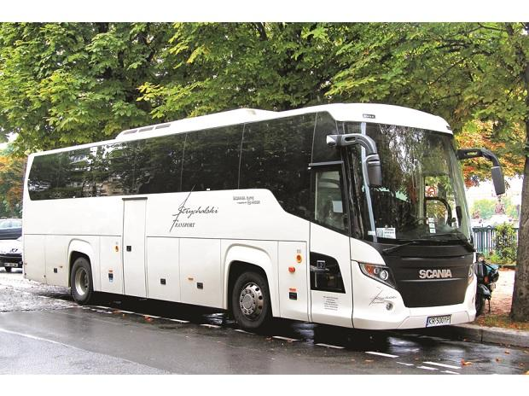
Anti-bribery Management System - ABMS
Volkswagen's Scania Uncovers Suspected Bribery for India Bus Contracts.
US Justice Department’s External Monitor related to its Diesel-Emissions Scandal was informed of the Case a Year Ago.

Slide 9

Anti-bribery Management System - ABMS
Corruption is Dishonest or Fraudulent Conduct by those in Power, Typically involving Bribery.
Bribery is offering, giving, or receiving Anything of Value with the Intention of Inducing a person to Act or to Reward a Person for having Acted.

Slide 10
Anti-bribery Management System - ABMS
Bribery
Bribery refers to the conduct of dishonestly influencing one’s position or role to receive something as well as promising something favorable to the party demonstrating such benefit.

Slide 11
Anti-bribery Management System - ABMS
Bribery
There are few problems where bribery arises, not always in such a role/position to offer anything.
When one acts beyond his Authority, it Obstructs the Company’s Profits and interests, which is Illegal to do so. (Delegation of Financial Powers in the Organization-DFP).

Slide 12
Anti-bribery Management System - ABMS
Conflict Of Interest
Anything on a related note, including Bribery, that is done to gain Personal Profit, and which is Unfavorable to the Company. (Mostly in Purchase Contracts-Without Tender System etc. – Not on L1 Quote).
‘By this Conducts ‘Forms’ the Objective of a Forensic Audit’

Slide 13
Anti-bribery Management System - ABMS
Bribery is often viewed as a “Necessary” Evil that Facilitates Business and Expedites Work (Some Officials School of Thought).

Slide 14
Anti-bribery Management System - ABMS
This perception is not only wrong, but it also places a heavy Burden on People, Economies, and Society as a Whole (It increase the Cost of Business Operations).
Loss of Business and Fines resulting from Bribery and Fraud, and associated Reputational Damage, can be severely detrimental to companies, causing Billions in Lost Revenue. (Image Risk to the Organization)

Slide 15
Anti-bribery Management System - ABMS
This Begs the Question:
Is your organization willing to work with a Company that has been embroiled in a bribery scandal? (Generally, the Answer is NO).
Such Organizations may face Harsh Penalties by Regulatory Bodies and Studies show that Employee Morale Suffers when individuals in their organization are found Guilty of Bribery. (Attrition Rate will Increase).

Slide 16
Anti-bribery Management System - ABMS
Taking steps to Prevent Unethical Practices in the workforce is therefore essential to establish Trust. (Immediate Step)
ISO 37001:2016, Anti-bribery Management Systems-Requirements with Guidance for Use, is designed to Help an Organization Implement and maintain a Proactive Anti-bribery System.

Slide 17
Anti-bribery Management System - ABMS
ISO is an Independent, Non-governmental International Organization with a Membership of 165 National Standards Bodies.
International Organization for Standardization
ISO Central Secretariat
Chemin de Blandonnet 8
CP 401 - 1214 Vernier, Geneva, Switzerland
India is a Member Body
Bureau of Indian Standards
Manak Bhavan
9 Bahadur Shah Zafar Marg
New Delhi 110002
India

Slide 18
Anti-bribery Management System - ABMS
Its Flagship Guidance Presents Globally Recognized Best Practices to:
Prevent. (Measures)
Detect and (Process)
Deal with Bribery at all Levels of an Organization. (Punishments)

Slide 19
Anti-bribery Management System - ABMS
Responding to the Growing Threat of Bribery and Corruption:
The International Organization for Standardization (ISO) and
United Nations Industrial Development Organization (UNIDO)
Have Joined Forces and will help users of ISO 37001:2016 create a Culture of Integrity and Compliance in their Workforce.

Slide 20
Anti-bribery Management System - ABMS
Section 177 of the Companies Act, 2013 mandates Certain Organizations to create a Vigil Mechanism which shall be Overseen by Audit Committee consisting of Board Members.
The Companies must take a Proactive Approach whereby they:
“Develop Anti-Bribery and Corruption Policies, Procedures, and Compliance Programs”.

Slide 21
Anti-bribery Management System - ABMS
The Institute of Company Secretaries of India published Corporate Anti-Bribery Code on the occasion of its Golden Jubilee Year Celebrations on 4th October 2017 at Vigyan Bhawan, New Delhi.
To Strengthened by the Support of 125 Crore Indians, India has become one of the bright spots in the Global Economy.

Slide 22
Anti-bribery Management System - ABMS
Incidents

Slide 23
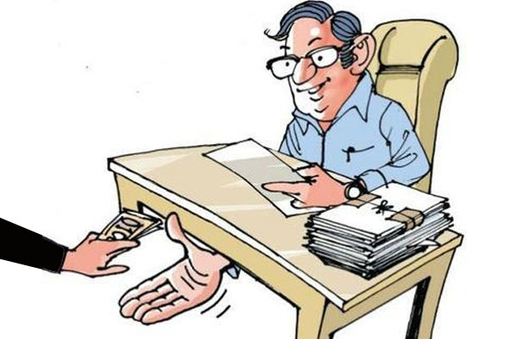
Anti-bribery Management System - ABMS
Rules Governing Government Officials:
According to the Rules of Conduct Governing Government Servants, they are Not to Accept or Permit Members of their Families (or other Persons acting on their Behalf) to Accept Gifts.
The expression “Gifts” includes free transport, boarding, lodging or other services, or any other pecuniary advantage provided by any person other than a near relative or personal friend with no official dealings with the civil servant.

Slide 24
Anti-bribery Management System - ABMS
Rules Governing Government Officials:
Acceptance of gifts needs to be well regulated on occasions such as Weddings, Anniversaries, Funerals, Religious Functions, transfers, and Retirement when the presentation of Gifts (including Gifts from their own Staff) is in conformity with prevailing Religious and Social Practices. A report should be submitted to the Government by Civil Servant if the value of such gifts exceeds the laid down limits defined on the basis of the Grade of Post of the Person.

Slide 25

Anti-bribery Management System - ABMS
Case:
Prosecution for the presentation of Expensive Gifts:
A large multinational company was prosecuted by the regulator for violating transnational bribery laws by presenting expensive gifts and offering extravagant hospitality to secure the sale of its products.

Slide 26
Anti-bribery Management System - ABMS
Case:
These expenses were improperly recorded by its subsidiaries and joint ventures, which paid for these. In addition, the subsidiaries also made payments to vendors for fictitious services to create a “Slush” fund for providing lavish entertainment to government officials to secure contracts. The company was charged with violating the laws and was found for a significant amount as a penalty.

Slide 27

Anti-bribery Management System - ABMS
Case:
Arrest for Small Payment made:
There is no degree in bribery and corruption-a small bribe may expose you to risk. There are reported instances of government officers being arrested for accepting bribes as small as INR 1,000. For instance, a forest officer was arrested for accepting a bribe of INR 1,000 from two people.

Slide 28

Anti-bribery Management System - ABMS
Case:
Arrest for Small Payment made:
He had demanded this bribe to not charge them an illegal collection of firewood, since they had been found by him in a forest. In another instance, an officer of the State Electricity Department was arrested for accepting a bribe of INR 1,000 for processing a request to replace a damaged transformer.

Slide 29

Anti-bribery Management System - ABMS
What happens if an Executives pay a bribe out of his pocket?
The regional head of a multinational company was suspended for paying INR 1,000 in cash to an Electricity Board Official. There was a sudden electricity outage. The Regional head rushed to the site and immediately paid an amount from his funds.

Slide 30

Anti-bribery Management System - ABMS
What happens if an Executives pay a bribe out of his pocket?
He paid the amount to restore continuous electricity supply and save the diesel cost of running the generators.
He did not claim the amount as reimbursement. However, as soon as the company came to know of this event, he was immediately suspended.

Slide 31

Anti-bribery Management System - ABMS
Indian Coal Allocation Scam–2012– ₹.1,86,000 Crore.
While many think that the 2G scam remains the biggest one in size in India. But this coal allocation scam dwarfs it by the amount involved.
This scam is in regards to the Indian Government’s allocation of the Nation’s Coal Deposit to PSU’s and Private Companies. The scam happened and came out in 2012.

Slide 32
Anti-bribery Management System - ABMS
Indian Coal Allocation Scam – 2012 – 1,86,000 Crore
The basic premise of this scam was the Wrongful allocation of Coal Deposits by the Government without resorting to competitive bidding, which would have made huge amounts to the Government (to the tune of ₹.1.86 Lakh Crore). However, the coal deposits were allocated arbitrarily.

Slide 33
Anti-bribery Management System - ABMS

Slide 34
Anti-bribery Management System - ABMS
Anti-bribery Management System (ABMS)

Slide 35
Anti-bribery Management System - ABMS
An Anti-bribery Management System (ABMS) signifies a Deep Commitment to Ethical Behaviour that helps an organization to function well, increase its Reputation and Avoid Potential Bribery Risks.

Slide 36
Anti-bribery Management System - ABMS
Involvement in Corruption can lead to Reputational Damage and Loss of Credentials.
Therefore, Antibribery Management is an Essential Component of an Organization.

Slide 37
Anti-bribery Management System - ABMS
Being aware that bribery has become a Significant Risk, and that many organizations consider it as the Easiest Path to Penetrate the Market, International Conventions require taking the Necessary Steps to Prevent it, and to increase awareness Worldwide about the Damages that an organization might Confront if Involved. (Market Share)

Slide 38
Anti-bribery Management System - ABMS
Aim of ABMS

Slide 39
Anti-bribery Management System - ABMS
The Aim of the International Standard is to support the establishment of a worldwide culture that Combats Bribery and Enhances Trust and Confidence in the Business World, as well as in Institutions.
This is the reason; Preventing Bribery is becoming a Global Initiative, starting from Individual Awareness to Organizations that have a Responsibility to Contribute to Bribery Prevention.

Slide 40
Anti-bribery Management System - ABMS
This target can only be met through
Commitment.
Transparency, and
Compliance.
With the “Anti-bribery Management System” framework, which has been set forth in the ISO 37001 Standard.

Slide 41
Anti-bribery Management System - ABMS
The term “Bribery” refers to any:
Offering.
Giving.
Accepting or
Promising Advantages with any Value or Bribe.
In order to influence the decision, action, or judgment of persons in charge of duty.

Slide 42
Anti-bribery Management System - ABMS
20 Countries Where Bribery In Business Is Common Practice
Rank | Country | % of Public Firms Receiving Bribe Requests
1 | Cambodia | 69.4%
2 | Yemen | 64.3%
3 | Kyrgyzstan | 59.8%
4 | DR Congo | 56.5%
5 | Ukraine | 50.4%
6 | South Sudan | 48.0%
7 | Bangladesh | 47.7%
8 | Afghanistan | 46.8%
9 | Myanmar | 42.9%
10 | Iraq | 37.3%
11 | Laos | 37.3%
12 | Morocco | 37.2%
13 | Tajikistan | 36.3%
14 | Mongolia | 33.4%
15 | Madagascar | 32.9%
16 | Moldova | 31.0%
17 | Pakistan | 30.8%
18 | Burundi | 30.3%
19 | Mauritania | 28.9%
20 | Nigeria | 28.9%

Slide 43
Anti-bribery Management System - ABMS
An Overview of ISO 37001-2016

Slide 44
Anti-bribery Management System - ABMS
ISO 37001 was published in 2016 and is the international standard for anti-bribery management systems.
The standard is designed to assist organizations in implementing and maintaining specific measures which assist them in preventing, detecting, and addressing bribery across the organization and its business activities.

Slide 45
Anti-bribery Management System - ABMS
The Role of the International Organization for Standardization is to Promote International Co-ordination and the Standardization of International Standards.
By facilitating International Standards, they Contribute to the Development of Organizations that operate in Compliance with the Standard.

Slide 46
Anti-bribery Management System - ABMS
Considering that, bribery has become a Significant Risk, ISO took the initiative to establish an “Anti-bribery Management System” that can be Certified, Aligned or Integrated with “Existing Management Systems” in order to Combat this “Rising Threat to Businesses and Institutions Worldwide”.

Slide 47
Anti-bribery Management System - ABMS
What is an Anti-bribery Management System?

Slide 48
Anti-bribery Management System - ABMS
An Anti-bribery Management System is the Establishment of a Closed-Loop Control Architecture that Establishes, Implements Maintains, Reviews, and Improves Management Strategies and Objectives that Address the Specific Requirements of ISO 37001 Standard.
Even though the Nature of an Organization Differs from One another, these Standard Addresses Management Objectives for the Prevention of Bribery.

Slide 49
Anti-bribery Management System - ABMS
In the following Contexts:
Bribery in the Public, Private and Not-for-Profit Sectors.
Bribery by the Organization.
Bribery by the Organization’s Personnel Acting on the Organization’s behalf or for its Benefit.
Bribery by the Organization’s Business Associates Acting on the Organization’s behalf or for its Benefit.

Slide 50
Anti-bribery Management System - ABMS
In the following Contexts:
Bribery of the Organization.
Bribery of the Organization’s Personnel in relation to the Organization’s Activities.
Bribery of the Organization’s Businesses Associates in relation to the Organization’s Activities.
Direct and Indirect Bribery.

Slide 51
Anti-bribery Management System - ABMS
ISO 37001 Applied to ‘All Types and Sizes’ of Organizations

Slide 52
Anti-bribery Management System - ABMS
ISO 37001 Applies to All Types and Sizes of Organizations that Wish to:
Implement the Necessary Measures Designed to prevent, detect and address bribery.
Promote Trust and Confidence for the Shareholders, Key Stakeholders, and Potential Investors.
Avoid and/or Minimize the Cost, Risk, and Damage of involvement in Bribery.
Mitigate Risks and achieve Reputational Notoriety by implementing Anti-bribery Management System Policies.

Slide 53
Anti-bribery Management System - ABMS
Key Clauses of ISO 37001:2016

Slide 54
Anti-bribery Management System - ABMS
Key Clauses of ISO 37001:2016
Scope.
Normative References.
Terms and Definitions.
Context of the Organization.
Leadership.

Slide 55
Anti-bribery Management System - ABMS
Key Clauses of ISO 37001:2016
Planning for the Anti-bribery Management System - ABMS.
Support.
Operation.
Performance Evaluation.
Improvement.

Slide 56
Anti-bribery Management System - ABMS
Clause 4: Context of the Organization

Slide 57
Anti-bribery Management System - ABMS
Clause 4: Context of the Organization:
An Organization is a person or Group of People that has its own functions with responsibilities, authorities, and relationships to achieve its objectives, such as a company, corporation, firm, enterprise, authority, partnership, charity or institution, or part or combination thereof, whether incorporated or not, public or private.

Slide 58
Anti-bribery Management System - ABMS
Clause 4: Context of the Organization:
In order to implement the Anti-bribery Management System, FIRST we should understand the organization and its context, understand the needs and expectations of the stakeholder, determine the Scope of the Anti-bribery Management System, Anti-bribery Management System, and Bribery Risk Assessment.

Slide 59
Anti-bribery Management System - ABMS
Clause 5: Leadership

Slide 60
Anti-bribery Management System - ABMS
Clause 5: Leadership:
A Governing Body (or Top Management if the Organization Does not have a Governing Body) of an organization shall demonstrate leadership and Commitment in respect to the Anti-bribery Management System.

Slide 61
Anti-bribery Management System - ABMS
Clause 5: Leadership:
Approving Anti-bribery Policies of the Organization.
Ensuring that the Organization’s Strategy and Anti-bribery Policy are Aligned.
Receiving and Reviewing Information related to the Content and Operation of the Anti-bribery Management System of the Organization at Planned Intervals.

Slide 62
Anti-bribery Management System - ABMS
Clause 5: Leadership:
Ensuring that Adequate and Appropriate Resources are allocated and assigned for an Effective Operation of the Anti-bribery Management System.
Ensuring that Appropriate Investigation and Remediation actions were taken into action and effectively documented.
Exercising reasonable oversight over the implementation of the organization’s ABMS by Top Management and its Effectiveness.

Slide 63
Anti-bribery Management System - ABMS
Clause 6: When Planning an Anti-bribery Management System

Slide 64
Anti-bribery Management System - ABMS
Clause 6: Planning When Planning an Anti-bribery Management System, the Organization shall refer to:
External and Internal Factors are Determined in Context.
Requirements of Stakeholders as Determined.
Bribery Risk Assessment and its Effective Control.
Opportunities for Improvement.

Slide 65
Anti-bribery Management System - ABMS
Clause 7: Support

Slide 66
Anti-bribery Management System - ABMS
Clause 7-Support:
The Organization shall provide the Necessary Resources needed for the
Establishment.
Implementation.
Maintenance and
Continual Improvement.
Of the Anti-bribery Management System.

Slide 67
Anti-bribery Management System - ABMS
Clause 7-Support:
Moreover, the organization shall determine competent persons to perform an Anti-bribery Management System framework along with its policies within the organization, and provide training and appropriate awareness to the personnel, including business associates acting on its behalf or for its benefit, and which could pose more than a low bribery risk to the organization.

Slide 68
Anti-bribery Management System - ABMS
Clause 8: Operation

Slide 69
Anti-bribery Management System - ABMS
Clause 8: Operation:
The Organization Shall-----
Plan.
Implement.
Monitor, and
Control
The processes needed to meet the requirements of the Anti-bribery Management System and to implement actions to address bribery risks and opportunities.

Slide 70
Anti-bribery Management System - ABMS
Clause 8: Operation:
The Organization shall Control and Review any planned or unintended changes and shall take action to mitigate any adverse effect, if necessary.
Moreover, Procedures that Prevent the Offer, Provision, or Gift Acceptance and Similar Benefits shall be Implemented because these could be Perceived as Bribery.

Slide 71
Anti-bribery Management System - ABMS
Clause 9: Performance Evaluation

Slide 72
Anti-bribery Management System - ABMS
Clause 9: Performance Evaluation
The Organization shall Monitor, Measure, Analyze and Evaluate Anti-bribery Policies. However, before Completing that, the Organization shall Determine:
What needs to be monitored?
What methods shall be used to ensure valid results?
When monitoring and measuring shall be performed?
How it is documented?

Slide 73
Anti-bribery Management System - ABMS
Clause 10: Improvement

Slide 74
Anti-bribery Management System - ABMS
Clause 10:
Improvement:
The Organization shall react Towards any Non-conformity that occurs by taking action to Control, Correct, and deal with Consequences.

Slide 75
Anti-bribery Management System - ABMS
Clause 10:
Improvement:
Moreover, the Organization shall Evaluate the need for Action to Eliminate the causes of Non-conformities by reviewing, determining the cause, and determining if similar Non-conformities exist or could Potentially Occur.
The Reason behind evaluating the need for action to Eliminate the Causes of Non-conformities is to Prevent the Recurrence of Non-conformities.

Slide 76
Anti-bribery Management System - ABMS
‘Key Business Benefits’ of Adopting the ISO 37001

Slide 77
Anti-bribery Management System - ABMS
Prevent, Detect and Address Bribery Risks:
Increased opportunity of Detecting Bribery Risk.
Efficient Mechanisms to Prevent and Address Bribery Risk.
General Improvement of Risk Assessment.

Slide 78
Anti-bribery Management System - ABMS
Prevent, Detect and Address Bribery Risks: Contd. ..
Gains Market Trust, improving its Reputation and Image.
Manages its Business Risks, including those Related to Third Parties.
Investigating Bribery Internally before the Incident comes to the Public.
Revenue Growth and Cost Savings.
Corporate Social Responsibility.

Slide 79
Anti-bribery Management System - ABMS
Increase International Recognition:
The International Organization for Standardization (ISO) is recognized worldwide as the authority on Anti-bribery Management.
Conformity to other Industry Standards.
Compliance with National and International Laws.

Slide 80
Anti-bribery Management System - ABMS
Prevent Conflict of Interest:
Awareness of Consequences if involved in Bribery.
General Improvement in the Effectiveness of the organization.
Improved Financial Performance.
Increased Opportunity for Detecting Fraud and Due Diligence.

Slide 81
Anti-bribery Management System - ABMS
Cost Reduction:
Control of Financial Statement.
Efficient Mechanisms to Track Transactions.
Transparent, Straightforward and Manageable Processes with a Clear Responsibility.
Implement a Robust Investigation Methodology and Due Diligence.
Develop Appropriate Documentary Maintenance and Review.

Slide 82
Anti-bribery Management System - ABMS
Promotes an Anti-bribery Culture:
Better Awareness of ABMS and Anti-bribery Culture.
General Improvement among Personnel.
General Improvement of Employee Performance.
Ethical Values within an Organization can be promoted among Industries and Markets.
Influence of the Common Social Processes in the Society via Self-regulatory Organizations and Civilian Control.

Slide 83
Anti-bribery Management System - ABMS
To Sum Up

Slide 84
Anti-bribery Management System - ABMS
To Sum Up:
ISO 37001 was published in 2016 and is the international standard for anti-bribery management systems.
The standard is designed to assist organizations in implementing and maintaining specific measures which assist them in preventing, detecting, and addressing bribery across the organization and its business activities.

Slide 85
Anti-bribery Management System - ABMS
This could include:
Bribery activities conducted by the organization.
Bribery activities conducted against the organization.
ISO 37001 certification is applicable to any size organization across the globe regardless of business activities and industry, and can easily be integrated into an existing management system.

Slide 86


THANK YOU
Good Night - Forensic Auditors

