Slide 1



Diploma in Forensic Audit
(An Initiative of Board of Advanced Studies & Research – 2021)
Ethical Hacking

Slide 2
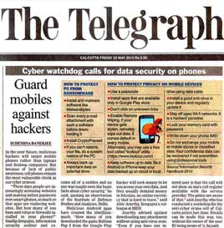
Ethical Hacking

Slide 3
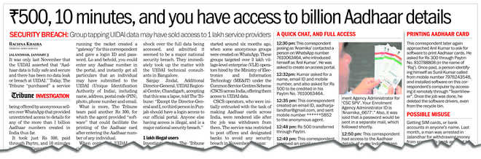
Ethical Hacking

Slide 4
Ethical Hacking
The Bank NSP Case
One of the leading cybercrime cases is the Bank NSP case is the one where a Management Trainee of the Bank was engaged to be married.
The couple exchanged many emails using the Bank computers.
After some time the two broke up and the Girl created fraudulent email ids such as “Indian Bar Associations" and sent emails to the Boy's foreign clients.

Slide 5
Ethical Hacking
The Bank NSP Case – Contd..
She used the Bank’s Computer to do this.
The Boy’s Bank lost a large number of clients and took the Bank to Court.
The Bank was held liable for the emails sent using the Bank’s System.

Slide 6
Ethical Hacking
The Bank NSP Case
Best Email Security Practices in 2021:
Use a Strong email password. ...
Use Two-Factor authentication. ...
Monitor Your Email habits. ...
Look out for “Phishing Emails” ...

Slide 7
Ethical Hacking
The Bank NSP Case
Best Email Security Practices in 2021:
Don’t Open Attachments without Scanning them first. ...
Never access Emails from public WiFi. ...
Change Your Password as often as possible. ...
Be careful with the Devices You Use.

Slide 8
Ethical Hacking
The Bank NSP Case
Why is CAPTCHA important?
One of the most important reasons for CAPTCHA is to defend against ad spammers who promote their scams in comments on web pages.
By requiring all users to negotiate the CAPTCHA authentication, administrators can filter out spammers who attempt to automate their activities.

Slide 9
Ethical Hacking
Cyber Attack on Cosmos Bank
In August 2018, the Pune branch of Cosmos bank was drained of ₹. 94 crores, in an extremely Bold Cyber Attack.
By Hacking into the main server, the Thieves were able to Transfer the money to a Bank in Hong Kong.

Slide 10
Ethical Hacking
Cyber Attack on Cosmos Bank – Contd. ..
Along with this, the Hackers made their way into the ATM Server, to gain details of various VISA and Rupay Debit Cards.
The ATM Switching System i.e. the link between the Centralized System and the Payment Gateway was attacked, meaning Neither the Bank nor the Account holders Caught wind of the Money being Transferred.

Slide 11
Ethical Hacking
Cyber Attack on Cosmos Bank-Contd. …..
According to the Cybercrime Case Study Internationally, a Total of 14,000 Transactions were carried out, Spanning Across 28 Countries using 450 cards.
Nationally, 2,800 transactions using 400 cards were carried out.
This was one of its kind, and in fact, the First Malware Attack that Stopped all Communication between the Bank and the Payment Gateway.

Slide 12
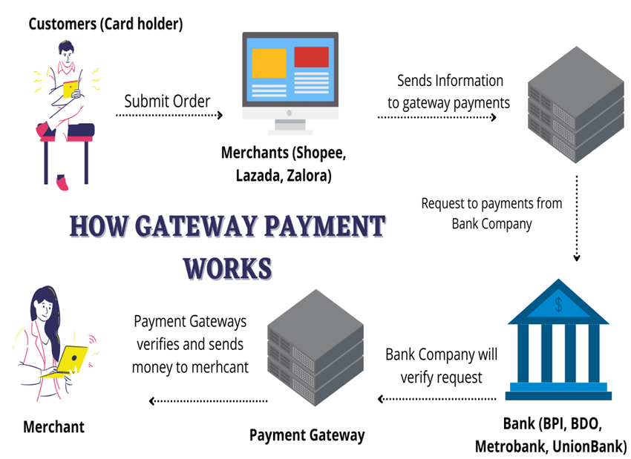
Ethical Hacking

Slide 13
Ethical Hacking
Best Online Payment Gateways in India
Citrus Pay Payment Gateway is one of the top payment gateways in India today..
CCAvenue Payment Gateway. ...
PayUBiz India Payment Gateway. ...
Direcpay Payment Gateway. ...
Zaakpay Payment Gateway. ...
Instamojo Payment Gateway. ...
Bill Desk. ...
Atom Paynetz Payment Gateway.

Slide 14
Ethical Hacking
BPO Fraud
In another incident involving MphasiS, India, four call center employees gained the PIN codes, from four of MphasiS’s clients, Citi Group, in spite of not being authorized to do so.
Various accounts were opened in Indian banks, under false names, and within two months, they managed to transfer money to these accounts from Citigroup customers’ accounts using their PINs and other personal information.

Slide 15
Ethical Hacking
BPO Fraud
This cyber fraud case and the Indian police were able to identify the individuals to make an arrest.
It was made possible with a Tip provided by a U.S. Bank when the accused tried to withdraw cash from these fake accounts.
From the $426,000 that was stolen, only $230,000 was recovered.
The accused were charged under Section 43(a), unauthorized access involved to carry transactions.

Slide 16
Ethical Hacking
Section 43A of the Information Technology Act, 2000
Compensation for Failure to Protect Data.
Where a body Corporate, Possessing, Dealing, or Handling any Sensitive Personal Data or information in a Computer resource which it owns, controls or operates, is negligent in implementing and maintaining reasonable security practices and procedures and thereby causes wrongful loss or wrongful gain to any person, such body corporate shall be liable to pay damages by way of compensation to the person so affected.

Slide 17
Cloud Computing

Slide 18
Cloud Computing
IT Function (In House)
Capital Expenditure - (Servers, Fixtures & Fittings, UPS / DRM / BCP / DC etc.) - IRR.
Recurring Expenditure – Firmware, Software, Humanware (Attrition Rate), Annual Maintenance Costs (AMC), Memory Management Costs.

Slide 19
Cloud Computing
IT Function (In House) – Contd.. ..
Technology Obsolescence (Hardware and Software).
Depreciation – Software-100% and Hardware – 33.33%.

Slide 20
Cloud Computing
In-house IT Function Vs. Hiring of IT Function
Supervision & Control Costs (Department / Function) / Risk Management Function.
Compliances – Cyber Laws – IT Act, 2000.
Virus Attacks / Cyber Frauds.

Slide 21
Cloud Computing
In-house IT Function Vs. Hiring of IT Function - Contd.. ..
Business Expansion.
Shutdown Costs / No salvage Value.

Slide 22
Cloud Computing
Cloud Computing is an:
  “On-demand Delivery” of Compute, Storage, Applications, and other IT Infrastructure.
  With Metered Payment based on Usage.

Slide 23
Cloud Computing
Cloud Computing (CC) provides to Business Organizations:
  Reinvent and “Optimise” relationship with Technology.
  For “Quickening” Go-to-Market.

Slide 24
Cloud Computing
Cloud Computing (CC) helps to Business Organizations: - Contd.. ..
  Increasing ‘Stakeholder Value’ and ‘Customer Experiences’.
  Reducing Overhead Costs / Capital Expenditure.

Slide 25
Cloud Computing
The Services of adoption of Cloud Computing are: - Contd.. ..
Capital Expenditure / Variable Expenses.
Benefit from Massive Economies of Scale.

Slide 26
Cloud Computing
The Services of adoption of Cloud Computing are: - Contd.. ..
Access to Greater Service Breadth and Depth.
Increase Speed and Agility (Move Quickly & Easily).

Slide 27
Cloud Computing
The Services of adoption of Cloud Computing are: - Contd.. ..
Global Footprint.
Security and Compliances.

Slide 28
Cloud Computing
The Services of adoption of Cloud Computing are: - Contd.. ..
Carbon Footprint.
Business Continuity.

Slide 29
Cloud Computing
The Services of adoption of Cloud Computing are: - Contd.. ..
Improved Performance.
Reduced Software Costs.
Instant Software Updates.

Slide 30
Cloud Computing
The Services of adoption of Cloud Computing are: - Contd.. ..
Unlimited Storage Capacity.
Latest Versions Availability.

Slide 31

Application of Cloud Computing in Business Research
(Core Banking System)

Slide 32
Ethical Hacking
IT Security:
Security is the condition of being protected against danger or loss.
In the general sense, security is a concept similar to safety.
In the case of networks, the security is also called information security.
Information security means protecting information and information systems from unauthorized access, use, disclosure, disruption, modification, or destruction.

Slide 33
Ethical Hacking
Need for Security: Computer Security is required because most organizations can be damaged by hostile software or intruders.
There may be several forms of damage that are interrelated which are produced by the intruders.

Slide 34
Ethical Hacking
These include:
Loss of confidential data.
Damage or destruction of data.
Damage or destruction of the computer system.
Loss of reputation of a company.

Slide 35
Ethical Hacking
Ethical Hacking

Slide 36
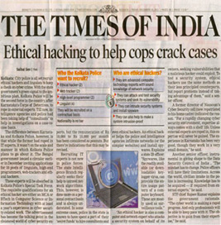
Ethical Hacking

Slide 37
Ethical Hacking
Ethical hacking involves an authorized attempt to gain unauthorized access to a computer system, application, or data.
Carrying out an ethical hack involves duplicating strategies and actions of malicious attackers.
This practice helps to identify Security Vulnerabilities that can then be resolved before a malicious attacker has the opportunity to exploit them.

Slide 38
Ethical Hacking
Today more and more software is developing and people are getting more and more options in their present software.
But many are not aware that they are being hacked without their knowledge.

Slide 39
Ethical Hacking
One reaction to this state of affairs is a behaviour termed “Ethical Hacking" which attempts to pro-actively increase security protection by identifying and repairing known security vulnerabilities on systems owned by other parties.
A good ethical hacker should know the methodology chosen by the hacker like investigation, host or target scanning, gaining access, maintaining access, and clearing tracks.

Slide 40
Ethical Hacking
For ethical hacking, he should know about the various tools and methods that can be used by a black hat hacker apart from the methodology used by him.
From the point of view of the user, one should know at least some of these because some hackers make use of those who are not aware of the various hacking methods to hack into a system.

Slide 41
Ethical Hacking
Also, when thinking from the point of view of the developer, he should be aware of these since he should be able to close holes in his software even with the usage of the various tools.
With the advent of new tools, hackers may make new tactics.
But at least the software will be resistant to some of the tools.

Slide 42
Ethical Hacking
Ethical hacking also known as penetration testing or white-hat hacking, involves the same tools, tricks, and techniques that hackers use, but with one major difference that Ethical hacking is legal.
Ethical hacking is performed with the target’s permission.
Ethical hacking intends to discover vulnerabilities from a hacker’s viewpoint so systems can be better secured.

Slide 43
Ethical Hacking
It’s part of an overall information risk management program that allows for ongoing security improvements.
Ethical hacking can also ensure that vendors’ claims about the security of their products are legitimate.

Slide 44
Ethical Hacking
Hacking: Eric Raymond, Compiler of “The New Hacker's Dictionary”, defines a hacker as a clever programmer.
A “Good Hack" is a clever solution to a programming problem and “Hacking" is the Act of doing it.

Slide 45
Ethical Hacking
Raymond lists Five Possible Characteristics that Qualify one as a Hacker are:
A person who Learning Details of a Programming Language or system.
A person who Actually does Programming rather than just Theorizing about it.
A person capable of appreciating someone else’s Hacking.
A person Who picks up Programming quickly.
A person Who is an expert at a particular programming language or system

Slide 46
Ethical Hacking
What is an ethical hacker?

Slide 47
Ethical Hacking
Also known as “White Hats,” Ethical Hackers are Security Experts that perform these security assessments.
The Proactive Work they do helps to improve an organization’s security posture.
With Prior Approval from the organization or Owner of the IT Asset / System, the mission of ethical hacking is opposite to malicious hacking.

Slide 48
Ethical Hacking
Types of Hackers

Slide 49
Ethical Hacking
Types of Hackers:
Hackers can be broadly classified on the basis of why they are hacking system or why they are indulging hacking.
There are mainly three types of hacker on this basis
Black-Hat Hacker
A black hat hackers or crackers are individuals with extraordinary computing skills, resorting to malicious or destructive activities.
That is black hat hackers use their knowledge and skill for their own personal gains probably by hurting others.

Slide 50
Ethical Hacking
White-Hat Hacker
White hat hackers are those individuals professing hacker skills and using them for defensive purposes.
This means that the white hat hackers use their knowledge and skill for the good of others and for the common good.

Slide 51
Ethical Hacking
Grey-Hat Hackers
These are individuals who work both offensively and defensively at various times.
We cannot predict their behavior.
Sometimes they use their skills for the common good while in some other times he uses them for their personal gains.

Slide 52
Ethical Hacking
What are the Key Concepts of ethical hacking?

Slide 53
Ethical Hacking
Hacking Experts follow Four Key Protocol concepts:
Stay Legal: Obtain proper approval before accessing and performing a Security Assessment.
Define the Scope: Determine the Scope of the Assessment so that the Ethical Hacker’s Work remains Legal and Within the Organization’s Approved Boundaries.

Slide 54
Ethical Hacking
Hacking Experts follow Four Key Protocol concepts:
Report Vulnerabilities: Notify the organization of all vulnerabilities discovered during the assessment. Provide remediation advice for resolving these vulnerabilities.
Respect Data Sensitivity: Depending on the Data Sensitivity, Ethical Hackers may have to Agree to a Non-disclosure Agreement, in addition to other terms and conditions required by the assessed organization.

Slide 55
Ethical Hacking
How are Ethical Hackers
Different than Malicious Hackers?

Slide 56
Ethical Hacking
Ethical Hackers use their Knowledge to secure and Improve the Technology of Organizations.
They provide an Essential Service to these Organizations by looking for vulnerabilities that can lead to a security breach.
An ethical hacker reports the identified vulnerabilities to the organization.
Additionally, they provide remediation advice. In many cases, with the organization’s Consent, the Ethical Hacker Performs a Re-Test to ensure the vulnerabilities are Fully Resolved.

Slide 57
Ethical Hacking
Malicious Hackers Intend to Gain Unauthorized Access to a Resource (The more Sensitive the Better) for Financial Gain or Personal Recognition.
Some Malicious Hackers Deface Websites or Crash Backend Servers for Fun, Reputation Damage, or to cause Financial Loss.
The Methods used and Vulnerabilities found remain unreported. They aren’t concerned with improving the organization’s security posture.

Slide 58
Ethical Hacking
What Skills and Certifications should an Ethical Hacker Obtain?

Slide 59
Ethical Hacking
An Ethical Hacker should have a wide range of Computer Skills.
They often Specialize, becoming Subject Matter Experts (SME) in a particular Area within the Ethical Hacking Domain.

Slide 60
Ethical Hacking
All Ethical Hackers should have:
Expertise in Scripting Languages.
Proficiency in Operating Systems.
A Thorough Knowledge of Networking.
A Solid Foundation in the Principles of Information Security.

Slide 61
Ethical Hacking
Some of the Most Well-known and Acquired Certifications include:
EC Council: Certified Ethical Hacking Certification.
Offensive Security Certified Professional (OSCP) Certification.
CompTIA Security+.
Cisco’s CCNA Security.
SANS GIAC.

Slide 62
Ethical Hacking
What problems does hacking identify?

Slide 63
Ethical Hacking
While assessing the security of an organization’s IT asset(s), ethical hacking aims to simulator an attacker.
In doing so, they look for attack vectors against the target.
The initial goal is to perform an investigation, gaining as much information as possible.

Slide 64
Ethical Hacking
Once the ethical hacker gathers enough information, they use it to look for vulnerabilities against the asset.
They perform this assessment with a combination of automated and manual testing. Even sophisticated systems may have complex countermeasure technologies which may be vulnerable.

Slide 65
Ethical Hacking
They don’t stop at uncovering vulnerabilities.
Ethical hackers use exploits against the vulnerabilities to prove how a malicious attacker could exploit it.

Slide 66
Ethical Hacking
Some of the most common vulnerabilities discovered by ethical hackers include:
Booster Attacks.
Broken Authentication.
Security Misconfigurations.
Use of components with known Vulnerabilities.
Sensitive Data Exposure.

Slide 67
Ethical Hacking
After the testing period, ethical hackers prepare a detailed report.
This documentation includes steps to compromise the discovered vulnerabilities and steps to patch or mitigate them.

Slide 68
Ethical Hacking
What are some limitations of ethical hacking?

Slide 69
Ethical Hacking
Limited scope. Ethical hackers cannot progress beyond a defined scope to make an attack successful.
However, it’s not unreasonable to discuss out-of-scope attack potential with the organization.

Slide 70
Ethical Hacking
Resource constraints. Malicious hackers don’t have time constraints that ethical hackers often face. Computing Power and Budget are additional constraints of ethical hackers.
Restricted Methods. Some organizations ask experts to Avoid Test Cases that lead the Servers to Crash (e.g., Denial of Service (DoS) attacks).

Slide 71
Ethical Hacking
Skills required for Ethical Hackers

Slide 72
Ethical Hacking
Required Skills of an Ethical Hacker:
Microsoft: skills in operation, configuration and management.
Linux: Knowledge of Linux/Unix; security setting, configuration, and services
Firewalls: configurations, and operation of intrusion detection systems.

Slide 73
Ethical Hacking
Required Skills of an Ethical Hacker:
Routers: knowledge of routers, routing protocols, and access control lists
Network Protocols: TCP/IP; how they function and can be manipulated (Transmission Control Protocol).
Project Management: leading, planning, organizing, and controlling a penetration testing team.

Slide 74
Ethical Hacking
Disadvantages of Ethical Hackers

Slide 75
Ethical Hacking
Disadvantages:
All depends upon the trustworthiness of the ethical hacker.
Hiring professionals is expensive.

Slide 76
Ethical Hacking
BUSINESS NEWS RBI Hires ‘Ethical Hackers’ to Check Cyber Security Vulnerabilities of Banks
In the first phase of this initiative, the Central Bank-constituted Team will Focus on Public Sector Units.

Slide 77


THANK YOU
Good Night - Forensic Auditors

