Slide 1
INTRODUCTION TO REGRESSION
Compiled by
Prof.. Gautam Bandyopadhyay

Slide 2



Example
Price of a House
Rs. 5,00,000
?
Rs. 15,00,000

Slide 3
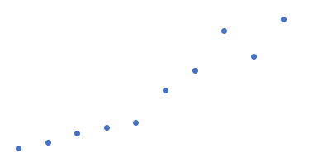
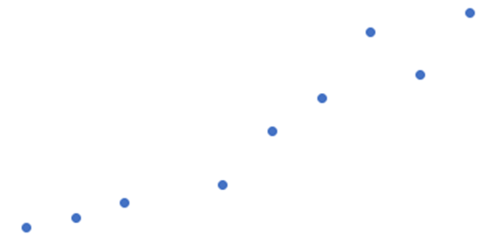



Cont….
20
What is the expected price of the house?
1)6 lakhs
2)8 lakhs
3)12 lakhs
Price
15
10
5
?
Size of the house

Slide 4
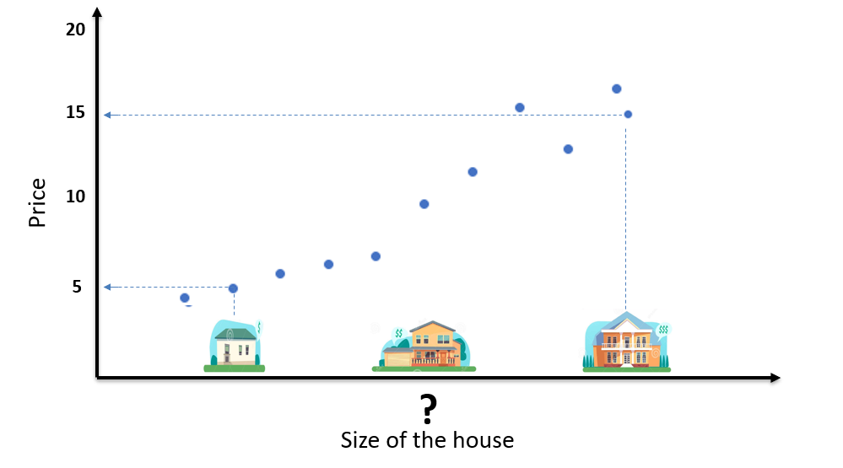
Cont….

Slide 6

Linear Regression

Slide 7
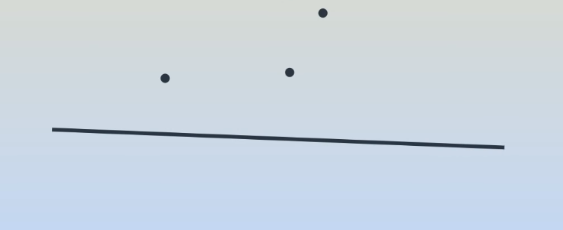
Linear Regression(Cont..)

Slide 8
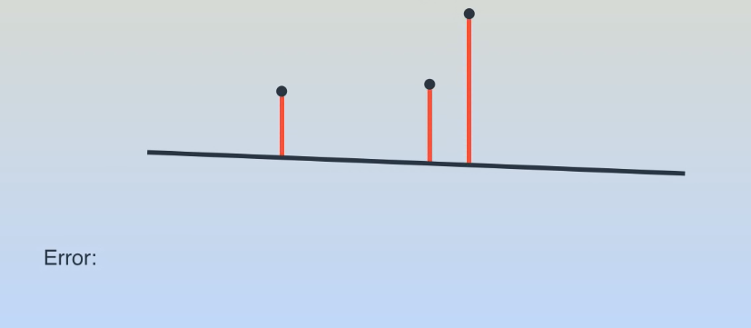
Cont..

Slide 9
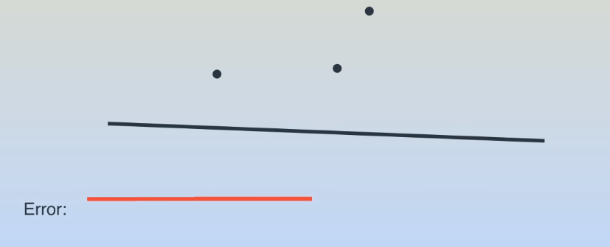
Cont..

Slide 10
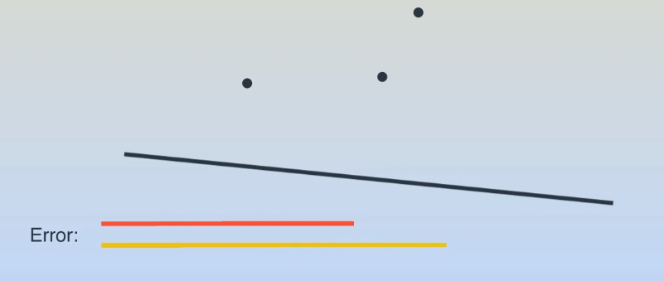
Cont..

Slide 11
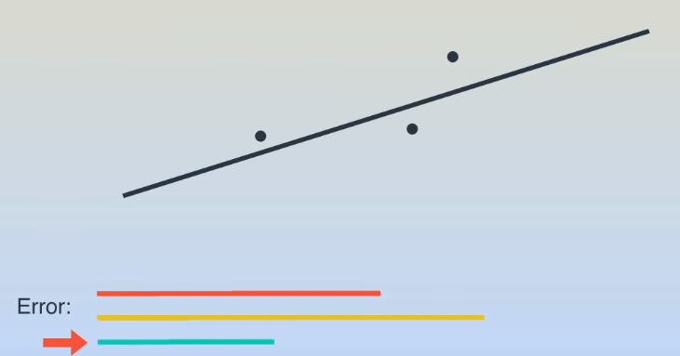
Cont..

Slide 12
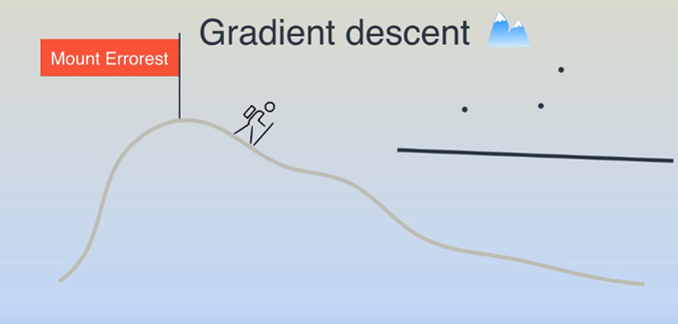
Gradient Descent
Mountain Peak

Slide 13
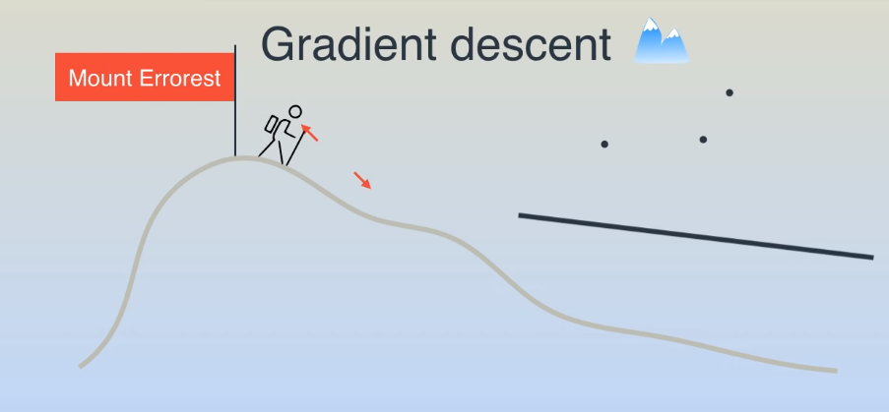
Gradient Descent
Mountain Peak

Slide 14
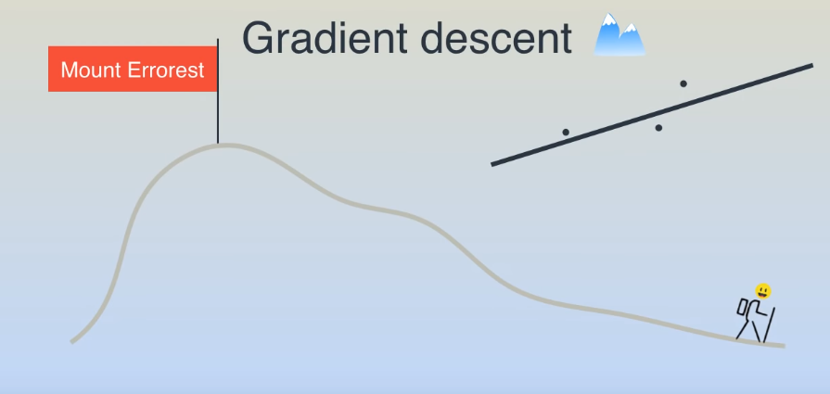
Gradient Descent
Mountain Peak

Slide 15
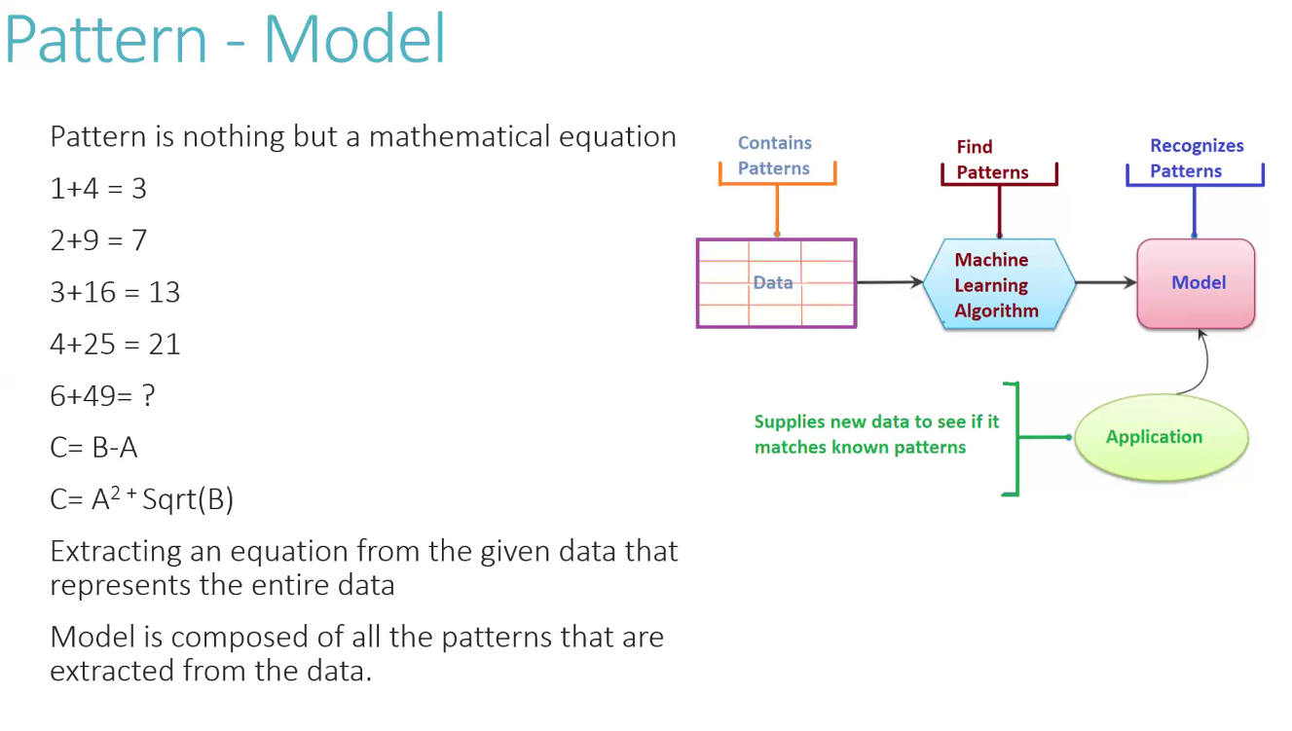

Slide 16
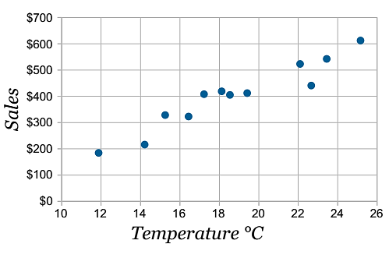
A Typical Example: Regression

Slide 17
Improvement – Stage I

Slide 18
Improvement – Stage II

Slide 19
Improvement – Stage III

Slide 20
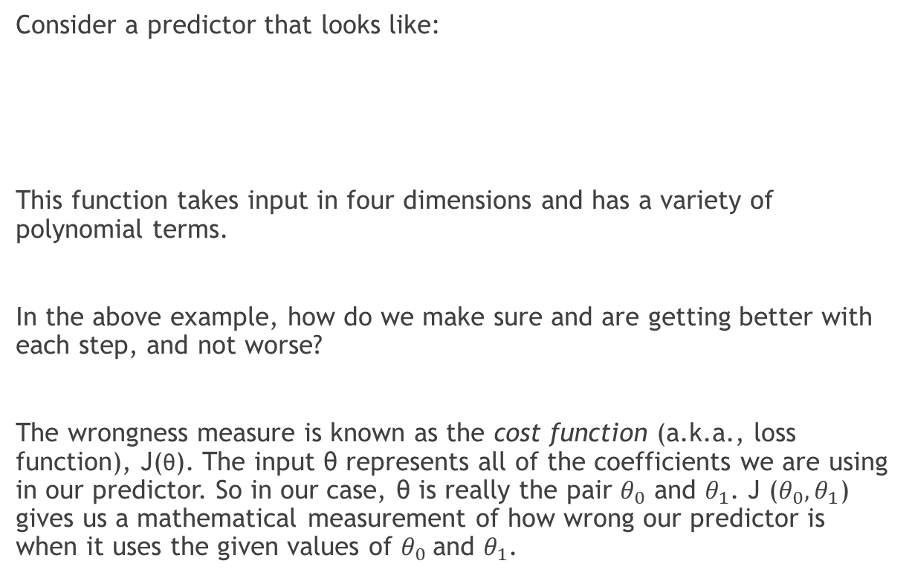
Level of Complexity
Consider a predictor that looks like:
This function takes input in four dimensions and has a variety of polynomial terms.
In the above example, how do we make sure and are getting better with each step, and not worse?
The wrongness measure is known as the cost function (a.k.a., loss function), J(θ). The input θ represents all of the coefficients we are using in our predictor. So in our case, θ is really the pair $θ_{0}$ and $θ_{1}$. J ($θ_{0},θ_{1}$) gives us a mathematical measurement of how wrong our predictor is when it uses the given values of $θ_{0}$and $θ_{1}$.

