Slide 1
Download SPSS & AMOS trail Version

Slide 2
Follow the Steps :

Slide 3
SPSS Download (Trail Version)

Slide 4
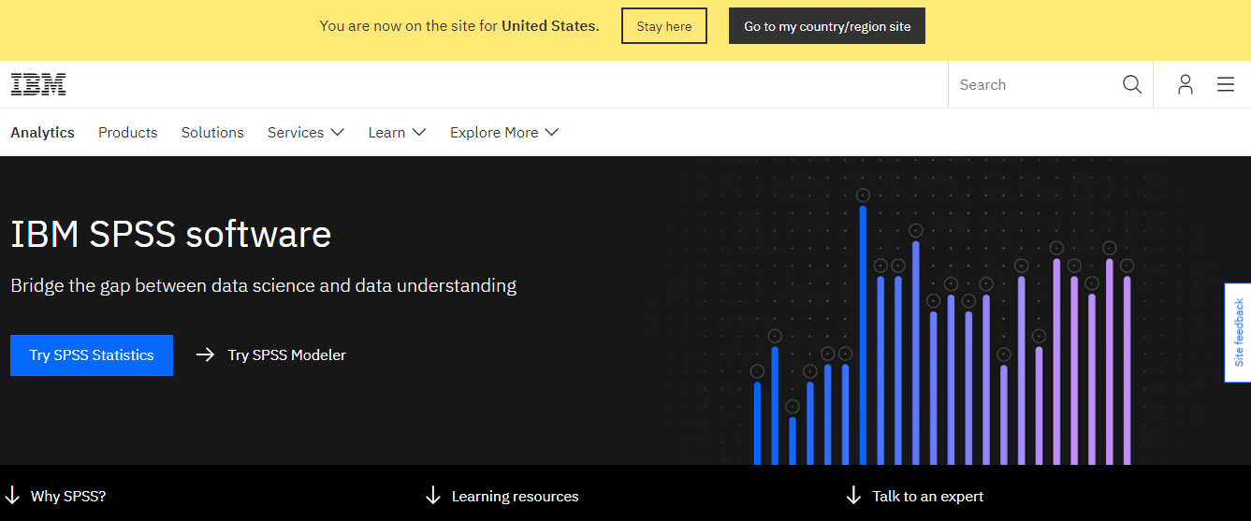
Go to the Website:
https://www.ibm.com/analytics/spss-statistics-software

Slide 5
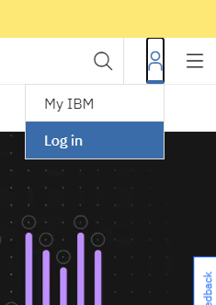
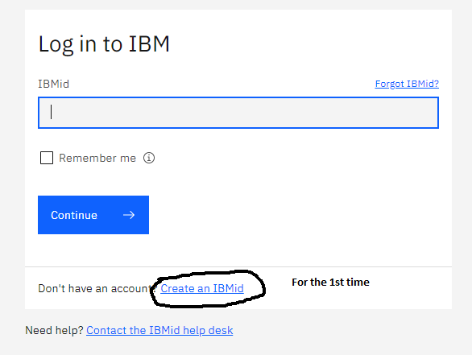

Slide 6
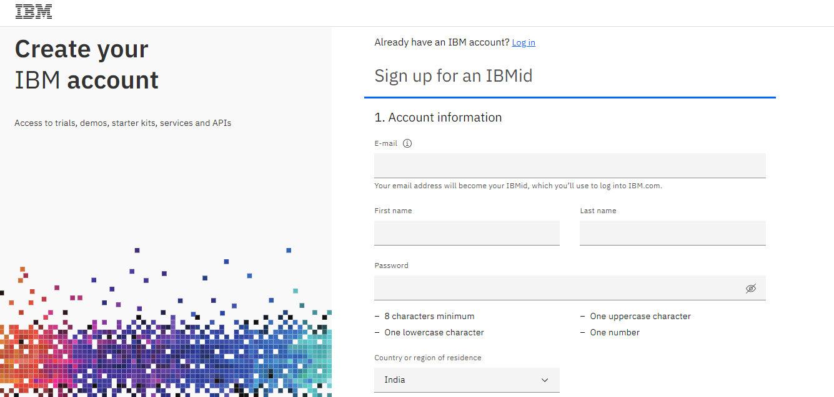

Slide 7
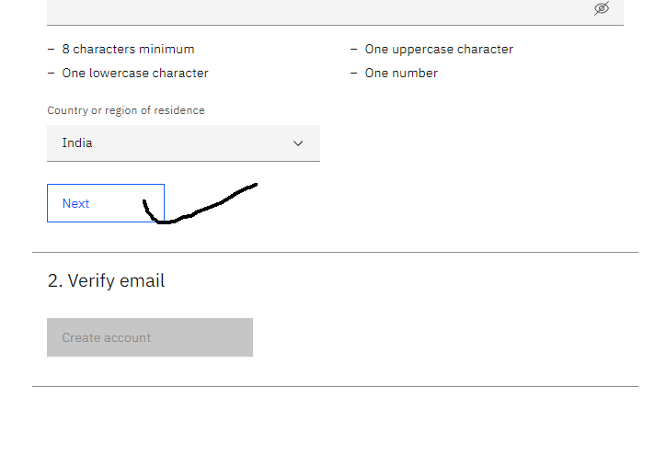
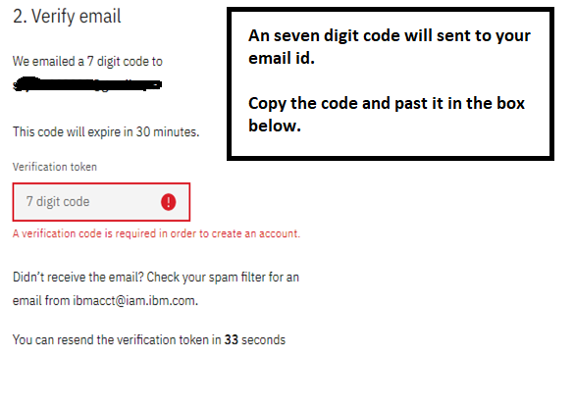

Slide 8
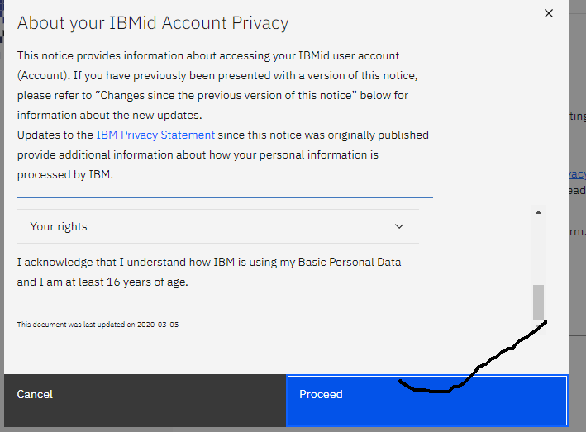
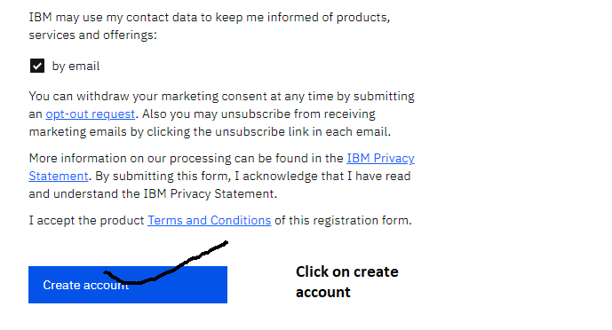

Slide 9
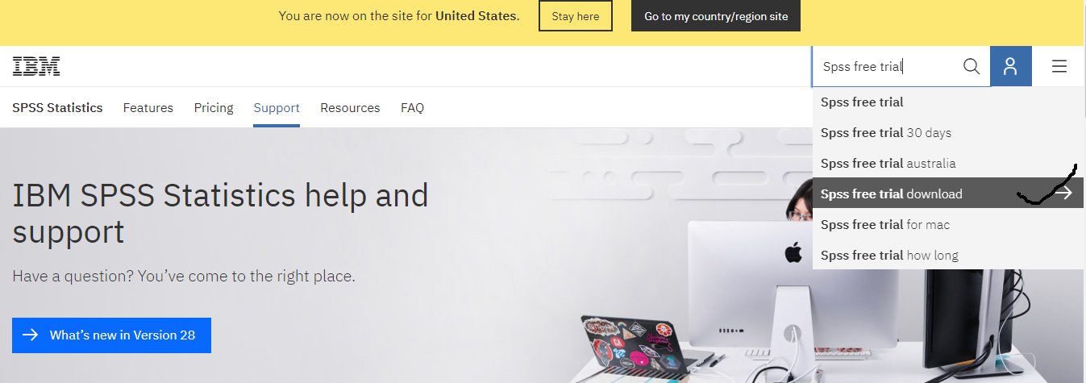

Slide 10
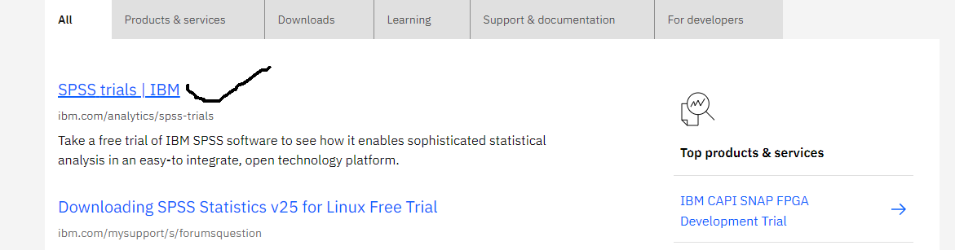
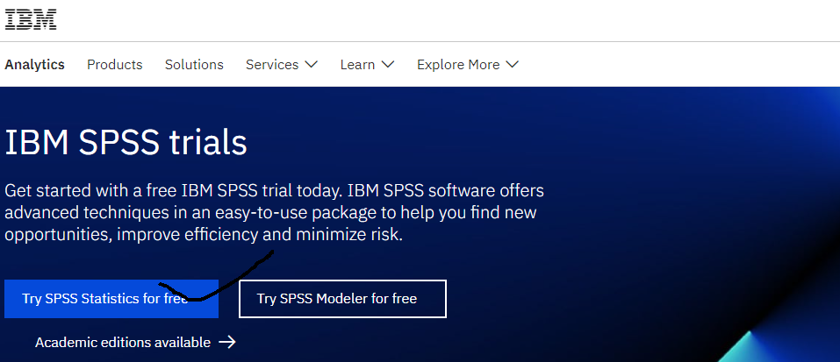
Click
Click

Slide 11
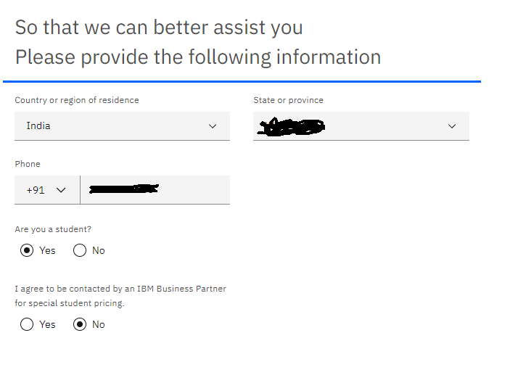
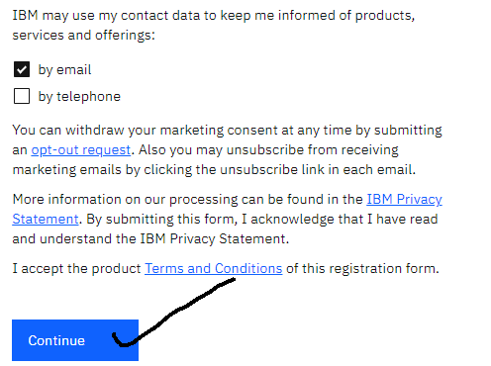
After the last step
A new page will open and you have give the appropriate state name and phone no and the appropriate radio button and check box as shown in the figure below:

Slide 12
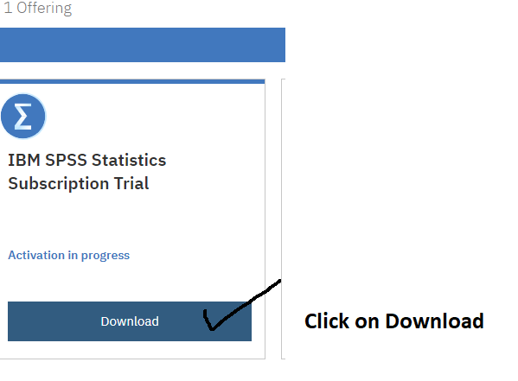
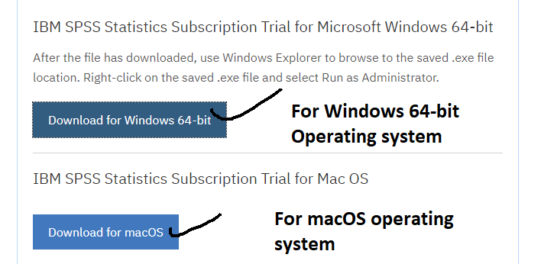
After clicking on “ Download for Windows 64-bit”, your download will start automatically.

Slide 13
Download “AMOS” trail Version

Slide 14
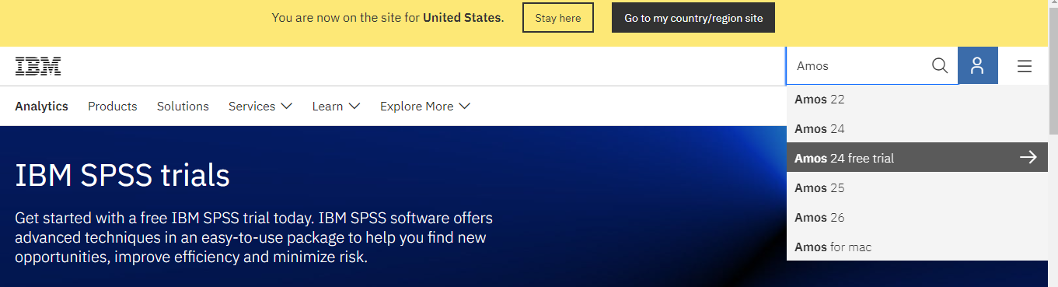
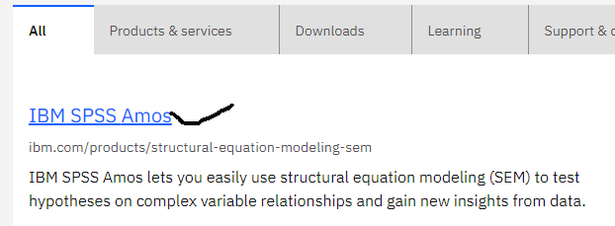
For Amos type “Amos”.
Search

Slide 15
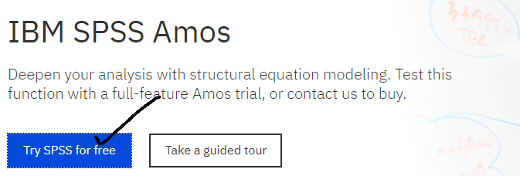
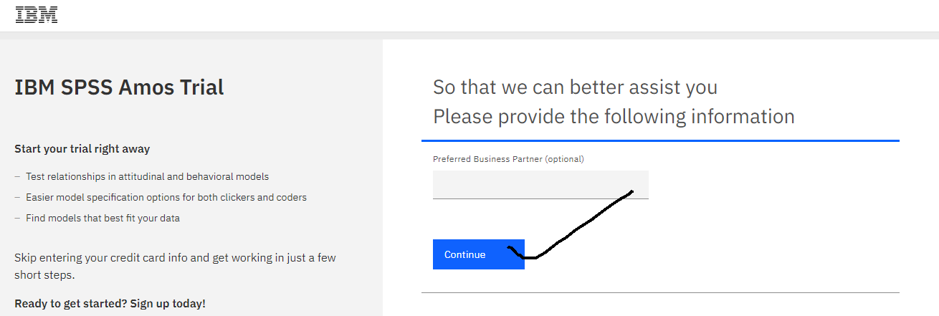
Click on Try SPSS for free. A new Page will open ,shown below:

Slide 16
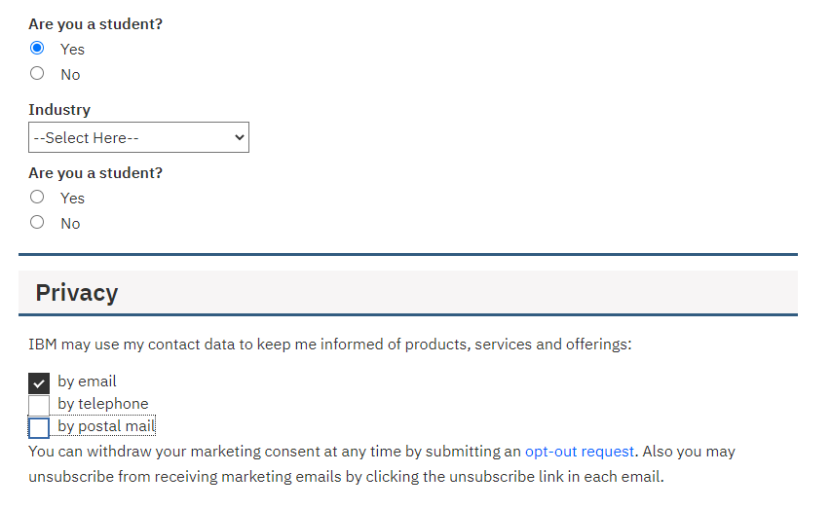
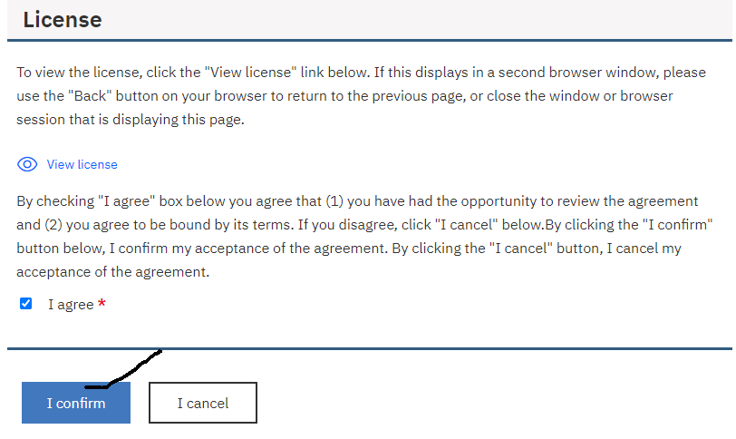
Choose the appropriate check box and radio button.
Then click on “I confirm”.

Slide 17
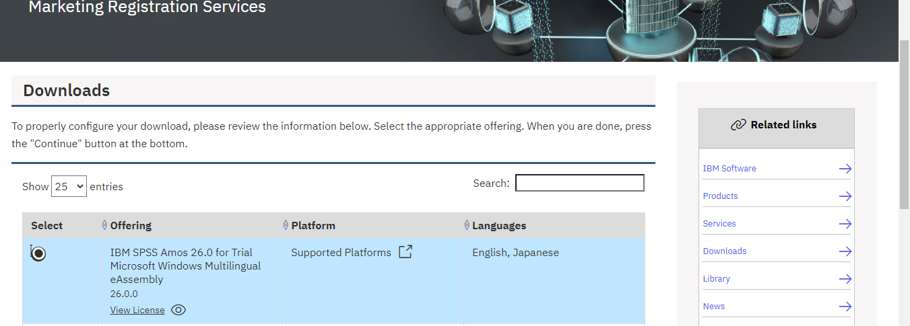
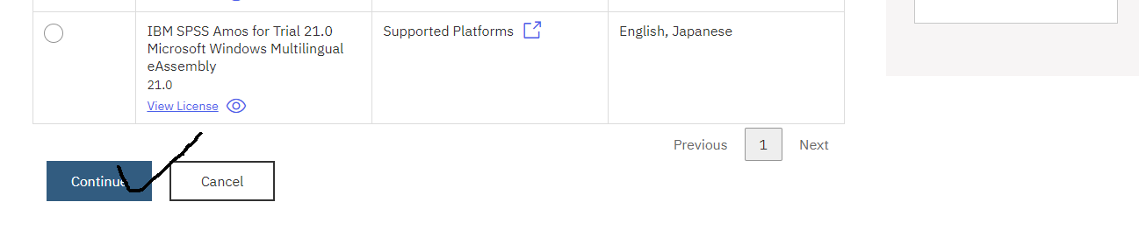

Slide 18
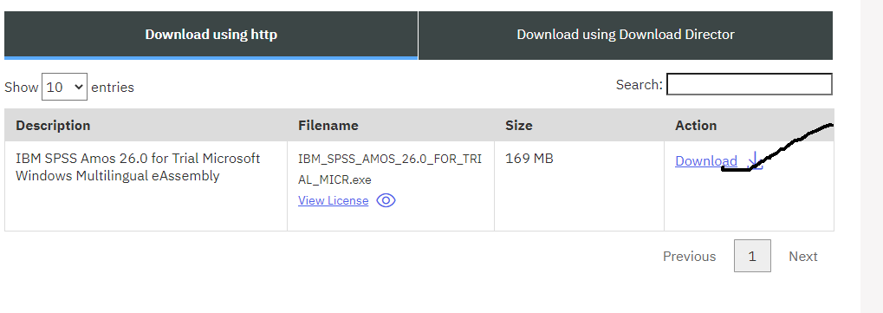
After clicking on “Download” , your Amos software will start download automatically

