Slide 1

Welcome to the Participants
DISSA Course
The Institute of Cost Accountants of India
Kolkata

Slide 2
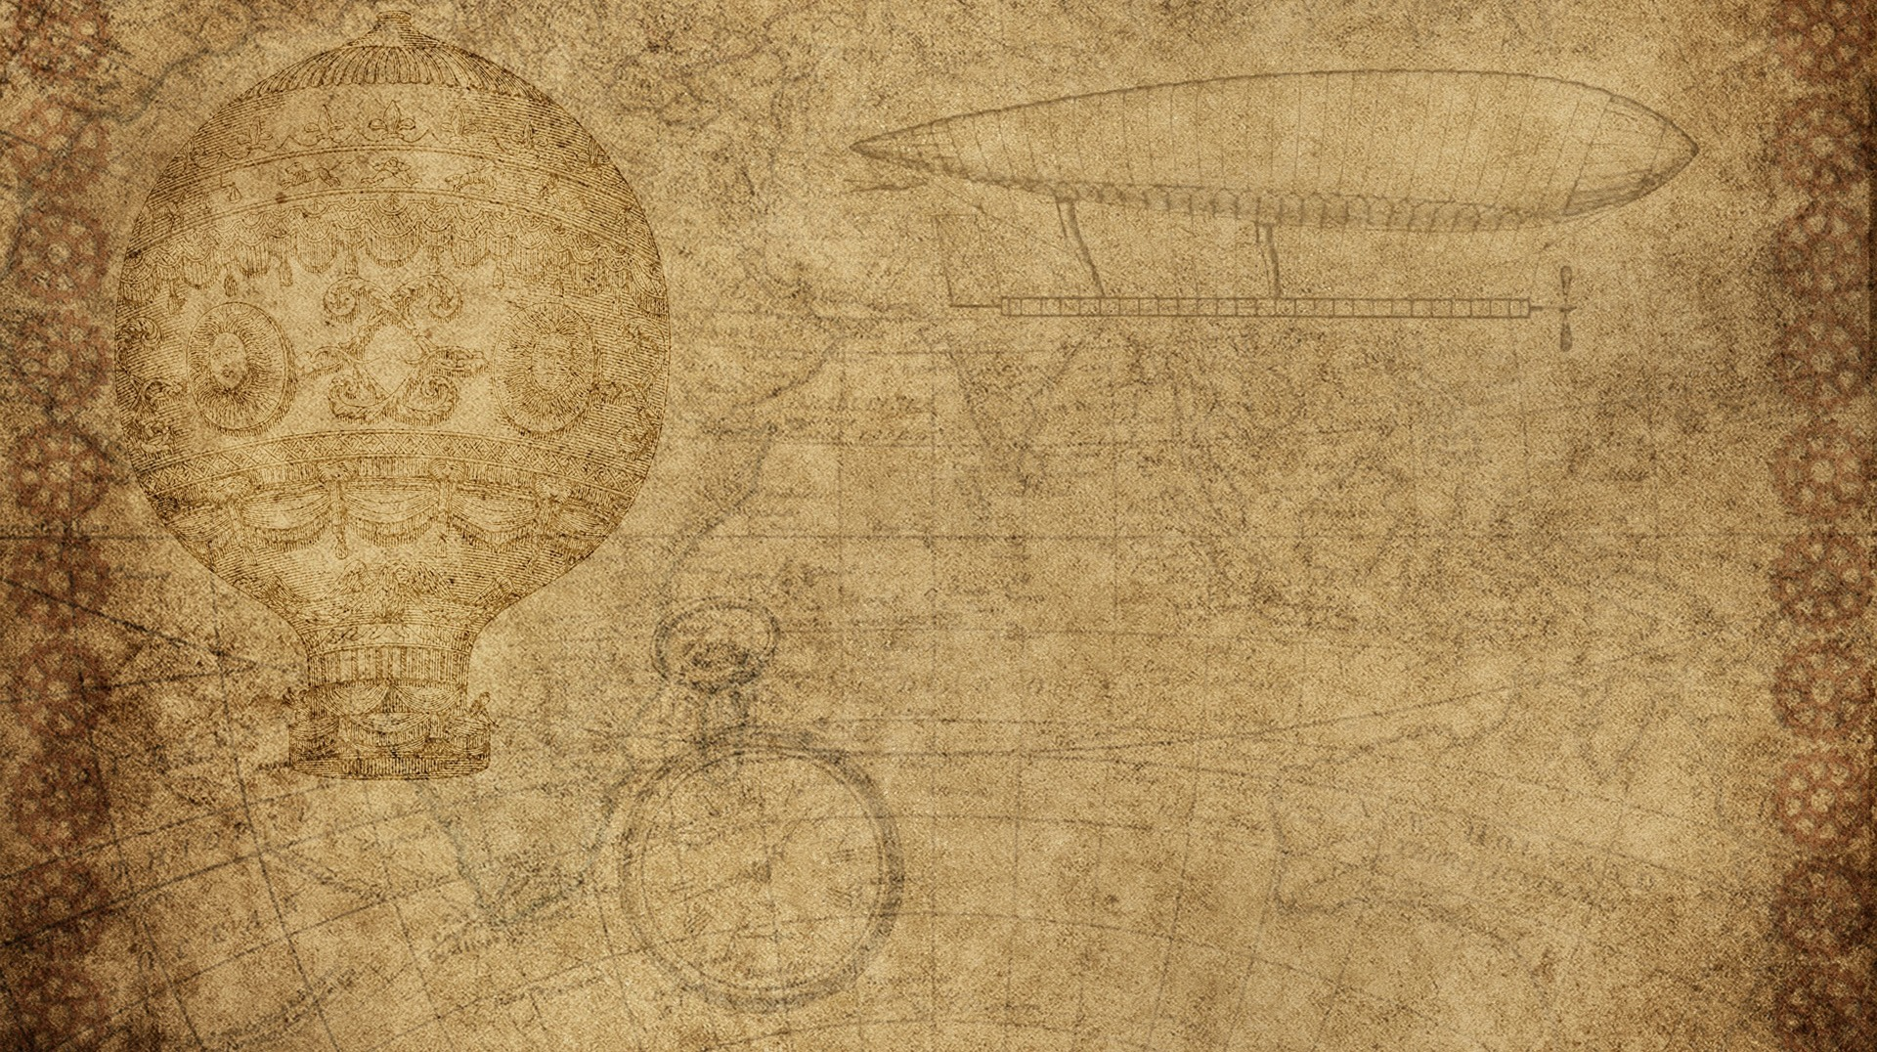

B. Cloud Computing Management Audit
CMA (Dr.) Siva Rama Prasad Puvvala
M.Com., MBA., FCMA., FCS., FIIBF., FIII (Life & General)., MAIMA.,

Slide 3
I. Understanding Cloud Computing
CMA (Dr.) Siva Rama Prasad Puvvala
M.Com., MBA., FCMA., FCS., FIIBF., FIII (Life & General)., MAIMA.,

Slide 4

Cloud Service Models
Cloud computing is a recently Developing Paradigm of distributed computing.
Though it is not a New Idea that Emerged Just Recently.
In 1969 L. Kleinrock anticipated:
As of now, Computer Networks are still in their Infancy. But as they Grow up and become more Sophisticated, we will probably see the spread of ‘Computer Utilities’ which, like present Electric and Telephone Utilities, will service Individual Homes and Offices across the Country.

Slide 5
Cloud Service Models
His Vision was the True Indication of Today’s Utility-based Computing Paradigm.
One of the Giant Steps Towards this World was taken in Mid 1990s when Grid Computing was First Coined to Allow Consumers to Obtain Computing Power on Demand.

Slide 6
Cloud Service Models
The Origin of Cloud Computing can be seen as an Evolution of Grid Computing Technologies.
The Term Cloud Computing was given Prominence First by Google’s CEO Eric Schmidt in Late 2006 (maybe he coined the term).
The phrase “Cloud Computing” Originated in a collaboration project between “IBM and Google”.

Slide 7
Cloud Service Models
So, the Birth of Cloud Computing is Very recent Phenomena although its Root belongs to Some Old Ideas with New Business, Technical and Social perspectives.
From the Architectural Point of View Cloud is Naturally Build on an Existing Grid-based Architecture and Uses the Grid Services and adds Some Technologies like Virtualization and Some Business Models.

Slide 8
Cloud Service Models
In Brief Cloud is essentially a Bunch of Commodity Computers Networked together in same or different Geographical Locations, Operating Together to serve a number of Customers with different need and Workload on Demand Basis with the help of Virtualization.
Cloud Services are provided to the Cloud users as Utility Services like Water, Electricity, Telephone using Pay-As-You-Use Business Model.
These Utility Services are generally described as XaaS (X as a Service) where X can be Software or Platform or Infrastructure etc.

Slide 9
Cloud Service Models
Cloud Users use these Services provided by the “Cloud Providers and build their Applications” in the Internet and thus Deliver them to their End Users.
So, the Cloud users don’t have to worry about Installing, Maintaining Hardware and Software Needed.

Slide 10
Cloud Service Models
And they also can Afford these Services as they have to Pay As Much, They Use.
So, the Cloud Users can Reduce their Expenditure and Effort in the field of IT using Cloud Services Instead of Establishing IT Infrastructure Themselves.

Slide 11
Cloud Service Models
Cloud is Essentially provided by Large Distributed Data Centres.
These Data Centers are often Organized as Grid and the Cloud is Built on Top of the Grid Services.
Cloud users are provided with Virtual Images of the Physical Machines in the Data Centers.

Slide 12
Cloud Service Models
This Virtualization is one of the key concepts of Cloud Computing as it Essentially Builds the Abstraction over the Physical System.
Many Cloud Applications are gaining Popularity Day by Day for their Availability, Reliability, Scalability and Utility Model.
These Applications made distributed Computing Easy as the Critical aspects are Handled by the Cloud provider itself.

Slide 13
Cloud Service Models
Cloud Computing is growing now-a-days in the Interest of Technical and Business Organizations but this can also be beneficial for solving social issues.
In the recent time E-Governance is being Implemented in Developing Countries to improve Efficiency and Effectiveness of Governance.
This Approach can be improved much by using Cloud Computing instead of Traditional ICT.

Slide 14
Cloud Service Models
In India, Economy is Agriculture based and most of the Citizens live in Rural Areas.
The Standard of Living, Agricultural Productivity etc Can be Enhanced by Utilizing Cloud Computing in a proper way.
Both of these Applications of Cloud Computing have Technological as well as Social Challenges to Overcome.

Slide 15
Cloud Service Models
CLOUD Computing is a way of Delivering IT enabled Capabilities to users in the Form of ‘Services' with Elasticity and Scalability, where Users can make use of Resources, Platform, or Software without having to Possess and Manage the underlying Complexity of the Technology.

Slide 16
Cloud Service Models
According to the National Institute of Standards and Technology (NIST), Cloud Computing is a Model for enabling Convenient, On-demand Network Access to a shared pool of Configurable Computing Resources (e.g., Networks, Servers, Storage, Applications, and Services) that can be rapidly provisioned and released with Minimal Management effort or Service Provider interaction.

Slide 17
Cloud Service Models
Essential Characteristics of Cloud Computing are:
Broad Network Access from a Variety of Devices or Platforms such as Mobiles, Desktops, Laptops, Workstations, etc., through Standard Mechanisms.
Rapid Elasticity and Scalability that allows Functionalities and Resources to be Rapidly and Automatically Scaled out or in, as Demand Rises or Drops.

Slide 18
Cloud Service Models
Essential Characteristics of Cloud Computing are:
Measured Provision to Automatically Control and Optimize Resource Allocation and to provide a Metering Capability to determine the usage for Billing Purpose, allowing Easy Monitoring, Controlling and Reporting.

Slide 19
Cloud Service Models
Essential Characteristics of Cloud Computing are:
On Demand Self-service that enables users to Consume Computing Capabilities (e.g., Applications, Server Time, and Network Storage) as and when required.
Multi-Tenancy and Resource Pooling that Allows Combining Heterogeneous Computing Resources (e.g., Hardware, Software, Processing, Serves, Network Bandwidth) to serve Multiple Consumers – such resources being Dynamically Assigned.

Slide 20
Cloud Service Models
Service Models
There are Three main Service Models in Cloud Computing.

Slide 21
Cloud Service Models
Software as a Service (SaaS):
It is a software distribution model through which a consumer can use the Provider’s Applications (Software) running on a Cloud Infrastructure.
The applications are Accessible from Various Client Devices such as a Web Browser (e.g., web-based Email).

Slide 22
Cloud Service Models
Software as a Service (SaaS):
The Consumer Does not Manage or Control the underlying Cloud Infrastructure, with the possible exception of Limited user-Specific Application Configuration Settings.
Software Testing takes place at a Faster Rate and IT Operational Costs are Drastically Reduced.

Slide 23
Cloud Service Models
Platform as a Service (PaaS):
The Service provides the Consumer Hardware and Software Infrastructure to deploy onto the Cloud Infrastructure Consumer-created or Acquired Applications and Tools Supported by the Provider.
Such Services enable the Integration of Web Services and Databases.

Slide 24
Cloud Service Models
Platform as a Service (PaaS):
The Consumer Does not Manage or Control Directly the Underlying Cloud Infrastructure but has Control over the Deployed Applications and possibly Application Hosting Environment Configurations.

Slide 25
Cloud Service Models
Infrastructure as a Service (IaaS):
It Provides Substantial Amount of Flexible Computing and Storage Infrastructure through Virtualization.
There are also other Service Models like Data as a Service (DaaS), Identity and Policy Management as a Service (IPMaaS), Network as a Service (NaaS), Video as a Service (VaaS) or Hardware as a Service (HaaS) amongst others.

Slide 26
Cloud Service Models
Infrastructure as a Service (IaaS):
It provides the Consumer Ability to Provision Processing, Storage, Networks, and other Fundamental Computing Resources where the “Consumer is Able to Deploy and Run” one’s own Software, which can include Operating Systems and Applications.

Slide 27
Cloud Service Models
End Users
MSME Sector.
Start-up Companies.
Educational Institutions.
Health Sector.
Coaching Institutions.
Professional Institutes.
Existing Companies – Hybrid Cloud.

Slide 28
THANK YOU
CMA (Dr.) Puvvala Siva Rama Prasad
M.Com., MBA (Finance)., FCMA., FCS., FIIBF., FIII (Life & General)., MAIMA

