Slide 1

Welcome to the Participants
DISSA Course
The Institute of Cost Accountants of India
Kolkata

Slide 2


B. Cloud Computing Management Audit
CMA (Dr.) Siva Rama Prasad Puvvala
M.Com., MBA., FCMA., FCS., FIIBF., FIII (Life & General)., MAIMA.,

Slide 3
IV. Migrating to the Cloud
CMA (Dr.) Siva Rama Prasad Puvvala
M.Com., MBA., FCMA., FCS., FIIBF., FIII (Life & General)., MAIMA.,

Slide 4

Re-architecting Applications for the Cloud
The Applications that have been Selected to be Migrated to the Cloud may require Significant Changes to take full Advantage of Cloud Characteristics such as High Availability and Scalability.
In particular, as Application Instances are Ephemeral and can be Started, Stopped or Fail at any Time, they must be Stateless and Share Nothing.

Slide 5
Re-architecting Applications for the Cloud
All Persistent Data must go to External Services (e.g., Databases, File Storage, Message Queues, Caches).
Applications should be Re-architected in order to take Full Advantage of the Cloud’s Features.

Slide 6
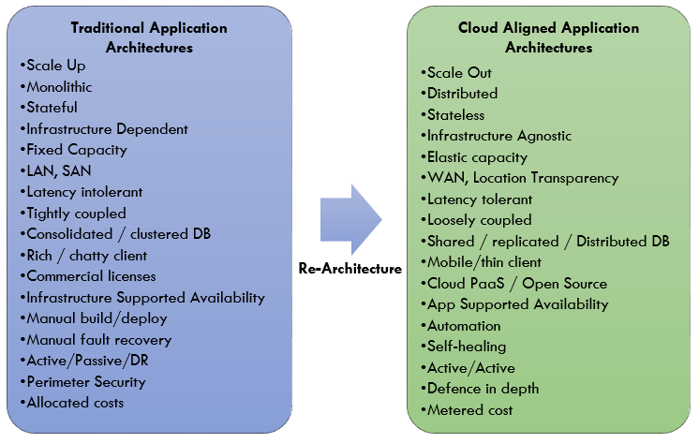
Re-architecting Applications for the Cloud

Slide 7
Re-architecting Applications for the Cloud
Moving an Application to the Cloud will require Some Work under the Hood. However, choosing to Re-architect an Application is Ideal when:
Hardware Cost is Substantial:
Re-Architecting an Application for the Cloud means access to World-class Hardware without needing a World-class Budget.
Companies are Able to Pay as they go and Avoid the Investment required for more Hardware.

Slide 8
Re-architecting Applications for the Cloud
Moving an application to the cloud will require some work under the hood. However, choosing to re-architect an application is ideal when:
IT Staffing Levels are Low:
Moving to the Cloud Automates a lot of the Server and Application Management, as well as Maintenance Tasks that would otherwise be Performed by In-house IT Staff.

Slide 9
Re-architecting Applications for the Cloud
Moving an application to the cloud will require some work under the hood. However, choosing to re-architect an application is ideal when:
Geolocation is a Requirement:
The Cost to do Geolocation on the Cloud is Miniscule Since many Data Centres are Located in Central Regions.

Slide 10
Re-architecting Applications for the Cloud
Moving an application to the cloud will require some work under the hood. However, choosing to re-architect an application is ideal when:
The Application needs to Scale for Predicted, but Infrequent, Uptime:
The Cloud allows Systems that have Occasional Spikes, such as an e-commerce Application that sees a Lot of Activity, to Quickly and Easily Scale Servers on Demand without an Expensive Hardware Investment or Footprint.

Slide 11
Re-architecting Applications for the Cloud
Determining the Right Migration Strategy for an Application Depends on its Level of Cloud Alignment, Cloud readiness, Potential Benefits achieved from Migrating and Risks.
There are Several Application Migration Common Methods and Approaches, which should consider the Public Authorities for their Existing Applications.

Slide 12
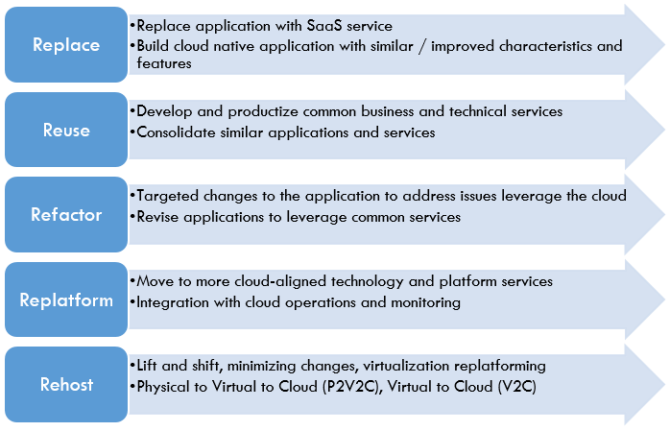
Re-architecting Applications for the Cloud
Application Migration Common Methods and Approaches

Slide 13
Re-architecting Applications for the Cloud
New Relic is a San Francisco, California-based Technology Company which Develops Cloud-based Software to help Website and Application Owners track the Performances of their Services.
Depending on the Changes the Enterprise Applications reach Different Cloud Maturity Levels.

Slide 14
Re-architecting Applications for the Cloud
Characteristics of Each Level
Maturity Level | Characteristics
Cloud Washed | Force fit to run in cloud environment. Resources not optimized – no horizontal scaling. Minimal modification done to be cloud compliant.
Cloud Adopted | Resources not Optimize – No automatic elasticity-instance manually started. Some modification done to be Cloud Compliant.
Cloud Optimized | Resources being optimized – Horizontal scaling possible. Elastic on instance level – cloud management layer determines. when to start / stop additional instances. Major modification done to be cloud compliant.
Cloud Native | Fully Cloud Aware – Can communicate with the cloud management layer to start-up or shutdown instances of itself. Designed for failure and self-healing. Elastic and resource efficient.

Slide 15
Re-architecting Applications for the Cloud
The “Scale-up” Architecture is the one where the Application can benefit from more Resources, such as CPU and Memory, being added to a Single Server or Node.
In contrast, the “Scale-out” Architecture is the One where an Application Scales by Additional Nodes being made available for the Workload; that is, it Scales Horizontally.

Slide 16
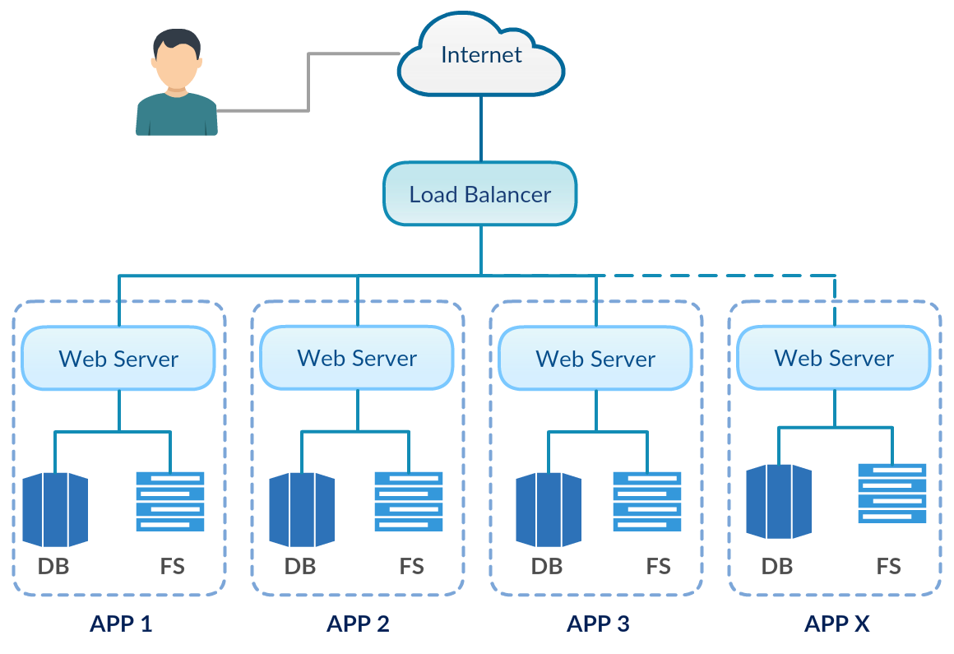
Re-architecting Applications for the Cloud
STORM CLOUDS Approach
STORM CLOUDS Platform Supports Two Different Architectures
A “Scale-up” Architecture for Applications with Traditional Architectures

Slide 17
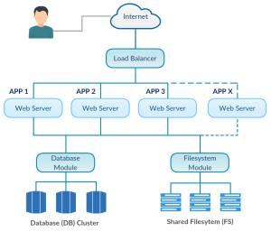
Re-architecting Applications for the Cloud
SCP “Scale-Out” Architecture for Cloud-Ready Applications

Slide 18
Re-architecting Applications for the Cloud
Scale-out Applications can take Advantage of the Pay-by-Usage Cost Model of the Cloud.
When there are increased requests for an Application, more Nodes can be deployed to handle the increased Load.
When the requests Slow Down, the Additional Nodes can be Powered-off to Reduce Costs.

Slide 19
Re-architecting Applications for the Cloud
Virtualisation Technologies (Virtualization is technology that lets you create useful IT services using Resources that are Traditionally Bound to Hardware. It allows you to use a Physical Machine’s Full Capacity by Distributing its Capabilities among Many Users or Environments. ... It's the same Hardware, you're just using more of it more Efficiently) have Started to Support the Dynamic Scale-up and Scale-down of a Single VM’s Resources (Memory, CPU and Disk Space), this action requires, at the moment, the use of Custom Scripts.
On the Contrary, the Systems that Support the Scale-out Architectures provide Native Support to the Dynamic increase of Resources.

Slide 20
Integrating the Cloud with Existing Applications
The Birth of Cloud Integration was a Game Changer.
It Revolutionized the Way Businesses Approach Integration and the Age-old Battle against Data Silos.
Offering Flexibility and Scalability, Cloud Integration opened a World of New Opportunities for Organizations to Connect Disparate Systems.

Slide 21
Integrating the Cloud with Existing Applications
Businesses have Benefited Greatly from the Ability to Combine all of their Cloud Applications as well as On-premises Systems.
This Practice gives Companies Comprehensive Access and Visibility into their Data as well as Improved Functional Connectivity.

Slide 22
Integrating the Cloud with Existing Applications
Cloud Integration is a System of Tools and Technologies that Connects Various Applications, Systems, Repositories, and IT Environments for the Real-time Exchange of Data and Processes.
Once Combined, the Data and Integrated Cloud Services can then be Accessed by Multiple Devices over a Network or Via the Internet.

Slide 23
Integrating the Cloud with Existing Applications
The Purpose of Cloud Integration
Cloud Integration was created to Break Down Data Silos, improve Connectivity and Visibility, and ultimately Optimize Business Processes.
It is a Response to the need to Share Data among Cloud-based Applications and to Unify Information Components.

Slide 24
Integrating the Cloud with Existing Applications
The Purpose of Cloud Integration
Cloud Integration has grown in Popularity as the use of Software as a Service (SaaS) Solutions Continues to Increase.
It Predicts this Growth will Continue and that nearly One Third of the Worldwide Enterprise Application Market reached SaaS-based.

Slide 25
Integrating the Cloud with Existing Applications
The Purpose of Cloud Integration
Additionally, More Businesses are Operating with a Hybrid Mix of SaaS and On-premises Applications, Creating a Greater need for Progressive Integration Methods.

Slide 26
Integrating the Cloud with Existing Applications
The Benefits of Cloud Integration
Companies who use Cloud Integration have Synchronized Data and Applications, improving their Ability to Operate Effectively and Nimbly.

Slide 27
Integrating the Cloud with Existing Applications
Other Benefits:
Improved Operational Efficiency.
Increased Flexibility and Scalability.
Faster Time-to-Market.
Better Internal Communication.
Improved Customer Service, Support, and Retention.
Increased Competitive Edge.
Reduced Operational Costs and Increased Revenue.

Slide 28
Integrating the Cloud with Existing Applications
Cloud Integration Types and Methods
Integration in the Cloud can involve Creating Cloud-to-Cloud Integration, Cloud-to-on-Premises Integration, or a Combination of both.
Integrations can Address Different Business Components, including Data and Applications.

Slide 29
Integrating the Cloud with Existing Applications
Cloud Integration Types and Methods
Data Integration: The Synchronization of Data between Repositories.
Data can be Processed, Transported and / or Transformed during Data Integration.
This is a Strictly Data-related Connection.

Slide 30
Integrating the Cloud with Existing Applications
Cloud Integration Types and Methods
Application Integration: Connects Various Applications and Arranges Continued Functionality and Interoperability.
This is More than Data Sharing.
It involves issuing Requests and Commands to Trigger Business Events or Processes.

Slide 31
Integrating the Cloud with Existing Applications
Businesses have the Option of Building their Own Integration Solutions or using a Third-party Provider to Create Cloud Integrations.
However, as the Number of Applications increases and Cloud Integrations Grow more Complex, it becomes far Less Scalable to Build Specialized in-house Integrations that must be Recreated for each Project.

Slide 32
Integrating the Cloud with Existing Applications
Using a Cloud Integration Platform Empowers Organizations to Perform Both Application and Data Integration using an Agile, Scalable, Reusable Solution.

Slide 33
THANK YOU
CMA (Dr.) Puvvala Siva Rama Prasad
M.Com., MBA (Finance)., FCMA., FCS., FIIBF., FIII (Life & General)., MAIMA

