Slide 1

Welcome to the Participants
DISSA Course
The Institute of Cost Accountants of India
Kolkata

Slide 2


A. IT Audit in Banking Sector
CMA (Dr.) Siva Rama Prasad Puvvala
M.Com., MBA., FCMA., FCS., FIIBF., FIII (Life & General)., MAIMA.,

Slide 3

Core Banking System
Technology has continuously played on important role in the working of banking institutions and the services provided by them.
It is also viewed as an instrument of cost reduction and effective communication with people and institutions associated with the banking business.

Slide 4
Core Banking System
To be able to survive and grow in the changing market environment banks are going for the latest technologies, which is being perceived as an 'enabling resource' that can help in developing learner and more flexible structure that can respond quickly to the dynamics of a fast-changing market scenario.

Slide 5
Core Banking System
CBS:
Core Banking Solution (CBS) is Networking of Bank Branches, which allows customers to manage their accounts, and use various banking facilities from any part of the world.
In simple term, there is No need to visit Customer own Branch to do banking transactions.
Customer can do it from any Location, any Time.
Customer can enjoy Banking Services from any Branch of the Bank which is on CBS Network regardless of Branch the Customer opened Account.

Slide 6
Core Banking System
CBS:
For the bank which implements CBS, the customer becomes the Bank’s Customer instead of customer of particular branch.
Core Banking Solutions has helped banks to offer Better Customer Service. It has also reduced the time and increased the efficiency.
The Core Banking Solutions mainly work on the support of Effective Communication and Good Information Technology.

Slide 7
Core Banking System
It is on account of merger of Communication Technology and Information Technology which enables the banks to offer Core Banking needs of the clients.
The computer software handles the Different Functions of the bank like, recording of transactions, updating the balances in the accounts based on the type of transactions, calculate interests and application of interest, charges etc.,

Slide 8
Core Banking System
Core Banking Solutions are Computer-based Banking Applications (Software) which works on a platform.
The Software is installed in the Branches and the Computer Systems are Interconnected with a main Computer Server though communication lines (telephones, satellite, internet, fibre optical).

Slide 9
Core Banking System
CBS is Required:
To meet the dynamically Changing Market & Customer Needs.
To Improve & Simplify Banking Processes so that bank staff can focus on sales & marketing stuff.
Convenience to Customer as well as Bank.
To Speed up the Banking Transactions.
To Expand presence in Rural & Remote Areas.

Slide 10
Core Banking System

Slide 11
Core Banking System
Basic Elements of CBS that helps Customers are:
Internet Banking.
Mobile Banking.
ATM.
POS & Kiosk Systems.
Fund Transfers – NEFT, RTGS.

Slide 12
Core Banking System
Benefits for Customers:
Quicker Services at the Bank Counters for routine transactions like Cash Deposits, Withdrawal, Passbooks, Statement of Accounts, Demand Drafts etc.
Anywhere banking by eliminating Branch Banking.
Provision of Banking Services 24 X 7.
Fast Payment Processing through Internet Banking, Mobile Banking.
Anytime Anywhere Banking through ATMs.

Slide 13
Core Banking System
All Branches access applications from Central Servers / Data Centre, so deposits made in any branch reflects immediately and Customer can withdraw money from any other branch throughout the world.
CBS is very helpful to people living in Rural Areas. The farmers can receive e-payments towards subsidy etc. in his account directly.
Transfer of funds from the Cities to the Villages and Vice Versa will be done Easily.

Slide 14
Core Banking System
Benefits for Banks:
Process Standardization within Bank & Branches.
Retention of Customers through Better Customer Service.
Accuracy in Transactions & Minimization of Errors.
Records having centralized databases results in quick gathering of data & MIS reports.
Ease in Submission of Various Reports to the Government & Regulatory Boards like RBI.
Convenience in Calculating Interest, Implementing Change in policies like changing interest rates etc.

Slide 15
Core Banking System
In India all most all Banks implemented the Core Banking Solutions including Co-operative Banks, Regional Rural Banks etc. to get the benefits of Core Banking System and also to provide Good Services to their Customers.

Slide 16
Core Banking System
Some of the Banks using Finacle are
  Bank of Baroda
  Bank of India
  Union Bank of India
  Canara Bank
  Federal Bank
  IDBI Bank
  ICICI Bank
  Axis Bank
  ABN Amro
  UCO Bank

Slide 17
Core Banking System
CRisMAC by D2K Technologies: The software is used by
Bank of Baroda
Bank of Maharashtra
Punjab National Bank
Bank of Rajasthan
Deutsche Bank

Slide 18
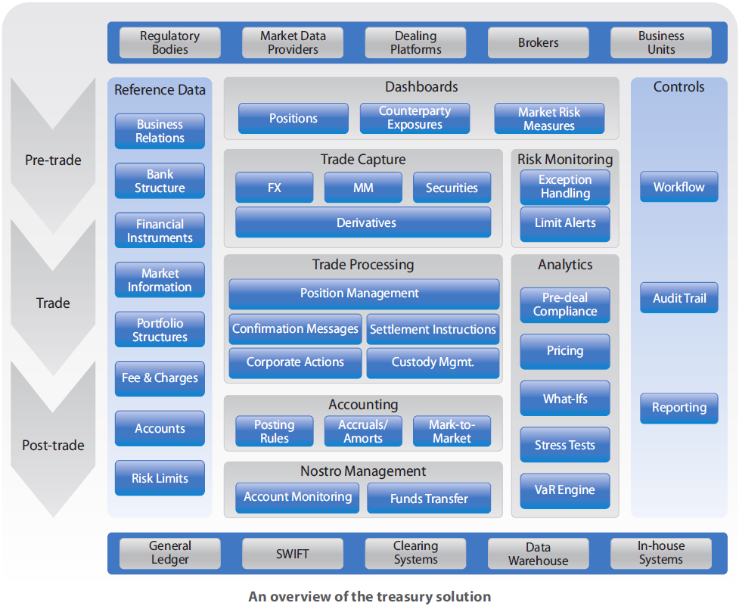
Treasury Management Solutions

Slide 19
Payment Applications
SWIFT, RTGS, IMPS, NEFT, NSS
SWIFT
India was the 74th country to join the Society for Worldwide Inter-bank Financial Telecommunication (SWIFT) network on December 2, 1991.
The initial membership of Banks in India was 34.

Slide 20
Payment Applications
SWIFT, RTGS, IMPS, NEFT, NSS
Using advanced data-processing and telecommunications technology, the SWIFT system is based on the following features:
It is available Worldwide, 24 hours a day, 7 days a week;
Standard Message Formats for transactions enable members to avoid language and interpretation problems;
Ensures a High Level of Security while transmitting all messages;
Assumes financial liability for the Accuracy, Completeness and Timely Delivery of all validated messages.

Slide 21
Payment Applications
SWIFT, RTGS, IMPS, NEFT, NSS
Each Country has a SWIFT gateway called the SWIFT Access Point (SAP) to which the individual users' terminals are connected.
The users are Connected to the SAP through leased lines with PSTN as backup.
The SAPs are connected to the Regional Processors, which in turn are connected on-line to Mother Operating Centres in the USA and Netherlands from where the messages are distributed to the ultimate destination address indicated in each message.

Slide 22
Payment Applications
SWIFT, RTGS, IMPS, NEFT, NSS
SWIFT has 9 types of Standard Message Categories. Each broad Message category has various message types for specific uses. A majority of the forex related messages are sent to correspondent banks abroad through SWIFT.
The Users of the Network in India are the Reserve Bank of India, all Major Banks including the Private Sector Banks, Branches of Foreign Banks and major Financial Institutions.

Slide 23
Payment Applications
SWIFT, RTGS, IMPS, NEFT, NSS
RTGS:
The Acronym 'RTGS' stands for Real Time Gross Settlement, which can be defined as the continuous (real-time) settlement of funds transfers individually on an Order-by-Order Basis (Without Netting).
Considering that the funds settlement takes place in the Books of the Reserve Bank of India, the payments are Final and Irrevocable.

Slide 24
Payment Applications
SWIFT, RTGS, IMPS, NEFT, NSS
Current Instructions on RTGS by RBI:
Reserve Bank of India (RBI) had announced making available the Real Time Gross Settlement (RTGS) system Round the Clock on all Days.
RBI decided to make RTGS available Round the clock on all days of the year with effect from 00:30 hours on December 14, 2020.

Slide 25
Payment Applications
SWIFT, RTGS, IMPS, NEFT, NSS
Current Instructions on RTGS by RBI:
RTGS shall be available for Customer and Inter-bank Transactions Round the Clock, except for the interval between ‘End-of-Day’ and ‘Start-of-Day’ processes, whose timings would be duly Broadcasted through the RTGS System.
RTGS shall continue to be governed by the RTGS System Regulations, 2013, as amended from time to time.

Slide 26
Payment Applications
SWIFT, RTGS, IMPS, NEFT, NSS
Current Instructions on RTGS by RBI:
Intra-Day Liquidity (IDL) facility to the Participating Banks shall be made available to facilitate smooth operations.
The Intra-Day Liquidity (IDL) availed, if any, shall be Reversed before the ‘End-of-Day’ process Begins.

Slide 27
Payment Applications
SWIFT, RTGS, IMPS, NEFT, NSS
IMPS:
IMPS stand for Immediate Payment Service in Indian Banking System Terminologies. It is a Money Transfer Mechanism made available by the Apex Bank of the Country, the Reserve Bank of India and the National Payments Corporation of India (NPCI). Initiated in 2010 by the NPCI with the help of a pilot project with 4 major banks, IMPS has now grown to 150+ Banks.
The major feature of IMPS is that it is available at all times for usage. It transfers funds instantly and is a great banking platform in case of emergencies. The transaction charges of this platform are also very nominal and the transfer limit is also considerable. Moreover, IMPS is available on mobile too which makes it super-convenient.

Slide 28
Payment Applications
SWIFT, RTGS, IMPS, NEFT, NSS
IMPS:
National Payments Corporation of India (NPCI) is responsible for managing the IMPS fund transfer mechanism.
This mechanism is Regulated by the Reserve Bank of India.
One can define IMPS as an Immediate, Inter-bank Real-time Fund Transfer mechanism enabled through Electronic Means.
IMPS was a revolutionary fund transfer system when it was launched in 2010.
It made payment settlements Faster and Easier.

Slide 29
Payment Applications
SWIFT, RTGS, IMPS, NEFT, NSS
Some features of the Immediate Payment Service system:
IMPS is one of the fastest and one of the most reliable ways to conduct inter-account money transfers. The Unified Payment Interface (UPI) is also built on this platform.
Immediate Payment Service (IMPS) is a fast, safe and secure way to send and receive funds.
IMPS work on both Net-banking and Mobile Platforms and its services are available at all times even on Public and Bank Holidays and Bank off-Days.

Slide 30
Payment Applications
SWIFT, RTGS, IMPS, NEFT, NSS
Some Features of the Immediate Payment Service System:
Money can be sent to any Beneficiary through IMPS Mobile Platform by only Providing his / her Mobile no. and Mobile Money Identifier (MMID).
Bank Account Nos. are not necessarily required for IMPS fund transfer if Customer is Transacting through Mobile.
Transfer notification is sent by the bank to Both the Payer and the Payee when the transfer is complete.

Slide 31
Payment Applications
SWIFT, RTGS, IMPS, NEFT, NSS
NEFT:
National Electronic Funds Transfer (NEFT) is a nation-wide payment system facilitating one-to-one funds transfer. Under this Scheme, Individuals, Firms and Corporate can electronically transfer funds from any Bank Branch to any Individual, Firm or Corporate having an Account with any other Bank Branch in the Country participating in the Scheme.
IFSC or Indian Financial System Code is an Alpha-numeric code that uniquely identifies a Bank-Branch participating in the NEFT system. This is an 11-digit code with the first 4 alpha characters representing the Bank, and the last 6 characters representing the Branch. The 5th character is 0 (zero). IFSC is used by the NEFT system to identify the Originating / Destination Banks / Branches and also to route the messages appropriately to the concerned Banks / Branches.

Slide 32
Payment Applications
SWIFT, RTGS, IMPS, NEFT, NSS
NEFT:
In case of Non-credit or delay in Credit to the Beneficiary Account, the NEFT Customer Facilitation Centre (CFC) of the respective Bank can be Contacted (the remitter can Contact his Bank’s CFC; the beneficiary may Contact the CFC of his Bank).
NEFT can be used to transfer funds from or to NRE and NRO accounts in the country subject to FEMA Guidelines.
NEFT cannot be used for remittance to abroad except to Nepal under Indo Nepal Remittance Scheme.

Slide 33
Payment Applications
SWIFT, RTGS, IMPS, NEFT, NSS
NEFT Benefits:
The remitter need not send the Physical Cheque or Demand Draft to the beneficiary.
The beneficiary Need not visit his / her Bank for depositing the paper instruments.
The beneficiary need not be Apprehensive of Loss / Theft of Physical Instruments or the likelihood of fraudulent encashment thereof.
Cost Effective.
Credit Confirmation of the remittances sent by SMS or Email.
Remitter can initiate the remittances from his Home / Place of work using the Internet Banking also.

Slide 34
Payment Applications
SWIFT, RTGS, IMPS, NEFT, NSS
NSS:
This casts a Liquidity Burden on the Banks as they do not get benefit of excess funds at one clearing centre to offset the deficit at another.
There is a need to settle the position of banks in the various clearing houses centrally in accounts maintained at Mumbai by means of a National Settlement System (NSS) to enhance liquidity management efforts in banks.

Slide 35
Payment Applications
SWIFT, RTGS, IMPS, NEFT, NSS
NSS:
It is proposed to achieve this Goal in a phased manner Starting with the Clearing Settlement at the Four Metro Centres being Centralized at Mumbai.
Appropriate technology-based solutions will be put in place so that Banks with Regional Presence can have access to the Settlement Account at Mumbai.

Slide 36
Payment Applications
SWIFT, RTGS, IMPS, NEFT, NSS
ECS:
ECS Credit enables payment of amounts towards Distribution of Dividend, Interest, Salary, Pension, etc., of the user institution. ECS Debit is used by an institution for raising debits to a large number of accounts maintained with bank branches at various locations within the jurisdiction of an ECS Centre for single credit to the bank account of the user institution.
ECS Debit is useful for payment of Telephone / Electricity / Water Bills, Cess / Tax Collections, loan instalment repayments, periodic investments in mutual funds, insurance premium etc., that are periodic or repetitive in nature and payable to the user institution by large number of customers etc.

Slide 37
Payment Applications
SWIFT, RTGS, IMPS, NEFT, NSS
ECS Debit:
ECS Debit transaction can be initiated by any institution (Called ECS Debit User) which has to receive / collect amounts towards telephone / electricity / water dues, cess / tax collections, loan instalment repayments, periodic investments in mutual funds, insurance premium etc. It is a Scheme under which an account holder with a bank branch can authorise an ECS User to recover an amount at a prescribed frequency by raising a debit to his / her bank account.
The User institution has to First register with an ECS Centre. The User institution has to also obtain the authorization (mandate) from its customers for debiting their account along with their Bank Account particulars prior to participation in the ECS Debit scheme. The Mandate has to be duly verified by the Beneficiary’s Bank.

Slide 38
Payment Applications
SWIFT, RTGS, IMPS, NEFT, NSS
ECS Credit:
ECS Credit payments can be initiated by any institution (Called ECS Credit User) which needs to make bulk or repetitive payments to a number of beneficiaries.
The institutional User has to First Register with an ECS Centre.
The User has to also obtain the Consent of Beneficiaries (i.e., the Recipients of Salary, Pension, Dividend, Interest etc.) and get their Bank Account particulars prior to participation in the ECS Credit Scheme.

Slide 39
THANK YOU
CMA (Dr.) Puvvala Siva Rama Prasad
M.Com., MBA (Finance)., FCMA., FCS., FIIBF., FIII (Life & General)., MAIMA

