Slide 1


Practical Aspects
Information Security Audit
CMA (Dr.) Siva Rama Prasad Puvvala
M.Com., MBA., FCMA., FCS., FIIBF., FIII (Life & General)., MAIMA.,

Slide 2

IS Auditor

Slide 3
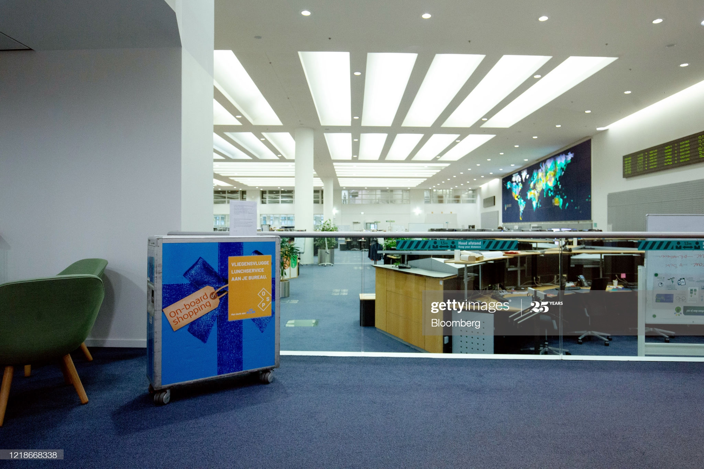
Core Banking System – CBS

Slide 4

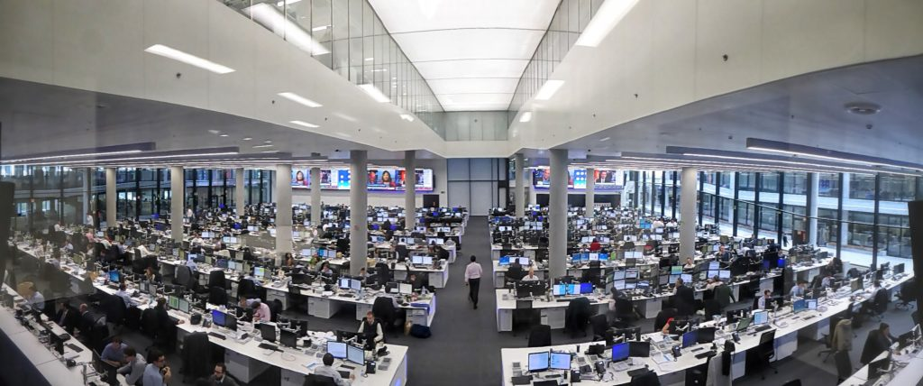
DISSA Course – Practical Aspects
(Core Banking System)

Slide 5


DISSA Course – Practical Aspects
(Core Banking System)
NABARD
‘43’ RRBs with 21,871 Branches
NEFT/RTGS
IT Platform is ~1,71,241 Branches

Slide 6
Information Security Audit
At present Life Insurance Companies in India are 24 (Only LIC of India is having more than 2,000 Branches)
At present General Insurance Companies in India are 34.

Slide 7
Information Security Audit

Slide 8
Information Security Audit
Information Security Audit – Check List

Slide 9
Information Security Audit
Security Policy - Governance, Implementation & Review

Slide 10
Information Security Audit
Security Policy - Governance, Implementation & Review
Whether there exists a well-documented Information security policy? Y/N.
When was the policy last approved by the Board of directors / Management? D/M/Y.
What is the review frequency of the policy? Q/H/Y.
When was the last review conducted? D/M/Y.
What was the last review purpose? Periodic / Incident Driven / Infrastructure Changes

Slide 11
Information Security Audit
Security Policy - Governance, Implementation & Review
Whether the policy addresses legal and regulatory requirements? Y/ N.
Who is the security policy owner for maintenance and review? BOD / Security Committee / CISO – Chief Information Security Officer.
Whether IS Committee is constituted comprising of representatives from all verticals? Y / N.
What is the meeting frequency of the IS committee? Q/H/Y.

Slide 12
Information Security Audit
Security Policy - Governance, Implementation & Review
Whether the role and responsibilities of IS committee is clearly defined? Y/N.
Whether the role and responsibilities of CISO is clearly defined? Y/N.
Whether the policy is communicated to relevant users? Y / N.
What is the medium of communication? Email / Intranet / In-house periodic Trainings / Induction Training to New Recruits / Undertaking.

Slide 13
Information Security Audit
Security Policy - Governance, Implementation & Review
Whether supporting procedures / sub-policies have been developed for organizational security? Y / N.
Who reviews the supporting procedures / sub-policies? CISO / IS Committee.
Whether security policy is in line with global best practices guidelines like ISO 27001 (and other frameworks like COBIT etc.) and / or as per requirements of RBI circular? Y / N - Control Objectives for Information and Related Technology.

Slide 14
Information Security Audit
Security Policy - Governance, Implementation & Review
Whether every procedure / sub-policy has a designated owner? Y / N.
Whether the policy takes into consideration the long-term business strategy of the organisation? Y / N.
Whether the organisation has considered IS security for budgetary allocation? Y / N.

Slide 15
Information Security Audit
Security Policy - Governance, Implementation & Review
Whether independent audit is conducted to ensure adherence to security policy? Q/H/Y.
Frequency of internal audit. Q / H / Y.
Frequency of external audit. Q / H / Y / Bi-Annually.

Slide 16
Information Security Audit
Asset Classification and Control - Accountability of Assets
Whether the organization has distinguished its information assets? Y/N.
Whether an inventory database is maintained for all information assets? Y/N.
Whether there is a designated owner for each distinguished asset? Y/N.

Slide 17
Information Security Audit
Asset Classification and Control - Accountability of Assets
How is the inventory database maintained? Centrally / Locally.
Whether a separate asset inventory exists for data centre and DR site? Y / N.
Whether there is a designated owner for the data centre asset inventory? Y / N.

Slide 18
Information Security Audit
Asset Classification and Control - Accountability of Assets
Whether a process exist for updation of asset inventory? Y / N.
Whether each information asset is labeled? Y / N.
Whether information classification guidelines exist and are enforced? Y / N.

Slide 19
Information Security Audit
Asset Classification and Control - Accountability of Assets
Whether the classification level of information asset is reviewed periodically? Y / N.
Who is responsible for deciding the asset classification level? IS Committee / CISO / Asset Owner.
Whether classification level for each asset is recorded in inventory database? Y / N.

Slide 20
Information Security Audit
Human Resource Security
How do you communicate individual security roles and responsibilities to employee end users? Employment Contract / Introduction Trainings / Periodic / IS Awareness Trainings.
Is there a training calendar for IS awareness trainings? Y / N.
Number of IS awareness trainings conducted in a year. -------.

Slide 21
Information Security Audit
Human Resource Security
Number of induction trainings conducted in a year. -----------.
Whether a background verification check is part of the recruitment process of the organisation? Y / N.

Slide 22
Information Security Audit
Human Resource Security
Whether HR informs IT in a timely manner about termination of employees for revoking IT access? Y / N.
How the background verification check is conducted? In-House / Outsourced.
Whether employment contract covers non-disclosure / confidentiality clause? Y / N.

Slide 23
Information Security Audit
Human Resource Security
Whether written acknowledgement w.r.t understanding and acceptance of employment contract is obtained? Y / N.
Whether employment contract covers appropriate controls to address post-employment responsibilities? Y / N.
Whether HR is responsible to define a disciplinary process in accordance with local law? Y / N.

Slide 24
Information Security Audit
Third Party Security / Vendor Management
How do you communicate individual security roles and responsibilities to third party users?
Whether a background verification check is a mandatory requirement in third party contracts?

Slide 25
Information Security Audit
Third Party Security / Vendor Management
What process there is to ensure background verification check is performed?
Whether third party contract mentions adherence to security policy and procedures of the organization?

Slide 26
Information Security Audit
Third Party Security / Vendor Management
Whether third party contract covers non-disclosure / confidentiality clause?
Whether the contracts and agreements with external parties are using legally enforceable terms and is reviewed by the appropriate legal department?

Slide 27
Information Security Audit
Third Party Security / Vendor Management
Whether written acknowledgement w.r.t understanding and acceptance of third-party contract is obtained? Y / N.
Whether changes to the provision of contract services are managed, and where needed a re-assessment of risks is taken place? Y / N.
Do you conduct due diligence for third parties / vendor before outsourcing? Y / N.

Slide 28
Information Security Audit
Third Party Security / Vendor Management
Do you conduct onsite security audit of third party / vendor before outsourcing? Y / N.
Have you identified the risks associated with third party contractors working on- site? Y / N.
Do you conduct periodic reviews of all accesses provided to third parties / Vendor? Y / N.

Slide 29
Information Security Audit
Third Party Security / Vendor Management
What is the frequency of such reviews? Monthly / Quarterly / Yearly.
Whether the CISO reviews all security controls w.r.t third party contracts? Y / N.

Slide 30
Information Security Audit
Compliance
Whether relevant regulatory and contractual requirements are documented for each information system? Y / N.
Whether responsibilities of individuals concerned to meet these requirements are well defined and communicated? Y / N.
Whether there exist procedures to ensure compliance with legal restrictions on use of material like intellectual property rights, trademarks, copy rights etc.? Y / N.

Slide 31
Information Security Audit
Compliance
Whether important records of the organisation are protected from loss destruction? Y/ N.
Whether there is a management structure and control in place to protect data and privacy of personal information? Y / N.
Whether at the log-on security banner or a warning message is presented on the computer screen indicating that the system being entered is private and that unauthorized access is not permitted? Y / N.
Whether the process involved in collecting the evidence is in accordance with legal best practices? Y / N.

Slide 32
Information Security Audit
Compliance
Whether all areas within the organization are considered for regular review to ensure compliance with security policy, standards and procedures? Y / N.
Whether information systems are regularly checked for compliance with security implementation standards? Y / N.
Whether the technical compliance check is carried out by, or under the supervision of, competent, authorized persons? Y / N.

Slide 33
Information Security Audit
Compliance
Whether all computers, systems and network devices like routers and switches within your organization regularly tested for exploitable vulnerabilities and illegally copied Software? Y/ N.
Whether audit requirements and activities involving checks on operational systems are planned and agreed upon to minimize the risk of disruptions to business process? Y / N.
Whether access to system audit tools such as software or data files are protected to prevent misuse? Y / N.
Whether there is a designated compliance officer for the organization? Y / N.

Slide 34
THANK YOU
CMA (Dr.) Puvvala Siva Rama Prasad
M.Com., MBA (Finance)., FCMA., FCS., FIIBF., FIII (Life & General)., MAIMA

