Slide 1


Practical Aspects - Case Studies
Information Systems Audit -IS Audit
CMA (Dr.) Siva Rama Prasad Puvvala
M.Com., MBA., FCMA., FCS., FIIBF., FIII (Life & General)., MAIMA.,

Slide 2
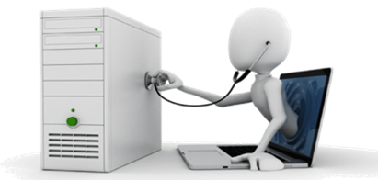
IS Auditor

Slide 3
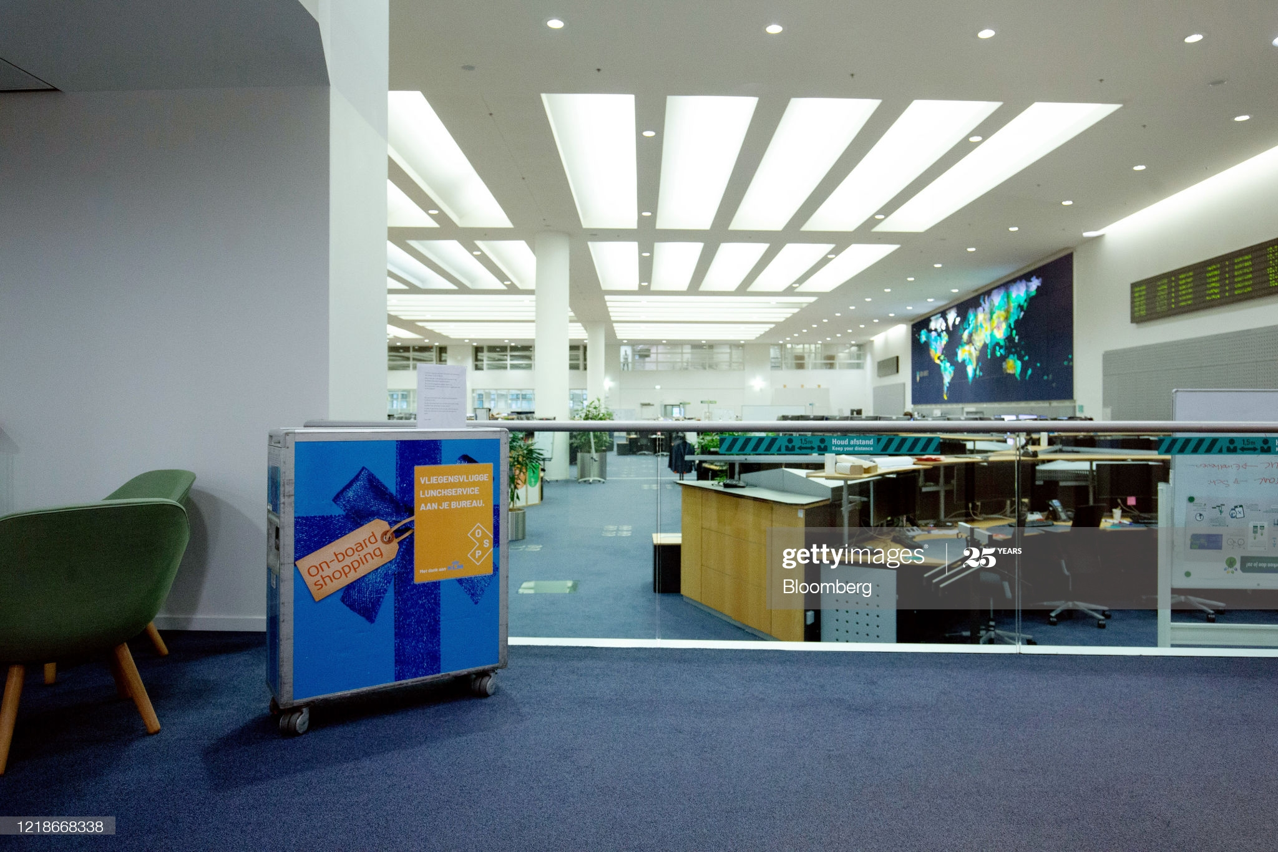
Core Banking System – CBS

Slide 4

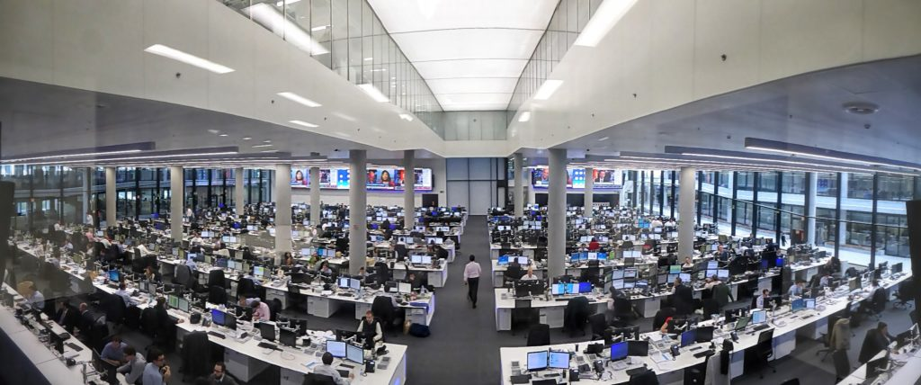
DISSA Course – Practical Aspects – Case Study
(Core Banking System)

Slide 5
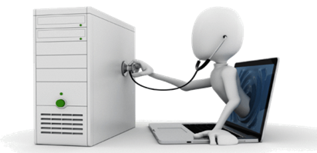

DISSA Course – Practical Aspects – Case Study
(Core Banking System)
NABARD
‘43’ RRBs with 21,871 Branches
NEFT/RTGS
IT Platform is ~1,71,241 Branches

Slide 6
Case Studies – Information Systems Audit
At present Life Insurance Companies in India are 24 (Only LIC of India is having more than 2,000 Branches)
At present General Insurance Companies in India are 34.

Slide 7
Case Studies – Information Systems Audit

Slide 8
Case Studies – Information Systems Audit
Major areas, which will require to be IS audited, are broadly as under:
Safeguarding of Assets.
Data Integrity.
System Effectiveness.
System Efficiency.
Organization and Administration.

Slide 9
Case Studies – Information Systems Audit
Safeguarding of Assets.

Slide 10
Case Studies – Information Systems Audit
The IS auditors will require to concentrate on the following areas to ensure that the Information Systems Assets of the organization are safeguarded:
Environmental Security
Uninterrupted Power Supply
Electrical Lines
Data Cables & Networking Products
Fire Protection

Slide 11
Case Studies – Information Systems Audit
The IS auditors will require to concentrate on the following areas to ensure that the Information Systems Assets of the organization are safeguarded: - Contd.. ..
Insurance of Assets
Annual Maintenance Contract
Logical Security & Access Control - Operating System Level
Logical Security & Access Control – Application System Level

Slide 12
Case Studies – Information Systems Audit
Environmental Security

Slide 13
Case Studies – Information Systems Audit
Checking: Central Server Level. The IS auditors should verify whether:
There is separate room for the server.
Server room has adequate space for operational requirements.
Server room is away from the basement, water / drainage systems.
Server is not in close proximity to the UPS room.

Slide 14
Case Studies – Information Systems Audit
Checking: Central Server Level. The IS auditors should verify whether: Contd.. ..
Server room can be locked and the key being under the custody of the authorized persons (System Administrator) only. Any failed attempts or system tampering as also unscheduled movement in restricted areas, glass breakage or the opening of doors will require to be logged and immediately reported to the control staff at the site. Log to be maintained for persons accessing the server room (who, when, for how much time, purpose of accessing server room).

Slide 15
Case Studies – Information Systems Audit
Checking: Central Server Level. The IS auditors should verify whether: Contd.. ..
Access to server room is restricted to authorized persons and activities in the server room are monitored. IS auditors should check whether physical access for third parties is documented and granted based on their respective maintenance contracts or agreements?
Air-conditioning system provides adequate cooling (i.e., Air-conditioning and humidity controls).
Storage devices to keep stationary and other such items are not kept inside the server room.

Slide 16
Case Studies – Information Systems Audit
Checking: Central Server Level. The IS auditors should verify whether: Contd.. ..
Smoking, eating and drinking are prohibited in the server room to prevent spillage of food or liquid into sensitive computer equipment.
Briefcases, handbags and other packages are restricted from the server room, Back-up library and other sensitive computer area to prevent unauthorized removal of data held on removable media as also to prevent entry of unacceptable material into the area.

Slide 17
Case Studies – Information Systems Audit
Checking: Central Server Level. The IS auditors should verify whether: Contd.. ..
Server room is neat and clean to ensure dust free environment.
Scanners are kept in safe custody and access is restricted.

Slide 18
Case Studies – Information Systems Audit
Uninterrupted Power Supply

Slide 19
Case Studies – Information Systems Audit
Checking: Central Server Level and Branch / Department Level. In addition to the availability of the Generator facility at the site, the IS auditor should verify whether:
There is a separate enclosure and locking arrangement for the UPS.
Maintenance agency provides battery service regularly.
There is a regular contract for maintenance of the UPS and the preventive maintenance is carried as per the contract.
The record of the tests undertaken is maintained to verify the satisfactory functioning of the UPS.

Slide 20
Case Studies – Information Systems Audit
Checking: Central Server Level and Branch / Department Level. In addition to the availability of the Generator facility at the site, the IS auditor should verify whether: Contd.. ..
UPS cabin has adequate ventilation to take care of acid fumes emitted by the Lead Acid batteries.
Capacity of the UPS system is sufficient to take care of the electricity load required for computers installed.
UPS is free of the electricity load relating to the tube-lights, fans, water coolers etc.
UPS functions properly when electricity fails.

Slide 21
Case Studies – Information Systems Audit
Electrical Lines

Slide 22
Case Studies – Information Systems Audit
Checking: Central Server Level and Branch / Department Level. The IS auditors should verify whether:
Power supply to computer equipment is through UPS system only.
The electrical wiring looks concealed and is not hanging from ceiling or nodes.
The circuit breaker switches exist in locked condition only.

Slide 23
Case Studies – Information Systems Audit
Data Cables

Slide 24
Case Studies – Information Systems Audit
Checking: Central Server Level and Branch / Department Level. The IS auditors should verify whether:
A map of the cable layout is kept in a secure place with proper authority. This is helpful in timely and fast repairs of LAN cable faults.
Cabling is properly identified and recorded as fiber optic, co-axial, unshielded twisted pair (UTP) or Shielded Twisted Pair (STP).
Electrical cable and data cable do not cross each other to avoid possible disturbance during data transfer within the network.

Slide 25
Case Studies – Information Systems Audit
Fire Protection

Slide 26
Case Studies – Information Systems Audit
Checking: Central Server Level and Branch / Department Level. The IS auditors should verify whether:
Fire alarm system is installed.
Smoke detectors are provided in the server room and in the other areas of computer installations.
Smoke detectors are tested on a regular basis to ensure that they work.
Gas type (Carbon dioxide, Halon etc.) fire extinguishers are installed at strategic places like server room, UPS room and near the nodes and printers.

Slide 27
Case Studies – Information Systems Audit
Checking: Central Server Level and Branch / Department Level. The IS auditors should verify whether: Contd.. ..
Dry powder or foam type extinguishers should not be used as they tend to leave deposits.
Staff knows how to use the fire extinguishers.
Fire extinguishers are regularly refilled / maintained.
An evacuation plan is documented and rehearsed at regular intervals for taking immediate action in the case of the outbreak of fire.

Slide 28
Case Studies – Information Systems Audit
Insurance

Slide 29
Case Studies – Information Systems Audit
Checking: Central Server Level. The IS auditors should verify whether:
All the computer equipment’s are covered under the appropriate electronic equipment insurance policy with a reputed insurance firm.
A record of the original policy is maintained with the detailed list of the equipment covered under the policy.
Information regarding shifting of computer equipment to or from or within the department / office is conveyed to the insurance firm.
Adequacy of the insurance cover should be verified as per the policy of the organization.

Slide 30
Case Studies – Information Systems Audit
Annual Maintenance Contract

Slide 31
Case Studies – Information Systems Audit
Checking: Central Server Level and Branch / Department Level. The IS auditors should verify whether:
Stamped agreements for maintenance contract are executed and available. Verify the process for evaluation and feedback on vendor competency at the time of awarding contract.
Activities carried out during maintenance have been reported in the registers and duly authenticated. IS auditors should check that whether all activities performed on the network of the organization (servers, network equipment) are logged where possible and reviewed to ensure traceability. Ideally the use of technology that allows real-time monitoring and auditing of the activities of the third-party contractors is preferred.

Slide 32
Case Studies – Information Systems Audit
Checking: Central Server Level and Branch / Department Level. The IS auditors should verify whether: Contd.. ..
Contract renewal rates are maintained in the register.
Access for maintenance purpose is granted only on verifying the identity of the service person.
The maintenance staff support is available in time.

Slide 33
Case Studies – Information Systems Audit
CASE STUDY -1

Slide 34
Case Studies – Information Systems Audit
ABC bank is a Large Bank with more than 4,000 Branches and 20,000 ATMs in India.
With an Aim to Grow Further, it has acquired Three Smaller Private Banks with Similar Lines of Business.

Slide 35
Case Studies – Information Systems Audit
This Acquisition has brought a Variety of Products, Applications and Branches under its Umbrella.
Besides Consumer Banking through Brick and Mortar branches, ABC Bank also wants to Consolidate its position through Internet Banking.

Slide 36
Case Studies – Information Systems Audit
The Growth Strategy of the Bank has resulted in Fragmented Business Operations that Operate in a Regional Structure as well as in Distributed IT Environment.

Slide 37
Case Studies – Information Systems Audit
Hence, ABC Bank Wishes to implement a New, Cutting-Edge Web-based Core Banking System to Manage all its Operations from a Single Window.

Slide 38
Case Studies – Information Systems Audit
ABC Bank also Recognizes that Failure or Malfunction of any Critical System will cause Significant Operational Disruptions and Materially Impact its Ability to provide Service to its Customers, besides Loss of Reputation.

Slide 39
Case Studies – Information Systems Audit
To Overcome this Risk, ABC Bank Plans to Implement Business Continuity Management (BCM).
You have been Appointed as an IT Consultant by ABC Bank to make a Presentation to the Board of Directors to justify the Need for the New System.
Answer the following Queries Raised by the Management:

Slide 40
Case Studies – Information Systems Audit
DISCUSSION POINTS

Slide 41
Case Studies – Information Systems Audit
What are the “Key Management Practices” which are required for Aligning the IT Strategy of ABC Bank with its Enterprise Strategy?

Slide 42
Case Studies – Information Systems Audit
What are the IT Tools you may Consider Critical for Business Growth?

Slide 43
Case Studies – Information Systems Audit
Explain the Five Stages or Components of the BCM Process which will help ABC Bank to manage any Future Disruptions to the Proposed New Core Banking System.

Slide 44
Case Studies – Information Systems Audit
What are the Key Management Practices which are required for Aligning the IT Strategy of ABC Bank with its Enterprise Strategy?
SOLUTION TO POINT-1

Slide 45
Case Studies – Information Systems Audit
The Key Management Practices, which are required for Aligning IT Strategy with Enterprise Strategy are as follows:
STEP-1: Understand Enterprise Direction-It involves the understanding of the Current Enterprise Environment and Business Processes, as well as the Enterprise Strategy and Future Objectives.
It also Considers the External Environment of the Enterprise (Industry Drivers, Relevant Regulations, Basis for Competition).

Slide 46
Case Studies – Information Systems Audit
STEP-2: Assess the Current Environment, Capabilities and Performance - It assesses the performance of Current Internal Business and IT Capabilities and External IT Services, and Develop an understanding of the Enterprise Architecture in relation to IT.
It Identifies issues Currently being Experienced and Develop Recommendations in Areas that could benefit from Improvement.
It considers Service Provider Differentiators and Options and the Financial Impact and Potential Costs and Benefits of using External Services.

Slide 47
Case Studies – Information Systems Audit
STEP-3 : Define the Target IT Capabilities - It defines the Target Business and IT Capabilities and required IT Services.
This should be based on the understanding of the Enterprise Environment and Requirements.
The Assessment of the Current Business Process and IT Environment and Issues; and Consideration of Reference Standards, Best Practices and Validated Emerging Technologies or Innovation Proposals.

Slide 48
Case Studies – Information Systems Audit
STEP-4: Conduct a Gap Analysis - It Identifies the Gaps between the Current and Target Environments and consider the Alignment of Assets (the Capabilities that Support Services) with Business Outcomes to Optimize Investment in and Utilization of the Internal and External Asset Base.

Slide 49
Case Studies – Information Systems Audit
STEP-5 : Define the Strategic Plan and Road Map - It creates a Strategic Plan that defines in Co-operation with relevant Stakeholders, how IT - related Goals will Contribute to the Enterprise’s Strategic Goals.
It includes how IT will support IT-enabled Investment Programs, Business Processes, IT Services and IT Assets.
IT should define the initiatives that will be required to Close the Gaps, the Sourcing Strategy, and the measurements to be used to monitor achievement of goals, then prioritize the initiatives and combine them in a High-level Road Map.

Slide 50
Case Studies – Information Systems Audit
STEP-6 : Communicate the IT Strategy and Direction: It Creates Awareness and Understanding of the Business and IT Objectives and Direction, as Captured in the IT Strategy, through Communication to Appropriate Stakeholders and users throughout the Enterprise.

Slide 51
Case Studies – Information Systems Audit
What are the IT Tools you may consider Critical for Business Growth?
SOLUTION TO POINT-II

Slide 52
Case Studies – Information Systems Audit
Some IT Tools that may be crucial for any business growth are as follows:
Business Website: By having a Website, Enterprise / Business becomes reachable to Large number of Customers.
In addition, it can also be used in an Advertisement, which is Cost Effective and in Customer Relationship Management.
These Websites can be designed by using HTML, XML, ASP.NET etc.

Slide 53
Case Studies – Information Systems Audit
Internet and Intranet:
It is the best source of Communication.
Time and Space are no more obstacles for conducting meeting of people working in a team from multiple locations, or with different vendors and companies.
Intranet is System that Permits the Electronic Exchange of business data within an Organization, mostly between managers and senior staff.

Slide 54
Case Studies – Information Systems Audit
Internet and Intranet:
E-commerce among partners (Suppliers, Wholesalers, Retailers, Distributors) using intranets, e-mail etc. provides new platform to the business world for conducting business in a faster and easier way.
E-commerce provides Business to Business, Business to Customer, Customer to Customer and Customer to Business Communication with a Click of Mouse.

Slide 55
Case Studies – Information Systems Audit
Business Intelligence (BI) – This refers to Applications and Technologies that are used to Collect and provide access and Analyze Data and Information about Companies’ Operations.
Some BI Applications are used to Analyze Performance or Internal Operations e.g. EIS (Executive Information System), Business Planning, Finance and Budgeting Tools.
While others are used to Store and Analyze Data e.g. Data Mining, Data Warehouses, Decision Support System etc. Some BI applications are also used to Analyze or Manage the Human Resources e.g. Customer Relationship and Marketing Tools.

Slide 56
Case Studies – Information Systems Audit
Software and Packages-DBMS, Data Warehousing, Data Mining Tools, Knowledge Discovery can be used for getting Information that Plays Important Role in Decision Making and can Boost the Business in the Competitive World.
These can be used in Supply Chain Logistics, including Planning, Purchasing, Replenishment, Logistics, and Space Management.

Slide 57
Case Studies – Information Systems Audit
Computer Systems, Scanners, Laptop, Printer, Webcam, Smart Phone etc.
Webcam, Microphone etc. are used in Conducting Long Distance Meeting.
Use of Computer Systems, Printer and Scanner lead to increase in Accuracy; reduced Processing Times, enable quick decision-making and Speed up Customer Service.

Slide 58
Case Studies – Information Systems Audit
Explain the Five Stages or Components of the BCM Process which will help ABC Bank to manage any Future Disruptions to the proposed New Core Banking System.
SOLUTION TO POINT-III

Slide 59
Case Studies – Information Systems Audit
The Components / Stages of Business Continuity Management (BCM) Process are given below:
Stage 1 - BCM Information Collection Process: The Activities of Assessment Process do the Prioritization of an Enterprise’s Products and Services and the Urgency of the activities that are required to Deliver them.
This sets the requirements that will determine the Selection of Appropriate BCM Strategies in the Next Process.

Slide 60
Case Studies – Information Systems Audit
Stage 2 - BCM Strategy Process: Finalization of Business Continuity Strategy requires assessment of a Range of Strategies.
This requires an Appropriate response to be selected at an Acceptable Level and during and after a Disruption within an acceptable timeframe for each product or service, so that the Enterprise Continues to Provide those Products and Services.

Slide 61
Case Studies – Information Systems Audit
Stage 3 - BCM Development and Implementation Process: Development of a Management Framework and a Structure of Incident Management, Business Continuity and Business Recovery and Restoration Plans.

Slide 62
Case Studies – Information Systems Audit
Stage 4 - BCM Testing and Maintenance Process: BCM testing, Maintenance and Audit Testify the Enterprise BCM to prove the extent to which its Strategies and Plans are Complete, Current and Accurate; and Identifies Opportunities for Improvement.

Slide 63
Case Studies – Information Systems Audit
Stage 5 - BCM Training Process: Extensive Trainings in BCM framework, Incident Management, Business Continuity and Business Recovery and Restoration plans enable it to become part of the Enterprise’s Core Values and Provide Confidence in all stakeholders in the ability of the enterprise to Cope with Minimum Disruptions and Loss of Service.

Slide 64
Case Studies – Information Systems Audit
CASE STUDY -II

Slide 65
Case Studies – Information Systems Audit
In order to Cope-up with the New Technology Usage in an Enterprise, the Auditor shall be Competent to provide Independent Evaluation as to whether the Business Process activities are Recorded and Reported according to Established Standards or Criteria.
In light of this, Discuss the Issues involved in the Performance of Evidence Collection and Understanding the Reliability of Controls.

Slide 66
Case Studies – Information Systems Audit
DISCUSSION POINTS TO CASE STUDY - II

Slide 67
Case Studies – Information Systems Audit
The Performance of Evidence Collection and Understanding the Reliability of Controls Involves Issues like:
Data Retention and Storage: A Client’s Storage Capabilities may restrict the amount of Historical Data that can be retained on-line and readily accessible to the Auditor.
If the Client has insufficient Data Retention Capacities, the Auditor may not be able to review a Whole reporting period Transactions on the Computer System.
For Example, the Client’s Computer System may Save Data on Detachable Storage Device by summarizing transactions into Monthly, Weekly or period End Balances.

Slide 68
Case Studies – Information Systems Audit
Absence of Input Documents: Transaction Data may be entered into the Computer Directly without the presence of Supporting Documentation e.g. Input of Telephone Orders into a Tele-sales System.
The increasing use of Electronic Data Interchange (EDI) will result in Less Paperwork being available for Audit Examination.

Slide 69
Case Studies – Information Systems Audit
Non-availability of Audit Trail: The Audit Trails in some Computer Systems may exist for only a Short Period of Time.
The Absence of an Audit Trail will make the Auditor’s Job very difficult and may call for an Audit Approach which involves Auditing around the Computer System by seeking other Sources of evidence to provide Assurance that the Computer Input has been Correctly Processed and Output.

Slide 70
Case Studies – Information Systems Audit
Lack of Availability of Printed Output: The Results of Transaction Processing may not Produce a Hard Copy form of Output, i.e. a Printed Record.
In the absence of Physical Output, it may be necessary for an Auditor to directly access the Electronic Data retained on the Client’s Computer.
This is normally achieved by having the client provide a Computer Terminal and being Granted “Read” Access to the required Data Files.

Slide 71
Case Studies – Information Systems Audit
Audit Evidence: Certain Transactions may be Generated Automatically by the Computer System.
For Example, a Fixed Asset System may Automatically Calculate Depreciation on Assets at the end of each Calendar Month.
The Depreciation Charge may be Automatically Transferred (Journalized) from the Fixed Assets Register to the Depreciation Account and hence to the Client’s Income and Expenditure Account.

Slide 72
Case Studies – Information Systems Audit
Legal Issues: The Use of Computers to carry out Trading Activities is also Increasing.
More Organizations in Both the Public and Private Sector intend to make use of EDI and Electronic Trading over the Internet.
This can Create Problems with Contracts, e.g. when is the Contract made, where is it made in terms of its Legal Jurisdiction, what are the terms of the Contract and which are the Parties to the Contract.
Furthermore, the Laws regarding the Admissibility of Computer Evidence Varies from One Country to another and from One Court to another.

Slide 73
Case Studies – Information Systems Audit
CASE STUDY -III

Slide 74
Case Studies – Information Systems Audit
PQR Insurance Company Limited is providing Insurance Services to Indian Citizens.
What are the requirements of IRDA for System Audit in respect of this Company?

Slide 75
Case Studies – Information Systems Audit
SOLUTION TO CASE STUDY - III

Slide 76
Case Studies – Information Systems Audit
The Requirements of Insurance Regulatory and Development Authority of India (IRDA) for System Audit in respect of PQR Insurance Company Ltd are as follows:
All Insurers shall have their Systems and Process Audited at Least Once in Three Years by a Professional Firm.
In Doing so, the Current Internal or Concurrent or Statutory Auditor is Not Eligible for Appointment.
Professional Firm must be having a Minimum of 3-4 years’ Experience of IT Systems of Banks or Mutual Funds or Insurance Companies.

Slide 77
Case Studies – Information Systems Audit
CASE STUDY -IV

Slide 78
Case Studies – Information Systems Audit
You are Appointed to Audit the Information Systems of XYZ Limited.
Please Enlighten the Management about Various “Categories of Information Systems Audits”.

Slide 79
Case Studies – Information Systems Audit
SOLUTION TO CASE STUDY - IV

Slide 80
Case Studies – Information Systems Audit
Information Systems Audit has been categorized into Five Types:
Systems and Application: An Audit to verify that Systems and Applications are Appropriate, are Efficient, and are Adequately Controlled to ensure Valid, Reliable, Timely, and Secure Input, Processing, and Output at all Levels of a System’s Activity.
Information Processing Facilities: An Audit to Verify that the Processing Facility is Controlled to Ensure Timely, Accurate, and Efficient Processing of Applications under Normal and Potentially Disruptive Conditions.

Slide 81
Case Studies – Information Systems Audit
Systems Development: An Audit to verify that the Systems under Development meet the Objectives of the Organization and to Ensure that the Systems are developed in accordance with Generally Accepted Standards for Systems Development.
Management of IT and Enterprise Architecture: An Audit to verify that IT Management has Developed an Organizational Structure and Procedures to Ensure a Controlled and Efficient Environment for Information Processing.

Slide 82
Case Studies – Information Systems Audit
Telecommunications, Intranets, and Extranets: An Audit to Verify that Controls are in Place on the Client (End-point Device), Server, and on the Network Connecting the Clients and Servers.

Slide 83
Case Studies – Information Systems Audit
CASE STUDY -V

Slide 84
Case Studies – Information Systems Audit
In the Present Day, the Enterprises not only need to Protect there IS Assets against Cyber-Attack but also need to take Steps to “Ensure Compliance” with Cyber Laws as well.
What are the Key Steps for Ensuring “Such Compliance”?

Slide 85
Case Studies – Information Systems Audit
SOLUTION TO CASE STUDY - V

Slide 86
Case Studies – Information Systems Audit
Enterprises not only need to Protect their Assets Against Cyber-attack but also need to take Steps to Ensure Compliance with Cyber Laws as well.
Some Key Steps for ensuring such Compliance are given below:
Designate a “Cyber Law Compliance Officer” as required.
Conduct “Regular Training” of relevant Employees on “Cyber Law Compliance”.
Implement Strict Procedures in “HR Policy for Non-compliance”.
Implement “Authentication Procedures” as suggested in Law.

Slide 87
Case Studies – Information Systems Audit
Implement “Policy and Procedures” for Data Retention as Suggested.
Identify and Initiate Safeguard Requirements as Applicable under Various Provisions of the Act such as: Sections 43A, 69, 69A, 69B, etc.
Implement Applicable “Standards of Data Privacy” on Collection, Retention, Access, Deletion etc.
Implement “Reporting Mechanism” for Compliance with Cyber Laws.

Slide 88
Case Studies – Information Systems Audit
43A - Section 43 of the IT Act, imposes a penalty of INR 10 million inter alia, for downloading data without consent. The same penalty would be imposed upon a person who, inter alia, introduces or causes to be introduced any computer contaminant or computer virus into any computer, computer system or computer network.
Section 69A of the IT Act, 2000, allows the Centre to block public access to an intermediary “in the interest of sovereignty and integrity of India, defence of India, security of the State, friendly relations with foreign States or public order or for preventing incitement to the commission of any cognizable offence.

Slide 89
Case Studies – Information Systems Audit
Section-69B - The Central Government may, to enhance cyber security and for identification, analysis and prevention of intrusion or spread of computer contaminant in the country, by notification in the Official Gazette, authorize any agency of the Government to monitor and collect traffic data or information generated, ...

Slide 90
THANK YOU
CMA (Dr.) Puvvala Siva Rama Prasad
M.Com., MBA (Finance)., FCMA., FCS., FIIBF., FIII (Life & General)., MAIMA

