Slide 1

Welcome to the Participants
DISSA Course
The Institute of Cost Accountants of India
Kolkata

Slide 2


B. Cloud Computing Management Audit
CMA (Dr.) Siva Rama Prasad Puvvala
M.Com., MBA., FCMA., FCS., FIIBF., FIII (Life & General)., MAIMA.,

Slide 3
III. Calculating the Financial Implications
CMA (Dr.) Siva Rama Prasad Puvvala
M.Com., MBA., FCMA., FCS., FIIBF., FIII (Life & General)., MAIMA.,

Slide 4

Comparing-in-House Facilities to the Cloud
Software Engineering isn’t Cheap.
High-Quality Development Costs.

Slide 5
Comparing-in-House Facilities to the Cloud
Very often the most Important Criteria for a Product Acquisition, when a person or Company Compares between Different Products is based on the Actual Product Pricing.
If the Comparison is Strictly done on a basis of what is the Price of the Product.

Slide 6
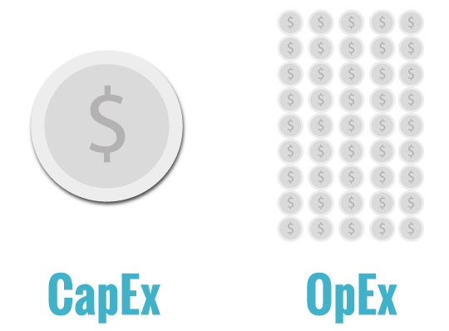
Comparing-in-House Facilities to the Cloud
TCO is the Metric that Organizations use to Quantify and Measure Cloud Adoption Success.
This helps you understand the Return on Investment so that you can Prioritize and Focus.

Slide 7
Comparing-in-House Facilities to the Cloud
By Capturing the Key Cost Considerations, a workable model that can use to make informed decisions.
TCO is a Financial Estimate Intended to help Evaluators to Determine the Direct and Indirect Costs of a Product during its Life-cycle.

Slide 8
Comparing-in-House Facilities to the Cloud
In a majority of the cases, it really makes sense as a significant portion of the price is directly related to the physical, actual work.
When looking at different ‘forms’ of expenses, it can be divided to two different expenditures:
An Operating Expense, Operating Expenditure, Operational Expense, Operational expenditure or OpEx is an on-going cost for running a system.

Slide 9
Comparing-in-House Facilities to the Cloud
Its Counterpart, a Capital Expenditure – CapEx – is the Cost of Providing Non-Consumable Parts for the System.
CapEx is a Business Expense incurred to Create Future Benefits or to Add to the Value of an Existing Asset. For example, a Mobile App Developer might Buy New Assets, like Mobile Devices, Tools, Infrastructure Hardware, Software or other Equipment, that will be useful for the Development and Testing of their Products.
Typically, these Expenses are Long Term and will provide Benefits during the Full Life Cycle of Development.

Slide 10
Comparing-in-House Facilities to the Cloud
OpEx refers to the Expenses that the Mobile App Developer spends in order to get their Day-to-Day activities going on and to get their Infrastructure Fully Working.
For Example, Mobile App Developers have Costs related to Wages, Utilities, Maintenance of the Infrastructure and the System, which all fall under the Category of Operational Expenses.

Slide 11
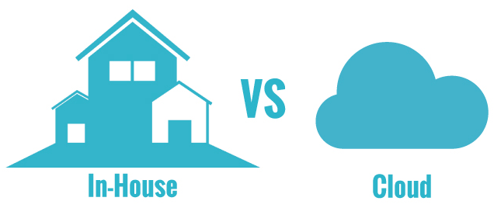
Comparing-in-House Facilities to the Cloud
This is the first in The Investments in Mobile App Development and Testing series and focus is on a brief comparison of two different approaches, deployment options for Mobile App Development and Testing the In-House and Cloud-based Solutions.

Slide 12
Comparing-in-House Facilities to the Cloud
In-House Solution
An in-house solution is something more traditional compared to today’s cloud-based software solutions.
It is typical that at the beginning when an in-house solution is acquired in use it involves more expenses as user need to buy a license and get the hardware infrastructure (e.g., servers, devices) in place.

Slide 13
Comparing-in-House Facilities to the Cloud
Naturally, the operative expense will be there as well and user need to take care of maintenance of the system, software (and sometimes even hardware) updates, fixing and resolving problems with the system and probably many other smaller tasks that eventually makes a financial burden to accumulate.
For example, when running an in-house mobile development and testing lab with tens powerful and power-hungry server hardware, hundreds of mobile devices and additional equipment needed for that, plus cooling of the room, user suddenly see some peak in user’s electricity bill.

Slide 14
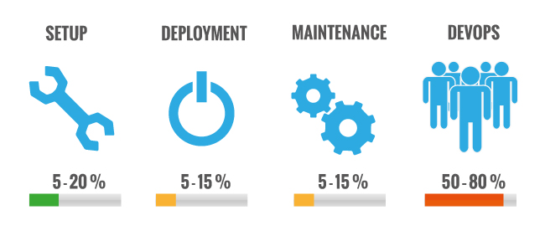
Comparing-in-House Facilities to the Cloud
One significant Cost of Building and Dealing with these more Traditional Solutions is Naturally the Cost related to Work (Salaries).
Typically, Setting up isn’t necessarily expensive, but running the system 24/7 can make astronomical.

Slide 15
Comparing-in-House Facilities to the Cloud
The CapEx, in this case, is the acquisition of server, device, networks, facilities and other Types of Equipment.
Depending on how large the Environment Users are setting up but this can be anything between 5 to 20 % in total costs during the life-cycle.
Another important item within in-house solutions is the deployment costs.

Slide 16
Comparing-in-House Facilities to the Cloud
This ‘deployment’ can include some integration work of the New Software / Environment with users Existing environments.
People claiming the integration, deployment, and all Configurations related to this are between 5 to 15 % of Total Costs.
Again, it Hugely Depends on how large is the system and how much Integration and Configuration is needed at the beginning.

Slide 17
Comparing-in-House Facilities to the Cloud
The maintenance of the environment includes all types of Equipment, Back-up Servers, Storage, Network connections, Software Updates, Administrative Tools and e.g., Support for Internal resources and typically varies between 5 and 15 % of total costs.
The Purpose of Maintenance is just to make sure the work, development, and testing, can proceed smoothly without any / little interruptions.

Slide 18
Comparing-in-House Facilities to the Cloud
The major part of the costs with in-house solutions is related to the OpEx. aspect – Running the System, making sure servers, devices and all other parts of the infrastructure is up and running.
As this varies Quite a lot depending on how much resources are used to keep the system up and running, it is still the major part of the costs with in-house solutions (50-80% of total costs).
The typical amortization period for all those investments done in hardware is around 3 years. After that, servers and devices are pretty old and have become obsolete for development and testing.

Slide 19
Comparing-in-House Facilities to the Cloud
Cloud-Based Solution
Cloud solutions provide an instant way to build mobile development and testing labs.
The greatest benefit of these solutions is that user don’t have to set up any server hardware or connect any physical mobile device in order to use them seamlessly as a part of user development process.
The majority of the costs related to cloud-service are included in the price of the service.
User very rarely even need any other software to be purchased to use these services.

Slide 20
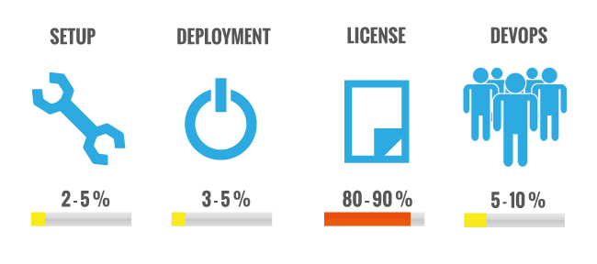
Comparing-in-House Facilities to the Cloud

Slide 21
Comparing-in-House Facilities to the Cloud
Typically, the setup costs with a cloud-based solution are minimal, this is between 2 to 5% of total costs.
For example, some basic installations to make the cloud-based solution fit with the existing system / environment and get everyone in the team to use it.
The same goes for deployment and the basic integration for example with existing used continuous integration environment, development tools, build systems or any internal infrastructure software and this also plays a minor role in total costs (3 to 5%).

Slide 22
Comparing-in-House Facilities to the Cloud
The recurring cost naturally is the license fee / price of the service. It’s worth of noting that all maintenance, server, device and other hardware acquisition costs are included in the license fee / price of the service.
This can be around 50 to 80% of total costs, including the service itself, training, updates, security, support and basically everything that is needed to make the service running.
Finally, some Op. Ex aspects of the cloud-based solutions, such as administrative costs, analysis of the usage, monitoring of the system and so on can make 5 to 10 % of total costs.

Slide 23
Comparing-in-House Facilities to the Cloud
The best and the most suitable deployment option whether it is a full in-house solution with user own devices, servers and other infrastructure or fully hosted for user, depends on various aspects.
For example, if users are OK to share devices with everyone else, then the public deployment option will work user like a charm.

Slide 24
Comparing-in-House Facilities to the Cloud
In addition, user have access to all the latest and greatest devices globally.
But, in case user need to have device access instantly and only share those devices with users own teams, the private cloud version will make user life a lot easier.

Slide 25
Estimating Economic Factors Downstream
Basics of Cloud Computing Economics
Back in the pre-cloud computing era, organizations had to invest heavily in the infrastructure, manpower, and training to set up their IT department.
This was time-consuming, relatively inflexible, and expensive.
With the evolution of cloud computing, this is now the go-to solution for all sorts of companies as cloud computing can help companies save time and money along with providing multitudes of benefits.

Slide 26
Estimating Economic Factors Downstream
Basics of Cloud Computing Economics
Many reliable cloud providers usually provide several customized configurations to address the need for all kinds of small or large businesses.
Because of this, return on user’s technology investment is often high as user business move to the cloud.

Slide 27
Estimating Economic Factors Downstream
However, the Economics of Cloud Computing can be Quite Complex to understand, as Several Factors impact user Cloud ROI.
For example, when choosing the Right Cloud Solution, there are dozens of different configurations to choose from, each one differing in terms of the number of CPU Cores, Memory and Local Storage attached to it.

Slide 28
Estimating Economic Factors Downstream
What is Cloud Economics?
In the simplest term, the economics of cloud computing deal with the knowledge concerning the principles, costs, and benefits of cloud computing.
For any Organization to derive the greatest value for the business, it must specifically determine how cloud services can affect IT Budget, Security and IT Infrastructure.

Slide 29
Estimating Economic Factors Downstream
What is cloud economics?
There is no hard and fast formula to determine that, it all depends on Assessing the Costs pertaining to Infrastructure, Management, Staffing Need, Research and Development (R&D), Security and Support.
All these Factors are Analysed to determine if Moving to the Cloud makes a Logical Next Step forward as per the organization’s specific Circumstances and Needs.

Slide 30
Estimating Economic Factors Downstream
How to Calculate the Cost of Moving to the Cloud?
Now here is where the economics of cloud computing comes into action.
Take a Holistic Approach to calculate the Cost of Cloud Computing.

Slide 31
Estimating Economic Factors Downstream
Total Cost of Ownership:
To put the Cost of a Cloud Solution into perspective, user need to calculate the total cost of ownership (TCO) for the on-premises first.
User can calculate that by figuring out the cost of the equipment user need, the cost of the capital and the project lifespan of the equipment.
User can also include the installation and maintenance costs as well.

Slide 32
Estimating Economic Factors Downstream
Cost of User Current Data Center: That’s the first step, to calculate the amount of time, money and infrastructure required in running user current data center.
Once user determines the Scope and Scale of user Current IT Infrastructure, it will provide user with the Baseline to help user Calculate the Potential Cost of the Cloud Resources the user will consume and compare it to current cost levels.

Slide 33
Estimating Economic Factors Downstream
Cost of User Current Data Center:
To precisely calculate the cost of user current data center, make sure to include all aspects.
For example, IT infrastructure consisting of hardware and software that can include physical servers, software licenses, maintenance contracts, warranties, supplies, material, spare parts, and anything else that user directly pay.

Slide 34
Estimating Economic Factors Downstream
Cost of User Current Data Center:
User need the cost of all these to correctly estimate how much user current IT infrastructure cost.
Then there are operational costs as well that include labour, facilities used to house IT hardware, internet connectivity.
These operational costs are part of the cost of user data center as well.

Slide 35
Estimating Economic Factors Downstream
Cost of estimated Cloud Infrastructure:
Once the Cost of user Current Data Center is determined, user now need to calculate the estimated cost of cloud infrastructure.
While cloud pricing can vary depending on the number of factors and can be quite complicated, it depends on user cloud provider to provide a simplified pricing structure that is easier to understand.
Alternatively, user can contact user cloud provider of choice for a quote.

Slide 36
Estimating Economic Factors Downstream
Cost of Cloud Migration Execution:
The next step is accounting for the costs involved in executing the migration of the IT operations to the cloud.
It is determined by the scope of user Current IT infrastructure and how much of its user plan on moving to the cloud will be.
Moreover, there is a cost involved in integrating and testing of apps or even consultation fees.

Slide 37
Estimating Economic Factors Downstream
Additional Post-migration Cost:
Often, many cloud providers require a monthly infrastructure fee to maintain and improve user new cloud environment.
Costs such as Continuous Integration and Testing of Apps, Training, Labour, Security, and Compliance, Administration, and Others need to be forecasted in order to determine an accurate post-migration budget.

Slide 38
Estimating Economic Factors Downstream
Benefits of Cloud Computing Versus Cost:
Cloud Computing is about storing and accessing data, programs, and applications users are using over the internet instead of storing and accessing the same thing from user computer’s hard drive.
Hence, the Cost of Shifting to the cloud may seem steep but in actual, maintenance of on-premises infrastructure is more expensive than cloud computing in the long run.
Moreover, cloud computing offers the flexibility to scale services to fit as per the company’s needs and customize applications.

Slide 39
Estimating Economic Factors Downstream
Summary:
A move to cloud computing can be a great step towards breaking free of out-dated IT practices and the financial constraints it carries.
A good cloud computing solution that is Compatible with user Company can provide a Significant Return on Investment, Affording Energy, Licensing and Administrative Costs, and it Frees up Capital and Personnel to Innovate on New Ideas Quickly.

Slide 40
Estimating Economic Factors Downstream
Summary:
However, it’s important to approach cloud computing adoption for user company with objectivity.
It is always a good idea to thoroughly look into the pros and cons of cloud computing for user company before making the decision.

Slide 41
THANK YOU
CMA (Dr.) Puvvala Siva Rama Prasad
M.Com., MBA (Finance)., FCMA., FCS., FIIBF., FIII (Life & General)., MAIMA

