Slide 1

Welcome to the Participants
DISSA Course
The Institute of Cost Accountants of India
Kolkata

Slide 2


B. Cloud Computing Management Audit
CMA (Dr.) Siva Rama Prasad Puvvala
M.Com., MBA., FCMA., FCS., FIIBF., FIII (Life & General)., MAIMA.,

Slide 3
II. Adopting the Cloud
CMA (Dr.) Siva Rama Prasad Puvvala
M.Com., MBA., FCMA., FCS., FIIBF., FIII (Life & General)., MAIMA.,

Slide 4

Evaluating Barriers to Cloud Computing
Software as a Service (SaaS) provides a Complete Solutions (Infrastructure, Platform and Application) that is managed by the Service Provider.
SaaS is software that is deployed over the Internet rather than Installed on a Computer. It is often used for Enterprise Applications that are distributed to multiple users. SaaS applications typically run within a Web Browser, which means users only need a Compatible Browser in order to Access the Software.
SaaS solution are like CRM, e-mail and Collaboration Tools, BI and Analytics, Secure Backup etc.
Organisations Do not have to Worry about how the Service is maintained or how the underlying Infrastructure is Managed.

Slide 5
Evaluating Barriers to Cloud Computing
Platform as a Service (PaaS): Organizations that use either in-house or Partner Staff to Perform Software Product Development can use PaaS to Develop, Deploy and Manage Applications.
Platform-as-a-Service (PaaS) is a type of Cloud Computing offering in which a Service Provider delivers a Platform to Clients, enabling them to Develop, Run, and Manage Business Applications without the need to Build and Maintain the Infrastructure such Software Development Processes typically require.
PaaS helps Organizations to be more Efficient as you do not need to worry about Software Procurement, Capacity Planning, Software Maintenance, Patching, or any of the other IT Operations involved in running Organizations Applications.

Slide 6
Evaluating Barriers to Cloud Computing
Infrastructure as a Service (IaaS) Contains all Basic Building Blocks for Cloud IT and Typically provides Compute, Network and Storage in a Virtual Environment. IaaS provides Organizations with Highest Level of flexibility and Management Control over their IT resources and is most similar to existing IT Resources that many IT Departments and Application Developers are familiar with Today.
IaaS Service Provider manages the entire Infrastructure while Organizations are responsible for all other aspects of the Deployment.

Slide 7
Evaluating Barriers to Cloud Computing
Evaluating Cloud Computing Services:
Criteria to consider for selecting a Cloud Computing provider is becoming increasingly Complex:
As Cloud Environments Mature, many Cloud providers Attempt to Differentiate themselves by focusing on Specific Aspects of their offerings, such as Technology stacks or service-level agreements (SLAs).
In short, Not all Cloud Providers are Created Equal.

Slide 8
Evaluating Barriers to Cloud Computing
Enterprises are beginning To Rely on Cloud Providers for hosting mission critical applications, which raises the stakes for selecting the right cloud service.

Slide 9
Evaluating Barriers to Cloud Computing
Few Key Factors for evaluating services as well as some resources to use:
Performance: One of the main concerns for enterprises that are considering cloud computing is performance.
Achieving High-Speed Delivery of Applications in the Cloud is a multifaceted challenge that requires a Holistic Approach and an end-to-end view of the application request-response path.

Slide 10
Evaluating Barriers to Cloud Computing
Performance: Performance issues include the Geographical Proximity of the Application and Data to the End user, Network Performance both within the Cloud and in-and-out of the Cloud and I/O Access Speed between the Compute Layer and the Multiple Tiers of Data Stores.

Slide 11
Evaluating Barriers to Cloud Computing
Technology Stack: Several cloud providers have focused their services on a particular Software Stack.
This typically moves them from being Infrastructure as a Service (IaaS) providers to the realm of Platform as a Service (PaaS).
As one would expect, the different stack-specific clouds align with the most popular software stacks out there.
Examples include Heroku and Engine Yard for Ruby on Rails; VM force and Google App Engine (GAE) for Java/Spring (GAE also supports Python), PHP Fog for PHP and Microsoft's Windows Azure for .NET.

Slide 12
Evaluating Barriers to Cloud Computing
Technology Stack:
If the application is built using One of the Stacks, they may want to consider these cloud platforms.
They can offer Tremendous Savings in terms of Time and Expense.
The flip side is that they often require developers to follow certain best practices in architecting and writing their apps, which creates a higher degree of vendor lock-in.

Slide 13
Evaluating Barriers to Cloud Computing
Service-level Agreements and Reliability:
Some Cloud providers Offer Guarantees for higher levels of service as a way to separate themselves from the pack.
In Rack Space: The Avis of Cloud Computing, Rack Space has higher levels of cloud service SLAs to Compete with Amazon, the 800-pound Gorilla of Cloud Computing.

Slide 14
Evaluating Barriers to Cloud Computing
Service-level Agreements and Reliability:
SLAs are often merely an indication of the consequences when the service fails and not the service's actual reliability.
A great example of this is Go Grid’s 10,000% Guaranteed SLA. In other words, Go Grid Offers a 100% Uptime Guarantee.
If it fail to meet that level of availability, it will compensate the customer with 100 times the fee paid for the downtime.

Slide 15
Evaluating Barriers to Cloud Computing
Although the SLA is a Good Indicator of any Provider’s Level of commitment, knowing the real uptime levels of a particular cloud provider.
Most Vendors have a Status Page that Acts as a Dashboard for the Health of their Services, but these generally display.
To get actual long-term numbers for Reliability and Availability, it's better to rely on Customer Testimonials and Comparison Services.

Slide 16
Evaluating Barriers to Cloud Computing
APIs:
API is the acronym for Application Programming Interface, which is a software intermediary that allows two applications to talk to each other.
Each time you use an app like Facebook, send an instant message, or check the weather on your phone, you're using an API.

Slide 17
Evaluating Barriers to Cloud Computing
APIs: Lock-in, Community and Ecosystem:
Another Critical aspect of selecting a Cloud Provider is the Application Programming Interface (API) it exposes for Accessing the Infrastructure and Performing Operations such as Provisioning and De-provisioning Servers.
The API is Important in a Number of Ways.

Slide 18
Evaluating Barriers to Cloud Computing
First, an API that is Supported by Multiple Providers and Vendors reduces Lock-in Because Migration from one provider to another-or simultaneously working with Multiple Providers - requires less change to the application and is, therefore, easier.

Slide 19
Evaluating Barriers to Cloud Computing
Second, an API that is Widely Supported by a Community of Developers and Vendors has an entire Ecosystem Around it of Complementary Services and Capabilities.
The APIs offered by Amazon Web Services (AWS) and the various VMware cloud offerings have large ecosystems built around them.

Slide 20
Evaluating Barriers to Cloud Computing
Security and Compliance:
Two of the biggest barriers for companies considering cloud computing continue to be security and compliance. In a recent Zenoss Inc. Survey conducted during the second quarter of 2010, Nearly 40% of respondents listed security when asked about their biggest concerns about cloud computing.
The Second most Common Answer was Management, which received only 26.5% of the responses.
The Zenoss Survey is Consistent with a number of other surveys related to cloud computing.

Slide 21
Evaluating Barriers to Cloud Computing
Security and Compliance:
The Real Concern for Enterprises is Not actually Security Threats but rather their Inability to Achieve Compliance with Security-related Standards such as Payment Card Industry (PCI).
In response, many Cloud Providers are now touting their Security and Compliance Chops with SAS-70 Type II Audits, Security White Papers and Other Measures.

Slide 22
Evaluating Barriers to Cloud Computing
Cost: A Straightforward way to Compare Cloud providers would appear to be Cost.
The problem is that there is No Consistency among Providers in regards to the Resources Customers actually receive and Pay for.
Providers Offer Virtual Machines (VMs) that vary Widely in Memory Capacity, CPU Clock Speed and other Features.

Slide 23
Evaluating Barriers to Cloud Computing
Furthermore, the units that are actually provided to Customers are often Virtualized, creating even further Confusion as to what the customer is actually getting and how it might be affected by other customers on the same Cloud.
The Only Truly reliable way to measure the Cost-performance of Different Cloud Providers at this point is to Conduct an Experiment with the Same Application or prototype on Multiple Providers and Compare the Results.

Slide 24
Evaluating Barriers to Cloud Computing
Choosing the Best Cloud Provider for an Application is a Multidimensional Problem.
As the number of Cloud Providers Increases, and as many of them Focus on Specialized Needs of the Clients.
Services are emerging that help compare cloud services so that Customers can tell which Provider is Best suited for which Application.

Slide 25
Handling Sensitive Data – Aspects of Cloud Security
Cloud Computing has raised Several Security Threats such as data breaches, data loss, denial of service, and malicious insiders that have been extensively studied.
These threats mainly Originate from Issues such as Multi-tenancy, Loss of Control over Data and Trust.

Slide 26
Handling Sensitive Data – Aspects of Cloud Security
Security Issues in Cloud Computing:
Multi-tenancy: Multi-tenancy refers to Sharing Physical Devices and Virtualized Resources between multiple independent users.
Cloud Providers use Multi-tenancy Features to Build Infrastructures that can Efficiently Scale to meet Customers’ Needs, however the Sharing of Resources means that it can be Easier for an Attacker to Gain Access to the Target’s Data.

Slide 27
Handling Sensitive Data – Aspects of Cloud Security
Privacy Considerations of Processing Sensitive Data:
Privacy is a Complex Topic that has different Interpretations depending on Contexts, Cultures and Communities, and it has been recognized as a Fundamental Human Right by the United Nations.
Privacy and Security are two distinct topics although Security is generally necessary for providing Privacy.

Slide 28
Handling Sensitive Data – Aspects of Cloud Security
Identity and Access Management:
They are Transferring their Work either on the Private or Public Cloud Platforms through various Vendors.
But Sometimes it is a Challenging Task for all the Companies to keep the Data Safe and Secure in the Cloud.

Slide 29
Handling Sensitive Data – Aspects of Cloud Security
Identity Access Management in Cloud Computing
The concept of Identity in the Cloud can refer to Many Things, the Two main entities are:
Users.
Cloud Resources.

Slide 30
Handling Sensitive Data – Aspects of Cloud Security
Confidentiality, Integrity, and Availability:
Confidentiality means that Data, Objects and Resources are Protected from Unauthorized Viewing and other Access.
Integrity Means that Data is Protected from Unauthorized Changes to Ensure that it is Reliable and Correct.
Availability means that Authorized users have Access to the Systems and the Resources they need.

Slide 31
Handling Sensitive Data – Aspects of Cloud Security
Security Monitoring and Incident Response:
A Centralized Monitoring Solution for Cloud Applications Consisting of Monitoring the Server, Monitors, Agents, Configuration Files and Notification Components.
Redundancy, Automatic Healing, and Multi-level Notifications are other benefits of the Proposed Solution which are designed to Avoid the Typical Drawbacks of a Centralized Monitoring System, such as Limited Scalability, Low Performance and Single Point of Failure.

Slide 32
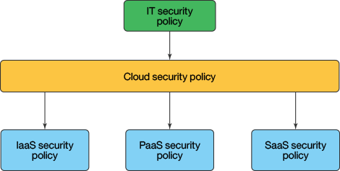
Handling Sensitive Data – Aspects of Cloud Security
Security Policy Management: When creating a secure Cloud Solution, Organizations must Adopt Strong Security Policy and Governances to Mitigate Risk and meet accepted Standards for Security and Compliance.

Slide 33
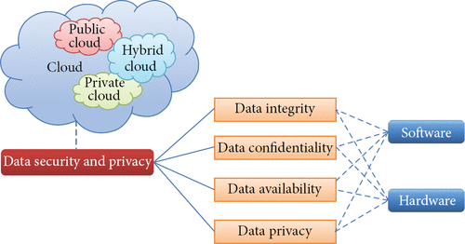
Handling Sensitive Data – Aspects of Cloud Security
Organization of Data Security and Privacy in Cloud Computing

Slide 34
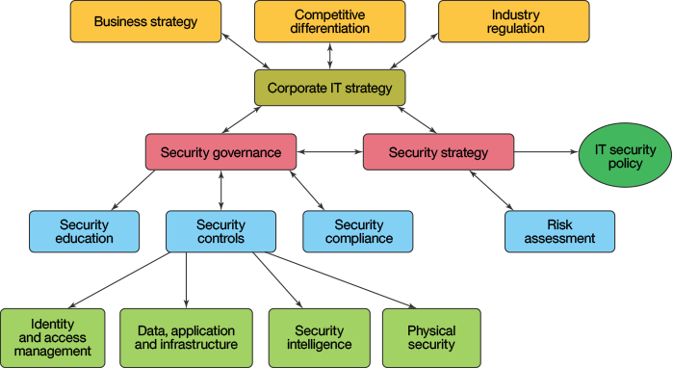
Handling Sensitive Data – Aspects of Cloud Security

Slide 35
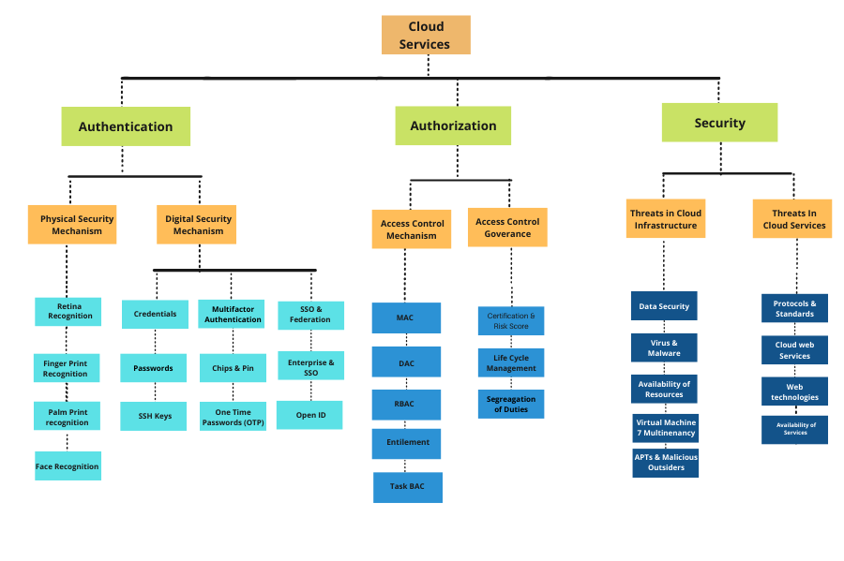
Handling Sensitive Data – Aspects of Cloud Security

Slide 36
THANK YOU
CMA (Dr.) Puvvala Siva Rama Prasad
M.Com., MBA (Finance)., FCMA., FCS., FIIBF., FIII (Life & General)., MAIMA

