Slide 1
Concept of Scaling and Supervised Data & Unsupervised Data Analysis
Compiled
By
Prof. Gautam Bandyopadhyay
NIT Durgapur

Slide 2
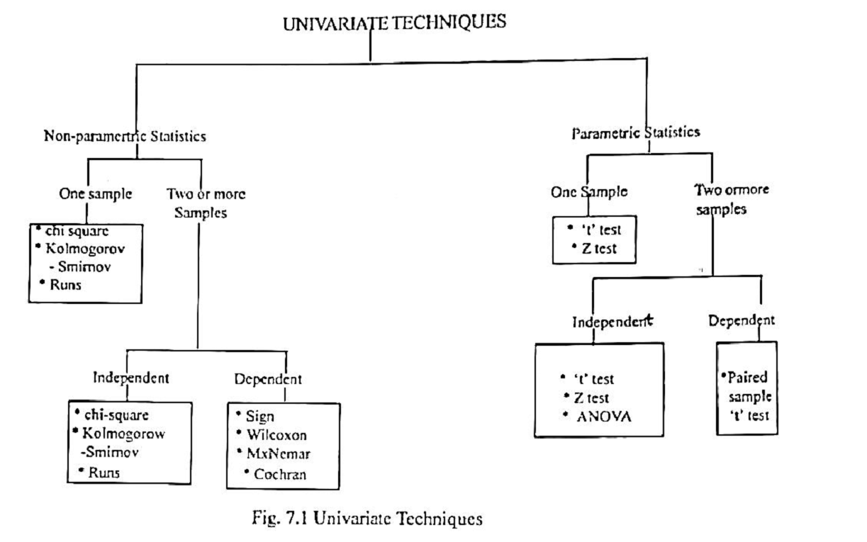

Slide 3
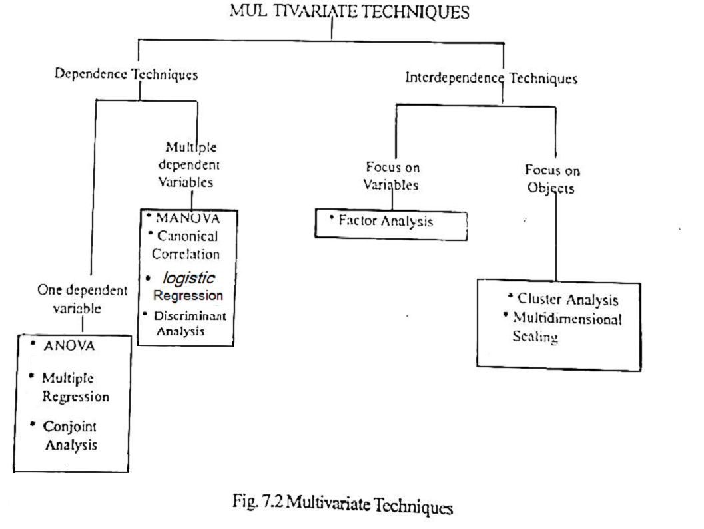

Slide 4
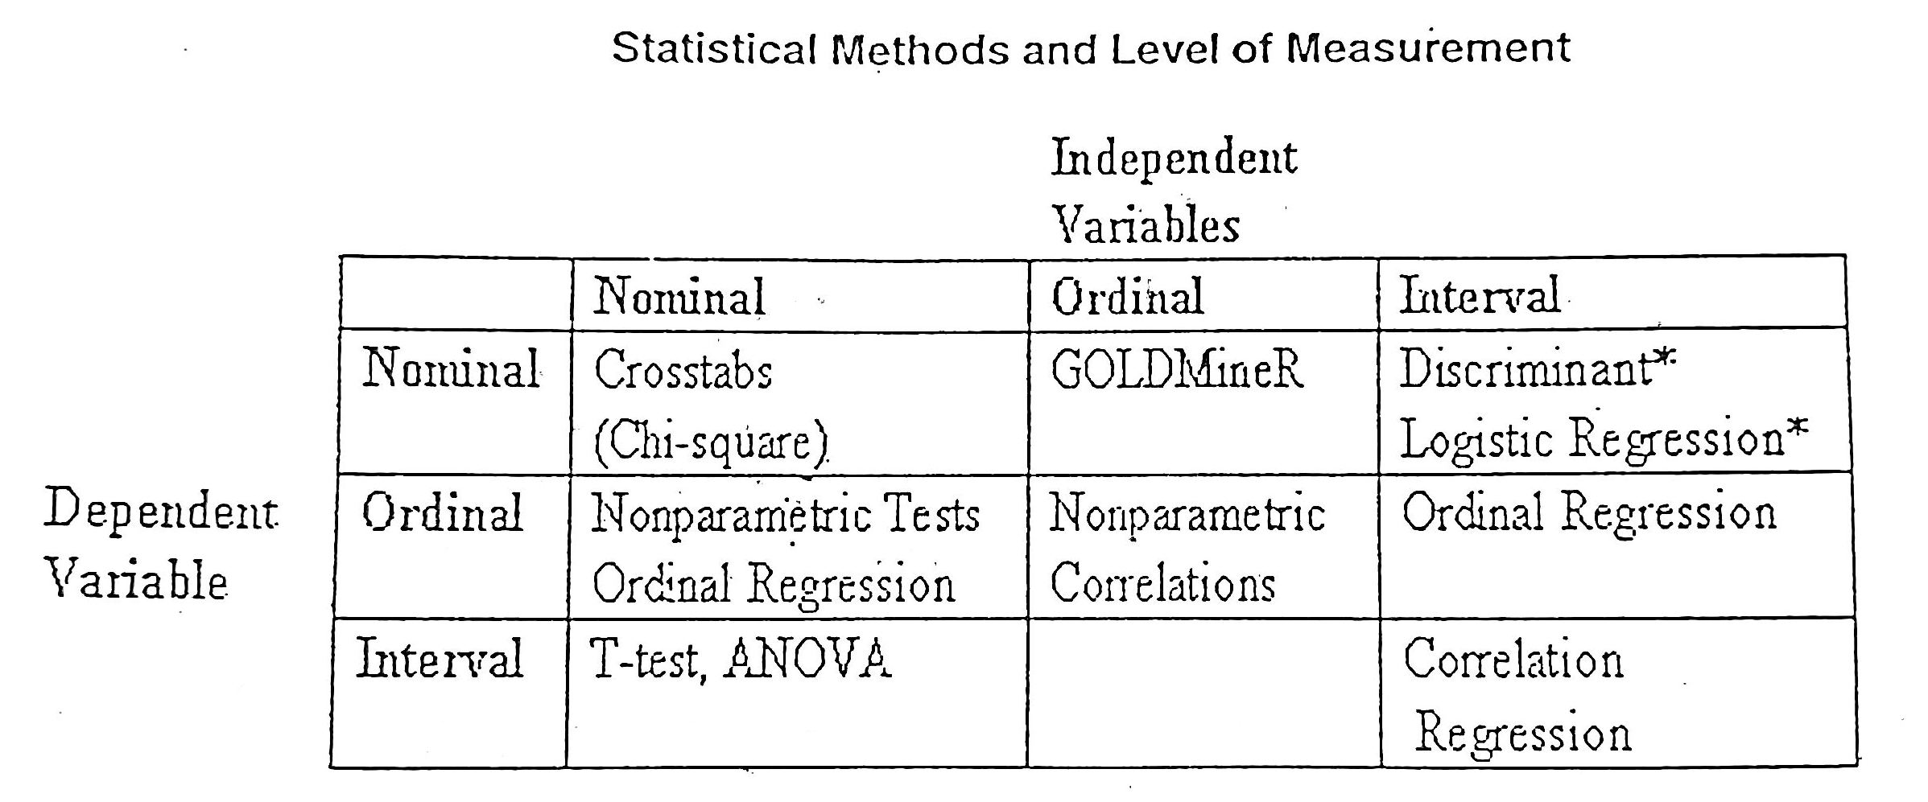

Slide 5
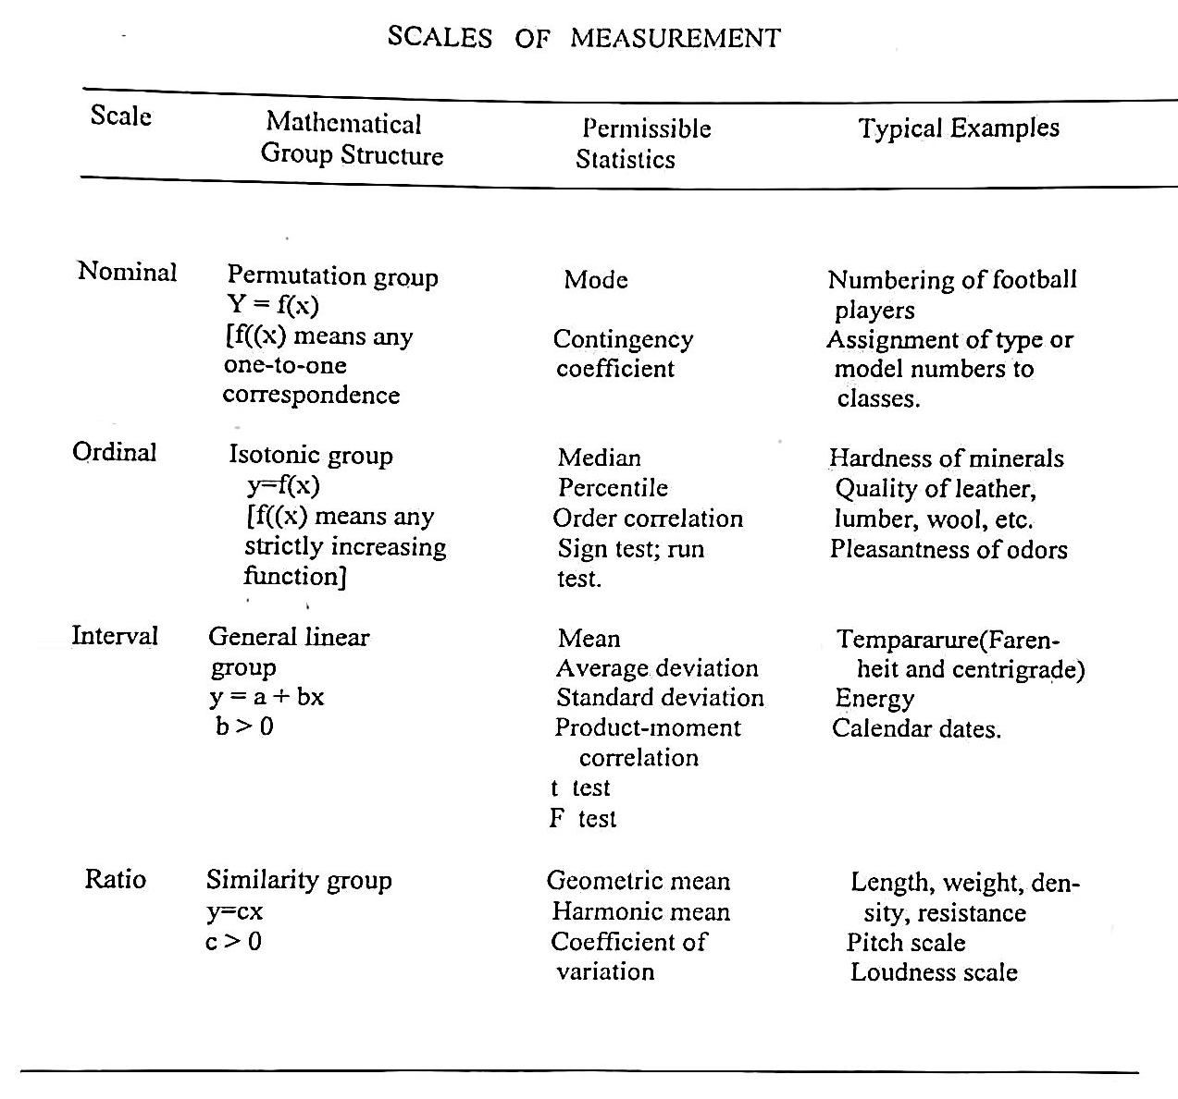

Slide 6
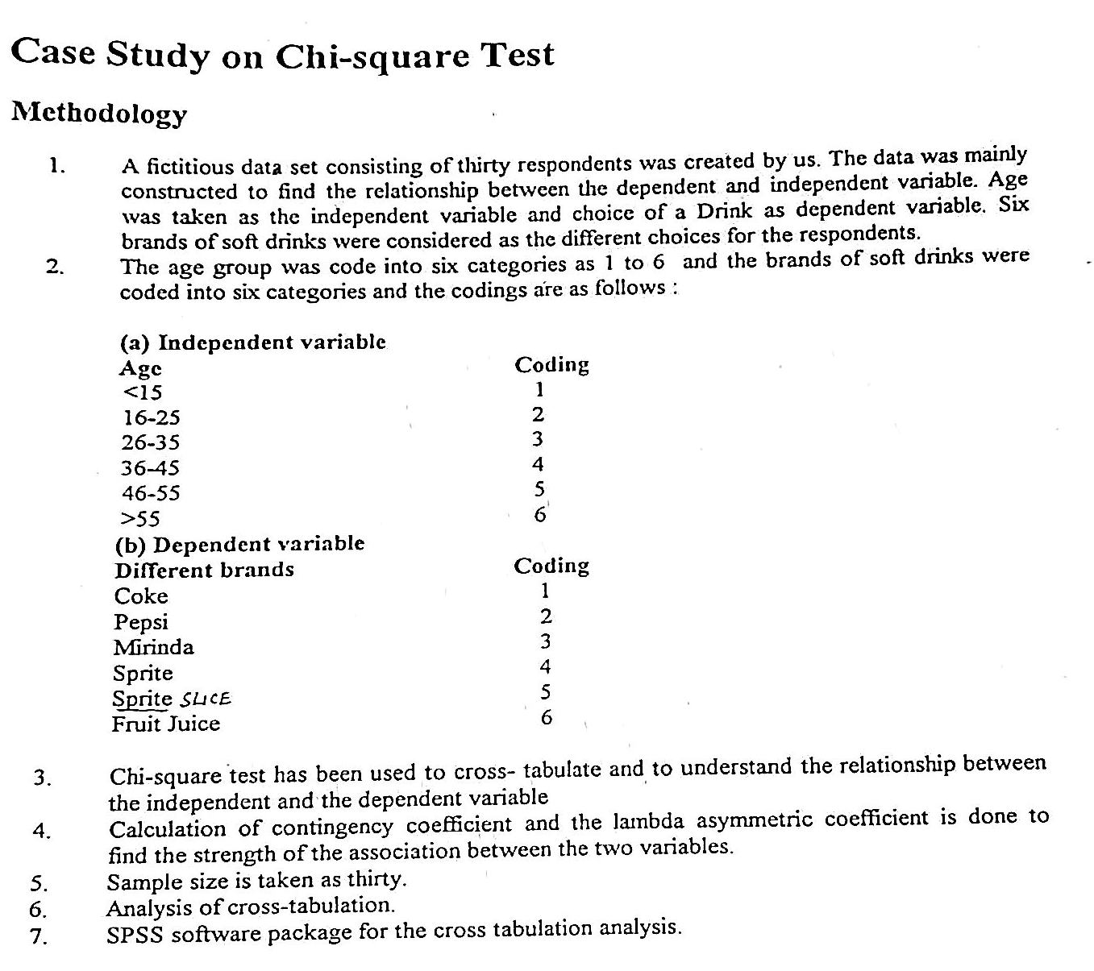

Slide 7
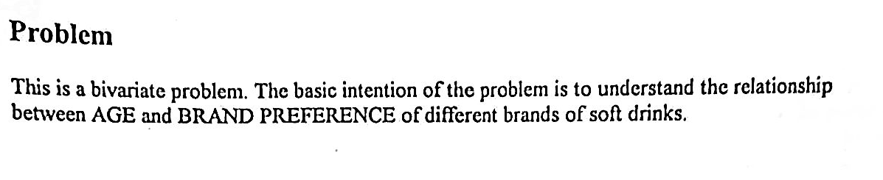

Slide 8
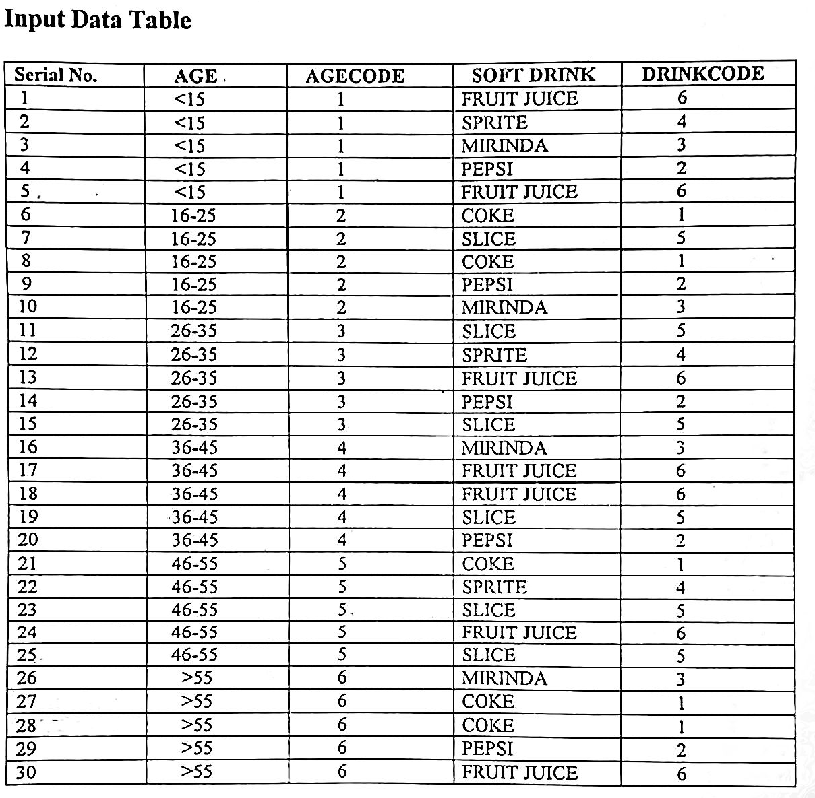

Slide 9
 | Bi-variate Analysis
 |  | Dependent Variable
Independent Variable |  | Metric | Non-Metric
 | Metric | Regression | Linear Discriminant Analysis Binary Regression
 | Non-Metric | Hypo testing/ Reg with Dummy Var | Cross-tab / Chi sq test

Slide 10
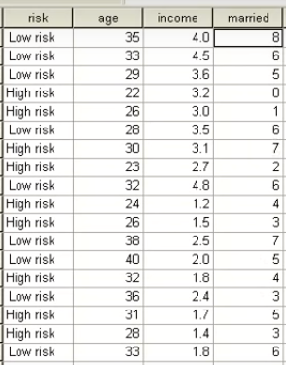
Example

Slide 11

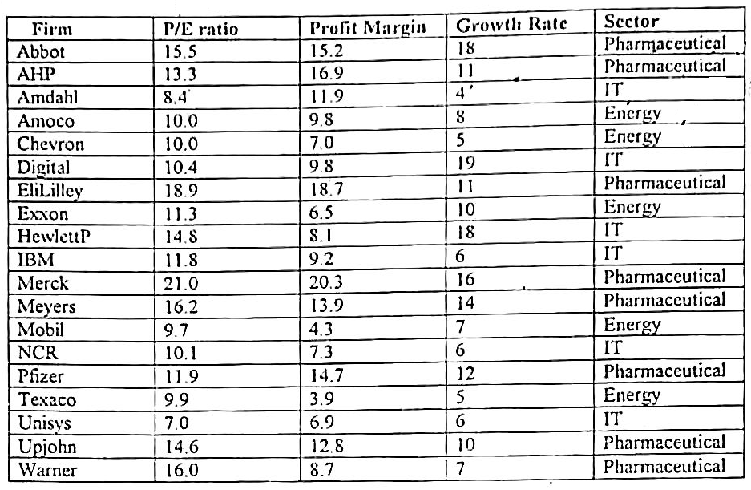

Slide 12
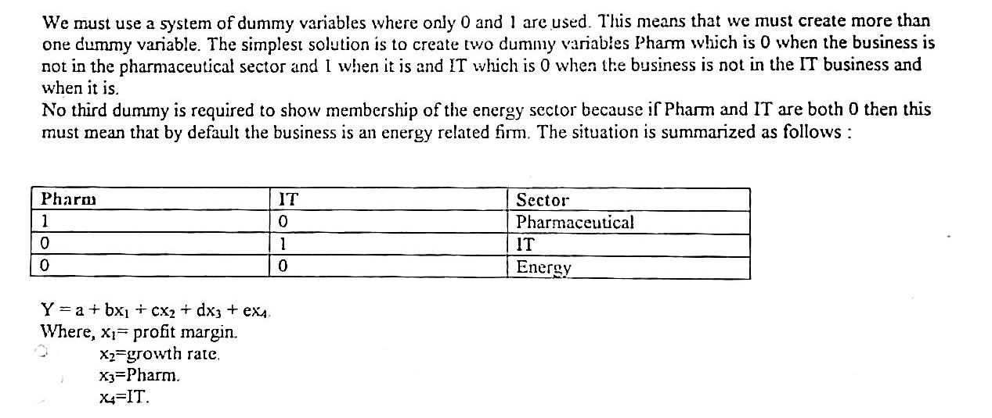

Slide 13
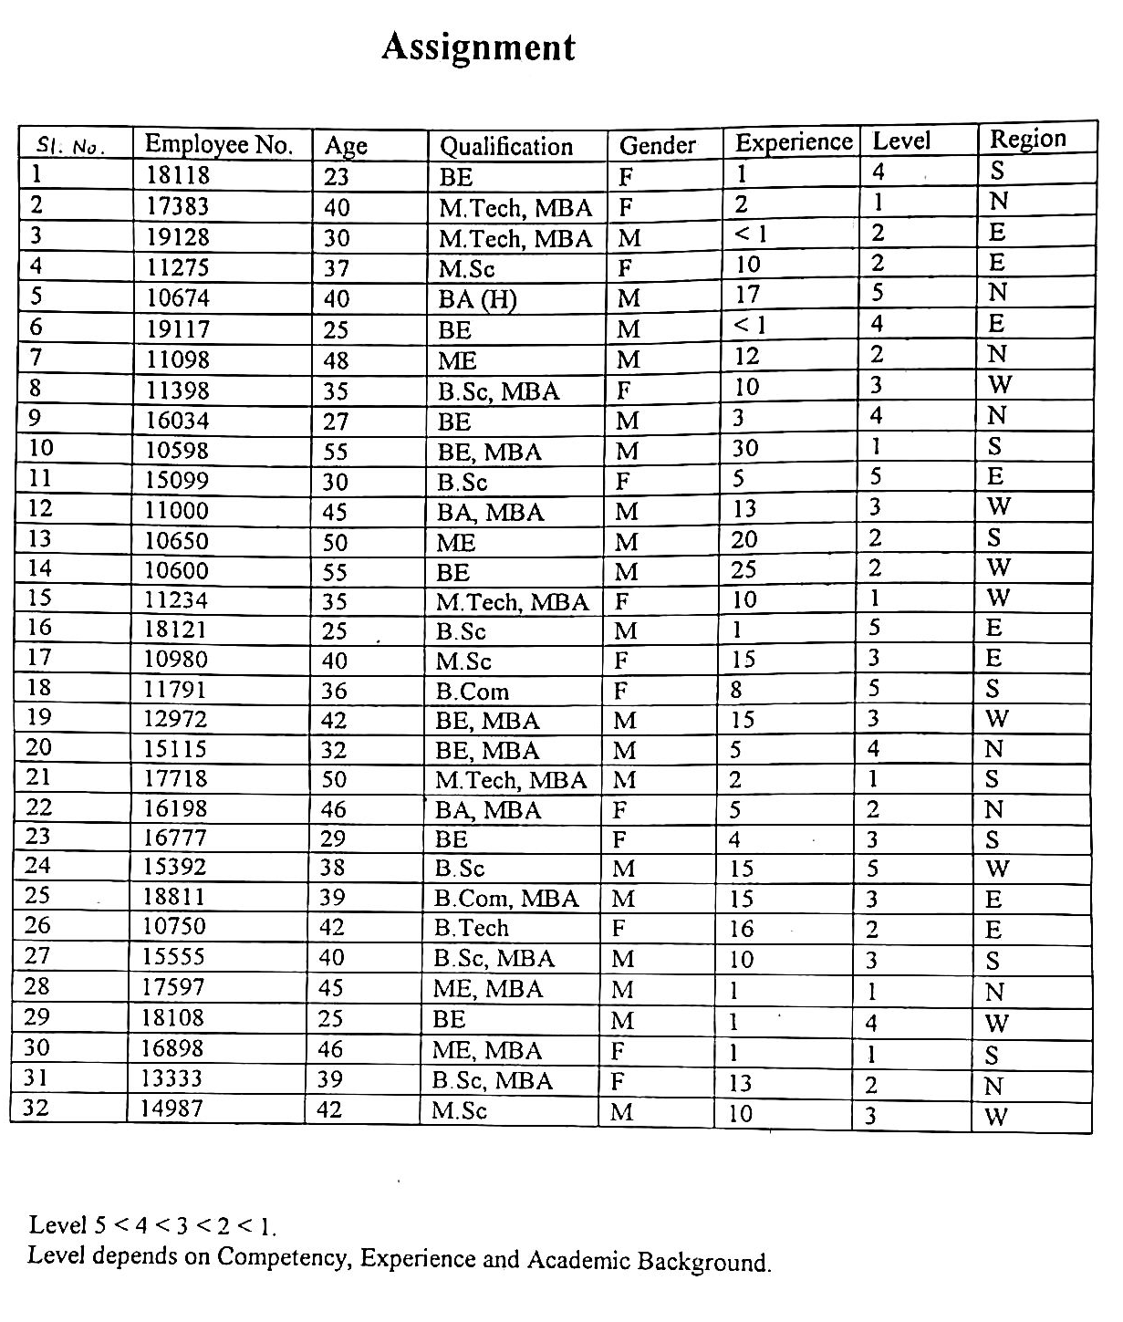

Slide 14
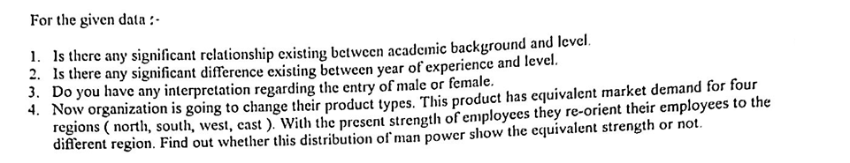

Slide 15
Thank you

