Slide 1
Secondary Market: Lecture Outline
Concept and importance
Trading in Secondary Market (Online) (OTC and NSE/BSE)
Trading Methods
Role of Intermediaries (Brokers and Sub-brokers)
Stock Exchanges
Stock Indices (Nifty and Sensex)

Slide 2
Decisions
Financing Decision
  (Raise finance- Source of Finances) : Long-term or short term
  IPO and FPO
  Equity and Debt Capital (Interest-Fixed Expenses)
  Business Operations
Investment Decision

Slide 3
Why to invest in Securities?
Capital growth
(Wealth Creation)
Diversification
Tax benefits
Returns

Slide 4
Indian Capital Market - Overview
Market Regulator SEBI
Stocks and Commodities Derivative Exchanges
Depositories
Other Intermediaries
NSE, BSE, MSE, MCX etc.
NSDL, CDSL
Stock Brokers, RTAs, Mutual Funds, Investment Advisors etc.

Slide 5
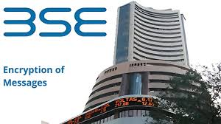


Stock and Commodity Exchanges

Slide 6
Commodity Exchanges in India
NCDEX, or National Commodity and Derivatives Exchange of India, primarily deals with agricultural commodities such as grains, pulses, and spices.
MCX, or Multi Commodity Exchange of India, specializes in various commodities, including metals, energy, and agricultural products.

Slide 7
Stock Exchange
Equity
  Cash Segment
  Derivative Segment (contract based)
  Debt (G sec,, Bond)
  Currency Derivatives (Forex market)

Slide 8
Who are the Investors in Secondary Market?
1. Institutional Investors or Qualified Institutional Investors (QIIs)
Commercial banks, mutual fund houses, public financial institutions, and foreign portfolio investors fall under this category.
2. Non-institutional Investors (NIIs) / High Net Worth Individuals (HNIs)
Individual investors or institutions (large trusts, big companies, and similar institutions) who are willing to invest more than ₹2 lakh are categorized as High Net Worth Individuals or Non-institutional Investors respectively.

Slide 9
Who are the investors?
3. Retail Individual Investors (RIIs)
This is one of the most common categories for applying for an IPO. Any individual investor who is willing to subscribe for shares less than or up to ₹2 lakh belong to this category. Along with resident Indian individuals, this category includes NRIs and HUFs.
4. Anchor Investors
This new category of investors was introduced by the market regulator, SEBI, in 2009. It is a form of QIIs that can apply for an IPO for a value of ₹10 crore or more through the book-building process. Out of shares reserved for QIIs, up to 60% of the shares can be sold to anchor investors.

Slide 10
Primary v/s Secondary Market : Key Differentiation
Features | Primary Market | Secondary Market
Definition | Securities issued first time to the public. | Trading of already issued and listed securities.
Also called as | New Issue Market. | Post Issue Market.
Price Determination | By Issuer Company in consultation with Merchant Bankers. | Supply and Demand Forces of Market.
Key Intermediaries | Merchant Bankers, Bankers/ Lead Managers, RTAs. | Stock Brokers and DPs.
Purpose | Raise capital for expansion, diversification, etc. To seek listing of securities. | Trading of securities. Providing liquidity to investors. Raising further capital for expansion.

Slide 11
Terms
Market Price (trading price/listed)-Market driven (demand and supply)
  How ? Quote (no of shares and price)
  Buy and sell (Bid and Ask)
  Non-listed (privately negotiated)
Market Capitalisation
  Face value Rs.10 per share (Balance Sheet / Fixed)
  Dividend paid on face value
  Market price x No of shares =

Slide 12
MC
Determination of Rank
Used for Calculation of Indices
  SENSEX -30
  NIFTY 50

Slide 13
How to calculate SENSEX
Index
= (Current Market Cap of 30 Companies /
Base Year Market Cap of 30 Companies) x 100

Slide 14
NSE
NIFTY 50
NIFTY 200
NIFTY 500

Slide 15
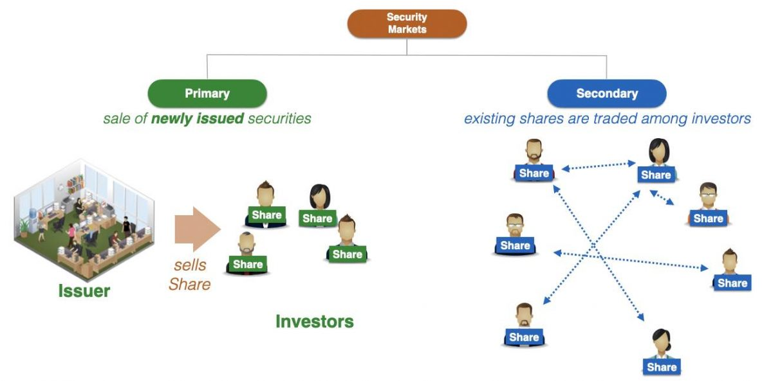
Concept and Definition

Slide 16
Segment of Capital Market in India
Equity and SME
Debt (Fixed Income and Debt Market) (Bond and G Sec)
Derivatives (Futures and Options)

Slide 17
Why Secondary Market?
The market where existing securities are traded among investors.
Secondary markets are important because they provide liquidity and price information.
The trading of securities in the secondary market has encouraged the development of market structures to facilitate trading.
The structures can be classified according to when securities are traded, and how they are traded.

Slide 18
Secondary market for corporates and financial intermediaries
Recognized stock exchanges
The National Stock Exchange of India Limited (NSE)
BSE
The Over the Counter Exchange of India (OTCEI) : De-recognized
The Interconnected Stock Exchange of India (ISE). De-recognised

Slide 19
Secondary market for government securities and public sector undertaking bonds
The trading in government securities is basically divided into the short-term money market instruments such as treasury bills and long-term government bonds ranging in maturity from 5 to 20 years.
The secondary market transactions in government securities have been conducted through the subsidiary general ledger (SGL) since September 1994. Both the government securities and public sector undertaking bonds are now traded in the wholesale debt market (WDM) segment of the NSE, the BSE, and the OTCEI.

Slide 20
Intermediaries
Depository Participants (DP)
Depositories (NSDL and CDSL)
Brokers
Sub-brokers
Share Transfer Agents

Slide 21
Secondary Market
The open outcry trading system, prevalent till 1995, was replaced by the on-line screen-based electronic trading.
Three new stock exchanges at the national level were set up in the 1990s. These were: the Over the Counter Exchange of India (1992), the National Stock Exchange of India (1994), and the Interconnected Stock Exchange of India (1999).

Slide 22
Quote-driven market
In quote-driven markets, traders transact with dealers or market makers who post bid and ask prices. The dealers maintain an inventory of securities.
Quote-driven markets are commonly known as over-the-counter markets because securities used to be literally traded over the dealer’s counter in the dealer’s office. Now, most trades in OTC markets are conducted electronically. Most securities other than stocks trade in quote-driven markets.

Slide 23
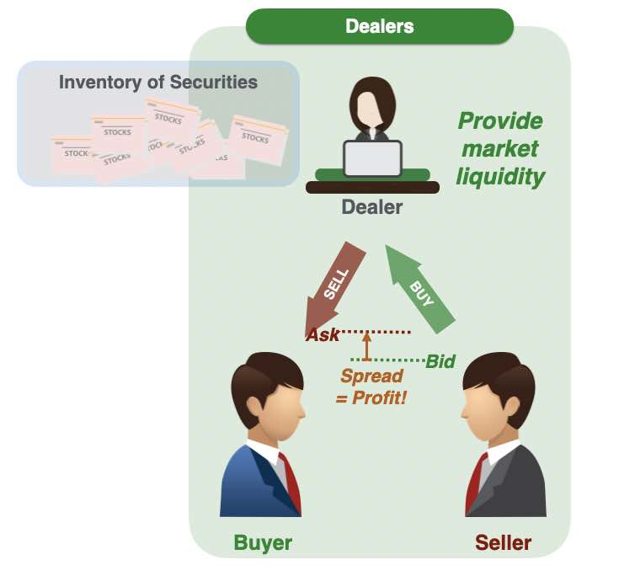
Dealers

Slide 24
Order-Driven Market
A type of secondary market that uses rules to match buy and sell orders.
NSE/BSE order-driven through their system
Types of Order
Price Priority
  Highest bid price
  Lowest ask price

Slide 25
Listing of Securities
Listing of securities or shares on the stock market or stock exchange is a process where the shares of a company become available to the public.
A listed security is traded in an exchange

Slide 26
Listing of Securities
A company has to list its securities on the exchange so that they are available for trading.
A company can seek listing on more than one stock exchange.
A company seeking listing of its securities on the stock exchange is required to file an application, in the prescribed form, with the Exchange before issue of Prospectus by the company, where the securities are issued by way of a prospectus or before issue of Offer for Sale, where the securities are issued by way of an offer for sale.

Slide 27
Objectives of Listing
It provides liquidity to securities;
It mobilizes savings for economic development;
It protects interest of investors by ensuring full disclosures.

Slide 28
BSE Listing Criteria
The minimum post-issue paid-up capital of the applicant company (hereinafter referred to as "the Company") shall be Rs. 10 crore for IPOs & Rs.3 crore for FPOs; and
The minimum issue size shall be Rs. 10 crore; and
The minimum market capitalization of the Company shall be Rs. 25 crore (market capitalization shall be calculated by multiplying the post-issue paid-up number of equity shares with the issue price).

Slide 29
NSE: Listing Criteria
Incorporation
Post Issue Paid Up Capital
Track Record
Other Listing Conditions
Disclosures

Slide 30
NSE
The Issuer should be a company incorporated under the Companies Act 1956 / 2013 in India.
The post issue paid up capital of the company (face value) shall not be more than Rs. 25 crore.

Slide 31
Over The Counter Exchange of India (OTCEI)
Over The Counter Exchange of India can be defined as an exchange without a specified trading floor."
It does not have a market place physically and the market is spread across the country through counters. All the counters are connected through a computer network and transactions takes place through satellite Communication.

Slide 32
BSE
Established in 1875, BSE (formerly known as Bombay Stock Exchange), is Asia's first & the Fastest Stock Exchange in world with the speed of 6 micro seconds and one of India's leading exchange groups.
High frequency data

Slide 33
BSE
No. of Listed Companies in BSE: Total 5,309 listed companies on BSE, with a market capitalisation of ₹37,636,886.59 Cr.

Slide 34
NSE
NSE was incorporated in 1992. It was recognised as a stock exchange by SEBI in April 1993 and commenced operations in 1994 with the launch of the wholesale debt market, followed shortly after by the launch of the cash market segment.
Launched index options based on the NIFTY 50 Index (then known as S&PCNX NIFTY) for trading.
Launched single stock futures and options on listed securities in 2001
No of listed companies as on 31st March 2024: 2379

Slide 35
Stock Market Index
The stock market index is the most important indices of all as it measures overall market sentiment through a set of stocks that are representative of the market.

Slide 36
Functions of an Index
To serve as a barometer of the equity market.
To serve as a benchmark for portfolio of stocks.
To serve as underlying for futures and options contracts.

Slide 37
Market Capitlisation
Holding pattern (investors category)
MC= MP x No. of shares outstanding
Large Cap (Big) (Market Capitalisation)
Small Cap (Small)
Mid Cap

Slide 38
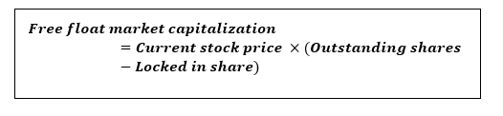
Free Float Market Cap
The free-float method excludes locked-in shares, such as those held by insiders, promoters, and governments.

Slide 39
NSE: Free Float
Shares held by founders/directors/acquirers which have control element
Shares held by persons/ bodies with "Controlling Interest"
Shares held by the Government(s) as promoters/acquirers
Holdings through the FDI route
Strategic stakes by private corporate bodies/ individuals
Equity held by associate/group companies (cross-holdings)
Equity held by Employee Welfare Trusts
Locked-in shares and shares which would not be sold in the open market in normal course

Slide 40
Free Float
Category | No. of Shares | %
Promoter and Promoter Group | 1,20,00,000 | 48.00
Promoter Depository Receipts (DR) | 10,000 | 0.04
Public Shareholders Locked in | 75,000 | 0.30
Strategic holding | 25,000 | 0.10
Total |  | 48.44
No. of Shares | %
Total Equity Shares | 2,50,00,000 | 100
Free Float Factor in the above case is (100-48.44)/100 = 0.51

Slide 41
Methodologies for Calculating the Index
Full market capitalization method: In this method, the number of shares outstanding multiplied by the market price of a company’s share determines the scrip’s weightage in the index.
The shares with the highest market capitalization would have a higher weightage and would be most influential in this type of index.

Slide 42
Free-float market capitalization method
Free-float is the percentage of shares that are freely available for purchase in the markets. It excludes strategic investments in a company such as the stake held by government, controlling shareholders and their families, the company’s management, restricted shares due to IPO regulations, and shares locked under the employee stock ownership plan.
In this methodology, the weight of a scrip is based on the free-float market capitalization. Free-float market capitalization reflects the investible market capitalization which may be much less than the total.

Slide 43
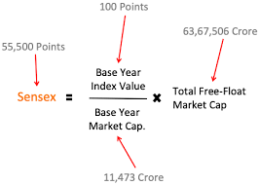
SENSEX = BSE 30 Index (MC)
Base year (Fixed) and Current year (variable) Index multiplier

Slide 44
Nifty 50
The Nifty 50 is a diversified 50 stock index accounting for 13 sectors of the economy. It is used for a variety of purposes such as benchmarking fund portfolios, index based derivatives and index funds.
The Nifty 50 Index represents about 59% of the free float market capitalization of the stocks listed on NSE as on September 29, 2023.

Slide 45
NSE Other indices
Nifty 100
Nifty 200
Nifty 500
Nifty Midcap
Nifty Smallcap
Dolex

Slide 46
India Vix Index
Volatility Index is a measure of market’s expectation of volatility over the near term. Volatility is often described as the “rate and magnitude of changes in prices" and in finance often referred to as risk. Volatility Index is a measure, of the amount by which an underlying Index is expected to fluctuate, in the near term, (calculated as annualised volatility, denoted in percentage e.g. 20%) based on the order book of the underlying index options.

Slide 47
Stock Broking
Brokers are members of stock exchange.
They enter into share trading transactions either on their own account or on behalf of their clients.
Sharekhan Limited
India Bulls
Angel Broking Limited
India Infoline Limited

Slide 48
Custodial Services
Maintaining accounts of the securities of a client.
Collecting the benefits/rights accruing to the client in respect of securities
Keeping the client informed of the actions taken by issuer of securities
Maintaining and reconciling records of the services as referred above.

Slide 49
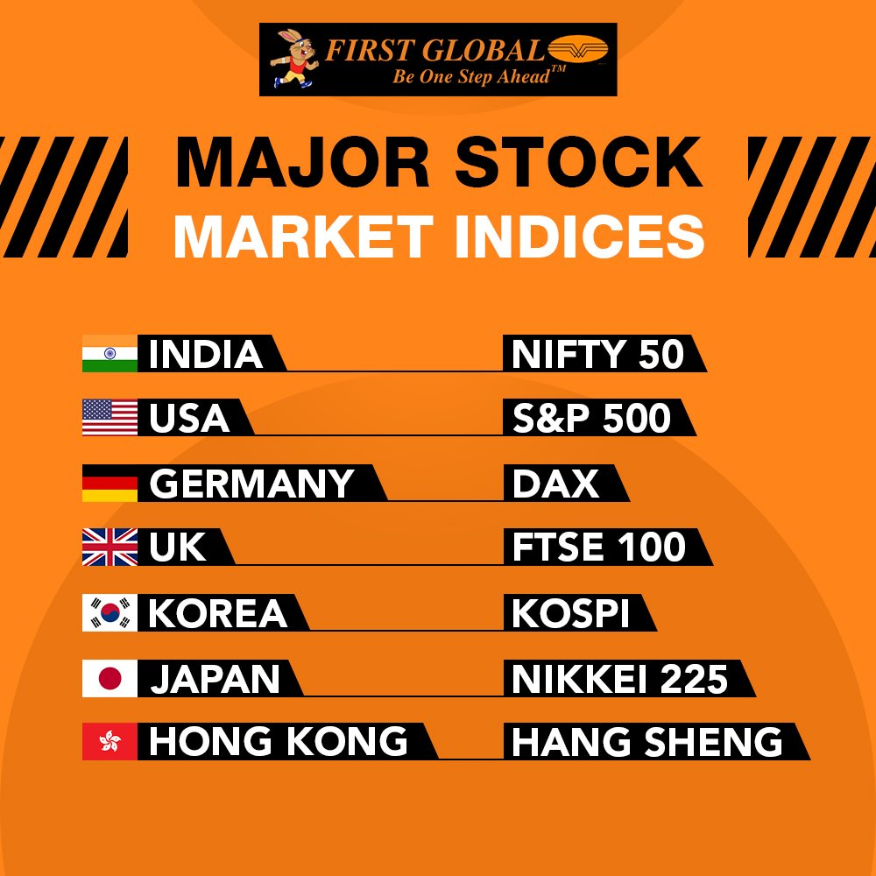
Global Stock Market Indices

Slide 50
Place Order : Online (Website/ App)
Steps for Trading Online
Link your Trading, Demat and Bank Account.
Sign the IBT (Internet based trading) agreement after checking the costs involved and the facilities provided.
Visit website of the Stockbroker / Install the Online Trading app.
Investor must login using Username and Password provided.
Some Stock Brokers also have 2-Factor verification system where additional OTP also needs to be entered.
Check current price and volume details of stock you want to buy/ sell on Market Watch Section of the Stock broker’s terminal.

Slide 51
Types of Orders
ORDER TYPE
Limit (L) | Buy only if price falls to certain level.
Market (Mkt) | Buy/Sell at price offered on market
Stop Loss (SL) | Sell as soon as price goes below a certain level (Trigger Price).

Slide 52
Place Order : Sample Order Screen
ORDER PLACEMENT
Order Type Limit Market
Quantity ______
Price Rs. _______
Trigger Price (Stop loss) Rs. ___________
Validity Day IOC
Place order →

Slide 53
Place Order : Client Order Book
Purpose of Order Book :
Trading History :
  Once Order is placed and trade get executed, details are trade are visible on Trade history Page.
  Prior to execution of trade one can Modify Order.
Keeps a record of all the orders put by the client
Check order details of past order
Modify the orders
Check Status of Order (Open / Completed / Rejected)

Slide 54
Place Order : Online (Website/ App)
Market Watch Section :
  Allows investor to check details of the stock that he wants to buy/ sell.
  Information Displayed in Market Watch:
  Last Traded Price (LTP).
  Percentage change – % Change from previous day close.
  Previous day close – At what price did the stock closed the previous day.
  O.H.L.C – Open, High, Low and Close Prices.
  Volumes – How many shares are being traded at a particular point of time?
  Bid and ask price ladder.

Slide 55
LTP/CLP
Closing price of the day on NSE is the weighted average price of the last 30 mins of trading.
The last traded price of the day is the actual last traded price.
The opening price is the price at which a security first trades upon the opening of an exchange on a trading day.
High and Low Price (52 Weeks)

Slide 56
Risk Management
The SEBI has laid down risk management policies to mitigate market, operational and systemic risks. Designing effective risk management policies leads to enhancement of investor protection and market development.

Slide 57
Electronic Trading Systems
Ensures transparency
Increases information efficiency
Increases operational efficiency
Improves depth and liquidity of the market
Provides a single trading platform

Slide 58
Rolling Settlement
Rolling settlement is a system of settling transactions in a fixed number of days after the trade is agreed.
Stock markets moved to the T + 2 system from April 1, 2003.

Slide 59
Margin Trading
Margin trading is a form of leveraged trading which allows an investor to invest in excess of his financial capacity by borrowing money.
Margin trading permits investors to buy shares by providing 50 per cent of the deal value as ‘margin,’ while borrowing 50 per cent from banks. From April 2004, the SEBI has permitted brokers, banks, non-banking finance companies (NBFCs) registered with the Reserve Bank, insurance companies and financial institutions to finance margin trading—borrowing money to part-finance stock purchases.

Slide 60


