Slide 1
Capital Market: Primary Market
Concept and Definition
Importance
Types/Segments
Intermediaries
Primary Market
Issue Mechanism
IDRs, ADRs, GDRs, ECBs

Slide 2
Capital Market
A capital market can be classified into primary and secondary markets.
The primary market is meant for new issues and the secondary market is one where outstanding issues are traded.
In other words, the primary market creates long-term instruments for borrowings, whereas the secondary market provides liquidity through the marketability of these instruments.
The secondary market is also known as the stock market.

Slide 3
Instruments
Instruments
Equity
Debt
Derivatives

Slide 4
What are Securities?
Equity Shares
Preference Shares
Debentures / Bonds
Mutual Fund Units
Government Securities
Others
What are not Securities?
Fixed deposit with banks or companies
Insurance policies
Provident Fund / Public Provident Fund

Slide 5
What is Securities Market?
Market is a place where things are bought and sold.
Securities market is a market where securities are bought and sold.
There are various participants / agents / entities and products in the securities market.
Securities Market is part of Capital Market.

Slide 6

Why is Securities Market essential?
Provide opportunity for entrepreneurs to raise capital for business.
For investors, stock markets provide a way to invest money and exit when they want.

Slide 7
Equity
Who will issue or raise funds?
Public Limited Co. or Private Limited Co.
How to issue? (Method)

Slide 8
Domestic Issues
Domestic Equity issues by — Corporates (primary issues) — Financial intermediaries (secondary issues)
Debt instruments by — Government (primary issues) — Corporates (primary issues) — Financial intermediaries (secondary issues)

Slide 9
External issues
External Equity issues through issue of — Global Depository Receipts (GDR) and American Depository Receipts (ADR)
Debt instruments through — External Commercial Borrowings (ECB)

Slide 10
Others
Other External Borrowings Foreign Direct Investments (FDI) — in equity and debt form Foreign Institutional Investments (FII) — in the form of portfolio investments Non-resident Indian Deposits (NRI) — in the form of short-term and medium-term deposits.

Slide 11
Primary market
The primary market is a market for new issues. It is also called the new issues market.
It is a market for fresh capital. Funds are mobilized in the primary market through prospectus, rights issues, and private placement.

Slide 12
Public issues are open to the general public. Wide publicity about the offer is given through the media.
In the past, the job of organizing public issues was generally entrusted to prominent brokers but that practice has now given way to the appointment of a merchant banker for the purpose.

Slide 13
IPO
Initial Public Offering (IPO) refers to the process where private companies sell their shares to the public to raise equity capital from the public investors.
The process of IPO transforms a privately-held company into a public company.
This process also creates an opportunity for smart investors to earn a handsome return on their investments.

Slide 14
Types of IPO
There are two common types of IPO.
They are-
1) Fixed Price Offering
2) Book Building Offering

Slide 15
1) Fixed Price Offering
Fixed Price IPO can be referred to as the issue price that some companies set for the initial sale of their shares. The investors come to know about the price of the stocks that the company decides to make public.
The demand for the stocks in the market can be known once the issue is closed. If the investors partake in this IPO, they must ensure that they pay the full price of the shares when making the application.

Slide 16
Price Band
A price band can be defined as a value-setting method where a seller offers an upper and lower cost limit, the range within which the interested buyers can place their bids.
The range of the price band guides the buyers.

Slide 17
Draft Red Herring Prospectus (DRHP)
The DRHP is the document that lets the public know about the company’s IPO listings after the approval made by SEBI.

Slide 18
Under Subscription
Under Subscription takes place when the number of securities applied for is less than the number of shares made available to the public.

Slide 19
Oversubscription
Oversubscription is when the number of shares offered to the public is less than the number of shares applied for.

Slide 20
Green Shoe Option
It refers to an over-allotment option.
It is an underwriting agreement that permits the underwriter to sell more shares than initially planned by the company.
It happens when the demand for a share is seen higher than expected.

Slide 21
Follow-on public offer (FPO)
A follow-on public offer is the issuance of shares after the company is listed on a stock exchange.
An FPO is done to raise additional capital or to reduce existing debt.

Slide 22
IPO Vs FPO
S.No. | Particulars | IPO | FPO
1. | Meaning | The first issue of shares by a company | Issuance of shares by a company to raise additional capital after IPO
2. | Price | Fixed or variable price range | Price is market driven and dependent on the number of shares increasing or decreasing
3. | Share capital | Increases because the company issues fresh capital to the public for listing. | Number of shares increases in dilutive FPO and remains the same in non-dilutive FPO
4. | Value | Expensive | Cheaper in most cases because the value of the company is getting further diluted.
5. | Risk | Riskier | Comparatively less risky
6. | Status of the company | An unlisted company issues an IPO | An already-listed company issues an FPO

Slide 24

Primary Market
New issues market where Company/ institutions raise funds or
capital from public by issuing new securities.
Objective: To raise capital.
Two major types of issuers of securities:
  Corporate Entities (Companies)
  Government (Central and State)
Major types of Issues in Primary Market:
  Public Issue
  Preferential Issue
  Rights Issue
  Bonus Issue

Slide 25
Primary Market -Objectives
Objects of Issue
New Projects
Expansion of existing projects/ modernization
Diversification
Up-gradation
Objects of the issue and intended utilization of funds
→ Given by issuers in the Offer Document

Slide 26
Primary Market
Money Market
New Issues market (Primary market)
Financial markets
Securities Market
Capital Market
Secondary Markets
Other forms of lending and borrowing

Slide 27
Intermediaries to an Issue
Merchant Banker (book running lead manager (BRLM) to an issue)
Registrar to the Issue
Bankers to the Issue
Underwriters to an issue
Portfolio Managers
Depositories (NSDL)
Depository participants
Custodians
Debenture Trustees
Investment banks

Slide 28
Merchant Bankers: Services
Project counseling
Loan syndication
Issue management
Underwriting of public issues
Consultants or advisers to the issue
Portfolio management
Advisory services relating to mergers and acquisitions
Offshore finance

Slide 29
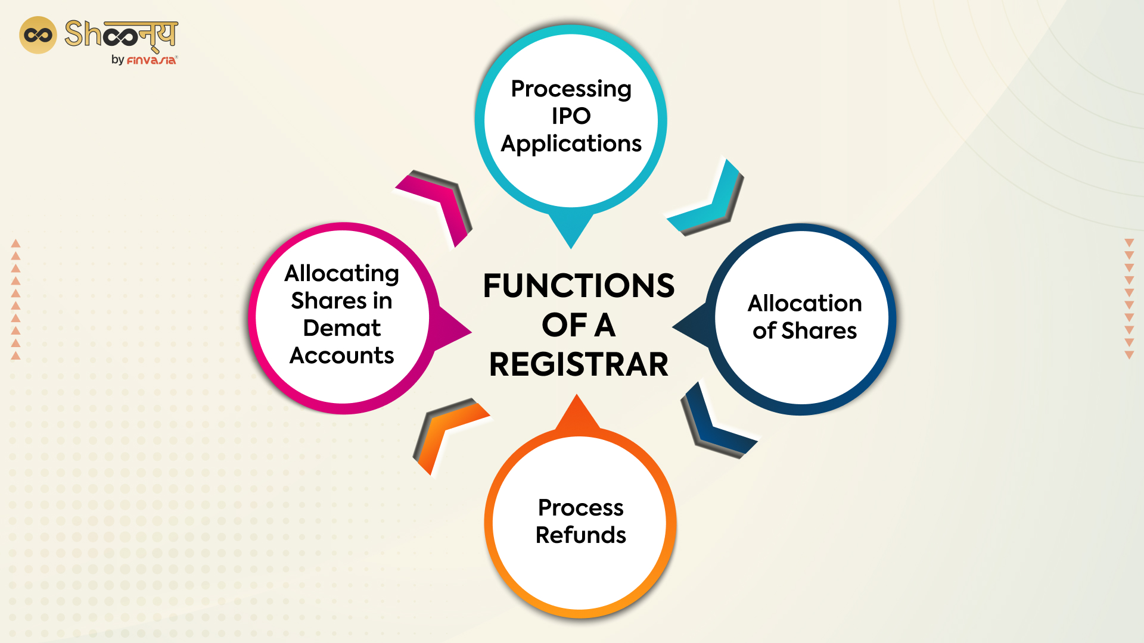
Registrar to an Issue
The role of the registrar is to finalize the list of eligible allottees, ensure crediting
of shares to the demat accounts of the eligible allottees, and dispatch refund orders.

Slide 30
Bankers to an Issue
Banker to the Issue means any bank so named in the prospectus to collect money as subscription against security.
Every banker to an issue shall maintain the following records with respect to :— (a) the number of applications received, the names of the investors, the dates on which the applications were received and the amount so received from the investors.
It is now mandatory to issue all new initial public offerings (IPOs) in dematerialized form as they are compulsorily traded in dematerialized form.

Slide 31
Underwriters to an Issue
The person or institutions underwriting a public issue of shares or debentures are called underwriters. Underwriters may be individuals, partnership firms or joint stock companies.
Their primary responsibility is to evaluate the risk associated with an investment, in order to determine an appropriate price for the IPO.

Slide 32
Issue Mechanism
The fund-raising in the primary market can be classified as follows:
Public issue by prospectus (IPO/FPO)
Private placement
Rights issues
Preferential issues

Slide 33
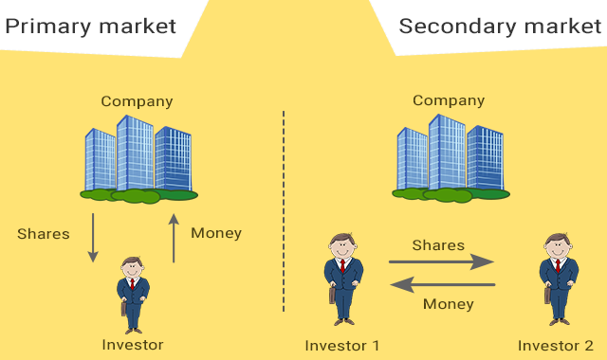
Primary and Secondary Market

Slide 34
Modes of Public issues
Issues
Public Issues
Rights Issues
Bonus Issues
Private Placements
Preferential Issue
Qualified Institutional Placement
IPO
Fresh Issues
Offer for sale
FPO
Fresh Issues
Offer for sale

Slide 35
Offer for Sale
It is an offer of sale of securities by a listed company. FPO is also known as subsequent or seasoned public offering. SEBI (DIP) Guidelines define a listed company as a company which has any of its securities offered through an offer document listed on a recognized stock exchange and also includes public sector undertakings whose securities are listed on a recognized stock exchange.

Slide 36
Methods for Determining the Offer Price
Fixed Price
Book Building

Slide 37
Modes of Capital Issuances
Initial Public Offering.
Done by unlisted company.
Fresh issue of securities/ offers its existing securities for sale/ Combination of both.
Securities issued for the first time to the public.
Paves way for listing and trading of the issuer’s securities in the Stock Exchange(s).
Further Public Offer / Follow-on Offer.
Done by already listed company.
Fresh issue of securities / Offer for sale of securities to public.
Done by already listed company.
Issue of securities to its existing shareholders (as on a Record date).
Record Date is fixed by the issuer.
The rights offered in a particular ratio to the number of securities held by existing shareholders as on the record date.

Slide 38
Modes of Capital Issuances
Done by already listed company.
Issue of shares to existing shareholders (as on a record date).
Existing shareholders need not make any payment for “Bonus” shares.
Shares are issued out of the company’s free reserve or share premium account.
Issued in a particular ratio to the number of securities held on record date.
Bonus Issue
Preferential Issue
Done by already listed company.
Issue of shares / convertible securities (like warrants) to a select group of persons.
Subject to prescribed norms such as minimum pricing, minimum public shareholding and lock-in.
Qualified Institutional Placement.
Done by already listed company.
Issue of shares / convertible securities (like warrants) to Qualified Institutional Buyers (QIBs).
Subject to prescribed norms such as minimum pricing and minimum public shareholding.
QIP

Slide 39
IPO - Initial Public Offering
Process of a company to be publicly listed and traded company.
IPO: Fresh issue of shares / Offer for Sale of shares by existing investors/ Combination of both.
Process of IPO is as follows:
Issuer files an Offer Document in prescribed format with Securities and Exchange Board of India (SEBI), Stock Exchanges and the Registrar of Companies (ROC) for listing on the stock exchanges
Issuer receives observations from regulatory authorities
After complying with all observations, issuer can open the offer inviting general public to invest in the IPO subject to stipulated timelines
Post successful completion of the Offer the shares of the company are traded on the stock exchange(s) where the shares are listed.

Slide 40
IPO: Case Study
Bharti Hexacom IPO Timeline
IPO Open Date | Wednesday, April 3, 2024
IPO Close Date | Friday, April 5, 2024
Basis of Allotment | Monday, April 8, 2024
Initiation of Refunds | Wednesday, April 10, 2024
Credit of Shares to Demat | Wednesday, April 10, 2024
Listing Date | Friday, April 12, 2024
Cut-off time for UPI mandate confirmation | 5 PM on April 5, 2024

Slide 41
Bharti Hexacom IPO Lot Size
Investors can bid for a minimum of 26 shares and in multiples thereof. The below table depicts the minimum and maximum investment by retail investors and HNI in terms of shares and amount.
Application | Lots | Shares | Amount
Retail (Min) | 1 | 26 | ₹14,820
Retail (Max) | 13 | 338 | ₹192,660
S-HNI (Min) | 14 | 364 | ₹207,480
S-HNI (Max) | 67 | 1,742 | ₹992,940
B-HNI (Min) | 68 | 1,768 | ₹1,007,760

Slide 42
Bharti Hexacom IPO Subscription Status (Bidding Detail)
Category | Subscription (times)
QIB | 48.57
NII | 10.52
bNII (bids above ₹10L) | 12.27
sNII (bids below ₹10L) | 7.00
Retail | 2.83
Total | 29.88

Slide 43
NII: Non-Institutional Investors
Indian individual residents
HUFs
NRIs
HNIs
Any trusts, societies or companies that bid for more than Rs. 2 Lakhs worth of shares

Slide 44
How to apply in Public Issue?
ONLINE MODE
ASBA | Application Supported by Blocked Amount. Facility provided by Self Certified Syndicate Banks (SCSBs) Full Bid Amount blocked in the bank account of the bidder.
UPI in ASBA | For → | Retail Individual Investors. Shareholders bidding in Shareholders Reservation Portion up to Rs.2,00,000/-.
 | Application via UPI facility of Sponsor Bank.
3-in-1 Account | Applying in IPO through 3-in-1 account (demat, trading and bank account).
OFFLINE MODE
Filled Form | To open a Demat Account first. Investors may obtain Application Form from Stock Broker/ Sponsor Bank/ Exchange Website. Form submitted to Stock Broker/ Sponsor Bank.

Slide 45
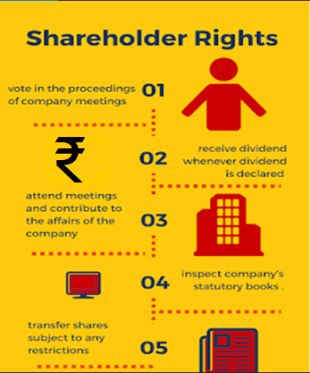
Rights of a Shareholder
Part-owner of the company, in proportion to their holding in the company.
Right to receive corporate benefits like dividend, whenever declared.
Right to receive:
Annual Reports
Audited Financial Statements
Notices of General Meetings and other notices
Other information disseminated by company.
Right to attend company meetings.
Right to contribute in key corporate governance decisions through postal ballot/ e-voting.

Slide 46
Rights of a Shareholder
(subject to certain limitations/ restrictions)
Right to:
Ask questions to the board of directors.
Place items on the agenda of general meetings.
Propose resolutions, etc.
Right to participate in matters needing shareholder approval like:
To vote in company proceedings.
To approve mergers & acquisitions, appointment of directors on company board, changing auditors, etc.
Right to Inspect company’s statutory books and records.
Right to Transfer shares by applicable laws.
To raise grievances, if any, against the company (using SCORES, etc.).

Slide 47
Responsibilities of Shareholder
Stay informed!
ANNUAL REPORT :
  Circulated to all Shareholders (via Post / Email).
  Available on website of Company and Stock Exchanges.
  NOTICE : for shareholder meetings with details of the agenda.
  MD’s NOTE : the managing director's note in the annual report to understand how the business is doing.
  AUDITOR’s NOTE : check if there are any red-flags / adverse findings flagged.
INFORMATION ON STOCK EXCHANGE WEBSITE :
  Company’s structural changes, updates, press release, investor presentations etc. under corporate announcements, which any investor should refer to.

Slide 48
Pre-Application Analysis : Broad Contours
Investors should take a well-informed decision of investing / applying in an IPO / FPO / Rights issue.
Don’t go by mere rumours / euphoria over expected returns as what the others feel.
Invest based on one own risk appetite and investment parameters.
Product, Plant and Pricing
Sustainability & Growth
Points to be considered as a part of pre-application analysis (before investing / applying in an IPO/ FPO / Rights application).
Scalability and Addressable Market
Business Beyond Numbers
Management Quality
Sustainable Margins: Absolute & Relative
Stakeholders Behavioral Pattern
Corporate Governance
Corporate Structure
Business Succession

Slide 49
Information in Offer Document
About the Company:
- Business: Company’s business model, strategies and manufactured products/ process/ services.
- History and Corporate Matters: Material events taken place in company’s history and other corporate matters
Management and Promoter Section
- Background and the experience of the company’s management team.
Financials
- Company's income statement and balance sheet.
- Understand company’s past performance and growth potential.
Risk Factors
- Risks associated with the business, industry etc.
Litigation and Dispute matters
- Litigations in which the issuer company, subsidiary(ies), group company(ies), promoter(s) are involved.

Slide 50
Information in Offer Document
Capital Structure
- Capital formation of the company,
- Existing shareholders and their percentage shareholdings etc.
Objects of the Issue
- Basic purpose of the company for going public and / or raising funds.
- Informs how the funds will be utilized.
Basis for Issue Price
- Helps understand the basis for pricing
- Comparison with other listed entities in the same / similar segment.
Managements discussions and Analysis of financial conditions and results of operations
- Information related to the strength of the company's business plan, recent developments, performance etc.
- Performance analysis with qualitative and quantitative measures.

Slide 51
Other key Sources of Information for Analysis
Research Reports
ROC Filings made by the Company since Inception;
Minutes of the meetings of the Board / Shareholders of the issuer company
Industry Reports;
Collaboration Agreements/Shareholders Agreements
Credit Ratings;
Third Party Reports/certification on project;
Techno Economic Viability Reports etc.

Slide 52
Price Discovery of Shares in a Public Offering
IPO
Fixed Price issue
Type of Issue
Mode of Price Discovery
Book Building Issue
More common mode of IPO

Slide 53
Book Building
The book building is basically an auction of shares.
Book building essentially means that the ‘book is being built.’
This helps the investor to know the market price.
It offers investors the opportunity to bid collectively.
It then uses the bids to arrive at a consensus price.

Slide 54
Price Discovery of Shares in a Public Offering - Fixed price issue
Fixed price issue:
Price at which the securities are offered and will be allocated is fixed by Company along with Merchant banker
Fixed price is printed in the Offer Document, usually along with reasoning behind the price at which shares are offered.
Demand for the securities offered is known only after the closure of the issue.
50% of the shares offered are reserved for applications below Rs. 2 lakh and the balance for higher amount applications.

Slide 55
Price Discovery of Shares in a Public Offering
Book Built Issue:
Company may offer a maximum of 20% price band in which one can bid for shares.
Floor Price: Lower end of Price Band
Cap Price: Higher end of Price Band
Eg: Rs.100/- to Rs.120/-
Issuance Price discovered on the basis of demand at various price levels (within Price band)
Investors must specify:
- Number of shares they want to buy.
- Price they are willing to pay per share (within the price band).
Price Band is independent of Face Value (FV) of shares.

Slide 56
Price Discovery of Shares in a Public Offering
Stages in Book Building:
Company who is planning an IPO appoints the Lead Merchant banker(s) as “Book Runner”.
Investors give their bids for these shares to “Syndicate Members”. Bids have to be entered within the specified price band. Investor can revise a bid before the book closes.
Syndicate members input the orders into an “Electronic Book” through process called “Bidding”.
Book normally remains open for a period of 5 days or as prescribed by the regulations
On closure of the book building period, the Book Runner evaluates the bids on the basis of the demand at various price levels.
Book runners and the issuing Company decide the final price at which the securities shall be issued.
Finally allocation of securities is made to the successful bidders. Money gets unblocked in bank accounts of rest of the bidders.

Slide 57
Price Discovery of Shares in a Public Offering
Illustration of Book Building issue:
  Price band = Rs. 20.00 (Floor Price) to Rs. 24.00 (Cap Price) per share
  Total available shares (issue size) = 3,000 shares.
  Company received five bids from bidders as mentioned below:
  Price discovery is a function of demand at various prices.
  Highest price at which the issuer is able to issue the entire size of 3000 shares is the price at which the “book cuts off” = Rs. 22.00.
  The issuer, in consultation with the Book Running Lead Manager will finalize the issue price at or below such cut-off price, i.e., at or below Rs.22.00.
  Valid Bids: All bids at or above this issue price and cut-off bids (allowed for retail investors only) and they are considered for allocation in the respective categories.
Bid Quantity | Bid Price (Rs.) | Cumulative Bid Quantity | Subscription
500 | 24 | 500 | 16.67%
1,000 | 23 | 1,500 | 50.00%
1,500 | 22 | 3,000 | 100.00%
2,000 | 21 | 5,000 | 166.67%
2,500 | 20 | 7,500 | 250.00%

Slide 58
Book Building v/s. Fixed Price Issue
Features | Fixed Price Process | Book Building Process
Pricing | Price at which securities are offered /allotted is known in advance to the Investor. | Price at which securities will be offered/allotted is not known in advance to the investor. An indicative price range is known.
Cut off price | Price is fixed in this process. | Only the Retail Individual Bidders are permitted to bid at a cut off price which makes the application valid irrespective of any discovered issue price with in the price band.
Demand | Known only after the closure of the Issue. | Demand can be known everyday as the book is built.

Slide 59
Process Flow : Fixed Price Method
Issuer Appoints SEBI Registered Intermediary except Syndicate Member
Determination of Issue period & Issue Price
Filing of Prospectus with ROC
Applicant submits application form to Intermediary for uploading on Stock Exchanges platform
Issue Opens
Issue Closes
Completion of Post Issue Compliances
Due Diligence
Lead Manager files Draft Prospectus with SEBI/Stock Exchange
Receipt of In-Principle Approval from Stock Exchange and observations from SEBI

Slide 60
Determination of Price
1. The issuer shall, in consultation with lead book runner, determine the issue price based on the bids received.
2. On determination of the price, the number of specified securities to be offered shall be determined (i.e., issue size divided by the price to be determined).
3. Once the final price (cut-off price) is determined, all those bidders whose bids have been found to be successful (i.e., at and above the final price or cut-off price) shall be entitled for allotment of specified securities.
4. Retail individual investors may bid at ‘cut off’ price instead of their writing the specific bid price in the bid forms.
5. The lead book runner may reject a bid placed by a qualified institutional buyer for reasons to be recorded in writing provided that such rejection shall be made at the time of acceptance of the bid and the reasons therefore shall be disclosed to the bidders.

Slide 61
Applications Supported by Blocked Amount (ASBA) Process
The SEBI launched an alternate payment system for book built public issues in August 2008. The alternate
payment system, called additional mode of payment through ASBA, exempts retail investors from
making full advance payment and instead let the amount to be retained in bank accounts till the completion
of allotment.

Slide 62
Allotment/Allocation in Book Built Issue
In case an issuer company makes an issue of 100 per cent of the net offer to public through 100 per cent book building process:
1. Not less than 35 per cent of the net offer to the public shall be available for allocation to retail individual investors;
2. Not less than 15 per cent of the net offer to the public shall be available for allocation to non institutional investors i.e., investors other than retail individual investors and qualified institutional buyers;
3. Not more than 50 per cent of the net offer to the public shall be available for allocation to qualified institutional buyers.

Slide 63
Allotment Intimation, Transfer of Shares and Debit/Credit of Funds
Basis of Allotment :
Finalized by the Company with the Lead Mangers, Registrar to Issue, and Stock Exchanges.
Published and gives details of category wise demand for shares and how shares have been allotted.
Intimation of allotment to applicants :
Made through ordinary post / SMS/ Email.
Available on the website of the Registrar to an Issue (RTI)

Slide 64
Allotment Intimation, Transfer of Shares and Debit/Credit of Funds
Issue gets oversubscribed (demand > shares available for subscription) → Shares are allotted on proportional basis / lottery system.
Registrar prepares and releases the fund transfer instruction for transfer of funds to Public Issue and unblocking of funds wherein bidders have not received allotment.
Registrar also gives instructions to NSDL and CDSL for credit of Equity Shares to the successful Bidders as specified in the Offer documents.
Date of allotment and date of listing of the shares can be checked in the Offer Document.

Slide 65
Checking Allotment Status and Grievance Mechanism
Contact Details of Registrar and Transfer Agent (RTA):
  Provided in Offer Document of IPO
  Available on SEBI Website at:
https://www.sebi.gov.in/sebiweb/other/OtherAction.do?doRecognisedFpi=yes&intmId=10
Non-Satisfactory Resolution by RTA -> File a complaint against RTA with SEBI on:
  SEBI SCORES website/ Mobile App (on Android and iOS platform)
43

Slide 66
Corporate Bond Market
Issuers in Corporate Bond Market
Corporates
Bank and FI
Public Sector Units
Local Bodies

Slide 67
IDRs/ADRs
Indian Depository Receipts (IDRs)
An IDR is an instrument denominated in Indian rupees in the form of a depository receipt against the underlying equity of issuing company to enable foreign companies to raise funds from the Indian capital market.
The Companies Act was amended in 2002 to permit foreign companies to offer shares in the form of depository receipts in India.

Slide 68
Private Placement Market
Private placement refers to the direct sale of newly issued securities by the issuer to a small number of investors through merchant bankers. The number of investors can go only up to 49.

Slide 69
Rights Issue
Incase of rights issues, all shareholders of the issuer company as on the record date are eligible, provided if he/she/it: (a) is holding shares in dematerialized form and has applied for entitlements. (b) is not a renounce to the issue. (c) applies through a bank account maintained with SCSBs

Slide 70
Retail Investors
A retail investor is one who can bid in a book-built issue or applies for securities for a value of not more than ₹ 2,00,000.

Slide 71
Anchor Investors
Anchor investors are qualified institutional buyers that buy a large chunk of shares a day before an IPO opens. They help arriving at an approximate benchmark price for share sales and generate confidence in retail investors.
An anchor investor shall make an application of a value of at least Rs.10 crore in the public issue.
The Adani Power IPO in July 2009 was the first issue in the country to attract investors under the anchor investor scheme. The six anchor investors were T Rowe Price, AIC, Ecofin, TPG (through CLSA), Legg Mason, and Sundaram MF. SKS Micro Finance attracted 36 anchor investor in its IPO issue in August 2010.

Slide 72


