Slide 1
Money Market
Global Financial Markets
Policies of Financial Markets
Money Market

Slide 2
Lecture Outline (2)
Concept and Definition
Importance
Money market organisation
Types
Call Money
Treasury Bills Market
Certificate of Deposits
Commercial Papers
Commercial Bills

Slide 3
Sources of Finance: Based on Time Period
Short-term [Current Assets][ Upto 1 year]
  Working Capital
Long-term [Fixed Assets]
Medium term [ Adv Campaign]

Slide 4
Sources of Finance: Based on Ownership
Owners Capital (Share capital)
  Equity Shares and Preference Shares
  9% Convertible Preference Shares
Borrowed Capital

Slide 5
Sources of Finance: Based on Generation
Internal Sources: Retained Earnings, Depreciation Funds
External Sources:

Slide 6
Global Financial System
The global financial system is the worldwide framework of legal agreements, institutions, and both formal and informal economic action that together facilitate international flows of financial capital for purposes of investment and trade financing.

Slide 7
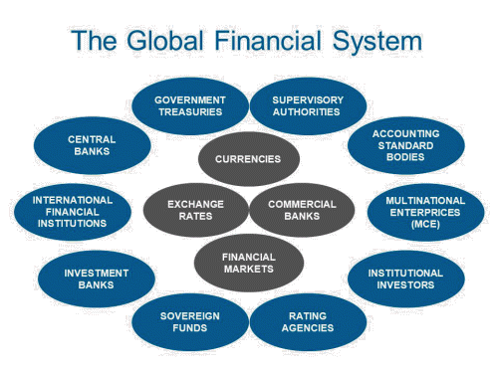

Slide 8
Stakeholders in Financial Markets
Primary Stakeholders
  Shareholders
  Lenders
  Companies
  Mutual Fund Organisations/holders/fund managers

Slide 9
Service Providers
Merchant Bankers
Brokers
Underwriters
Depositors
Custodians

Slide 10
Merchant Banker
Merchant banker means any person who is engaged in the business of issue management, either by making arrangements regarding selling, buying, or subscribing to securities or acting as a manager, consultant, or adviser, or rendering corporate advisory services in relation to such issue management.
It is mandatory to appoint a merchant banker in case of a public issue.

Slide 11
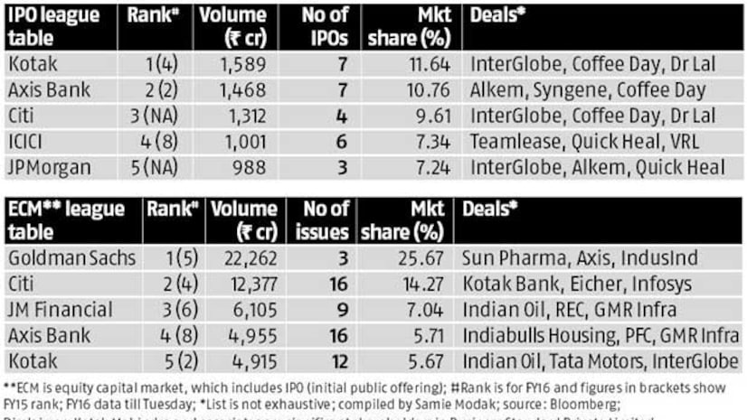
Merchant Bankers

Slide 12
Regulators
Securities and Exchange Board of India (SEBI)
Reserve Bank of India (RBI)
IRDA
Pension Fund Regulatory and Development Authority

Slide 13
Administrators to facilitate
Association of Mutual Funds of India (AMFI)
Foreign Exchange Dealers Association of India
Fixed Income Money Market and Derivative Association of India
Association of Investment Bankers of India

Slide 14
Credit Policy of RBI
Maintenance of Price stability
Achieving economic growth
Exchange rate stability
External balance of payment equilibrium
Moderate structure of interest rates

Slide 15
Instruments of Credit Policy
CRR
SLR
Liquidity Adjustment Faculty (Commercial can borrow from RBI through discount window against the collateral of securities)
  REPO and Reverse Repo
Margin Standing Facility
Open Market Operations

Slide 16
Others
FED (Federal Reserve System) Policy
Cost of Inflation Index (For computation of Long Term Capital Gains)
Consumer Price Index
Wholesale Price Index

Slide 17
Financial Markets
Financial Markets
Money Market (Short Period
Less than one year )
Capital Market
(Long Period More than one Year)

Slide 18
Money Market
Money Market
Organised
Unorganised

Slide 19
Organised Segment
Commercial and other banks
NBFCs
Cooperative banks
Financial and Investment institutions
Corporates
Mutual Funds
Discount and Finance House of India

Slide 20
Unorganised Segment
Money lenders
Indigenous Bankers
Nidhis (Mutual Fund Association)
Chit Funds

Slide 21
Money Market
Money market is the market for financial asset that close substitutes for money.
It is the market for instruments ranging from one day deployment for example call money market to a few months but up to or less than one year.
Duration: From 1 day to 1 year

Slide 22
Concept and Definition
The money market is a market for financial assets that are close substitutes for money. It is a market for overnight to short-term funds and instruments having a maturity period of one or less than one year.
It is not a physical location (like the stock market), but an activity that is conducted over the telephone. The money market constitutes a very important segment of the Indian financial system.

Slide 23
It is not a single market but a collection of markets for several instruments.
It is a wholesale market of short-term debt instruments.
Its principal feature is honour where the creditworthiness of the participants is important.
It is a need-based market wherein the demand and supply of money shape the market.

Slide 24
Main Participants of Money Market
Reserve Bank of India (RBI)
Discount and Finance House of India (DFHI)
Mutual funds, Insurance companies
Banks, Corporate investors
Non-banking finance companies (NBFCs)
State governments, Provident funds
Primary dealers
Securities Trading Corporation of India (STCI)
Public sector undertakings (PSUs)
Non-resident Indians.

Slide 25
Importance
Provides a stable source of funds to banks
Encourages development of non-bank entities
Facilitates government market borrowing
Makes effective monetary policy actions
Helps in pricing different floating

Slide 26
Role of RBI
To ensure that liquidity and short-term interest rates are maintained at levels consistent with the monetary policy objectives of maintaining price stability;
To ensure an adequate flow of credit to the productive sectors of the economy; and
To bring about order in the foreign exchange market.

Slide 27
Money Market Instruments
1. Treasury bills (T-bills)
2. Call/notice money market—Call (overnight) and short notice (up to 14 days)
3. Commercial Papers (CPs);
4. Certificates of Deposits (CDs);
5. Commercial Bills (CBs)
6. Collateralised Borrowing and Lending Obligation (CBLO)

Slide 28
Treasury Bills
Who will issue?
Why?
60 Days TB (auction basis)
  Face Value Rs.100
  Issue Price?
  Rs.98
182 Days
365 Days

Slide 29
Call Money, Notice Money and Term Money
This is the short-term borrowing and lending operations between banks and sometimes with and between primary dealers.
Call money is for overnight deployment i.e. for one day.
Notice money is 2 to 14 days
Term Money is for a tenure 15 days and longer

Slide 30
Location: Call Money
Inter-bank money market
Centrally- Mumbai
Sub-markets Delhi, Kolkata, Chennai and Ahmedabad

Slide 31
Call Money
Call money is required mostly by banks. Commercial banks borrow money without collateral from other banks to maintain a minimum cash balance known as the cash reserve requirement (CRR).
This inter-bank borrowing has led to the development of the call money market.

Slide 32
Call Rate
The interest rate paid on call loans is known as the ‘call rate.’ It is a highly volatile rate.
It varies from day-to-day, hour-to-hour, and sometimes even minute-to-minute.
It is very sensitive to changes in the demand for and supply of call loans. Within one fortnight, rates are known to have moved from 1–2 per cent to over 140 per cent per annum.

Slide 33
MIBOR
The National Stock Exchange (NSE) developed and launched the NSE Mumbai Inter-bank Bid Rate (MIBID) and the NSE Mumbai Inter-bank Offer Rate (MIBOR) for overnight money markets on June 15, 1998.

Slide 34
NSE MIBID/MIBOR are based on rates pooled by the NSE from a representative panel of 31 banks/institutions/ primary dealers. Currently, quotes are pooled and processed daily by the exchange at 9:40 (1ST), for the overnight rate and at 11.30 (IST) for the 14 day, 1 month, and 24 month rates. The rates pooled are then processed using the boost trap method to arrive at an efficient estimate of the reference rates. This rate is used as a benchmark rate for majority of the deals struck for floating rate debentures and term deposits.
The benchmark is the rate at which money is raised in the financial markets. These rates are used in hedging strategies and as reference points in forwards and swaps.

Slide 35
Government Treasury Bills
T-Bills are short-term instruments used by the government to raise short-term funds.
Issued by the Reserve Bank on behalf of the government to tide over short-term liquidity shortfalls.

Slide 36
TBs
Negotiable securities.
Highly liquid.
Absence of default risk.
Assured yield, low transaction cost, and are eligible for inclusion in the securities for SLR purposes.
Purchases and sales are effected through the Subsidiary General Ledger (SGL) account.

Slide 37
Types of TBs
At present, there are 91-day, 182-day, and 364-day T-bills.
The 91-day T-bills are auctioned by the RBI every Friday and the 364-day T-bills every alternate Wednesday, i.e., the Wednesday preceding the reporting Friday.
Treasury bills are available for a minimum amount of Rs. 25,000 and in multiples thereof.

Slide 38
Participants in the T-Bills Market
The Reserve Bank of India, banks, mutual funds, financial institutions, primary dealers, provident funds, corporates, foreign banks, and foreign institutional investors are all participants in the T-bills market.
The state governments can invest their surplus funds as non-competitive bidders in T-bills of all maturities.

Slide 39
Participants in the T-Bills Market
The Reserve Bank of India,
Banks, mutual funds,
Financial institutions,
Primary dealers, provident funds, corporates, foreign banks, and foreign institutional investors are all participants in the T-bills market.
The state governments can invest their surplus funds as non-competitive bidders in T-bills of all maturities

Slide 40
Types of Auctions
(i) Multiple-price Auction
• Each winning bidder pays the price it bid
(ii) Uniform-price Auction
• Each winning bidder pays the uniform price decided by the Reserve Bank.

Slide 41
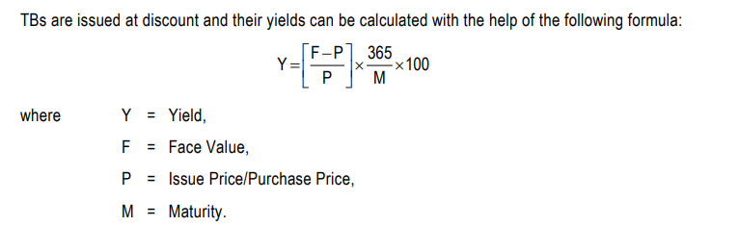
TBs: How to calculate yield

Slide 42
Illustration 1
The RBI offers 91-Day Treasury Bills to raise ₹15000 crores. The following bids have been received. Face Value ₹100.
Bidder | Bid Rate | Amount (₹) Crore
A | 98.95 | 18,000
B | 98.93 | 7,000
C | 98.92 | 10,000
What is the Yield for each of the price at which the bid has been made?
Who are the winning bidders if it was a yield-based auction, and how much of the security will be allocated to each winning bidder?

Slide 43
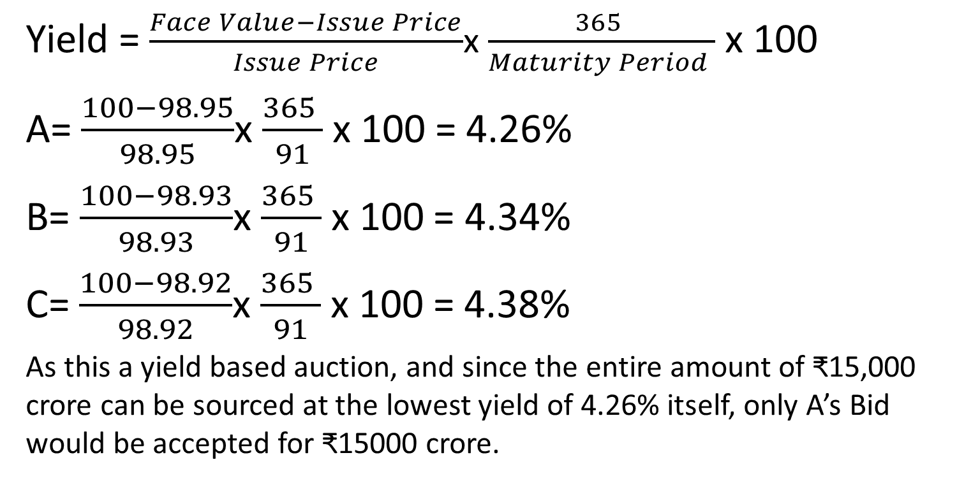
Solution

Slide 44
Commercial paper
A commercial paper is an unsecured short-term promissory note, negotiable and transferable by endorsement and delivery with a fixed maturity period.
It is generally issued at a discount by the leading creditworthy and highly rated corporates to meet their working capital requirements.
Depending upon the issuing company, a commercial paper is also known as a finance paper, industrial paper, or corporate paper.

Slide 45
Investors in CP
Individuals
Banks
Corporates
Unincorporated bodies
NRIs
FIIs

Slide 46
Role of RBI
Prior approval of RBI is required before issue
RBI controls the broad timing of the issue to ensure orderly fund raising.
Every issue of CP launched by a company including rollover will be treated as fresh issue.

Slide 47
Commercial Paper
Size of CP: Rs. 5 Lakhs or multiple thereof
Maximum size of CP issue hundred percent of the issuers working capital.
Minimum : 7 days from the date of issue
Maximum: One year from the date of issue

Slide 48
Certificate of Deposits
Certificates of deposit (CDs) are unsecured, negotiable, short-term instruments in bearer form, issued by commercial banks and development financial institutions.
CDs can be issued by (i) scheduled commercial banks excluding Regional Rural Banks (RRBs) and Local Area Banks (LABs); and (ii) select all-India Financial Institutions that have been permitted by the RBI to raise short-term resources within the umbrella limit fixed by the RBI.
Minimum amount of a CD should be Rs. 1 lakh, i.e., the minimum deposit that could be accepted from a single subscriber should not be less than Rs. 1 lakh and in the multiples of Rs. 1 lakh thereafter.

Slide 49
Certificate of Deposits
The maturity period of CDs issued by banks should be not less than 7 days and not more than 1 year.
FIs can issue CDs for a period not less than 1 year and not exceeding 3 years from the date of issue.

Slide 50
Certificate of Deposits
CDs may be issued at a discount on face value.
Banks have to maintain the appropriate reserve requirements, i.e., cash reserve ratio (CRR) and statutory liquidity ratio (SLR), on the issue price of the CDs.

Slide 51
Commercial Bills
Commercial bills are negotiable instruments drawn by the seller on the buyer which are, in turn, accepted and discounted by commercial banks.
Commercial bill is an important tool to finance credit sales.
Commercial bills were introduced in the money market in 1970.
The RBI rediscounted genuine trade bills at the bank rate or at a rate specified by it. The development of the bills market enabled banks and financial institutions to invest their short-term surplus funds in bills of varying maturities.

Slide 52
Types of Commercial Bills
Demand Bill: A demand bill is payable on demand, i.e., immediately at sight or on presentation to the drawee.
Usance Bill: A usance bill is payable after a specified time. If the seller wishes to give some time for payment, the bill would be payable at a future date.
Clean Bill: In a clean bill, documents are enclosed and delivered against acceptance by the drawee, after which it becomes clear.
Documentary Bill: In the case of a documentary bills, documents are delivered against payment accepted by the drawee and documents of the file are held by bankers till the bill is paid.

Slide 53
Commercial Bills
Inland Bill : Inland bills must (a) be drawn or made in India and must be payable in India; or (b) drawn upon any person resident in India.
Foreign Bill: Foreign bills, on the other hand, are (a) drawn outside India and may be payable in and by a party outside India, or may be payable in India or drawn on a party in India; or (b) it may be drawn in India and made payable outside India.
Hundi: The indigenous variety of bill of exchange for financing the movement of agricultural produce, called a ‘hundi,’ has a long tradition of use in India. It is in vogue among indigenous bankers for raising money or remitting funds or to finance inland trade.

Slide 54
Derivative Usance Promissory Note
With a view to eliminating movement of papers and facilitating multiple rediscounting, the RBI introduced an innovative instrument known as ‘Derivative Usance Promissory Notes,’ backed by such eligible commercial bills for required amounts and usance period (up to 90 days).

Slide 55
Collateralised Borrowing and Lending Obligation (CBLO)
The Clearing Corporation of India Limited (CCIL) launched a new product–Collateralised Borrowing and Lending Obligation (CBLO)—on January 20, 2003 to provide liquidity to non-bank entities hit by restrictions on access to the call money market.
CBLO is a discounted instrument available in electronic book entry form for the maturity period ranging from 1 day to 19 days.
Banks, Cooperative Banks, Financial institutions, Insurance Companies, Mutual Funds, and Primary Dealers who are members of negotiated dealing system (NDS) are allowed to participate in CBLO transactions.

Slide 56
Illustration 2
X Ltd. issued Commercial Paper as per the following details:
Date of issue : 17th January 2022
Date of Maturity : 17th April 2022
No of Days : 90 Days
Face Value : ₹100
Interest Rate: 11.25%
What was the net amount received by the Company on issue of Commercial Paper?

Slide 57
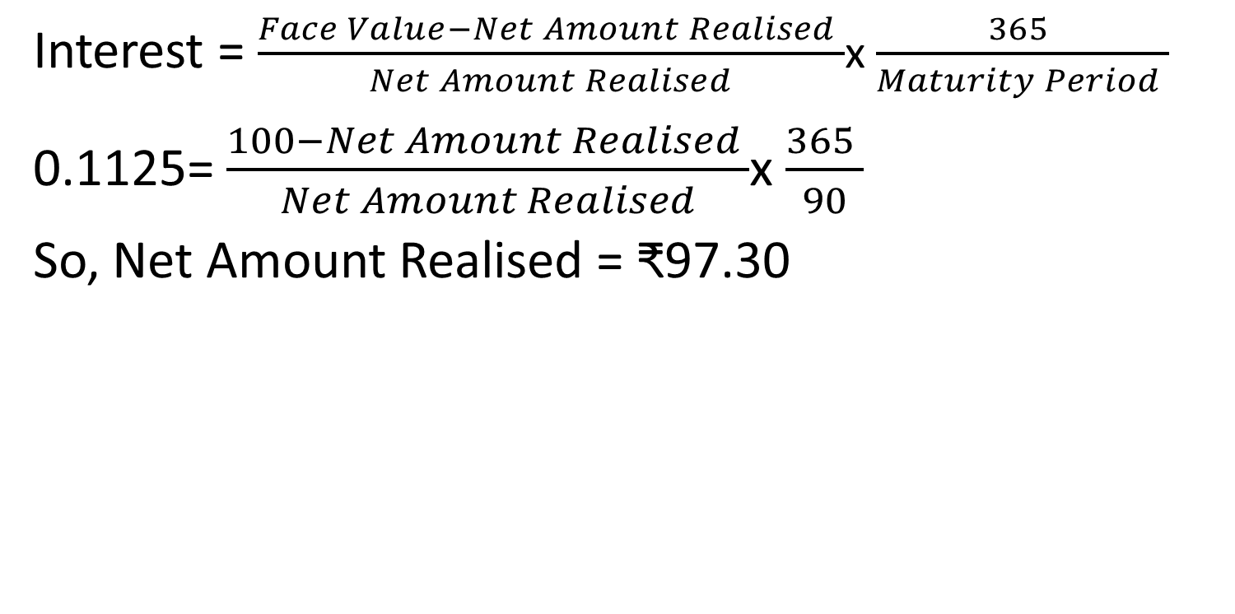
Solution

Slide 58


