Slide 1
Module III: Syllabus
FINANCIAL INSTITUTIONS & MARKETS
And
PROJECT MANAGEMENT

Slide 2
PART A: FINANCIAL INSTITUTIONS AND MARKETS
1. Overview of Financial System
  Lending, Payments and Risk Trading
  Interest rates and Exchange rates
  Capital Market and Money Market, Primary Market & Secondary Market
  Stock Exchange
  SEBI

Slide 3
PART A: FINANCIAL INSTITUTIONS AND MARKETS
2. Financial Intermediaries
  a. Banks
  b. NBFCs
  c. RBI
  d. Other Financial Institutions
3. Insurance (General Insurance)
4. Mutual Funds

Slide 4
PART B: PROJECT MANAGEMENT
1. Project Identification, Planning and Formulation
2. Project Selection & Feasibility Studies and Project Appraisal
3. Project Organisation

Slide 5
PART B: PROJECT MANAGEMENT
4. Source of Project Finance, Estimation of Project Costs
5. Risk Factors, Project Planning & Scheduling including PERT & CPM
6. Project Cost Control, Project Review & Appraisal
7. Computer aided Project Management (MS Project)

Slide 6
Why it is important
For Individual
For Business Organisation
For Government

Slide 7
Lecture Outline
Financial System
  Meaning and Importance
  Functions
Relationship between Financial System and capital formation
Structure of Financial System
Components of Financial System

Slide 8
Finance
Finance refers to monetary resources and to the study and discipline of money, currency, assets and liabilities.
Raising of Resources (How)
Investing of Resources (where)
Tools and Techniques

Slide 9
Finance
Finance can be broadly divided into three categories:
Public finance
Corporate finance
Personal finance
Subcategories of finance include social finance and behavioral finance.

Slide 10
Public Finance
Public finance includes tax systems, government expenditures, budget procedures, stabilization policies and instruments, debt issues, and other government concerns.

Slide 11
Corporate and Personal Finance
Corporate finance involves managing assets, liabilities, revenues, and debts for businesses.
Personal finance defines all financial decisions and activities of an individual or household, including budgeting, insurance, mortgage planning, savings, and retirement planning.

Slide 12
Corporate Finance
Corporate finance is a subfield of finance that deals with how corporations address funding sources, capital structuring, accounting, and investment decisions.

Slide 13
Social Finance
Social finance typically refers to investments made in social enterprises including charitable organizations and some cooperatives.
These investments take the form of equity or debt financing in which the investor seeks both a financial reward and a social gain.

Slide 14
Behavioral Finance
Behavioral finance is an economic theory that studies how psychology affects the financial decisions of investors and analysts.
It explains why people make irrational financial decisions that may not seem rational or have unpredictable consequences.

Slide 15
Financial System
Financial system is a set of complex and closely-connected or intermixed institutions, agents, practices, markets, claims, and so on in an economy.
A financial system may be defined as a set of institutions, instruments and markets which promotes savings and channels them to their most efficient use. It consists of individuals (savers), intermediaries, markets and users of savings (investors).

Slide 16
Informal Financial System
The informal financial system is a sector of the economy that consists of financial activities that take place outside of regulatory authorities.
It's characterized by personal relationships between the provider.

Slide 17
Informal Indian Financial System
Individual lenders, groups of people acting as funds or associations, partnership firms made up of local brokers.

Slide 18
Informal Financial System
Advantages
  Low transaction costs
  Minimum default risk
  Transparency of procedures
Disadvantages
  Wide range of interest rates
  Higher rates of interest
  Unregulated

Slide 19
Functions of a Financial System
Mobilize and allocate savings
Monitor corporate performance
Provide payment and settlement systems
Optimum allocation of risk-bearing and reduction
Disseminate price related information
Offer portfolio adjustment facility
Lower the cost of transactions
Promote the process of financial deepening and broadening

Slide 20
Pre-requisites of a well-functioning Financial System
A strong legal and regulatory environment,
Stable money,
Sound public finances and public debt management,
A central bank,
A sound banking system,
An information system, and
A well-functioning securities market

Slide 21
Financial System Designs
Bank-Based: In bank-based financial systems, banks play a pivotal role in mobilizing savings, allocating capital, overseeing the investment decisions of corporate managers, and providing risk management facilities.
Example:
  Developed Countries: Japan, Germany, France, Italy
  Under-developed Nations: Argentina, Pakistan, Sri Lanka, Bangladesh

Slide 22
Financial System Designs
Market-based: In market-based financial systems, the securities markets share centre stage with banks in mobilizing the society’s savings for firms, exerting corporate control, and easing risk management.
Example:
  Developed Countries: US, UK, Singapore, Malaysia, Korea
  Under-developed Nations: Brazil, Mexico, the Philippines, Turkey
  Source: Demirguc Kunt, A. and R. Levine (1999), Bank-based and Market-based Financial System: Cross-Country Comparisons, World Bank Policy Research Working Paper No. 2143.

Slide 23
Capital Formation
The main function of financial systems is the collection of savings and their distribution for industrial investment, thereby stimulating the capital formation and, to that extent, accelerating the process of economic growth.
Types of Economic Units:
  Surplus-spending Economic Units
  Deficit-spending Economic Units

Slide 24
Process of capital formation
Savings: The ability by which claims to resources are set aside and become available for other purposes.
Finance: The activity by which claims to resources are either assembled from those released by domestic savings, obtained from abroad, or specially created usually as bank deposits or notes and then placed in the hands of the investors.
Investments: The activity by which resources are actually committed to production.

Slide 25
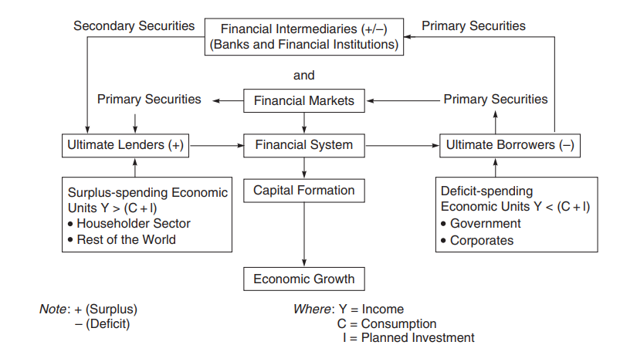
Financial System and Economic Growth
Source: Bharati V. Pathak, Indian Financial System, Pearson

Slide 26
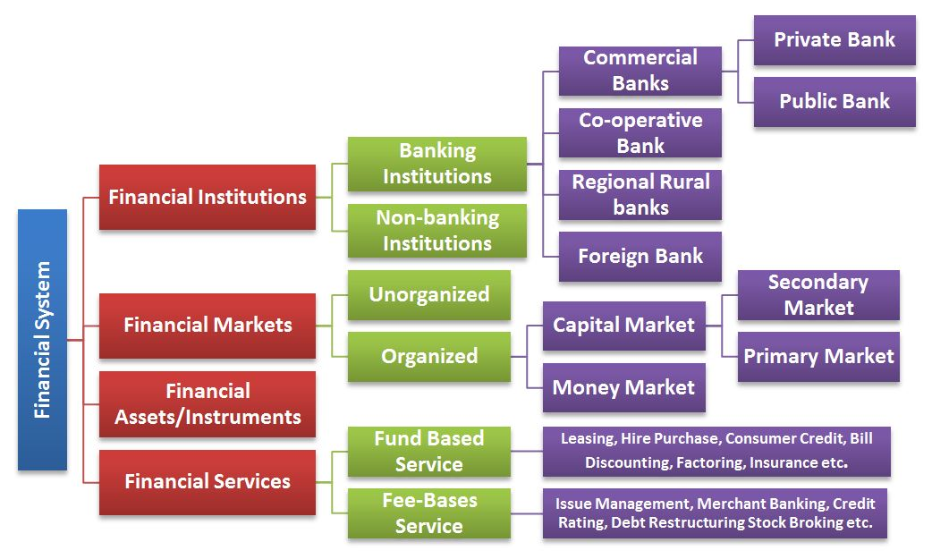
Structure of Financial System

Slide 27
Components of Financial System
Financial Institutions
Financial Instruments
Financial Markets
Financial Services
Financial Regulators

Slide 28
Financial Institutions
They are business organizations dealing in financial resources.
They collect resources by accepting deposits from individuals and institutions and lend them to trade, industry and others.
This means financial institutions mobilize the savings of savers and give credit or finance to the investors.

Slide 29
Classification of FI
On the basis of the nature of activities, financial institutions may be classified as:
Banking Financial Institutions:
  Banking institutions mobilize the savings of the people.
  They provide a mechanism for the smooth exchange of goods and services.
  They extend credit while lending money.
  They not only supply credit but also create credit.

Slide 30
Non-banking Financial Institutions
Mobilize financial resources directly or indirectly from the people.
Lend funds but do not create credit. Companies like LIC, GIC,UTI, Development Financial Institutions.
Non-banking financial institutions can be categorized as investment companies, housing companies, leasing companies, hire purchase companies, specialized financial institutions.

Slide 31
Financial Markets
Financial markets are the centres or arrangements that provide facilities for buying and selling of financial claims and services.
They create financial assets.
Financial markets exist wherever financial transactions take place.
Financial transactions include issue of equity shares by a company, purchase of bonds in the secondary market, deposit of money in a bank account, transfer of funds from a current account to a savings account etc.

Slide 32
Classification of Financial Markets
Classification on the basis of structure
1. Organized markets
  These are financial markets in which financial transactions take place within the well established exchanges or in the systematic and orderly structure.
2. Unorganized markets.
  These are financial markets in which financial transactions take place outside the well established exchange or without systematic and orderly structure or arrangements.

Slide 33
Classification of Financial Markets
Classification on the basis of instruments
Money Market—a market for short-term debt instruments
Capital Market—a market for long-term equity and debt instruments

Slide 34
Money Market
A market where short term funds are borrowed and lend is called money market.
It deals in short term monetary assets with a maturity period of one year or less.
Call market, Treasury-bills market, Commercial bills market, Commercial papers (CPs) market, Certificate of deposits (CDs)

Slide 35
Capital Markets
Capital market is the market for long term funds.
This market deals in the long-term claims, securities and stocks with a maturity period of more than one year.
Participants: Mutual funds, insurance organisations, foreign institutional investors, corporates and individuals.

Slide 36
Financial Instruments
They represent claims on a stream of income and/or assets of another economic unit and are held as a store of value and for the return that is expected.
The maturity and sophistication of the financial system, indeed, depends on the prevalence of a variety of securities/ financial assets to suit the investment requirements of heterogeneous investors.
Ordinary/equity shares, preference shares, debentures/bonds including innovative debt instruments.
Treasury bills, gilt-edge securities, state government and public sector instruments, commercial paper, certificate of deposit, commercial bills etc.

Slide 37
Financial Services
The term ‘financial services' in a broad, sense means "mobilizing and allocating savings". Thus, it includes all activities involved in the transformation of savings into investment.
Financial services can also be called 'financial inter mediation'. Financial intermediation is a process by which funds are mobilizing from a large number of savers and make them available to all those who are in need of it and particularly to , corporate customers.

Slide 38
Types of Financial Services
Financial Services
Fee-based
Leasing
Hire purchase
Factoring
Credit Financing
Housing Financing
Fund-based
Issue Management
Portfolio Management
Corporate Counsellig
Merchant banking
Credit rating

Slide 39
Regulators
Regulators
RBI
Banks
SEBI
Securities Market and Mutual Funds
IRDA
Insurance Companies

Slide 40


