Slide 1
Industry Analysis, PEST Analysis
P.S.S.Murthy
M.Com, M.phil, Ph.D, FCMA

Slide 2
CIMA defines MA
“The practical science of Value creation within organizations in both the private and public sectors”

Slide 3
The Agenda
A brief recap of the Journey so far
Industry Analysis (Porter’s Five force model)
Audit of Internal and External Environment (PEST Analysis)
Company Analysis
  Analysis of the past growth in ROIC
  Analysis of the Core Competencies of the business
  -Ability to take future opportunities
  Establishing relationship between each item of P & L

Slide 4
The Journey So far (slides 2-5 of Lecture I By Prof AKB)
  Valuation is n Art, Judgemental
  Valuation of an investment asset depends on its ability to generate cash in future.
  Valuation of an asset requires clear understanding of the factors that drive the Value
  The Valuer
    Develops perceptions about the future
    Makes necessary assumptions

Slide 5
Suitability of different valuation Methods in different contexts
Choice based on
  Growth stage of the firm
  Nature of the industry
  Availability of information

Slide 6
Valuation Contexts( Prasanna Chandra, “Corp. valuation and Value creation, 2011”)
Following situations
  Raising Capital for a Nascent Venture
  IPO
  Acquisitions
  Divestiture
  PSU Divestment
  ESOPs
  Portfolio Management

Slide 7
Miles to go , before we sleep
  Industry Analysis
    Valuation depends on the type of Industry
    Therefore , let’s visit Michael Porters’ Industry Analysis
What is Porter’s five force analysis?
  It is a frame work for industry analysis and business strategy development
  Principal innovator is Prof Michael Porter of Harvard University

Slide 8
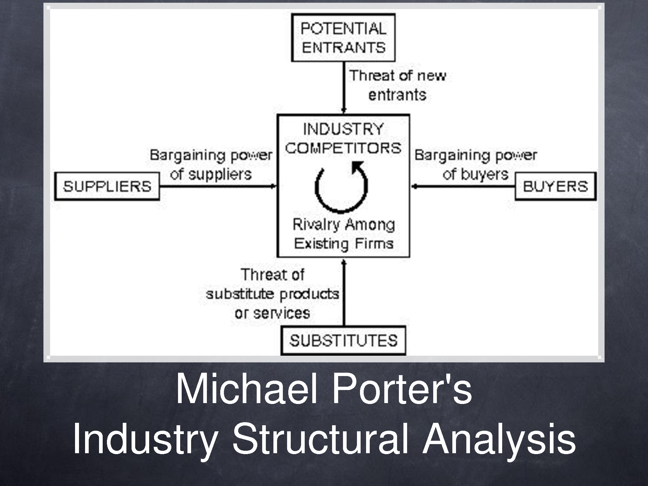
Porter’s industry analysis

Slide 9
The First One: Rivalry among existing firms
Why does rivalry exist?
  Because of high returns, new firms will get attracted.
  Over a period of time, the profitability decreases and a sort of normalcy sets in.. Zero profit is of course a sign of perfect competition
  These new entrants pose a threat to the existing ones

Slide 10
Factors having an effect on the degree of threat
Barriers to entry ( Patents, rights etc.,). The most attractive segment is where entry barriers are high and exit barriers are low.
  Pharmaceuticals Industry , software industry, infrastructure , telecom, Hotel and Hospitality—rank them ?
  FMCG --- if a MNC wants to enter?
Capital needed
Government’s policy of encouraging/discouraging.. Like the extension of Tax Holiday to the existing firms

Slide 11
Barriers contd...
Economies of scale ( mass production, mass customization)
Product differentiation (differences in quality, functional features,)
  Involves offering a Product or service that is perceived by customers as distinctive or unique and they are expected to pay a higher price
The firm must identify some attributes of a product or service that customers really value
It may be achieved through quality, product range, bundled services , brand image, delivery etc.,
  Examples of firms( Intel in Chips, Apple in Computers, Rolex in wrist watches Coca-cola in beverages )

Slide 12
Barriers Continued.....
Brand equity
Switching costs or sunk costs
  Types of switching costs include exit fees, search costs, learning costs, cognitive effort, emotional costs, equipment costs, installation and start-up costs, financial risk, psychological risk, and social risk.
Access to distribution channels
Expected retaliation
Customer loyalty

Slide 13
Threat of substitute products or services
Pepsi vs. coke vs. Drinking water provided by the Government , Coconut water..
Pepsi vs. Coke war....
Buyer propensity to substitute
Relative price performance of substitutes
Buyer switching costs
Number of substitute products available in the market
Ease of substitution
Substandard Product
Quality depreciation

Slide 14
Bargaining Power of customers( Buyers)
It is the ability of the customers to put the firm under pressure
It affects the customer’s sensitivity to price changes
Firms try to reduce the buyer power by implementing a Loyalty Program
The Buyer power is high if the buyer has many alternatives
Potential factors
  Buyer concentration to firm concentration ratio
  Concentration ratio indicates relative size of firms in relation to the size of the Industry. Low ratio indicates greater competition.

Slide 15
---- Contd...Potential factors
Degree of dependency on existing channels of distribution
Buyer information availability
Force down prices
Availability of existing substitute products
Buyer price sensitivity
RFM Analysis ..( in Direct Marketing,)(when, how much )
Buyer switching costs relative to firm switching costs

Slide 16
Bargaining Power of suppliers
Suppliers of raw materials, components, labour and services to the firm
Suppose there is only supplier ????
Suppliers may refuse to work with the firm or may charge high prices
Potential factors
  Supplier switching costs relative to firm switching costs
  Degree of differentiation of inputs
  Impact of inputs on cost or differentiation
  Strength of distribution channel

Slide 17
Intensity of competitive rivalry
It is a major determinant of the competitiveness of the Industry
Potential factors
  Sustainable competitive advantage through innovation
  Competition between online and offline companies
  Ad spend
  Powerful competitive strategy
  Degree of transparency

Slide 18
Audit of Internal and External environment
PEST Analysis
  Political, Economic , Social and Technological environment
  It is a framework to scan the environment in which a company operates
  These factors play an important role in the value creating opportunities of a company’s strategy

Slide 19
Political Factors to consider
How did the recent elections change/changed governments Policy?
How does the views of the Government Policy on Business Affect your business?
How are the Government’s policy on transparency likely to affect the way of doing business ? Impact on your business?
Could any pending legislation or taxation issue changes affect your business-positively or negatively

Slide 20
----- Contd
Are you experiencing any regulation/deregulation
How does government approach corporate policy, corporate social responsibility, environmental issues, and customer protection legislation? What impact does this have, and is it likely to change?
What is the likely timescale of proposed legislative changes?
Are there any other political factors that are likely to change?

Slide 21
Economic Factors
How stable is the economy-Growing, stagnating, decline?
  There are hopes that economy should grow at 6 per cent...
  It is no doubt growing but at a lesser rate. Many factors influence
    RBI Chief says,
      High inflation remains a threat for the economy
      Households savings as percentage of GDP declined to 7 per cent in 2013-14
      Gross Capital Formation declined for the second consecutive year in 2012-13

Slide 22
--Contd
Infrastructure growth
  Requires Coal
    Power Minister wants private sector to mine faster and more.
    Wants to improve the Coal India’s efficiency to speed up Coal Supplies
Subsidies ( these were rs71k in 2007-08 and rose to Rs2,56,000 crores in 2013-14
The interim budget for 2014-15 gave the fiscal deficit at 4 per cent of GDP.Should a stimulus work? At which sector’s cost

Slide 23
---Contd
Are customers' levels of disposable income rising or falling? How is this likely to change in the next few years?
What is the unemployment rate? Will it be easy to build a skilled workforce? Or will it be expensive to hire skilled labor?
Do consumers and businesses have easy access to credit? If not, how will this affect your organization?
How is globalization affecting the economic environment?
Are there any other economic factors that you should consider?
Gas Price increase deferment.. Impacts the incomes of Reliance and ONGC-Says Moody ..

Slide 24
Socio cultural factors
Population growth rate and age profile? How is to going to change?
(Y)our society's levels of health, education, and social mobility? How are these changing, and what impact does this have?
What employment patterns, job market trends, and attitudes toward work can you observe? Are these different for different age groups?
What social attitudes and social taboos could affect your business? Have there been recent socio-cultural changes that might affect this?
How do religious beliefs and lifestyle choices affect the population?
Are any other socio-cultural factors likely to drive change for your business?

Slide 25
Technological Factors to Consider
Are there any new technologies that you could be using?
Are there any new technologies on the horizon that could radically affect your work or your industry?
Do any of your competitors have access to new technologies that could redefine their products?
In which areas do governments and educational institutions focus their research? Is there anything you can do to take advantage of this?
How have infrastructure changes affected work patterns (for example, levels of remote working)?
Are there existing technological hubs that you could work with or learn from?
Are there any other technological factors that you should consider?
INCONCLUSIVE......

