Slide 1
Business Valuation: Lecture 2
Asish K Bhattacharyya
2014

Slide 2
Guiding Principles
Value of an investment asset is the present value of future cash flows that the asset will generate.
For example, value of a fixed income instrument is the present value of future cash flows that the instrument will generate till its maturity.
The appropriate discount rate is estimated based on the riskiness of those cash flows.

Slide 3
Guiding Principles (Contd.)
Firms create value by generating future cash flows at a rate of return on invested capital (ROIC) that exceeds the cost of capital.
EVA = Invested Capital × (ROIC − WACC)

Slide 4
Guiding Principles (Contd.)
Faster the increase in revenues and deployment of capital in attractive rates of return, higher is the value created by companies.
The combination of growth and return on invested capital (ROIC) relative to its cost of capital is what derives value.

Slide 5
Guiding Principles (Contd.)
Companies can sustain strong growth and high returns on invested capital only if they could create sustainable competitive advantage.
  Example: Nirma lost its way in soap and detergent market
  Example: Investors are worried about Infosys.

Slide 6
Guiding Principles (Contd.)
Creating sustainable value is a long-term endeavour.
Competition tends to erode competitive advantages.
  Hindustan Motors lost its competitive advantage on emergence of Maruti

Slide 7
Guiding Principles (Contd.)
Some companies enjoy increasing return to scale.
The basic idea of increasing return to scale is that in certain situations, as companies get bigger, their unit costs fall. This is a phenomenon that is being observed in knowledge driven industry.

Slide 8
Guiding Principles (Contd.)
While, in most industries, competition forces returns back to reasonable levels, in increasing-returns industries due to the low and decreasing unit costs of the market leader, new entrants find it difficult to survive and the leader continues to generate attractive returns on investment.

Slide 9
Guiding Principles (Contd.)
Valuers should carefully assess whether the firm being valued truly enjoys the increasing return to scale and should not go by a pre-conceived notion.

Slide 10
Guiding Principles (Contd.)
Firms operating in the knowledge-driven industry might not be able to continue to retain the competitive advantage when new wave of technology arises.
Therefore, valuers need to understand the ecology in which the firm operates and understand the impact of the emerging technology on its ecology.

Slide 11
Guiding Principles (Contd.)
Similarly, a firm that enjoys almost monopoly situation might suddenly face competition when a new competitor comes with a new business model.

Slide 12
Guiding Principles (Contd.)
It is difficult to earn monopoly-sized returns on capital for any length of time except in very special circumstances.
Therefore, valuer needs to identify sources of high returns on investment over a long period.

Slide 13
Cash Is The King
Anything that does not increase cash flows does not create value.
Valuers should focus on cash flows, rather than on accounting numbers.
While earnings and cash flow are correlated, earnings do not tell the whole story of value creation.
Too much focus on earnings and earnings growth might lead to stray from value-creating path.

Slide 14
Cash Is The King
If all firms in an industry earns the same ROIC, then earnings growth would be the differentiating factor.
However, this is a simplistic assumption. ROIC may vary considerably, even between companies in the same industry.
  Example: Automobile industry

Slide 15
Dividend Discount Model

Slide 16
Dividend Discount Model
Shareholders receive cash pay-off from a company in the form of dividend.
Therefore, the value of their equity is the present value of future dividends, including any liquidity dividend.

Slide 17
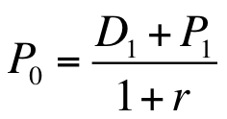
One Period Formula

Slide 18
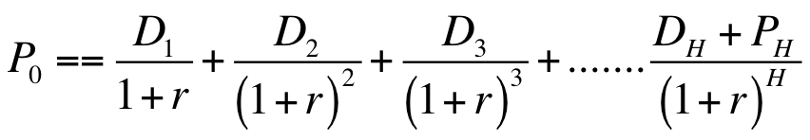
Multi-Period Formula

Slide 19
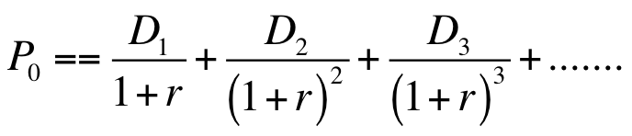
General Formula

Slide 20
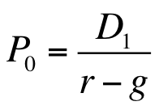
Constant Growth Formula

Slide 21
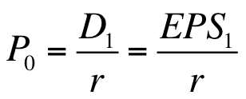
Share Price and EPS:
Firm Does Not Grow At All

Slide 22
Share Price and EPS:
Return equal to ‘r’
Assume that the firm’ EPS₁ per share is 10 and r is 10 per cent.
Further assume that it has decided to skip next year’s dividend and to invest the whole EPS in a new investment that is expected to provide a return equal to the market capitalisation rate (r), that is, 10 per cent.

Slide 23
Share Price and EPS:
Return equal to ‘r’ (Contd.)
NPV of the investment per share at year 1= −10+(1/.10) =0
Thus, the new investment is not adding any value to the firm.

Slide 24
Share Price and EPS:
Return equal to ‘r’ (Contd.)
From year 2, the firm will earn EPS of 11 because of the additional earnings of Re 1 on the new investment.
Therefore, P₁ = (Rs 11/.10) = Rs 110; and
P₀ = (D₁+P₁)/(1+.10) = Rs 110/1.10 = Rs. 100

Slide 25
Share Price and EPS:
Return equal to ‘r’ (Contd.)
Therefore, the equity value of firm can be determined by dividing EPS₁ by the market capitalisation rate.
  P₀ = EPS₁/r = Rs 100/10 = Rs. 100
We may conclude that EPS₁/P₀ ratio equals the market capitalisation rate (r) only when the NPV of new investments is zero.

Slide 26
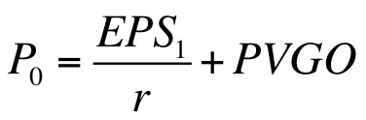
Share Price and EPS:
General Formula
In general, the share price is the capitalised value of average earnings under no-growth policy, plus, the net present value of growth opportunities (PVGO).

Slide 27
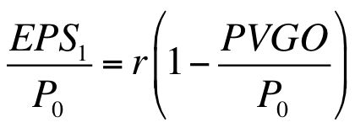
Share Price and EPS:
General Formula (Contd.)
The earnings-price ratio, therefore, equals:

Slide 28
Share Price and EPS:
General Formula (Contd.)
Thus, earnings-price ratio underestimates r when PVGO is positive and overestimates r when PVGO is negative.
Firms usually do not take negative NPV projects. Therefore, it is less likely that the earnings-price ratio overestimates r.

Slide 29
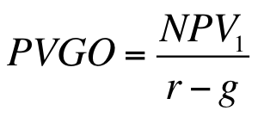
PVGO
If, the firm maintains a constant payout ratio and earns a constant Return on Equity (ROE), the NPV will grow at a constant rate.

Slide 30
Expanded Perpetuity Formula

Slide 31
Perpetuity Formula
The perpetuity formula for the valuation of equity is:

Slide 32
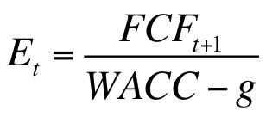
Enterprise Value: Perpetuity Formula
In valuing the enterprise as a whole, that is valuing the total capital invested in the business, we need replace D₁ by Free Cash Flow (FCF) in perpetuity formula.

Slide 33
Free Cash Flow
FCF is the amount that is available for distribution to all the investors after meeting investment needs.
FCF_{t+1} = NOPLAT_{t+1} – Net Investment_{t+1}

Slide 34
NOPLAT
NOPLAT (Net operating profits less adjusted taxes) represents the profit generated from the company’s core operations after subtracting the income taxes related to the core operations.
For the time being, we assume,
NOPLAT = EBIT× (1- Tax Rate)

Slide 35
WACC
Weighted Average Cost of Capital (WACC) is the average of the rate of return that investors, including debt holders, expect to earn from investing in the company and therefore, the appropriate discount rate for the FCF.

Slide 36
Constant Growth Rate (g)
Constant growth rate (g) is the rate at which the company’s NOPLAT and cash flow grows each year.

Slide 37
Net Investment
Net investment is the increase in invested capital from one year to the next.
Net Investment_{t1}  
Invested Capital_{t1} -  Invested Capital_{t}
Invested capital represents the cumulative amount the business has invested in its core operations

Slide 38
Invested Capital
Invested capital is the total of equity and total borrowings in the balance sheet of a company, reduced by the amount of non-operating assets.

Slide 39
ROIC
Return on Invested Capital (ROIC) is the return the company earns on each rupee invested in the business
ROIC = NOPLAT /Invested capital

Slide 40
Investment Rate
Investment Rate (IR) is the portion of NOPLAT invested back into the business.
IR = Net investment/NOPLAT

Slide 41
FCF in Terms of NOPLAT
If the company’s revenue and NOPLAT grow at a constant rate and the company’s IR is also constant, its FCF will grow a constant rate.
Now we may write,
  FCF = NOPLA T – Net Investment
  FCF = NOPLAT – (NOPLAT x IR)
  FCF = NOPLAT x (1-IR)

Slide 42
FCF in Terms of Growth
g = ROIC x IR
IR = g/ROIC
FCF = NOPLAT x (1 – IR)
FCF = NOPLAT x (1-g/ROIC)

Slide 43
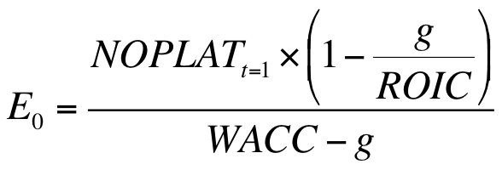
Expanded Perpetuity Formula

Slide 44
Key Value Drivers
Weighted average cost of capital (WACC),
Return on invested capital (ROIC) and
Growth (g)

Slide 45
Value Drivers
Revenue growth
Profit margin (percent)
Cash tax rate
Working capital intensity ratio
Capital intensity ratio
Weighted Average Cost of capital
Value growth duration period (years)

Slide 46
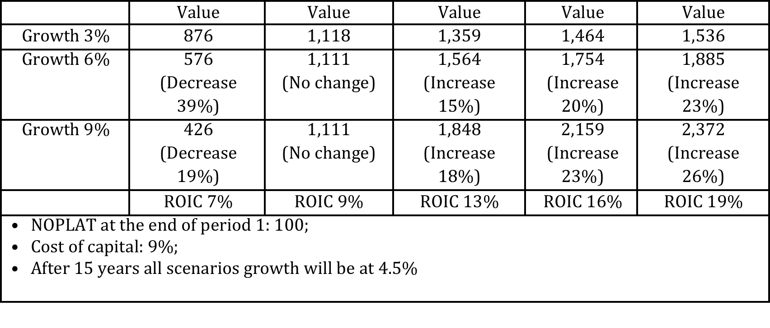
Interactions between WACC, ROIC and g

Slide 47
Interactions between WACC, ROIC and g
for any level of growth, value increases with improvement in ROIC.
Therefore, a company that earns low ROIC should always focus on improving ROIC.
A company that is able to maintain ROIC at a high level, it is valued at a level higher than its peers that earn low ROIC.

Slide 48
Interactions between WACC, ROIC and g (Contd.)
It is a myth that if a company grows, ROIC will naturally increase.
This is true only for young, start-up businesses.
Most often in mature companies, a low ROIC indicates a flawed business model or unattractive industry structure.

Slide 49
Interactions between WACC, ROIC and g (Contd.)
Achieving either type of increase poses different degrees of difficulty for different companies in different industries.
Impact of a change in growth and ROIC also vary between companies.
Every company needs to make the analysis in order to set its strategic priorities.

Slide 50
Growth Strategies
Introduce new products to market
Expand an existing market
Increase share in growing market
Compete for share in a stable market
Acquire business

Slide 51
Growth Strategies (Contd.)
Different types of growth earn different degrees of return
Therefore, not all growth is equally value creating.
Each company must understand the pecking order of growth-related value creation that applies to its industry and company type.

Slide 52
Discounted Abnormal Earnings Method

Slide 53
Link Between Book Value and Earnings
If all equity effects (other than capital transactions) is incorporated in income (called clean surplus), as in the comprehensive income defined in IFRS, the book value of equity at the end of year 1 (BVE₁) equals the book value at the beginning of the year (BVE₀) plus expected net income (NI₁) less expected dividend (DIV₁).

Slide 54

Link Between Book Value and Earnings (Contd.)

Slide 55

Link Between Book Value and Earnings (Contd.)

Slide 56
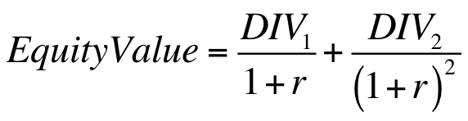
Dividend Discount Model
If, we consider only two periods, according to the dividend discount model,

Slide 57
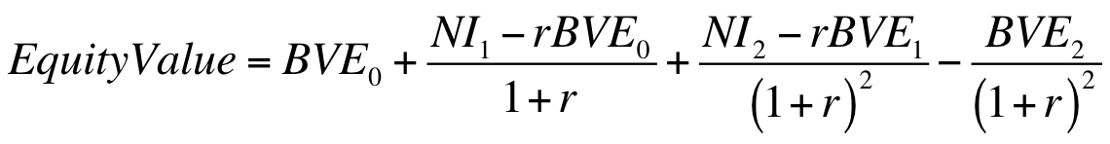
Dividend Discount Model and Abnormal Earnings

Slide 58
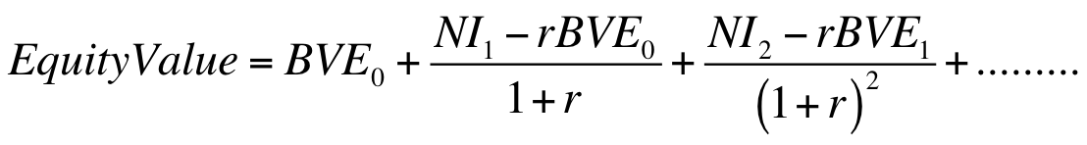
Dividend Discount Model and Abnormal Earnings
As the time horizon tends to infinity, the horizon value tends to zero.
Therefore, if we take a long time horizon, it can be ignored.

Slide 59
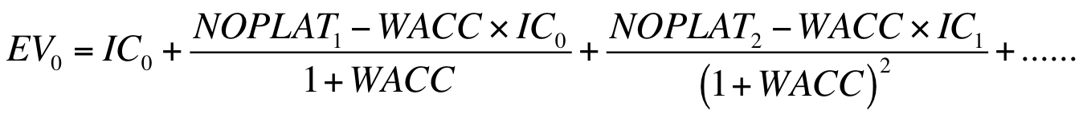
Enterprise Value

Slide 60
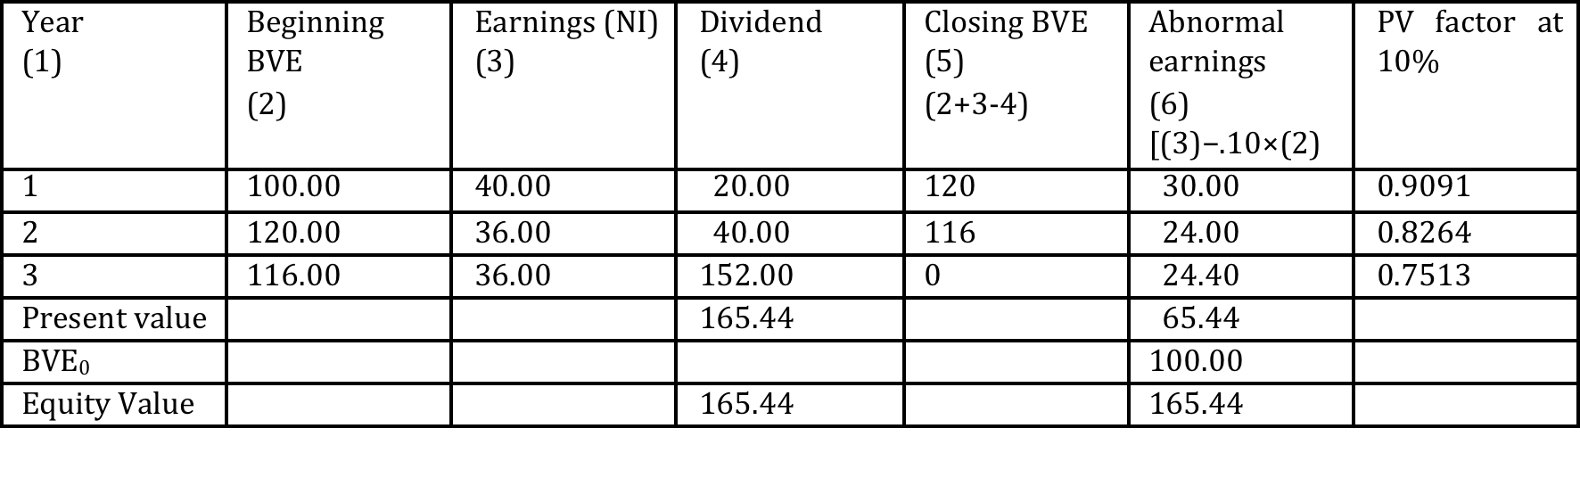
Abnormal Earnings Method: Example

Slide 61

Abnormal Earnings Method: Change in Accounting Policy

Slide 62
Free Cash Flow Method

Slide 63
Fundamental Principle
Under this method, the enterprise value is estimated by adding the market value of non-operating assets to the value of forecasted operating cash flows (FCF) that the enterprise will generate in future.
Equity value is estimated by deducting non-equity claim from the enterprise value.

Slide 64
Free Cash Flow
Free Cash Flow (FCF) is the operating cash flw that is available for distribution to all the investors, including debt holders, after meeting the internal needs of the firm.

Slide 65
Free Cash Flow (contd.)
Internal needs are investment in fixed assets and incremental investment in working capital.
FCF =
Net Profit + Interest × (1- T) + Depreciation – Δ Inv – Δ WC

Slide 66
Free Cash Flow (contd.)
In calculating FCF, the net profit or EBIT should not include non-operating expenses and non-operating incomes.
In adjusting net profit for non-operating income and non-operating expenses, we need to consider the tax affect.
If, a different tax rate is applicable to the non-operating income, the same should be applied instead of the marginal tax rate.

Slide 67
Operating and Non-operating Items
Enterprise value method requires clear identification of non-operating assets, non-operating liabilities, non-operating income and non-operating expenses.

Slide 68
Discount Rate
In FCF model the tax-shield on interest is captured in the discounting rate.
FCF being the cash flow available to all investors, the appropriate discount rate is the weighted average cost of capital (WACC).
In estimating the WACC, after-tax cost of debt is considered. Therefore, tax-shield is not included in the estimated the FCF.

Slide 69
Discount Rate (Contd.)
Cost of unlevered equity is not specific to a articular company, although the cost of debt might be specific to the company.
Cost of unlevered equity is specific to the industry.
Therefore, capital market inputs are used to estimate the cost of unlevered equity.

Slide 70
Discount Rate (Contd.)
Theoretically, each year’s FCF should be discounted by the weighted average cost of capital (WACC) applicable to that year.
WACC depends of the capital structure because after-tax cost of debt is used to estimate the same.
As the amount of debt in the total invested capital changes, the WACC changes.

Slide 71
Target Capital Structure
To simplify calculations, a single discount rate is used to discount FCF of all the years.
This discount rate is estimated based on the target capital structure.
Target capital structure is one that is sustainable over a long period.

Slide 72
Target Capital Structure (Contd.)
It is advisable to examine the historical average capital structure of the industry to decide the target capital structure that will be used to estimate the WACC.

Slide 73
An Example: Assumptions
Asset beta (β_{A}) = 1;
Risk free rate of return (r_{f})= 10 %;
Risk premium (r_{m} - r_{f} ) = 8%
Debt-to-value ratio = 40%; Debt is risk-free

Slide 74
Discount Rate
β_{E} = β_{A}× (V/E) = 1× (100/60) = 1.67
(2) r_{e} = r_{f} + β_{E}× Risk premium = 0.10 +1.67× .08 = 0.234
(3) Post-tax WACC = r_{d}× (1-t) × (D/V) + r_{e}× (E/V) = .10× (1-.40) ×.40 +.234× ×.60 =.024 +.14 = .164 or 16.4%

Slide 75
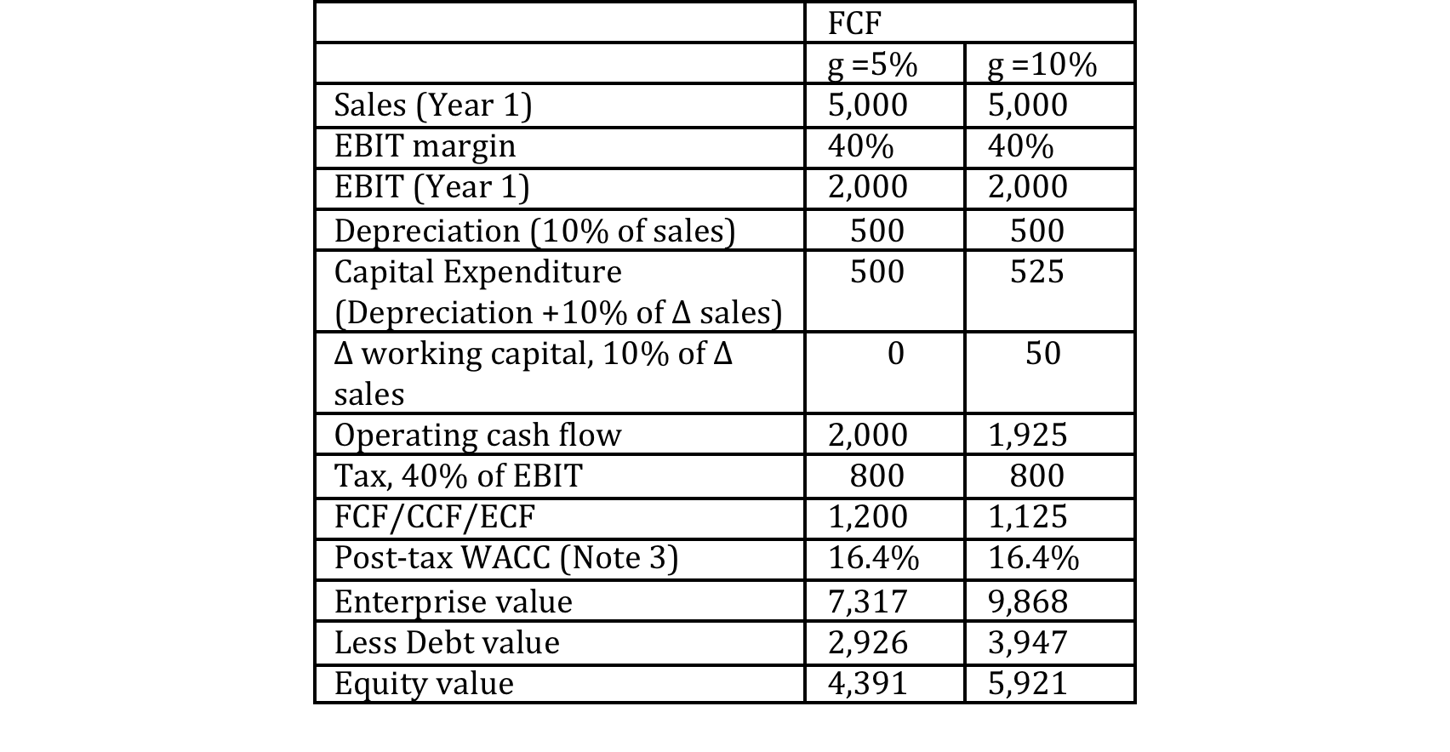
Value of Operating Cash flows

Slide 76
Two-Stage Valuation
The perpetuity formula cannot be applied until the business reaches the steady state.
When a business reaches the steady state its qualitative behaviour remains the same year after year.
Consequently, profit margin, sales growth, and productivity ratios remain constant from year to year.

Slide 77
Explicit Time Horizon
FCF for each year for the period from the valuation date to the year in which the business is expected to reach the steady state are discounted separately by the appropriate discount rate to calculate the present value of FCF for each year.

Slide 78
Continuing Value
The value that is estimated based on the cash flows to be generated to perpetuity after the business reaches the steady state is called the continuing value or the terminal value.
Often, continuing value constitutes the major portion of the total value of the business.

Slide 79
Value of Operating Cash Flows
Value =
PV of FCFs of the Explicit Forecast Period + Continuing Value

Slide 80
Explicit Time Horizon
For some businesses it is difficult to estimate the year in which the business will reach the steady state.
Even in that situation, we have to use the two-stage valuation method because we cannot forecast year-to-year FCF for indefinite period.

Slide 81
Explicit Time Horizon (Contd.)
Valuers assume a constant growth rate after a particular time horizon, which is called the explicit forecast period.
The estimation of the year in which the business will reach the steady state is a matter of judgement.

Slide 82
Explicit Time Horizon (Contd.)
Explicit forecast period should neither be too short nor too long.
A business cannot grow at a high rate forever.
As a thumb rule, a business cannot grow faster than the average growth rate of the industry or the growth rate of the economy in which it operates.

Slide 83
Explicit Time Horizon (Contd.)
For a startup, the explicit time horizon should be shorter than the same for an established business because it is difficult to perceive how the business will shape up in future.
It is better to be conservative in valuing a start-up business.

Slide 84
Explicit Time Horizon (Contd.)
The explicit time horizon for a company operating in a cyclical industry (e.g. steel and cement) should be long enough to cover a complete business cycle.
The explicit forecast period for a rapidly growing company should be long.

Slide 85
Explicit Time Horizon (Contd.)
The choice of the length of the explicit time horizon depends on period for which the valuer is able to forecast year-to-year cash flows.
This depends on the level of uncertainties surrounding the business.

Slide 86
Long Explicit Time Horizon
We shall be required to estimate year-to-year growth for the explicit time horizon.
It might be difficult to estimate figures for each line item in the profit and loss account for all the years, say 15 years.

Slide 87
Long Explicit Time Horizon (Contd.)
Therefore, it is appropriate to forecast figures for each line item for the first five years and
focus on value drivers (e.g., NOPLAT, g and RONIC) for the next ten years.
Forecasting growth and Return on New Invested Capital (RONIC) will require understanding the industry, the company and the environment

Slide 88
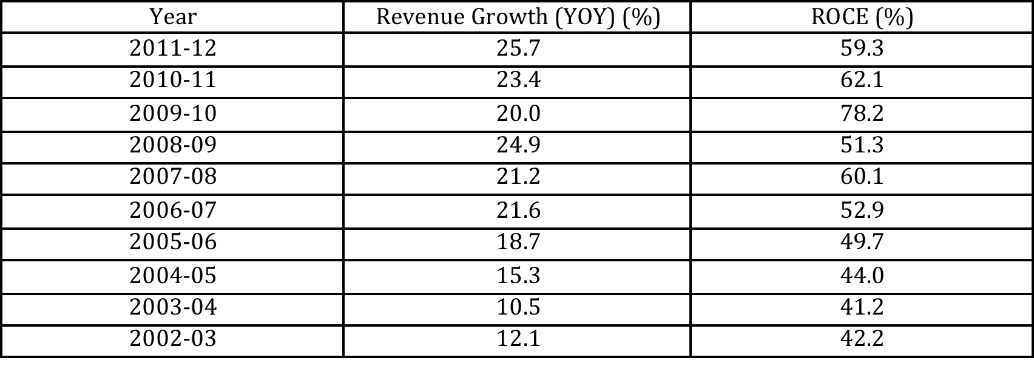
Historical Growth and ROCE of Asian Paints

Slide 89
Asian Paints
The company could maintain a very high ROCE. We need to ask the question whether the high growth and high ROCE achieved by the company are sustainable.
It is imperative that we need to search the drivers for that high growth and high ROCE in order to answer the question.

Slide 90
Sum of The Parts
The enterprise value of a conglomerate cannot be estimated at the aggregate level.
All Businesses usually differ in terms of risks, ROIC and growth.
Therefore, each business is to be valued separately.

Slide 91
Sum of The Parts (Contd.)
Value of each business and the value of non- operating assets are added together to calculate the enterprise value.
The PV of the expenses at the corporate office should be deducted in estimating the enterprise value.

Slide 92
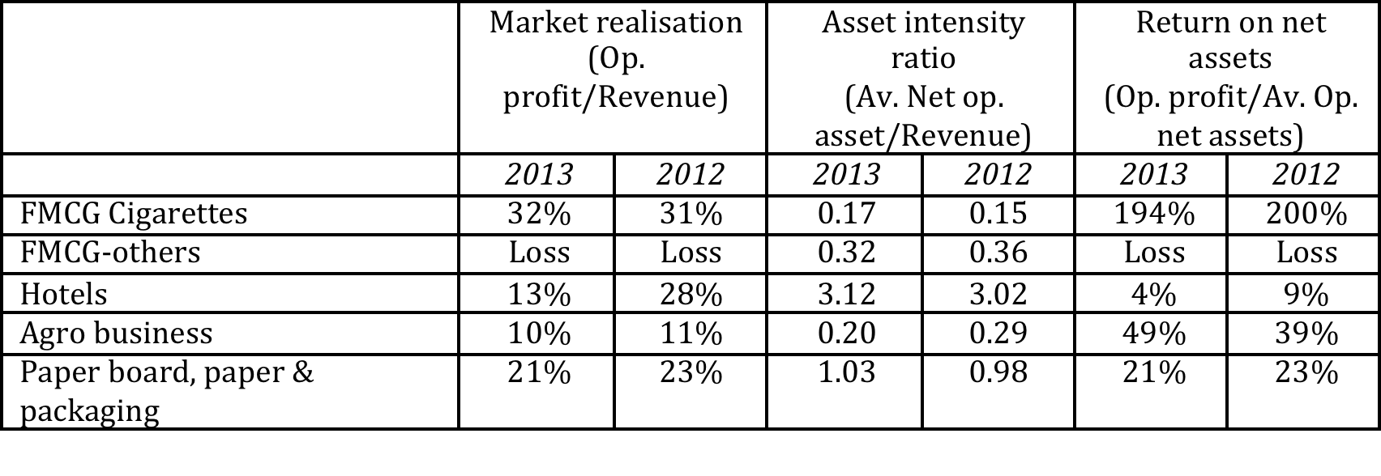
Sum of The Parts (Contd.): Example ITC Limited

Slide 93
Sum of The Parts (Contd.)
A question that often arises is whether the intrinsic value of separate businesses should be estimated without considering the benefits that they derive being a part of the conglomerate or they should be valued by considering those benefits.
It depends on the valuation context.

Slide 94
Sum of The Parts (Contd.)
If the purpose of valuation is to evaluate alternative strategies, it is appropriate to consider those benefits.
On the other hand, if the purpose of the valuation is to estimate the value that the company will realise by selling the business, those benefits should be ignored.

Slide 95
Non-operating Assets and Liabilities
Enterprise cash flow method requires valuing non-operating assets and liabilities separately.
Present value of free cash flow (FCF) estimates the value of operating cash flows.
However, a company might hold valuable assets that are not being used for generating operating cash flows.

Slide 96
Capital Cash Flow Model

Slide 97
Capital Cash flow
Capital Cash Flow (CCF) measures the cash available to all holders of capital.
Since the interest tax shields are included in the cash flows, a before-tax discount rate that corresponds to the riskiness of the assets is appropriate to value the capital cash Flows.

Slide 98
Capital Cash flow Method: Advantages
The advantage to the Capital Cash Flow method is its simplicity.
There are circumstances in which the FCF method is cumbersome or difficult to apply.
For example,
  it is difficult to apply the FCF method when the debt policy is defined as an absolute amount of borrowings instead of as a target percentage of the enterprise value, and
  when the amount of debt changes over time.

Slide 99
Pre-tax Cost of Capital
Pre–tax WACC= (D/V) × k_{d} +(E/V) × k_{e}
The alternative method is to calculate the asset beta and use the Capital Asset Pricing Model (CAPM) to estimate the discount rate.
The beta of the assets is a weighted average of the debt and equity beta.
Thus, β_{A} = (D/V) × β_{D} +(E/V) × β_{E}

Slide 100
An Example: Assumptions
Asset beta (β_{A}) = 1;
Risk free rate of return (r_{f})= 10 %;
Risk premium (r_{m} - r_{f} ) = 8%
Debt-to-value ratio = 40%; Debt is risk-free

Slide 101
An Example: Discount Rate
Debt when growth is 0%: Value as per FCF (7,317) × .40 = 2926;
Interest at 10% = 292.6;
Debt when growth is 5%: Value as per FCF (9,868) × .40 = 3,947;
Interest at 10% = 394.7
In CCF tax deducted from EBIT:
at 0% growth: = (2,000 – 292.6) × .40 = 682.96; at 5% growth: = (2,000 – 394.7) × .40 = 642.12
Pre-tax WACC = r_{A} = r_{f} + β_{A}× Risk premium = 0.10 +1× .08 = 0.18

Slide 102
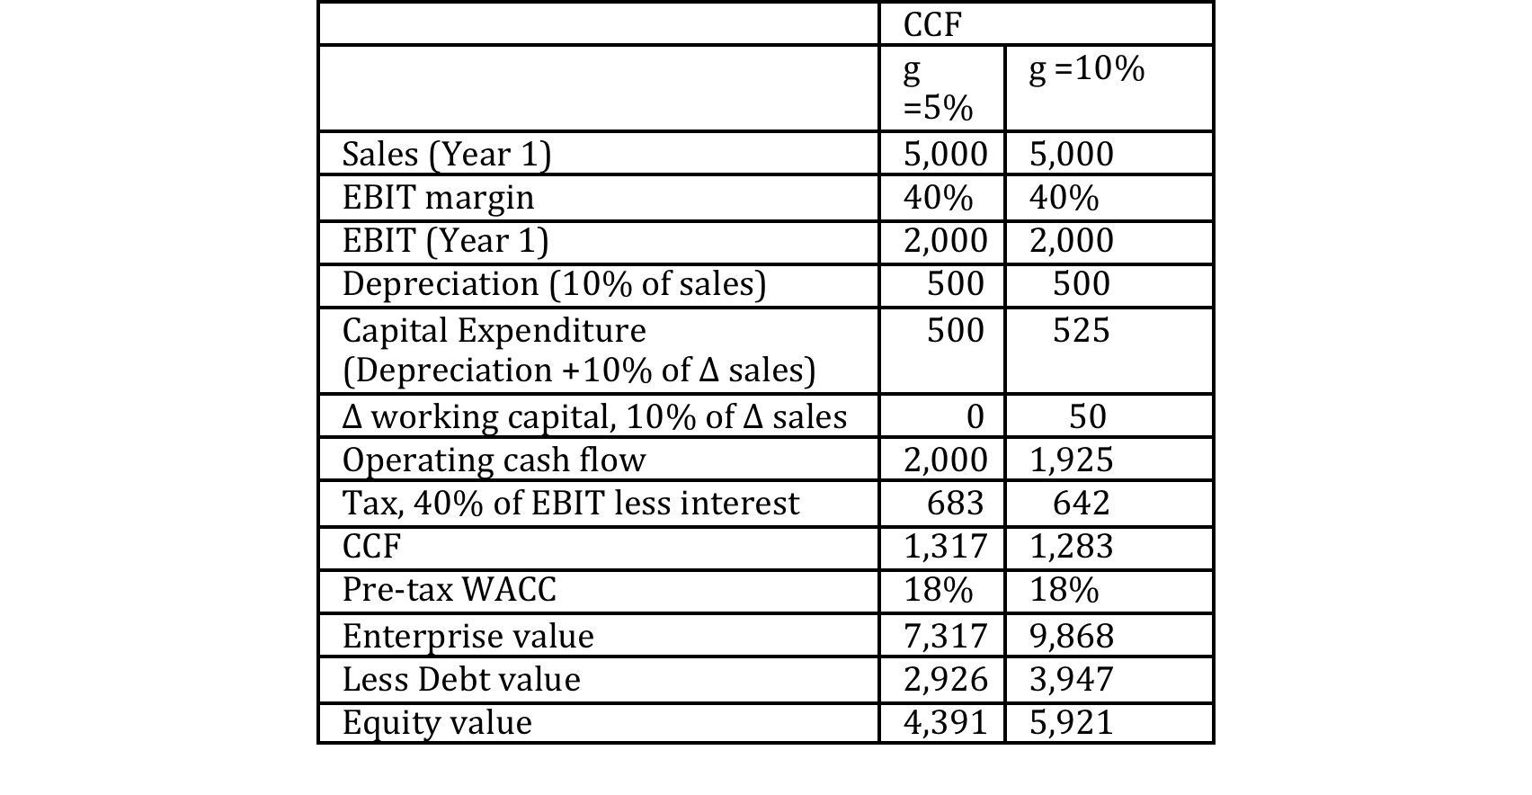
Value of Operating Cash Flows

Slide 103
Equity Cash Flow Method

Slide 104
Equity Cash Flow
Equity Cash Flow (ECF) model directly estimates the equity value.
In FCF and CCF methods, equity value is estimated indirectly.
Subtracting taxes, interest, and debt repayments from operating cash flow and adding increase in debt, we calculate Equity Cash Flows (ECF).

Slide 105
Equity Cash Flow (Contd.)
Alternatively, ECF can be calculated as Capital Cash Flows less Debt Cash Flows
  Capital Cash Flows =
  Equity Cash Flows + Debt Cash Flows
Debt Cash Flows are the cash flows to and from debt holders.
Debt Cash Flows include interest and changes in the amount of debt.

Slide 106
An Example: Assumptions
Assumptions:
Asset beta (β_{A}) = 1;
Risk free rate of return (r_{f})= 10 %;
Risk premium (r_{m} - r_{f} ) = 8%
Debt-to-value ratio = 40%;
Debt is risk-free

Slide 107
Discount Rate and Increase in Debt
β_{E} = β_{A}× (V/E) = 1× (100/60) = 1.67
r_{e} = r_{f} + β_{E}× Risk premium = 0.10 +1.67× .08 = 0.234
Debt when growth is 0%: Value as per FCF (7,317) × .40 = 2926; Value as per FCF (9,868) × .40 = 3,947;
ECF: Increase in debt is 5% of existing debt; 5% of 3,947 = 197; Increase in debt increases ECF

Slide 108
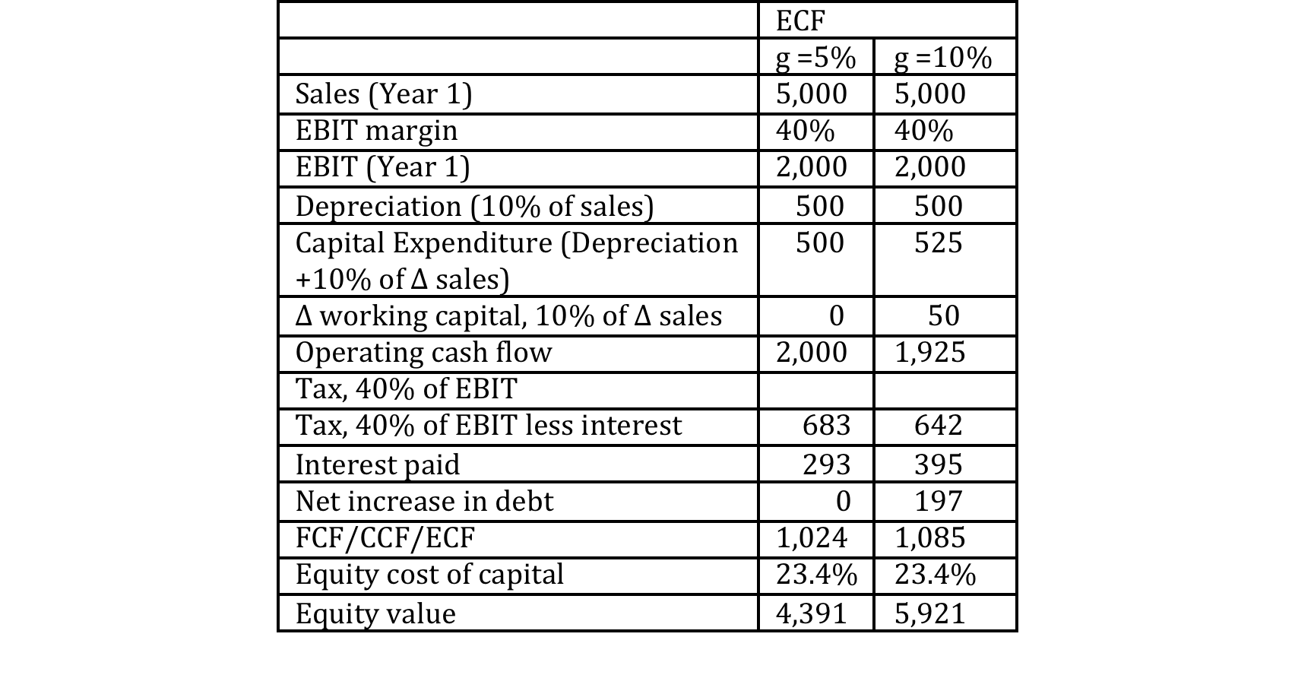
Equity Value

Slide 109
Adjusted Present Value Method

Slide 110
Fundamental Principle
Adjusted Present Value (APV) method is appropriate when the firm changes its capital structure (debt-to-value ratio) frequently.

Slide 111
Fundamental Principle (Contd.)
APV separates the value of operations into two components: the value of operations as if the firm is an unlevered firm and the value of tax shields that arises from debt financing.
APV =
Enterprise value as if the firm is unlevered + PV of tax shields

Slide 112
Economic Value Added Model

Slide 113
Fundamental Principle
The value of a company equals the amount of capital invested, plus a premium equal to the present value of the value created each year.
Economic Profit (EP) = Invested capital × (ROIC – WACC)

Slide 114
Guidelines For Using Price Multiples

Slide 115
Steps Involved
Step 1:
  Select a measure of performance or value (e.g., earnings and book value of equity);
Step 2:
  Estimate price multiples for comparable firms using the measure of performance or value; and
Step 3:
  Apply the comparable firm multiple to the performance or value measure of the firm being analysed.

Slide 116
Underlying Principle
In using price multiples, analysts depend on the market wisdom and avoid measuring the parametres.
They assume that the pricing of comparable firms is applicable to the firm under analysis.

Slide 117
Comparable Firms
Comparable firms are those that have similar operating and financial characteristics.
The starting point is that the companies should operate in the same industry.
However, difficulty arises because many firms are in multiple industries, making it difficult to identify benchmark firms.

Slide 118
Comparable Firms (Contd.)
Often, the single criterion that the firms are in the same industry is not adequate. Size of the company is also an important criterion.
Similarly, strategy, growth opportunities and profitability of the firms are also important.

Slide 119
Comparable Firms (Contd.)
In order to address the problem of identifying comparators, analysts relax comparability criteria to identify a set of comparable firms and estimate the average of the price multiple.
It must be remembered that we should not work with a very small set of companies as that might lead to statistical error.

Slide 120
Market Value-to-Book Value Multiple

Slide 121
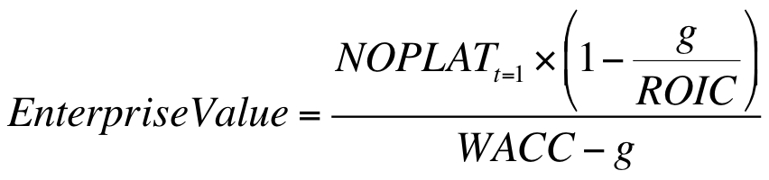
Drivers of Enterprise Value-to Invested Capital

Slide 122
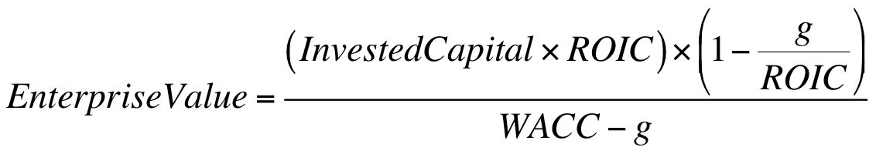
Drivers of Enterprise Value-to Invested Capital (Contd.)

Slide 123
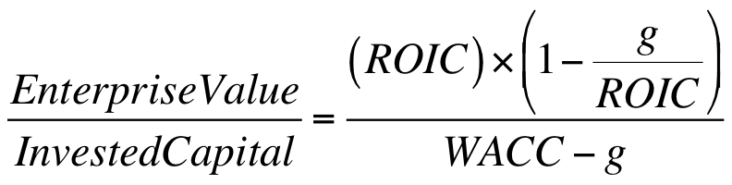
Drivers of Enterprise Value-to Invested Capital (Contd.)

Slide 124
Drivers of Enterprise Value-to Invested Capital (Contd.)
the drivers of the enterprise value-to-invested capital are WACC, growth and ROIC.
In an unlevered firm, equity value is the same as enterprise value and invested capital is the same as the book value of equity.

Slide 125
Drivers of Enterprise Value-to Invested Capital (Contd.)
Although the market value-to-book is affected by leverage, it is appropriate to assume that the same factors, which drive the ratio of enterprise value-to-invested capital, drive market value-to-book value ratio.

Slide 126
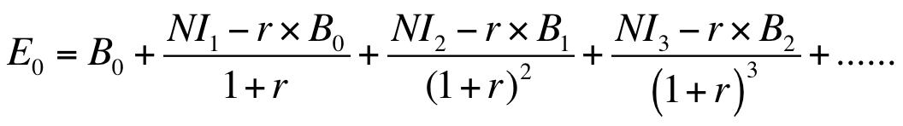
Abnormal Return and Market-to-Book Value Ratio

Slide 127
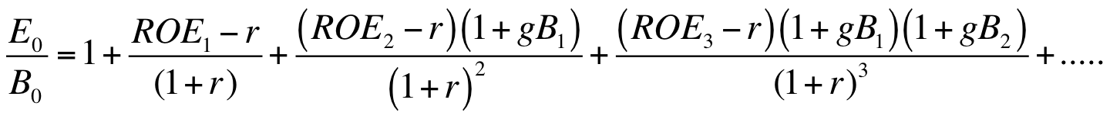
Abnormal Return and Market-to-Book Value Ratio (Contd.)

Slide 128
Abnormal Return and Market-to-Book Value Ratio (Contd.)
Where, ROE_{t} = (NI_{t}/B_{t-1});
gB_{t}=growth in book value from year t-1 to year t or
(B_{t}−B_{t-1})/ B_{t-1}

Slide 129
Abnormal Return and Market-to-Book Value Ratio (Contd.)
The firm’s equity value-to-book value ratio is determined by its
  Future abnormal ROE (measured by the difference between the ROE and cost of equity capital),
  Growth in book value and
  The cost of equity capital.

Slide 130
Abnormal Return and Market-to-Book Value Ratio (Contd.)
The (E₀/B₀) ratio is greater than one when the ROE is higher than the cost of capital. If the firm earns ROE lower than the cost of capital, the (E₀/B₀) ratio will be lower than 1.

Slide 131
Abnormal Return and Market-to-Book Value Ratio (Contd.)
(E₀/B₀) ratio is also determined by the growth in the book value of equity.
Book value of equity grows if the firm reinvests its net income or issues fresh equity.
If, new investments earn ROE greater than the cost of equity, it boosts its (E₀/B₀) ratio.
Similarly, if the firm earns ROE greater than the cost of equity, higher the growth in the book value of equity, higher will be the (E₀/B₀) ratio.

Slide 132
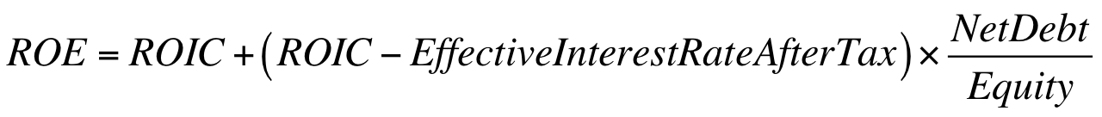
ROE

Slide 133
Earnings Multiple

Slide 134
P/E Ratio: Fundamental Principle
Although, business dailies report P/E ratio based on past earnings, it is appropriate to estimate P/E taking into account projected-earnings.

Slide 135
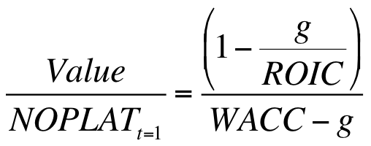
P/E Ratio: Drivers

Slide 136
P/E Ratio: Drivers (Contd.)
Firm’s earnings multiple is driven by both its expected growth (g) and its return on invested capital (ROIC) and also by WACC.
It may not be very incorrect to assume that WACC is the same for all the companies operating in a particular industry.
However, ROIC and growth of firms operating in the same industry vary significantly.

Slide 137
P/E Ratio: Drivers (Contd.)
Therefore, it is not appropriate to apply average P/E ratio of the industry to estimate the value of equity of the firm being valued.
Average P/E ratio should be adjusted for the ROIC and growth of the firm if they differ from the industry average.

Slide 138
P/E Ratio: Drivers (Contd.)
We should also remember that ‘earnings per share’ (EPS) is affected by capital structure.
Consequently P/E ratio is also affected by capital structure.
Therefore, (Enterprise Value/NOPLAT) is considered a superior multiple than the P/E ratio.

Slide 139
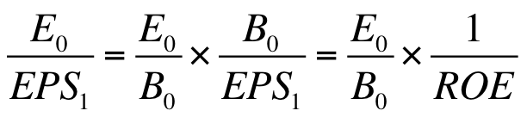
P/E Multiple and Market-to-Book Value Multiple

Slide 140
P/E Multiple and Market-to-Book Value Multiple
The factors that determine the market value-to-book value multiple also determine the P/E ratio.
However, there is a difference between the two multiples.
While market value-to-book value multiple is not affected by current ROE, P/E multiple is affected by current ROE.
If the current ROE is low, P/E ratio will be high. If, ROE is negative, P/E cannot be calculated.

