Slide 1
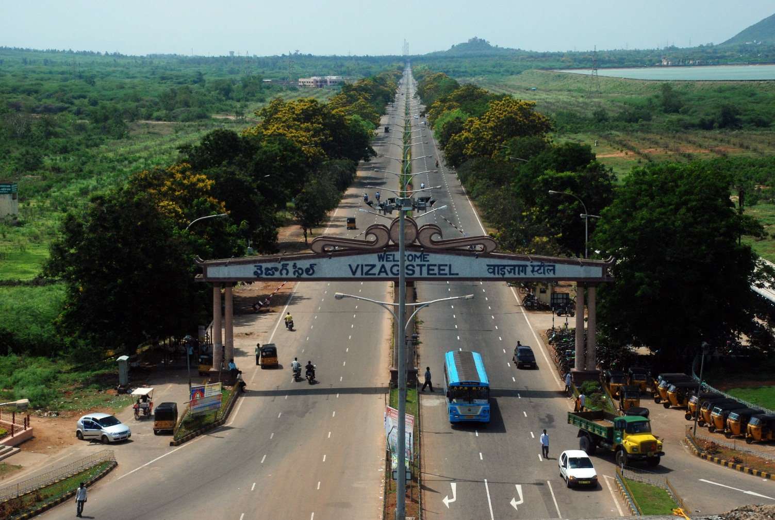
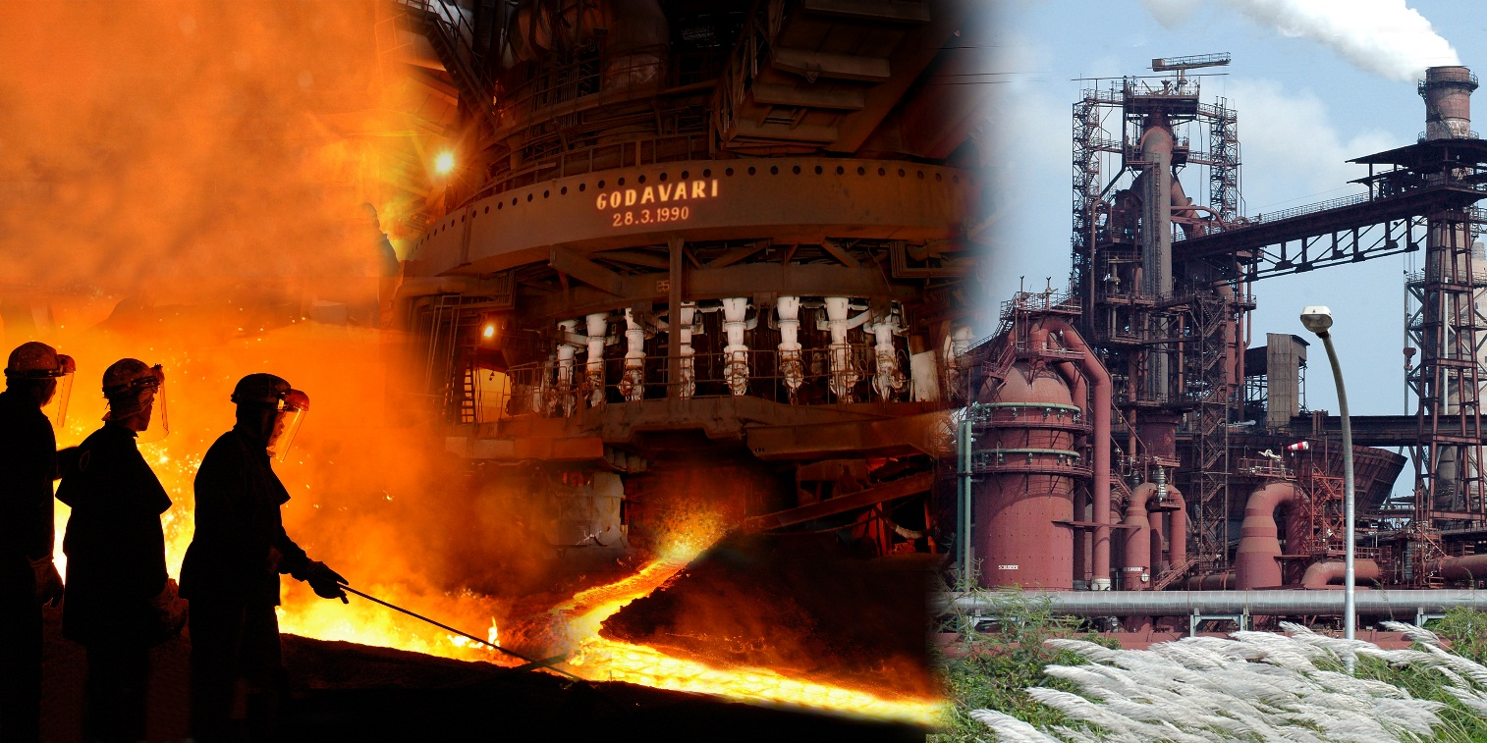
An Overview of Operations in an Integrated Steel Plant A case study -RINL/VSP

Slide 2
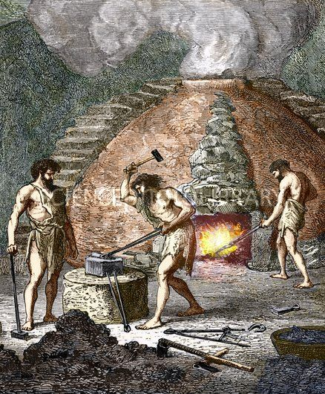
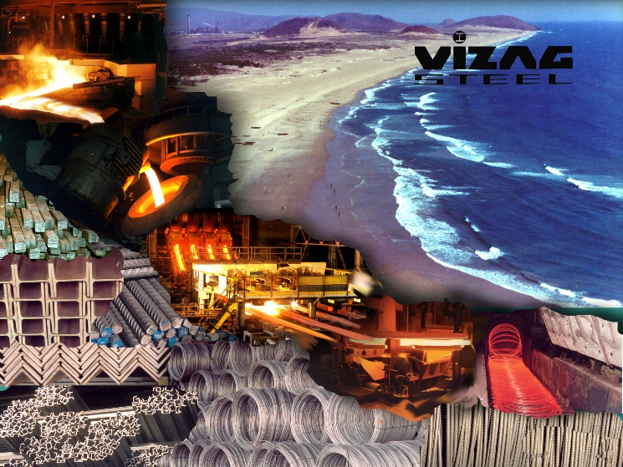
Flow of the presentation
History of Iron and Steel
Evolution of processes
Operations at VSP

Slide 4
Iron- Prehistoric Evidence
History of Iron & Steel
The Rig Veda refers to ayas, and also states that the Dasyus had Ayas. (RV 2.20.8).
"The gods [are] smelting like metal Iron the human generations". (R.V4.2.17)
The Sanskrit term Ayas means Basic Iron.
Genesis says that Tubal-Cain, seven generations from Adam, was "an instructor of every artificer in brass and iron." (Genesis.4:22; “And Zillah, she also bare Tubalcain, an instructor of every artificer in brass and iron: and the sister of Tubalcain was Naamah”)
Quote from QURAN
“…and We sent down Iron in which is incredible strength and many benefits for mankind"
(Chapter 57: Verse 25).

Slide 5
Iron- Prehistoric Evidence
History of Steel
Around 4000 BC the Sumerians and the Egyptians made tips of spears, daggers and ornaments from iron recovered from the meteorites.

Slide 6
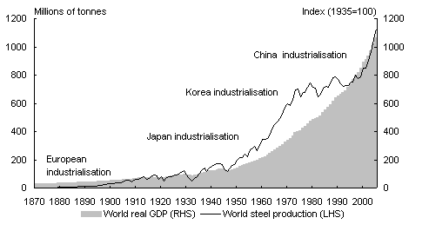
History of Iron & Steel
2007 Onwards China emerged as world leader
Japan World Leader
40% of World Steel from Britain
US emerged World Leader

Slide 7
Iron and the Universe
History of Iron & Steel
Iron is the tenth most abundant element in the universe.
Iron makes up 5% of the Earth’s crust and is second in abundance to aluminum among the metals and fourth in abundance among the elements.
Iron is the most abundant element by mass, making up 35% of the mass of the Earth as a whole.
The concentration of iron in the various layers of the Earth ranges from very high at the inner core to only a few percent in the outer crust.

Slide 8
Rustless Wonder
History of Iron & Steel
Dating back to 4th century A.D, the Delhi iron pillar is testimony to the high level of skill achieved by ancient Indian iron smiths in the processing of iron.
7.3 m tall, with one m below the ground; the dia is 48 cm at the foot, tapering to 29 cm at the top, just below the base of the wonderfully crafted capital; it weighs about 6.5 t, and was manufactured by forged welding.

Slide 9
Damascus Sword
History of Iron & Steel
Wootz steel first appeared in India between 300 BC and AD 500.
They used to make it in crucible.
Damascus swords were prized for their strength and sharpness. They were famous for being so sharp that they could cut a silk scarf in half as it fell to the ground.

Slide 10
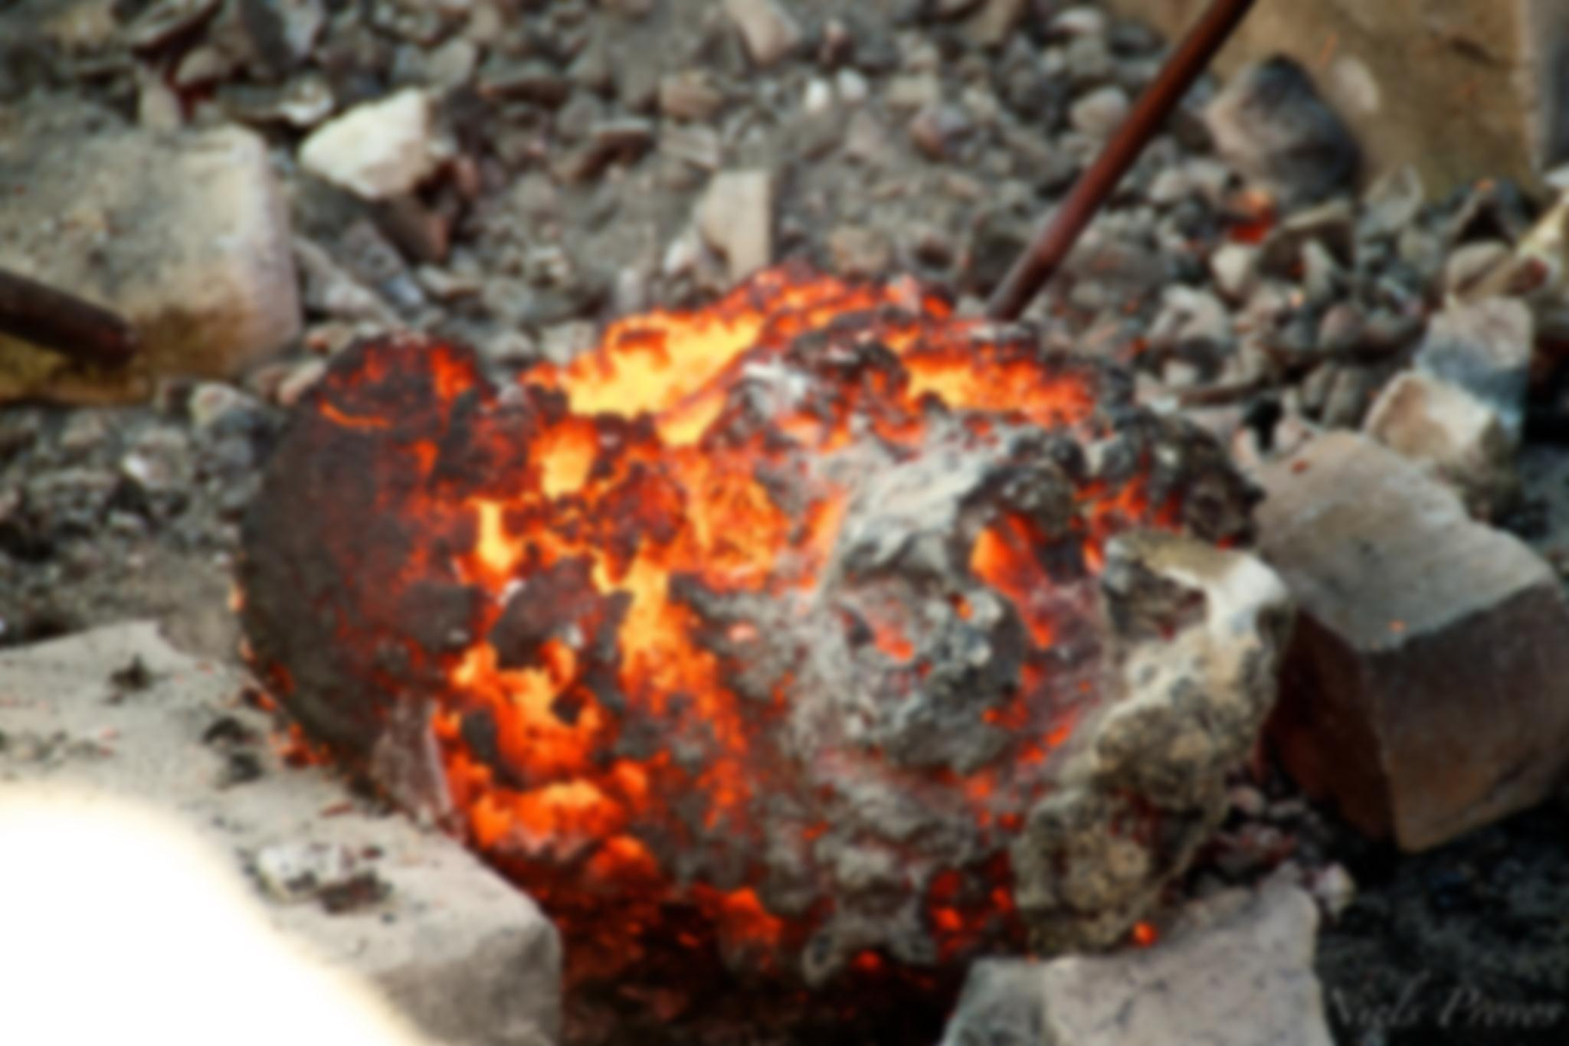
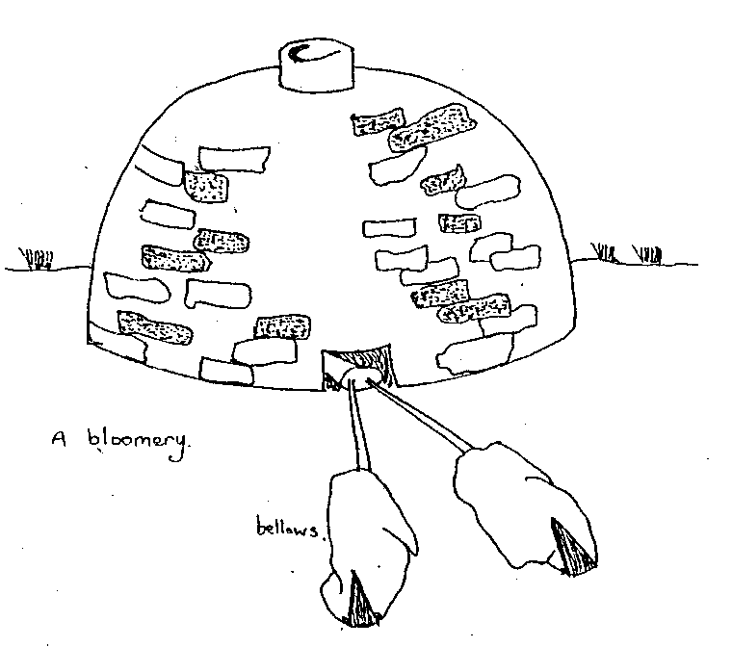
The Bloomery
Evolution of process
This is the process that started the Iron Age.
It seems most likely that a lump of Iron Ore in a particularly hot fire lead to a strange material left in the embers of the fire.
From this, the Bloomery Furnace developed.

Slide 11
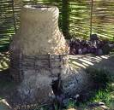
Bloomery Furnaces
Evolution of process
In this a mixture of Iron Ore and Charcoal was burnt with the help of a blast of air from hand worked bellows.
The Output was typically a small lump of Wrought Iron of poor quality, but even this was enough to make an impact on history.

Slide 12
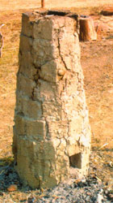
Making of Iron
Evolution of process
Intentional reduction of iron metal from terrestrial ores (Haematite ore), started near the end of the Late Bronze Age (ca. 1600–1150 BC).
Fe₂O₃+ 3CO -> 2Fe + 3CO₂

Slide 13
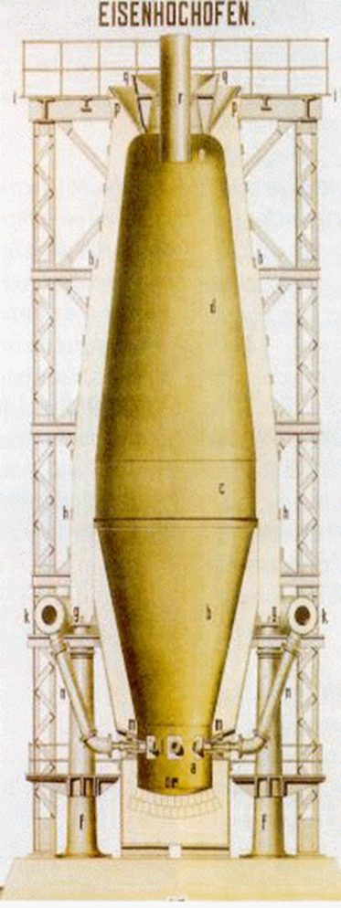
Stuckofen, 1350 A.D.
Evolution of process
This type of furnace, called “Stuckofen" is generally recognized as the forerunner of the blast furnace.
Such furnaces were used in Germany, Austria, Belgium and the Netherlands.
They had a height of 3-5 m and a round, oval or rectangular cross section.
Iron ore and fuel were charged at the top whereas the combustion air was supplied at low pressure through one or two "tuyeres", situated about 0.5 m above the bottom stone of the furnace.
At the bottom of the furnace a drawing hole was provided in the wall for extracting the blooms; this hole was closed with brickwork that had to be torn out each time a bloom was drawn.

Slide 14
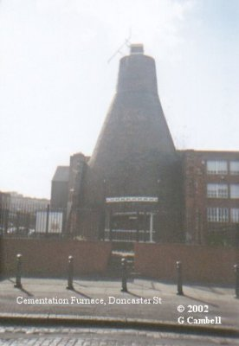
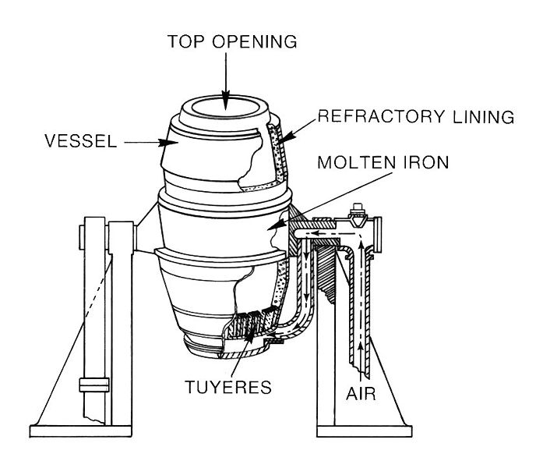
Bessemer Process 1856 AD
Evolution of process
First process for mass scale production of steel from Iron
The key principle is removal of impurities from the iron by oxidation with air being blown through the molten iron.
The blowing of air through the molten pig iron introduces oxygen into the melt which results in oxidation, removing impurities found in the pig iron, such as silicon, manganese, and carbon in the form of oxides.
The oxidation also raises the temperature of the iron mass and keeps it molten.
Using the Bessemer process, it took between 10 and 20 minutes to convert three to five tons of iron into steel — it used to take at least a full day of heating, stirring and reheating to achieve this
The refractory lining of the converter also plays a role in the conversion — clay linings are used when there is little phosphorus in the raw material – this is known as the acid Bessemer process. When the phosphorus content is high, dolomite, or sometimes magnesite, linings are used in the alkaline Bessemer limestone process.

Slide 15
VIZAG STEEL – THE FIRST SHORE BASED
INTEGRATED STEL PLANT
After reaching 120% Capacity Utilization in 3.0 Mtpa stage
6.3Mtpa / 7.3 Mtpa

Slide 16
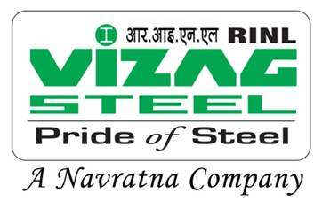
Overview of VSP

Slide 17
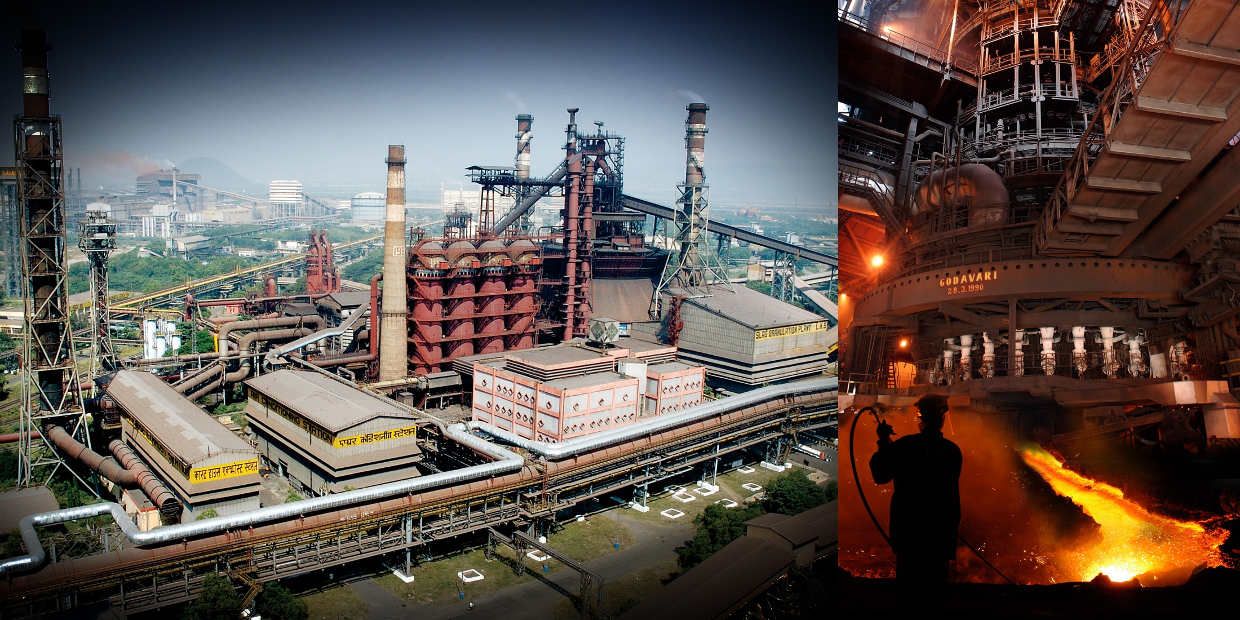
Blast Furnace
Parameter | Unit | Value
BF Productivity | t/day/cum | 1.60
Fuel Rate | Kg/tHM | 545
- BF Coke Rate | Kg/tHM | 462
- Nut Coke Rate | Kg/tHM | 20
- PCI Rate | Kg/tHM | 64
`25400/-

Slide 18
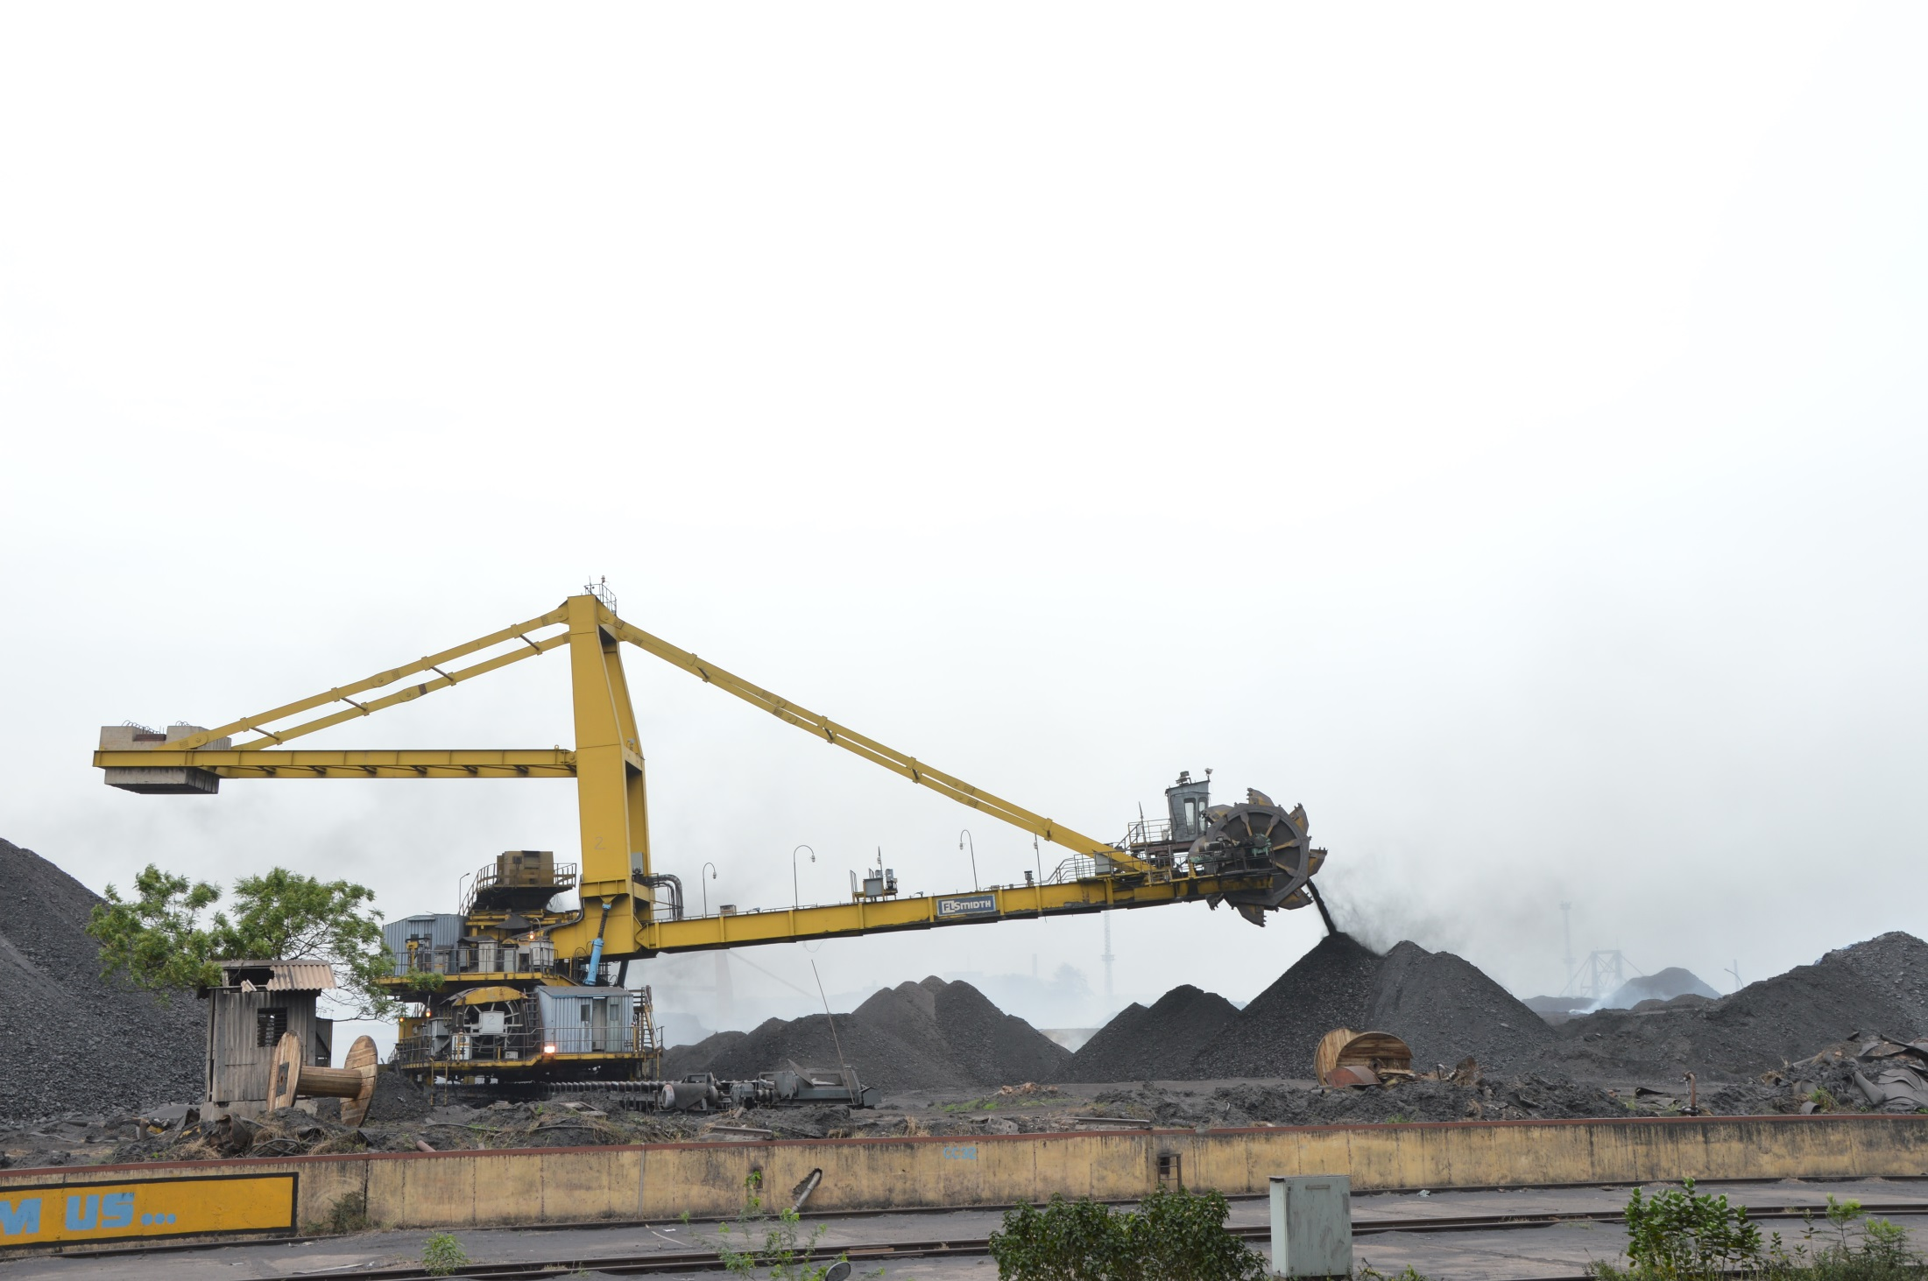
Raw Material Handling Plant

Slide 19
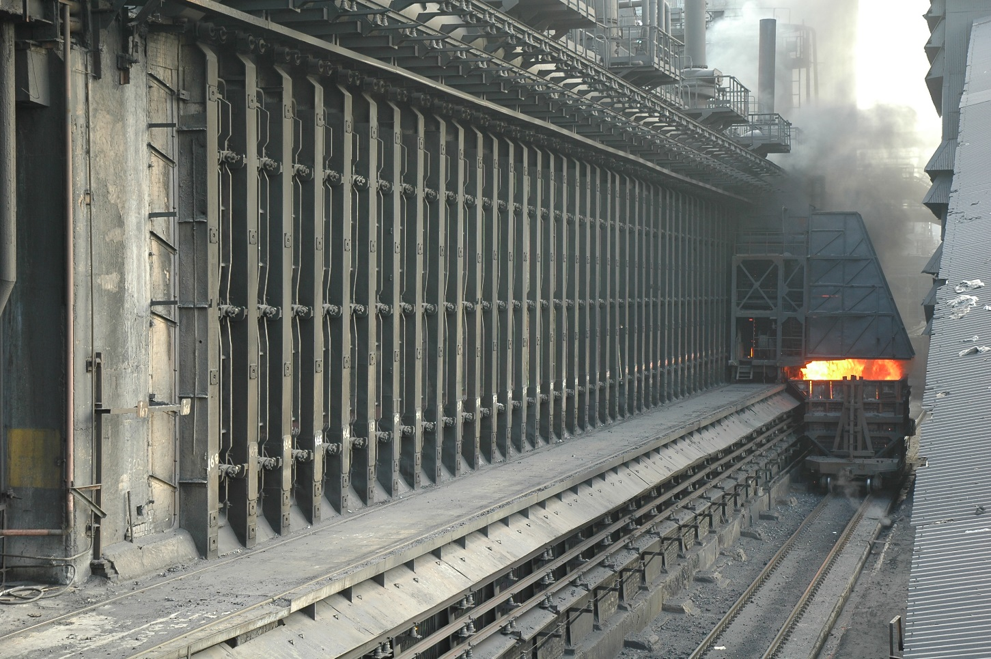
Coke Ovens
`22,700/-
Yields (%) | Unit | Value
Gross Coke | /tdcc | 72.70
CO gas (Ncum) | /tdcc | 335
Ammonium Sulphate | /tdcc | 1.22
Crude Tar | /tdcc | 3.10
Crude Benzol | /tdcc | 0.50
Parameter | Unit | Value
Avg. Pushings | Nos/day | 338.8
Coal Blend (ICC:MCC) | % | 90:10

Slide 20
Sinter Plant
Input
Iron Ore Fines
BF Dolomite & Limestone
Sand/Qtz Fines
Coke Breeze
Mn Ore Fines
Calcined Flux screenings
LD Slag
Metallurgical Waste
Output
Sinter
`6,900/-
Parameter | Unit | Value
Sinter M/c Productivity | t/hr/sq.m. | 1.09

Slide 21
Overview of VSP

Slide 22
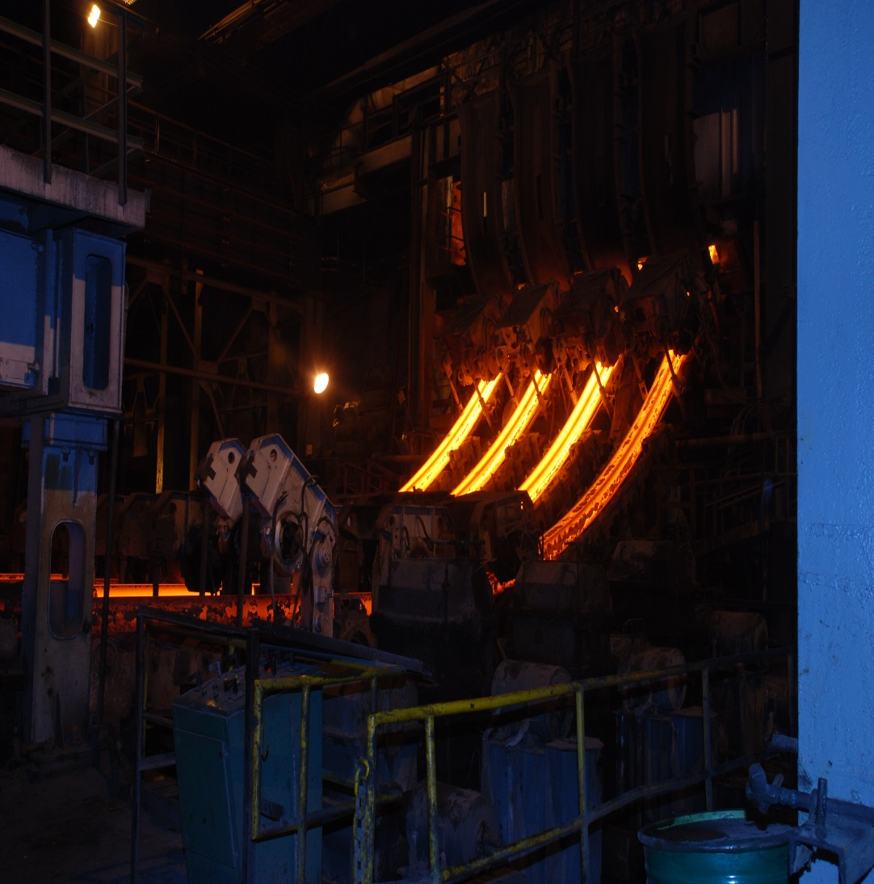
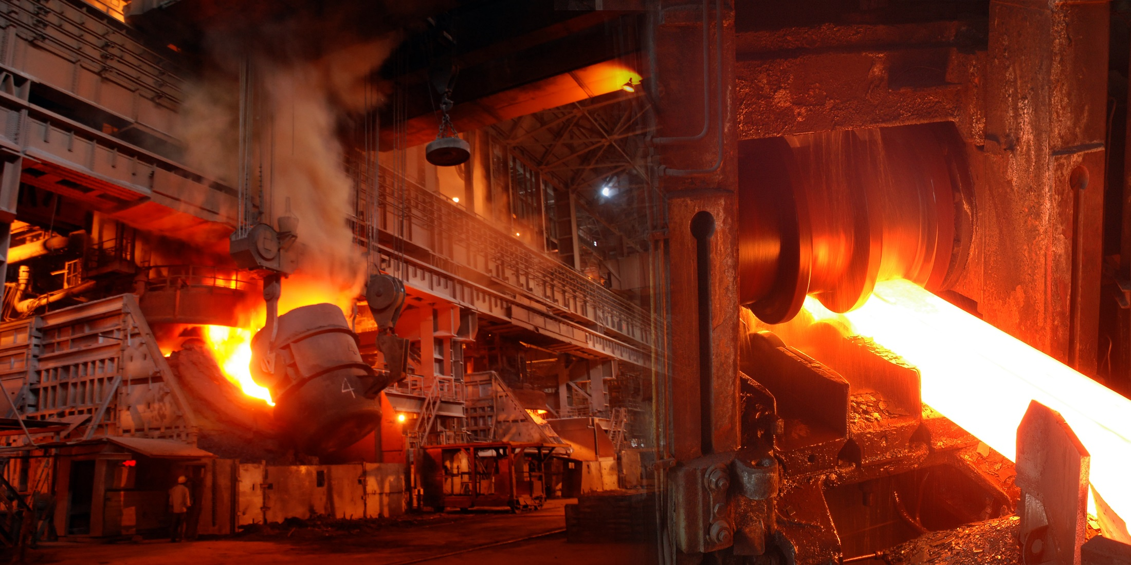
Steel Melt Shop
Parameter | Unit | Value
Converter Productivity | Heats/avl. Conv./year | 9000
Tap to tap time | min | 60
CC Blooms yield | % | 95
`34,000/-

Slide 23
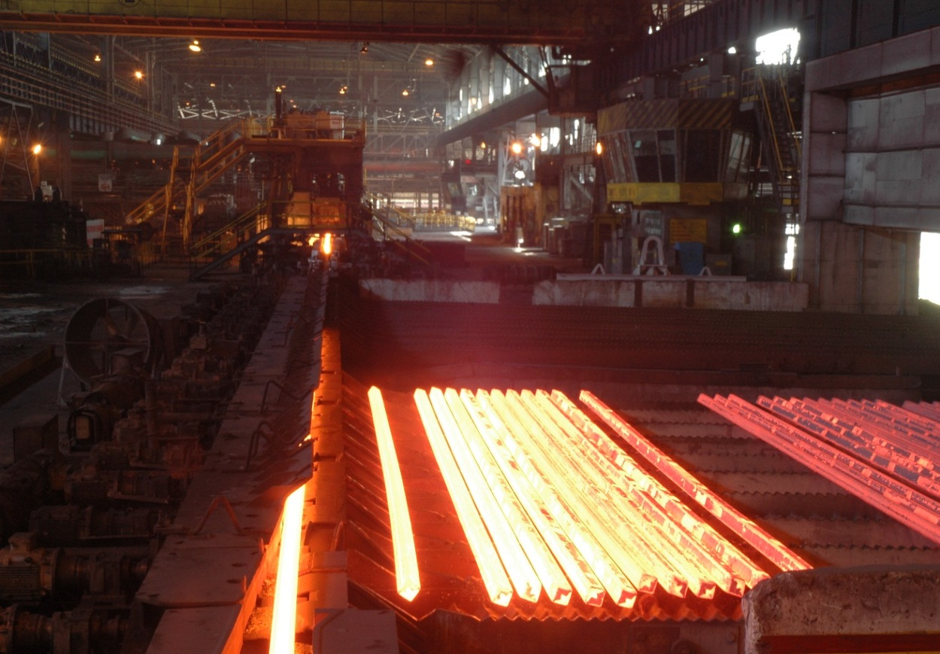
LMMM
Parameter | Unit | Value
Yield of Billets | % | 97.36
Avg. Rolling Rate (Billet Mill) | t/W.hr | 329
Yield of Bar products | % | 97.71
Avg. Rolling Rate (Bar Mill) | t/W.hr | 152
Billets
`37,000/-
Bars
`39,000/-

Slide 24
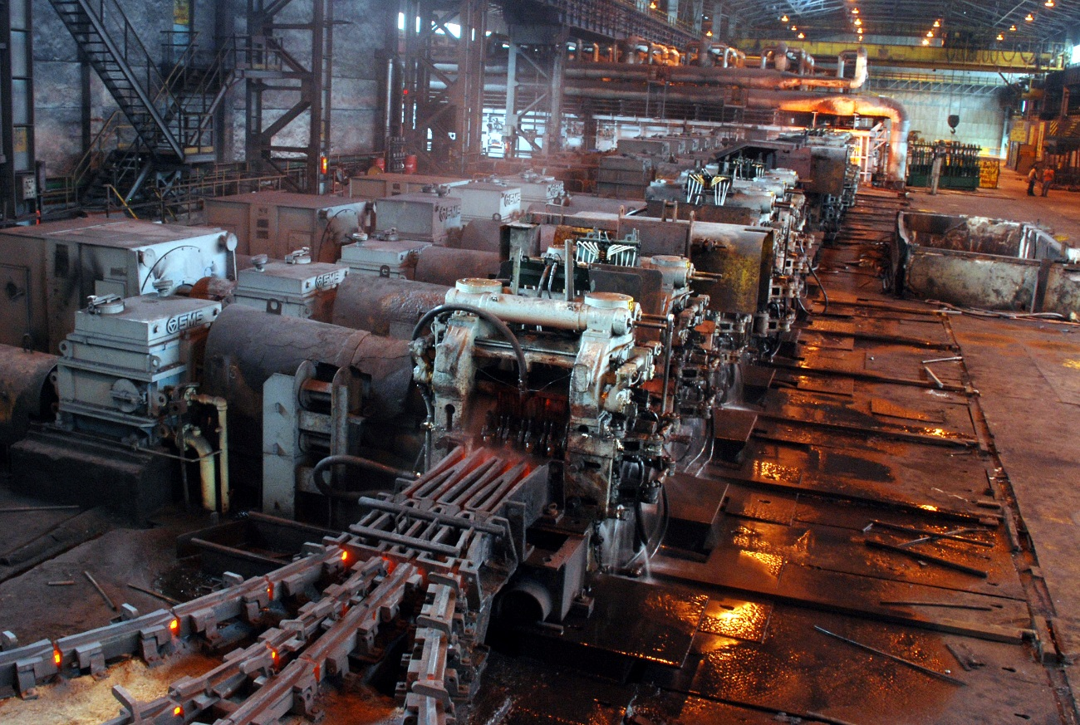
WRM
Parameter | Unit | Value
Yield of Wire Rods | % | 97.29
Avg. Rolling Rate (WRM) | t/W.hr | 167
Yield of WRM-2 products | % | 97.07
Avg. Rolling Rate (WRM-2) | t/W.hr | 116
`40,000/-

Slide 25
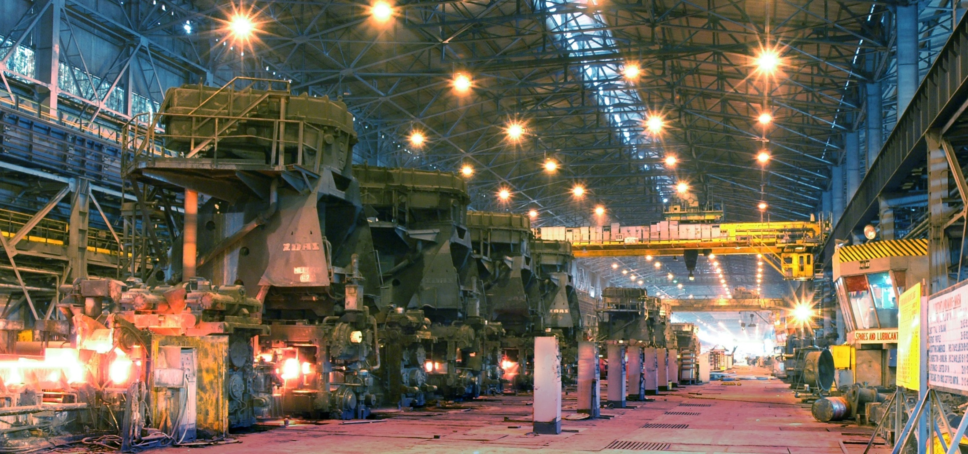
MMSM
Parameter | Unit | Value
Yield of MMSM Products | % | 96.19
Avg. Rolling Rate (MMSM) | t/W.hr | 181
Yield of STM products | % | 94.58
Avg. Rolling Rate (STM) | t/W.hr | 91
`39,000/-

Slide 26
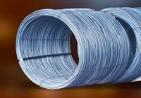
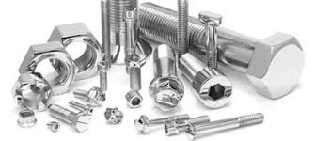
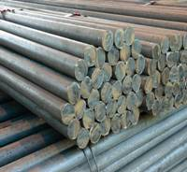
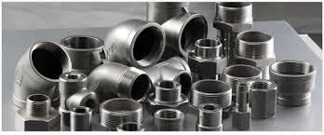
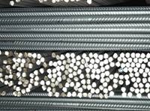
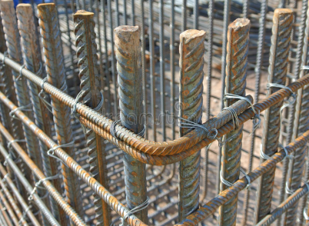
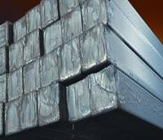
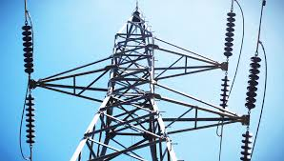
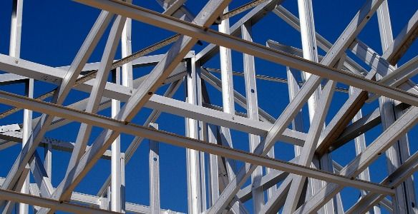
PRODUCT MIX & APPLICATIONS
Existing | After Expansion
5.5 – 14 mm | Upto 20.64 mm
Wire drawing, Bright bars, Fasteners, etc.
Wire Rods
Existing | After Expansion
16 to 80 mm | Upto 45 mm in coil form as well
Fasteners, Forging, Re-rolling, Railways, Construction
Rounds
Existing | After Expansion
8 – 36 mm
Construction – Reinforcement, etc.
Re-bars
Existing | After Expansion
65 – 90 mm
Bright bars, Forging, Re-rolling, etc.
Squares
Existing | After Expansion
75-150 mm | 55-175 mm
Construction / Fabrication / Auto leaf spring
Structurals

Slide 27
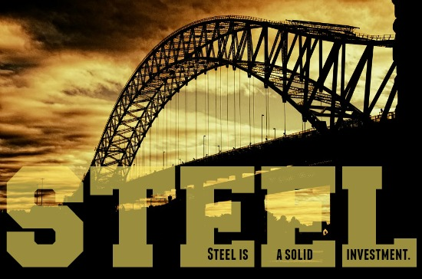
Thank You

