Slide 1
GST:
THE ROAD AHEAD…
A PRESENTATION BY:
CMA. MIHIR TURAKHIA
B.Com, FCMA, LL.B

Slide 2
DECODING THE IMPACT OF GST

Slide 3
TABLE OF CONTENTS
1.
TAX STRUCTURE
2.
IMPACT ON YOUR BUSINESS
3.
SECTORAL IMPACT ANALYSIS
4.
WAY FORWARD…

Slide 4
1. TAX STRUCTURE
GST
INTER STATE
SUPPLIES
CGST
SGST
INTRA STATE
SUPPLIES
IGST

Slide 6
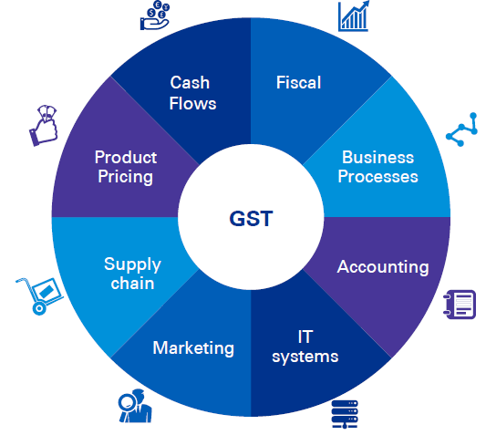
3. IMPACT ON YOUR BUSINESS

Slide 7
IMPACT ON CASH FLOWS, AFTER GST IS TRIGGERED DUE TO NUMBER OF REASONS:
RATE CHANGES
TAX ON STOCK T/F
WORKING CAPITAL STRUCTURE
EXEMPTIONS WITHDRAWN
CHANGE IN P.O.T/ CREDIT
IMPACT ON CASH FLOWS :

Slide 8
AFTER GST, THERE IS A NEED TO RATIONALIZE THE NETWORK MODELS WHICH WERE CREATED TO AVOID THE CST
INTRA STATE/ INTER STATE PROCUREMENT AND ITS CREDIT
WAREHOUSE LOCATION/ STRUCTURE & CAPACITY
WAREHOUSE OPERATING COSTS- RENTAL, LABOUR ETC.
ALIGNMENT BETWEEN FACTORIES/ HUBS & WAREHOUSES
PLANT LOCATIONS
(RELOOKING AT TAX HOLIDAYS)
IMPACT ON PROCUREMENT

Slide 9
AFTER GST, THERE IS A NEED TO RATIONALIZE THE NETWORK MODELS WHICH WERE CREATED TO AVOID THE CST
DIRECT SALES/ STOCK TRANSFER
WAREHOUSE LOCATION/ STRUCTURE & CAPACITY
EFFICIENCY OF EXISTING SUPPLY CHAIN NETWORK
TRADE OFF BETWEEN SERVICE EXCELLANCE AND COST REDUCTION
DISTIBUTION STRUCTURE
IMPACT ON DISTRIBUTIONS

Slide 10
REASSESSING THE PRODUCT PRICING STRATAGIES IS PLAYING AN IMPORTANT ROLE IN MAINTAINING THE COMPETITIVENESS UNDER GST
TAX SAVING UNDER GST
CREDIT FLOWS
IMPACT ON OVERHEADS
LOST CREDITS
DISTIBUTION STRUCTURE
IMPACT ON PRODUCT PRICING

Slide 11
EFFECT ON DEMAND
PRICING STRATAGIES
IMPACT ON CURRENT CONTRACTS
EXPORT SALES
CUSTOMER STATUS UNDER GST
IMPACT ON SALES

Slide 12
ACCOUNTING SYSTEM CHANGES
MAINTAINING & UPDATING THE MASTER DATA
SOFTWARE UPDATES
MAJOR CHANGES IN ERP
COMPLIANCE WITH GSTN
IMPACT ON INFORMATION TECHNOLOGY

Slide 13
MIGRATION OF REGISTRATION
TRANSITION OF AVAILABLE TAX CREDIT INTO GST
REDESIGN IT SYSTEMS
MULTIPLE PERIODICAL RETURNS
NEW FORMATS, CHALLAN, RETURNS ETC.
IMPACT ON COMPLIANCES

Slide 14
TAX CREDITS & PAYMENTS
CHANGES IN WORKING CAPITAL
CHANGE IN ACCOUNTING ENTRIES
IDENTIFYING THE TRANSACTION AND TAX LIABILITIES
RISK & CONTROLS
IMPACT ON ACCOUNTS & FINANCE

Slide 15
TECHNICAL TRAINING & EDUCATION
ADAPTABILITY WITH THE UPDATED IT STRUCTURE
EMPLOYEE FRINGE BENEFIT POLICY
ADDITIONAL HUMAN CAPITAL REQUIREMENT
DUE COMPLIANCE HABITS
IMPACT ON HUMAN CAPITAL

Slide 16
4. SECTORAL IMPACT ANALYSES

Slide 17
SERVICE SECTOR

Slide 18
CONSTRUCTION SERVICES
Removal of Multiple Taxes like VAT/ST etc.
Valuation Rules exclude the value of Land.
Many services consumed previously are out of the purview of GST in light of the exemption limit of 20 lacs.

Slide 19
LOGISTICS/ C&F SERVICES
Many depots has become redundant.
Development of Zonal Warehousing Hubs
Importance of Bundled Services has grow.
Logistics optimization is now a key to business success, sans tax imbalances.
More pressure on the overheads to beat the competition.

Slide 20
OTHER SERVICES
Works Contract Services
Business Auxiliary Services.
Renting of Immovable Property
IT & ITES

Slide 21
MANUFACTURING SECTOR

Slide 22
KEY CONCEPTS FOR MANUFACTURING
The ITC of many supplies has increased substantially.
Procurement Process is revamped.
The vendors with GST registration are more preferred.
MRP Valuation is no more relevant.
Post sales expenses and Logistics has became the critical factor.
Inter Company/Depot Sales/Group Company transfers are Taxable

Slide 23
TRADING SECTOR

Slide 24
KEY CONCEPTS FOR TRADERS
Many types of trading outfits has become redundant, and so the traders will have to update current system.
However some types of trading has also got the boost as the tax component will not affect.
Overall Cost has gone down.
Getting more ITC as compared to earlier regime

Slide 25
EXPORT IMPORT

Slide 26
Zero rated supplies are allowed for Refunds
Fast Refunds resulting in smooth WC management.
Effective ITC reduceing Export product cost.
SEZ supplies under duty payment allowed as refunds in the hands of buyer
Imports attract only IGST
Direct imports increased as compared to large importer concept.

Slide 27
WAY FORWARD

Slide 28
Setting up of a core GST Committee – having representatives from Finance, Supply Chain, IT and Marketing teams
Impact assessment
― Fiscal
― IT
― Supply chain
― Contract
― Specific business aspects
― Revisiting the business plan
Advocacy – Preparation of detailed paper covering relevant tax issues and their representation with respective policy makers
Drawing up a detailed plan for various new compliances & provisions under GST to ensure business continuity…

Slide 29
THANKS
FOR
WATCHING
PRESENTED BY:
CMA MIHIR TURAKHIA
B.com, FCMA, LLB

