Slide 1
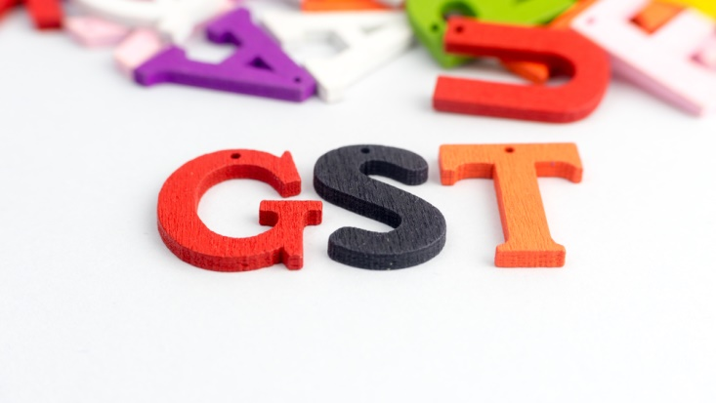
Place of Supply of Goods and Services under GST
Presented by
CMA Sudha Rani V

Slide 2
Present Laws
Central Excise- origin based – levy on removal of goods
Service Tax- consumption based – levy is on services when POPS is in India(except J&k)
VAT/CST-origin based – levy is on sale - movement of goods
Customs-on import of goods from outside India

Slide 3
Dual GST
Intra – state supplies – CGST & SGST
Inter-State supplies – IGST
Imports – IGST
Exports – Zero rated

Slide 4
Place of Supply
Place of Supply of Goods
Place of Supply of Services
Domestic transactions
Supplier or recipient is outside India
Both Supplier and recipient are in India
Import /Export of Goods

Slide 5
International Transactions – Export of Goods
Deemed Interstate Supply – Section 7(5) of IGST Act
Location of supply is Outside India – Section 11(b) of the IGST Act
Zero rated
Option to export under Bond or Rebate

Slide 6
International Transactions – Import of Goods
Deemed Interstate Supply – Section 7(2) of IGST Act
POS - Location of importer – Section 11(a) of the IGST Act
Proviso to Sec 5(1) of the IGST Act:
Levied and collected under sec3 of Customs Tariff Act
At the point when duties of customs are levied

Slide 7
Domestic Transactions
Supply involves movement
Scenario | Place of Supply
Supply involves movement of goods – by supplier/ recipient/ any other person | location of the goods at the time at which the movement of goods terminates for delivery to the recipient;
Example
A (Hyderabad) sold goods to C( Chennai) POS: Chennai Taxes: IGST A (Hyderabad) sold goods to C( Warangal) POS: Warangal Taxes: CGST +SGST

Slide 8
Movement of goods on the direction of third person
Scenario | Place of Supply
Place of supply where the goods are delivered by the supplier to a recipient or any other person, on the direction of a third person. | whether acting as an agent or otherwise, before or during movement of goods, either by way of transfer of documents of title to the goods or otherwise, it shall be deemed that the said third person has received the goods and the place of supply of such goods shall be the principal place of business of such person

Slide 9
Examples
Scenario-A
Supplier of Goods | (Hyd)Telangana
Recipient of Goods | (Toopran)Telangana
Third party | (Warangal)Telangana
Movement of Goods (Intra State) | Telangana to Telangana
Supplier of Goods
CGST & SGST
Intra State Supply.
Invoice to be raised
Recipient of Goods
Third Party
Invoice to be raised
Intra State Supply.
CGST & SGST

Slide 10
Examples
Scenario-B
Supplier of Goods | (Rajamundry)AP
Recipient of Goods | (Vizag)AP
Third party | (Warangal)Telangana
Movement of Goods (Intra State) | Andhra Pradesh to Andhra Pradesh
Supplier of Goods
Invoice to be raised
Recipient of Goods
Inter State Supply.
IGST
Third Party
Invoice to be raised
Inter State Supply.
IGST

Slide 11
Examples
Scenario-C
Supplier of Goods | (Hyd)Telangana
Recipient of Goods | (Vizag)AP
Third party | (Warangal)Telangana
Movement of Goods (Inter State) | Telangana to Andhra Pradesh
Supplier of Goods
Third Party
Recipient of Goods
CGST & SGST
Intra State Supply.
Invoice to be raised
Invoice to be raised
Inter State Supply.
IGST

Slide 12
Examples
Scenario-D
Supplier of Goods | (Rajamundry)AP
Recipient of Goods | (Toopran)Telangana
Third party | (Warangal)Telangana
Movement of Goods (Inter State) | Andhra Pradesh to Telangana
Supplier of Goods
Recipient of Goods
IGST
Inter State Supply.
Invoice to be raised
Third Party
Invoice to be raised
Intra State Supply.
CGST & SGST

Slide 13
Does not involve movement of goods
Scenario | Place of Supply
Supply does not involve movement of goods | Location of goods at time of delivery to recipient
Examples – 1.Counter sales 2.Sale of furniture to lessee while leasing the office/home

Slide 14
Goods installed or assembled at site
Scenario | Place of Supply
Goods assembled/ installed at site | Place of such installation/assembly
Example
M/s.ABC (Hyderabad) supplied & installed machine in factory, located at Vizag. POS : Vizag(Site of installation). Taxes : IGST Mr.A (Hyderabad) assembled computer at the residence of Mr.C (Hyderabad) POS : Hyderabad Taxes : CGST & SGST

Slide 15
Goods supplied on board a conveyance
Scenario | Place of Supply
Supplied on board a conveyance including vessel, aircraft, train / motor vehicle. | Location at which such goods are taken on board
Example
Ms.Aruna is travelling from Hyd to Delhi. Mr.A boarded the train along with toys at Nagpur and sold the goods to Aruna at Gwalior. Place of supply: Nagpur

Slide 16
Residuary rule
Scenario | Place of Supply
Place of Supply cannot be determined as above | Determined by law made by Central Govt w.r.t. recommendation of Council

Slide 17
Place of Supply – Services
Location of Supplier of service
Where a supply is made from a place of business for which registration has been obtained, the location of such place of business
Where a supply is made from a place other than the place of business , (a fixed establishment elsewhere) - the location of such fixed establishment
Where a supply is made from more than one establishment - establishment most directly concerned
In absence of such places, the location of the usual place of residence of the supplier

Slide 18
Place of supply – Services
Location of Recipient of service
Where a supply is received at a place of business for which registration has been obtained, the location of such place of business
Where a supply is received at a place other than the place of business (a fixed establishment elsewhere) - the location of such fixed establishment
Where a supply is received at more than one establishment - establishment most directly concerned
In absence of such places, the location of the usual place of residence of the recipient

Slide 19
International Transactions – Export of Services
Section 2(6) of IGST Act
Export of Service means supply of any Service When
Supplier of service is located in India
Recipient of Service is located outside India
The place of supply of service is outside India
The payment for such service is has been received by the supplier of service in convertible foreign exchange
supplier of service and receiver of service are not merely establishments of distinct persons in accordance with expl. 1 Of Sec.8

Slide 20
International Transactions – Export of Services
If all of the above criteria is satisfied
Zero rated
If anyone of the above criteria is not satisfied
Inter-state supply
IGST applicable

Slide 21
International Transactions – Import of Services
Section 2(11) of the IGST Act
Import of Services means supply of any service, Where
Supplier of service is located outside India
Recipient of service is located in India
Place of supply of service is in India
General Rule – location of recipient

Slide 22
International Transactions – Services
Sec |  | POS
13(3a) | Service in respect of goods that are required to be made physically available | Place of performance
13(3b) | Services supplied to an individual , which requires the physical presence of the individual | Place of performance
13(4) | In relation to immovable property | Location of the immovable property
13(5) | Admission to/organisation of event | Location of the event
13(6) | Services in relation to above, supplied at more than one location, including a location in taxable territory | Taxable territory
13(7) | Services in relation to above, supplied at more than one state or UT | Proportionately to the value of services

Slide 23
International Transactions – Services
Sec |  | POS
13(8) | Banking, Intermediary services, hiring of means of transport | Location of supplier
13(9) | Services of Transportation of goods | Destination of goods
13(10) | Transportation of passenger | Place of embarkation
13(11) | Services provided on board a conveyance | first scheduled point of the departure of that conveyance for the journey
13(12) | Online information and database access or retrieval services | Location of the recipient

Slide 24
POS when Supplier & Recipient are in India
Residuary Rule
Scenario | Place of Supply
Supplied to registered person | Location of such person
Supplied to person other than registered person | Location of recipient as per records; otherwise, location of supplier
Example
1.X Ltd, Delhi provided services to Y Ltd, Mumbai a registered company, then the place of supply is Mumbai. 2. X Ltd, Delhi provided services to Mr. Arjun of Hyderabad, who did not provide his address to the X Ltd then the place of Supply is Delhi.

Slide 25
Services in relation to Immovable property
Scenario | Place of Supply
Services in relation to immovable property - architects/interior decorators, lodging accommodation & ancillary services | Location of such immovable property If immovable property is outside India, then place of supply is location of recipient If located in more than one State, the supply of service shall be treated as made in each of these states in proportion to the value for services separately collected or determined, in terms of the contract or agreement entered into in this regard
Example
Mr. A (Builder)- Bangalore Mr.B (Architect)-Bangalore Site of construction-Hyderabad POS-Hyderabad Taxes-IGST

Slide 26
Example
XYZ Ltd, Hyderabad, agreed to provide architect services to ABC Group of Hotel where their immovable properties are located at Hyderabad and Sholapur contract value is determined based on the Sq.ft. covered.
Hyderabad: POS Telangana, for total no. of Sq.ft. covered Hyd.property
Taxes: CGST & SGST of Telangana
Sholapur: POS- Maharashtra, for total no. of Sq.ft. covered in Sholapur property
Taxes: IGST

Slide 27
Place of Supply of Services
For the services listed below, POS = Location of recipient (if registered)
Scenario | Place of Supply (if not regd.)
In relation to training and performance appraisal | Place where service is performed
Transportation of goods, including mail/courier | Place where such goods are handed over for their transportation.
Transportation of Passengers | Place where the passenger embarks on the conveyance for the continuous journey.
Insurance services | Location of the service receiver available on the records of the service provider.
Organization of events, conference, fair, exhibition, Ancillary services Or Assigning of sponsorship to above events | Place where event actually held

Slide 28
Place of Supply of Services
Scenario | Place of Supply
Restaurant, catering, personal grooming, fitness, beauty treatment & plastic surgery | Location where services actually performed
Admission to events/ amusement parks & ancillary services | Location where event is held or park is situated
Service on board a conveyance such as vessel, aircraft, train or motor vehicle | Location of the first scheduled point of departure of that conveyance for the journey.

Slide 29
Place of supply of Services
Scenario | Place of Supply
Banking or other financial services including stock broking | Location of the service receiver on the record of the service provider. Where the location of recipient is not on record of supplier, the place of supply shall be location of the supplier of services
Advertisement services to the central government, state government, a statutory body or a local authority meant for identifiable states. | Each such State

Slide 30
Case Studies:
An architect(Hyderabad) providing architectural services to M/s. Ramgadh estates(Jaipur) for its properties located at Singapore and Dubai. What is place of supply?
Ans: Jaipur (location of recipient) – proviso to Sec. 12(3) of IGST
XYZ School(Secunderabad) took it’s students for attending an entertainment event at Vizag conducted by ABC entertainers. ABC entertainers collected admission fee from XYZ School. What is the place of supply?
Ans: Vizag (place of event) – Sec 12(6) of IGST
Ms.Anitha travelling from Singapore to Chennai in Vessel, availed the beauty treatment services on vessel. What is the place of supply?
Ans: Singapore (first scheduled point of the departure of the Conveyance)
Mr.Dhawan(Mumbai) provided software skills to the employees of VSR & Co(unregistered person located at Hyd). Training took place in Pune.
Ans: Pune (location of service actually performed)

Slide 31
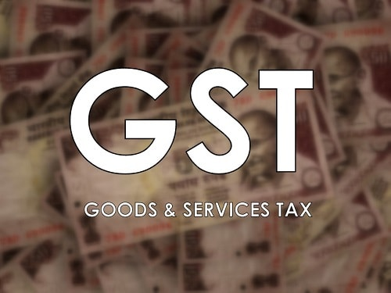
For any clarification
sudha@hiregange.com
sudhacma@gmail.com

