Slide 1
INSIDE THE GST RULES At Aurangabad Chapter
By CMA Suresh R. Pimple
B.Sc(Hons), FCMA
DISA

Slide 2
REGISTRATION
1. Application for registration
Every person who is liable to be registered under sec.25(1) & every person seeking registration under sec.25(3) shall, before applying for registration, declare his Permanent Account Number (PAN), mobile number, e-mail address, State or Union territory in Part A of FORM GST REG-01 on the Common Portal either directly or through a Facilitation Centre notified by the Commissioner.
The PAN, mobile number, e-mail shall be verified & on successful verification a temporary reference number shall be generated and communicated to the applicant on the said mobile number and e-mail address.

Slide 3
Con..
Using the reference number generated the applicant shall electronically submit an application in Part B of FORM GST REG-01, duly signed, along with documents specified in the said Form at the Common Portal.
On receipt of an application an acknowledgement shall be issued electronically to the applicant in FORM GST REG-02.

Slide 4
Con..
A person applying for registration as a casual taxable person shall be given a temporary reference number by the Common Portal for making advance deposit of tax in accordance with the provisions of section 27 and the acknowledgement under sub-rule (5) shall be issued electronically only after the said deposit in the electronic cash ledger.
2. Verification of the application and approval :
if application and the accompanying documents are found-
- To be in order approve the grant of registration to the applicant within three working days from the date of submission of application.
- to be deficient then proper officer may issue a notice to the applicant electronically in FORM GST REG-03 within three working days from the date of submission of application and the applicant shall furnish such clarification, information or documents sought electronically, in FORM GST REG-04, within seven working days from the date of receipt of such intimation.

Slide 5
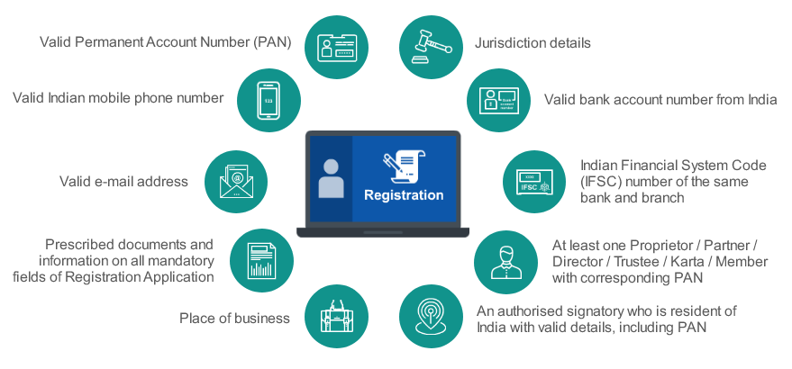
Con..

Slide 6
Con..
If proper officer is-
satisfied he may approve the grant of registration to the applicant within seven working days from the date of receipt of such clarification or information or documents .
not satisfied he shall, for reasons to be recorded in writing, reject such application and inform the applicant electronically in FORM GST REG-05.
If the proper officer fails to take any action –
within three working days from the date of submission of application, or
within seven working days from the date of receipt of clarification, information or documents furnished by the applicant
the application for grant of registration shall be deemed to have been approved.

Slide 7
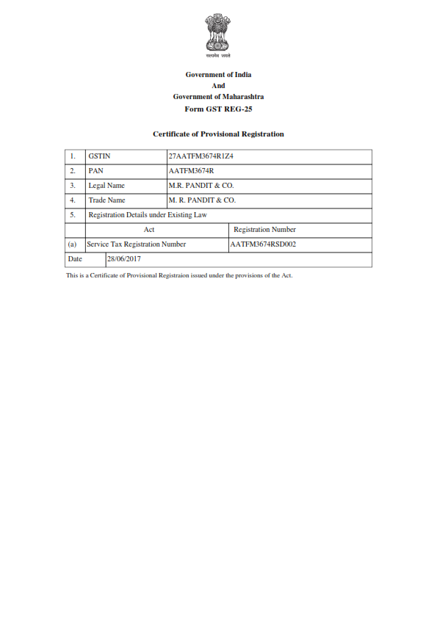

Slide 8
Con..
Registration to persons required to TDS sec.51 or TCS sec.52
Any person required to deduct tax or collect tax at source shall electronically submit an application, duly signed, in FORM GST REG-07 for grant of registration through the Common Portal.
The proper officer may grant registration after due verification and issue a certificate of registration in FORM GST REG-06 within three working days from the date of submission of application.

Slide 9
FAQ
Q1. Can a person without GST registration claim ITC and collect tax?
Ans. No, a person without GST registration can neither collect GST from his customers nor can claim any input tax credit of GST paid by him.
Q2. Who are the persons liable to take a Registration under the GST Law?
Ans. As per Section 22 of the CGST/SGST Act 2017, every supplier (including his agent) who makes a taxable supply which are leviable to tax under GST law, and his aggregate turn over in a financial year exceeds the threshold limit of twenty lakh rupees shall be liable to register himself in the State or the Union territory of Delhi or Puducherry from where he makes the taxable supply.

Slide 10
TAX INVOICE Rule 7
1. A tax invoice in section 31 shall be issued by the registered person containing the following particulars:-
name, address and GSTIN of the supplier ;
a consecutive serial number & date of its issue;
name, address and GSTIN or UIN, if registered, of the recipient;
HSN code of goods or Accounting Code of services;
description of goods or services;
quantity in case of goods and unit or Unique Quantity Code thereof;
total value of supply of goods or services or both;
rate & amount of tax
place of supply along with the name of State
address of delivery where the same is different from the place of supply;
signature or digital signature of the supplier or his authorized representative

Slide 11
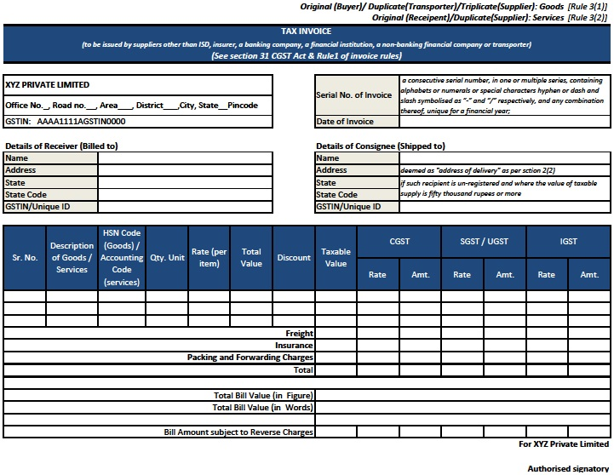

Slide 12
Con..
2. Time limit for issuing tax invoice:
in case of taxable supply of services, shall be issued within a period of thirty days from the date of supply of service
If supplier of services is an insurer or a banking company or a financial institution, including a non-banking financial company, the period within which the invoice or any document in lieu thereof is to be issued shall be forty five days from the date of supply of service

Slide 13
Con..
3. Manner of issuing invoice:
The invoice in three copy, in case of supply of goods;
the original copy being marked as ORIGINAL FOR RECIPIENT;
the duplicate copy being marked as DUPLICATE FOR TRANSPORTER; and
the triplicate copy being marked as TRIPLICATE FOR SUPPLIER.
The invoice in duplicate, in case of supply of services;
the original copy being marked as ORIGINAL FOR RECIPIENT; and
the duplicate copy being marked as DUPLICATE FOR SUPPLIER.
The serial number of invoices issued during a tax period shall be furnished electronically through the Common Portal in FORM GSTR-1.

Slide 14
Con..
4. Bill of Supply
Tax invoice is generally issued to charge the tax and pass on the credit. In GST there are some instances where the supplier is not allowed to charge any tax and hence a Tax invoice can’t be issued instead another document called Bill of Supply is issued.
Cases where a registered supplier needs to issue bill of supply:
Supply of exempted goods or services
Supplier is paying tax under composition scheme

Slide 15
RETURNS
1. Form and manner of furnishing details of outward supplies;
Every registered person required to furnish the details of outward supplies of goods or services or both u/s 37, shall furnish such details in FORM GSTR-1 electronically through the Common Portal.
FORM GSTR-1 shall include inter-alia,–
invoice wise details of all –
(i) inter-State and intra-State supplies made to registered persons;
(ii) inter-State supplies with invoice value more than rupees 2.5 lakh made to unregistered persons;
(b) consolidated details of all –
(i) intra-State supplies made to unregistered persons for each rate of tax; and
(ii) State wise inter-State supplies with invoice value less than Rupees 2.5 lakh made to unregistered persons for each rate of tax; and
(c) debit and credit notes, if any issued during the month for invoices issued previously.

Slide 16
Con..
The details of outward supplies furnished by the supplier shall be made available electronically to the concerned registered persons (recipients) in Part A of FORM GSTR-2A, in FORM GSTR-4A and in FORM GSTR-6A through the Common Portal after the due date of filing of FORM GSTR-1.
The details of inward supplies added, corrected or deleted by the recipient in his FORM GSTR-2 under section 38 or FORM GSTR-4 under section 39 shall be made available to the supplier electronically in FORM GSTR-1A through the Common Portal and such supplier may either accept or reject the modifications made by the recipient and FORM GSTR-1 furnished earlier by the supplier shall stand amended to the extent of modifications accepted by him.

Slide 17
Con..
2. Form and manner of furnishing details of inward supplies (FORM GSTR-2);
Every registered person required to furnish the details of inward supplies of goods or services or both u/s38(2) shall, on the basis of details contained in Part A, Part B, Part C and Part D of FORM GSTR-2A, prepare such details and furnish the same in FORM GSTR-2 electronically through the Common Portal.
The registered person shall specify the inward supplies in respect of which he is not eligible, either fully or partially, for input tax credit in FORM GSTR-2 where such eligibility can be determined at the invoice level.
The details of invoices furnished by an Input Service Distributor in his return in FORM GSTR-6 under rule 7 shall be made available to the recipient of credit in Part B of FORM GSTR -2A electronically through the Common Portal and the said recipient may include the same in FORM GSTR-2.

Slide 18
Con...
The details of tax deducted at source furnished by the deductor under sub-section (3) of section 39 in FORM GSTR-7 shall be made available to the deductee in Part C of FORM GSTR-2A electronically through the Common Portal and the said deductee may include the same in FORM GSTR-2.
The details of tax collected at source furnished by an e-commerce operator under section 52 in FORM GSTR-8 shall be made available to the concerned person in Part D of FORM GSTR - 2A electronically through the Common Portal and such taxable person may include the same in FORM GSTR-2.

Slide 19
RETURNS
Return | Description | Who files? | Date for Filing
GSTR-1 | Monthly Statement of Outward supplies of Goods or Services | Registered Person | 10th of the next month
GSTR-2 | Monthly Statement of Inward supplies of Goods or Services | Registered Person | 15th of the next month
GSTR-3 | Monthly Consolidated Return | Registered Person | 20th of the next month
GSTR-4 | Quarterly Return | Taxable Person opting for Composition Levy | 18th of the month succeeding the quarter
GSTR-5 | Monthly Return for a Non- Resident taxpayer | Non-resident Taxpayer | 20th of the month succeeding the tax period & within 7 days after expiry of registration

Slide 20
Con..
GSTR-6 | Monthly Return for an Input Service Distributor (ISD) | Input Service Distributor | 13th of the next month
GSTR-7 | Monthly Return for Tax Deductor | Tax Deductor | 10th of the next month
GSTR-8 | Monthly Statement for Ecommerce Operator depicting supplies effecting through it | E-Commerce Operator | 10th of the next month
GSTR-9 | Annual Return | Registered Person other than an ISD, TDS/TCS Taxpayer, Casual Taxable Person and Non-resident Taxpayer | 31st December of next Financial Year
GSTR-10 | Final Return | Taxable Person whose registration has been surrendered or cancelled | Within 3 months of the date of cancellation or date of order of cancellation, whichever is later.

Slide 21
Con..
Valid Return-
A return will be treated as valid only if the appropriate GST has been paid in full.
Rectification Vs. Revise Return
-In GST regime Revised Return cannot be filed.
However Rectification of Errors/Omissions is allowed.
Rectification is not allowed after –
(a) furnishing the return for the month of September following the end of the financial year to which, such details pertain; or
(b) furnishing of the relevant Annual Return,
-whichever is earlier.
Penalty-
Any registered person who fails to furnish form GSTR-1, GSTR-2, GSTR-3 or Final Return within the due dates, shall be liable to pay a late fee of Rs. 100 per day, subject to a maximum of Rs. 5,000.

Slide 22
ITC MATCHING AND AUTO-REVERSAL
It is a mechanism to prevent revenue leakage.
The process of ITC Matching begins after the due date for filing of the return (20th of every month). This is carried out by GSTN.
The details of every inward supply furnished by the recipient in form GSTR-2 shall be matched with the corresponding details of outward supply furnished by the corresponding supplier in his valid return.
In case the details match, then the ITC claimed by the recipient in his valid returns shall be considered as finally accepted and such acceptance shall be communicated to the recipient. Failure to file valid return by the supplier may lead to denial of ITC in the hands of the recipient.
In case the ITC claimed by the recipient is in excess of the tax declared by the supplier or where the details of outward supply are not declared by the supplier in his valid returns, the discrepancy shall be communicated to both the supplier and the recipient. Similarly, in case, there is duplication of claim of ITC, the same shall be communicated to the recipient.

Slide 23
Con..
The recipient will be asked to rectify the discrepancy of excess claim of ITC and in case the supplier has not rectified the discrepancy communicated in his valid returns for the month in which, the discrepancy is communicated, then such excess ITC as claimed by the recipient shall be added to the output tax liability of the recipient in the succeeding month.
Similarly, duplication of ITC claimed by the recipient shall be added to the output tax liability of the recipient in the month in which, such duplication is communicated.
The recipient shall be liable to pay interest on the excess or duplicate ITC added back to the output tax liability of the recipient from the date of availing of ITC till the corresponding additions are made in their returns.
Re-claim of ITC refers to taking back the ITC reversed in the Electronic Credit Ledger of the recipient by way of reducing the output tax liability. Such re-claim can be made by the recipient only in case the supplier declares the details of the Invoice and/or Debit Notes in his valid return within the prescribed timeframe. In such case, the interest paid by the recipient shall be refunded to him by way of crediting the amount to his Electronic Cash Ledger.

Slide 24
VALUATION RULES Determination of Value of Supply
1. Value of supply of goods or services where the consideration is not wholly in money; the value of the supply shall,
(a) be the open market value of such supply;
(b) if open market value is not available, be the sum total of consideration in money and any such further amount in money as is equivalent to the consideration not in money if such amount is known at the time of supply;
(c) if the value of supply is not determinable under clause (a) or clause (b), be the value of supply of goods or services or both of like kind and quality;
2. Value of supply of goods or services or both between distinct or related persons, other than through an agent
Same as above

Slide 25
Con..
3. Value of supply of goods made or received through an agent
The value of supply of goods between the principal and his agent shall,-
(a) be the open market value of the goods being supplied, or at the option of the supplier, be ninety percent of the price charged for the supply of goods of like kind and quality by the recipient to his customer not being a related person, where the goods are intended for further supply by the said recipient;
Illustration: Where a principal supplies groundnut to his agent and the agent is supplying groundnuts of like kind and quality in subsequent supplies at a price of Rs.5000 per quintal on the day of supply. Another independent supplier is supplying groundnuts of like kind and quality to the said agent at the price of Rs.4550 per quintal. The value of the supply made by the principal shall be Rs.4550 per quintal or where he exercises the option the value shall be 90% of the Rs.5000 i.e. is Rs.4500 per quintal.
(b) where the value of a supply is not determinable under clause (a), the same shall be determined by application of rule 4 or rule 5 in that order.

Slide 26
Con.
4. Value of supply of goods or services or both based on cost
Where the value of a supply of goods or services or both is not determinable by any of the preceding rules, the value shall be one hundred and ten percent of the cost of production or manufacture or cost of acquisition of such goods or cost of provision of such services.
5. Residual method for determination of value of supply of goods or services or both
Where the value of supply of goods or services or both cannot be determined under rules 1 to 4, the same shall be determined using reasonable means consistent with the principles and general provisions of section 15 and these rules:
Provided that in case of supply of services, the supplier may opt for this rule, disregarding rule 4.

Slide 27
FAQ
Q 1. What is the value of taxable supply to be adopted for the levy of GST?
Ans. The value of taxable supply of goods and services shall ordinarily be ‘the transaction value’ which is the price paid or payable, when the parties are not related and price is the sole consideration.
the transaction value shall not include refundable deposit, discount allowed subject to certain conditions before or at the time of supply.
Q 2. Whether post-supply discounts or incentives are to be included in the transaction value?
Ans. Yes. where the post-supply discount is established as per the agreement which is known at or before the time of supply and where such discount specifically linked to the relevant invoice and the recipient has reversed input tax credit attributable to such discount, the discount is allowed as admissible deduction under Section 15 of the model GST law.

Slide 28
FAQ
Q.3 When are the provisions of the Valuation Rules applicable?
Ans. Valuation Rules are applicable when
consideration either wholly or in part not in money terms;
parties are related or supply by any specified category of supplier; and
transaction value declared is not reliable.

Slide 29
COMPOSITION RULES
Intimation for composition levy
Any person who has been granted registration on a provisional basis under sub-rule (1) of rule Registration.16 and who opts to pay tax under section 10, shall electronically file an intimation in FORM GST CMP-01, duly signed, on the Common Portal, prior to the appointed day, but not later than thirty days after the said day, or such further period as may be extended by the Commissioner in this behalf:
Provided that where the intimation in FORM GST CMP-01 is filed after the appointed day, the registered person shall not collect any tax from the appointed day but shall issue bill of supply for supplies made after the said day.

Slide 30
Con.
Any registered person who opts to pay tax u\s 10 shall electronically file an intimation in FORM GST CMP-02, duly signed, prior to the commencement of the financial year for which the option to pay tax under the aforesaid section is exercised on the Common Portal, and shall furnish the statement in FORM GST ITC-3 in accordance with the provisions of sub-rule (4) of rule ITC.9 within sixty days from the commencement of the relevant financial year,
Any person who files an intimation u\s 10 shall furnish the details of stock, including the inward supply of goods received from unregistered persons, held by him on the day preceding the date from which he opts to pay tax under the said section, electronically, in FORM GST CMP-03, on the Common Portal within sixty days of the date from which the option for composition levy is exercised or within such further period as may be extended by the Commissioner in this behalf.

Slide 31
Rate of tax of the composition levy
Sl No. | Category of registered persons | Rate of tax
1 | Manufacturers | 2%
2 | Supply of Services in Restaurant, Hotels etc. | 5%
3 | Traders | 1%

Slide 32
FAQ
Q.1 What is the threshold for opting to pay tax under the composition scheme?
Ans. The threshold for composition scheme is Rs. 75 Lakhs of aggregate turnover in the preceding financial year. The benefit of composition scheme can be availed up to the turnover of Rs. 75 Lakhs in current year.
Q.2 Will a taxable person, having multiple registrations, be eligible to opt for composition scheme only for a few of registrations?
Ans. All registered persons having the same Permanent Account Number (PAN) have to opt for composition scheme. If one registered person opts for normal scheme, others become ineligible for composition scheme.

Slide 33
FAQ
Q 3. Who are not eligible to opt for composition scheme?
Ans. Broadly, five categories of registered person are not eligible to opt for the composition scheme. These are:
supplier of services other than supplier of restaurant service;
supplier of goods which are not taxable under the CGST Act/SGST Act/UTGST Act.
an inter-State supplier of goods;
person supplying goods through an electronic commerce operator;
manufacturer of certain notified goods.
Q 4. Can the registered person under composition scheme claim input tax credit?
Ans. No, registered person under composition scheme is not eligible to claim input tax credit.

Slide 34
Input Tax Credit
Documentary requirements and conditions for claiming input tax credit
documents, namely:
an invoice issued by the supplier of goods or services or both;
(b) a debit note issued by a supplier;
(c) a bill of entry;
(d) a document issued by an Input Service Distributor
Input tax credit shall be availed by a registered person only if all the applicable particulars as prescribed in Invoice Rules are contained in the said document, and the relevant information, as contained in the said document, is furnished in FORM GSTR-2 by such person.
No input tax credit shall be availed by a registered person in respect of any tax that has been paid in pursuance of any order where any demand has been raised on account of any fraud, willful misstatement or suppression of facts.

Slide 35
FAQ
Q 1. Can GST paid on reverse charge basis be considered as input tax?
Ans. Yes. The definition of input tax includes the tax payable under the reverse charge.
Q 2. Does input tax includes tax (CGST/IGST/SGST) paid on input goods, input services and capital goods?
Ans. Yes, it includes taxes paid on input goods, input services and capital goods. Credit of tax paid on capital goods is permitted to be availed in one instalment.
Q 3. Is credit of all input tax charged on supply of goods or services allowed under GST?
Ans. A registered person is entitled to take credit of input tax charged on supply of goods or services or both to him which are used or intended to be used in the course or furtherance of business, subject to other conditions and restrictions.

Slide 36
FAQ
Q 4. Where the goods against an invoice are received in lots or instalments, how will a registered person be entitled to ITC?
Ans. The registered person shall be entitled to the credit only upon receipt of the last lot or installment.
Q 5. Can a person take input tax credit without payment of consideration for the supply along with tax to the supplier?
Ans. Yes, the recipient can take ITC. But he is required to pay the consideration along with tax within 180 days from the date of issue of invoice. This condition is not applicable where tax is payable on reverse charge basis.

Slide 37
FAQ
Q 6. Who will get the ITC where goods have been delivered to a person other than taxable person (‘bill to’- ‘ship to ’scenarios)?
Ans. It would be deemed that the registered person has received the goods when the goods have been delivered to a third party on the direction of such taxable person. So ITC will be available to the person on whose order the goods are delivered to third person.

Slide 38
FAQ
Q 7. What is the time limit for taking ITC and reasons therefor?
Ans. A registered person cannot take ITC in respect of any invoice or debit note for supply of goods or services after the due date for furnishing the return under section 39 for the month of September following the end of financial year to which such invoice/invoice relating to debit note pertains or furnishing of the relevant annual return, whichever is earlier. So, the upper time limit for taking ITC is 20th October of the next FY or the date of filing of annual return whichever is earlier.
The underlying reasoning for this restriction is that no change in return is permitted after September of next FY. If annual return is filed before the month of September, then no change can be made after filing of annual return.

Slide 39
FAQ
Q 8. Is credit of tax paid on every input used for supply of taxable goods or services or both is allowed under GST?
Ans. Yes, except a small list of items provided in the law, the credit is admissible on all items. The list covers mainly items of personal consumption, inputs use of which results into formation of an immovable property (except plant and machinery), telecommunication towers, pipelines laid outside the factory premises, etc. and taxes paid as a result of detection of evasion of taxes.
Q 9. Sometimes goods are destroyed or lost due to various reasons? Can a person take ITC to the extent of such goods?
Ans. No, a person cannot take ITC with respect to goods lost, stolen, destroyed or written off. In addition, ITC with respect of goods given as gifts or free samples are also not allowed.

Slide 40
FAQ
Q 10. What is the ITC entitlement of a newly registered person?
Ans. A person applying for registration can take input tax credit of inputs held in stock and inputs contained in semi-finished or finished goods held in stock on the day immediately preceding the date of grant of registration. If the person was liable to take registration and he has applied for registration within thirty days from the date on which he became liable to registration, then input tax credit of inputs held in stock and inputs contained in semi-finished or finished goods held in stock on the day immediately preceding the date on which he became liable to pay tax can be taken.
Q 11. A person becomes liable to pay tax on 1st August, 2017and has obtained registration on 15th August, 2017. Such person is eligible for input tax credit on inputs held in stock as on:
(a) 1st August, 2017
(b) 31st July, 2017
(c) 15th August, 2017
(d) He cannot take credit for the past period
Ans. 31st July, 2017.

Slide 41
FAQ
Q 12. What is the eligibility of input tax credit on inputs in stock for a person who obtains voluntary registration?
Ans. The person who obtains voluntary registration is entitled to take the input tax credit of input tax on inputs in stock, inputs in semi- finished goods and finished goods in stock, held on the day immediately preceding the date of registration.
Q 13. Is input tax credit allowed only after matching?
Ans. No, input tax credit is allowed provisionally for two months. The supply details are matched by the system and discrepancies are communicated to concerned supplier and recipient. In case mismatch continues, the ITC taken would be reversed automatically.

Slide 43
THANK YOU
CMA Suresh Pimple
Aurangabad
Date:07/07/2017

