Slide 1
GOODS AND SERVICE TAX
Filings
28-11-17
Mohd. Irshad Ahmed
Chartered Accountant
Hyderabad

Slide 2
RETURNS Overview
GSTR 1 – Applicable for reporting outward supplies
GSTR 2 – Applicable for reporting inward supplies
GSTR 3 – Auto populated from GSTR 1 & 2 including details of input tax credit, cash balances and tax liability
GSTR 3B – Simplified return to be filed each month by 20th
All the returns are filed each month unless the date is extended
GSTR 1 shall be filed by 10th of each month, GSTR 2 between 11th and 15th of each month and GSTR 3 by 20th of each month after paying the tax unless the date is extended

Slide 3
RETURNS (continued) Latest position of due dates
Taxpayers whose annual aggregate turnover upto Rs. 1.5 crore
GSTR 1 – to be filed on quarterly basis as under:
The time period for filing GSTR 2 for all the months starting July 2017 has been deferred and it will be notified at a later date
GSTR 1 will have to be filed as per the above schedule pending GSTR 2 & 3
Period | Dates
Jul-Sep | 31 Dec 17
Oct-Dec | 15 Feb 18
Jan-Mar | 30 Apr 18

Slide 4
RETURNS (continued) Latest position of due dates (continued...)
Taxpayers whose annual aggregate turnover more than Rs. 1.5 crore
GSTR 1 – to be filed on monthly basis as under:
The time period for filing GSTR 2 for all the months starting July 2017 has been deferred and it will be notified at a later date
GSTR 1 will have to be filed as per the above schedule pending GSTR 2 & 3
Period | Dates
Jul-Oct | 31 Dec 17
Nov | 10 Jan 18
Dec | 10 Feb 18
Period | Dates
Jan | 10 Mar 18
Feb | 10 Apr 18
Mar | 10 May 18

Slide 5
GSTR 3B
Before filing GSTR 3B
Ensure Trial balance is finalised for the month
Reconcile previous month transactions to see any changes in current month
Analyse the nature of outward supplies and categorise them into taxable, exempted, zero rated, nil rated etc
Analyse the nature of inward supplies to check applicability of reverse charge provisions
All inter-state supplies needs to be sub-divided into supplies to registered and un-registered persons

Slide 6
GSTR 3B
Form GSTR 3B
3.1 Details of outward supplies and inward supplies liable to reverse charge
All outward supplies whether inter-state or intra-state or to a registered or un-registered persons, taxable or exempted, GST or Non-GST have to be reported under this Table
Outward supplies also includes value of debit notes and value of advances received for which invoices have not been issued
Outward supplies does not include value of credit notes and advances adjusted against the invoices
Only those inward supplies which are liable to reverse charge have to be reported i.e. Notified supplies from registered persons

Slide 7
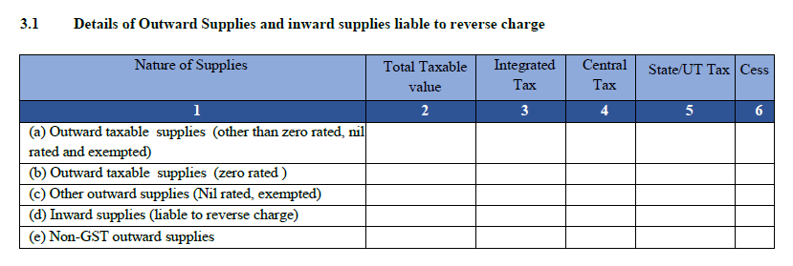
GSTR 3B

Slide 8
GSTR 3B
Form GSTR 3B continued....
4 - Eligible Input Tax Credit (ITC)
All input credits whether eligible or not eligible, whether adjusted or not adjusted have to be captured in 4(A). Input credit paid on RCM basis on import of goods or services or other than imports have to be separately reported
Input credits pertaining to previous periods that were not taken earlier can be taken in the current month
Input credit pertaining to exempted supplies shall be reported separately and shall be deducted in 4(B)
All other input credits subject to deduction shall be deducted including ineligible credits

Slide 9
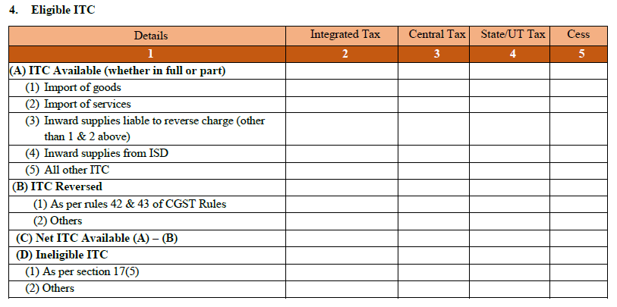
GSTR 3B

Slide 10
GSTR 1
Before filing GSTR 1
Ensure Trial balance is finalised for the month
Ensure sales is materialised and there are no discrepancies with customers
All the supplies should be sub-divided into the registered or un-registered customer wise
In respect of each transaction, certain minimum information shall be extracted
Details of amendments to previous transactions
Extract the quantitative details
HSN summary

Slide 11
GSTR 1 continued...
Before filing GSTR 1
Outward supplies
Registered
Un-registered
Intra-state
Inter-state
Forward charge
Reverse charge
Zero rated or Deemed exports
Zero rated or deemed exports
more than 2.5l & vice-versa
E-commerce
Others

Slide 12
GSTR 1 continued...
Transaction level information
GSTIN of the recipient, if available
Invoice or bill of export or shipping bill number, date and value
Debit or credit notes (GST formats)
Eligibility to the input tax credit for the transaction
Previous or fresh advances and the subsequent adjustments thereof
Movement of serial numbers of every GST document such as invoice, debit note, credit note, receipt voucher, payment voucher, delivery challan etc
HSN wise summary of outward supplies

Slide 13
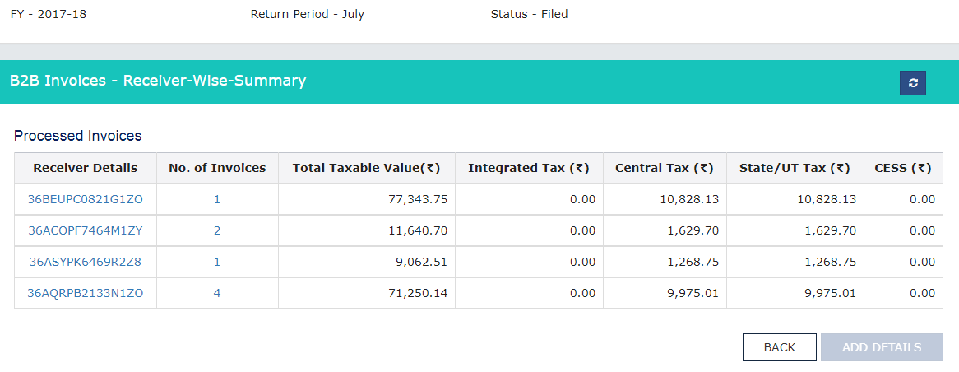
GSTR 1 continued...
Table 4

Slide 14
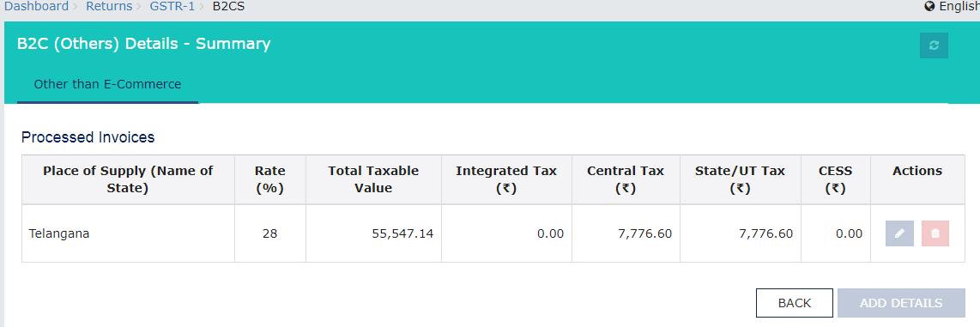
GSTR 1 continued...
Table 7

Slide 15
GSTR 2
Before filing GSTR 2
Ensure Trial balance is finalised for the month
Obtain all the vendor invoices for the month in order to finalise trial balance
All the supplies should be identified from the registered or un-registered supplier wise
In respect of each transaction, certain minimum information shall be extracted
Details of amendments to previous transactions
Extract the quantitative details of invoices, credit notes, debit notes etc
HSN summary

Slide 16
GSTR 2 continued...
Before filing GSTR 2
Inward supplies
Registered
Un-registered
Forward charge
Reverse charge
Forward charge
Reverse charge
Composition, exempt, nil, Non-GST
Composition, exempt, nil, Non-GST
Imported or SEZ
Imported or SEZ

Slide 17
GSTR 2 continued...
Transaction level information
GSTIN of the supplier, if available
Invoice or bill of entry number, date and value
Debit or credit notes issued by the supplier or changes in existing transactions (GST formats)
Eligibility to the input tax credit for the transaction
The above requirements are also applicable to supplies from un-registered persons (However vide notification 38/2017 dated 13-10-17, levy of tax u/s 9(4) i.e. Tax on RCM basis on intra-state supplies from un-registered persons has been deferred till 31 March 2018)
Previous or fresh advances and the subsequent adjustments thereof

Slide 18
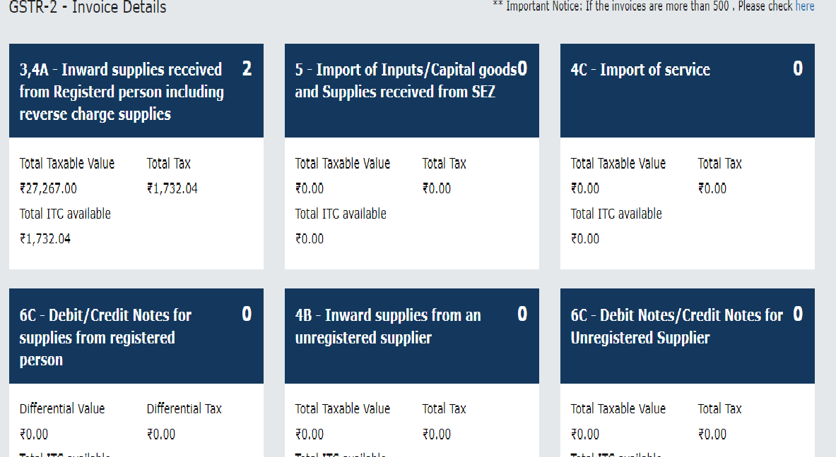
GSTR 2 continued...
Dashboard

Slide 19
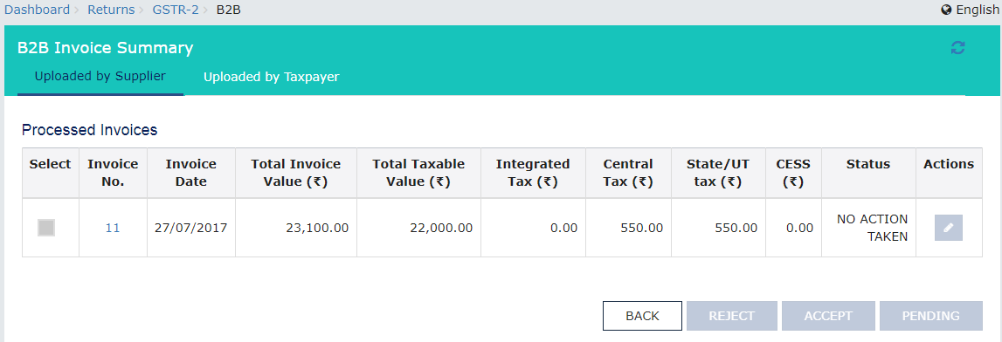
GSTR 2 continued...
Table 3 & 4A

Slide 20
GSTR 2 continued...
Table 6C

Slide 21
GSTR 2 continued...
Table 11 – Input Tax Credit Reversal/Reclaim
This table deals with those input tax credits which have been recorded in credit ledger and are required to be reversed under the following circumstances:
Failure to settle the consideration to the supplier
Input service distributor (ISD) credits arising due to credit notes
Common credit attributable to exempt or non-business supplies
Common credit attributable to exempt or non-business supplies in respect of capital goods
Subsequent settlement of consideration to the supplier
Any other liability to be specified

Slide 22
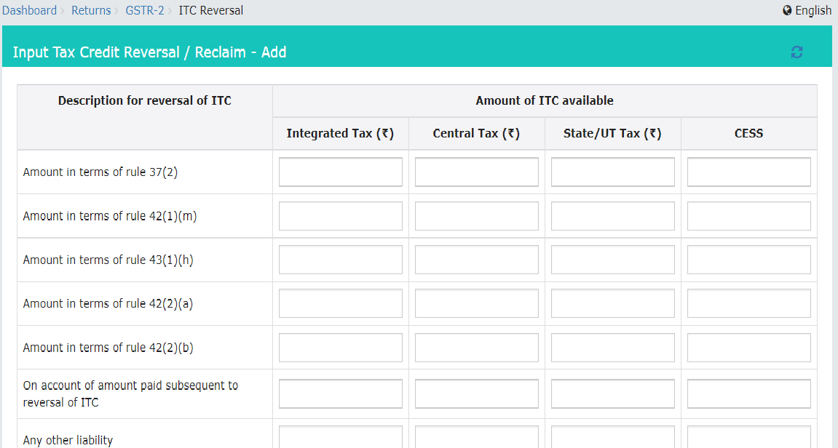
GSTR 2 continued...

Slide 23
GSTR 2 continued...
Table 12 – Addition and reduction of amount in output tax for mismatch and other reasons
This table deals with those items which will affect the output tax due to the following reasons:
Reversal of ITC due to mismatch of invoices or debit notes
Reversal of ITC due to duplication of invoices or debit notes
Mismatch of credit notes leading to additional tax liability
Reclaims on account of rectifying the above transactions
Negative tax liability from previous tax periods
Adjustment of advances with tax invoices and reduction of output tax

Slide 24
GSTR 3
Before filing GSTR 3
Ensure GSTR 1 & GSTR 2 are submitted based on accounting records and close coordination with vendors and customers
Ensure sales is materialised and there are no discrepancies with customers
All the supplies should be identified from the registered or un-registered supplier wise
In respect of each transaction, certain minimum information shall be extracted

Slide 25
RETURNS
Common Questions
How should the transactions not reported in previous month be treated?
The transactions pertaining to previous period not reported earlier shall be reported in the current month
Where should the corrections if any arising in data submitted be done?
Any subsequent discovery of errors or omissions in returns already submitted shall be rectified in the following month in form 3B
How to revise the returns already submitted?
Form 3B cannot be rectified once submitted. It has to be filed and any corrections have to be done next month

Slide 26
RETURNS
Common Questions
What are the applicable forms for Generation, Transmission and Distribution Companies?
GSTR 3B GSTR 1till 31 March 2018. If there are no taxable outward supplies, than Nil GSTR 1 has to be filed
Whether GST TDS is to be deducted on payments to suppliers?
TDS provisions are applicable to a) a department or establishment of the Central Government or State Government; or (b) local authority; or (c) Governmental agencies. TDS shall be deducted on gross value excluding GST. However, this section is not effective yet and hence TDS need not be deducted.

Slide 27
RETURNS
Common Questions
How to verify Invoice number given in bill is same as their filings?
This is relevant for taking Input Tax Credit. ITC can be taken if the invoice no, date and GSTIN matches in GSTR 2. However, GSTR 2 return has been postponed till further notice.
Forms to be filed by Contractors who purchase materials and does work like Substation construction, Laying of Power towers, Cable works and Construction of Civil Works?
GSTR 3B & GSTR 1. TRAN1 for taking transitional credit

Slide 28
RETURNS
Common Questions
Forms to be filed by Hire Vehicle Providers, House Keeping and Man Power suppliers?
GSTR 3B & GSTR 1. TRAN1 for taking transitional credit
Rates of GST for Electrical Works, Civil Works, Hire Vehicle, House Keeping, Man Power, Professional Services, Accounting services etc...
Standard rate for works contract service and other services is 18%

Slide 29
THANK YOU
Email: irshad@miallp.com

