Slide 1
An Overview of Goods & Services Tax ( GST)
R.S.Maheshwari
Additional Commissioner
Bhopal

Slide 2
PRESENTATION PLAN
Introduction: GST A Game Changer
Problems In Present Indirect Tax Structure
Salient Features of GST
The Taxable event , Time & place of Supply and Valuation
Input Tax Credit
Registration, Returns,
Payment of tax, refund , Job work
Transition provision
Migration
Way forward

Slide 3
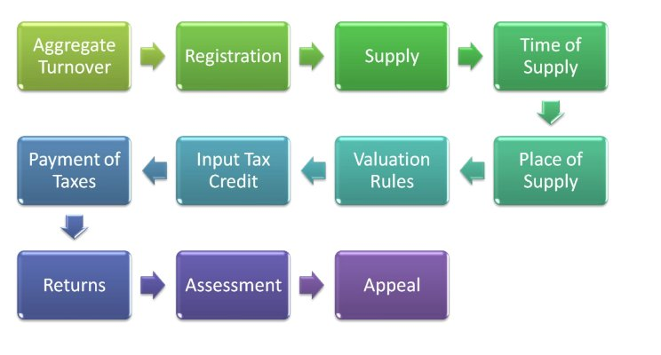

Slide 4
Multi Stage Supply Chain
A
Value Rs. 5000 + Taxes (Rs1000) Guj
B
Value Rs. 6000 + Taxes (Rs 200)
C
Value Rs. 7000 + Taxes (Rs 200)
Tax rides the supply
D
Value Rs. 8000 + Taxes (Rs200)
R
Value Rs. 15000 + Taxes (Rs 1400)
Multi stage VAT
GST is destination based consumption tax
Real Revenue
ITC utilization means less cash
Consumer (MP)
160 countries (90% )
The concept behind GST was invented by a French tax official in the 1950s

Slide 5
PRESENT INDIRECT TAXES
Central taxes
Excise duty.
Customs duty
CST.
Additional Excise Duty.
Service tax.
CVD (Countervailing Duty).
SAD (Special Additional Duty).
Central Cesses & Surcharges.
State taxes
VAT.
Entertainment Tax.
Luxury tax.
Tax on Lottery, betting, gambling.
Entry tax.
Purchase tax
State Surcharges & Cesses.

Slide 6
Present Structure of Indirect Tax
Nature of Tax | Excise Duty | Service Tax | Customs Duty | Sales Tax/VAT/ CST | Entry tax/ Entertainment Tax
Authority for levy of Tax | Entry No. 84, List I, Schedule VII | Residuary Entry No. 97, List I, Schedule VII | Entry No. 83, List I, Schedule VII | Entry No. 54 of List II (VAT) and 92A of List I (CST) | Entry No. 52 &62 List II, Schedule VII
Taxable Event | Manufacture | Provision of Service | Import & Export | Sale of goods | Entertainment & Entry of Goods
.

Slide 7
Shortcomings in the Present Indirect Tax Structure
Shortcomings in the present structure
Cascading of taxes
Varied concessions
&
exemptions
Sales Vs Service dilemma
Multiple Compliance requirements
Lack of uniformity in rules and rates
Lack of transparency/
cohesion
Interpretational issues
Narrow base
Multiple
administration
.

Slide 8
Taxes Proposed to be Subsumed under GST
Central taxes
Excise duty.
Additional Excise Duty.
Service tax.
CVD (Countervailing Duty).
SAD (Special Additional Duty).
Central Cesses & Surcharges.
Rates : 5,12,18 & 28%
State taxes
VAT.
CST.
Entertainment Tax.
Luxury tax.
Tax on Lottery, betting, gambling.
Entry tax.
Purchase tax
State Surcharges & Cesses.
CGST
SGST

Slide 9
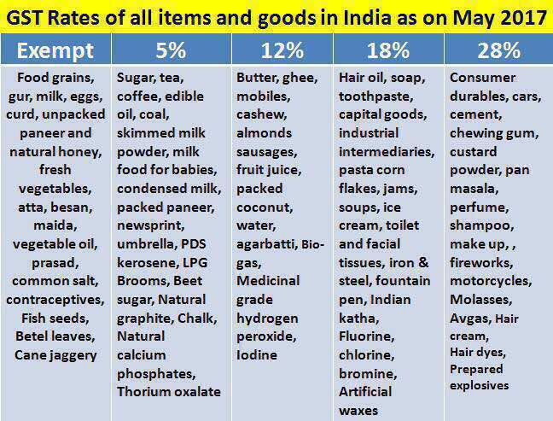

Slide 10
GST : A Game Changer
A single tax would replace multiple taxes.
Mitigate the ill effects of cascading.
Reduce economic distortions caused by inter-State variations in taxes. Common national market.
Streamline tax administration and avoid harassment of business.

Slide 11
Taxes not subsumed under GST
Basic Custom Duties
Excise on liquor
Property Tax
Stamp Duty
Tax on sale / consumption of electricity

Slide 12
Complications in the existing system
of taxation of inter state sales
The Constitution (Sixth Amendment) Act, 1956
Central Sales Tax Act 1956 :
CST is levied by the Centre but Collected by the originating state government.
ITC of CST not allowed .
Forms for accountal ( Form A to J)
Entry Tax : –
(Art. 246 read with Entry 52 of List II)

Slide 13
The Constitution (101st Amendment) Act, 2016
Passed by RS & LS and ratified by the states. Presidential assent received on 8th Sept,2016
“goods and services tax” means
any tax on supply of goods, or services or both except taxes on the supply of the alcoholic liquor for human consumption.
GST COUNCIL –Article 279A

Slide 14
Article 246A & 269A to be inserted .
Concurrent power to levy GST on intra state supply.
Exclusive jurisdiction to centre to levy GST on interstate supply.
IGST to be apportioned.
Import also considered inter state supply
Parliament will frame the principles for determination of place of supply

Slide 15
GST COUNCIL
One of India’s most powerful federal bodies that will oversee and administer the GST.
Constitution : Union FM & MoS and MoF of each State.
Weightage of votes: Centre :States = 1/3rd : 2/3rd
Quorum = 50% of total members.
Decisions by 3/4th majority .
Council to make recommendations on :
Taxes, etc. to be subsumed in GST. Exemptions & thresholds . GST rates. Band of GST rates. Modal GST Law & procedures

Slide 16
GST : A Game Changer
A single tax would replace multiple taxes.
Set-off of prior-stage taxes would mitigate the ill effects of cascading.
Tax burden on goods and services would decrease, benefiting common man.
Make our products competitive in domestic and international markets.
boost economic activity and create more jobs. The GDP would grow .
widening of tax base, increase in trade volumes and improved tax compliance.
Reduce economic distortions caused by inter-State variations in taxes. Common national market.
Streamline tax administration and avoid harassment of business.
Compliance costs for the industry will go down

Slide 17
The Statutory Scheme of Levy Under GST
INTRA STATE
supplies
CGST
SGST
INTER STATE Supplies
IGST

Slide 18
What IGST achieves :
Maintain integrity of ITC chain in interstate supplies
1
inter-state supplies taxed effectively while keeping the regime simple
2
3
Tax is collected at Origin state but transferred to the destination state
4
Incidence of tax is same in inter/intra state supplies

Slide 19
SALIENT FEATURES OF GST
Dual GST.
All goods other than alcoholic liquor
Five petroleum products to be included later.
Tobacco and tobacco products : GST + Central Excise duty
The exemption list would be common for the Centre and the States.

Slide 20
Threshold exemption under GST :
Aggregate turnover* : Rs.20 lakhs.
For NE States and Sikkim : Rs. 10 lakhs.
* To be calculated at all India level (same PAN)
inter-State supplies
Not Eligible
reverse charge
Supply by unregistered person to registered person under reverse charge

Slide 21
Composition Scheme
Small taxpayers with an aggregate turnover up to Rs. 50 lakhs
For all traders , select manufacturing sectors , Restaurants,
All the registered taxable persons, having the same PAN have to opt.
who makes inter-State supplies
NOT ELIGIBLE :
through an E commerce Operator
Manufacturers - 1% CGST and 1% SGST –
Restaurants - 2.5% each Other supplies - 0.5% each

Slide 22
HSN /SAC code for classification.
HSN code shall be used for classifying the goods .
Turnover (Rs. 1.5 cr- Rs. 5 cr) : 2-digit
Above Rs. 5 crores : 4-digit
Export : 8-digit
Service Accounting Code for services

Slide 23
The meaning and scope of “Supply”
Section 3 read with three schedules

Slide 24
Taxable Event under Various laws
LEVY | TAXABLE EVENT
Excise Duty | Manufacture
Service tax | Provision of Service
Sales tax | Sale of goods
GST | Supply

Slide 25
Meaning & Scope of Supply
All forms of supply
for a Consideration
in the course or furtherance of Business

Slide 26
Business Includes
any trade, commerce, manufacture, profession, vocation or any other similar activity, whether or not it is for a pecuniary benefit;
(b) any activity or transaction in connection with or incidental or ancillary to (a) above;
(c) any activity or transaction in the nature of (a) above, whether or not there is volume, frequency, continuity or regularity of such transaction;
(d) supply or acquisition of goods including capital assets and services in connection with commencement or closure of business;
(e) provision by a club, association, society, or any such body (for a subscription or any other consideration) of the facilities or benefits to its members, as the case may be;
(f) admission, for a consideration, of persons to any premises; and
(g) services supplied by a person as the holder of an office which has been accepted by him in the course or furtherance of his trade, profession or vocation;
(h) services provided by a race club by way of totalisator or a licence to book maker in such club;
(i) any activity or transaction undertaken by the Central Government, a State Government or any local authority in which they are engaged as public authorities;

Slide 27
SCHEDULE I ACTIVITIES TO BE TREATED AS SUPPLY EVEN IF MADE WITHOUT CONSIDERATION
Permanent transfer/disposal of business assets where input tax credit has been availed on such assets.
Supply of goods or services between related persons, or between distinct persons as specified in section 9, when made in the course or furtherance of business.
Provided that gifts not exceeding fifty thousand rupees in value in a financial year by an employer to an employee shall not be treated as supply of goods or services or both.
3. Supply of goods—
by a principal to his agent where the agent undertakes to supply such goods on behalf of the principal, or
(b) by an agent to his principal where the agent undertakes to receive such goods on behalf of the principal.
4. Importation of services by a taxable person from a related person or from any of his other establishments outside India, in the course or furtherance of business.

Slide 28
Meaning & Scope of Supply
All forms of supply
for a consideration
in the course or furtherance of business
Importation of service
for consideration
A supply specified in Schedule I
Not a supply Schedule III
“Business” includes –
any trade, commerce, manufacture, profession, vocation
or any other similar activity, whether or not it is for a pecuniary benefit
b)any transaction in connection with or incidental or ancillary
to (a) above;

Slide 29
Schedules- GST Law
SCHEDULE I
SCHEDULE II
SCHEDULE III
Activities to be treated as supply even if made without consideration
Activities to be treated as supply of goods or services
Activities or transactions which shall be treated neither as a Supply of goods nor a supply of services

Slide 30
SCHEDULE-II ACTIVITIES TO BE TREATED AS SUPPLY OF GOODS OR SERVICES---
1. Transfer
Transfer of the title in goods is a supply of goods
Transfer of goods or of right in goods or of undivided share in goods without the transfer of title is a supply of services
Transfer of title in goods under an agreement that property in goods will pass at a future date on payment of full consideration, is a supply of goods
2. Land and Building
Lease, tenancy, easement, license to occupy land is a supply of services
Lease or letting out of the building including a commercial, industrial or residential complex for business or commerce, either wholly or partly, is a supply of services
3. Treatment or process
Treatment or process applied to another person’s goods is a supply of services

Slide 31
-----SCHEDULE-II : ACTIVITIES TO BE TREATED AS SUPPLY OF GOODS OR SERVICES-----
4. Transfer of business assets
(a) where goods forming part of the assets of a business are transferred or disposed of by or under the directions of the person carrying on the business so as no longer to form part of those assets, whether or not for a consideration, such transfer or disposal is a supply of goods by the person;
(b) where, by or under the direction of a person carrying on a business, goods held or used for the purposes of the business are put to any private use or are used, or made available to any person for use, for any purpose other than a purpose of the business, whether or not for a consideration, the usage or making available of such goods is a supply of services;
(c) where any person ceases to be a taxable person, any goods forming part of the assets of any business carried on by him shall be deemed to be supplied by him in the course or furtherance of his business immediately before he ceases to be a taxable person, unless—
(i) the business is transferred as a going concern to another person; or
(ii) the business is carried on by a personal representative who is deemed to be a taxable person.

Slide 32
-----SCHEDULE-II : ACTIVITIES TO BE TREATED AS SUPPLY OF GOODS OR SERVICES-----
5. Following shall be treated as supply of service
Renting of immovable property
Construction of a complex, building, civil structure or a part thereof, including a complex or building intended for sale to a buyer, wholly or partly, except where the entire consideration has been received after issuance of completion certificate, where required, by the competent authority or before its first occupation, whichever is earlier
Temporary transfer or permitting the use or enjoyment of any intellectual property right
Development, design, programming, customization, adaptation, upgradation, enhancement, implementation of information technology software
Agreeing to the obligation to refrain from an act, or to tolerate an act or a situation, or to do an act
transfer of the right to use any goods for any purpose (whether or not for a specified period) for cash, deferred payment or other valuable consideration.

Slide 33
------SCHEDULE-II : MATTERS TO BE TREATED AS SUPPLY OF GOODS OR SERVICES.
6. Composite supply :
The following composite supplies shall be treated as a supply of services, namely:—
(a) works contract as defined in clause (119) of section 2; and
(b) supply, by way of or as part of any service or in any other manner whatsoever, of goods, being food or any other article for human consumption or any drink (other than alcoholic liquor for human consumption), where such supply or service is for cash, deferred payment or other valuable consideration.

Slide 34
------SCHEDULE-II : MATTERS TO BE TREATED AS SUPPLY OF GOODS OR SERVICES.
7. Supply of Goods
The following shall be treated as supply of goods, namely:—
Supply of goods by any unincorporated association or body of persons to a member thereof for cash, deferred payment or other valuable consideration

Slide 35
SCHEDULE III : Activities or transactions which shall be treated neither as a supply of goods nor a supply of services
Services by an employee to the employer in the course of or in relation to his employment.
Services by any Court or Tribunal established under any law for the time being in force.
3. (a) The functions performed by the Members of Parliament, Members of State Legislature, Members of Panchayats, Members of Municipalities and Members of other local authorities;
(b) The duties performed by any person who holds any post in pursuance of the provisions of the Constitution in that capacity; o
(c) The duties performed by any person as a Chairperson or a Member or a Director in a body established by the Central Government or a State Government or local authority and who is not deemed as an employee before the commencement of this clause.

Slide 36
SCHEDULE III : Activities or transactions which shall be treated neither as a supply of goods nor a supply of services
4. Services of funeral, burial, crematorium or mortuary including transportation of the deceased.
5. Sale of land and, subject to clause (b) of paragraph 5 of Schedule II, sale of building.
6. Actionable claims, other than lottery, betting and gambling.
Explanation.—For the purposes of paragraph 2, the term "court" includes District Court, High Court and Supreme Court.

Slide 37
DEFINITION OF GOODS AND SERVICES
“Goods’’ means
Every kind of movable property
other than money & securities,
Includes actionable claim, growing crops, grass and things attached to or forming part of the land which are agreed to be severed before supply or under a contract of supply;
“services’’ means
anything other than goods, money and securities
But includes activities relating to the use of money or its conversion by cash or by any other mode, from one form, currency or denomination, to another form, currency or denomination for which a separate consideration is charged;

Slide 38
Input Tax Credit (ITC)
TAXABLE PERSON
Inward supply
Outward Supply
C
A
Input tax
Output tax
Seamless flow of credit
Definition of input/input services /capital goods much wider.
Negative list. Proportionate credit
Capital goods credit in one go.
Time limit
Matching of invoices

Slide 39
ITC NEGATIVE LIST
Motor vehicle & Conveyance.
Specified supply of goods or services
Used in construction of immovable property.
Compounding scheme (section 8).
Used for personal consumption.
goods lost, stolen, destroyed, written off or disposed of by way of gift or free samples.
any tax paid in terms of sections 67 , 89 or 90 .

Slide 40
GOODS / SERVICES NOT ELIGIBLE FOR ITC….
Motor vehicles and other conveyances except when they are used
for making the following taxable supplies, namely
further supply of such vehicles or conveyances ; or
(B Transportation of passengers; or
(C) imparting training on driving, flying, navigating such vehicles or conveyances;
(ii) for transportation of goods.

Slide 41
GOODS / SERVICES NOT ELIGIBLE FOR ITC….
(b) supply of goods and services, namely
food and beverages,
outdoor catering,
beauty treatment,
health services,
cosmetic and plastic surgery,
membership of a club,
health and fitness center,
Rent a cab
life insurance,
health insurance,
travel benefits extended to employees on vacation such as leave or home travel concession,
Except where outward taxable supply is of same category
Except where Govt notifies services obligatory under law for an emloyer

Slide 42
….GOODS / SERVICES NOT ELIGIBLE FOR ITC....
(c) works contract services when supplied for construction of immovable property, other than plant and machinery, except where it is an input service for further supply of works contract service;
(d) goods or services received by a taxable person for construction of an immovable property on his own account, other than plant and machinery, even when used in course or furtherance of business;
Principal
SUB CONTRACTOR
MAIN CONTRACTOR
Immovable properties

Slide 43
….GOODS / SERVICES NOT ELIGIBLE FOR ITC.......
(e) goods and/or services on which tax has been paid under compounding scheme (section 9)
(f) goods and/or services used for personal consumption,
(g) Goods lost, stolen, destroyed, written off or disposed of by way of gift or free samples; and
(h) any tax paid in terms of sections 67, 89 or 90.

Slide 44
No ITC
Pre-requisite
No ITC after furnishing of the return for the month of September following the end of financial year to which such invoice pertains or furnishing of the relevant annual return, whichever is earlier.
Goods against an invoice are received in lots.
Conditions prescribed for taking ITC
When partly for the purpose of any business and partly for other purposes, or partly for effecting taxable suppliest and partly for effecting exempt supplies
Recipient fails to pay to the supplier of services, within a period of 6 month
(i) Invoice,(ii) Goods/services are received (iii) tax is paid (iv) return is filed
credit shall be restricted to so much of the input tax as is attributable to the said taxable supplies or business purpose
If depreciation is claimed on tax component.
ITC upon receipt of last lot
ITC availed would be added to output liability with interest.
Time limit
Notes:
Animated pointer and light-up text
(Advanced)
To reproduce the background effects on this slide, do the following:
On the Home tab, in the Slides group, click Layout, and then click Blank.
Right-click the slide background area, and then click Format Background. In the Format Background dialog box, click Fill in the left pane, select Solid fill in the right pane, and select White, Background 1 (first row, first option from the left).
To reproduce the rectangle on this slide, do the following:
On the Home tab, in the Drawing group, click Shapes, and then under Rectangles click Rounded Rectangle (second option from the left). On the slide, drag to draw a rounded rectangle.
Select the rectangle. Drag the yellow diamond adjustment handle to the left to decrease the amount of rounding on the corners.
With the rounded rectangle still selected, under Drawing Tools, on the Format tab, in the Size group, do the following:
In the Shape Height box, enter 3.5”.
In the Shape Width box, enter 0.25”.
Under Drawing Tools, on the Format tab, in the bottom right corner of the Shape Styles group, click the Format Shape dialog box launcher. In the Format Shape dialog box, click Fill in the left pane. In the Fill pane, select Solid fill, click the button next to Color, and then under Theme Colors click White, Background 1, Darker 15% (third row, first option from the left).
Also in the Format Shape dialog box, click Line Color in the left pane. In the Line Color pane, select No line.
Also in the Format Shape dialog box, click Shadow in the left pane. In the Shadow pane, click the button next to Presets, under Outer select Offset Bottom (first row, second option from the left), and then do the following:
In the Transparency box, enter 0%.
In the Size box, enter 100%.
In the Blur box, enter 8.5 pt.
In the Angle box, enter 90°.
In the Distance box, enter 1 pt.
Also in the Format Shape dialog box, click 3-D Format in the left pane. In the 3-D Format tab, do the following:
Under Bevel, click the button next to Top, and then under Bevel click Circle (first row, first option from the left). Next to Top, in the Width box, enter 5 pt, and in the Height box, enter 5 pt.
Under Surface, click the button next to Material, and then under Standard click Matte (first row, first option from the left). Click the button next to Lighting, and then under Neutral click Soft (first row, third option from the left).
On the slide, select the rounded rectangle. On the Home tab, in the Clipboard group, click the arrow to the right of Copy, and then click Duplicate.
Select the duplicate rectangle. On the Home tab, in the Drawing group, do the following:
Click the arrow next to Shape Fill, and then click No Fill.
Click the arrow next to Shape Outline, and then click No Outline.
Drag the second rectangle above the first rectangle until the lower edge overlays the top edge of the first rectangle. (Note: When the spinning animation effect is created later for these rectangles, the spin will center where the edges of the rectangles meet.)
Press and hold CTRL, and then select both rectangles. On the Home tab, in the Drawing group, click Arrange, and do the following:
Point to Align, and then click Align Selected Objects.
Point to Align, and then click Align Center.
Click Group.
On the slide, drag the group until it is centered horizontally on the left edge of the slide (straddling the edge).
On the Home tab, in the Drawing group, click Arrange, point to Align, and then do the following:
Click Align to Slide.
Click Align Middle.
To reproduce the dashed arc on this slide, do the following:
On the Home tab, in the Drawing group, click Shapes, and then under Basic Shapes click Arc (third row, 12th option from the left). On the slide, drag to draw an arc.
Select the arc. Under Drawing Tools, on the Format tab, in the Size group, do the following:
In the Shape Height box, enter 7.5”.
In the Shape Width box, enter 7.5”.
With the arc still selected, on the Home tab, in the Drawing group, click the arrow next to Shape Outline and then do the following:
Under Theme Colors, click White, Background 1, Darker 15% (third row, first option from the left).
Point to Dashes, and then click Dash (fourth option from the top).
On the slide, drag the yellow diamond adjustment handle on the right side of the arc to the bottom of the arc to create a half circle.
Drag the arc until the yellow diamond adjustment handles are on the left edge of the slide.
With the arc still selected, on the Home tab, in the Drawing group, click the arrow under Arrange, point to Align, and then do the following:
Click Align to Slide.
Click Align Middle.
To reproduce the half circle on this slide, do the following:
On the slide, select the arc. On the Home tab, in the Clipboard group, click the arrow to the right of Copy, and then click Duplicate.
Select the duplicate arc. Under Drawing Tools, on the Format tab, in the Size group, do the following:
In the Shape Height box, enter 3.33”.
In the Shape Width box, enter 3.33”.
With the second arc still selected, under Drawing Tools, on the Format tab, in the Shape Styles group, click the arrow next to Shape Fill, and then under Theme Colors click White, Background 1, Darker 5% (second row, first option from the left).
Under Drawing Tools, on the Format tab, in the Shape Styles group, click the arrow next to Shape Outline, and then click No Outline.
Under Drawing Tools, on the Format tab, in the Shape Styles group, click Shape Effects, point to Shadow, and then click Shadow Options. In the Format Shape dialog box, click Shadow in the left pane. In the Shadow pane, click the button next to Presets , under Inner click Inside Right (second row, third option from the left), and then do the following:
In the Transparency box, enter 86%.
In the Blur box, enter 24 pt.
In the Angle box, enter 315°.
In the Distance box, enter 4 pt.
On the slide, drag the second arc until the yellow diamond adjustment handles are on the left edge of the slide. On the Home tab, in the Drawing group, click Arrange, and then do the following:
Point to Align, and then click Align to Slide.
Point to Align, and then click Align Middle.
Click Send to Back.
To reproduce the button shapes on this slide, do the following:
On the Home tab, in the Drawing group, click Shapes, and then under Basic Shapes click Oval (first row, second option from the left). On the slide, drag to draw an oval.
Select the oval. Under Drawing Tools, on the Format tab, in the Size group, do the following:
In the Shape Height box, enter 0.34”.
In the Shape Width box, enter 0.34”.
Under Drawing Tools, on the Format tab, in the Shape Styles group, click More, and then click Light 1 Outline, Colored Fill – Olive Green, Accent 3 (third row, first option from the left).
Under Drawing Tools, on the Format tab, in the bottom right corner of the Shape Styles group, click the Format Shape dialog box launcher. In the Format Shape dialog box, click Fill in the left pane. In the Fill pane, select Solid Fill. Click the button next to Color, and then under Theme Colors click Olive Green, Accent 3, Lighter 80° (second row, seventh option from the left).
Also in the Format Shape dialog box, click Line Color in the left pane. In the Line Color pane, select No line.
Also in the Format Shape dialog box, click Shadow in the left pane. In the Shadow pane, click the button next to Presets, under Outer click Offset Bottom (first row, second option from the left), and then do the following:
In the Transparency box, enter 0%.
In the Size box, enter 100%.
In the Blur box, enter 8.5 pt.
In the Angle box, enter 90°.
In the Distance box, enter 1 pt.
Also in the Format Shape dialog box, click 3-D Format in the left pane, and then do the following in the 3-D Format pane:
Under Bevel, click the button next to Top, and then under Bevel click Art Deco (third row, fourth option from the left). Next to Top, in the Width box, enter 5 pt, and in the Height box, enter 5 pt.
Under Contour, click the button next to Color, and then under Theme Colors click White, Background 1 (first row, first option from the left). In the Size box, enter 3.5 pt.
Under Surface, click the button next to Material, and then under Standard click Matte (first row, first option from the left). Click the button next to Lighting, and then under Neutral click Soft (first row, third option from the left).
On the slide, select the oval. Under Drawing Tools, on the Format tab, in the bottom right corner of the Size group, click the Size and Position dialog box launcher. In the Format Shape dialog box, click Position in the left pane, and in the Position pane, do the following to position the third and fourth ovals:
In the Horizontal box, enter 2.98”.
In the Vertical box, enter 1.5”.
Select the oval. On the Home tab, in the Clipboard group, click the arrow under Paste, and then click Duplicate.
Select the duplicate oval. Under Drawing Tools, on the Format tab, in the bottom right corner of the Size group, click the Size and Position dialog box launcher. In the Format Shape dialog box, click Position in the left pane, and in the Position pane, do the following to position the third and fourth ovals:
In the Horizontal box, enter 3.52”.
In the Vertical box, enter 2.98”.
Repeat step 9 two more times, for a total of four ovals. Under Drawing Tools, on the Format tab, in the bottom right corner of the Size group, click the Size and Position dialog box launcher. In the Format Shape dialog box, click Position in the left pane, and in the Position pane, do the following to position the third and fourth ovals:
Select the third oval on the slide, and then enter 3.52” in the Horizontal box and 4.27” in the Vertical box.
Select the fourth oval on the slide, and then enter 2.99” in the Horizontal box and 5.66” in the Vertical box.
To reproduce the text on this slide, do the following:
On the Insert tab, in the Text group, click Text Box, and then on the slide, drag to draw the text box.
Enter text in the text box and select the text. On the Home tab, in the Font group, do the following:
In the Font list, select Corbel.
In the Font Size list, select 22.
Click the arrow next to Font Color, and then under Theme Colors click White, Background 1, Darker 50% (sixth row, first option from the left).
On the Home tab, in the Paragraph group, click Align Text Left to align the text left in the text box.
On the slide, drag the text box to the right of the first oval.
Select the text box. On the Home tab, in the Clipboard group, click the arrow to the right of Copy, and then click Duplicate.
Click in the text box and edit the text.
Drag the second text box to the right of the second oval.
Repeat steps 5-7 to create the third and fourth text boxes, dragging them to the right of the third and fourth ovals.
To reproduce the animation effects on this slide, do the following:
On the Home tab, in the Editing group, click Select, and then click Selection Pane.
In the Selection and Visibility task pane, select the rectangle group.
On the Animations tab, in the Advanced Animation group, click Add Animation, and then under Emphasis click Spin.
Also on the Animations tab, in the Animation group, click the Effect Options dialog box launcher. In the Spin dialog box, do the following:
On the Effects tab, in the Amount list, in the Custom box, enter 123°, and then press ENTER. Also in the Amount list, click Counterclockwise.
On the Timing tab, in the Duration box, select 1.00.
On the Timing tab, in the Start list, select With Previous.
On the slide, select the first oval. On the Animations tab, in the Advanced Animation group, click Add Animation, and then click More Emphasis Effects. In the Add Emphasis Effect dialog box, under Basic, click Fill Color.
On the Animations tab, in the Animation group, click the Effect Options dialog box launcher. In Fill Color dialog box, the do the following:
On the Effects tab, in the Fill Color list, click More Colors. In the Colors dialog box, on the Custom tab, enter values for Red:130, Green:153, Blue: 117.
On the Timing tab, in the Duration box, , enter 0.50.
On the Timing tab, in the Start list, select After Previous.
On the slide, select the first text box. On the Animations tab, in the Advanced Animation group, click Add Animation, and then under Entrance click Fade.
Also on the Animations tab, in the Timing group, do the following:
In the Start list, select With Previous.
In the Duration box, enter 0.50.
In the Selection and Visibility task pane, select the rectangle group. On the Animations tab, in the Advanced Animation group, click Add Animation, and then under Emphasis click Spin.
Also on the Animations tab, in the Animation group, click the Effect Options dialog box launcher. In the Spin dialog box, do the following:
On the Effects tab, in the Amount list, in the Custom box, enter 22°, and then press ENTER. Also in the Amount list, click Clockwise.
On the Timing tab, in the Start list, select On Click.
On the Timing tab, in the Duration box, enter 0.50.
On the slide, select the second oval. On the Animations tab, in the Advanced Animation group, click Add Animation, and then click More Emphasis Effects. In the Add Emphasis Effect dialog box, under Basic, click Fill Color.
On the Animations tab, in the Animation group, click the Effect Options dialog box launcher. In the Fill Color dialog box, do the following:
On the Effects tab, in the Fill Color list, click More Colors. In the Colors dialog box, on the Custom tab, enter values for Red:130, Green:153, Blue: 117.
On the Timing tab, in the Start list, select After Previous.
On the Timing tab, in the Duration box, enter 0.50.
On the slide, select the second text box. On the Animations tab, in the Advanced Animation group, click Add Animation, and then under Entrance click Fade.
Also on the Animations tab, in the Timing group, do the following:
In the Start list, select With Previous.
In the Duration box, enter 0.50.
On the slide, select the third oval. On the Animations tab, in the Advanced Animation group, click Add Animation, and then click More Emphasis Effects. In the Add Emphasis Effect dialog box, under Basic, click Fill Color.
On the Animations tab, in the Animation group, click the Effect Options dialog box launcher. In the Fill Color dialog box, do the following:
On the Effects tab, in the Fill Color list, click More Colors. In the Colors dialog box, on the Custom tab, enter values for Red:130, Green:153, Blue: 117.
On the Timing tab, in the Start list, select After Previous.
On the Timing tab, in the Speed list, select Very Fast.
On the slide, select the third text box. On the Animations tab, in the Advanced Animation group, click Add Animation, and then under Entrance click Fade.
Also on the Animations tab, in the Timing group, do the following:
In the Start list, select With Previous.
In the Duration box, enter 0.50.
On the slide, select the fourth oval. On the Animations tab, in the Advanced Animation group, click Add Animation, and then click More Emphasis Effects. In the Add Emphasis Effect dialog box, under Basic, click Fill Color.
On the Animations tab, in the Animation group, click the Effect Options dialog box launcher. In the Fill Color dialog box, do the following:
On the Effects tab, in the Fill Color list, click More Colors. In the Colors dialog box, on the Custom tab, enter values for Red:130, Green:153, Blue: 117.
On the Timing tab, in the Start list, select After Previous.
On the Timing tab, in the Duration box, enter 0.50.
On the slide, select the fourth text box. On the Animations tab, in the Advanced Animation group, click Add Animation, and then under Entrance click Fade.
On the Animations tab, in the Timing group, do the following:
In the Start list, select With Previous.
In the Duration box, enter 0:50.

Slide 45
----Conditions prescribed for taking ITC
Invoice, receipt of goods / services ,tax payment, return
ITC upon receipt of last lot
Three installment
ITC availed would be added to output liability with interest
No ITC
No ITC after furnishing of the return for the month of next September or furnishing of the relevant annual return, whichever is earlier.
Pre requisite
Goods against an invoice are received in lots.
Credit on pipelines and tele communication tower fixed to earth by foundation or structural support including foundation and structural support thereto.
Recipient fails to pay to the supplier of services, within a period of 3 month
If depreciation is claimed on tax component.
Time limit

Slide 46
Proportionate ITC ( Section 17(1) & 17(2))
Manner of attributable ITC to be prescribed by notification
Credit on capital goods also on proportionate basis.
exempt supplies shall include supplies on which recipient is liable to pay tax on reverse charge basis
Where goods and/or services are partly used for
Business
Non -Business
Taxable
Exempt
ITC restricted to Input Tax attributable to Business,Taxable including zero rated supply

Slide 47
7. Manner of determination of ITC in certain cases and reversal thereof
ITC available for business or taxable supplies only.
If used partly, then it shall be attributed.
T1 = Input tax attributable to-- used exclusively for purposes other than business.
T2 = exclusively exempt supplies
T3= Negative list
To be declared at Invoice level

Slide 48
FORM GSTR-2: Table 4. From Registered Taxable Persons including supplies received from unregistered person in case of reverse charge
Eligibility of ITC as inputs/ capital goods / input services /none | Total Tax available as ITC |  |  | ITC available this month
 | IGST | CGST | SGST | IGST | CGST | SGST
 | Amt | Amt | Amt | Amt | Amt | Amt
(15) | (16) | (17) | (28) | (19) | (20) | (21)

Slide 49
Proportionate reversal of credit
C1 = T- (T1+T2+T3);
Common credit C2 = C1- T4;
D1 : The amount of input tax credit attributable towards exempt supplies.
D1= (E÷F) × C2
‘E’ is the aggregate value of exempt supplies,
‘F’ is the total turnover of the registered person during the tax period:
T4 = Input tax attributable to-- used exclusively for taxable /business purposes.

Slide 50
Proportionate reversal of credit
the amount of credit attributable to non-business purposes
D2 =5% of C2
the remainder of the common credit shall be the eligible ITC
C3 = C2 - (D1+D2)
The amount equal to ‘D1’ and ‘D2’ shall be added to the output tax liability of the registered person:

Slide 51
WHO IS ELIGIBLE FOR ITC ?
Only registered taxable person can take ITC
Every registered taxable person
New Registration.
Voluntary Registration
Switching over to Normal scheme from composition
Where an exempt supply of goods or services by a registered taxable person becomes a taxable supply,
Section 18.
Availability of credit in special circumstances

Slide 52
WHO IS ELIGIBLE FOR ITC
Every registered taxable person -
subject to such conditions and restrictions as may be prescribed.
within the time and manner specified in section 44 ( payment of tax)- section 16(1)

Slide 53
Section 18. Availability of credit in special circumstances
New Registration* | Voluntary registration | Switching over to normal scheme from composition scheme | Where an exempt supply by a registered taxable person becomes a taxable supply
ITC of inputs held in stock* CG credit not allowed | ITC of inputs held in stock* CG credit not allowed | ITC of inputs held in stock* Reduced CG credit also allowed | ITC of inputs held in stock* relatable to such exempt supply Reduced CG credit also allowed
No ITC on an invoice after the expiry of one year from the date of issue of such invoice. The ITC entitlement subject to such conditions and restrictions as may be prescribed.
* applied for registration within 30 days . ** inputs as such and inputs contained in semi-finished or finished goods

Slide 54
Section 18. Availability of credit in special circumstances
New Registration
A person who has applied for registration within 30 days of becoming liable for registration –
entitled to ITC of input tax in respect of inputs held in stock* (inputs as such and inputs contained in semi-finished or finished goods) held in stock . on the day immediately preceding the date from which he becomes liable to pay tax .
Capital goods credit not allowed. .Capital intensive industries will need registration before purchase of CG
Voluntary registration u/s 23(3) :
entitled to ITC of input tax in respect of inputs held in stock* . on the day immediately preceding the date of registration. Capital goods credit not allowed
Switching over to normal scheme from composition scheme u/s 9:
entitled to ITC of input tax in respect of inputs held in stock* . on the day immediately preceding the date from which he becomes liable to pay tax as normal taxpayer. reduced Credit on capital goods also allowed
Where an exempt supply of goods or services by a registered taxable person becomes a taxable supply,
entitled to take credit of input tax in respect of inputs held in stock and inputs contained in semi-finished or finished goods held in stock relatable to such exempt supply . on the day immediately preceding the date from which such supply becomes taxable . Reduced credit on capital goods exclusively used for such exempt supply

Slide 55
Cross utilization of ITC permitted
IGST
CGST
SGST

Slide 56
The order of utilization of credit of IGST, CGST and SGST
A
ITC_ IGST
1. IGST
2. CGST
3. SGST
B
ITC_
CGST
1. CGST
2. IGST
C
ITC_ SGST
1. SGST
2. IGST
56

Slide 57
Location of Supplier
Place of Supply
Supply
Intra state supplies
Inter state supplies
State A
State B
Location of Supplier
Place of Supply
Including supplies to/by SEZ, Import or Export /High sea supply of goods

Slide 58
Location of supplier of goods
“supplier” in relation to any goods and/or services shall mean the person supplying the said goods and/or services and shall include an agent acting as such on behalf of such supplier in relation to the goods and/or services supplied;
“Place of business” includes
a place from where the business is ordinarily carried on, and includes
a warehouse, a godown or any other place where a taxable person stores his goods, provides or receives goods and/or services; or
(c) a place where a taxable person maintains his books of account; or
(d) a place where a taxable person is engaged in business through an agent, by whatever name called.
22. (1) Every supplier shall be liable to be registered under this Act in the State or Union territory, other than special category States, from where he makes a taxable supply of goods or services or both, if his aggregate turnover in a financial year exceeds twenty lakh rupees:
The Location of supplier of goods is the location of the goods before supply

Slide 59
Location of supplier of service” means
Regular place of business;
Sometime service provider has to go to client location or open a temporary office
Fixed establishment ;
sufficient degree of permanence and suitable structure in terms of human and technical resources
More than One :- Location of the establishment most directly concerned.
Usual place of residence ;

Slide 60
Location of taking on board the goods
Supply involves movement of goods
To be prescribe on reco of GST Council
Delivery on the direction of third person
Place of supply of Goods
Supply does not involve movement of goods
Goods are assembled or installed at site
Location of termination of movement for delivery to recipient
Location at the time of delivery of goods
Principal place of business of third person
Location of installation/Assembly
Goods are supplied on board a conveyance
Other supplies of goods
Notes:
Animated pointer and light-up text
(Advanced)
To reproduce the background effects on this slide, do the following:
On the Home tab, in the Slides group, click Layout, and then click Blank.
Right-click the slide background area, and then click Format Background. In the Format Background dialog box, click Fill in the left pane, select Solid fill in the right pane, and select White, Background 1 (first row, first option from the left).
To reproduce the rectangle on this slide, do the following:
On the Home tab, in the Drawing group, click Shapes, and then under Rectangles click Rounded Rectangle (second option from the left). On the slide, drag to draw a rounded rectangle.
Select the rectangle. Drag the yellow diamond adjustment handle to the left to decrease the amount of rounding on the corners.
With the rounded rectangle still selected, under Drawing Tools, on the Format tab, in the Size group, do the following:
In the Shape Height box, enter 3.5”.
In the Shape Width box, enter 0.25”.
Under Drawing Tools, on the Format tab, in the bottom right corner of the Shape Styles group, click the Format Shape dialog box launcher. In the Format Shape dialog box, click Fill in the left pane. In the Fill pane, select Solid fill, click the button next to Color, and then under Theme Colors click White, Background 1, Darker 15% (third row, first option from the left).
Also in the Format Shape dialog box, click Line Color in the left pane. In the Line Color pane, select No line.
Also in the Format Shape dialog box, click Shadow in the left pane. In the Shadow pane, click the button next to Presets, under Outer select Offset Bottom (first row, second option from the left), and then do the following:
In the Transparency box, enter 0%.
In the Size box, enter 100%.
In the Blur box, enter 8.5 pt.
In the Angle box, enter 90°.
In the Distance box, enter 1 pt.
Also in the Format Shape dialog box, click 3-D Format in the left pane. In the 3-D Format tab, do the following:
Under Bevel, click the button next to Top, and then under Bevel click Circle (first row, first option from the left). Next to Top, in the Width box, enter 5 pt, and in the Height box, enter 5 pt.
Under Surface, click the button next to Material, and then under Standard click Matte (first row, first option from the left). Click the button next to Lighting, and then under Neutral click Soft (first row, third option from the left).
On the slide, select the rounded rectangle. On the Home tab, in the Clipboard group, click the arrow to the right of Copy, and then click Duplicate.
Select the duplicate rectangle. On the Home tab, in the Drawing group, do the following:
Click the arrow next to Shape Fill, and then click No Fill.
Click the arrow next to Shape Outline, and then click No Outline.
Drag the second rectangle above the first rectangle until the lower edge overlays the top edge of the first rectangle. (Note: When the spinning animation effect is created later for these rectangles, the spin will center where the edges of the rectangles meet.)
Press and hold CTRL, and then select both rectangles. On the Home tab, in the Drawing group, click Arrange, and do the following:
Point to Align, and then click Align Selected Objects.
Point to Align, and then click Align Center.
Click Group.
On the slide, drag the group until it is centered horizontally on the left edge of the slide (straddling the edge).
On the Home tab, in the Drawing group, click Arrange, point to Align, and then do the following:
Click Align to Slide.
Click Align Middle.
To reproduce the dashed arc on this slide, do the following:
On the Home tab, in the Drawing group, click Shapes, and then under Basic Shapes click Arc (third row, 12th option from the left). On the slide, drag to draw an arc.
Select the arc. Under Drawing Tools, on the Format tab, in the Size group, do the following:
In the Shape Height box, enter 7.5”.
In the Shape Width box, enter 7.5”.
With the arc still selected, on the Home tab, in the Drawing group, click the arrow next to Shape Outline and then do the following:
Under Theme Colors, click White, Background 1, Darker 15% (third row, first option from the left).
Point to Dashes, and then click Dash (fourth option from the top).
On the slide, drag the yellow diamond adjustment handle on the right side of the arc to the bottom of the arc to create a half circle.
Drag the arc until the yellow diamond adjustment handles are on the left edge of the slide.
With the arc still selected, on the Home tab, in the Drawing group, click the arrow under Arrange, point to Align, and then do the following:
Click Align to Slide.
Click Align Middle.
To reproduce the half circle on this slide, do the following:
On the slide, select the arc. On the Home tab, in the Clipboard group, click the arrow to the right of Copy, and then click Duplicate.
Select the duplicate arc. Under Drawing Tools, on the Format tab, in the Size group, do the following:
In the Shape Height box, enter 3.33”.
In the Shape Width box, enter 3.33”.
With the second arc still selected, under Drawing Tools, on the Format tab, in the Shape Styles group, click the arrow next to Shape Fill, and then under Theme Colors click White, Background 1, Darker 5% (second row, first option from the left).
Under Drawing Tools, on the Format tab, in the Shape Styles group, click the arrow next to Shape Outline, and then click No Outline.
Under Drawing Tools, on the Format tab, in the Shape Styles group, click Shape Effects, point to Shadow, and then click Shadow Options. In the Format Shape dialog box, click Shadow in the left pane. In the Shadow pane, click the button next to Presets , under Inner click Inside Right (second row, third option from the left), and then do the following:
In the Transparency box, enter 86%.
In the Blur box, enter 24 pt.
In the Angle box, enter 315°.
In the Distance box, enter 4 pt.
On the slide, drag the second arc until the yellow diamond adjustment handles are on the left edge of the slide. On the Home tab, in the Drawing group, click Arrange, and then do the following:
Point to Align, and then click Align to Slide.
Point to Align, and then click Align Middle.
Click Send to Back.
To reproduce the button shapes on this slide, do the following:
On the Home tab, in the Drawing group, click Shapes, and then under Basic Shapes click Oval (first row, second option from the left). On the slide, drag to draw an oval.
Select the oval. Under Drawing Tools, on the Format tab, in the Size group, do the following:
In the Shape Height box, enter 0.34”.
In the Shape Width box, enter 0.34”.
Under Drawing Tools, on the Format tab, in the Shape Styles group, click More, and then click Light 1 Outline, Colored Fill – Olive Green, Accent 3 (third row, first option from the left).
Under Drawing Tools, on the Format tab, in the bottom right corner of the Shape Styles group, click the Format Shape dialog box launcher. In the Format Shape dialog box, click Fill in the left pane. In the Fill pane, select Solid Fill. Click the button next to Color, and then under Theme Colors click Olive Green, Accent 3, Lighter 80° (second row, seventh option from the left).
Also in the Format Shape dialog box, click Line Color in the left pane. In the Line Color pane, select No line.
Also in the Format Shape dialog box, click Shadow in the left pane. In the Shadow pane, click the button next to Presets, under Outer click Offset Bottom (first row, second option from the left), and then do the following:
In the Transparency box, enter 0%.
In the Size box, enter 100%.
In the Blur box, enter 8.5 pt.
In the Angle box, enter 90°.
In the Distance box, enter 1 pt.
Also in the Format Shape dialog box, click 3-D Format in the left pane, and then do the following in the 3-D Format pane:
Under Bevel, click the button next to Top, and then under Bevel click Art Deco (third row, fourth option from the left). Next to Top, in the Width box, enter 5 pt, and in the Height box, enter 5 pt.
Under Contour, click the button next to Color, and then under Theme Colors click White, Background 1 (first row, first option from the left). In the Size box, enter 3.5 pt.
Under Surface, click the button next to Material, and then under Standard click Matte (first row, first option from the left). Click the button next to Lighting, and then under Neutral click Soft (first row, third option from the left).
On the slide, select the oval. Under Drawing Tools, on the Format tab, in the bottom right corner of the Size group, click the Size and Position dialog box launcher. In the Format Shape dialog box, click Position in the left pane, and in the Position pane, do the following to position the third and fourth ovals:
In the Horizontal box, enter 2.98”.
In the Vertical box, enter 1.5”.
Select the oval. On the Home tab, in the Clipboard group, click the arrow under Paste, and then click Duplicate.
Select the duplicate oval. Under Drawing Tools, on the Format tab, in the bottom right corner of the Size group, click the Size and Position dialog box launcher. In the Format Shape dialog box, click Position in the left pane, and in the Position pane, do the following to position the third and fourth ovals:
In the Horizontal box, enter 3.52”.
In the Vertical box, enter 2.98”.
Repeat step 9 two more times, for a total of four ovals. Under Drawing Tools, on the Format tab, in the bottom right corner of the Size group, click the Size and Position dialog box launcher. In the Format Shape dialog box, click Position in the left pane, and in the Position pane, do the following to position the third and fourth ovals:
Select the third oval on the slide, and then enter 3.52” in the Horizontal box and 4.27” in the Vertical box.
Select the fourth oval on the slide, and then enter 2.99” in the Horizontal box and 5.66” in the Vertical box.
To reproduce the text on this slide, do the following:
On the Insert tab, in the Text group, click Text Box, and then on the slide, drag to draw the text box.
Enter text in the text box and select the text. On the Home tab, in the Font group, do the following:
In the Font list, select Corbel.
In the Font Size list, select 22.
Click the arrow next to Font Color, and then under Theme Colors click White, Background 1, Darker 50% (sixth row, first option from the left).
On the Home tab, in the Paragraph group, click Align Text Left to align the text left in the text box.
On the slide, drag the text box to the right of the first oval.
Select the text box. On the Home tab, in the Clipboard group, click the arrow to the right of Copy, and then click Duplicate.
Click in the text box and edit the text.
Drag the second text box to the right of the second oval.
Repeat steps 5-7 to create the third and fourth text boxes, dragging them to the right of the third and fourth ovals.
To reproduce the animation effects on this slide, do the following:
On the Home tab, in the Editing group, click Select, and then click Selection Pane.
In the Selection and Visibility task pane, select the rectangle group.
On the Animations tab, in the Advanced Animation group, click Add Animation, and then under Emphasis click Spin.
Also on the Animations tab, in the Animation group, click the Effect Options dialog box launcher. In the Spin dialog box, do the following:
On the Effects tab, in the Amount list, in the Custom box, enter 123°, and then press ENTER. Also in the Amount list, click Counterclockwise.
On the Timing tab, in the Duration box, select 1.00.
On the Timing tab, in the Start list, select With Previous.
On the slide, select the first oval. On the Animations tab, in the Advanced Animation group, click Add Animation, and then click More Emphasis Effects. In the Add Emphasis Effect dialog box, under Basic, click Fill Color.
On the Animations tab, in the Animation group, click the Effect Options dialog box launcher. In Fill Color dialog box, the do the following:
On the Effects tab, in the Fill Color list, click More Colors. In the Colors dialog box, on the Custom tab, enter values for Red:130, Green:153, Blue: 117.
On the Timing tab, in the Duration box, , enter 0.50.
On the Timing tab, in the Start list, select After Previous.
On the slide, select the first text box. On the Animations tab, in the Advanced Animation group, click Add Animation, and then under Entrance click Fade.
Also on the Animations tab, in the Timing group, do the following:
In the Start list, select With Previous.
In the Duration box, enter 0.50.
In the Selection and Visibility task pane, select the rectangle group. On the Animations tab, in the Advanced Animation group, click Add Animation, and then under Emphasis click Spin.
Also on the Animations tab, in the Animation group, click the Effect Options dialog box launcher. In the Spin dialog box, do the following:
On the Effects tab, in the Amount list, in the Custom box, enter 22°, and then press ENTER. Also in the Amount list, click Clockwise.
On the Timing tab, in the Start list, select On Click.
On the Timing tab, in the Duration box, enter 0.50.
On the slide, select the second oval. On the Animations tab, in the Advanced Animation group, click Add Animation, and then click More Emphasis Effects. In the Add Emphasis Effect dialog box, under Basic, click Fill Color.
On the Animations tab, in the Animation group, click the Effect Options dialog box launcher. In the Fill Color dialog box, do the following:
On the Effects tab, in the Fill Color list, click More Colors. In the Colors dialog box, on the Custom tab, enter values for Red:130, Green:153, Blue: 117.
On the Timing tab, in the Start list, select After Previous.
On the Timing tab, in the Duration box, enter 0.50.
On the slide, select the second text box. On the Animations tab, in the Advanced Animation group, click Add Animation, and then under Entrance click Fade.
Also on the Animations tab, in the Timing group, do the following:
In the Start list, select With Previous.
In the Duration box, enter 0.50.
On the slide, select the third oval. On the Animations tab, in the Advanced Animation group, click Add Animation, and then click More Emphasis Effects. In the Add Emphasis Effect dialog box, under Basic, click Fill Color.
On the Animations tab, in the Animation group, click the Effect Options dialog box launcher. In the Fill Color dialog box, do the following:
On the Effects tab, in the Fill Color list, click More Colors. In the Colors dialog box, on the Custom tab, enter values for Red:130, Green:153, Blue: 117.
On the Timing tab, in the Start list, select After Previous.
On the Timing tab, in the Speed list, select Very Fast.
On the slide, select the third text box. On the Animations tab, in the Advanced Animation group, click Add Animation, and then under Entrance click Fade.
Also on the Animations tab, in the Timing group, do the following:
In the Start list, select With Previous.
In the Duration box, enter 0.50.
On the slide, select the fourth oval. On the Animations tab, in the Advanced Animation group, click Add Animation, and then click More Emphasis Effects. In the Add Emphasis Effect dialog box, under Basic, click Fill Color.
On the Animations tab, in the Animation group, click the Effect Options dialog box launcher. In the Fill Color dialog box, do the following:
On the Effects tab, in the Fill Color list, click More Colors. In the Colors dialog box, on the Custom tab, enter values for Red:130, Green:153, Blue: 117.
On the Timing tab, in the Start list, select After Previous.
On the Timing tab, in the Duration box, enter 0.50.
On the slide, select the fourth text box. On the Animations tab, in the Advanced Animation group, click Add Animation, and then under Entrance click Fade.
On the Animations tab, in the Timing group, do the following:
In the Start list, select With Previous.
In the Duration box, enter 0:50.

Slide 61
Place of Supply of Services
Services are intangible.
POS for 12 categories of services is determined with reference to certain proxies.
Specific Provision has been made for 12 services.
Default rule for the Rest of the Services

Slide 62
Immovable property related services,
Restaurant and catering services, personal grooming, fitness, beauty treatment, health service,
Training and performance appraisal ,
Admission to a event or amusement park
Organization of event.
Transportation of goods.
Passenger transportation.
Services on board a conveyance
Tele communication services
Banking and other financial services,
Insurance services
Advertisement services to the Central Government
Specific Provisions for 12 services

Slide 63
Specific Provisions for 12 services
Immovable property related services,
Restaurant and catering services, personal grooming, fitness, beauty treatment, health service,
Training and performance appraisal ,
Admission to a event or amusement park
Organization of event.
Transportation of goods.
Passenger transportation.
Services on board a conveyance
Telecommunication services
Banking and other financial services,
Insurance services
Advertisement services to the Government

Slide 64
Default Rule for the Services other than twelve Specified Services
Description of Supply | Place of Supply
B2B | Location of the Recipient
B2C | Location of the recipient where the address on record exists, and the location of the supplier of services in other cases.

Slide 65
Immovable property related services
in relation to an immovable property, including services provided by architects, interior decorators, surveyors, engineers and other related experts etc
grant of rights to use immovable property .
lodging accommodation by a hotel, inn, Boat, GH.
Function Halls etc.
any services ancillary to the services referred
Location at which the immovable property or boat or vessel is located or intended to be located.
Pro rata if located in more than one state. Storage & Warehousing
interior decorator supplies a corporate colour scheme/style for a hotel chain to use in their own properties

Slide 66
Performance based services:
Restaurant and catering services,
Personal grooming, fitness, beauty treatment,
Health service including cosmetic and plastic surgery
Location where the services are actually performed.
home delivery of food by restaurant.

Slide 67
Goods Transportation
Services by way of transportation of goods, including by mail or courier
B2B : Location of the Recipient;
B2C : Location at which such goods are handed over for their transportation
Contradictory with the POPS Rule.
Truck Hiring not covered ?

Slide 68
Passenger transportation
Passenger transportation service
Place where the passenger embarks on the conveyance for a continuous journey:
Where the right to passage is given for future use
Return journey shall be treated as a separate journey

Slide 69
Time of Supply

Slide 70
Time of Supply of Goods
Earlier of the following
The date of issue of invoice
or
the last date of issuing invoice under section 28
The date of receipt of payment
Receipt up to Rs 1000/- in excess of the amount indicated in the tax invoice-Optional
The supply shall be deemed to have been made to the extent it is covered by the invoice or, as the case may be, the payment.
date on which the payment is entered in his books of accounts or the date on which the payment is credited to his bank account, whichever is earlier.

Slide 71
Time of Supply of Goods under reverse charge
Earliest of the following
The date of receipt of goods
The date on which payment made
30 days from the date of invoice
Otherwise , the date of entry in the books of account of the recipient of supply.
date on which the payment is entered in the books of accounts of the recipient or the date on which the payment is debited in his bank account, whichever is earlier.

Slide 72
Time of Supply of Goods In case of supply of vouchers
by whatever name called, issued by a supplier, the time of supply shall be-
(a) the date of issue of voucher, if the supply is identifiable at that point; or
(b) the date of redemption of voucher, in all other cases;

Slide 73
Time of Supply of goods in other cases
In case it is not possible to determine the time of supply under the provisions of sub-section (2), (3), or (4) ,the time of supply shall
in a case where a periodical return has to be filed, be the date on which such return is to be filed, or
(b) in any other case, be the date on which the CGST/SGST is paid.

Slide 74
Time of Supply of services
Earlier of the following
The date of issue of invoice
or
the last date of issuing invoice under section 28
The date of receipt of payment
Receipt up to Rs 1000/- in excess of the amount indicated in the tax invoice-Optional
The supply shall be deemed to have been made to the extent it is covered by the invoice or, as the case may be, the payment.
date on which the payment is entered in his books of accounts or the date on which the payment is credited to his bank account, whichever is earlier.

Slide 75
Time of Supply of Services under reverse charge
Earliest of the following
The date on which payment made
60 days from the date of invoice
Otherwise , the time of supply shall be the date of entry in the books of account of the recipient of supply
Provided further that in case of ‘associated enterprises‘, where the supplier of service is located outside India, the time of supply shall be the date of entry in the books of account of the recipient of supply or the date of payment, whichever is earlier.

Slide 76
Time of Supply of service In case of supply of vouchers
by whatever name called, issued by a supplier, the time of supply shall be-
(a) the date of issue of voucher, if the supply is identifiable at that point; or
(b) the date of redemption of voucher, in all other cases;

Slide 77
Time of Supply of services in other cases
In case it is not possible to determine the time of supply under the provisions of sub-section (2), (3), or (4) ,the time of supply shall
in a case where a periodical return has to be filed, be the date on which such return is to be filed, or
(b) in any other case, be the date on which the CGST/SGST is paid.

Slide 78
Change in Rate of tax in case of supply of goods or services
Supply made
date of Payment
date of Invoice
After
Before
2/3 rule

Slide 79
CHAPTER VII
TAX INVOICE,
CREDIT AND DEBIT NOTES

Slide 80
Tax invoice for supply of goods
issue a tax invoice
before or at the time of removal of goods for supply to the recipient or delivery of goods,
showing the description, quantity and value of goods, the tax charged thereon and such other particulars as may be prescribed:
prepared in triplicate
Provided that the Central/State Government may, on the recommendation of the Council, by notification, specify the categories of goods and/or supplies in respect of which the tax invoice shall be issued within such time as may be prescribed.

Slide 81
Tax invoice for supply of Services
issue a tax invoice
within a period of 30 days from the date of supply of service:
showing the description, value, the tax payable thereon and such other particulars as may be prescribed:
prepared in Duplicate
Provided that the Government may, on the recommendations of the Council, by notification and subject to such conditions as may be mentioned therein, specify the categories of services in respect of which––
(a) any other document issued in relation to the supply shall be deemed to be a tax invoice; or
(b) tax invoice may not be issued.

Slide 82
Consolidated Tax invoice in certain cases
subject to the following conditions:-
(a) the recipient is not a registered person; and
(b) the recipient does not require such invoice,
shall issue a consolidated tax invoice for such supplies at the close of each day in respect of all such supplies.

Slide 83
Delivery challan in lieu of invoice
8. Transportation of goods without issue of invoice
(a) supply of liquid gas,
(b) transportation of goods for job work,
(c) transportation of goods for reasons other than by way of supply, or
(d) such other supplies as may be notified by the Board,

Slide 84
Bill of supply for exempt supply
instead of a tax invoice,
Issue a bill of supply
containing such particulars and in such manner as may be prescribed.
< Rs 200/- not necessary

Slide 85
Receipt of advance payment
issue a receipt voucher or any other document,
Containing such particulars as may be prescribed, evidencing receipt of such payment;
What if subsequently no supply is made
Issue a refund voucher against such payment;

Slide 86
Under Reverse Charge Mechanism
Two kinds of reverse charge
(i) The supplier is not registered
Recipient who is a RP shall issue an invoice
on the date of receipt.
Notified supplies under reverse charge
Recipient who is a RP shall issue a payment voucher
at the time of making payment to the supplier

Slide 87
Prohibition of unauthorised collection of tax
32. (1) A person who is not a registered person shall not collect in respect of any supply of goods or services or both any amount by way of tax under this Act.
(2) No registered person shall collect tax except in accordance with the provisions of this Act or the rules made thereunder.

Slide 88
Amount of tax to be indicated in tax invoice and other documents.
where any supply is made for a consideration,
Supplier shall prominently indicate
the amount of tax
in all documents relating to assessment, tax invoice and other like documents,
which shall form part of the price at which such supply is made.

Slide 89
Revised invoice by New Registrants
within one month from the date of issuance of certificate of registration .
and in such manner as may be prescribed,
issue a revised invoice against the invoice already issued
during the period starting from the effective date of registration till the date of issuance of certificate of registration to him;

Slide 90
Credit Note
Excess
Returned
Debit note
Less tax paid in the tax invoice
Deficient
Declare such credit note/debit note in the return in that month

Slide 91
Accounts and other records.
(a) production or manufacture of goods;
(b) inward and outward supply of goods or services or both;
(c) stock of goods;
(d) input tax credit availed;
(e) output tax payable and paid; and
(f) such other particulars as may be prescribed
the accounts relating to each place of business shall be kept at such places of business:
may be in electronic form in such manner as may be prescribed
expiry of seventy two months from the due date of furnishing of annual return

Slide 92
warehouse operator and transporter .
irrespective of whether he is a registered person or not,
shall maintain records of the consigner, consignee and other relevant details of the goods
in such manner as may be prescribed.

Slide 93
continuous supply of goods/services---
In case of continuous supply of goods,
where successive statements of accounts or successive payments are involved, the invoice shall be issued before or at the time each such statement is issued or, as the case may be, each such payment is received.
In case of continuous supply of services,
(a) where the due date of payment is ascertainable from the contract, the invoice shall be issued before or after the payment is liable to be made by the recipient but within a period prescribed in this behalf whether or not any payment has been received by the supplier of the service;
(b) where the due date of payment is not ascertainable from the contract, the invoice shall be issued before or after each such time when the supplier of service receives the payment but within a period prescribed in this behalf;
(c) where the payment is linked to the completion of an event, the invoice shall be issued before or after the time of completion of that event but within a period prescribed in this behalf. (6) In a case where the supply of services ceases under a contract before

Slide 94
---continuous supply of goods/services
In a case where the supply of services ceases under a contract before the completion of the supply, the invoice shall be issued at the time when the supply ceases and such invoice shall be issued to the extent of the supply effected before such cessation.
GSTC would notify :
For the purposes of sub section (4) and (5), the Central or a State Government may on the recommendation of the Council, specify, by notification, the supply of goods or services that shall be treated as continuous supply of goods or services.
Goods sent on approval etc
Notwithstanding anything contained in sub-section (1), where the goods (being sent or taken on approval or sale or return or similar terms) are removed before it is known whether a supply will take place, the invoice shall be issued before or at the time when it becomes known that the supply has taken place or six months from the date of removal, whichever is earlier

Slide 95
VALUATION

Slide 96
VALUATION
The value of a supply shall be the transaction value :
i.e the price actually paid or payable
where the supplier and the recipient of the supply are not related and
the price is the sole consideration for the supply.

Slide 97
(2) The value of supply shall include–––
(a) any taxes, duties, cesses, fees and charges levied under any law for the time being in force other than this Act, the State Goods and Services Tax Act, the Union Territory Goods and Services Tax Act and the Goods and Services Tax (Compensation to States) Act, if charged separately by the supplier;
(b) any amount that the supplier is liable to pay in relation to such supply but which has been incurred by the recipient of the supply and not included in the price actually paid or payable for the goods or services or both;
(c) incidental expenses, including commission and packing, charged by the supplier to the recipient of a supply and any amount charged for anything done by the supplier in respect of the supply of goods or services or both at the time of, or before delivery of goods or supply of services;

Slide 98
(2) The value of supply shall include–––
(d) interest or late fee or penalty for delayed payment of any consideration for any supply; and
(e) subsidies directly linked to the price excluding subsidies provided by the Central Government and State Governments.
Explanation.––For the purposes of this sub-section, the amount of subsidy shall be included in the value of supply of the supplier who receives the subsidy.

Slide 99
(3) The value of the supply shall not include any discount which is given––
before or at the time of the supply
if such discount has been duly recorded in the invoice issued in respect of such supply; and
(b) after the supply has been effected, if—
such discount is established in terms of an agreement entered into at or before the time of such supply and specifically linked to relevant invoices; and
(ii) input tax credit as is attributable to the discount on the basis of document issued by the supplier has been reversed by the recipient of the supply.

Slide 100
Transaction Price not available or notified supplies
15 (4) Where the value of the supply of goods or services or both cannot be determined under sub-section (1), the same shall be determined in such manner as may be prescribed.
(5) Notwithstanding anything contained in sub-section (1) or sub-section (4), the value of such supplies as may be notified by the Government on the recommendations of the Council shall be determined in such manner as may be prescribed.

Slide 101
Related person ---
(i) such persons are officers or directors of one another’s businesses;
(ii) such persons are legally recognised partners in business;
(iii) such persons are employer and employee;
(iv) any person directly or indirectly owns, controls or holds twenty-five per cent or more of the outstanding voting stock or shares of both of them;
(v) one of them directly or indirectly controls the other;
(vi) both of them are directly or indirectly controlled by a third person;
(vii) together they directly or indirectly control a third person; or they are members of the same family;
sole agent or sole distributor or sole concessionaire, howsoever described, of the other, shall be deemed to be related
“person” also includes legal persons;

Slide 102
Valuation Rules situations:-
The consideration is not wholly in money .
price is not the sole consideration .
between distinct or related persons or agent .
certain supplies like money changing etc.

Slide 103
GST VALUATION RULES
Rule 1. Value of supply of goods or services where the consideration is not wholly in money.
Rule 2. Value of supply of goods or services or both between distinct or related persons, other than through an agent .
Rule 3. Value of supply of goods made or received through an agent.
Rule 4. Value of supply of goods or services or both based on cost.
Rule 5. Residual method for determination of value of supply of goods or services or both.
Rule 6. Determination of value in respect of certain supplies.
Rule 7. Value of supply of services in case of pure agent
Rule 8. Rate of exchange of currency, other than Indian rupees, for determination of value

Slide 104
Rule 1 where the consideration is not wholly in money
Open market Value of the goods / service supplied or.
b) If OMV is not available : sum total of Money received money equivalent of non monetary consideration .
c) In case value cannot be determined by above mentioned methods then value of supply of like kind & quality.
d) In case the value cannot be determined on the basis of like kind & quality
then the value as per rule 4 (Cost + 10%) & 5 (Residual value method) in sequential manner.

Slide 105
Rule 2 between distinct or related person other than through agent
Open market Value of the goods / service supplied or
If OMV not available : then value of supply of like kind & quality.
Else the value as per rule 4 (Cost + 10%) & 5 (Residual value method) in sequential manner
If full ITC eligible : the Invoice value will be deemed to be open market value.

Slide 106
Rule 3 supply of goods made or received through an agent
a) Open Market Value or
b) 90% of value charged by the agent of goods of like kind & quality to unrelated customer where goods are intended for further supply at the option of supplier
c) In case the value cannot be determined on the basis of above
then the value as per rule 4 (Cost + 10%) & 5 (Residual value method) in sequential manner.

Slide 107
-Open Market Value -like kind & quality
(a) “open market value” of a supply of goods or services or both means the full value in money, excluding the integrated tax, central tax, State tax, Union territory tax and the cess payable by a person in a transaction, where the supplier and the recipient of the supply are not related and price is the sole consideration, to obtain such supply at the same time when the supply being valued is made.
(b) “supply of goods or services or both of like kind and quality” means any other supply of goods or services or both made under similar circumstances that, in respect of the characteristics, quality, quantity, functional components, materials, and reputation of the goods or services or both first mentioned, is the same as, or closely or substantially resembles, that supply of goods or services or both

Slide 108
Rule 4 : Value of supply of goods or services or both based on cost
The value shall be 110 % of the cost of
-production or manufacture or
- acquisition of such goods or
-provision of such services.
CAS-4 for goods is extended to Trading & Services. Costing as per Cost Accounting Standards issued by ICAI.
Rule 5 : Residual method
using reasonable means consistent with the principles and general provisions of section 15 and these rules .
However, Supplier of service may opt for this rule bypassing the rule 4 (i.e. Cost + 10%).

Slide 109
Rule 6 (1) Determination of value in respect of certain supplies –
Valuation in the specified supplies should be under this rule over riding the Rules & Act
money changing
Air travel agent
Life Insurance.
Trading in second hand goods
Vouchers
Notified services

Slide 110
1. Money changing ---
For a currency, when exchanged from, or to, Indian Rupees (INR),
value = (buying rate or the selling rate - minus RBI reference rate) * total units of currency:
in case the RBI reference rate not available, the value shall be 1% of the gross amount of Indian Rupees
: If neither of the currencies exchanged is Indian Rupee, the value shall be equal to 1% of the lesser of the two in Rs
A person supplying the services may exercise option to ascertain value in terms of clause (b) for a financial year and such option shall not be withdrawn during the remaining part of that financial year.

Slide 111
--- 1. Money changing
(b) At the option of supplier of services, the value in relation to supply of foreign currency, including money changing, shall be deemed to be
one per cent. of the gross amount of currency exchanged for an amount up to one lakh rupees, subject to a minimum amount of two hundred and fifty rupees;
(ii) one thousand rupees and half of a per cent. of the gross amount of currency exchanged for an amount exceeding one lakh rupees and up to ten lakh rupees; and
(iii) five thousand rupees and one tenth of a per cent. of the gross amount of currency exchanged for an amount exceeding ten lakh rupees, subject to maximum amount of sixty thousand rupees

Slide 112
2. Air travel agent
shall be deemed to be an amount calculated at the rate of five percent. of the basic fare in the case of domestic bookings, and at the rate of ten per cent. of the basic fare in the case of international bookings of passage for travel by air.
Explanation - For the purposes of this sub-rule, the expression “basic fare” means that part of the air fare on which commission is normally paid to the air travel agent by the airline.

Slide 113
3. Life Insurance
(a) the gross premium charged from a policy holder reduced by the amount allocated for investment, or savings on behalf of the policy holder, if such amount is intimated to the policy holder at the time of supply of service;
(b) in case of single premium annuity policies other than (a), ten per cent. of single premium charged from the policy holder; or
(c) in all other cases, twenty five per cent. of the premium charged from the policy holder in the first year and twelve and a half per cent. of the premium charged from policy holder in subsequent years: Provided that nothing contained in this sub-rule shall apply where the entire premium paid by the policy holder is only towards the risk cover in life insurance.

Slide 114
4. Trading in second hand goods
Value of supply shall be :
SP minus CP
and where the value of such supply is negative it shall be ignored.
Condition :No ITC

Slide 115
5. Redeemable Vouchers
The value of a token, or a voucher, or a coupon, or a stamp (other than postage stamp)
which is redeemable against a supply of goods or services or both
shall be equal to the money value of the goods or services or both redeemable against such token, voucher, coupon, or stamp.

Slide 116
Deeming value of Notified services
The value of notified taxable services
Supplied between distinct persons
without consideration
other than those where ITC is not available (negative list),
shall be deemed to be NIL

Slide 117
Rule 7 : Pure agent
Concept of Pure agent in Service Tax is carried forward in GST.
Expenditure incurred as Pure Agent shall be excluded from value of Supply.
Explanation . - For the purposes of this rule, “pure agent” means a person who - (a) enters into a contractual agreement with the recipient of supply to act as his pure agent to incur expenditure or costs in the course of supply of goods or services or both;
(b) neither intends to hold nor holds any title to the goods or services or both so procured or provided as pure agent of the recipient of supply;
(c) does not use for his own interest such goods or services so procured; and
(d) receives only the actual amount incurred to procure such goods or services.

Slide 118
------Pure agent
(i) the supplier acts as a pure agent of the recipient of the supply, when he makes payment to the third party for the services procured as the contract for supply made by third party is between third party and the recipient of supply;
(ii) the recipient of supply uses the services so procured by the supplier service provider in his capacity as pure agent of the recipient of supply;
(iii) the recipient of supply is liable to make payment to the third party;
(iv) the recipient of supply authorises the supplier to make payment on his behalf;
(v) the recipient of supply knows that the services for which payment has been made by the supplier shall be provided by the third party;
(vi) the payment made by the supplier on behalf of the recipient of supply has been separately indicated in the invoice issued by the supplier to the recipient of service;
(vii) the supplier recovers from the recipient of supply only such amount as has been paid by him to the third party; and
(viii) the services procured by the supplier from the third party as a pure agent of the recipient of supply are in addition to the supply he provides on his own account.

Slide 119
Rule 8: Rate of exchange of currency, other than Indian rupees, for determination of value
It shall be the reference rate for that currency
as determined by the RBI
on the date when point of taxation arises
in respect of such supply in terms of section 12 or, as the case may be, section 13 of the Act

Slide 120
Zero rated supply
export of goods and/or services;
supply of goods and/or services to a SEZ developer or an SEZ unit
ITC may be availed .
Either of the following options, namely:––
under bond without payment of iIGST and claim refund of unutilised ITC; or
(b) on payment of IGST and claim refund of such tax

Slide 121
Job work under GST
Definition /scope much wider
Job work means undertaking any treatment or process on goods belonging to Principal
Principal must be a registered person .
It would be treated as supply of service.
Simpler valuation.
the job worker would be required to obtain registration if his aggregate turnover exceeds the prescribed threshold.
input/capital goods :1 year/3 years

Slide 122
REGISTRATION ( Schedule V & Chapter VI )

Slide 123
Registrations and Threshold Limits under various Laws at Present*
Total active taxpayers as on January, 2016 under different Acts.
Variation in the formats and processes for registration under various Acts and the Centre and the States.
Single entity needs multiple registrations under various Acts.
*Source: GSTN
Taxes | Number of Tax Payers | Threshold Limit
Excise | 4,09,596 | 1.5 Cr
Service Tax | 26,41,093 | 10 Lakh
VAT | 66,59,394 | Varies from Rs. 1 to 20 Lakh under different VAT Acts of the States (Rs. 1 Lakh in Meghalaya & Rs. 20 Lakh in Delhi)
CST |  | Compulsory registration for inter-State transactions

Slide 124
Overview of Registration---
Online application and online registration.
Common registration for three Acts.
Registration - PAN based.
Required to be obtained for each State from where taxable supplies are being made
One registration for each State & facility of multiple registrations within a State.
Submission of scanned copies of prescribed documents.

Slide 125
---Overview of Registration---
Liability to be registered:
- Every person who is registered or who holds a license under an earlier law;
- Every person whose turnover in a year exceeds the threshold
A person, though not liable to be registered, may take voluntary registration
Certain suppliers liable for registration without threshold
Self –serviced Amendments except for certain core fields

Slide 126
--Overview of Registration
Registration within 3 working days.
Only post registration physical verification.
No security deposits for registration.
No separate application for composition for new registration.
Provision for surrender of registration and also for suo-moto cancellation by the tax authorities.

Slide 127
Structure of Registration Number (GSTIN)
State Code as defined under the Indian Census 2011
Entity Code: For multiple registration within a State
Up to 9 business verticals…………...1 to 9
From 10 to 35 business verticals ….. A to Z
State Code |  | PAN |  |  |  |  |  |  |  |  |  | Entity Code | Blank | Check Digit
1 | 2 | 3 | 4 | 5 | 6 | 7 | 8 | 9 | 10 | 11 | 12 | 13 | 14 | 15

Slide 128
Migration of existing assessees
All existing taxpayers (84 lacs) will be transitioned to GST.
https://www.gst.gov.in/,
Phase I : 60.5 lakh out of 84 lakh enrolled.
Last Phase : Reopen for 15 days from June 1.
There is no deemed enrolment under GST. Enrollment at the GST Common Portal

Slide 129
Process of migration of existing assessees
Provisional Id & pasword .
Mobile number and email address of authorised signatory needs to be provided.
All future correspondence from the GST portal will be sent on this registered mobile number and email address.
OTP would be sent to email ID and mobile number which needs to be updated in the system.
After this, the taxpayer would be able to login and fill the enrolment form - information can be entered and details/ images can be uploaded to fill up the provisional registration form.

Slide 130
S.No. | Document | File Format | Max Size
1. | Proof of Constitution of Business In case of Partnership firm: Partnership Deed of Partnership Firm (PDF and JPEG format in maximum size of 1 MB) In case of Others: Registration Certificate of the Business Entity | PDF or JPEG | 1 MB
2. | Photograph of Promoters/ Partners/ Karta of HUF | JPEG | 100 KB
3. | Proof of Appointment of Authorized Signatory | PDF or JPEG | 1 MB
4. | Photograph of Authorized Signatory | JPEG | 100 KB
5. | Opening page of Bank Passbook/ Statement containing Bank Account Number of < Account Number>, Address of Branch, Address of Account holder and few transaction details | PDF and JPEG | 1 MB

Slide 132
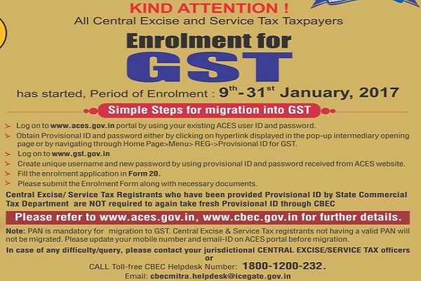

Slide 135
RETURNS under GST

Slide 137
Types of Returns in GST
Format | Description | Due date
GSTR-1 | Statement of Outward Supplies | 10th of next month
GSTR-2 | Statement of Inward Supplies | 15th of next month
GSTR-3 | Return | 20th of next month
GSTR-4 | Return for Compounding suppliers | 18th of month in next quarter
GSTR-5 | Return for Non-resident suppliers | 20th of next month
GSTR-6 | Return for ISD | 13th of next month
GSTR-7 | Return for TDS Deductors | 10th of next month
GSTR-8 | Return for E commerce Operator | 10th of the next month
GSTR-9 | ANNUAL RETURN | on or before 31st December following the end of the FY

Slide 138
Various Types of Supply and Business Processes
Taxable Supply
B2B B2C inter/intra
Non Taxable Supply
Exempt Supply
Non GST Supply
Export – with/ without tax
Credit and Debit Notes
Advances.
Reverse Charge
Other Business process

Slide 139
GSTR-1 :Statement of Outward Supplies
Details of all supply made are captured
All B2B supplies –invoice wise.
B2C supplies more than Rs. 2.5 lakh (Only interstate )
Other supplies made to customers-state wise
Credit and Debit Notes – linkage to original invoice
Reverse Charge
Exports – with and without payment of tax
Exempt, Nil rated and Non-GST supplies
Tax paid on advances and adjustment of advances
Amendment of any of the above details filed in previous months

Slide 140
GSTR-2 :Statement of Inward Supplies
Significance :
It determines the ITC eligibility.
It is also transaction based statement.
would be Auto populated from outward supply/ ISD/ TDS returns.
Since it is a ITC claim made by the taxpayer, he can change/delete/add auto populated details.

Slide 141
Statement of Inward Supplies:GSTR-2
Invoices Auto-populated from GSTR-1
Claimed – non auto-populated
Supplies attracting reverse charge
Import of Services
Details of credit and debit notes : Auto-populated/claimedISD Credit received
TDS Credit received
Other details of inward supplies
From exempt/composition suppliers
Exempt, nil rated and non-GST supplies

Slide 142
Monthly Return-GSTR-3
Auto-populated based on GSTR-1 and GSTR-2
Outward Supplies
Inward Supplies
Tax Liability
Payment details
Claim of Refund of ITC or cash ledger

Slide 143
ITC Claim : Provisional acceptance, Matching, Reversal & Reclaim

Slide 144
ITC Matching Flow Chart
File GSTR-1 by 10th July
Month
June
Reconcile 7days
File GSTR-2 By 15th July
File GSTR-3 by 20th July
Duplicates
Add in next month with interest
first Cycle
Unmatched
Convey Both
Second Cycle
Supplier does not accept. Auto reversed in Aug return with 2 month interest
Supplier accepts. Shown in july return. One month interest

Slide 145
Payment of Tax under GST

Slide 146
PAYMENT OF TAX Chapter IX
Online tax payments :
internet banking , credit or debit cards or NEFT or RTGS etc
Bank payments are restricted to Rs. 10,000/- per challan.
Challan to be generated from GSTN which will have unique Common Portal identification no. (CPIN). Valid for 15 days
Common challan for all the three taxes.

Slide 147
Electronic Ledgers
Running electronic ledgers would be maintained on the portal :
Tax Liability ledger
ITC ledger
Cash ledger
different ledgers for SGST, CGST, IGST

Slide 148
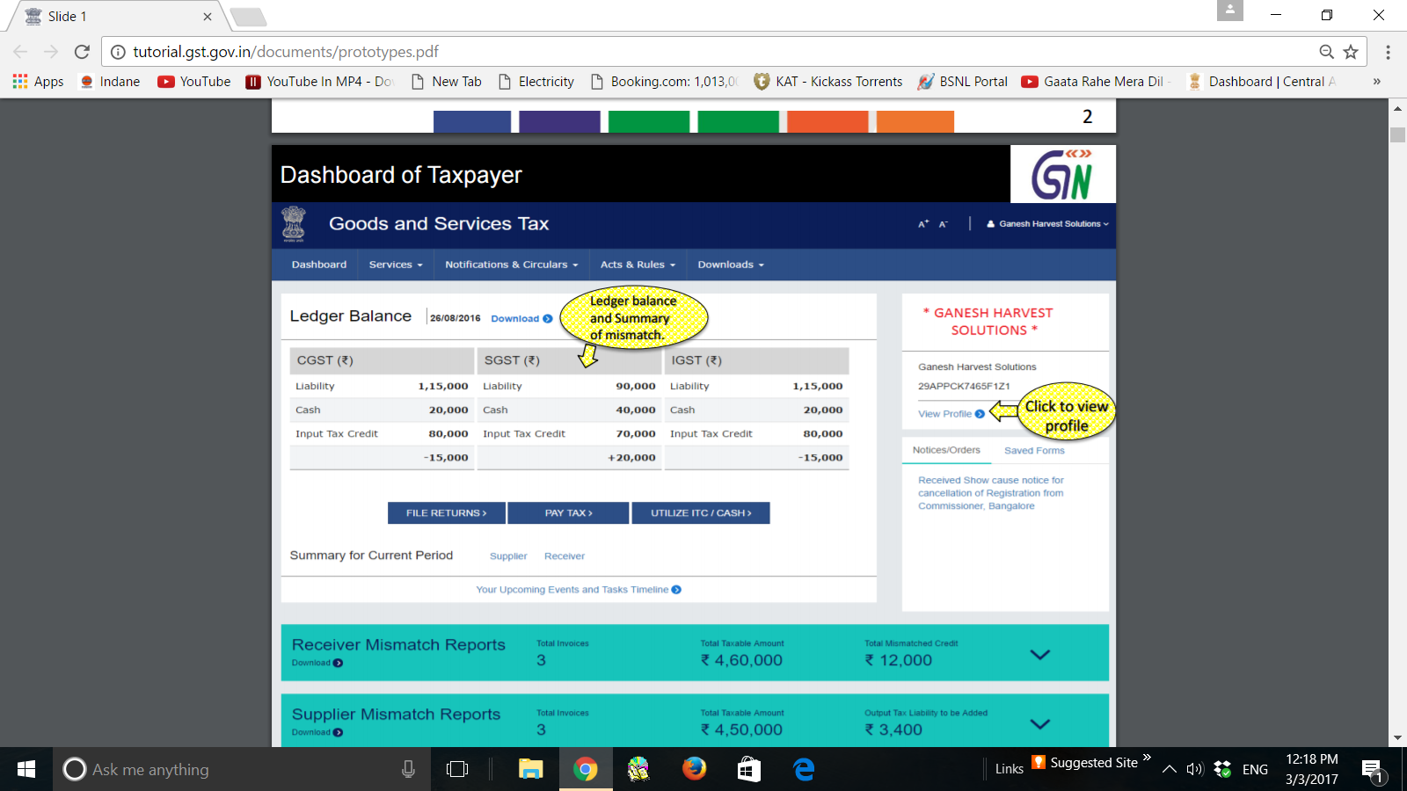

Slide 149
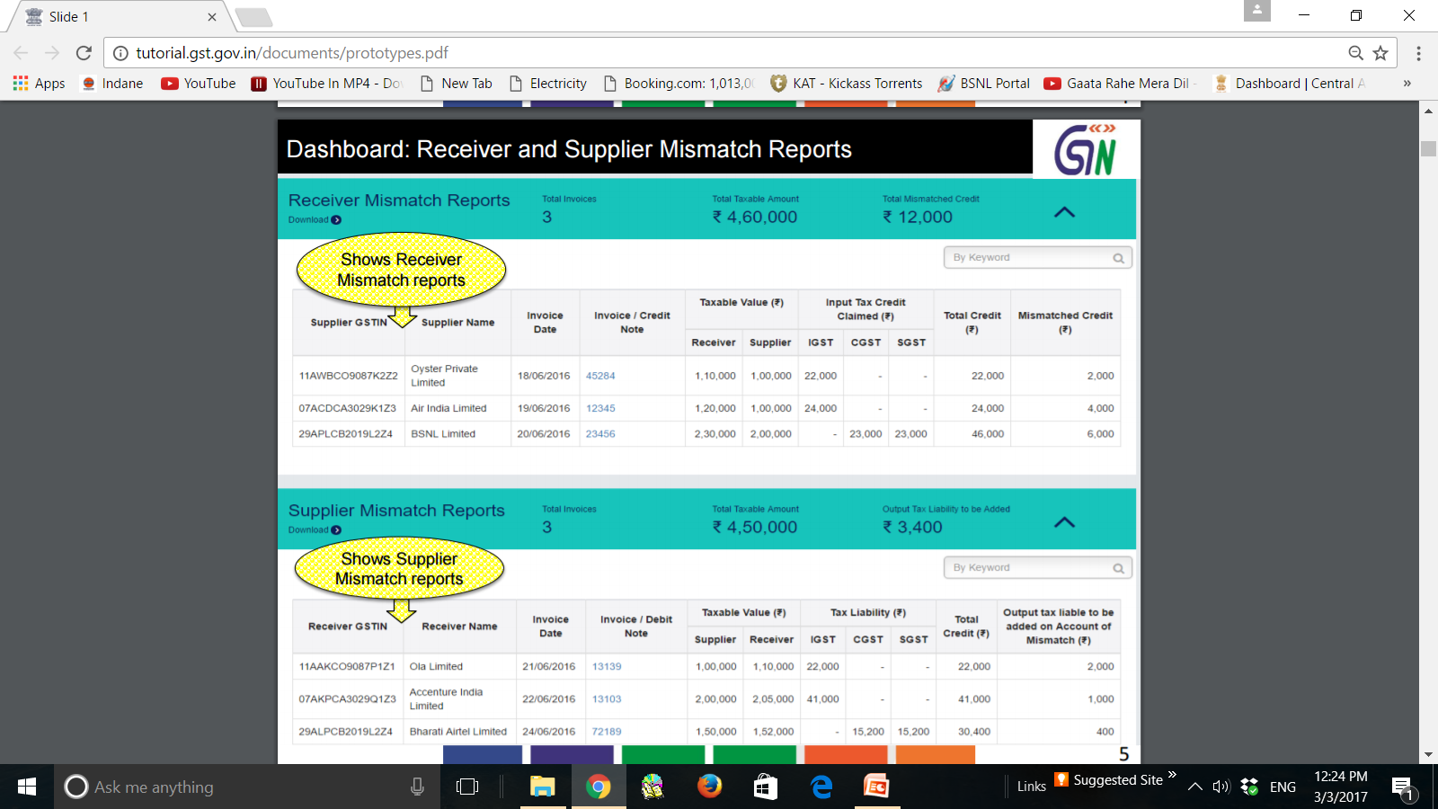

Slide 150
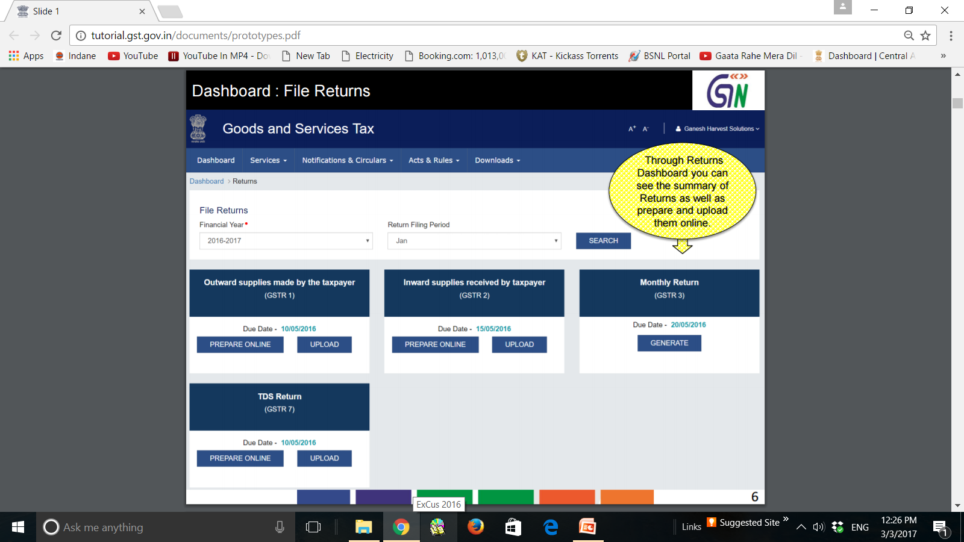

Slide 151
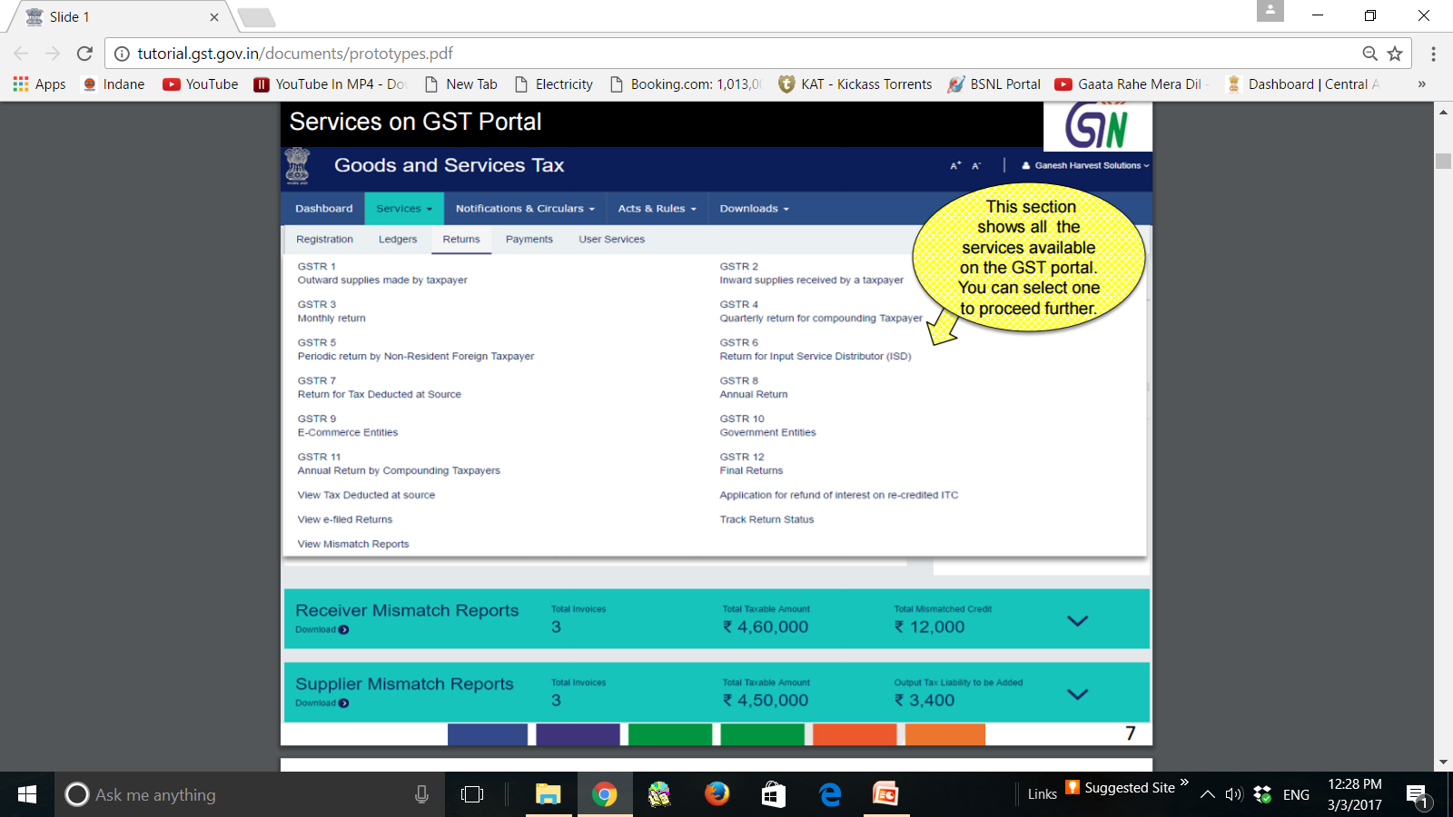

Slide 152
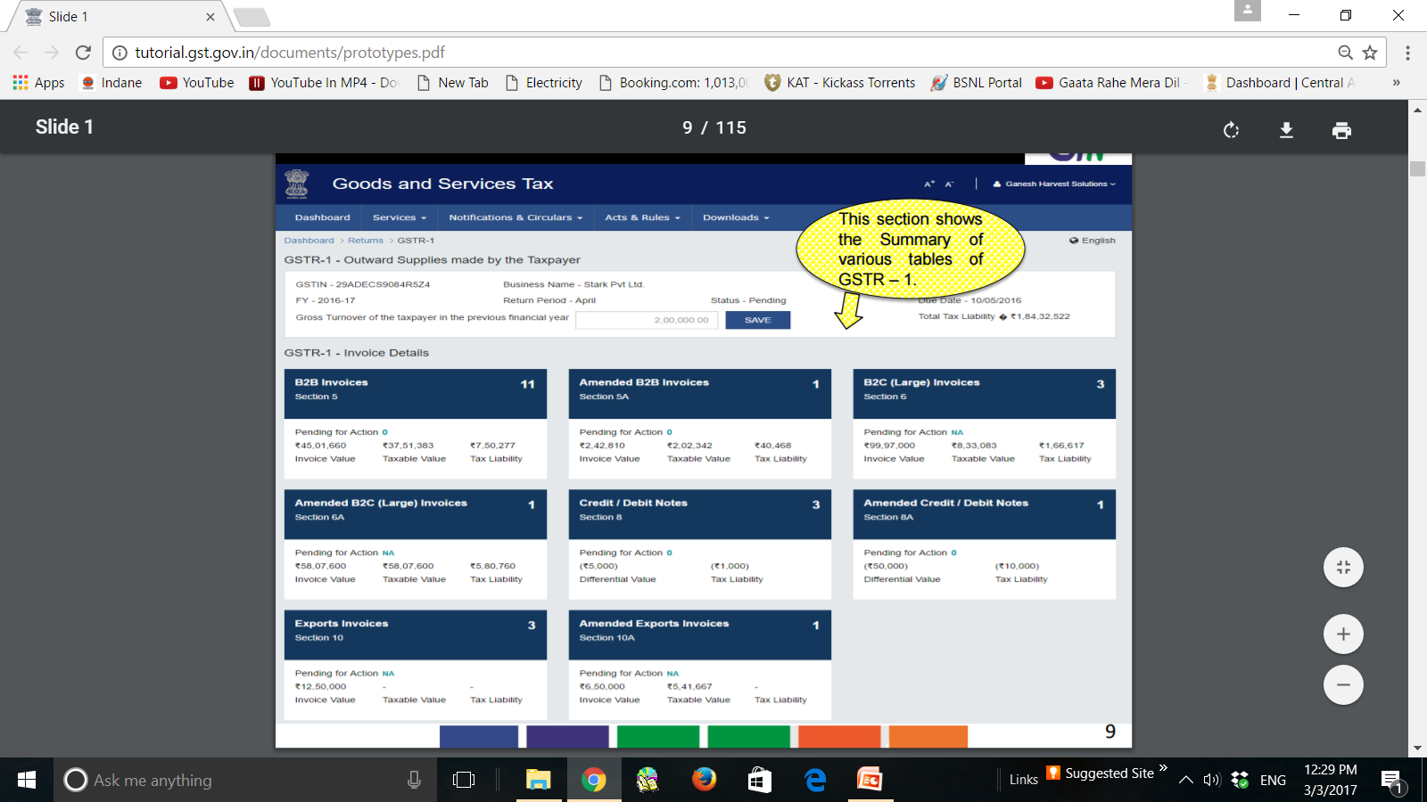

Slide 153
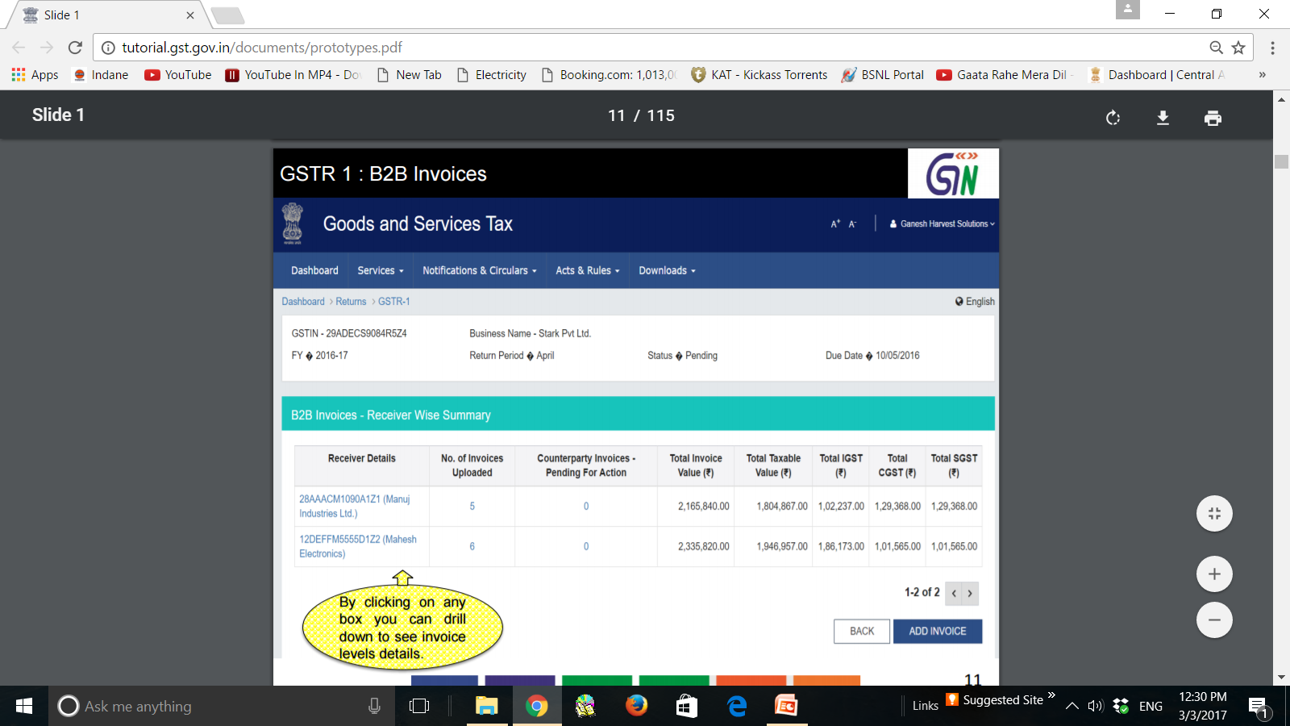

Slide 154
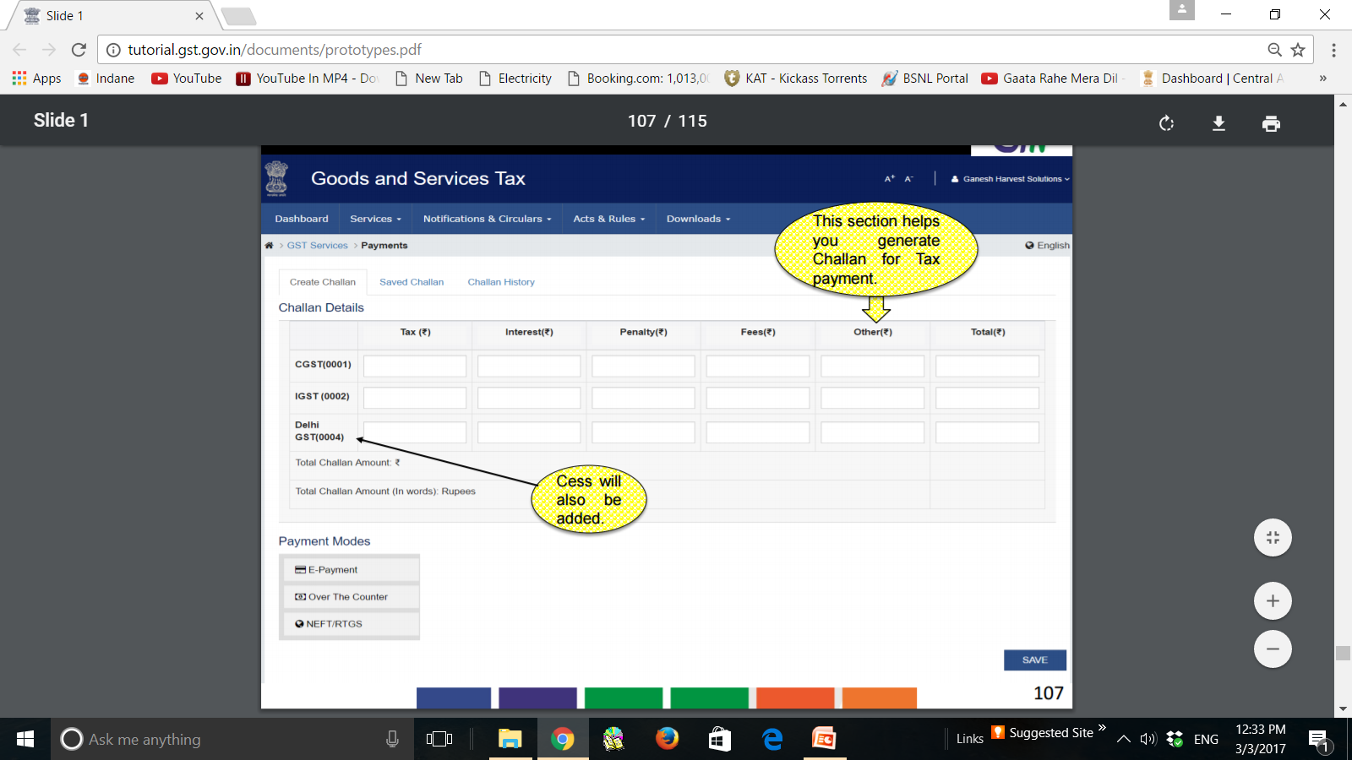

Slide 156
REFUND
SYSTEM

Slide 157
Advantages of refund system in GST
Refund scenarios limited.
Total online process.
Online verification to the extent possible.
Refund shall be granted within 60 days.
Immediate provisional sanction of 80% in certain cases.
Claimed within 2 years from the relevant date.

Slide 158
REFUNDS Sec. 38
Refund of ITC allowed in case of exports or where the credit accumulation is on account of inverted duty structure.
No need to furnish evidence ( Unjust Enrichment) if the refund claim is less than Rs. 2 lakhs. Self-certification would suffice.
Communication and status check of refund application by the dealer online.
Minimal or no blockage of Capital

Slide 159
Assessment & Audit
Self –assessment of tax
Provisional assessment- on request – to be finalized in six months .
Provisions for assessment of non-filers, unregistered persons & summary assessments in certain cases
Audit :
(i) Statutory Audit for prescribed turnover (ii) Departmental Audit (Iii) Special Audit
Audit can be conducted at the place of business of the taxable person or at the office of the tax authorities, after prior intimation to taxable person
To be completed within 3 months, extendable by period of 6 months .
Taxpayer to be informed about findings, his rights and obligations .

Slide 160
Demand and recovery
Adjudication order to be issued within 3/5 years of filing of annual return in normal cases & fraud / suppression cases respectively .
time lines for issue of SCN : at least 3/6 month before adjudication order .
Taxable person can settle at any stage, right from audit/ investigation to the stage of passing of adjudication order and even thereafter.
Alternate dispute resolution mechanism such as advance ruling, Settlement Commission

Slide 161
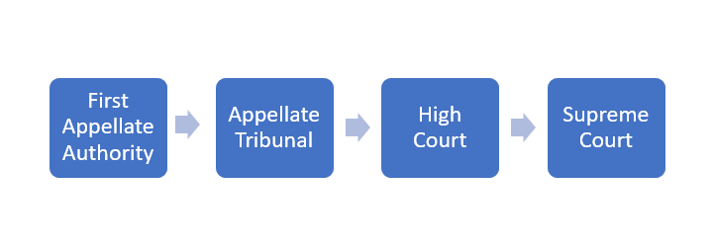
Adjudication & Appeals
Additional /Joint Commissioner shall be the final Adj authority
Commissioner / Additional Commissioner (Appeals) will be FAA.
The second Appeal shall lie to the proposed GST Tribunals
The National Bench or Regional Benches : to hear POS cases.
State Bench for each state.

Slide 162
Dual Control & Cross-empowerment
Each assessee would be assessed only by one authority.
Taxpayers to be shared between assessment machinery
90 :10 turnover upto 1.5 crore
50: 50 above Rs 1.5 crore
Intelligence based enforcement : with both.
Coastal states jurisdiction extends to territorial waters
CGST/ SGST Officers have been cross empowered

Slide 163
Tax deduction at source
Govt bodies & such other persons notified
@1% each
> Rs 2.5 lacs
pay by 10th of next month.
TDS certificate
File a return
Collection of tax at source.
E Commerce Operator
Not exceeding 1% each

Slide 164
TRANSITIONAL PROVISIONS
MIGRATION,
CREDIT
Job work
SALES RETURN
PRICE REVISION,
Goods sent on approval basis

Slide 165
CHAPTER XX TRANSITIONAL PROVISIONS
139. Migration of existing taxpayers.
140. Transitional arrangements for ITC
141. Transitional provisions relating to job work.
142. Miscellaneous transitional provisions.

Slide 166
INPUT TAX CREDIT
TRANSITION
OLD PROCEDURE
JOB WORK ETC
PROCEEDIGNGS
EXISTING LAW

Slide 167
Carry forward of c/b credit
Unavailed credit capital goods
INPUT TAX CREDIT
DUTY PAID STOCK
Taxable plus Exempt earlier
GOODS /SERVICES IN TRANSIT
ISD C. REGISTRATION

Slide 168
OLD PROCEDURES
JOB WORK .
GOODS RETURNED.
GOODS SENT ON APPROVAL BASIS.
PRICE REVISION OLD CONTRACT
TDS deducted under VAT law.
any goods or CG belonging to the principal are lying at the premises of the agent (SGST)

Slide 169
PROCEEDINGS UNDER EXISTING LAW
Refund claim of CENVAT credit, duty, tax, interest filed before / after AD .
Refund claim filed after the AD for any duty or tax paid under existing law in respect of the goods or services exported before or after the appointed day,
Refund claim of Service tax filed after AD in respect of services not provided.
Old return revised after the AD- results in recovery or refund.

Slide 170
PROCEEDINGS UNDER EXISTING LAW
Every proceeding of appeal, review or reference relating to
CENVAT credit initiated whether before, on or after the AD under the existing law ( Claim or recovery)
any output duty or tax liability initiated whether before, on or after the AD under the existing law –( recoverable/admissible)
assessment or adjudication proceedings instituted ,whether before, on or after the AD, under the existing law, any amount of tax, interest, fine or penalty becomes recoverable or refundable

Slide 171
Section 142 (10) of the GST ACT,2017
Save as otherwise provided in this Chapter,
the goods or services or both supplied on or after the appointed day
in pursuance of a contract entered into prior to the appointed day
shall be liable to tax under the provisions of this Act.

Slide 172
Point of taxation of existing law
(11) (a) notwithstanding anything contained in section 12, no tax shall be payable on goods under this Act to the extent the tax was leviable on the said goods under the Value Added Tax Act of the State;
(b) notwithstanding anything contained in section 13, no tax shall be payable on services under this Act to the extent the tax was leviable on the said services under Chapter V of the Finance Act, 1994;
(c) Tax shall be leviable under works contract to the extent of supply made after AD with credit entitlement

Slide 173
GST from AD. No Tax if returned within : 6 + 2 months
ITC shall be liable to be recovered as per section 142(8)(a)
JOB WORK
INPUT
SEMI FINISHED
FINISHED
Manufacturer may transfer the goods on payment of tax or export
Manufacturer may transfer the goods to premises of a RP

Slide 174
Migration of existing tax Payer
Any person registered under any of the existing law and
having PAN
Provisional registration .
Final registration after submission of certain documents

Slide 175
INPUT TAX CREDIT TRANSITION

Slide 176
Transitional arrangements for ITC
Carry forward of c/b credit
Unavailed credit on capital goods:
Credit on goods lying in stock
Taxable plus Exempt activity earlier
Input/Input Services in transit
ISD
Centralised registration

Slide 177
CGST
LEDGER
CX duty
Service tax
SGST
LEDGER
VAT
Entry tax
Compounding dealers under Section 10 not eligible

Slide 178
Carry forward of CENVAT/VAT
CENVAT credit /VAT carried forward in the last return can be taken as Credit in electronic credit ledger.
Credit shall not be allowed if
Input credit is not allowed under this act.
He has not filed in last six months all returns proceeding the appointed day.
Where the credit relates to goods manufactured and cleared under exemption notification as are notified.
File GST TRAN-1 within sixty days of appointed day.
CGST

Slide 179
Additional Condition for SGST
VAT c/f credit relating to CST cases
Provided further that so much of the said credit as is attributable to
any claim related to Sections 3, 5(3), 6, 6A or 8(8) of the CST, Act,
which is not substantiated in the manner, and within the period, prescribed in rule 12 of the Central Sales Tax (Registration and Turnover) Rules, 1957
shall not be eligible to be credited to the electronic credit ledger:
The same shall be refunded under the existing law when the said claims are substantiated

Slide 180
Sections of the CST Act
Statutory Provisions | Particulars of the transaction
Section 3 | Inter-state sale of goods from one state to another
Section 5(3) | Penultimate sale of goods preceding the export of those goods
Section 6 | In-transit sale, sale to officer, personnel, consular or diplomatic agent of any foreign diplomatic mission or United Nations or a similar body
Section 6A | Inter-state branch transfer, transfers between principal and agent, job-work transactions

Slide 181
Form | Description | Frequency
C | Declaration by purchasing registered dealer to obtain goods at concessional rate | To be obtained for every quarter and submitted on quarterly basis
D | Form of certificate for making government purchases) | Abolished from 1 4-2007.
E-I/E-II | Certificates for sale in transit | To be obtained for every quarter and submitted on quarterly basis
F | Form by branch/consignment agent for goods received on stock transfer | Monthly, but to be submitted to authorities quarterly
G | Indemnity bond when C form lost | When required
H | Certificate of Export | Upto the time of assessment by first assessing authority.
I | Certificate by SEZ unit | Not specified in rules (but should be submitted before assessment).
J | Certificate to be issued by foreign diplomatic mission or consulate in India or the UN Agency | Upto the time of assessment by first assessing authority.

Slide 182
Unavailed CENVAT/VAT on capital goods which is not carried forward
Registered Person may take such balance credit
Conditions :
if it is allowed in the existing law as well under this Act.
Specify the following in Form GST TRAN-1 :
i] ITC availed under existing law before appointed day
ii] ITC to be availed till appointed day.

Slide 183
Who were not under CX/ST earlier
RP who was not liable to be registered under the existing law, or
engaged in the manufacture of exempted goods or
provision of exempted services or
who was providing work contract services and was availing the benefit of notification no. 26/2012 (abatement) or
first stage dealer or second stage dealer or
registered importer or depot of manufacturer,
credit of eligible duties on input in stock

Slide 184
Who were not under CX/ST earlier
Credit of eligible duties on input in stock on the appointed day
subject to the following conditions .
If the Input is used for taxable supply under this Act
RP is entitle for input tax credit under this Act
RP is in possession of Invoice or other duty payment documents
Such Invoices not more than twelve months old.
Supplier of services is not eligible for abatement under this Act.

Slide 185
Who were not under VAT earlier
A RP who was not liable to be registered under the existing law or
engaged in the sale of exempted goods or tax free goods, or
goods which have suffered tax at the first point of their sale in the State and the subsequent sales of which are not subject to tax
where the person was entitled to the credit of input tax at the time of sale of goods,
VAT credit on input on his stock

Slide 186
Who were not under VAT earlier
VAT credit on input on his stock on the appointed day admissible:
subject to the following conditions .
If the Input is used for taxable supply under this Act
RP is entitle for input tax credit under this Act
RP is in possession of Invoice or other duty payment documents
Such Invoices were not more than twelve months old.

Slide 187
Explanation 1.—For the purposes of sub-sections (3), (4) and (6), the expression “eligible duties” means––
(i) the additional duty of excise leviable under section 3 of the Additional Duties
of Excise (Goods of Special Importance) Act, 1957;
(ii) the additional duty leviable under sub-section (1) of section 3 of the Customs
Tariff Act, 1975;
(iii) the additional duty leviable under sub-section (5) of section 3 of the Customs
Tariff Act, 1975;
(iv) the additional duty of excise leviable under section 3 of the Additional
Duties of Excise (Textile and Textile Articles) Act, 1978;
(v) the duty of excise specified in the First Schedule to the Central Excise Tariff
Act, 1985;
(vi) the duty of excise specified in the Second Schedule to the Central Excise
Tariff Act, 1985; and
(vii) the National Calamity Contingent Duty leviable under section 136 of the
Finance Act, 2001;
in respect of inputs held in stock and inputs contained in semi-finished or finished
goods held in stock on the appointed day.

Slide 188
Not in possession of documents evidencing payment of VAT /CX duty.
There is a Scheme for RP for six tax period
Not available to manufacturer or supplier of service
Credit @ 40% of central/state tax applicable
Conditions.
Such goods were not exempt or nil rated
Document of procurement is available with RP
pass on the benefit of such credit by way of reduced prices.
Submit statement of supply of such goods in each of six tax period.
Stocks stored should be easily identifiable

Slide 189
Taxable as well as exempted activities earlier but now taxable
Such RP is also entitled to
Cenvat credit/VAT in respect of input , semi-finished and finished goods in stock.
attributable to such exempted goods or services
Same conditions apply

Slide 190
Input /input services in transit
Received on or after the appointed day but the duty or tax paid earlier
RP may take credit of eligible duties and taxes
the invoice has been recorded in the books within 30 days from the appointed day.
Extendable by 30 days by Commissioner
furnish a statement
ISD can also distribute such credit

Slide 191
tax at fixed rate or paying fixed amount in lieu of tax payable under the existing law
Earlier under Composition Scheme
RP is entitled to the credit on his input stock, semi finished and finished stock on the appointed date .
subject to the following conditions;
Such Input stock used for taxable supply under this Act.
RP is not covered under section 10 of this Act.
RP is eligible for ITC under this Act.
RP is in possession of such Invoice or other duty payment documents.
Such Invoices are not more than twelve months old on appointed day

Slide 192
Centralised Registration
can take credit of the amount of CENVAT carry forward in return furnished under the existing law .
If the original / revised return under the existing law has been filed within three months .
such credit may be transferred to any of the registered persons having the same PAN for which the centralised registration was obtained.

Slide 193
Reclaim the reversed Input Service credit
Cenvat reversed on account of non payment within three months.
Can be reclaimed
If payment made in 3 months from the AD.

Slide 194
Transition provision for Job work
inputs
Semi finished
Finished goods
no tax shall be payable if such goods are received within six months .
Period extendable by two months by Commissioner.
Otherwise the ITC shall be recovered .
No tax shall be payable in above cases , if such goods are declared by manufacturer and job worker as prescribed.
File declaration of stock in GST TRAN-1 detail of stock including capital goods specifying stock held as principal, agent or branch
removed before appointed day but returned after

Slide 195
Goods returned
Removed Before 6 months
Appointed day
returned within 6 months
Returned by a unregistered person : Refund
Returned by a registered person : return of goods shall be treated as supply of goods

Slide 196
Goods sent on approval basis
Removed Before 6 months
Appointed day
returned within 6 months
No tax is payable by the returner.
Commissioner may extend the period by 2 month.
If returned after that, tax is payable if taxable under GST ( by the returner)
If not returned , tax is payable by the person who sent the goods on approval basis.

Slide 197
TDS deduction
Where a supplier has made any sale of goods
TDS required under VAT Act and
Invoice issued before the appointed day,
where payment made on or after appointed day.
no TDS under GST.

Slide 198
Price revision
Contract entered before appointed day
Upward price revision
RP here will issue supplementary invoice or debit notes within 30 days from the date of revision.
Such revision shall be treated as supply under this Act.
Downward Revision
RP may issue credit note within 30 days from such revision and
credit note shall be deemed to have been issued in respect of outward supply made under this Act.
RP will reduce his tax liability for such credit note

Slide 199
Any claim for refund of CENVAT credit under the existing law
filed by RP before or after the appointed date
shall be disposed under the existing law
to be paid in cash
If rejected , the credit shall lapse.
no refund of CENVAT if carry forwarded.
Same in respect of any proceeding of appeal, review or reference for cenvat credit or output liability under the exiting law
In case of any demand , the same shall be recovered as arrear of tax under this Act.

Slide 200
RETURN REVISED
RECOVERY
REFUND
IF REVISED IN TIME
IN CASH
RECOVERED AS ARREARS OF TAX

Slide 201
E-WAY BILL

Slide 202
Section 68 :Inspection of goods in movement.
The Government may require the person in charge of a conveyance carrying any consignment of goods of value exceeding such amount as may be specified to carry with him such documents and such devices as may be prescribed.
(2) The details of documents required to be carried under sub-section (1) shall be validated in such manner as may be prescribed.
(3) Where any conveyance referred to in sub-section (1) is intercepted by the proper officer at any place, he may require the person in charge of the said conveyance to produce the documents prescribed under the said sub-section and devices for verification, and the said person shall be liable to produce the documents and devices and also allow the inspection of goods

Slide 203
Draft Electronic Way Bill Rules
Rule 1.
Rule 2.
Rule 3.
Rule 4.
Rule 5.
Information to be furnished prior to commencement of movement of goods and generation of e-way bill
Documents and devices to be carried by a person-in-charge of a conveyance
Verification of documents and conveyances
Inspection and verification of goods
Facility for uploading information regarding detention of vehicle

Slide 204
Furnishing of Information to generate e- way bill
Before commencement of movement of goods
In relation to a ‘supply .Other than a supply. inward ‘supply’ from an unregistered person.
Where consignment value > Rs. 50,000.
FORM GST INS-01 Part A Part B
Goods Carriage
Who will generate
SUPPLIER
RECIPIENT
TRANSPORTER

Slide 205
Period of validity
1 day to 15 days - 100KM to 1000 KM
Unique E-Way bill Number (EBN)
Generation and cancellation through SMS.
Communication of details of E-Way bill to recipient, if he is registered . 72 hours
Transfer of goods from one conveyance to another during transit- a new e-way bill

Slide 206
Transportation of multiple consignments in one conveyance .
Consolidated e-way bill in FORM GST INS-2
FORM GST INS-1
Cancellation of E-Way Bill
within 24 hours of its generation.
Can’t be cancelled if verified in transit

Slide 207
Documents & Devices to be carried by a person In Charge of Conveyance.
The invoice or bill of supply or delivery challan, as the case may be; and
A copy of e-way bill: either physically or mapped to embedded RFID
Embedded RFID with conveyance necessary for certain transporters
Invoice Reference Number in lieu of the tax invoice
Upload tax invoice in FORM GST INV-1
IRN valid for 30 days

Slide 208
Verification of documents and conveyance
Proper officer to intercept and verify the e way bill .
RFID reader would be installed.
Inspection and verification of goods in transit
Only with permission from Commissioner
Physical verification only once
Summary Report within 24 hours of inspection- Part A of FORM GST INS-03.
Final Report shall within 3 days of inspection- Part B of FORM GST INS-03.
Detention of Vehicle : exceeding 30 minutes
The transporter may upload the said information in FORM GST INS-04.

Slide 209
Summary of various FORMS prescribed in e way bill rule
GST INS – 01 -
GST INS – 02 -
GST INS – 03 -
GST INS – 04 -
Information relating to movement of goods in Part A and part B
Consolidated e-way bill information
Summary report of Inspection in part A and final report in part B
Information by transporter on common portal of any detention of conveyance exceeding 30 minutes

Slide 210
GSTN

Slide 211
GST Network (GSTN)
Incorporated on 28.03.2013 as Section 25 private limited company with authorized equity of Rs. 10 crore .
Strategic control to remain with Government.
Equity Holders
Central Government - 24.5%
EC and all States together - 24.5%
Financial Institutions – 51%
GSTN would provide three front end services, namely registration, payment and return to taxpayers.
It will also assist some States with the development of back end modules.
GSTN has already appointed M/s Infosys as Managed Service Provider at a total project cost of around Rs 1380 crores for a period of five years.
60 per cent of the software development has been completed;.

Slide 212
WAY FORWARD….
Constitution (101st ) Amendment Act,2016.
GST Council held 13 meetings so far.
CGST/IGST/UTGST ACTS passed by Parliament .
SGST Act also passed by many states
Out of nine sets of rules, five are finally approved and four are tentatively approved.
14th meet on May 18-19 in Srinagar

Slide 213
WAY FORWARD….
Fitment of goods & services in four slabs.
Establishment and upgradation of IT framework.
Training of Officials and Trade & Industry
GST outreach programme.
Reorganization of field formations

Slide 215
It is time…………
Thank you…….
maheshwarirs@yahoo.com
8989743422

